Slide 1
Refining the Amino Acid Scoring Matrix for Intrinsically Disordered Proteins with Meta-heuristic Algorithms
Authors: Tz-Hsu Lee (李子旭),
Chang-Biau Yang (楊昌彪),
Kuo-Si Huang (黃國璽)
Presenter: Jing-Ping Jan (詹敬平)
Date: May 28, 2022

Slide 2
Sequence Homology
Sequence homology indicates that two or more proteins or DNA sequences have the same ancestry. Homologous sequences are also likely to have similar functions.
The homology of protein and DNA is often judged by the similarity of their sequences.
Sequences with high similarity often have a homology relationship, but it does not mean that as long as the similarity is high, it is homology.
Notes:
首先我們要介紹的是同源檢測，生物的同源檢測大多都是以DNA以及蛋白質序列來作同源檢測，兩序列具有高相似度通常代表具有同源關係，但並不表示只要相似度是高的，就具有同源關係。

Slide 3
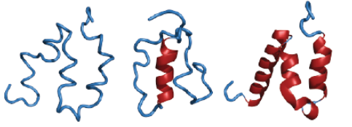
Intrinsically Disordered Proteins (IDPs)
An intrinsically disordered protein (IDP) is a protein that lacks a fixed or ordered three-dimensional structure, but IDPs are a very large and functionally important class of proteins.
Sanjeev, A., Kaushik, S., Meher, B. R. and Mattaparthi, V. S. Disorder in Proteins, 2018, pages 9.
Notes:
內在非結構(無序)蛋白
接下來要介紹的是內在非結構(無序)蛋白，IDPs，IDPs是一種缺乏穩定或有序三級結構的蛋白質，而蛋白質的三級結構能了解蛋白質的生物功能或是蛋白質和鹼基之間的相互作用，由於內在非結構(無序)蛋白的不穩定性， 他們再與其他蛋白質結合時，有可能會改變自身的結構來作結合，所以內在非結構(無序)蛋白會影響蛋白質序列對齊的準確度

Slide 4
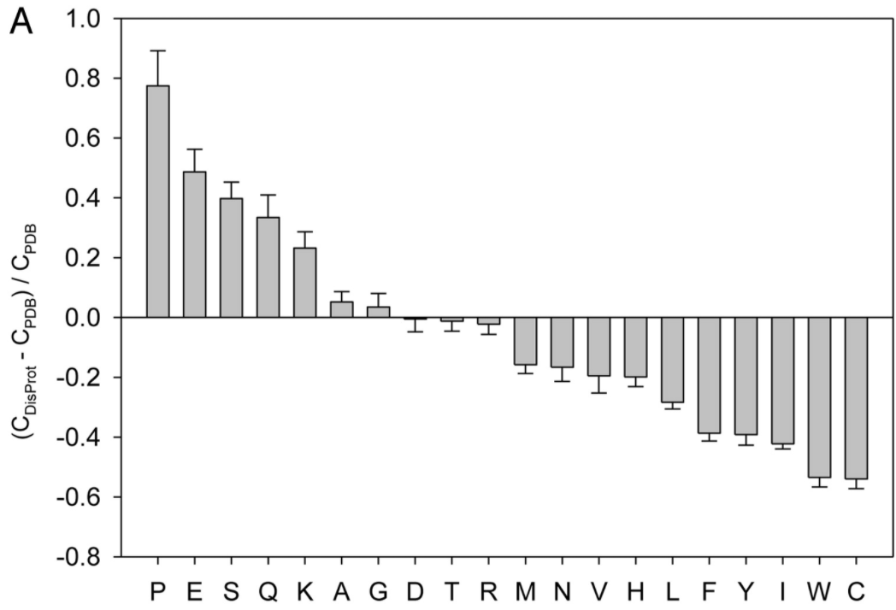
Intrinsically Disordered Proteins (IDPs)
In disordered regions, the residues (A,G,Q,S,P,E and K) have higher percentage than ordered regions or ordered proteins; the residues (M,H,W,C,F,I,Y,V,L and N) have lower percentage in disordered proteins.
Uversky, V. N. The alphabet of intrinsic disorder: II. Various roles of glutamic acid in ordered and intrinsically disordered proteins, 2013, Intrinsically disordered proteins, Vol. 1, No. 1, pp. e24684.
Notes:
這邊是要介紹在常見的蛋白質氨基酸中，在圖中，A,G,Q,S,P,E and K 在無序的區域中占有比較高的percent，而M,H,W,C,F,I,Y,V,L and N則比較低，Disprot是內在無序蛋白的資料庫，而PDB是protein data bank，蛋白質資料庫
C = 比例，所以是每個蛋白質胺基酸在該資料庫中的比例

Slide 5
Motivation
In sequence alignments, it needs a quantified value to describe the relevance and similarity of two sequences.
Widely used substitution scoring matrices, such as BLOSUM and PAM are not suitable for homology searches involving proteins enriched with disordered regions.
Notes:
根據我們剛剛所介紹的知識，對於序列同源，我們必須進行序列比對來得到相似度，而序列比對需要一個實質上的數值來描述兩序列的相似度，所以使用scoring matrices來輔助，但現今常用的scoring matrices 像是blosum或是pam，僅針對一般的蛋白質，沒有針對IDPs，所以不適合用在含有高無序區域的蛋白質同源檢測。

Slide 6
The Example of Sequence Alignment
S
V
E
T
D
Gap open = 6
Gap extension = 1
0
0
0
0
0
0
T
0
1
0
0
5
0
S
0
4
0
0
1
5
V
0
0
8
2
1
0
N
0
1
2
8
1
2
Q
0
0
1
4
7
1
E
0
0
0
6
3
9
BLOSUM62 scoring matrix
T
0
1
0
0
11
5
A = TSVNQET
B = SVETD
S V - - E T
| | - - | |
S V N Q E T
Notes:
那這邊是一個利用scoring matrix來進行序列對齊的範例，我們所使用的是blosum62，進行比對的序列是A=，B=，

Slide 7
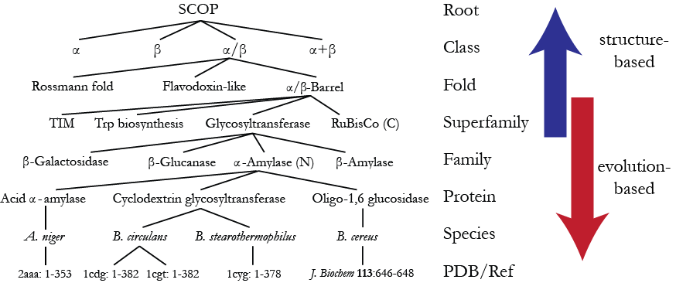
An Example of the SCOP Hierarchy
C
C.1
C.1.8
C.1.8.1
Fox NK, Brenner SE, Chandonia JM. 2014. SCOPe: Structural Classification of Proteins—extended, integrating SCOP and ASTRAL data and classification of new structures. Nucleic Acids Research 42:D304-309.
Notes:
這邊是我們如何判斷這2個蛋白質序列是否具有實質上的同源，就是看SCOP，越往上相似度越低，往下的話相似度越高

Slide 8
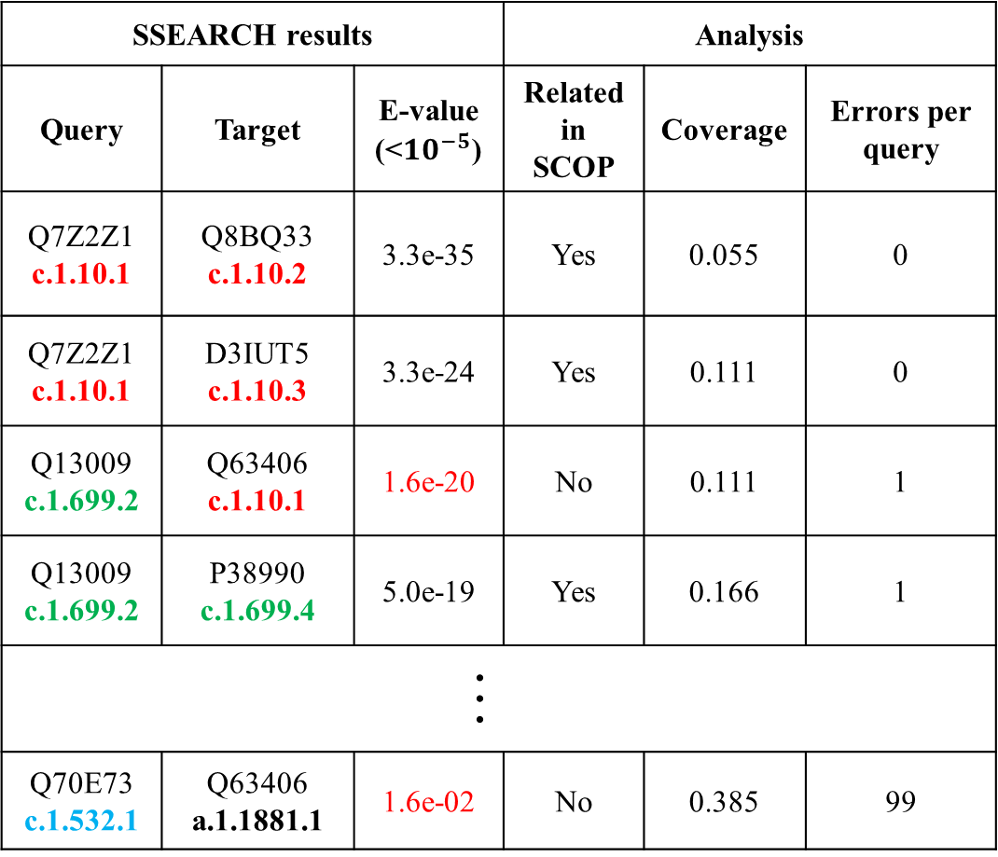

An Example of SSEARCH Results
SSEARCH results |  |  | Analysis
Query | Target | E-value (<${10}^{−5}$) | Related in SCOP | Coverage | Errors per query
Q7Z2Z1 c.1.10.1 | Q8BQ33 c.1.10.2 | 3.3e-35 | Yes | 0.055 | 0
Q7Z2Z1 c.1.10.1 | D3IUT5 c.1.10.3 | 3.3e-24 | Yes | 0.111 | 0
Q13009 c.1.699.2 | Q63406 c.1.10.1 | 1.6e-20 | No | 0.111 | 1
Q13009 c.1.699.2 | P38990 c.1.699.4 | 5.0e-19 | Yes | 0.166 | 1
…
Q70E73 c.1.532.1 | Q63406 a.1.1881.1 | 1.6e-02 | No | 0.385 | 99
Superfamily c.1.10:
3 sequences
Superfamily c.1.699:
3 sequences
Superfamily c.1.532:
3 sequences
100 sequences in
dataset
EPQ = 0.01
2$\left({100 \atop 2}\right)$ $×$ 0.01 = 99
Notes:
E-value:
這是統計結果。根據 database 大小以及 alignment 長短而定。

Slide 9

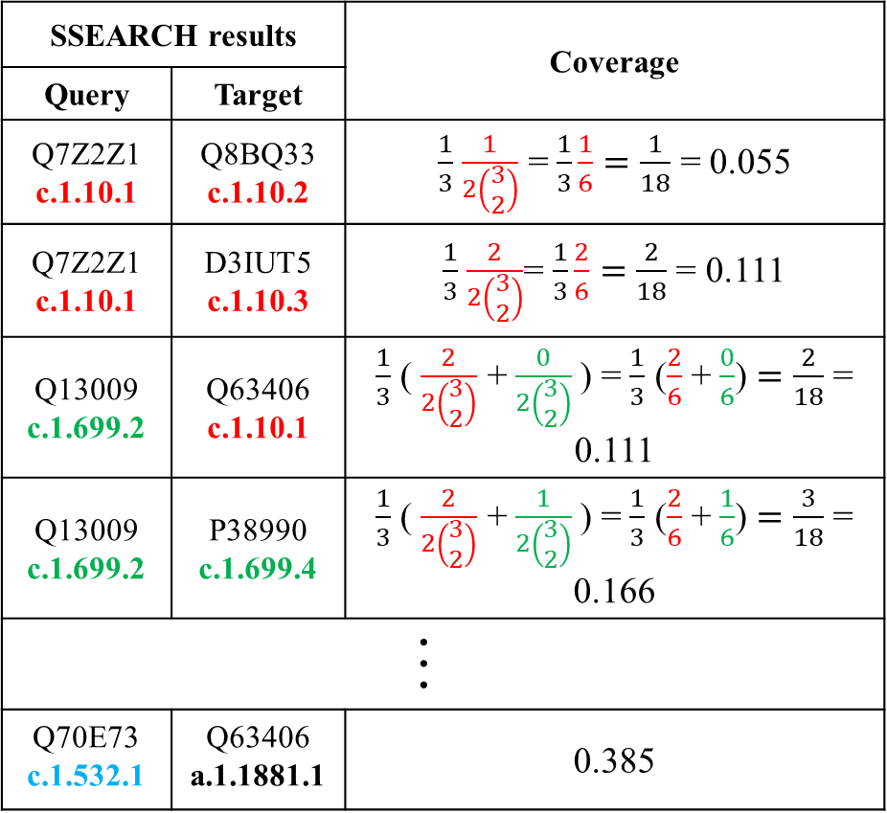
Calculating Coverage Q
$Q=\frac{1}{S}\sum_{i=1}^{S}{\frac{T_{i}}{2\left(\begin{matrix}d_{i} \\ 2\end{matrix}\right)}}$
$S:$ # of superfamilies.
$T_{i}:$# of true positive
relations in superfamily $i$.
$d_{i}:$ # of sequences in
superfamily $i$.
SSEARCH results |  | Coverage
Query | Target
Q7Z2Z1 c.1.10.1 | Q8BQ33 c.1.10.2 | $\frac{1}{3}$ $\frac{1}{2\left(\begin{matrix}3 \\ 2\end{matrix}\right)}$ = $\frac{1}{3}\frac{1}{6}=\frac{1}{18}$ = 0.055
Q7Z2Z1 c.1.10.1 | D3IUT5 c.1.10.3 | $\frac{1}{3}$ $\frac{2}{2\left(\begin{matrix}3 \\ 2\end{matrix}\right)}$= $\frac{1}{3}\frac{2}{6}=\frac{2}{18}$ = 0.111
Q13009 c.1.699.2 | Q63406 c.1.10.1 | $\frac{1}{3}$ ( $\frac{2}{2\left(\begin{matrix}3 \\ 2\end{matrix}\right)}$ + $\frac{0}{2\left(\begin{matrix}3 \\ 2\end{matrix}\right)}$) = $\frac{1}{3}$ ($\frac{2}{6}$ + $\frac{0}{6}$) $=\frac{2}{18}$ = 0.111
Q13009 c.1.699.2 | P38990 c.1.699.4 | $\frac{1}{3}$ ( $\frac{2}{2\left(\begin{matrix}3 \\ 2\end{matrix}\right)}$ + $\frac{1}{2\left(\begin{matrix}3 \\ 2\end{matrix}\right)}$) = $\frac{1}{3}$ ($\frac{2}{6}$ + $\frac{1}{6}$) $=\frac{3}{18}$ = 0.166
…
Q70E73 c.1.532.1 | Q63406 a.1.1881.1 | 0.385
Notes:
Q的意義

Slide 10
Our Method
PSO+TLBO with diversity-guided

Slide 11
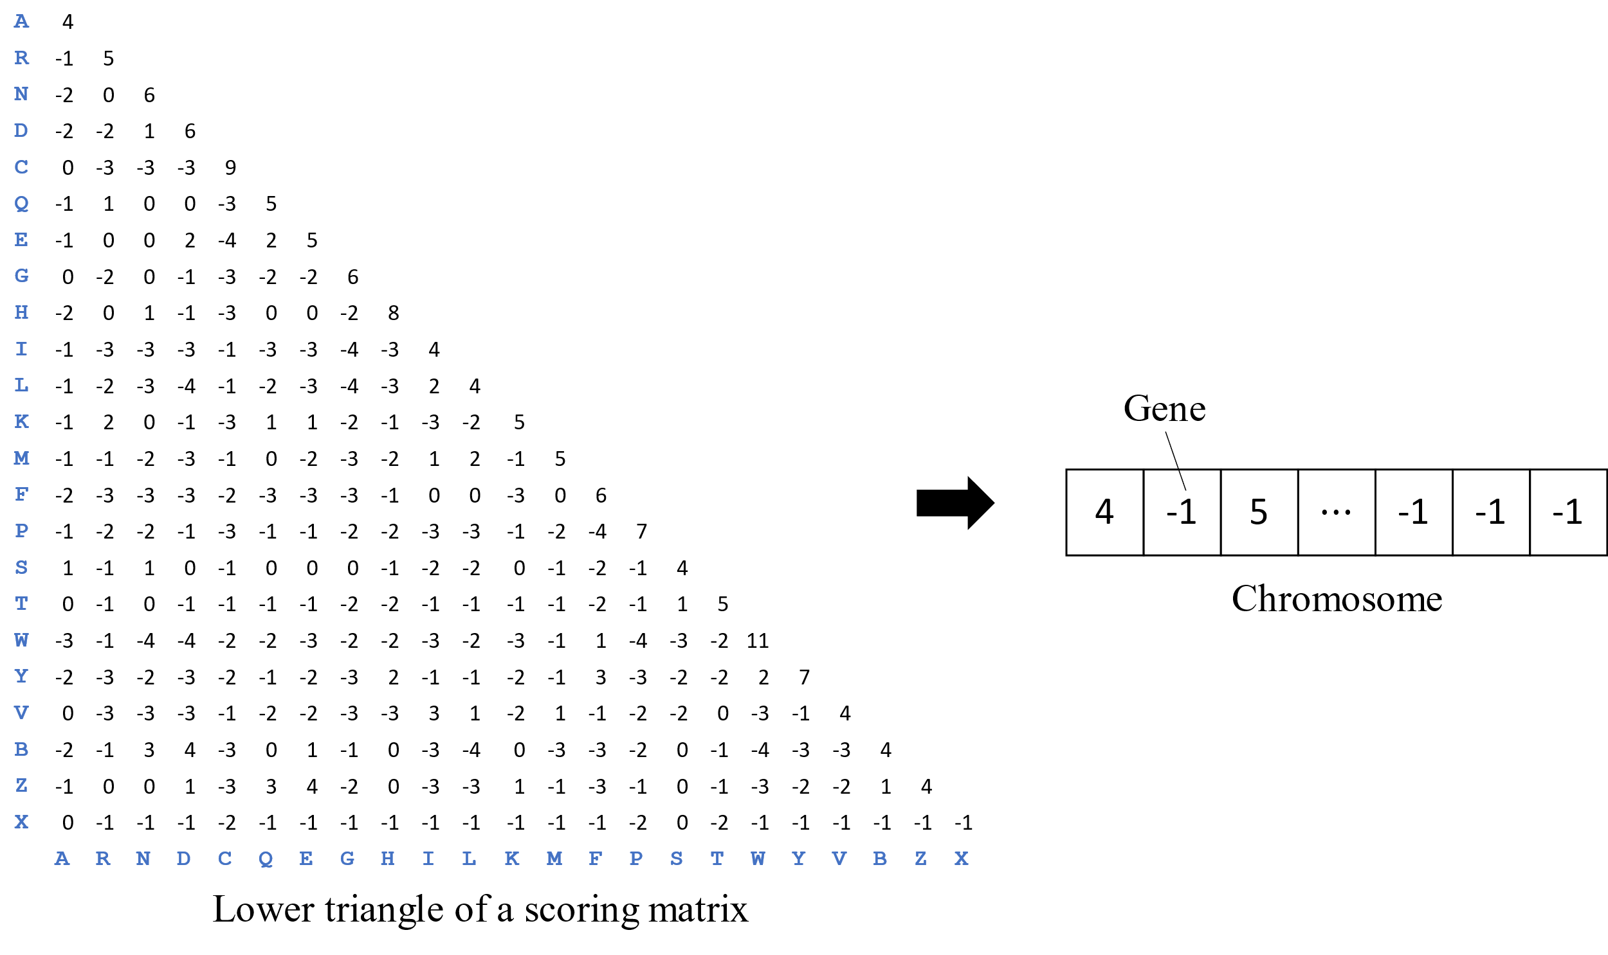
The Transformation of a Scoring Matrix to a Chromosome

Slide 12
PSO+TLBO with Diversity-guided
Initial 27 populations
(scoring matrix)
Calculating fitness
PSO
No
Termination condition?
TLBO teaching
Yes
TLBO learning
Output
Diversity-guided
mutation

Slide 13
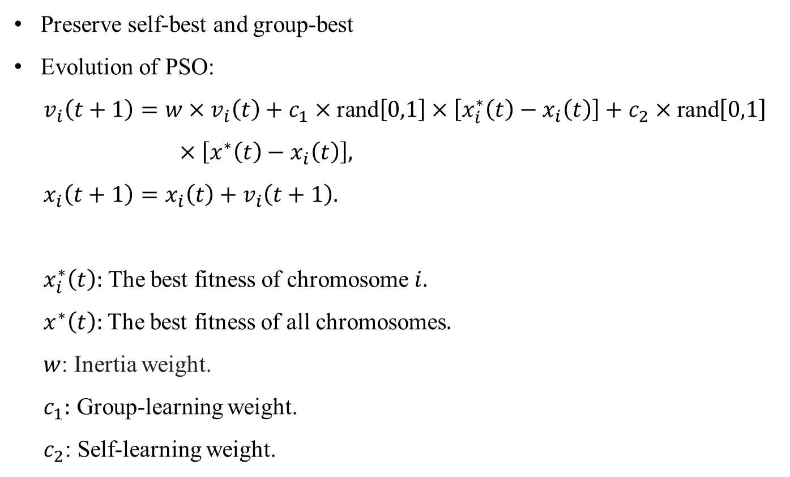
PSO
Preserve self-best and group-best
Evolution of PSO:
$v_{i}\left(t+1\right)=w×v_{i}\left(t\right)+c_{1}×\text{rand}\left[0,1\right]×\left[x_{i}^{∗}\left(t\right)−x_{i}\left(t\right)\right]+c_{2}×\text{rand}\left[0,1\right]$
$×\left[x^{∗}\left(t\right)−x_{i}\left(t\right)\right],$
$x_{i}\left(t+1\right)=x_{i}\left(t\right)+v_{i}\left(t+1\right).$
$x_{i}^{∗}\left(t\right):$ The best fitness of chromosome $i.$
$x^{∗}\left(t\right):$The best fitness of all chromosomes$.$
$w$: Inertia weight.
$c_{1}:$ Group-learning weight.
$c_{2}$: Self-learning weight.

Slide 14
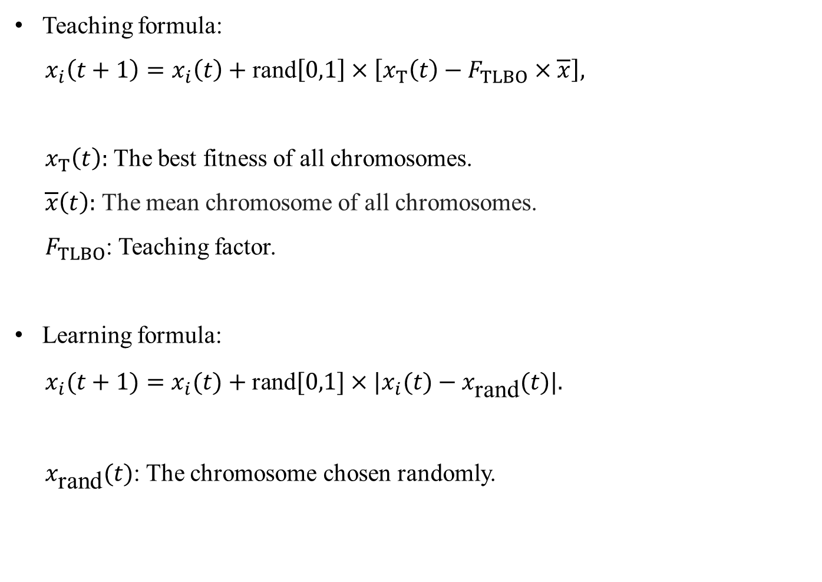
TLBO Teaching and Learning
Teaching formula:
$x_{i}\left(t+1\right)=x_{i}\left(t\right)+\text{rand}\left[0,1\right]×\left[x_{T}\left(t\right)−F_{TLBO}×\overline{x}\right],$
$x_{T}\left(t\right):$ The best fitness of all chromosomes.
$\overline{x}\left(t\right):$ The mean chromosome of all chromosomes.
$F_{TLBO}$: Teaching factor.
Learning formula:
$x_{i}(t+1)=x_{i}(t)+\text{rand}[0,1]×|x_{i}(t)−x_{\text{rand}}(t)|.$
$x_{\text{rand}}(t)$: The chromosome chosen randomly.

Slide 15
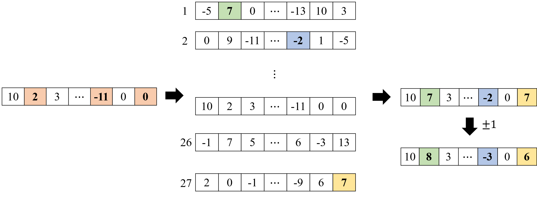

Diversity-guided Mutation
Major and minor mutation
Major mutation
Minor mutation
Avg: 3 -5 7 $⋯$ -8 3 2
$ⅆ\left(\text{Chromosome}\text{ 1 − }\text{Avg}\right)=$ $\sqrt{{\left(−8\right)}^{2}+ {\left(12\right)}^{2}+ {\left(−7\right)}^{2}+ ⋯ + {\left(−5\right)}^{2}+ {\left(7\right)}^{2}+ {\left(1\right)}^{2}}$
…
$ⅆ\left(\text{Chromosome}\text{ 27 − }\text{Avg}\right)=$ $\sqrt{{\left(−1\right)}^{2}+ {\left(5\right)}^{2}+ {\left(−8\right)}^{2}+ ⋯ + {\left(−1\right)}^{2}+ {\left(3\right)}^{2}+ {\left(5\right)}^{2}}$

Slide 16
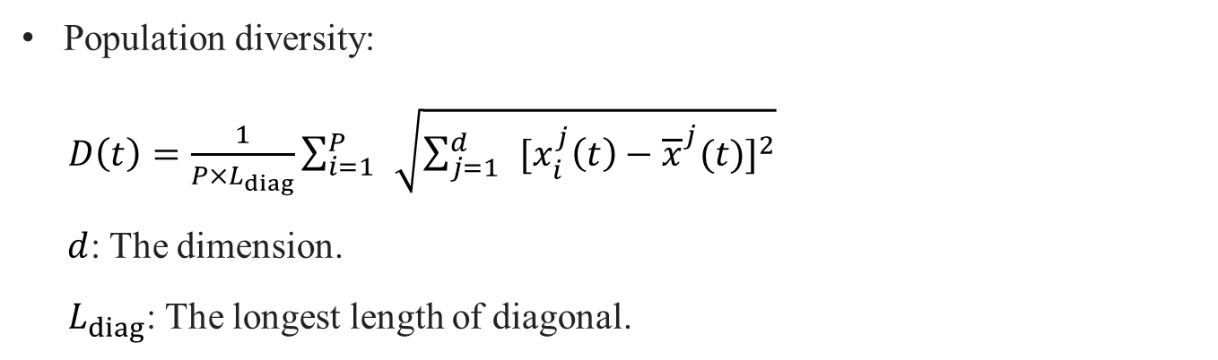
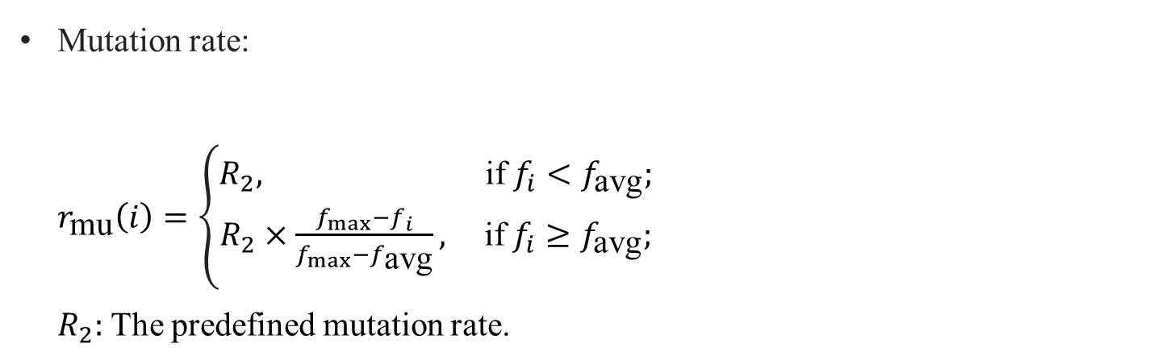
Diversity-guided Mutation
Population diversity:
$D\left(t\right)=\frac{1}{P×L_{diag}}\sum_{i=1}^{P}{ }\sqrt{\sum_{j=1}^{d}{ }[x_{i}^{j}\left(t\right)−{\overline{x}}^{j}(t)]^{2}}$
$d$: The dimension.
$L_{diag}$: The longest length of diagonal.
Mutation rate:
$r_{\text{mu}}\left(i\right)=\left\{\begin{aligned}R_{2}, \text{if} f_{i}<f_{\text{avg}}; \\ R_{2}×\frac{f_{max}−f_{i}}{f_{max}−f_{\text{avg}}}, \text{if} f_{i}≥f_{\text{avg}};\end{aligned}\right.$
$R_{2}:$ The predefined mutation rate.

Slide 17
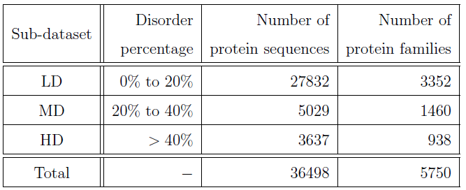
Experimental Results
Database: EUMAT
Disorder percentage is mean fraction of residues that was
predicted to be disordered by the disordered protein predictors.
R. Trivedi and H. A. Nagarajaram, Amino acid substitution scoring matrices speciﬁc to intrinsically disordered regions in proteins, Scientiﬁc reports, Vol. 9, No. 1, pp. 1–12, 2019.

Slide 18
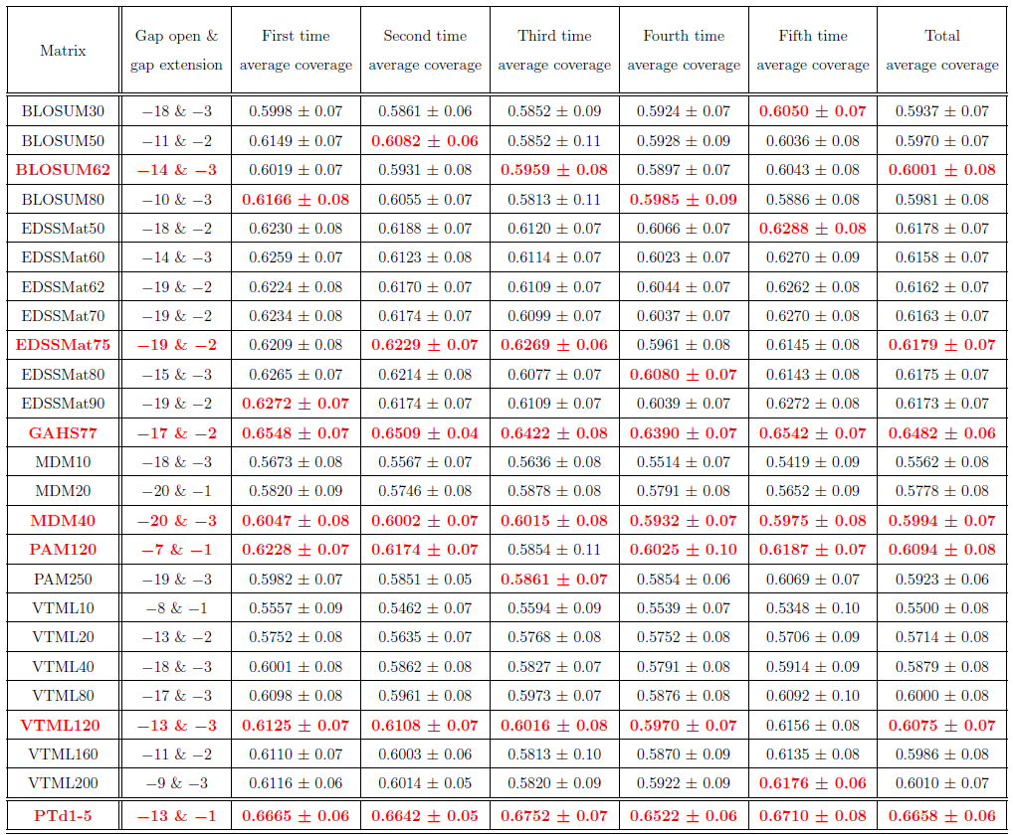

Slide 19
Conclusion
PSO+TLBO with diversity-guided (PTd).
As the results, our method can get the higher coverage than other matrices in the HD dataset.
It requiring a large amount of computational time on the sequence alignment.
We can try to perform a rough sequence alignment.
Notes:
Bootstrap是現代統計學較為流行的一種統計方法，在小樣本時效果很好。通過方差的估計可以構造信賴區間等，其運用範圍得到進一步延伸。

Slide 20
Thanks for your listening.

Slide 21
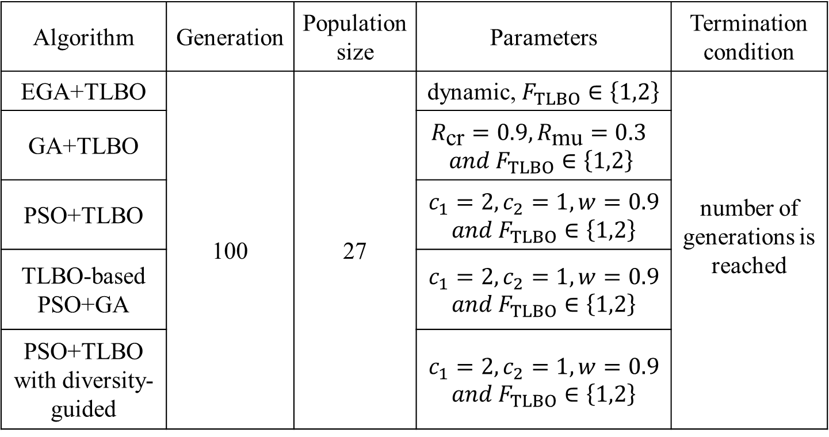
Experimental Results
Primitive experiment parameter settings
Algorithm | Generation | Population size | Parameters | Termination condition
EGA+TLBO | 100 | 27 | dynamic, $F_{TLBO}∈\left\{1,2\right\}$ | number of generations is reached
GA+TLBO |  |  | $$R_{\text{cr}}=0.9,R_{\text{mu}}=0.3$$ $$and F_{TLBO}∈\left\{1,2\right\}$$
PSO+TLBO |  |  | $$c_{1}=2,c_{2}=1, w=0.9$$ $$and F_{TLBO}∈\left\{1,2\right\}$$
TLBO-based PSO+GA |  |  | $$c_{1}=2,c_{2}=1, w=0.9$$ $$and F_{TLBO}∈\left\{1,2\right\}$$
PSO+TLBO with diversity-guided |  |  | $$c_{1}=2,c_{2}=1, w=0.9$$ $$and F_{TLBO}∈\left\{1,2\right\}$$

Slide 22
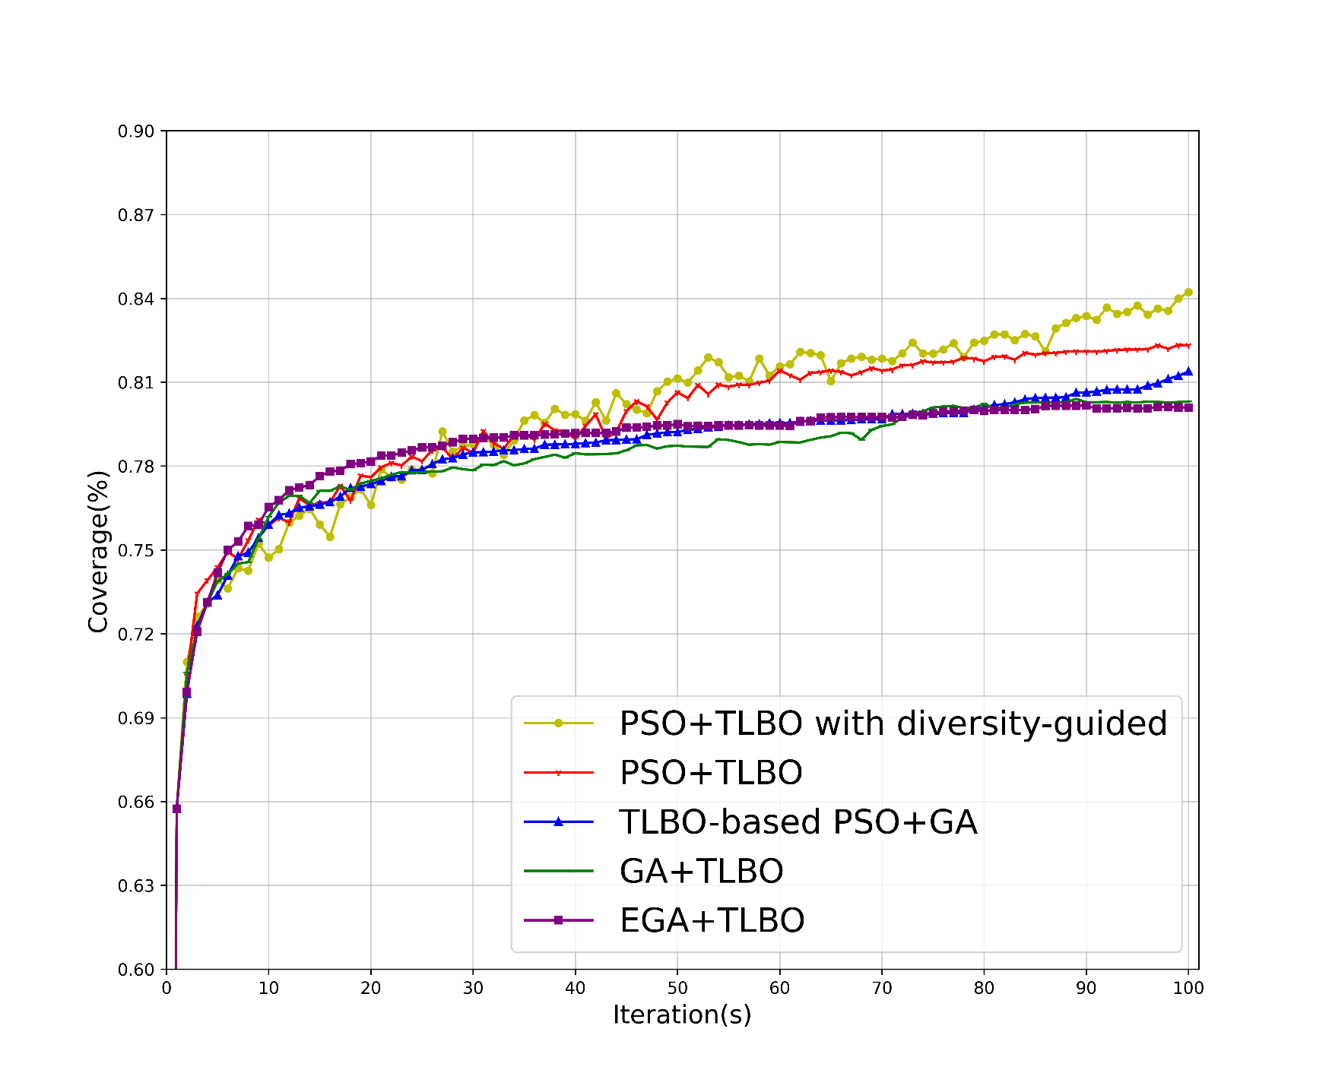
Experimental Results
Primitive experiment result (30 disjointed small datasets)
Notes:
介紹primitive 實驗目的

Slide 23
Experimental Results
10-fold cross-validation for 5 times
LD (27832) | MD (5029) | HD (3637 )
Training dataset
Test dataset
D1 | D2 | D3 | D4 | D5 | D6 | D7 | D8 | D9 | D10
D1 | D2 | D3 | D4 | D5 | D6 | D7 | D8 | D10 | D9
…
D2 | D3 | D4 | D5 | D6 | D7 | D8 | D9 | D10 | D1
LD (2783) | MD (503) | HD (364)

Slide 24
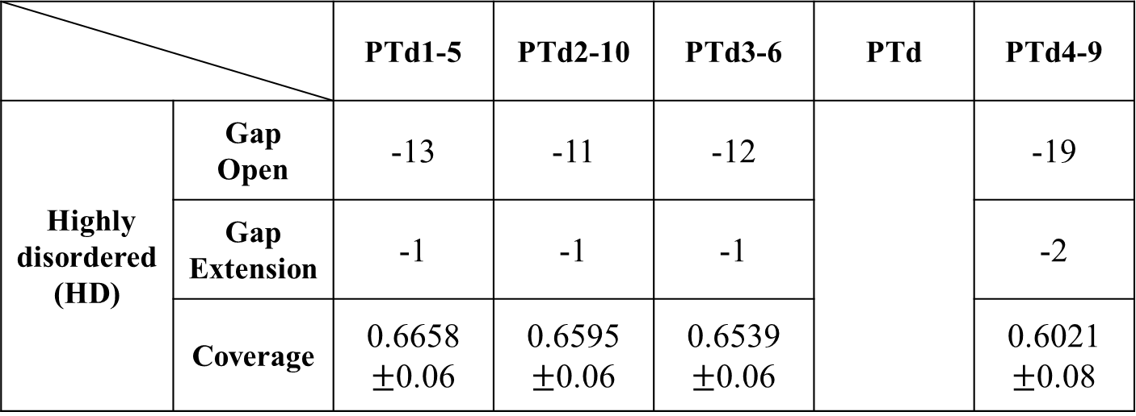
Experimental Results
10-fold cross-validation for 5 times
 |  | PTd1-5 | PTd2-10 | PTd3-6 | PTd | PTd4-9
Highly disordered (HD) | Gap Open | -13 | -11 | -12 |  | -19
 | Gap Extension | -1 | -1 | -1 |  | -2
 | Coverage | 0.6658 $±$0.06 | 0.6595 $±$0.06 | 0.6539 $±$0.06 |  | 0.6021 $±$0.08
•••

Slide 25
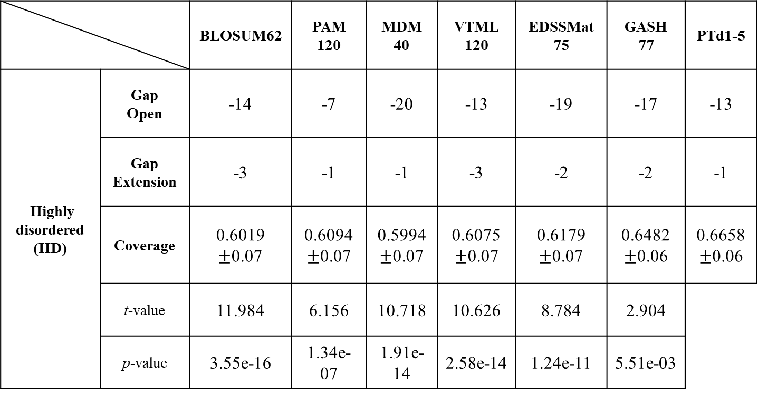
Experimental Results
10-fold cross-validation for 5 times (t-value > 2.0096 and p-value < 0.05 correspond to the 95% confidence)
 |  | BLOSUM62 | PAM 120 | MDM 40 | VTML 120 | EDSSMat 75 | GASH 77 | PTd1-5
Highly disordered (HD) | Gap Open | -14 | -7 | -20 | -13 | -19 | -17 | -13
 | Gap Extension | -3 | -1 | -1 | -3 | -2 | -2 | -1
 | Coverage | 0.6019 $±$0.07 | 0.6094 $±$0.07 | 0.5994 $±$0.07 | 0.6075 $±$0.07 | 0.6179 $±$0.07 | 0.6482 $±$0.06 | 0.6658 $±$0.06
 | t-value | 11.984 | 6.156 | 10.718 | 10.626 | 8.784 | 2.904
 | p-value | 3.55e-16 | 1.34e-07 | 1.91e-14 | 2.58e-14 | 1.24e-11 | 5.51e-03

Slide 26
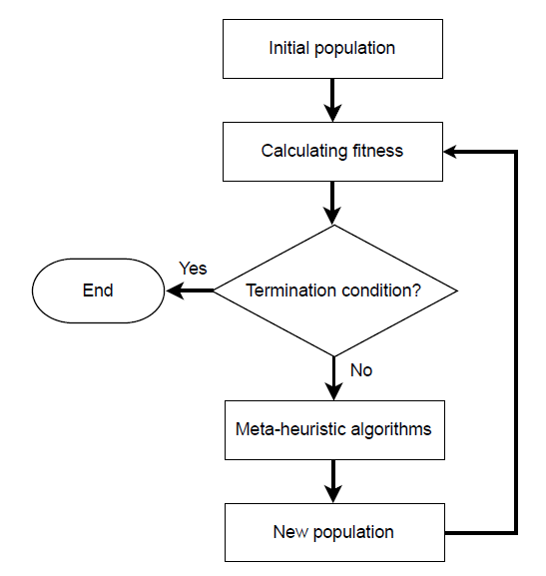
Flow Chart of Scoring Matrix Refination

