Slide 1
A Path Recorder Algorithm for Multiple Longest Common Subsequences (MLCS) Problems ​
Shiwei Wei, Yuping Wang, Yuanchao Yang and Sen Liu
Bioinformatics, Volume 36, Issue 10, 15 May 2020, Pages 3035–3042,
Presenter:Chien-Ting Lee
Date: May. 18, 2022

Slide 2
Abstract(1/2)
Motivation: Searching the Longest Common Subsequences of many sequences is called a Multiple Longest Common Subsequence (MLCS) problem which is a very fundamental and challenging problem in many fields of data mining. The existing algorithms can not applicable to problems with long and large-scale sequences due to their huge time and space consumption. To efficiently handle large-scale MLCS problems, a Path Recorder Directed Acyclic Graph (PRDAG) model and a novel Path Recorder Algorithm (PRA) are proposed.

Slide 3
Abstract(2/2)
Results: In PRDAG, we transform the MLCS problem into searching the longest path from the Directed Acyclic Graph (DAG), where each longest path in DAG corresponds to an MLCS. To tackle the problem efficiently, we eliminate all redundant and repeated nodes during the construction of DAG, and for each node, we only maintain the longest paths from the source node to it but ignore all non-longest pathes. As a result, the size of the DAG becomes very small, and the memory space and search time will be greatly saved. Empirical experiments have been performed on a standard benchmark set of both DNA sequences and protein sequences. The experimental results demonstrate that our model and algorithm outperform the related leading algorithms, especially for large-scale MLCS problems.
Notes:
MLCS這個問題:主要有dynamic programming方法與dominant point方法
這篇論文主要想改善dominant point方法

Slide 4
Successor Table
 | 0 | 1 | 2 | 3 | 4 | 5 | 6 | 7 | 8
 |  | G | A | A | G | C | G | T | A
A | 2 | 2 | 3 | 3 | 8 | 8 | 8 | 8 | --
C | 5 | 5 | 5 | 5 | 5 | -- | -- | -- | --
G | 1 | 4 | 4 | 4 | 6 | 6 | -- | -- | --
T | 7 | 7 | 7 | 7 | 7 | 7 | 7 | -- | --
 | 0 | 1 | 2 | 3 | 4 | 5 | 6 | 7 | 8
 |  | A | G | T | C | T | G | A | C
A | 1 | 7 | 7 | 7 | 7 | 7 | 7 | -- | --
C | 4 | 4 | 4 | 4 | 8 | 8 | 8 | 8 | --
G | 2 | 2 | 6 | 6 | 6 | 6 | -- | -- | --
T | 3 | 3 | 3 | 5 | 5 | -- | -- | -- | --
Notes:
O(d|Σ|n)

Slide 5
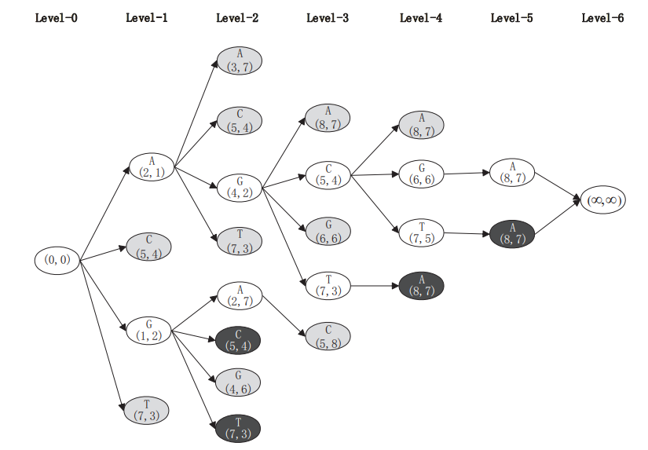
Dominant point based approaches
GAAGCGTA
AGTCTGAC
Notes:
Dominate的方法就是建立一個這種的有向無環圖
那這個圖是依照這兩個字串所建立的
每個元素都會往後延伸A、C、G、T 延伸的方式就是去查找Successor Table
灰色的點代表的意思是說可以被其他點所支配 (2,1)就能支配(5,4)因為他點兩個字串的index都比較小
黑色的點為同一LEVEL中已經出現過這個點
那我們每一層LEVEL都去探索所有的可能，重複此步驟，直到找不到其他點
1.大量重複點與支配點 ，浪費了大量的空間和計算時間。
2.在圖中，找到重複的節點與被支配的節點是很耗費時間的，因為需要做多維度向量的比較。

Slide 6
PRDAG(1)
Step1:將原點( O(0, 0, · · · , 0))加入至queue,並記錄長度為0
Step2 :從queue取一點找到其successors 檢查是否在set裡
在:就檢查長度大小決定是否取代
不在:加入至queue，並記錄長度, precursor
Step3 :重複step2直到queue為空，即完成

Slide 7
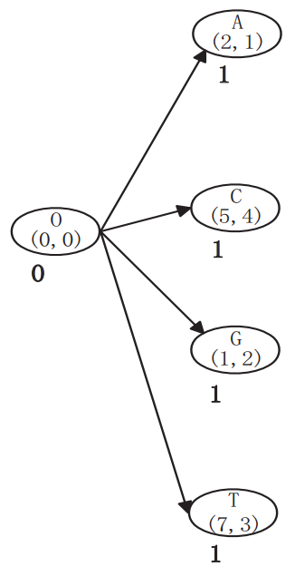
PRDAG(1)
 | 0 | 1 | 2 | 3 | 4 | 5 | 6 | 7 | 8
 |  | G | A | A | G | C | G | T | A
A | 2 | 2 | 3 | 3 | 8 | 8 | 8 | 8 | --
C | 5 | 5 | 5 | 5 | 5 | -- | -- | -- | --
G | 1 | 4 | 4 | 4 | 6 | 6 | -- | -- | --
T | 7 | 7 | 7 | 7 | 7 | 7 | 7 | -- | --
 | 0 | 1 | 2 | 3 | 4 | 5 | 6 | 7 | 8
 |  | A | G | T | C | T | G | A | C
A | 1 | 7 | 7 | 7 | 7 | 7 | 7 | -- | --
C | 4 | 4 | 4 | 4 | 8 | 8 | 8 | 8 | --
G | 2 | 2 | 6 | 6 | 6 | 6 | -- | -- | --
T | 3 | 3 | 3 | 5 | 5 | -- | -- | -- | --
Notes:
一開始先create 一個原點，找到 A,C,G,T四個successors，檢查是否有在集合裡，因為一開始為空集合故將此四點加入至queue

Slide 8
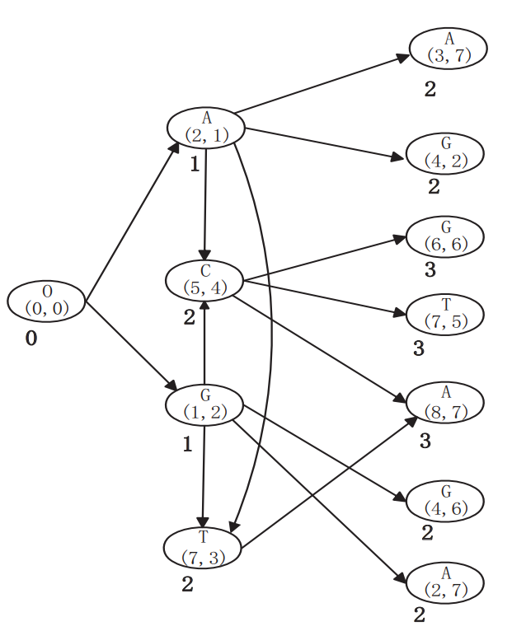
PRDAG(2)
 | 0 | 1 | 2 | 3 | 4 | 5 | 6 | 7 | 8
 |  | G | A | A | G | C | G | T | A
A | 2 | 2 | 3 | 3 | 8 | 8 | 8 | 8 | --
C | 5 | 5 | 5 | 5 | 5 | -- | -- | -- | --
G | 1 | 4 | 4 | 4 | 6 | 6 | -- | -- | --
T | 7 | 7 | 7 | 7 | 7 | 7 | 7 | -- | --
 | 0 | 1 | 2 | 3 | 4 | 5 | 6 | 7 | 8
 |  | A | G | T | C | T | G | A | C
A | 1 | 7 | 7 | 7 | 7 | 7 | 7 | -- | --
C | 4 | 4 | 4 | 4 | 8 | 8 | 8 | 8 | --
G | 2 | 2 | 6 | 6 | 6 | 6 | -- | -- | --
T | 3 | 3 | 3 | 5 | 5 | -- | -- | -- | --
Notes:
接著取出queue的元素為(2,1)，一樣找到他的四個successors，分別為(3,7)(4,2)(5,4)(7,3)，其中successors已經在上一張投影片時已經加入set，這時候去比較長度

Slide 9
PRDAG(3)
C(5,4), because L(C(5, 4)) < L(A(2, 1)) + 1,
C(7,3), because L(C(7, 3)) < L(A(2, 1)) + 1,
更換此兩點的 precursor
L(G(1, 2)) + 1 = L(C(5, 4))
L(G(1, 2)) + 1 = L(T(7, 3))
G(1, 2) is also a key precursor of C(5, 4) and T(7, 3).

Slide 10
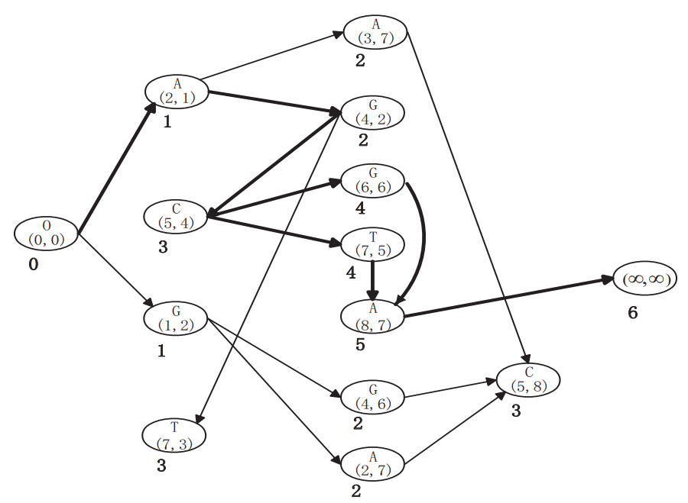
PRDAG(4)

Slide 11
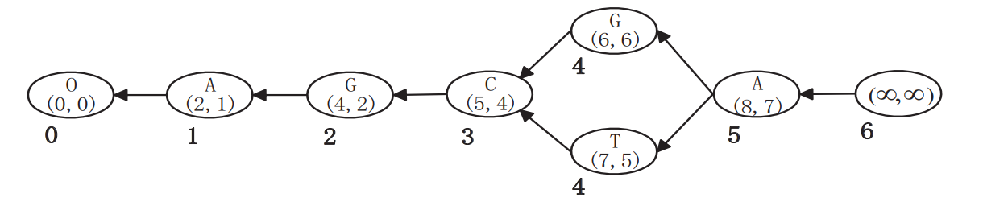
PRDAG(5)
MLCSs: AGCGA and AGCTA

Slide 12
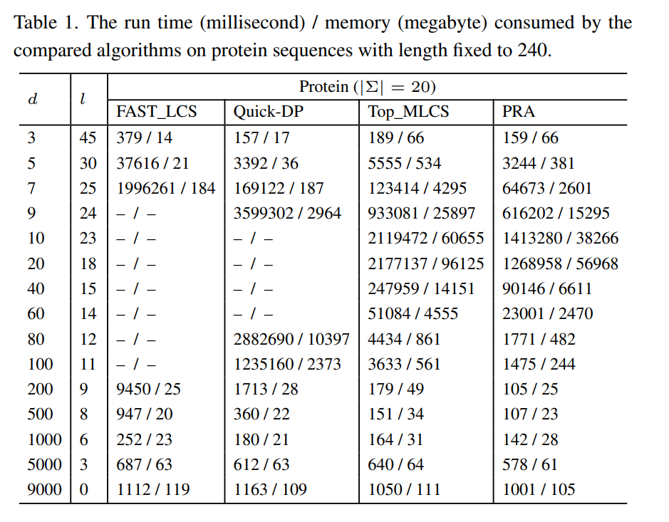
EXPERIMENTAL RESULTS
PRA is more suitable for large-scale MLCS problems.
Notes:
序列長度固定240 字母種類20種 d是序列數量由3-9000遞增 l 是MLCS最終長度
無法跑出來原因是因為序列數量上升導致維度成長 因為這兩個方法都需比較誰可以Dominate
PRA is 33.34% in average faster than Top_MLCS.

Slide 13
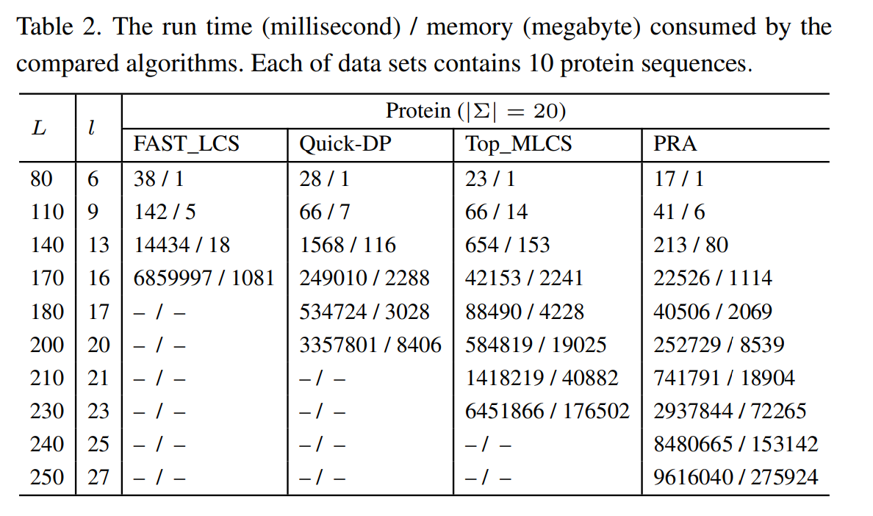
EXPERIMENTAL RESULTS
Notes:
序列數量固定10 字母種類20種 L是序列長度由80-250遞增 l 是MLCS最終長度
隨著序列長度增加 FAST_LCS 和 Quick-DP 時間消耗增加極快

