Slide 1
Chapter 1
Introduction
1 -<number>

Slide 2
Why to study algorithms?
Sorting problem:
To sort a set of elements into increasing or decreasing order.
  11, 7, 14, 1, 5, 9, 10
↓sort
1, 5, 7, 9, 10, 11, 14
Insertion sort
Quick sort
1 -<number>

Slide 3
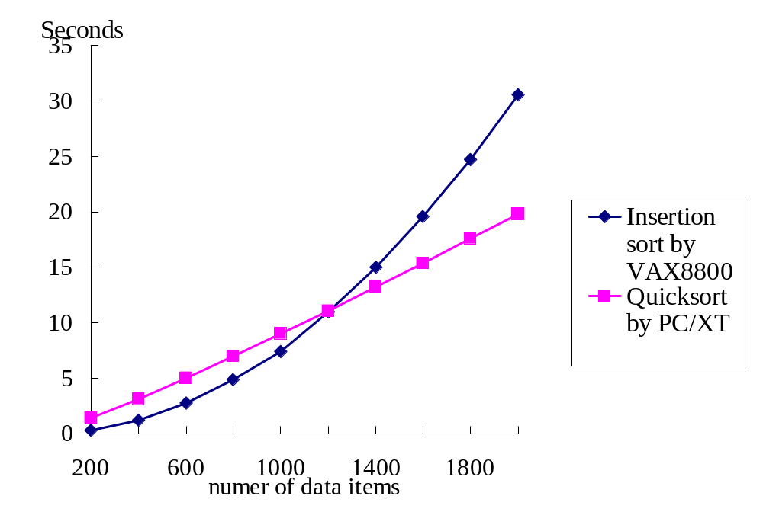
Comparison of two algorithms implemented on two computers
1 -<number>

Slide 4
Analysis of algorithms
Measure the goodness of algorithms
  efficiency
  asymptotic notations: e.g. O(n²)
  worst case
  average case
  amortized
Measure the difficulty of problems
  NP-complete
  undecidable
  lower bound
Is the algorithm optimal?
1 -<number>

Slide 5
0/1 Knapsack problem
M(weight limit)=14
best solution: P₁, P₂, P₃, P₅(optimal)
This problem is NP-complete.
 | P₁ | P₂ | P₃ | P₄ | P₅ | P₆ | P₇ | P₈
Value | 10 | 5 | 1 | 9 | 3 | 4 | 11 | 17
Weight | 7 | 3 | 3 | 10 | 1 | 9 | 22 | 15
1 -<number>

Slide 6
Traveling salesperson problem
Given: A set of n planar points
Find: A closed tour which includes all points exactly once such that its total length is minimized.
This problem is NP-complete.
1 -<number>

Slide 7
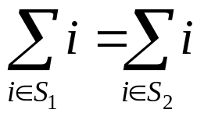
Partition problem
Given: A set of positive integers S
Find: S₁ and S₂ such that S₁∩S₂=∅, S₁∪S₂=S,
(partition into S₁ and S₂ such that the sum of S₁ is equal to that of S₂)
e.g. S={1, 7, 10, 4, 6, 8, 3, 13}
  S₁={1, 10, 4, 8, 3}
  S₂={7, 6, 13}
This problem is NP-complete.
1 -<number>

Slide 8
Art gallery problem
Given: an art gallery
Determine: min # of guards and their placements such that the entire art gallery can be monitored.
NP-complete
1 -<number>

Slide 9
Minimum spanning tree
graph: greedy method
geometry(on a plane): divide-and-conquer
# of possible spanning trees for n points: n^{n-2}
n=10→10⁸, n=100→10¹⁹⁶
1 -<number>

Slide 10
Convex hull
Given a set of planar points, find a smallest convex polygon which contains all points.
It is not obvious to find a convex hull by examining all possible solutions
divide-and-conquer
1 -<number>

Slide 11
One-center problem
Given a set of planar points, find a smallest circle which contains all points.
Prune-and-search
1 -<number>

