Slide 1
Chapter 10
Amortized Analysis
10 -<number>

Slide 2
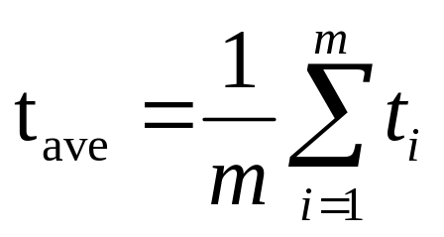
An example– push and pop
A sequence of operations: OP₁, OP₂, … OP_{m}
OP_{i} : several pops (from the stack) and
one push (into the stack)
t_{i} : time spent by OP_{i}
the average time per operation:
10 -<number>

Slide 3
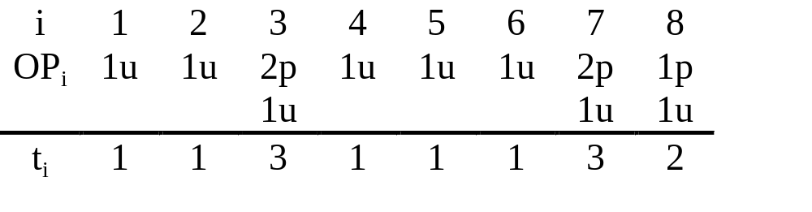
Example: a sequence of push and pop
p: pop , u: push
t_{ave} = (1+1+3+1+1+1+3+2)/8
= 13/8
= 1.625
10 -<number>

Slide 4
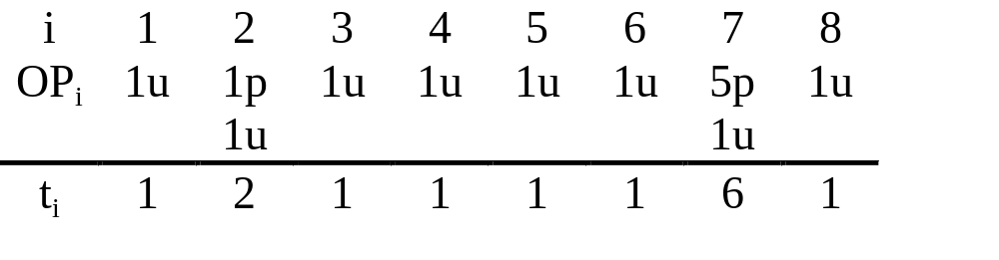
Another example: a sequence of push and pop
p: pop , u: push
t_{ave} = (1+2+1+1+1+1+6+1)/8
= 14/8
= 1.75
10 -<number>

Slide 5
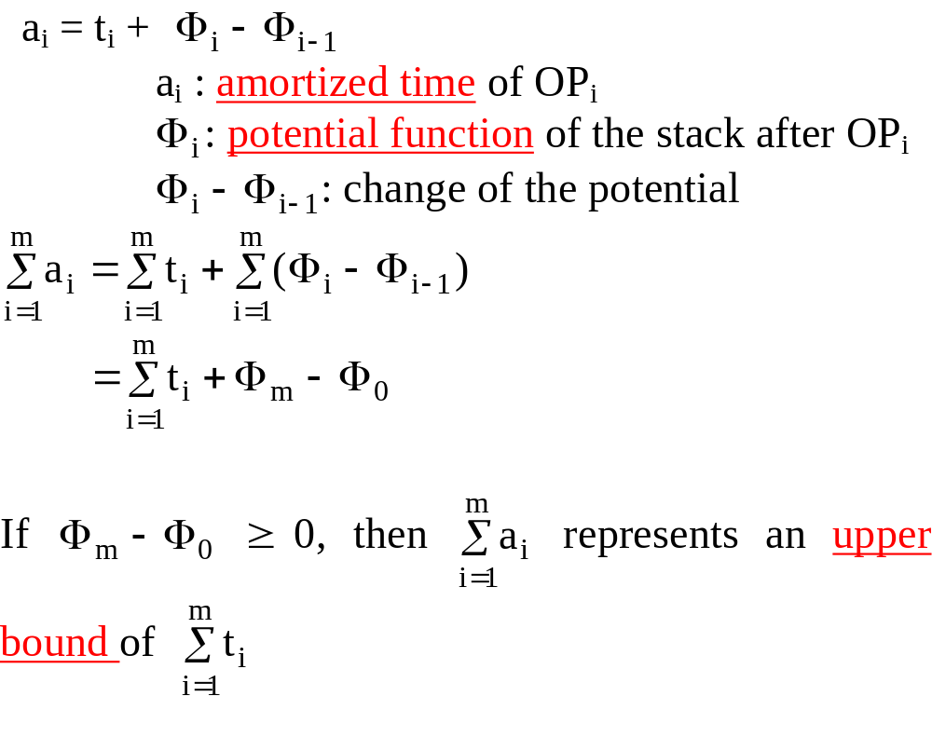
Amortized time and potential function
10 -<number>

Slide 6
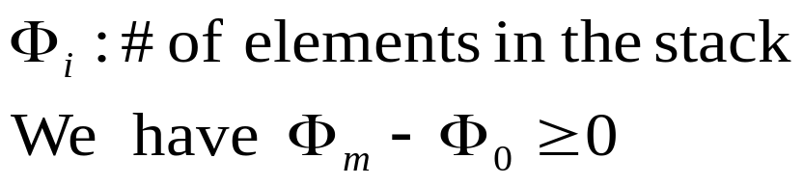
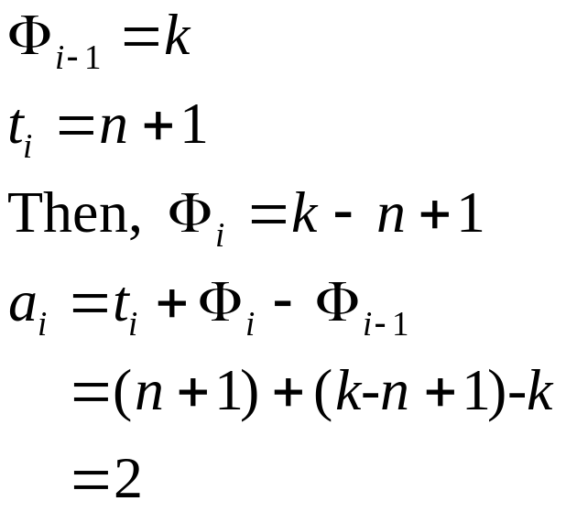
Amortized analysis of the push-and-pop sequence
Suppose that before we execute Op_{i} , there are k elements in the stack and Op_{i} consists of n pops and 1 push.
10 -<number>

Slide 7
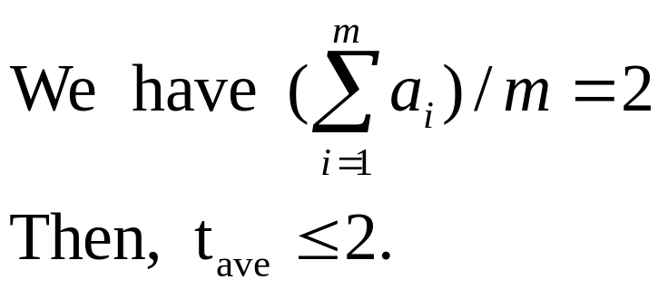
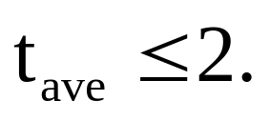
By observation, at most m pops and m pushes are executed in m operations. Thus,
10 -<number>

Slide 8
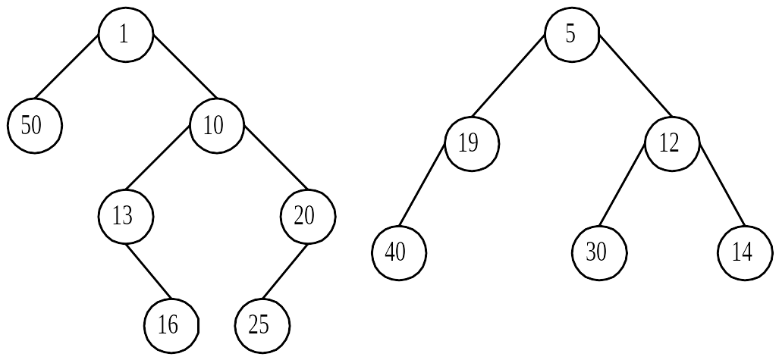

Skew heaps
meld: merge + swapping
Two skew heaps
Step 1: Merge the right paths.
5 right heavy nodes: yellow
10 -<number>

Slide 9
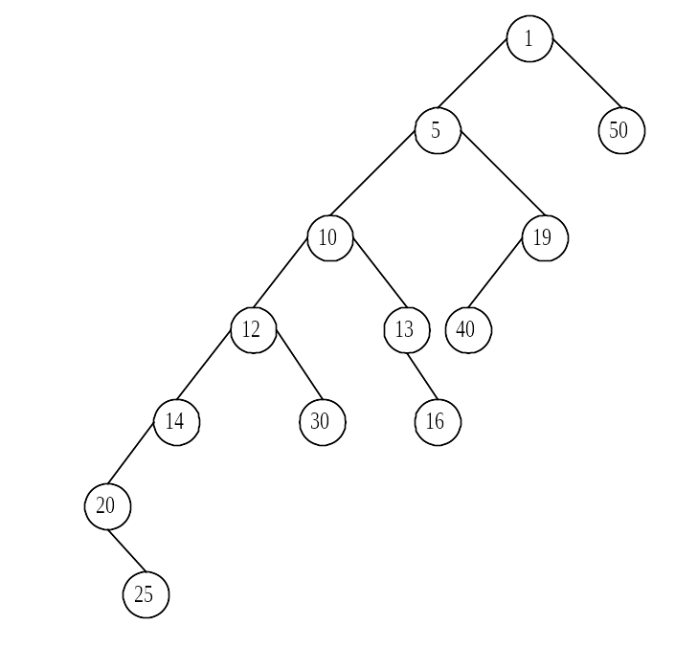
Step 2: Swap the children along the right path.
No right heavy node
10 -<number>

Slide 10
Amortized analysis of skew heaps
meld: merge + swapping
operations on a skew heap:
  find-min(h): find the min of a skew heap h.
  insert(x, h): insert x into a skew heap h.
  delete-min(h): delete the min from a skew heap h.
  meld(h₁, h₂): meld two skew heaps h₁ and h₂.
The first three operations can be implemented by melding.
10 -<number>

Slide 11
Potential function of skew heaps
wt(x): # of descendants of node x, including x.
heavy node x: wt(x) > wt(p(x))/2, where
p(x) is the parent node of x.
light node : not a heavy node
potential function Φ_{i}: # of right heavy nodes of the skew heap.
10 -<number>

Slide 12
Any path in an n-node tree contains at most ⎣log₂n⎦ light nodes.
light nodes ≤ ⎣log₂n⎦
# heavy=k₃≤ ⎣log₂n⎦
possible heavy nodes
# of nodes: n
The number of right heavy nodes attached to the left path is at most ⎣log₂n ⎦.
10 -<number>

Slide 13
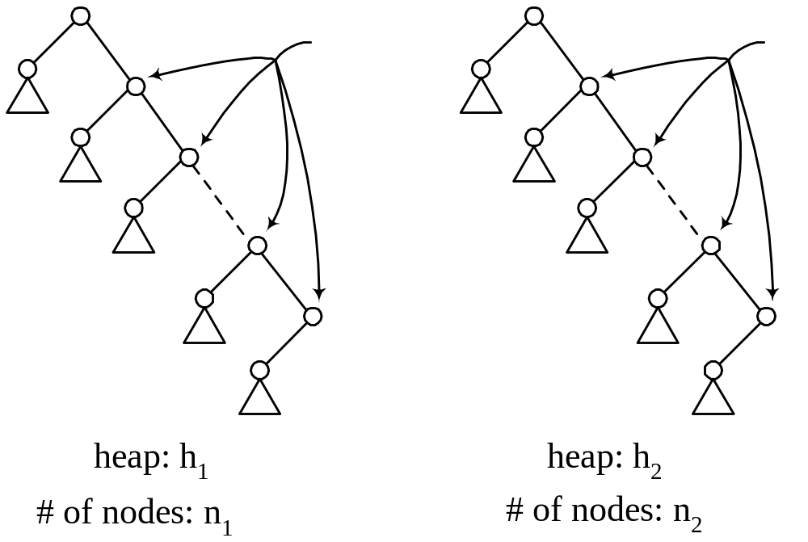
Amortized time
# light ≤ ⎣log₂n₁⎦
# heavy = k₁
# light ≤ ⎣log₂n₂⎦
# heavy = k₂
10 -<number>

Slide 14
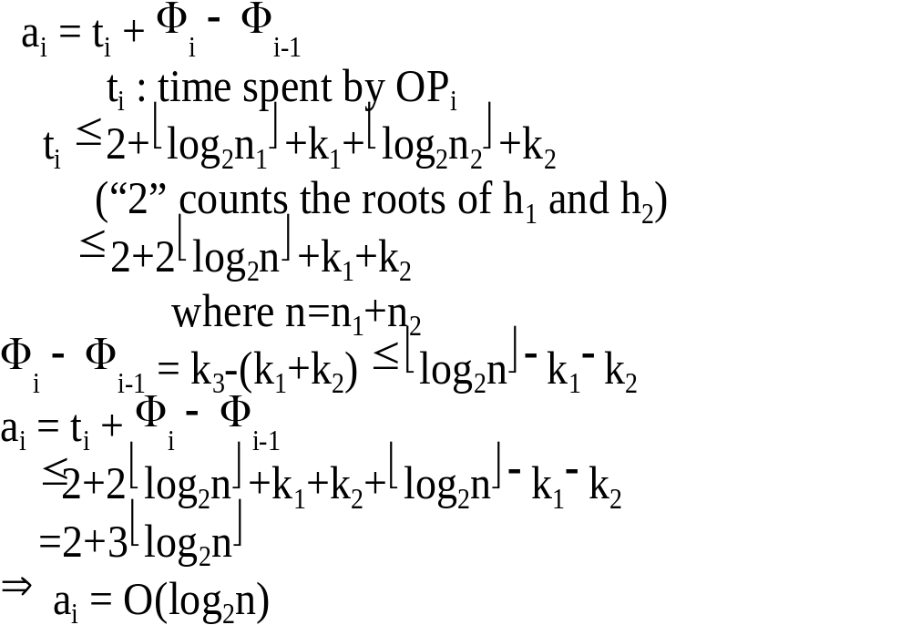
10 -<number>

Slide 15
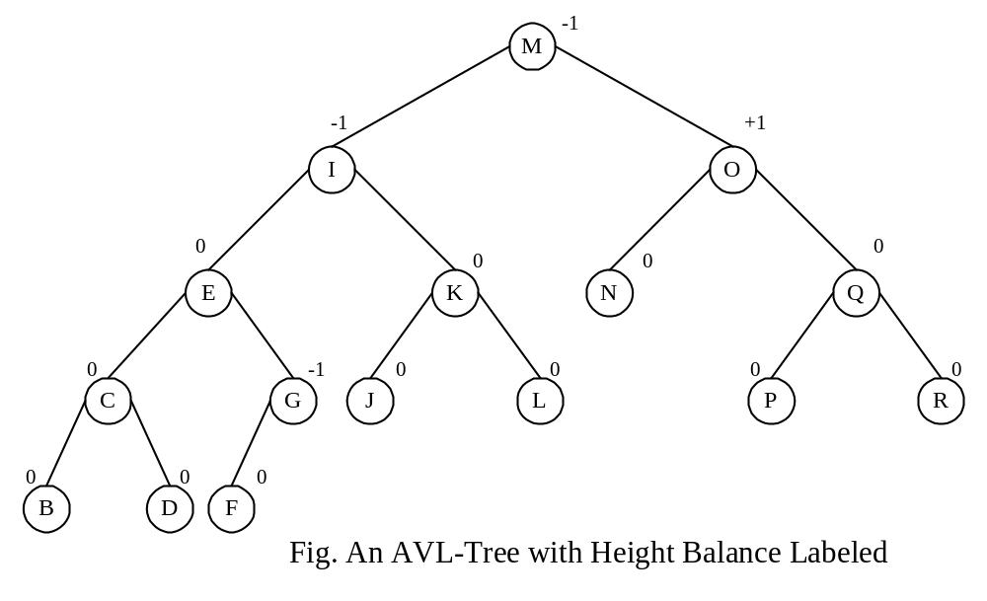
AVL-trees
height balance of node v:
hb(v)= (height of right subtree) – (height of left subtree)
The hb(v) of every node never differ by more than 1.
10 -<number>

Slide 16
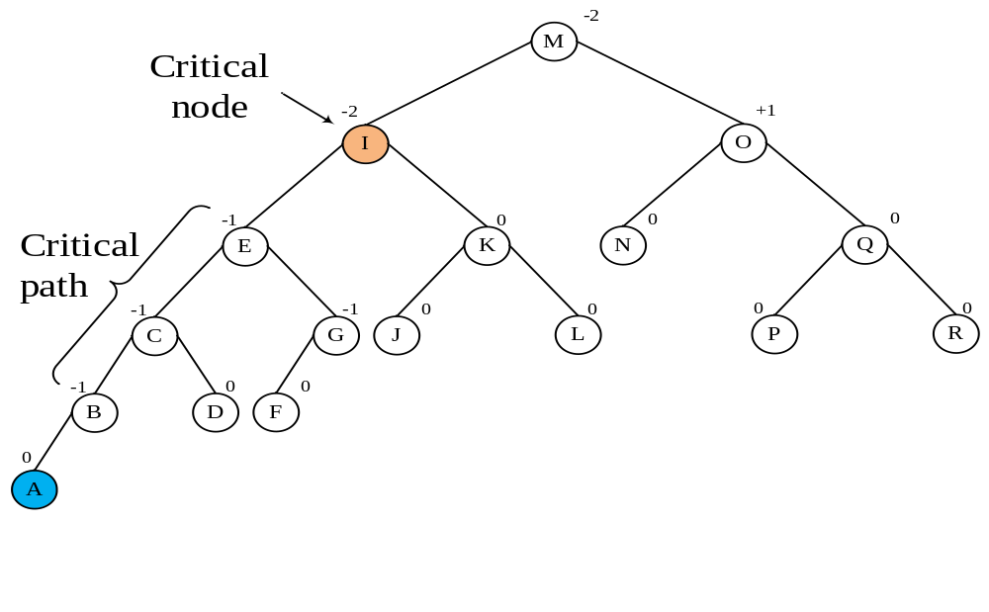
Add a new node A.
Before insertion, hb(B)=hb(C)=hb(E)=0
hb(I)≠0 the first nonzero from leaves.
10 -<number>

Slide 17

Amortized analysis of AVL-trees
Consider a sequence of m insertions on an empty AVL-tree.
  T₀: an empty AVL-tree.
  T_{i}: the tree after the ith insertion.
  L_{i}: the length of the critical path involved in the ith insertion.
  X₁: total # of balance factor changing from 0 to +1 or -1 during these m insertions (the total cost for rebalancing)
10 -<number>

Slide 18
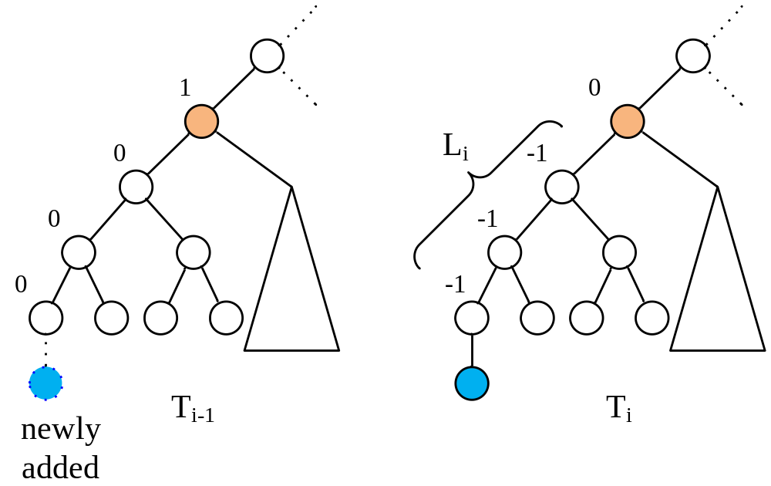
Case 1 : Absorption
The tree height is not increased, we need not rebalance it.
Val(T_{i})=Val(T_{i-1})+(L_{i}−1)
10 -<number>

Slide 19
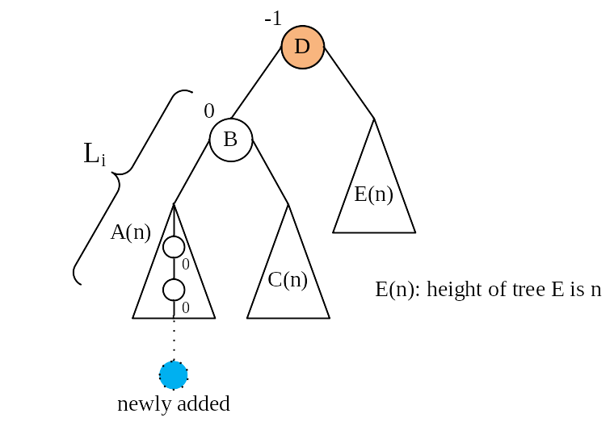
Case 2.1 Single rotation
10 -<number>

Slide 20
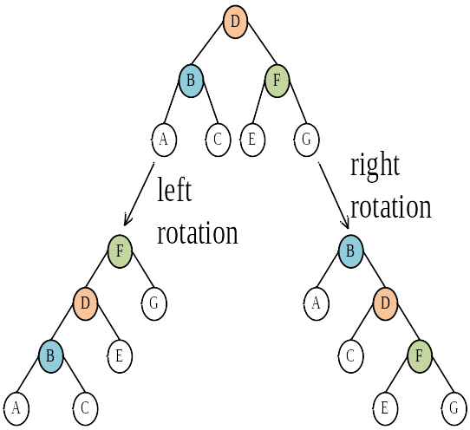
Case 2 : Rebalancing the tree
10 -<number>

Slide 21
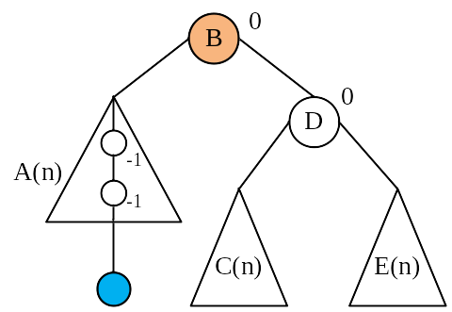
Case 2.1 Single rotation
After a right rotation on the subtree rooted at D:
Val(T_{i})=Val(T_{i-1})+(L_{i}-2)
10 -<number>

Slide 22
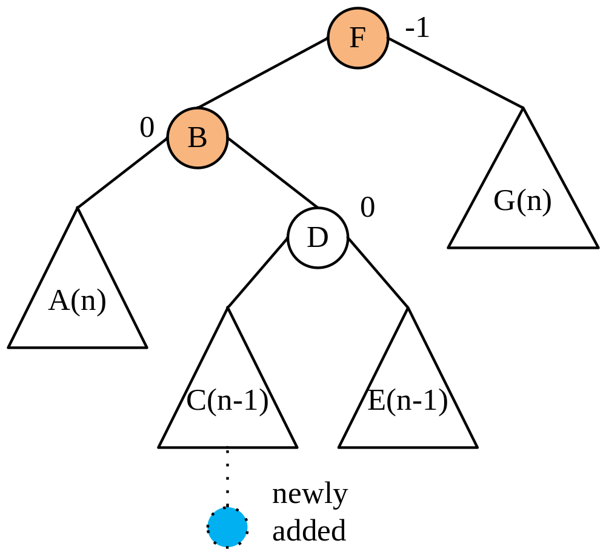
Case 2.2 Double rotation
10 -<number>

Slide 23
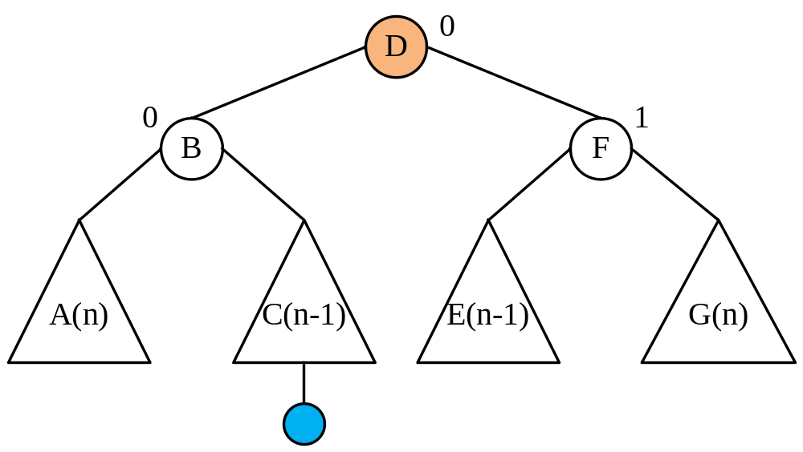
Case 2.2 Double rotation
After a left rotation on the subtree rooted at B and a right rotation on the subtree rooted at F:
Val(T_{i})=Val(T_{i-1})+(L_{i}-2)
10 -<number>

Slide 24
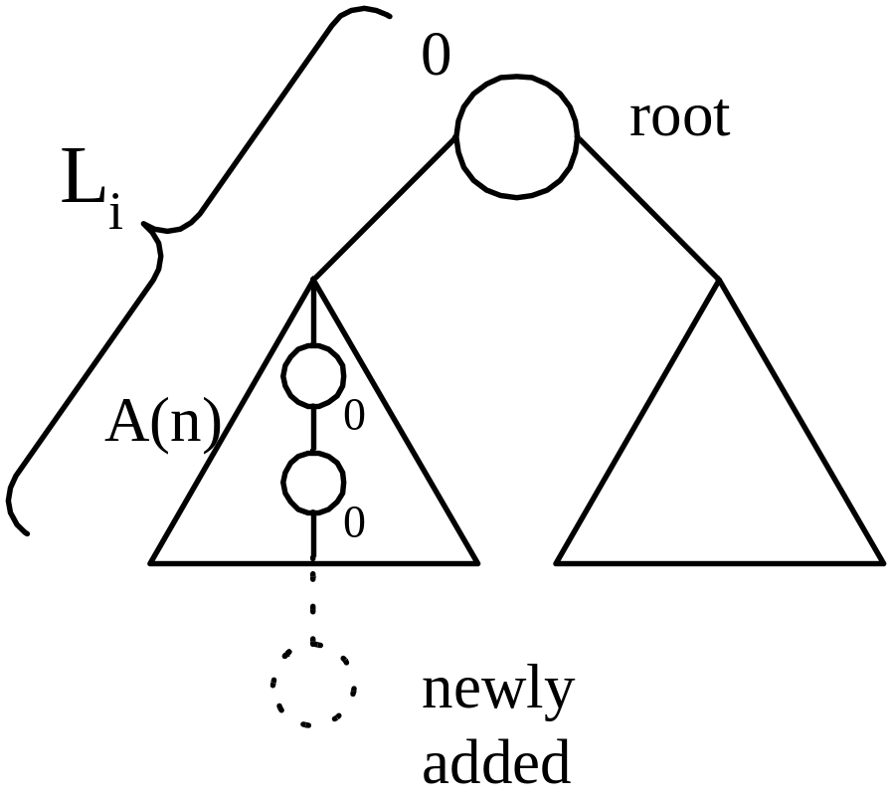
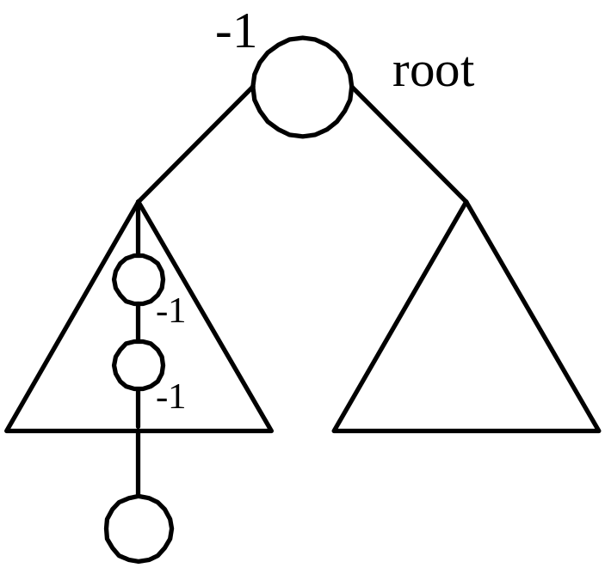
Case 3 : Height increase
L_{i} is the height of the root.
Val(T_{i})=Val(T_{i-1})+L_{i}
10 -<number>

Slide 25
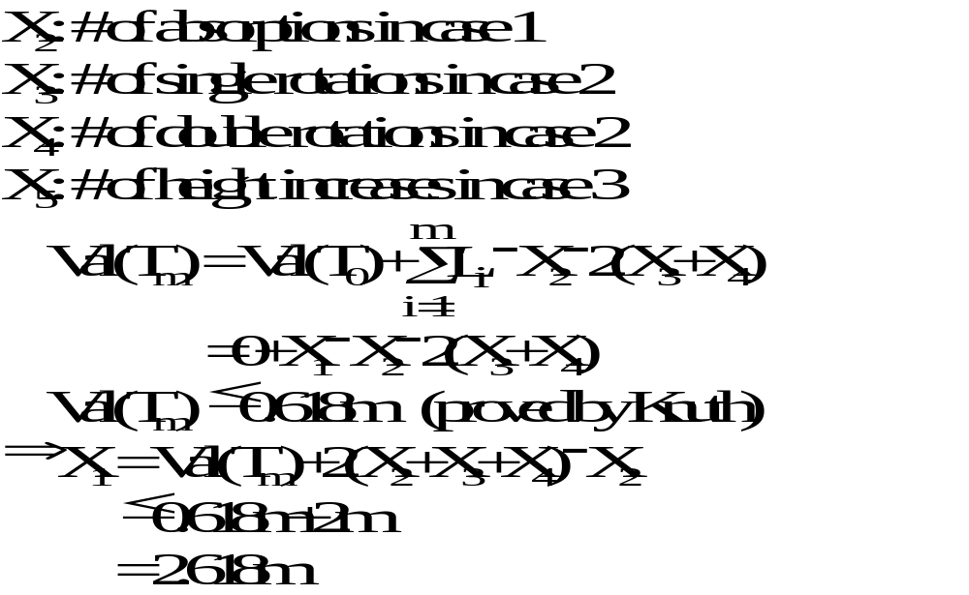
Amortized analysis of X₁
10 -<number>

Slide 26
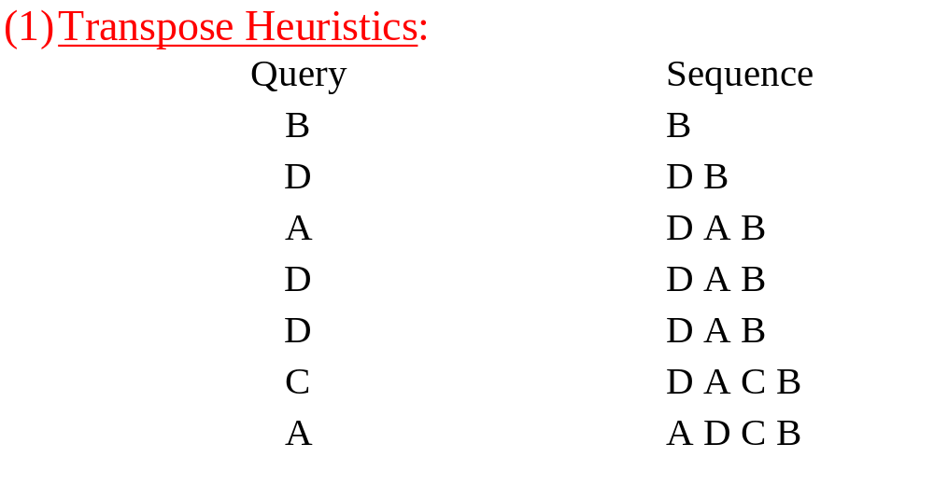
A self-organizing sequential search heuristics
3 methods for enhancing the performance of sequential search
10 -<number>

Slide 27
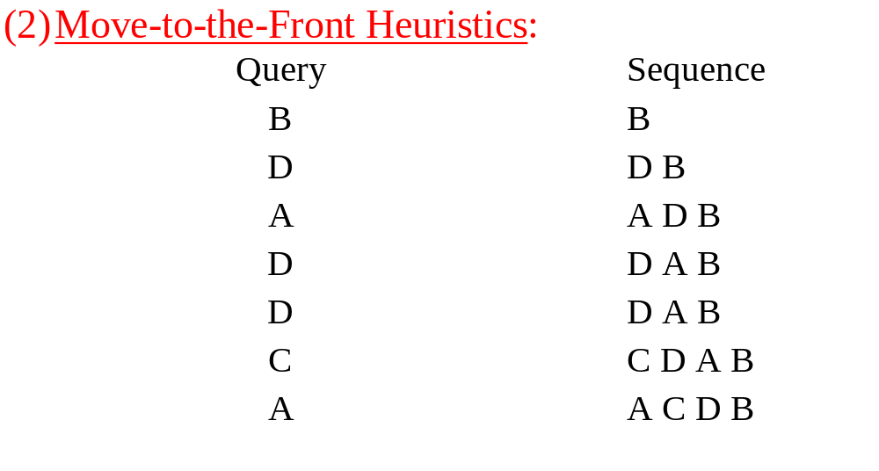
10 -<number>

Slide 28
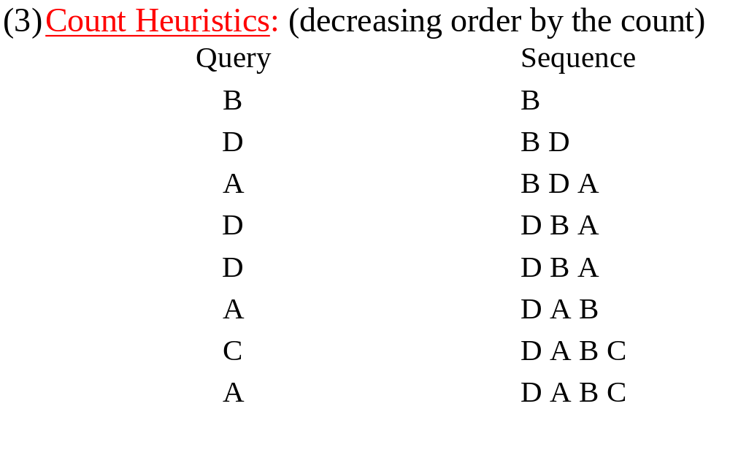
10 -<number>

Slide 29
Analysis of the move-to-the-front heuristics
interword comparison: unsuccessful comparison
intraword comparison: successful comparison
pairwise independent property:
  For any sequence S and all pairs P and Q, # of interword comparisons of P and Q is exactly # of interword comparisons made for the subsequence of S consisting of only P’s and Q’s.
  (See the example on the next page.)
10 -<number>

Slide 30
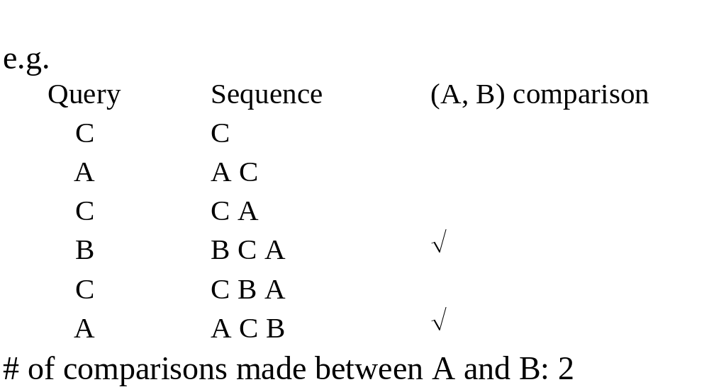
Pairwise independent property in move-to-the-front
10 -<number>

Slide 31
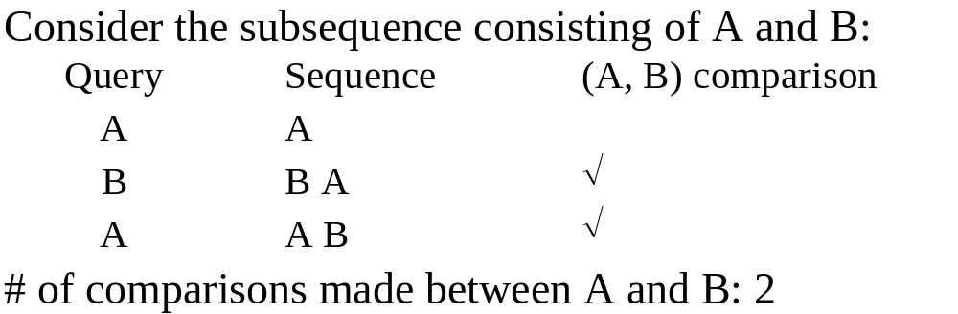
10 -<number>

Slide 32
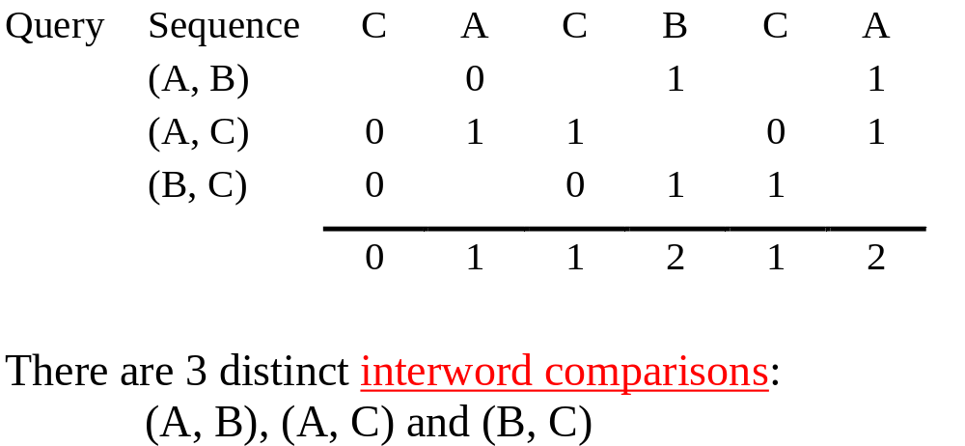
We can consider them separately and then add them up.
the total number of interword comparisons:
0+1+1+2+1+2 = 7
10 -<number>

Slide 33
Theorem for the move-to-the- front heuristics
C_{M}(S): # of comparisons of the move-to-the-front heuristics
C_{O}(S): # of comparisons of the optimal static ordering
C_{M} (S)≤ 2C_{O}(S)
10 -<number>

Slide 34
Proof
Proof:
Inter_{M}(S): # of interword comparisons of the move to the front heuristics
Inter_{O}(S): # of interword comparisons of the optimal static ordering
Let S consist of a A’s and b B’s, a < b.
The optimal static ordering: BA
Inter_{O}(S) = a
Inter_{M}(S) ≤ 2a
⇒ Inter_{M}(S) ≤ 2Inter_{O}(S)
10 -<number>

Slide 35
Proof (cont.)
Consider any sequence consisting of more than two items. Because of the pairwise independent property, we have Inter_{M}(S) ≤ 2Inter_{O}(S)
Intra_{M}(S): # of intraword comparisons of the move-to-the-front heuristics
Intra_{O}(S): # of intraword comparisons of the optimal static ordering
Intra_{M}(S) = Intra_{O}(S)
Inter_{M}(S) + Intra_{M}(S) ≤ 2Inter_{O}(S) + Intra_{O}(S)
⇒ C_{M}(S) ≤ 2C_{O}(S)
10 -<number>

Slide 36
The count heuristics
The count heuristics has a similar result:
C_{C}(S) ≤ 2C_{O}(S), where C_{C}(S) is the cost of the count heuristics
10 -<number>

Slide 37
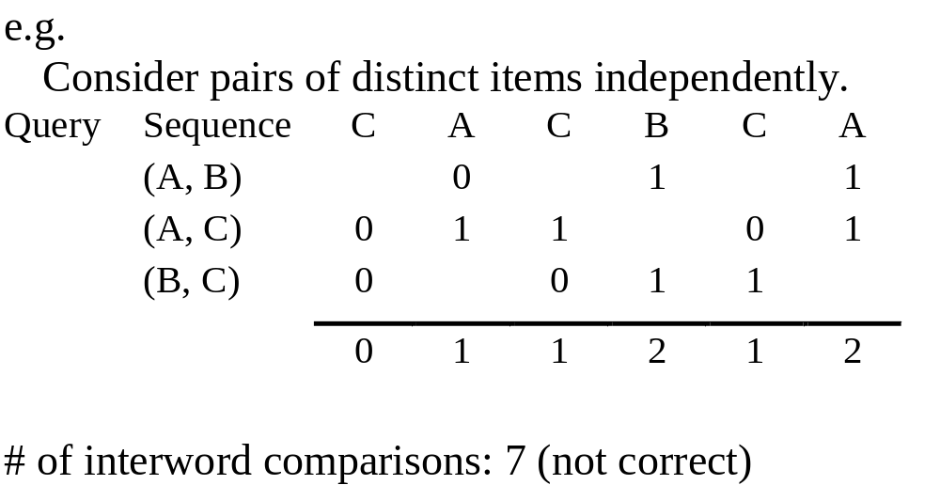
The transposition heuristics
The transposition heuristics does not possess the pairwise independent property.
We can not have a similar upper bound for the cost of the transposition heuristics.
10 -<number>

Slide 38
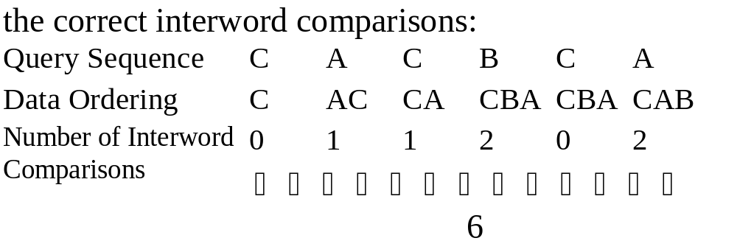
10 -<number>

