Slide 1
Chapter 11
Randomized Algorithms

Slide 2
Randomized algorithms
In a randomized algorithm (probabilistic algorithm), we make some random choices.
2 types of randomized algorithms:
  For an optimization problem, a randomized algorithm gives an optimal solution. The average case time-complexity is more important than the worst case time-complexity.
  For a decision problem, a randomized algorithm may make mistakes. The probability of producing wrong solutions is very small.

Slide 3
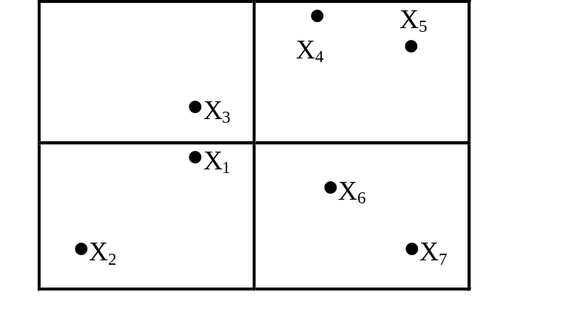
The closest pair problem
This problem can be solved by the divide-and-conquer approach in O(nlogn) time.
The randomized algorithm:
  Partition the points into several clusters:
  We only calculate distances among points within the same cluster.
  Similar to the divide-and-conquer strategy. There is a dividing process, but no merging process.

Slide 4
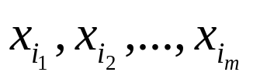
A randomized algorithm for closest pair finding
Input: A set S consisting of n elements x₁, x₂,…, x_{n}, where S⊆ R².
Output: The closest pair in S.
Step 1: Randomly choose a set S₁={ } where m=n^{2/3}. Find the closest pair of S₁ and let the distance between this pair of points be denoted as δ .
Step 2: Construct a set of squares T with mesh-size δ.

Slide 5
Step 3: Construct four sets of squares T₁, T₂, T₃ and T₄ derived from T by doubling the mesh-size to 2δ .
Step 4: For each T_{i}, find the induced decomposition S=S₁^{(i)} ∪S₂^{(i)} ∪ … ∪ S_{j}^{(i)}, 1≤i ≤4, where S_{j}^{(i)} is a non-empty intersection of S with a square of T_{i}.
Step 5: For each x_{p}, x_{q}∈S_{j}^{(i)}, compute d(x_{p}, x_{q}). Let x_{a} and x_{b} be the pair of points with the shortest distance among these pairs. Return x_{a} and x_{b} as the closest pair.

Slide 6
An example
6δ
n=27 points.
m=n^{2/3}
S₁ = {x₁, x₂, …, x₉},
δ = d(x₁, x₂)
5δ
X₄
X₃
4δ
X₅
X₂
3δ
X₁
X₉
2δ
X₇
X₆
δ
X₈
δ
2δ
3δ
4δ
5δ
6δ

Slide 7
6δ
5δ
X₄
X₃
4δ
T₁
X₅
X₂
3δ
X₁
X₉
2δ
X₆
X₇
δ
X₈
δ
2δ
3δ
4δ
5δ
6δ
6δ
5δ
X₄
X₃
4δ
X₅
X₂
T₂
3δ
X₁
X₉
2δ
X₆
X₇
δ
X₈
δ
2δ
3δ
4δ
5δ
6δ

Slide 8
6δ
5δ
X₄
X₃
4δ
T₃
X₅
X₂
3δ
X₁
X₉
2δ
X₆
X₇
δ
X₈
δ
2δ
3δ
4δ
5δ
6δ
6δ
5δ
X₄
X₃
T₄
4δ
X₅
X₂
3δ
X₁
X₉
2δ
X₇
X₆
δ
X₈
δ
2δ
3δ
4δ
5δ
6δ

Slide 9
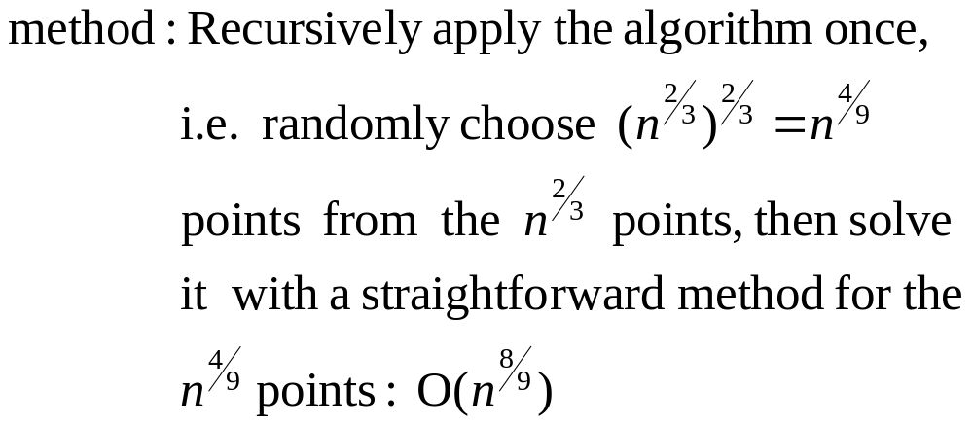

Time complexity
Time complexity: O(n) in average
step 1: O(n)
step 2 ~ Step 4: O(n)
step 5: O(n)with probability 1-2e^{-cn}

Slide 10
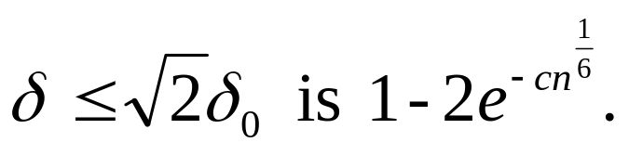
Analysis of Step 5
How many distance computations in step 5?
δ : mesh-size in step 1
T_{i}: partition in step 5
N(T_{i}): # of distance computations in partitionT_{i}
Fact: There exists a particular partition R₀, whose mesh-size is δ₀ such that
(1) N(R₀) ≤ c₀n.
(2) the probability that

Slide 11
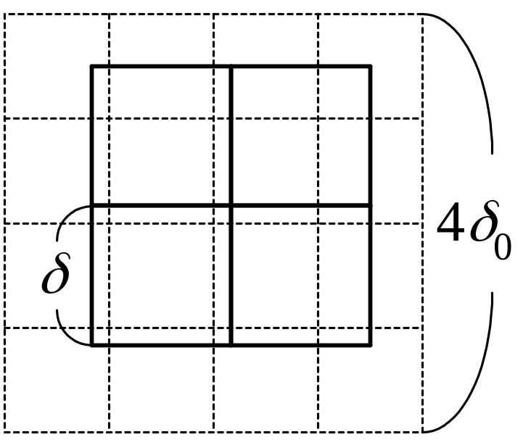
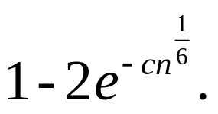
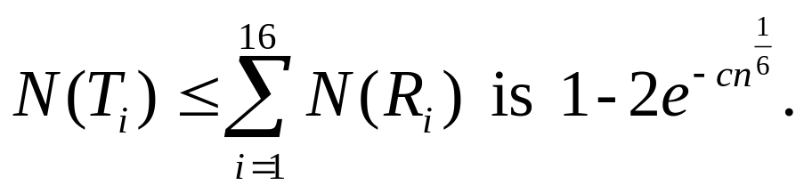
Construct R₁, R₂, …, R₁₆
mesh-size: 4δ₀
The probability that each square in T_{i} falls into at least one square of R_{i} , 1 ≤ i ≤ 16 is
The probability that

Slide 12
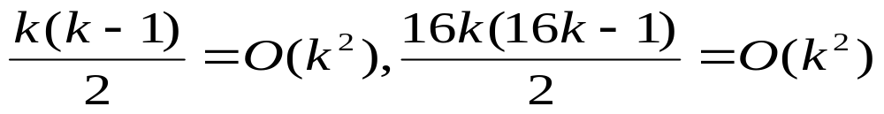
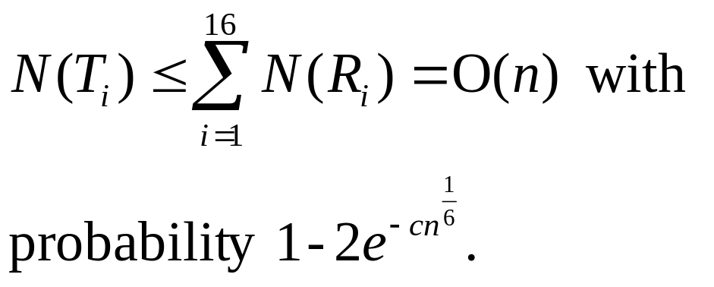
Let the square in R₀ with the largest number of elements among the 16 squares have k elements.
N(R₀) ≤ c₀n => N(R_{i} ) ≤ c_{i}n
4
δ
0
R
:
δ
i
0
k

Slide 13

A randomized algorithm to test whether a number is prime.
This problem is very difficult and no polynomial algorithm has been found to solve this problem
Traditional method:
use 2,3,… to test whether N is prime.
input size of N : B=log₂N (binary
representation)
=2^{B/2}, exponential function of B
Thus can not be viewed as a polynomial function of the input size.

Slide 14

Randomized prime number testing algorithm
Input: A positive number N, and a parameter m.
Output: Whether N is a prime or not, with probability of being correct at least 1-ε = 1-2^{-m}.
Step 1: Randomly choose m numbers b₁, b₂, …, b_{m}, 1≤ b₁, b₂, …, b_{m} <N, where m≥log₂(1/ε).
Step 2: For each b_{i}, test whether W(b_{i}) holds where W(b_{i}) is defined as follows:
  (1) b_{i}^{N-1} ≠ 1 mod N or
  (2) ∃ j such that = k is an integer and the greatest common divisor of (b_{i})^{k}-1 and N is not 1 or N.
  If any W(b_{i}) holds, then return N as a composite number, otherwise, return N as a prime.

Slide 15
Examples for randomized prime number testing
Example 1: N = 12
Randomly choose 2, 3, 7
2¹²⁻¹ = 2048 ≠ 1 mod 12
⇒ 12 is a composite number.

Slide 16
Example 2: N = 11
Randomly choose 2, 5, 7
  (1) 2¹¹⁻¹=1024≡1 mod 11
  j=1, (N-1)/2^{j}=5
  GCD(2⁵-1, 11) = GCD(31,11) = 1
  W(2) does not hold .
  (2) 5¹¹⁻¹=9765625≡1 mod 11
  GCD(5⁵-1, 11) = GCD(3124,11) = 11
  W(5) does not hold .
  (3) 7¹¹⁻¹=282475249≡1 mod 11
  GCD(7⁵-1, 11) = GCD(16806,11) = 1
  W(7) does not hold .
Thus, 11 is a prime number with the probability of correctness being at least
1-2⁻³= 7/8 .

Slide 17
Theorem for number theory
Theorem:
  If W(b) holds for any 1≤ b<N, then N is a composite number .
  If N is composite, then
  (N-1)/2 ≤ | { b | 1 ≤ b<N, W(b) holds } |.

Slide 18
Pattern matching
Pattern string : X length : n
Text string : Y length : m, m ≥ n
To find the first occurrence of X as a consecutive substring of Y .
Assume that X and Y are binary strings.
e.g. X = 01001 , Y = 1010100111
Straightforward method : O(mn)
Knuth-Morris-Pratt’s (KMP) algorithm : O(m)
The randomized algorithm : O(mk) with a mistake of small probability. (k:# of testings)
X

Slide 19
Binary representation
X = x₁ x₂…x_{n}∈{0,1}
Y = y₁ y₂…y_{m}∈{0,1}
Let Y(i)=y_{i} y_{i+1}….y_{i+n-1}
A match occurs if X=Y(i) for some i .
Binary values of X and Y(i):
B(X) = x₁2^{n-1} + x₂2^{n-2} + … + x_{n}
B(Y(i)) = y_{i}2^{n-1}+y_{i+1}2^{n-2}+…+y_{i+n-1} ,
1≤ i ≤ m-n+1

Slide 20
Fingerprints of binary strings
Let p be a randomly chosen prime number in {1,2,…,nt²}, where t = m - n + 1.
Notation: (x_{i})_{p} = x_{i} mod p
Fingerprints of X and Y(i):
B_{p}(x) = ( ( ( (x₁2)_{p}+x₂)_{p}2)_{p}+x₃)_{p}2…
B_{p}(Y(i)) = ( ( ( (y_{i}2)_{p}+y_{i+1})_{p}2+y_{i+2})_{p}2…
⇒ B_{p}(Y(i+1))= ( (B_{p}(Y_{i})-2^{n-1}y_{i}) 2+Y_{i+n})_{p}
=( ( (B_{p}(Y_{i})-( (2^{n-1})_{p}y_{i})_{p} )_{p} 2)_{p} +y_{i+n})_{p}
If X=Y(i), then B_{p}(X) = B_{p} (Y(i)), but not vice versa.

Slide 21
Examples for using fingerprints
Example: X = 10110 , Y = 110110
n = 5 , m = 6 , t = m - n + 1 = 2
suppose P=3.
B_{p}(X) = (22)₃ = 1
B_{p}(Y(1)) = (27)₃ = 0
⇒ X≠Y(1)
B_{p}(Y(2)) = ( (0-2⁴)₃ 2+0)₃ = 1
⇒ X = Y(2)

Slide 22
e.g. X = 10110 , Y = 10011 , P = 3
B_{p}(X) = (22)₃ = 1
B_{p}(Y(1)) = (19)₃ = 1
⇒ X= Y(1) WRONG!
If B_{p}(X) ≠ B_{p}(Y(i)), then X ≠ Y(i) .
If B_{p}(X) = B_{p}(Y(i)), we may do a bit by bit checking or compute k different fingerprints by using k different prime numbers in {1,2,…nt²} .

Slide 23
A randomized algorithm for pattern matching
Input: A pattern X = x₁ x₂…x_{n}, a text Y = y₁ y₂…y_{m} and a parameter k.
Output:
  (1) No, there is no consecutive substring in Y which matches with X.
  (2) Yes, Y(i) = y_{i} y_{i+1}.…y_{i+n-1} matches with X which is the first occurrence.
If the answer is “No” , there is no mistake.
If the answer is “Yes” , there is some probability that a mistake is made.

Slide 24
Step 1: Randomly choose k prime numbers p₁, p₂, …, p_{k} from {1,2,…,nt²}, where t = m - n + 1.
Step 2: i = 1.
Step 3: j = 1.
Step 4: If B(X)_{Pj} ≠ (B(Y_{i}))_{pj}, then go to step 5.
If j = k, return Y(i) as the answer.
j = j + 1.
Go to step 4.
Step5: If i = t, return “No, there is no consecutive substring in Y which matches with X.”
i = i + 1.
Go to Step 3.

Slide 25
An example for the algorithm
X = 10110 , Y = 100111 , P₁ = 3 , P₂ = 5
B₃(X) = (22)₃ = 1
B₅(X) = (22)₅ = 2
B₃(Y(2)) = (7)₃ = 1
B₅(y(2)) = (7)₅ = 2
Choose one more prime number, P₃ = 7
B₇(x) = (22)₇ = 1
B₇(Y(2)) = (7)₇ = 0
⇒X ≠ Y(2)

Slide 26
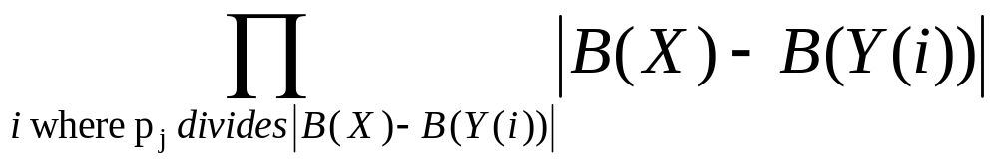
How often does a mistake occur?
If a mistake occurs in X and Y(i), then
B(X) - B(Y(i)) ≠ 0, and
p_{j} divides | B(X) - B(Y(i)) | for all p_{j}’s.
Let Q =
Q<2^{n(m-n+1)}
reason: B(x)<2^{n}, and at most (m-n+1) B(Y(i))’s
2^{n} 2^{n}…2^{n}
m-n+1

Slide 27
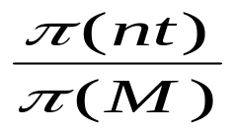
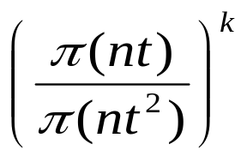
Theorem for number theory
Theorem: If u≥29 and q<2^{u}, then q has fewer than π(u) diffferent prime number divisors where π(u) is the number of prime numbers smaller than u.
Assume nt ≥ 29 .
Q < 2^{n(m-n+1)} = 2^{nt}
⇒ Q has fewer than π(nt) different prime number divisors.
If p_{j} is a prime number selected from {1, 2, …, M},
the probability that p_{j} divides Q is less than .
If k different prime numbers are selected from {1, 2, …nt²} , the probability that a mistake occurs is less than provided nt ≥ 29.

Slide 28
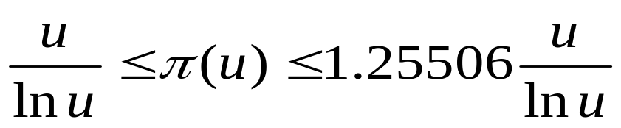
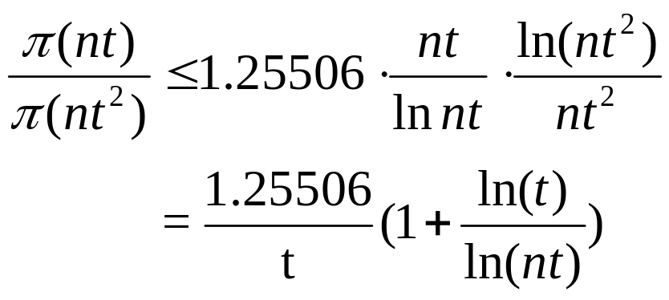
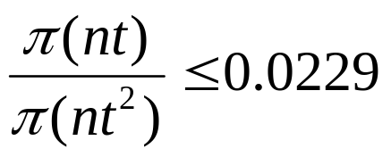
An example for mistake probability
How do we estimate
Theorem: For all u ≥ 17,
Example: n = 10 , m = 100 , t = m - n + 1 = 91
Let k=4 (0.0229)⁴≈2.75×10⁻⁷ // very small

Slide 29
Interactive proofs: method I
Two persons: A : a spy
B : the boss of A
When A wants to talk to B , how does B know that A is the real A, not an enemy imitating A ?
Method I : a trivial method
B may ask the name of A’s mother (a private secret)
Disadvantage:
The enemy can collect the information, and imitate A the next time.

Slide 30
Interactive proofs: method II
Method II:
B may send a Boolean formula to A and ask A to determine its satisfiability (an NP-complete problem).
It is assumed that A is a smart person and knows how to solve this NP-complete problem.
B can check the answer and know whether A is the real A or not.
Disadvantage:
The enemy can study methods of mechanical theorem proving and sooner or later he can imitate A.
In Methods I and II, A and B have revealed too much.

Slide 31
A randomized algorithm for interactive proofs
Method III:
B can ask A to solve a quadratic nonresidue problem in which the data can be sent back and forth without revealing much information.
Definition:
GCD(x, y) = 1, y is a quadratic residue mod x if
z² ≡ y mod x for some z, 0 < z < x, GCD(x, z) = 1, and y is a quadratic nonresidue mod x if otherwise.
(See the example on the next page.)

Slide 32
An example for quadratic residue/nonresidue
Let
QR = {(x, y) | y is a quadratic residue mod x}
QNR = {(x, y) | y is a quadratic nonresidue mod x}
Try to test x = 9, y = 7:
1² ≡ 1 mod 9 2² ≡ 4 mod 9
3² ≡ 0 mod 9 4² ≡ 7 mod 9
5² ≡ 7 mod 9 6² ≡ 0 mod 9
7² ≡ 4 mod 9 8² ≡ 1 mod 9
We have (9,1), (9,4), (9,7) ∈ QR
but (9,5), (9,8) ∈ QNR

Slide 33
Detailed method for interactive proofs
A and B know x and keep x confidential .
B knows y.
Action of B:
  Step 1: Randomly choose m bits: b₁, b₂, …, b_{m}, where m is the length of the binary representation of x.
  Step 2: Find z₁, z₂, …, z_{m} s.t. GCD(z_{i} , x)=1 for all i .
  Step 3:Compute w₁, w₂, …, w_{m}:
  w_{i} ←z_{i}² mod x if b_{i}=0 //(x, w_{i}) ∈ QR
  w_{i} ← (z_{i}²y) mod x if b_{i}=1 //(x, w_{i}) ∈ QNR
  Step 4: Send w₁, w₂, …, w_{m} to A.

Slide 34
Action of A:
  Step 1: Receive w₁, w₂, …, w_{m} from B.
  Step 2: Compute c₁, c₂, …, c_{m}:
  c_{i} ←0 if (x, w_{i}) ∈ QR
  c_{i} ←1 if (x, w_{i}) ∈ QNR
  Send c₁, c₂, …, c_{m} to B.
Action of B:
  Step 1: Receive c₁, c₂, …, c_{m} from A.
  Step 2: If (x, y) ∈ QNR and b_{i} = c_{i} for all i, then A is the real A (with probability 1-2^{-m}).

