Slide 1
Chapter 2
The Complexity of Algorithms and the Lower Bounds of Problems
2 -<number>

Slide 2
The goodness of an algorithm
Time complexity (more important)
Space complexity
For a parallel algorithm :
  time-processor product
For a VLSI circuit :
  area-time (AT, AT²)
2 -<number>

Slide 3
Measure the goodness of an algorithm
Time complexity of an algorithm
  efficient (algorithm)
  worst-case
  average-case
  amortized
2 -<number>

Slide 4
Measure the difficulty of a problem
NP-complete ?
Undecidable ?
Is the algorithm best ?
  optimal (algorithm)
We can use the number of comparisons to measure a sorting algorithm.
2 -<number>

Slide 5
Asymptotic notations
Def: f(n) = O(g(n)) "at most"
∃ c, n₀ ∋ |f(n)| ≤ c|g(n)| ∀ n ≥ n₀
e.g. f(n) = 3n² + 2
g(n) = n²
⇒ n₀=2, c=4
∴ f(n) = O(n²)
e.g. f(n) = n³ + n = O(n³)
e. g. f(n) = 3n² + 2 = O(n³) or O(n¹⁰⁰ )
2 -<number>

Slide 6
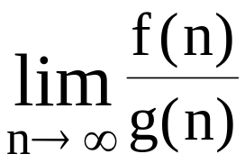
Def : f(n) = Ω(g(n)) “at least“, “lower bound"
∃ c, and n₀, ∋ |f(n)| ≥ c|g(n)| ∀ n ≥ n₀
e. g. f(n) = 3n² + 2 = Ω(n²) or Ω (n)
Def : f(n) = Θ(g(n))
  ∃ c₁, c₂, and n₀, ∋ c₁|g(n)| ≤ |f(n)| ≤ c₂|g(n)| ∀ n ≥ n₀
e. g. f(n) = 3n² + 2 = Θ (n²)
Def : f(n) ∼ o(g(n))
→ 1
e.g. f(n) = 3n²+n = o(3n²)
2 -<number>

Slide 7
Problem size
 | 10 | 10² | 10³ | 10⁴
log₂n | 3.3 | 6.6 | 10 | 13.3
n | 10 | 10² | 10³ | 10⁴
nlog₂n | 0.33x10² | 0.7x10³ | 10⁴ | 1.3x10⁵
n² | 10² | 10⁴ | 10⁶ | 10⁸
2^{n} | 1024 | 1.3x10³⁰ | >10¹⁰⁰ | >10¹⁰⁰
n! | 3x10⁶ | >10¹⁰⁰ | >10¹⁰⁰ | >10¹⁰⁰
Time Complexity Functions
2 -<number>

Slide 8
Common computing time functions
O(1) < O(log n) < O(n) < O(n log n) < O(n²) < O(n³) < O(2^{n}) < O(n!) < O(n^{n})
  Exponential algorithm: O(2^{n})
  Polynomial algorithm: e.g. O(n²), O(nlogn)
Algorithm A : O(n³), Algorithm B : O(n)
  Should Algorithm B run faster than A?
  NO !
  It is true only when n is large enough!
2 -<number>

Slide 9
Analysis of algorithms
Best case: easiest
Worst case
Average case: hardest
2 -<number>

Slide 10
Straight insertion sort
input: 7,5,1,4,3
7,5,1,4,3
5,7,1,4,3
1,5,7,4,3
1,4,5,7,3
1,3,4,5,7
2 -<number>

Slide 11
Algorithm 2.1 Straight Insertion Sort
Input: x₁,x₂,...,x_{n}
Output: The sorted sequence of x₁,x₂,...,x_{n}
For j := 2 to n do
Begin
i := j-1
x := x_{j}
While x<x_{i} and i > 0 do
Begin
x_{i+1} := x_{i}
i := i-1
End
x_{i+1} := x
End
2 -<number>

Slide 12
Inversion table
(a₁,a₂,...,a_{n}) : a permutation of {1,2,...,n}
(d₁,d₂,...,d_{n}): the inversion table of (a₁,a₂,...a_{n})
d_{j}: the number of elements to the left of j that are greater than j
e.g. permutation (7 5 1 4 3 2 6)
inversion table 2 4 3 2 1 1 0
e.g. permutation (7 6 5 4 3 2 1)
inversion table 6 5 4 3 2 1 0
2 -<number>

Slide 13
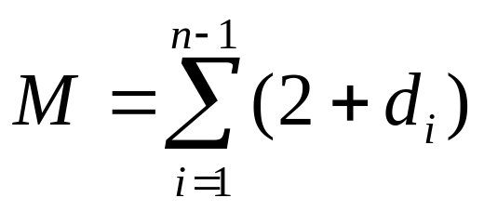
Analysis of # of movements
M: # of data movements in straight insertion sort
1 5 7 4 3
temporary
e.g. d₃=2
2 -<number>

Slide 14
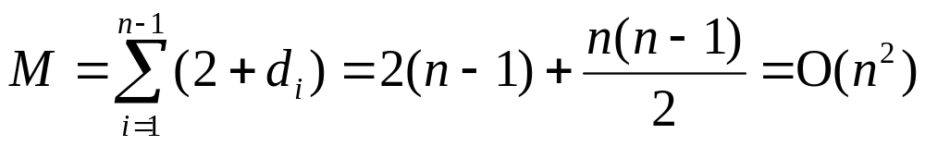
Analysis by inversion table
best case: already sorted
d_{i} = 0 for 1 ≤ i ≤ n
⇒M = 2(n − 1) = O(n)
worst case: reversely sorted
d₁ = n − 1
d₂ = n − 2
:
d_{i} = n − i
d_{n} = 0
2 -<number>

Slide 15
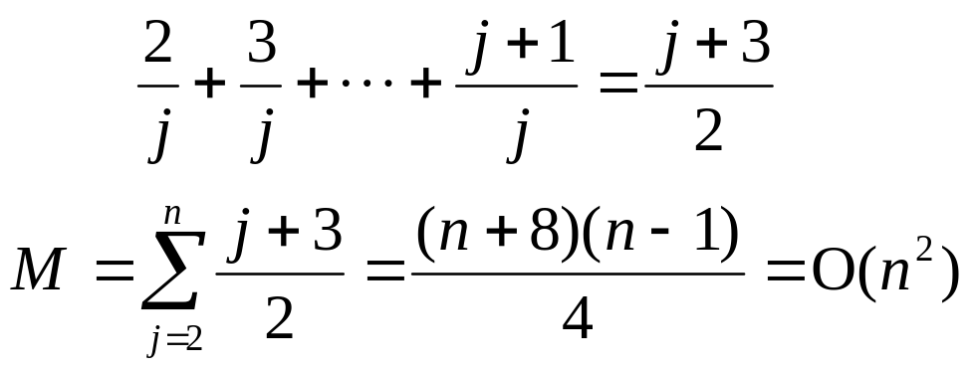
average case:
x_{j} is being inserted into the sorted sequence
x₁ x₂ ... x _{j-1}
the probability that x_{j} is the largest: 1/j
  takes 2 data movements
the probability that x_{j} is the second largest : 1/j
  takes 3 data movements
:
# of movements for inserting x_{j}:
1 4 7 5
2 -<number>

Slide 16
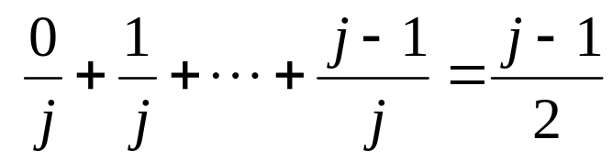
Analysis of # of exchanges
Method 1 (straightforward)
x_{j} is being inserted into the sorted sequence
x₁ x₂ .... x_{j-1}
If x_{j} is the kth (1≤k≤j) largest, it takes (k−1) exchanges.
e.g. 1 5 7↔4
1 5↔4 7
1 4 5 7
# of exchanges required for x_{j} to be inserted:
2 -<number>

Slide 17
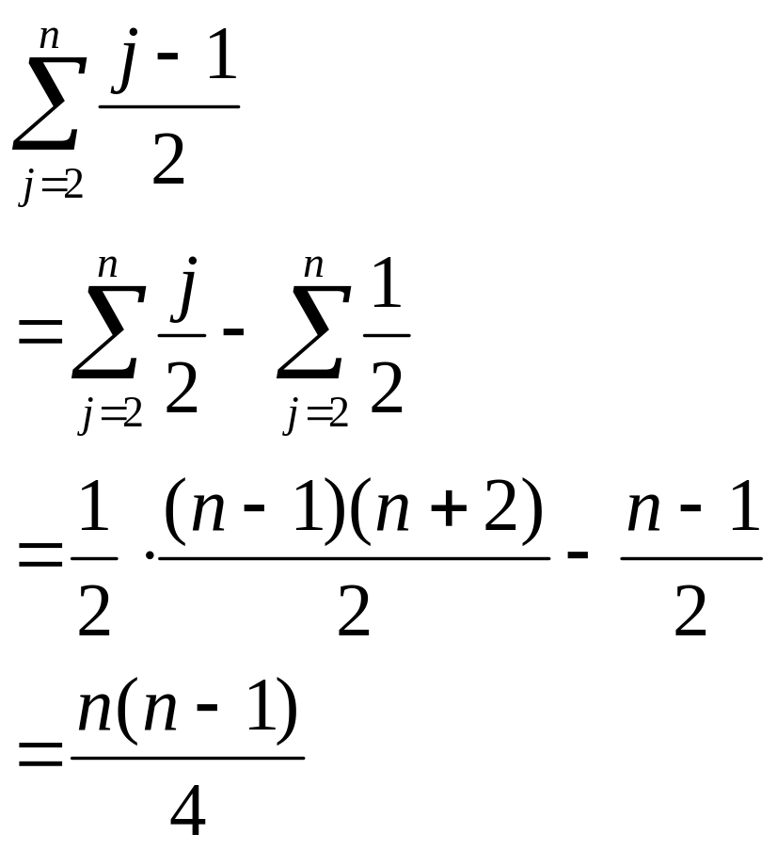
# of exchanges for sorting:
2 -<number>

Slide 18
Method 2: with inversion table and generating function
I_{n}(k): # of permutations in n nmbers which have exactly k inversions
n\k | 0 | 1 | 2 | 3 | 4 | 5 | 6
1 | 1 | 0 | 0 | 0 | 0 | 0 | 0
2 | 1 | 1 | 0 | 0 | 0 | 0 | 0
3 | 1 | 2 | 2 | 1 | 0 | 0 | 0
4 | 1 | 3 | 5 | 6 | 5 | 3 | 1
2 -<number>

Slide 19
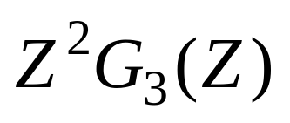
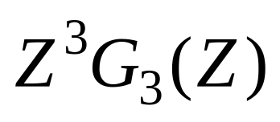
Assume we have I₃(k), 0 ≤ k ≤ 3. We will calculate I₄(k).
(1) a₁ a₂ a₃ a₄ (2) a₁ a₂ a₃ a₄
↑ ↑
largest second largest
G₃(Z) ZG₃(Z)
(3) a₁ a₂ a₃ a₄ (4) a₁ a₂ a₃ a₄
↑ ↑
third largest smallest
2 -<number>

Slide 20
case | I₄(0) | I₄(1) | I₄(2) | I₄(3) | I₄(4) | I₄(5) | I₄(6)
1 | I₃(0) | I₃(1) | I₃(2) | I₃(3)
2 |  | I₃(0) | I₃(1) | I₃(2) | I₃(3)
3 |  |  | I₃(0) | I₃(1) | I₃(2) | I₃(3)
4 |  |  |  | I₃(0) | I₃(1) | I₃(2) | I₃(3)
case | I₄(0) | I₄(1) | I₄(2) | I₄(3) | I₄(4) | I₄(5) | I₄(6)
1 | 1 | 2 | 2 | 1
2 |  | 1 | 2 | 2 | 1
3 |  |  | 1 | 2 | 2 | 1
4 |  |  |  | 1 | 2 | 2 | 1
total | 1 | 3 | 5 | 6 | 5 | 3 | 1
2 -<number>

Slide 21
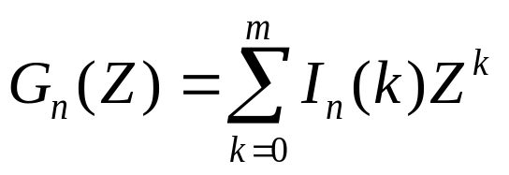
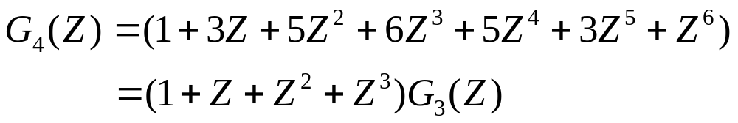
generating function for I_{n}(k)
for n = 4
in general,
2 -<number>

Slide 22
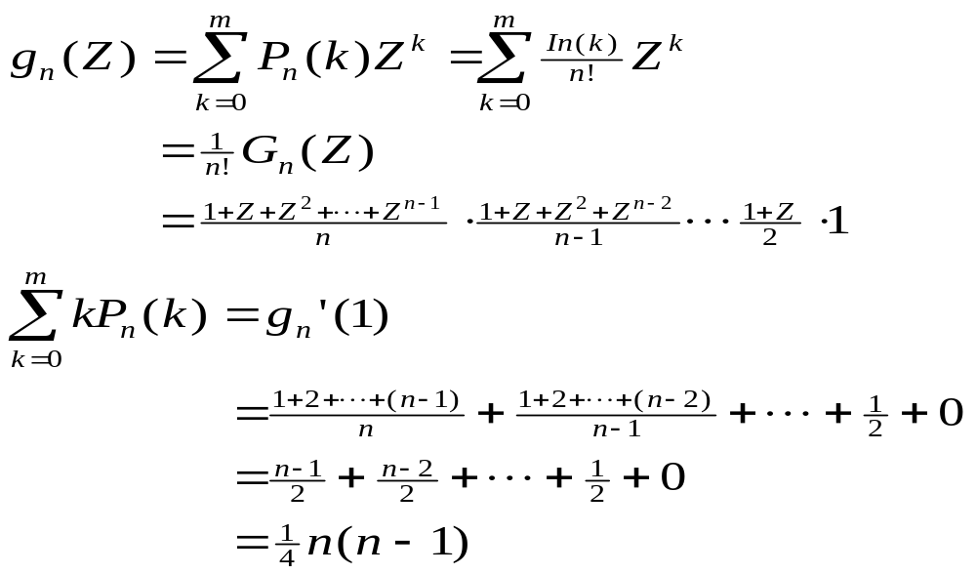
P_{n}(k): probability that a given permutation
of n numbers has k inversions
generating function for P_{n}(k):
2 -<number>

Slide 23
Binary search
sorted sequence : (search 9)
1 4 5 7 9 10 12 15
step 1 ↑
step 2 ↑
step 3 ↑
best case: 1 step = O(1)
worst case: (⎣log₂ n⎦+1) steps = O(log n)
average case: O(log n) steps
2 -<number>

Slide 24
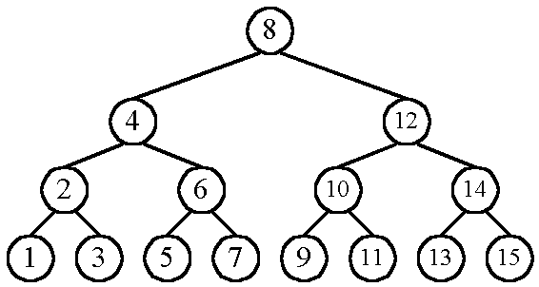
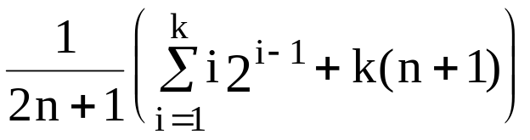
    n cases for successful search
    n+1 cases for unsuccessful search
    Average # of comparisons done in the binary tree:
    A(n) = , where k = ⎣log n⎦+1
2 -<number>

Slide 25
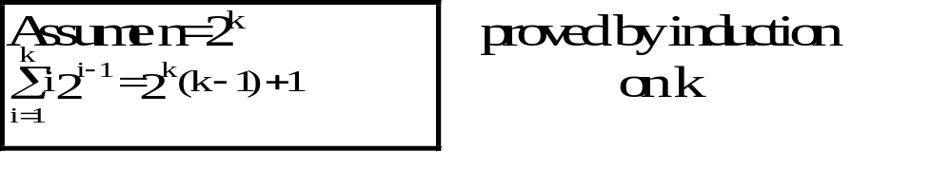
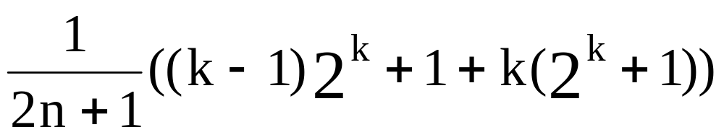
      A(n) =
      ≈ k as n is very large
      = log n
      = O(log n)
2 -<number>

Slide 26
Straight selection sort
7 5 1 4 3
1 5 7 4 3
1 3 7 4 5
1 3 4 7 5
1 3 4 5 7
Only consider # of changes in the flag which is used for selecting the smallest number in each iteration.
  best case: O(1)
  worst case: O(n²)
  average case: O(n log n)
2 -<number>

Slide 27
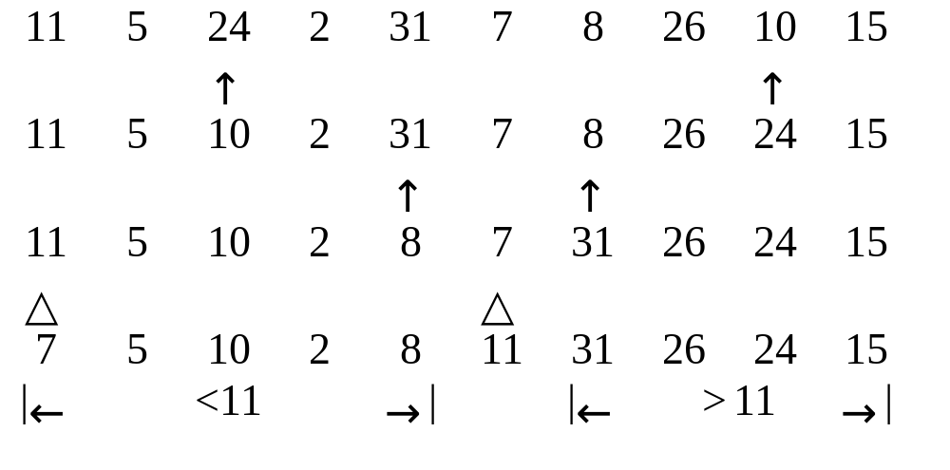
Quicksort
Recursively apply the same procedure.
2 -<number>

Slide 28
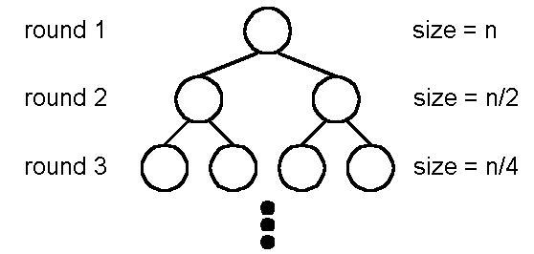
Best case of quicksort
Best case: O(nlogn)
A list is split into two sublists with almost equal size.
log n rounds are needed
In each round, n comparisons (ignoring the element used to split) are required.
2 -<number>

Slide 29
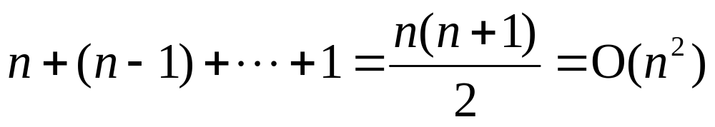
Worst case of quicksort
Worst case: O(n²)
In each round, the number used to split is either the smallest or the largest.
2 -<number>

Slide 30
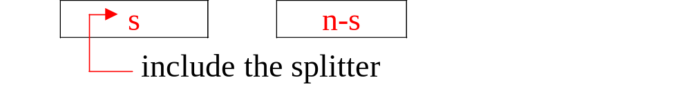

Average case of quicksort
Average case: O(n log n)
2 -<number>

Slide 31
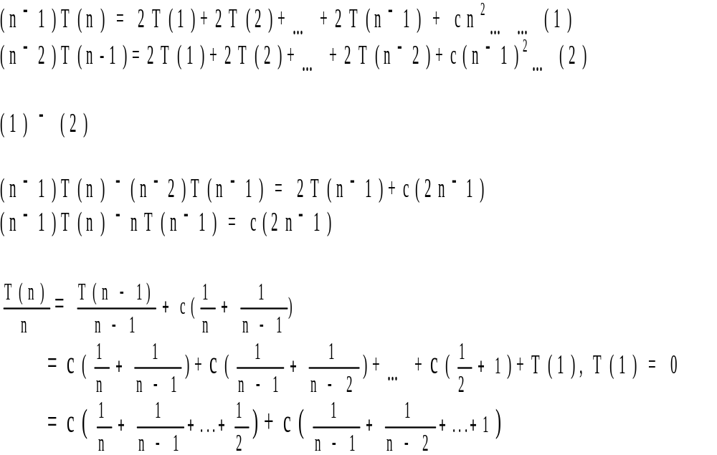
2 -<number>

Slide 32
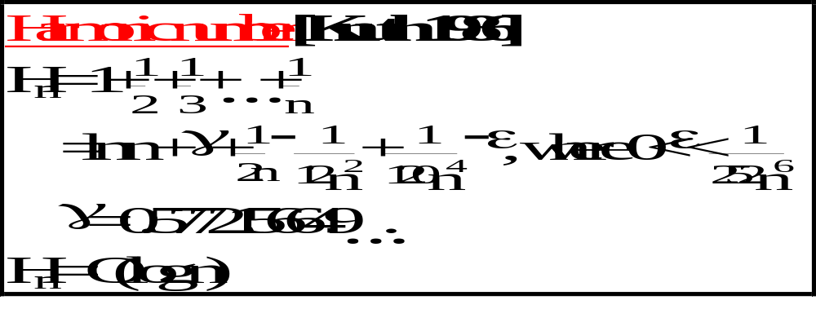
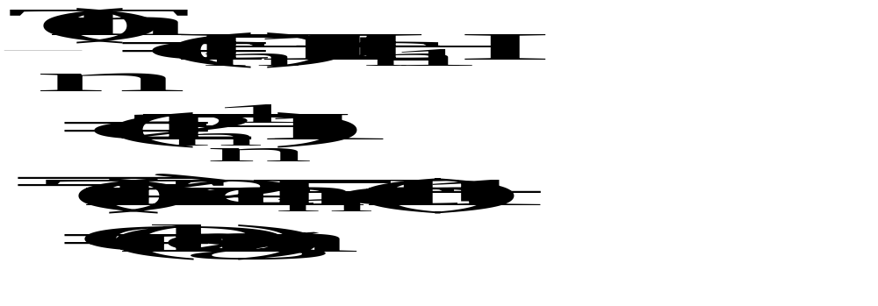
2 -<number>

Slide 33
2-D ranking finding
Def: Let A = (x₁,y₁), B = (x₂,y₂). B dominates A iff x₂ > x₁ and y₂ > y₁
Def: Given a set S of n points, the rank of a point x is the number of points dominated by x.
D
B
A
C
E
rank(A)= 0 rank(B) = 1 rank(C) = 1
rank(D) = 3 rank(E) = 0
2 -<number>

Slide 34
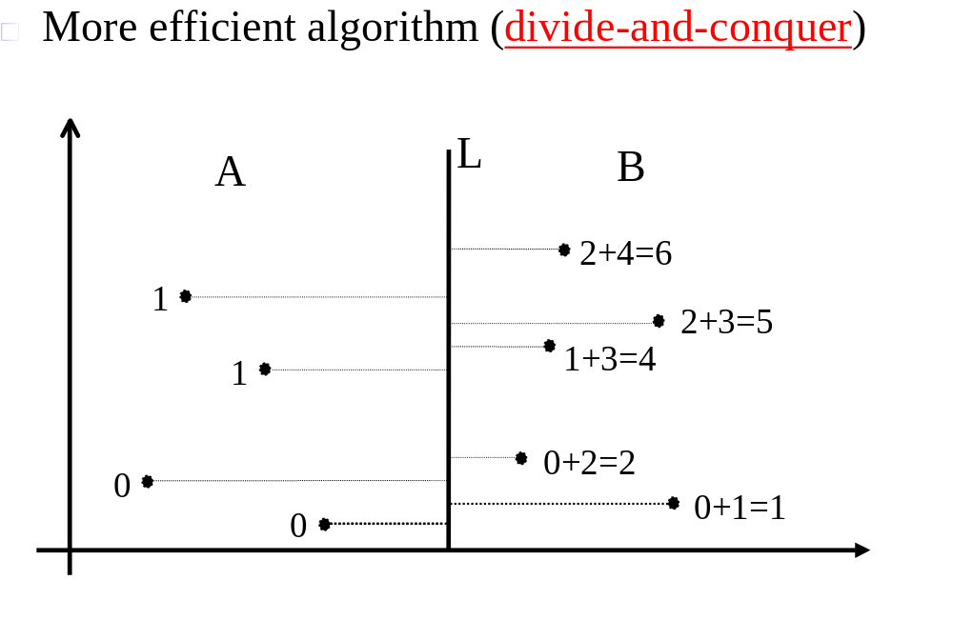
Straightforward algorithm:
compare all pairs of points : O(n²)
2 -<number>

Slide 35
Divide-and-conquer 2-D ranking finding
Step 1: Split the points along the median line L into A and B.
Step 2: Find ranks of points in A and ranks of points in B, recursively.
Step 3: Sort points in A and B according to their y-values. Update the ranks of points in B.
2 -<number>

Slide 36
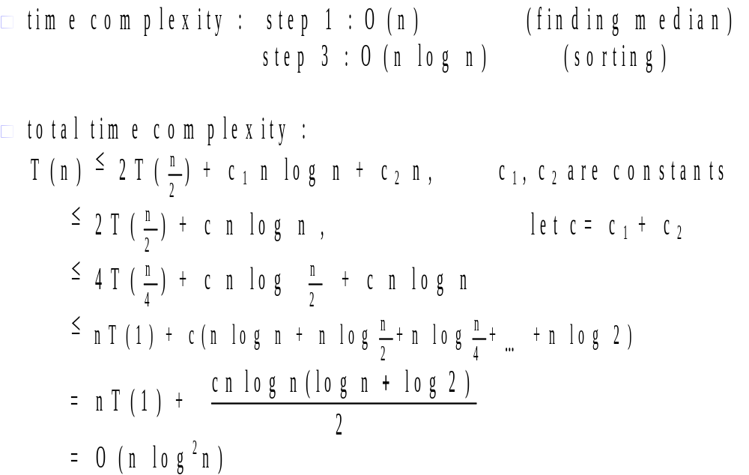
2 -<number>

Slide 37
Lower bound
Def : A lower bound of a problem is the least time complexity required for any algorithm which can be used to solve this problem.
☆ worst case lower bound
☆ average case lower bound
The lower bound for a problem is not unique.
  e.g. Ω(1), Ω(n), Ω(n log n) are all lower bounds for sorting.
  (Ω(1), Ω(n) are trivial)
2 -<number>

Slide 38
At present, if the highest lower bound of a problem is Ω(n log n) and the time complexity of the best algorithm is O(n²).
  We may try to find a higher lower bound.
  We may try to find a better algorithm.
  Both of the lower bound and the algorithm may be improved.
If the present lower bound is Ω(n log n) and there is an algorithm with time complexity O(n log n), then the algorithm is optimal.
2 -<number>

Slide 39
The worst case lower bound of sorting
6 permutations for 3 data elements
a₁ a₂ a₃
1 2 3
1 3 2
2 1 3
2 3 1
3 1 2
3 2 1
2 -<number>

Slide 40
Straight insertion sort:
input data: (2, 3, 1)
(1) a₁:a₂
(2) a₂:a₃, a₂↔a₃
(3) a₁:a₂, a₁↔a₂
input data: (2, 1, 3)
(1)a₁:a₂, a₁↔a₂
(2)a₂:a₃
2 -<number>

Slide 41
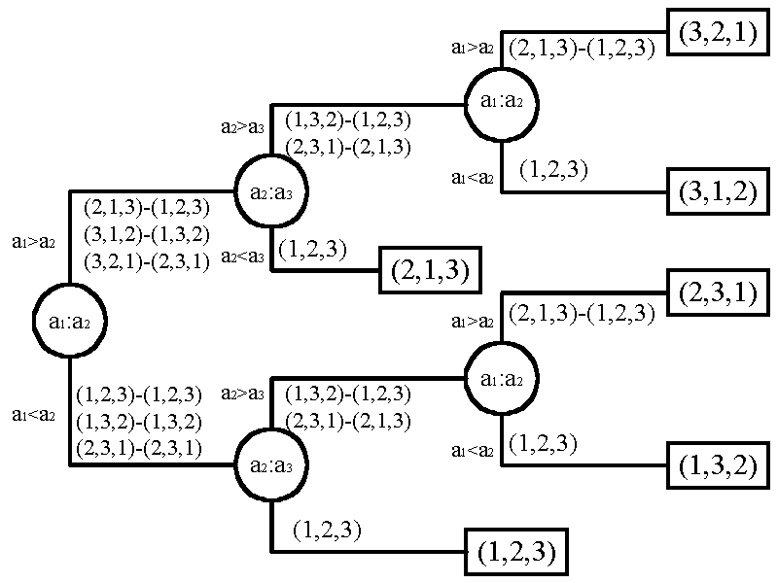
Decision tree for straight insertion sort
2 -<number>

Slide 42
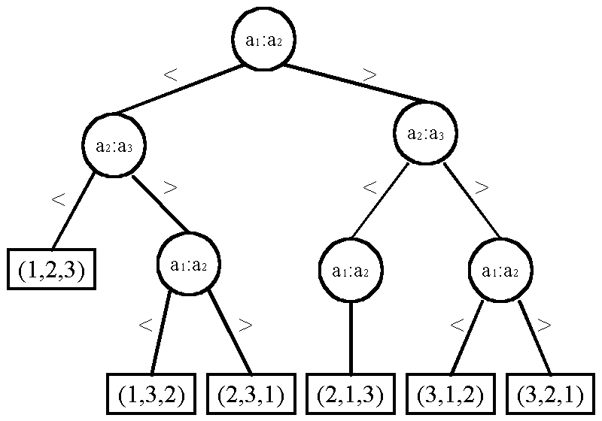
Decision tree for bubble sort
2 -<number>

Slide 43
Lower bound of sorting
Every sorting algorithm (based on comparisons) corresponds to a decision tree.
To find the lower bound, we have to find the depth of a binary tree with the smallest depth.
n! distinct permutations
n! leaf nodes in the binary decision tree.
balanced tree has the smallest depth:
⎡log(n!)⎤ = Ω(n log n)
lower bound for sorting: Ω(n log n)
(See the next page.)
2 -<number>

Slide 44
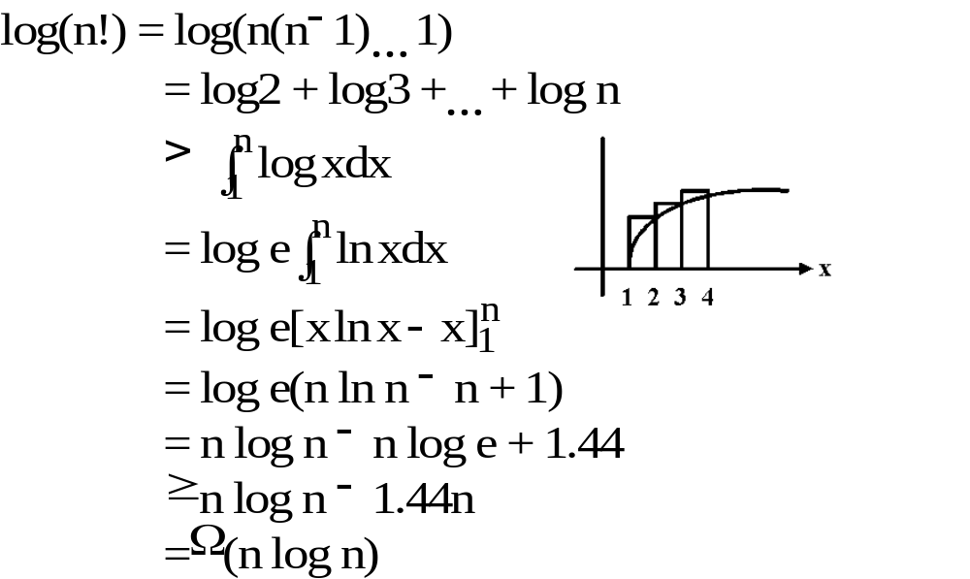
Method 1:
2 -<number>

Slide 45
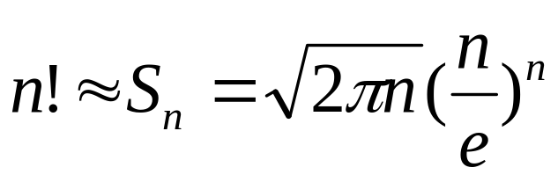
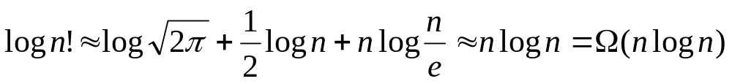
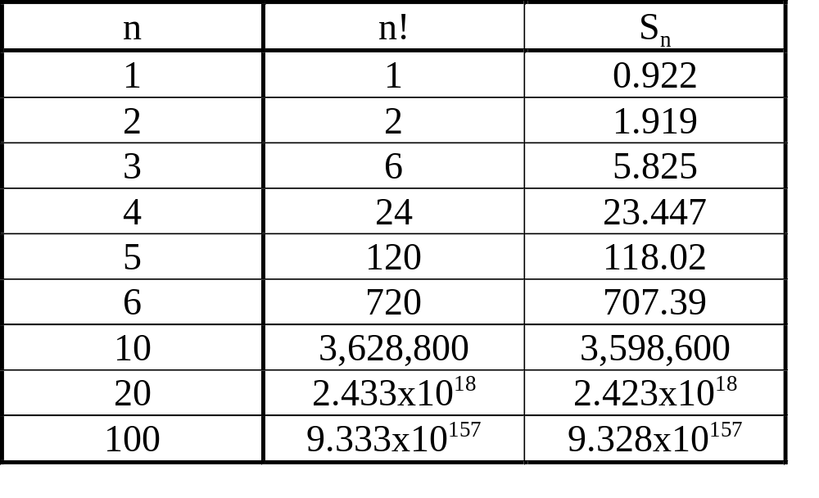
Method 2:
Stirling approximation:
2 -<number>

Slide 46
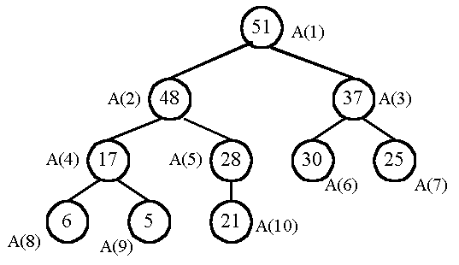
Heapsort—An optimal sorting algorithm
A heap : parent ≥ son
2 -<number>

Slide 47
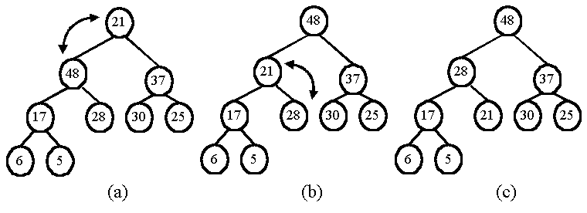
output the maximum and restore:
Heapsort:
  Phase 1: Construction
  Phase 2: Output
2 -<number>

Slide 48
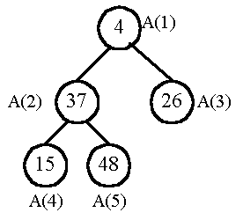
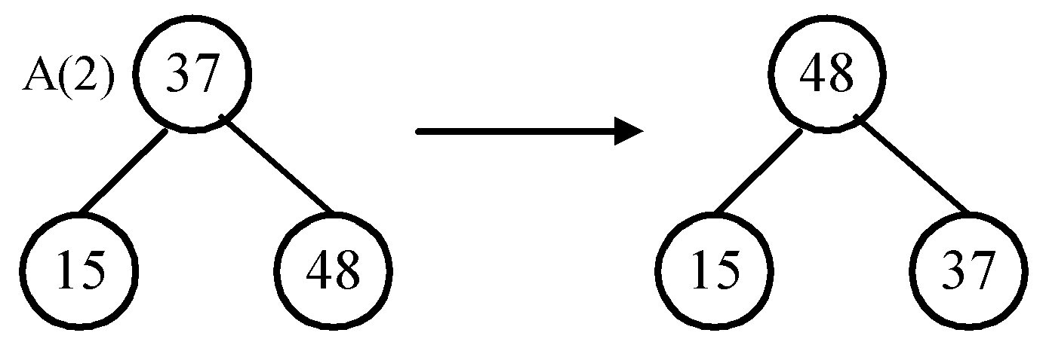
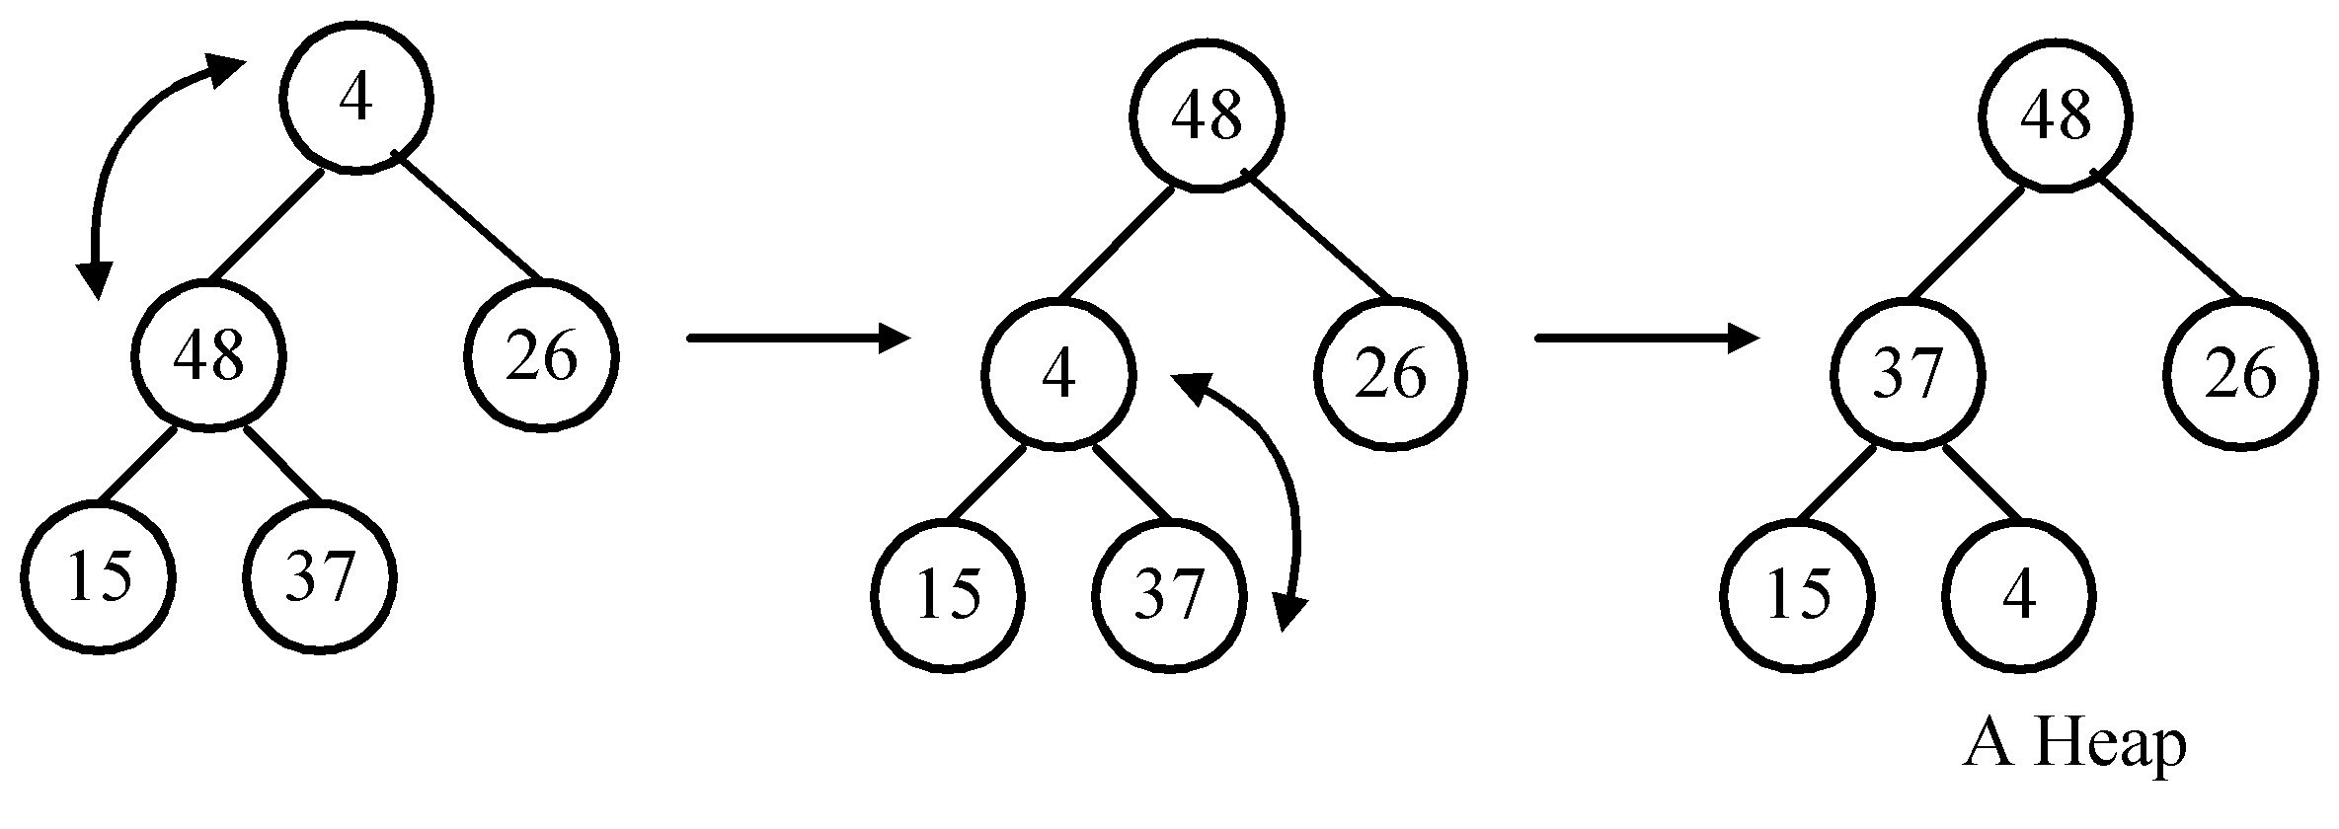
Phase 1: construction
input data: 4, 37, 26, 15, 48
restore the subtree rooted at A(2):
restore the tree rooted at A(1):
2 -<number>

Slide 49
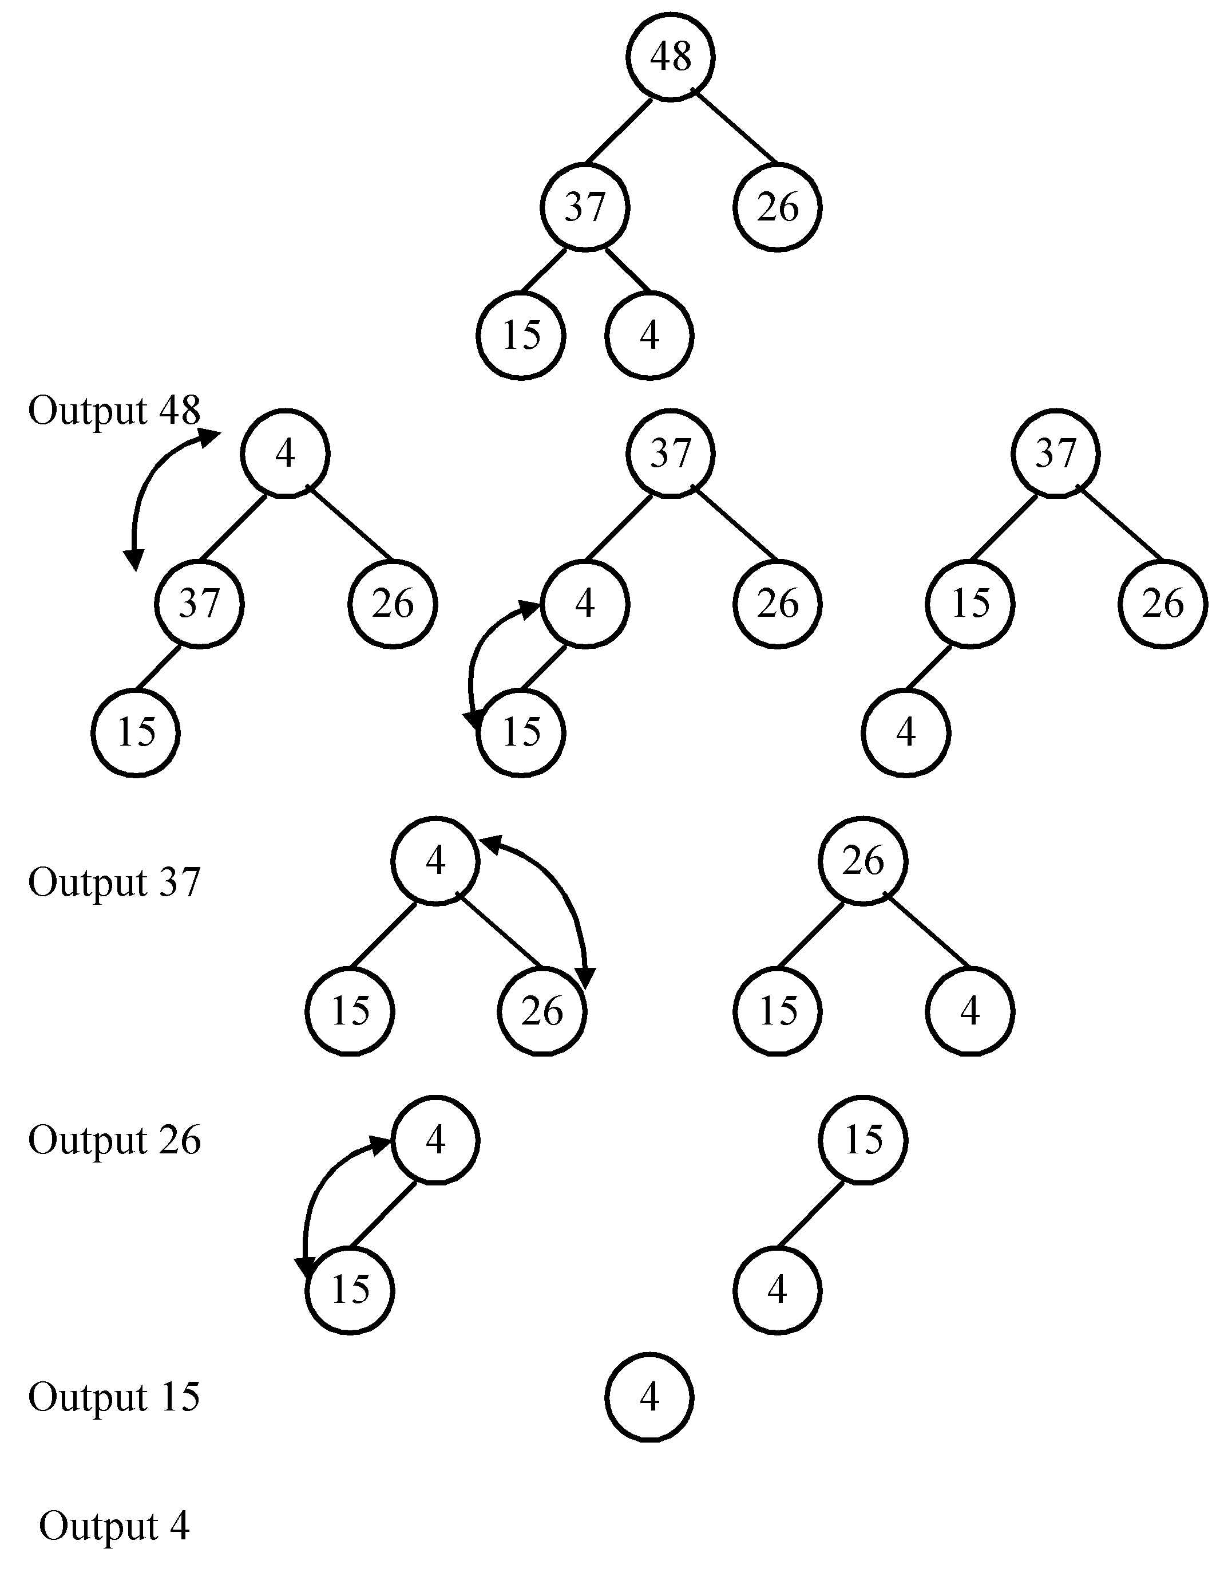
Phase 2: output
2 -<number>

Slide 50
Implementation
using a linear array
not a binary tree.
  The sons of A(h) are A(2h) and A(2h+1).
time complexity: O(n log n)
2 -<number>

Slide 51
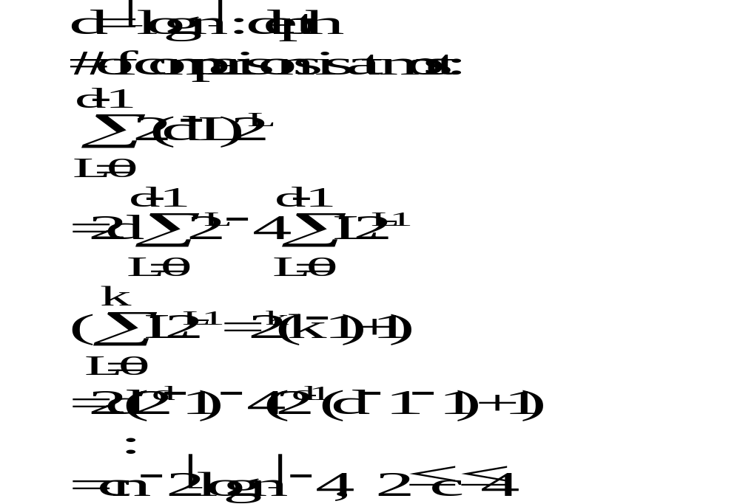
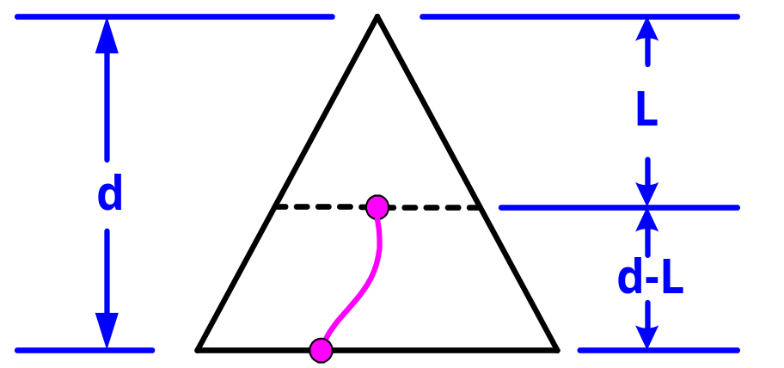
Time complexity
Phase 1: construction
2 -<number>

Slide 52
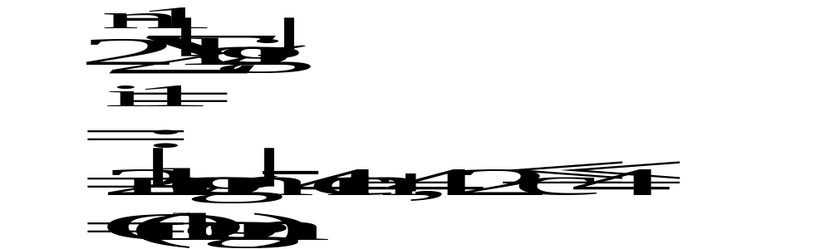
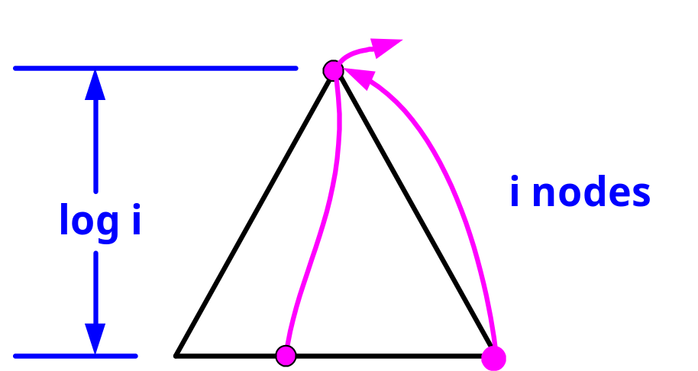
Time complexity
Phase 2: output
max
2 -<number>

Slide 53
Average case lower bound of sorting
By binary decision tree
The average time complexity of a sorting algorithm:
the external path length of the binary tree
n!
The external path length is minimized if the tree is balanced.
(all leaf nodes on level d or level d−1)
2 -<number>

Slide 54
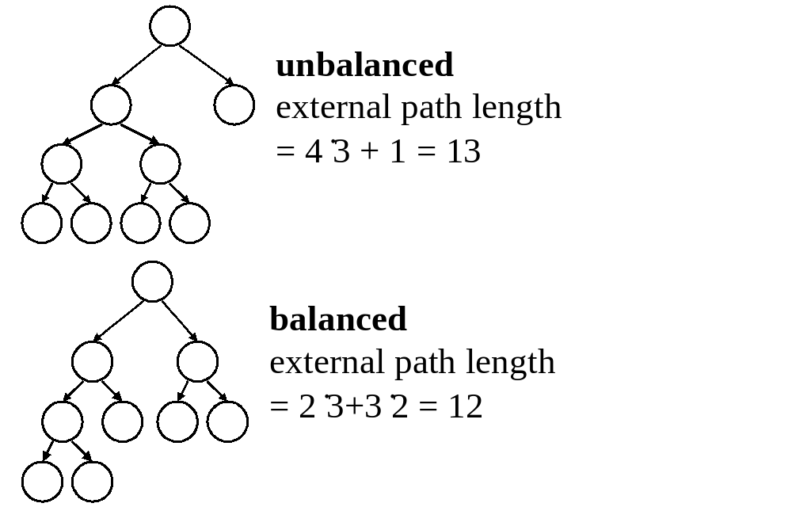
2 -<number>

Slide 55


Compute the min external path length
1. Depth of balanced binary tree with c leaf nodes:
d = ⎡log c⎤
Leaf nodes can appear only on level d or d−1.
2. x₁ leaf nodes on level d−1
x₂ leaf nodes on level d
  x₁ + x₂ = c
  x₁ + = 2^{d-1}
⇒ x₁ = 2^{d} −c
x₂ = 2(c − 2^{d-1})
2 -<number>

Slide 56
3. External path length:
M= x₁(d − 1) + x₂d
= (2^{d} − c)(d − 1) + 2(c − 2^{d-1})d
= c+cd - 2^{d}, log c ≤ d < log c+1
≥ c+c log c − 2*2^{log c}
= c log c − c
4. c = n!
M = n! log n! − n!
M/n! = log n! − 1
= Ω(n log n)
Average case lower bound of sorting: Ω(n log n)
2 -<number>

Slide 57
Quicksort & Heapsort
Quicksort is optimal in the average case.
( O(n log n) in average )
(i)worst case time complexity of heapsort is
O(n log n)
(ii)average case lower bound: Ω(n log n)
  average case time complexity of heapsort is O(n log n)
  Heapsort is optimal in the average case.
2 -<number>

Slide 58
Improving a lower bound through oracles
Problem P: merge two sorted sequences A and B with lengths m and n.
Conventional 2-way merging:
2 3 5 6
1 4 7 8
Complexity: at most m+n-1 comparisons
2 -<number>

Slide 59
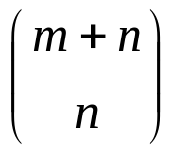
(1) Binary decision tree:
  There are ways !
leaf nodes in the decision tree.
⇒ The lower bound for merging:
⎡log ⎤ ≤ m + n − 1
(conventional merging)
2 -<number>

Slide 60
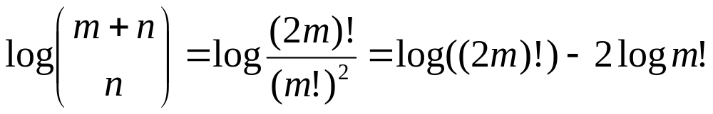
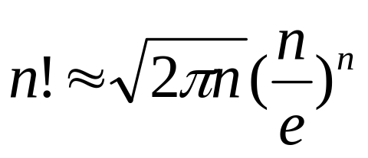
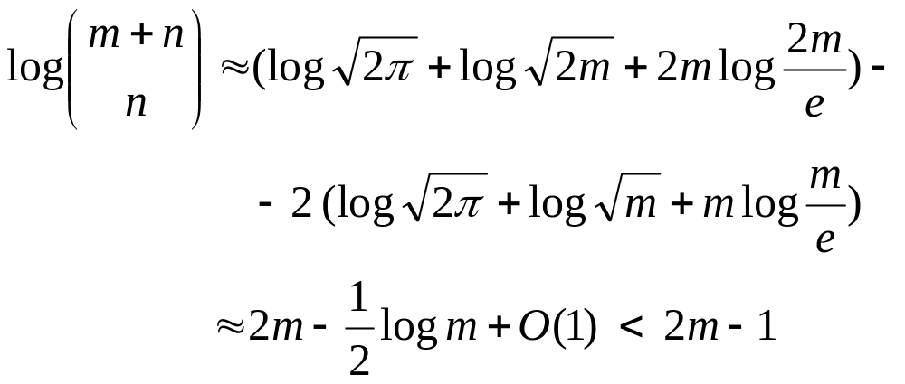
When m = n
Using Stirling approximation
Optimal algorithm: conventional merging needs 2m-1 comparisons
2 -<number>

Slide 61
(2) Oracle:
The oracle tries its best to cause the algorithm to work as hard as it might. (to give a very hard data set)
Two sorted sequences:
  A: a₁ < a₂ < … < a_{m}
  B: b₁ < b₂ < … < b_{m}
The very hard case:
  a₁ < b₁ < a₂ < b₂ < … < a_{m} < b_{m}
2 -<number>

Slide 62
We must compare:
a₁ : b₁
b₁ : a₂
a₂ : b₂
:
b_{m-1} : a_{m-1}
a_{m} : b_{m}
Otherwise, we may get a wrong result for some input data.
e.g. If b₁ and a₂ are not compared, we can not distinguish
a₁ < b₁ < a₂ < b₂ < … < a_{m} < b_{m} and
a₁ < a₂ < b₁ < b₂ < … < a_{m} < b_{m}
Thus, at least 2m−1 comparisons are required.
The conventional merging algorithm is optimal for m = n.
2 -<number>

Slide 63
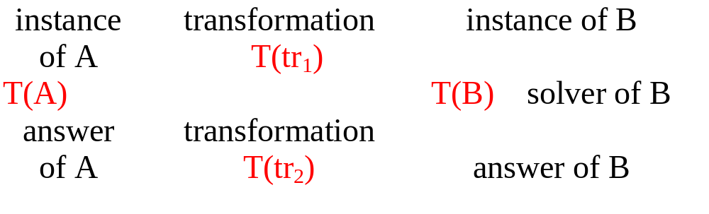
Finding lower bound by problem transformation
Problem A reduces to problem B (A∝B)
  iff A can be solved by using any algorithm which solves B.
  If A∝B, B is more difficult.
Note: T(tr₁) + T(tr₂) < T(B)
T(A) ≤ T(tr₁) + T(tr₂) + T(B) ∼ O(T(B))
2 -<number>

Slide 64
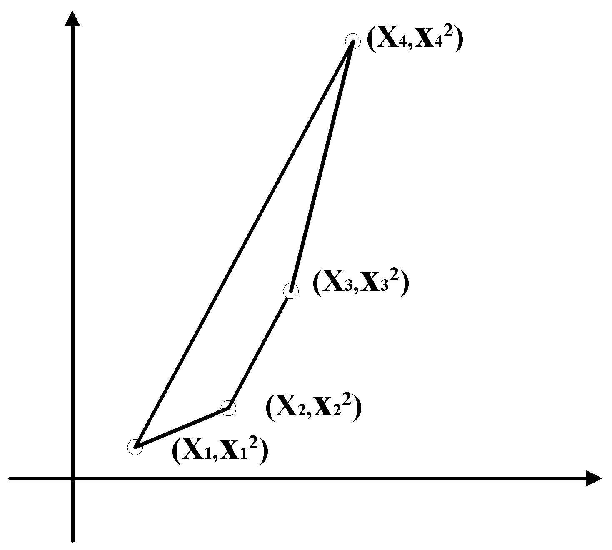
The lower bound of the convex hull problem
sorting ∝ convex hull
A B
an instance of A: (x₁, x₂,…, x_{n})
↓transformation
an instance of B: {( x₁, x₁²), ( x₂, x₂²),…, ( x_{n}, x_{n}²)}
assume: x₁ < x₂ < …< x_{n}
2 -<number>

Slide 65
If the convex hull problem can be solved, we can also solve the sorting problem.
  The lower bound of sorting: Ω(n log n)
The lower bound of the convex hull problem: Ω(n log n)
2 -<number>

Slide 66
The lower bound of the Euclidean minimal spanning tree (MST) problem
sorting ∝ Euclidean MST
A B
an instance of A: (x₁, x₂,…, x_{n})
↓transformation
an instance of B: {( x₁, 0), ( x₂, 0),…, ( x_{n}, 0)}
  Assume x₁ < x₂ < x₃ <…< x_{n}
  ⇔there is an edge between (x_{i}, 0) and (x_{i+1}, 0) in the MST, where 1 ≤ i ≤ n−1
2 -<number>

Slide 67
If the Euclidean MST problem can be solved, we can also solve the sorting problem.
  The lower bound of sorting: Ω(n log n)
The lower bound of the Euclidean MST problem: Ω(n log n)
2 -<number>

