Slide 1
Chapter 4
The Divide-and-Conquer Strategy
4 -<number>

Slide 2
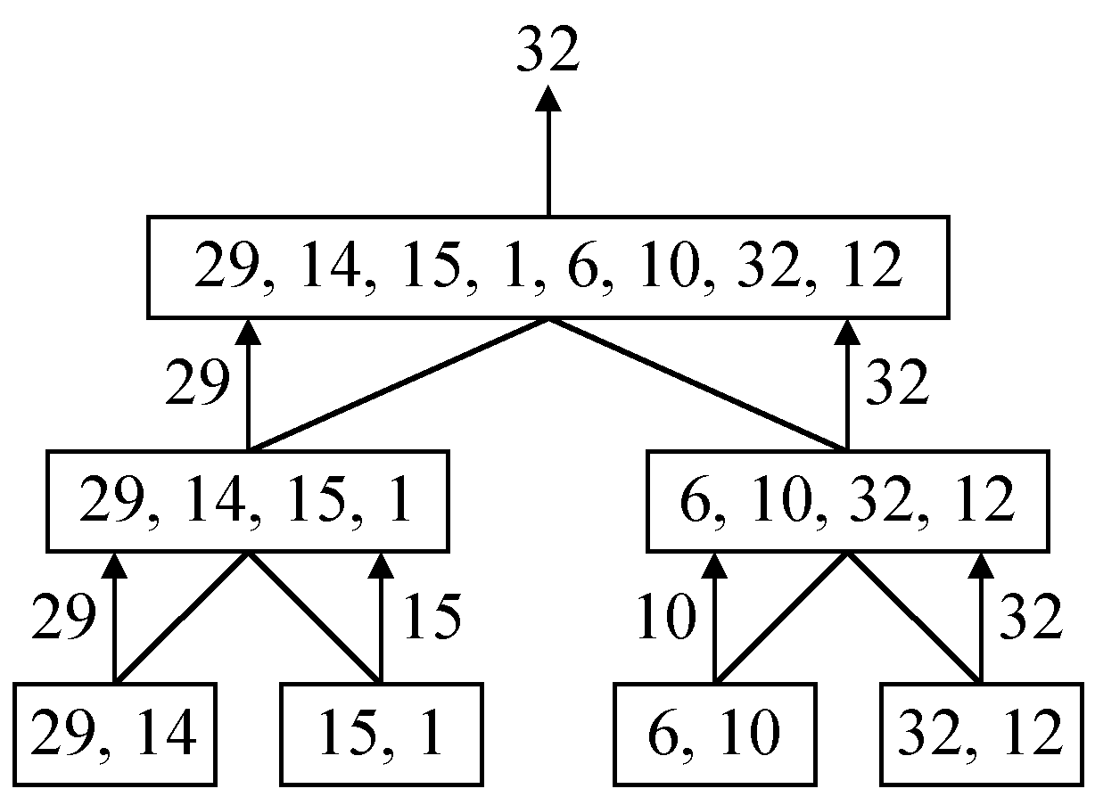
A simple example
finding the maximum of a set S of n numbers
4 -<number>

Slide 3

Time complexity
Time complexity:
Calculation of T(n):
Assume n = 2^{k},
T(n) = 2T(n/2)+1
= 2(2T(n/4)+1)+1
= 4T(n/4)+2+1
:
=2^{k-1}T(2)+2^{k-2}+…+4+2+1
=2^{k-1}+2^{k-2}+…+4+2+1
=2^{k}-1 = n-1
4 -<number>

Slide 4
諫逐客書—李斯
文選自 <史記.李斯列傳>，是李斯上呈秦王政的一篇奏疏。
「惠王用張儀之計，拔三川之地，西并巴、蜀，北收上郡，南取漢中，包九夷，制鄢(一ㄢ)、郢(ㄧㄥˇ)，東據成皋之險，割膏腴之壤，遂散六國之從(縱)，使之西面事秦，功施(一ˋ)到今。」
註：秦滅六國順序：韓、趙、魏、楚、燕、齊
4 -<number>

Slide 5
A general divide-and-conquer algorithm
Step 1: If the problem size is small, solve this problem directly; otherwise, split the original problem into 2 sub-problems with equal sizes.
Step 2: Recursively solve these 2 sub-problems by applying this algorithm.
Step 3: Merge the solutions of the 2 sub- problems into a solution of the original problem.
4 -<number>

Slide 6
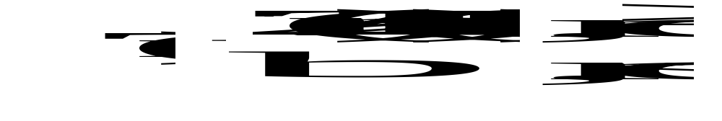
Time complexity of the general algorithm
Time complexity:
where S(n) : time for splitting
M(n) : time for merging
b : a constant
c : a constant
e.g. Binary search
e.g. quick sort
e.g. merge sort e.g. 2 6 5 3 7 4 8 1
4 -<number>

Slide 7
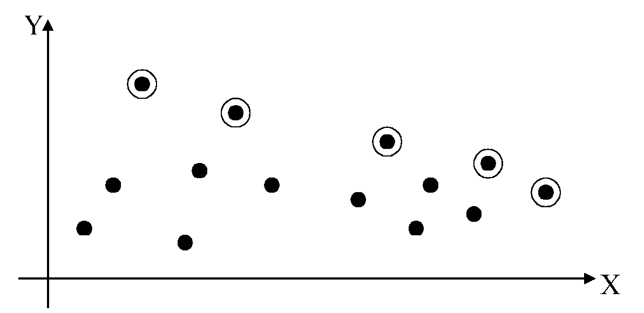
2-D maxima finding problem
Def : A point (x₁, y₁) dominates (x₂, y₂) if x₁ > x₂ and y₁ > y₂. A point is called a maximum if no other point dominates it
Straightforward method : Compare every pair of points.
Time complexity:
O(n²)
4 -<number>

Slide 8
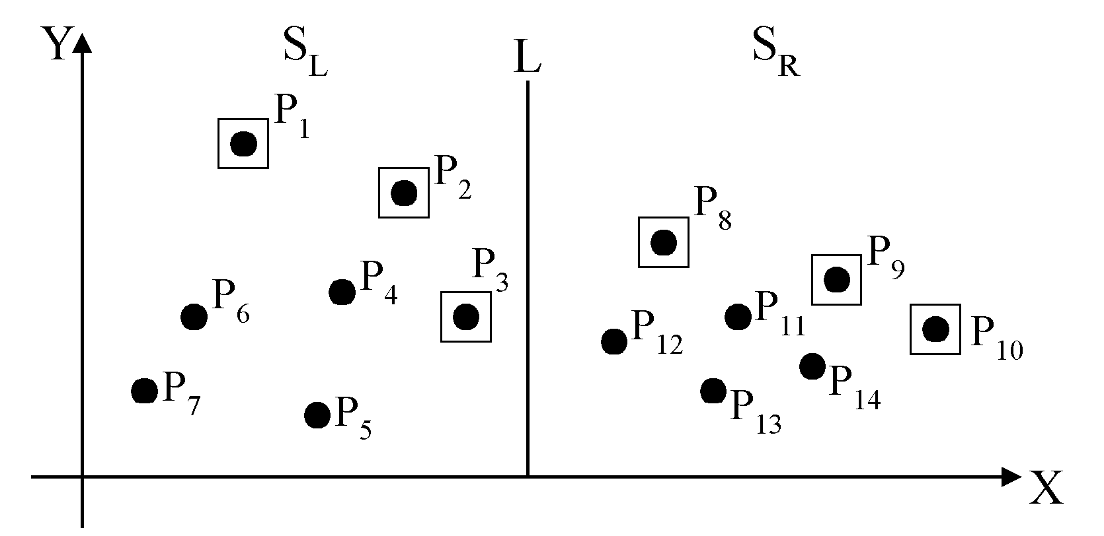
Divide-and-conquer for maxima finding
The maximal points of S_{L} and S_{R}
4 -<number>

Slide 9
The algorithm:
Input: A set S of n planar points.
Output: The maximal points of S.
Step 1: If S contains only one point, return it as the maximum. Otherwise, find a line L perpendicular to the X-axis which separates S into S_{L}and S_{R}, with equal sizes.
Step 2: Recursively find the maximal points of S_{L} and S_{R} .
Step 3: Find the largest y-value of S_{R}, denoted as y_{R}. Discard each of the maximal points of S_{L} if its y-value is less than or equal to y_{R}.
4 -<number>

Slide 10
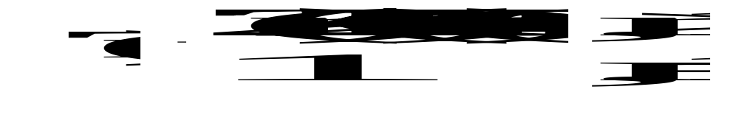
Time complexity: T(n)
Step 1: O(n)
Step 2: 2T(n/2)
Step 3: O(n)
Assume n = 2^{k}
T(n) = O(n log n)
4 -<number>

Slide 11
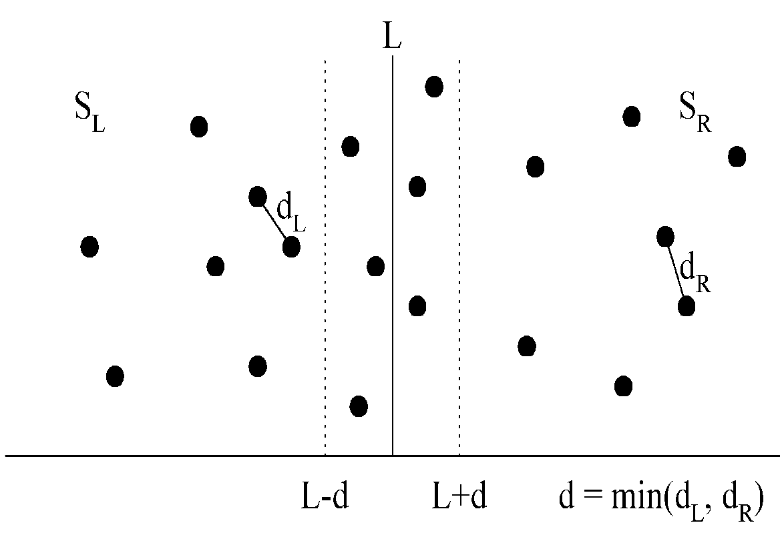
The closest pair problem
Given a set S of n points, find a pair of points which are closest together.
1-D version :
Solved by sorting
Time complexity :
O(n log n)
 2-D version
4 -<number>

Slide 12
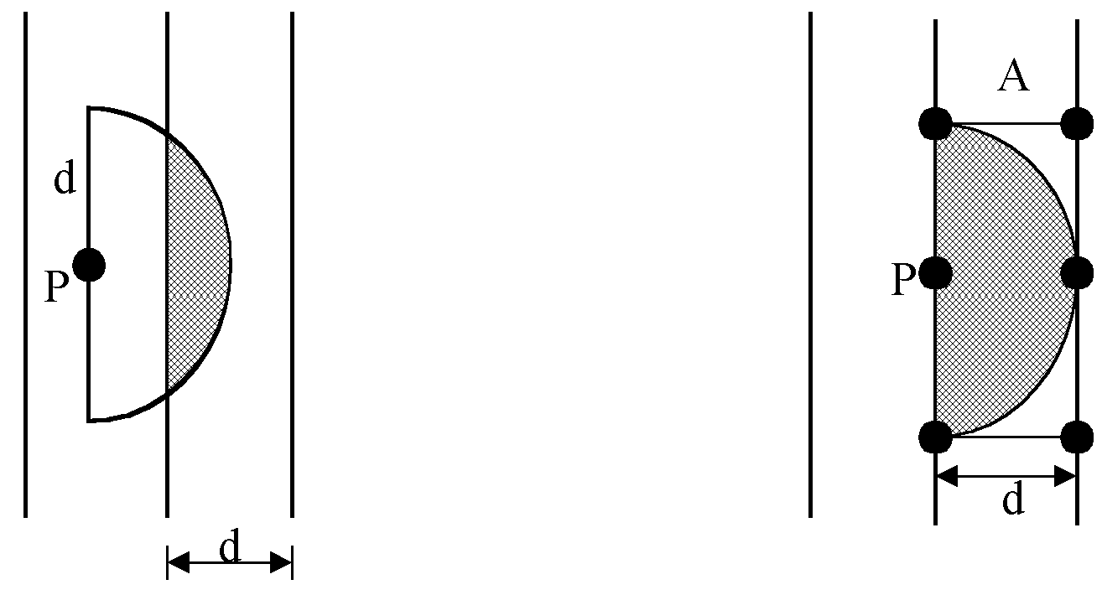
at most 6 points in area A:
4 -<number>

Slide 13
The algorithm:
Input: A set S of n planar points.
Output: The distance between two closest points.
Step 1: Sort points in S according to their y-values.
Step 2: If S contains only one point, return infinity as its distance.
Step 3: Find a median line L perpendicular to the X-axis to divide S into S_{L} and S_{R}, with equal sizes.
Step 4: Recursively apply Steps 2 and 3 to solve the closest pair problems of S_{L} and S_{R}. Let d_{L}(d_{R}) denote the distance between the closest pair in S_{L} (S_{R}). Let d = min(d_{L}, d_{R}).
4 -<number>

Slide 14
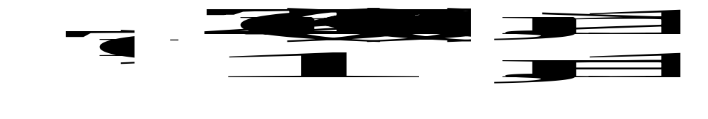
Step 5: For a point P in the half-slab bounded by L-d and L, let its y-value be denoted as y_{P} . For each such P, find all points in the half-slab bounded by L and L+d whose y-value fall within y_{P}+d and y_{P}-d. If the distance d′ between P and a point in the other half-slab is less than d, let d=d′. The final value of d is the answer.
Time complexity: O(n log n)
Step 1: O(n log n)
Steps 2~5:
⇒T(n) = O(n log n)
4 -<number>

Slide 15
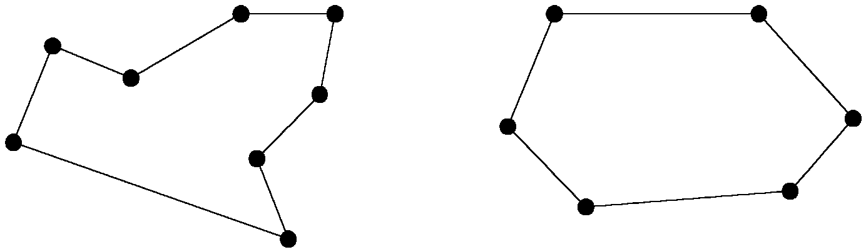
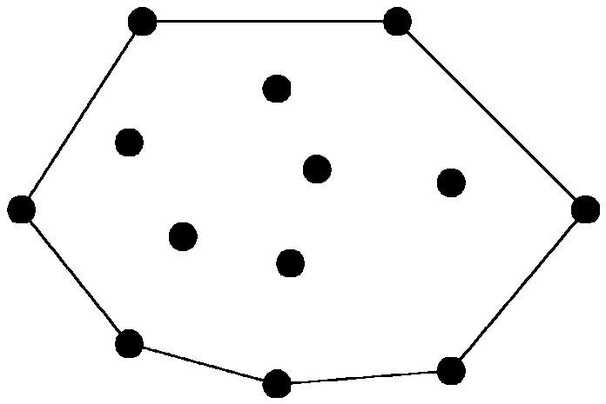
The convex hull problem
concave polygon:
convex polygon:
The convex hull of a set of planar points is the smallest convex polygon containing all of the points.
4 -<number>

Slide 16
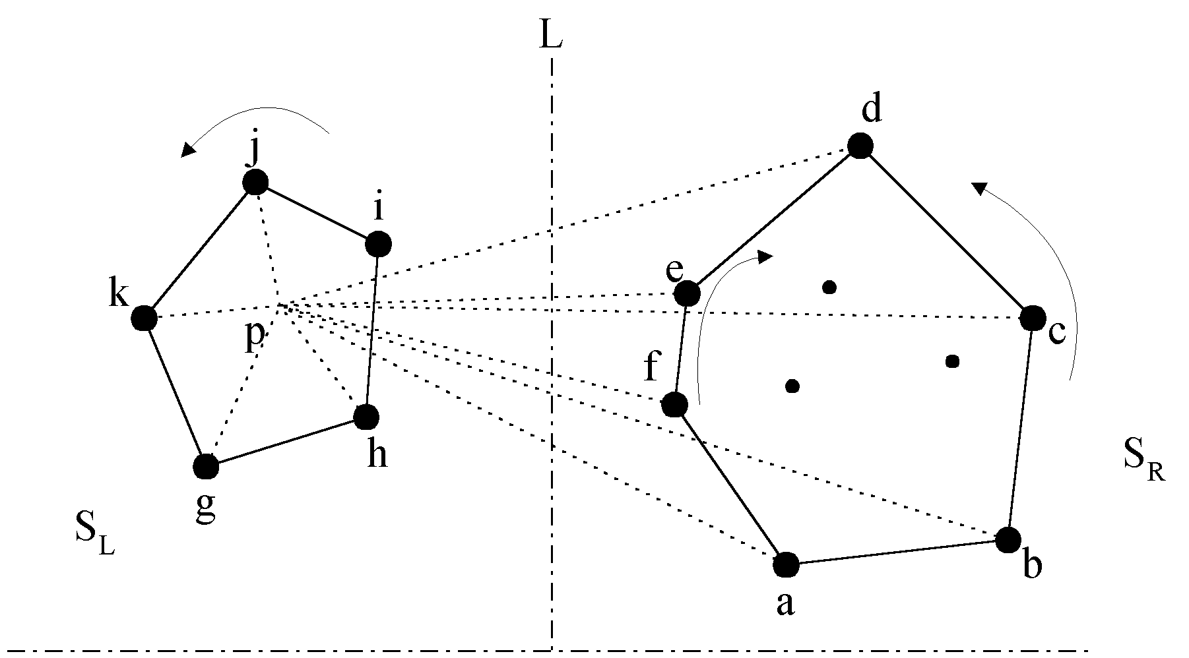
The divide-and-conquer strategy to solve the problem:
4 -<number>

Slide 17
The merging procedure:
Select an interior point p.
There are 3 sequences of points which have increasing polar angles with respect to p.
(1) g, h, i, j, k
(2) a, b, c, d
(3) f, e
Merge these 3 sequences into 1 sequence:
g, h, a, b, f, c, e, d, i, j, k.
Apply Graham scan to examine the points one by one and eliminate the points which cause reflexive angles.
(See the example on the next page.)
4 -<number>

Slide 18
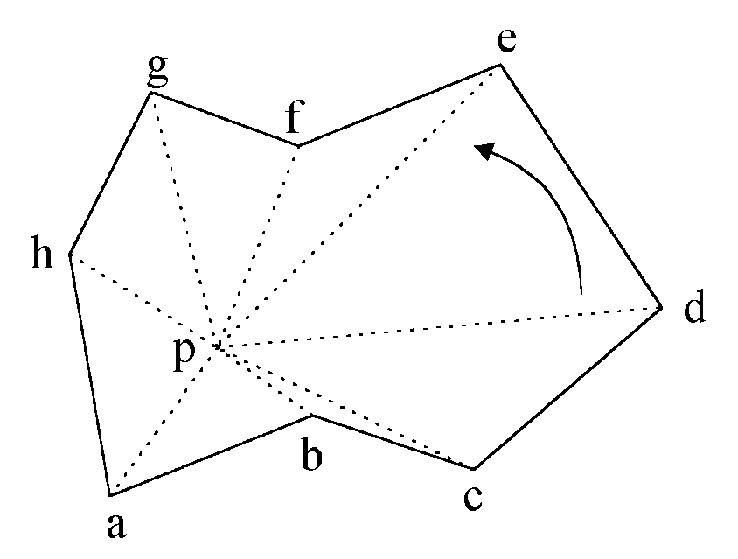
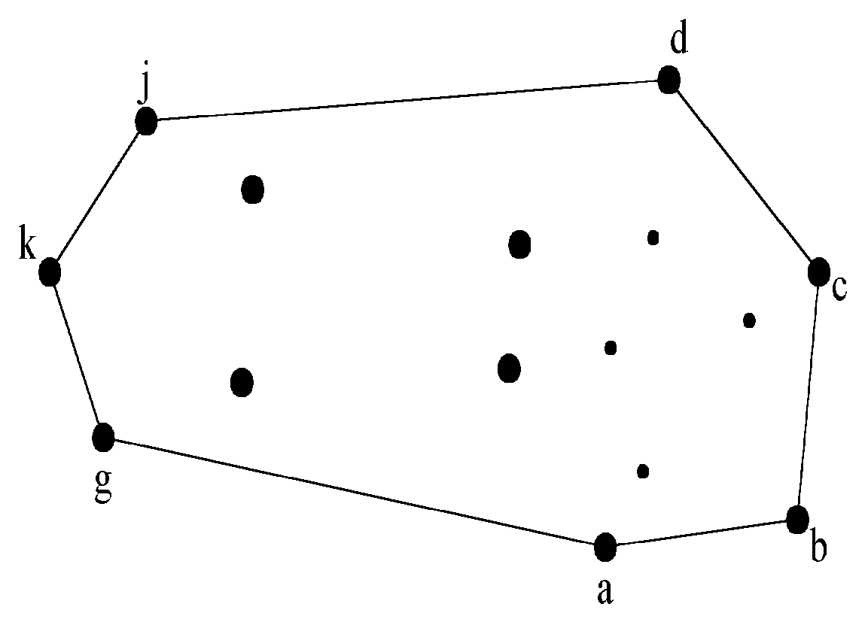
e.g. points b and f need to be deleted.
Final result:
4 -<number>

Slide 19
Divide-and-conquer for convex hull
Input : A set S of planar points
Output : A convex hull for S
Step 1: If S contains no more than five points, use exhaustive searching to find the convex hull and return.
Step 2: Find a median line perpendicular to the X-axis which divides S into S_{L} and S_{R}, with equal sizes.
Step 3: Recursively construct convex hulls for S_{L} and S_{R}, denoted as Hull(S_{L}) and Hull(S_{R}), respectively.
4 -<number>

Slide 20
Step 4: Apply the merging procedure to merge Hull(S_{L}) and Hull(S_{R}) together to form a convex hull.
Time complexity:
T(n) = 2T(n/2) + O(n)
= O(n log n)
4 -<number>

Slide 21
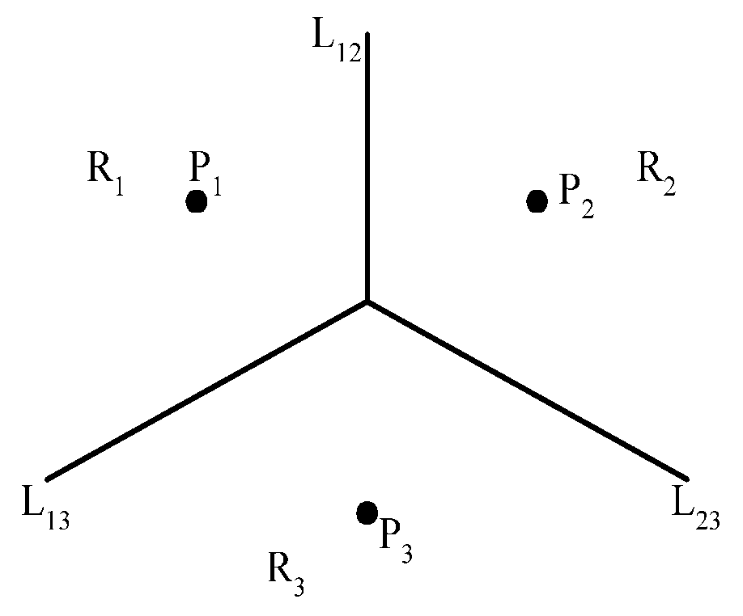

The Voronoi diagram problem
e.g. The Voronoi diagram for three points
Each L_{ij} is the perpendicular bisector of line segment . The intersection of three L_{ij}‘s is the circumcenter (外心) of triangle P₁P₂P₃.
4 -<number>

Slide 22
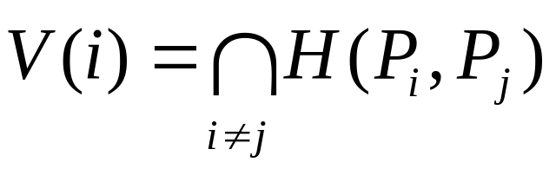
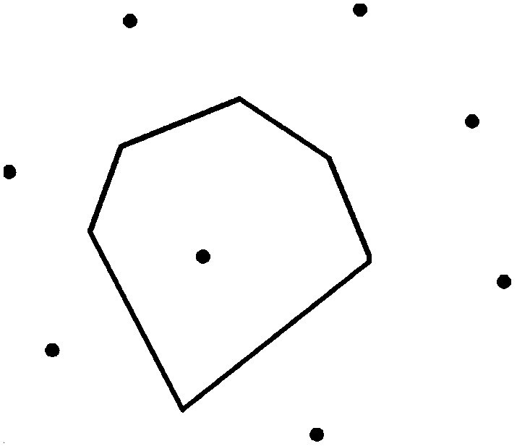
Definition of Voronoi diagrams
Def : Given two points P_{i}, P_{j} ∈ S, let H(P_{i},P_{j}) denote the half plane containing P_{i}. The Voronoi polygon associated with P_{i} is defined as
4 -<number>

Slide 23
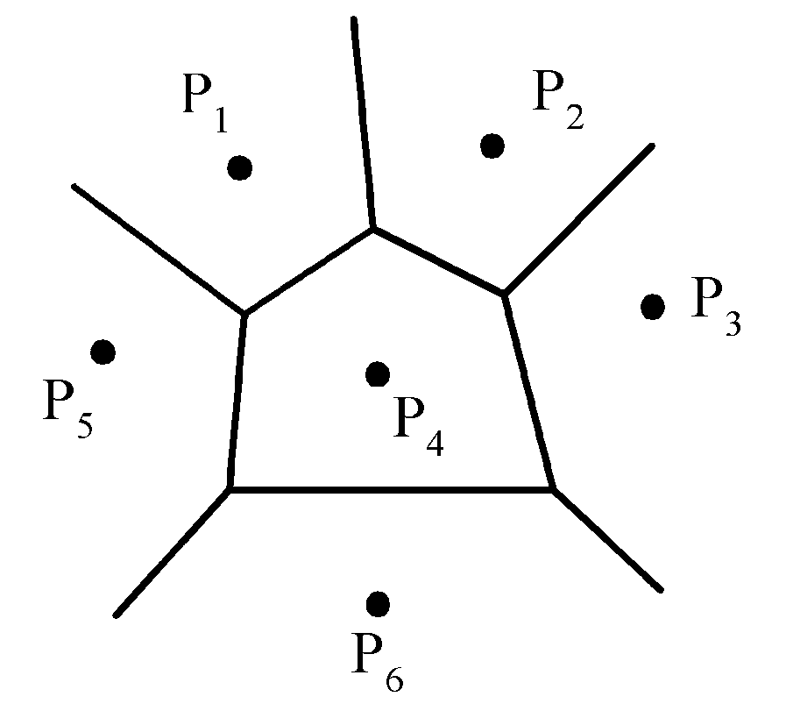
Given a set of n points, the Voronoi diagram consists of all the Voronoi polygons of these points.
The vertices of the Voronoi diagram are called Voronoi points and its segments are called Voronoi edges.
4 -<number>

Slide 24
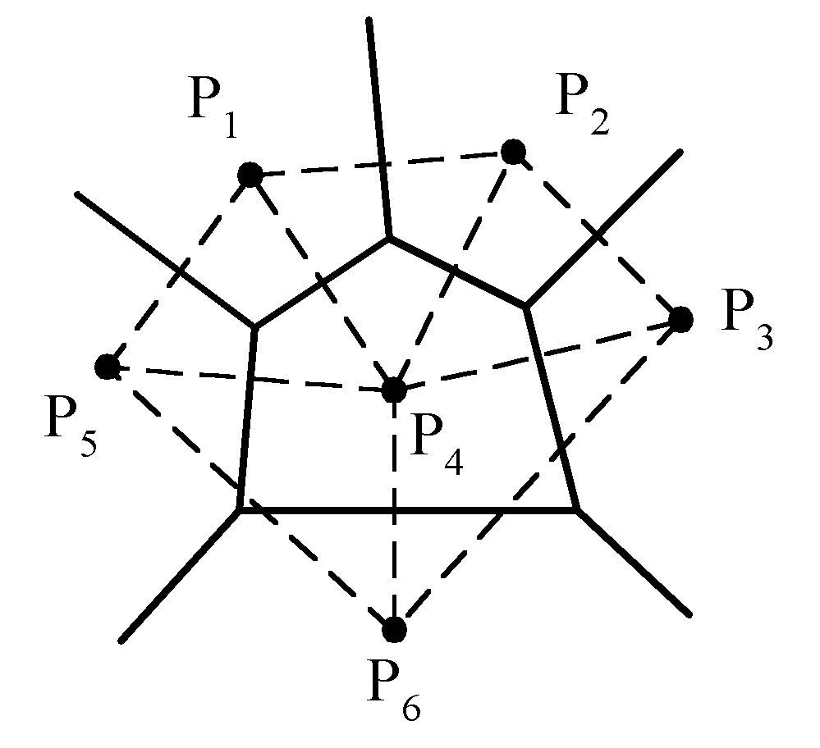
Delaunay triangulation
4 -<number>

Slide 25
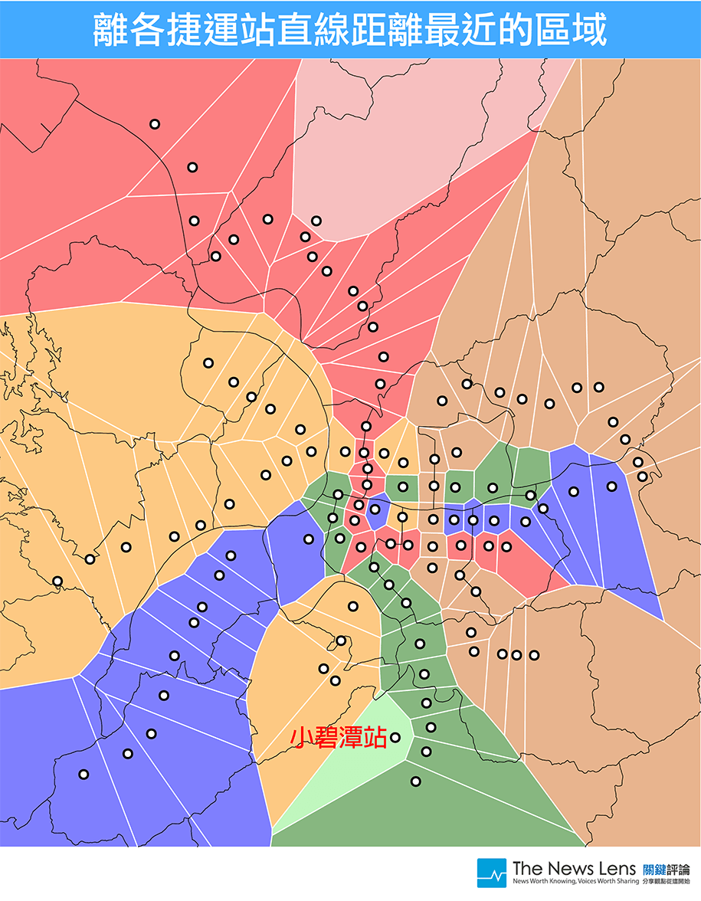
臺北捷運站涵蓋區域圖
4 -<number>

Slide 26
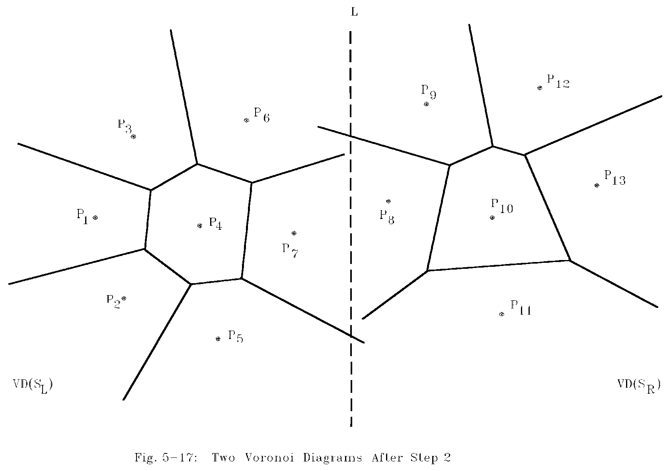
Example for constructing Voronoi diagrams
Divide the points into two parts.
4 -<number>

Slide 27
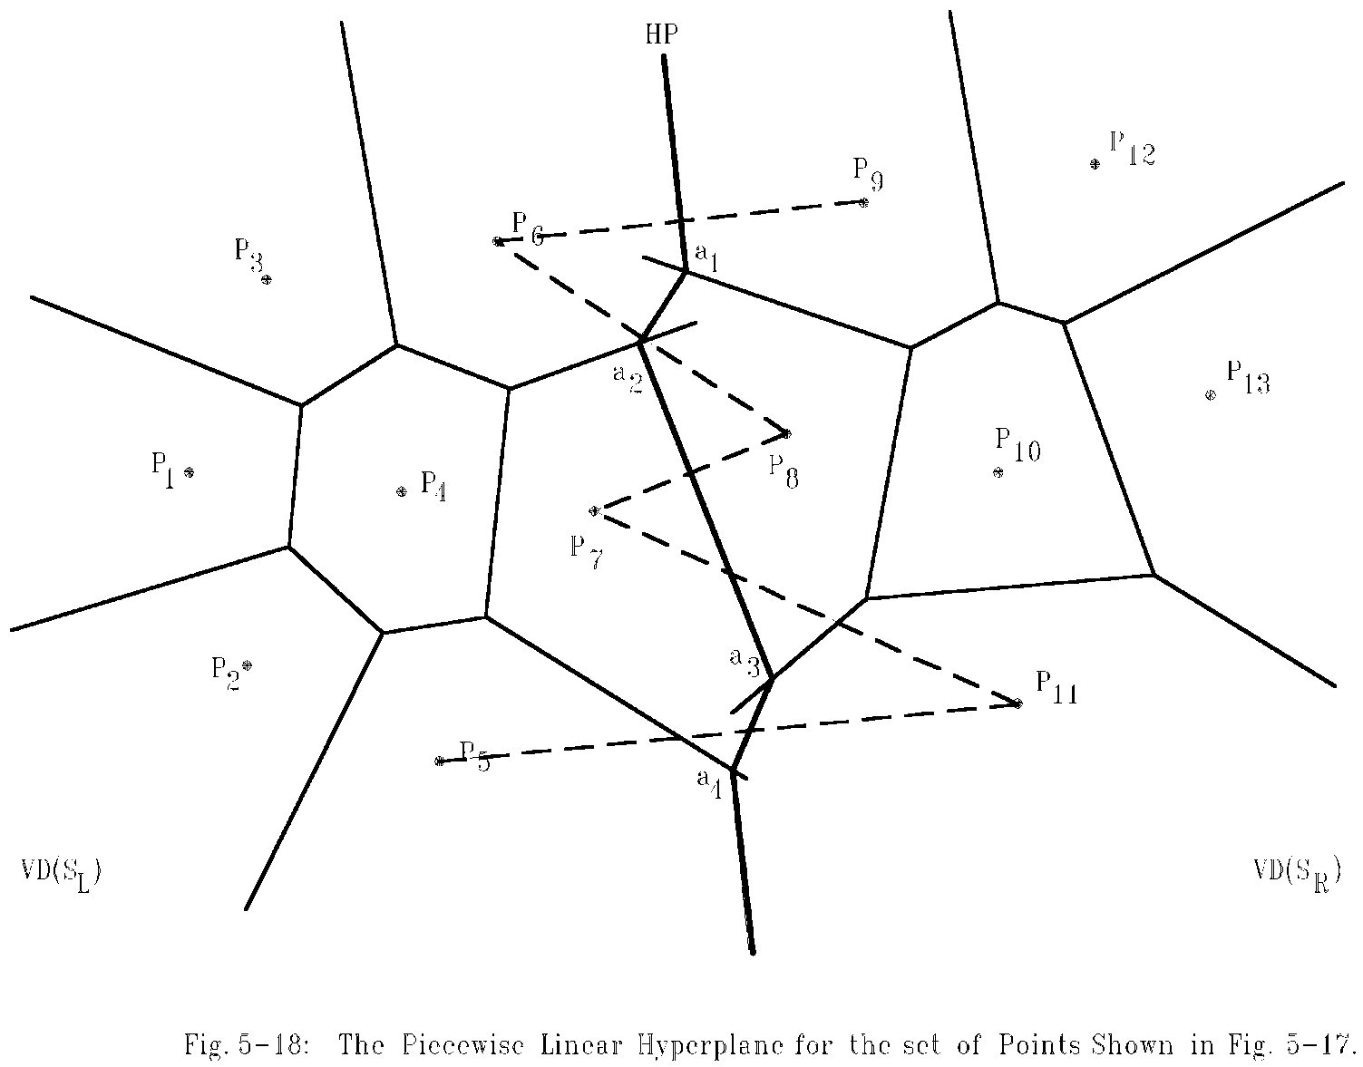
Merging two Voronoi diagrams
Merging along the piecewise linear hyperplane
4 -<number>

Slide 28
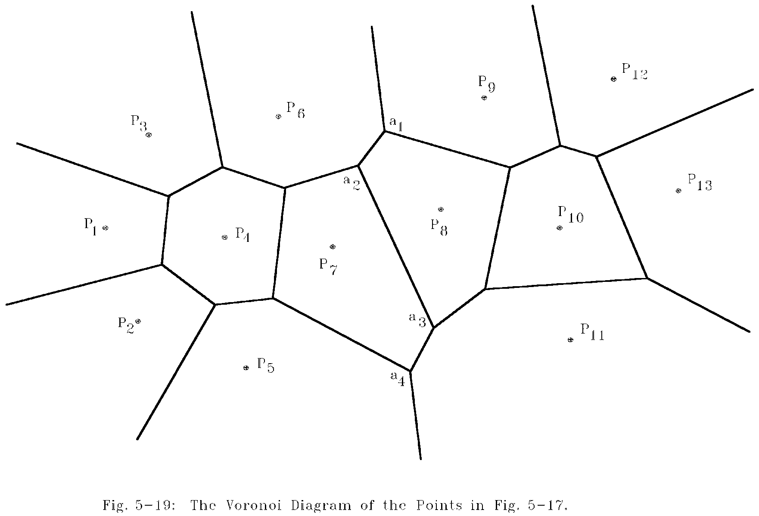
The final Voronoi diagram
After merging
4 -<number>

Slide 29
Divide-and-conquer for Voronoi diagram
Input: A set S of n planar points.
Output: The Voronoi diagram of S.
Step 1: If S contains only one point, return.
Step 2: Find a median line L perpendicular to the X-axis which divides S into S_{L} and S_{R}, with equal sizes.
4 -<number>

Slide 30
Step 3: Construct Voronoi diagrams of S_{L} and S_{R} recursively. Denote these Voronoi diagrams by VD(S_{L}) and VD(S_{R}).
Step 4: Construct a dividing piece-wise linear hyperplane HP which is the locus of points simultaneously closest to a point in S_{L} and a point in S_{R}. Discard all segments of VD(S_{L}) which lie to the right of HP and all segments of VD(S_{R}) that lie to the left of HP. The resulting graph is the Voronoi diagram of S.
(See details on the next page.)
4 -<number>

Slide 31
Mergeing Two Voronoi Diagrams into One Voronoi Diagram
Input: (a) S_{L} and S_{R} where S_{L} and S_{R} are divided by a perpendicular line L.
(b) VD(S_{L} ) and VD(S_{R} ).
Output: VD(S) where S = S_{L} ∩S_{R}
Step 1: Find the convex hulls of S_{L} and S_{R}, denoted as Hull(S_{L}) and Hull(S_{R}), respectively. (A special algorithm for finding a convex hull in this case will by given later.)
4 -<number>

Slide 32
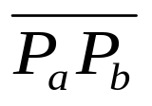
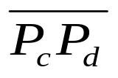
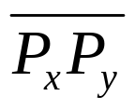
Step 2: Find segments and which join HULL(S_{L} ) and HULL(S_{R} ) into a convex hull (P_{a} and P_{c} belong to S_{L} and P_{b} and P_{d} belong to S_{R}) Assume that lies above . Let x = a, y = b, SG= and HP = ∅ .
Step 3: Find the perpendicular bisector of SG. Denote it by BS. Let HP = HP∪{BS}. If SG = , go to Step 5; otherwise, go to Step 4.
4 -<number>

Slide 33
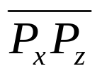

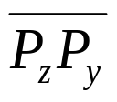
Step 4: The ray from VD(S_{L} ) and VD(S_{R}) which BS first intersects with must be a perpendicular bisector of either or for some z. If this ray is the perpendicular bisector of , then let SG = ; otherwise, let SG = . Go to Step 3.
Step 5: Discard the edges of VD(S_{L}) which extend to the right of HP and discard the edges of VD(S_{R}) which extend to the left of HP. The resulting graph is the Voronoi diagram of S = S_{L}∪S_{R}.
4 -<number>

Slide 34
Properties of Voronoi Diagrams
Def : Given a point P and a set S of points, the distance between P and S is the distance between P and P_{i} which is the nearest neighbor of P in S.
The HP obtained from the above algorithm is the locus of points which keep equal distances to S_{L} and S_{R} .
The HP is monotonic in y.
4 -<number>

Slide 35


# of Voronoi edges
# of edges of a Voronoi diagram ≤ 3n - 6, where n is # of points.
Reasoning:
  # of edges of a planar graph with n vertices ≤ 3n - 6.
  A Delaunay triangulation is a planar graph.
  Edges in Delaunay triangulation
  edges in Voronoi diagram.
4 -<number>

Slide 36
# of Voronoi vertices
# of Voronoi vertices ≤ 2n - 4.
Reasoning:
  Let F, E and V denote # of face, edges and vertices in a planar graph.
  Euler’s relation: F = E - V + 2.
  In a Delaunay triangulation,
  triangle Voronoi vertex
  V = n, E ≤ 3n – 6
  ⇒ F = E - V + 2 ≤ 3n - 6 - n + 2 = 2n - 4.
4 -<number>

Slide 37
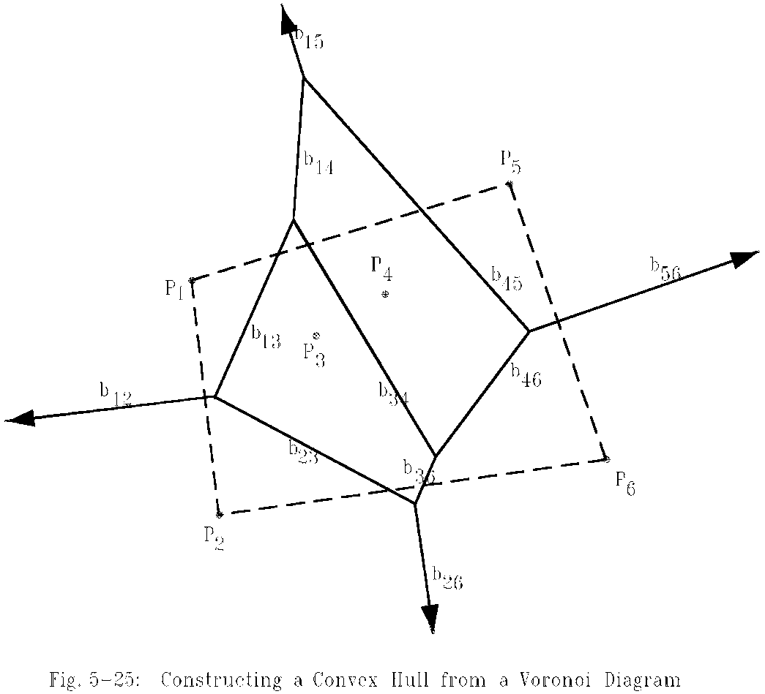
Construct a convex hull from a Voronoi diagram
After a Voronoi diagram is constructed, a convex hull can by found in O(n) time.
4 -<number>

Slide 38
Construct a convex hull from a Voronoi diagram
Step 1: Find an infinite ray by examining all Voronoi edges.
Step 2: Let P_{i} be the point to the left of the infinite ray. P_{i} is a convex hull vertex. Examine the Voronoi polygon of P_{i} to find the next infinite ray.
Step 3: Repeat Step 2 until we return to the starting ray.
4 -<number>

Slide 39
Time complexity
Time complexity for merging 2 Voronoi diagrams:
Total: O(n)
  Step 1: O(n)
  Step 2: O(n)
  Step 3 ~ Step 5: O(n)
  (at most 3n - 6 edges in VD(S_{L}) and VD(S_{R}) and at most n segments in HP)
Time complexity for constructing a Voronoi diagram: O(n log n)
  because T(n) = 2T(n/2) + O(n)=O(n log n)
4 -<number>

Slide 40
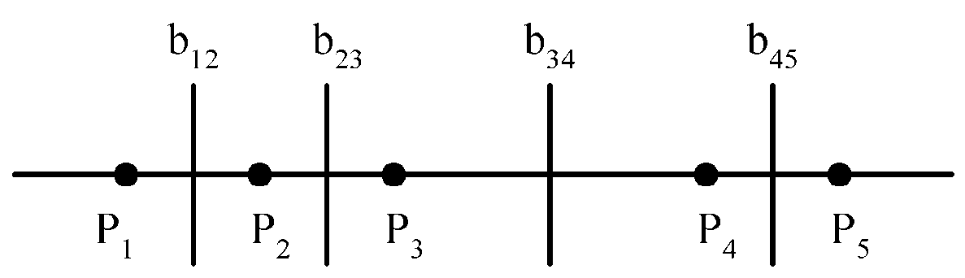
Lower bound
The lower bound of the Voronoi diagram problem is Ω(n log n).
sorting ∝ Voronoi diagram problem
The Voronoi diagram for a set of points on a straight line
4 -<number>

Slide 41
Applications of Voronoi diagrams
The Euclidean nearest neighbor searching problem.
The Euclidean all nearest neighbor problem.
4 -<number>

Slide 42
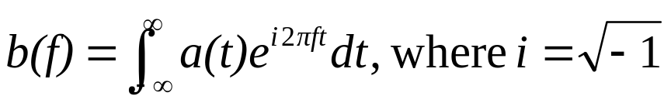
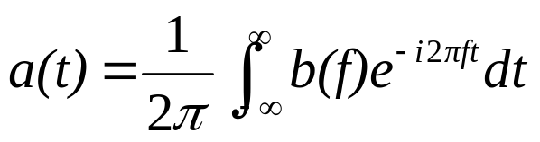
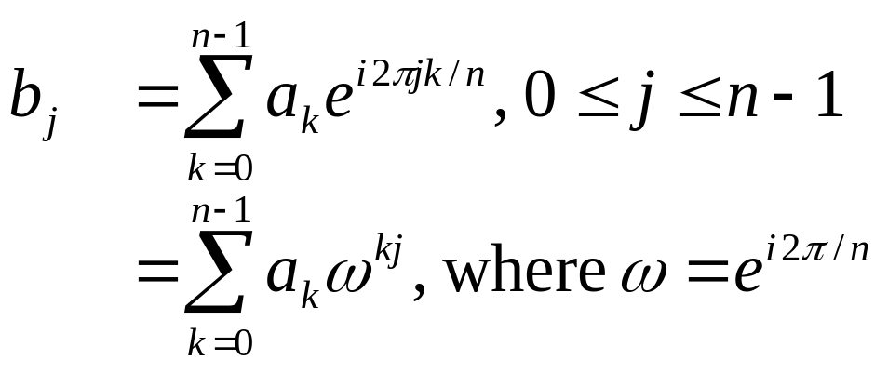
Fast Fourier transform (FFT)
Fourier transform
Inverse Fourier transform
Discrete Fourier transform(DFT)
Given a₀, a₁, …, a_{n-1} , compute
4 -<number>

Slide 43
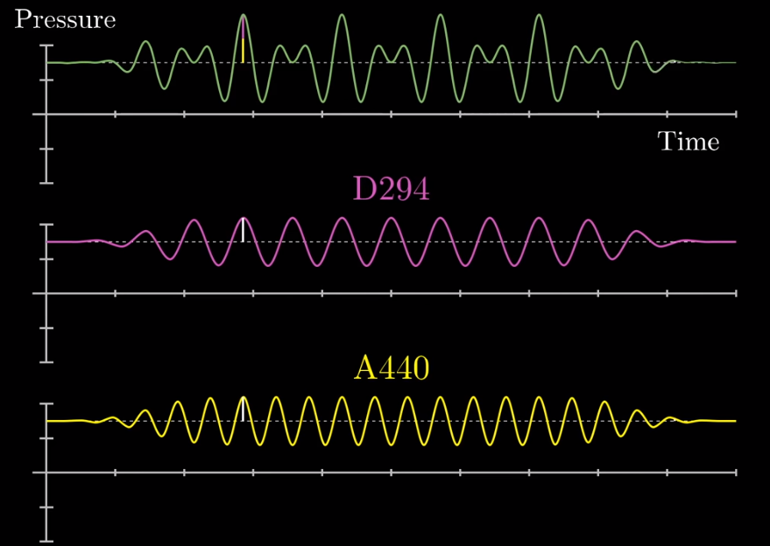
DFT and waveform(1)
Any periodic waveform can be decomposed into the linear sum of sinusoid functions (sine or cosine).
4 -<number>

Slide 44
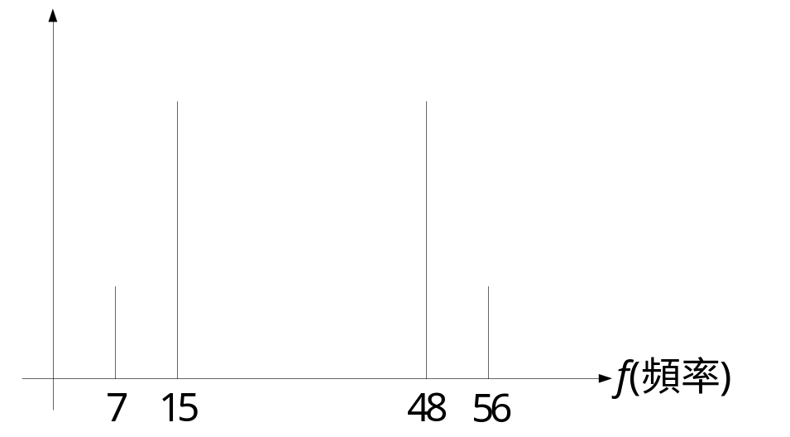
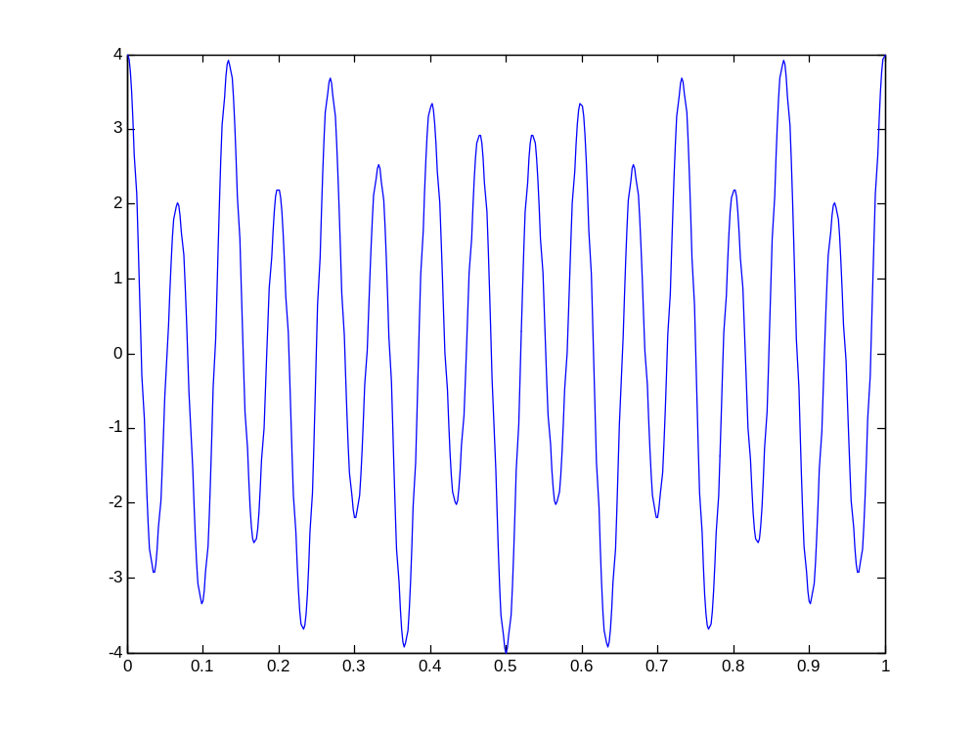
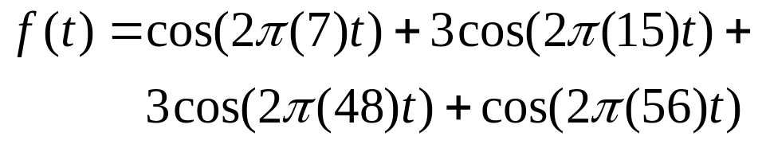
DFT and waveform(2)
Any periodic waveform can be decomposed into the linear sum of sinusoid functions (sine or cosine).
4 -<number>

Slide 45
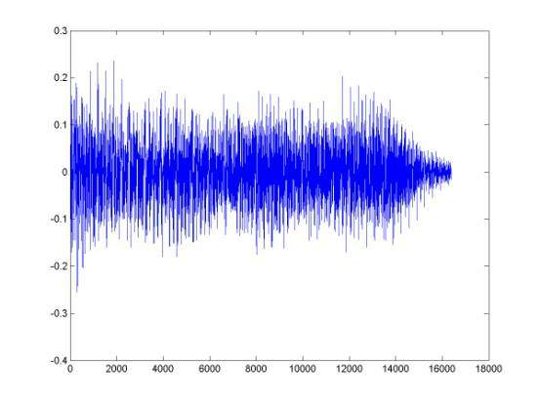
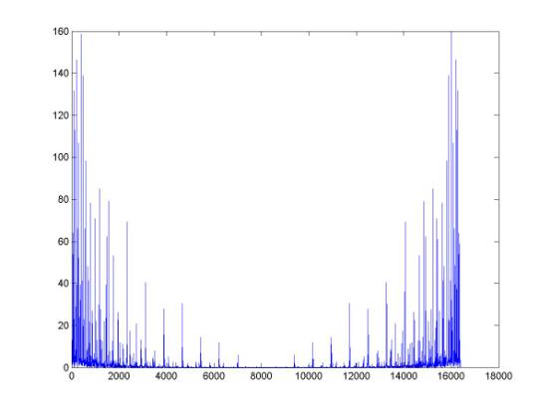
DFT and waveform (3)
The waveform of a music signal of 1 second
The frequency spectrum of the music signal with DFT
4 -<number>

Slide 46
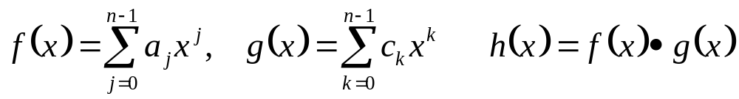
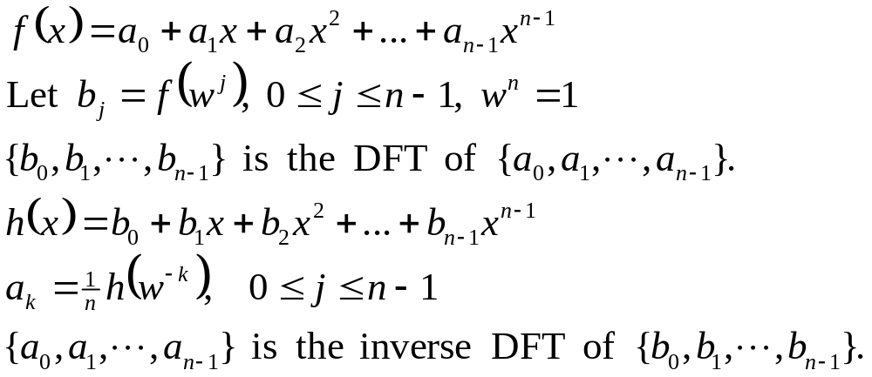
An application of the FFT ⎯ polynomial multiplication
Polynomial multiplication:
The straightforward product requires O(n²) time.
DFT notations:
4 -<number>

Slide 47
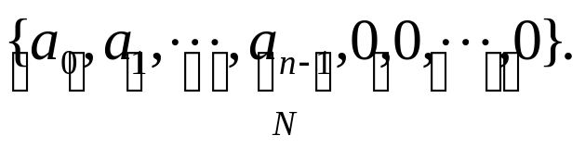
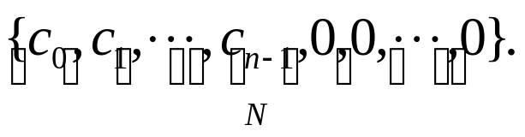
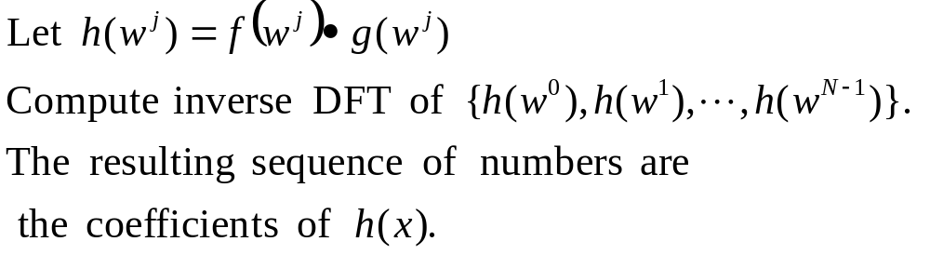
Fast polynomial multiplication
Step 1: Let N be the smallest integer that N=2^{q} and N≥2n-1.
Step 2: Compute FFT of
Step 3: Compute FFT of
Step 4:
Step 5:
Time complexity: O(NlogN)=O(nlogn), N<4n.
4 -<number>

Slide 48
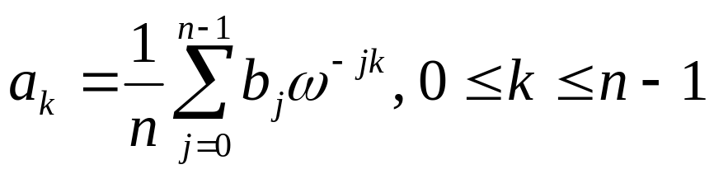
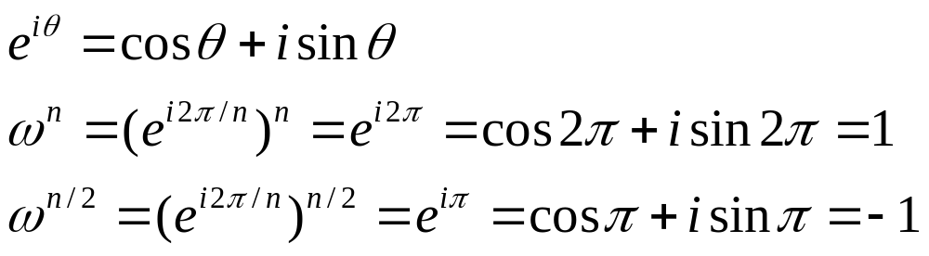
FFT algorithm
Inverse DFT:
DFT can be computed in O(n²) time by a straightforward method.
DFT can be solved by the divide-and-conquer strategy (FFT) in O(nlogn) time.
4 -<number>

Slide 49
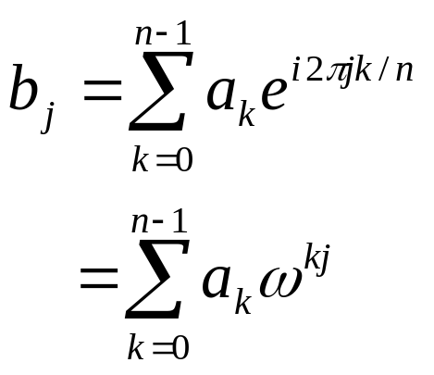
FFT algorithm when n=4
n=4, w=e^{i2π/4} , w⁴=1, w²=-1
  b₀=a₀+a₁+a₂+a₃
  b₁=a₀+a₁w+a₂w²+a₃w³
  b₂=a₀+a₁w²+a₂w⁴+a₃w⁶
  b₃=a₀+a₁w³+a₂w⁶+a₃w⁹
another form:
  b₀ =(a₀+a₂)+(a₁+a₃)
  b₂ =(a₀+a₂w⁴)+(a₁w²+a₃w⁶) =(a₀+a₂)-(a₁+a₃)
When we calculate b₀, we shall calculate (a₀+a₂) and (a₁+a₃). Later, b₂ van be easily calculated.
Similarly,
  b₁ =(a₀+ a₂w²)+(a₁w+a₃w³) =(a₀-a₂)+w(a₁-a₃)
  b₃ =(a₀+a₂w⁶)+(a₁w³+a₃w⁹) =(a₀-a₂)-w(a₁-a₃).
4 -<number>

Slide 50
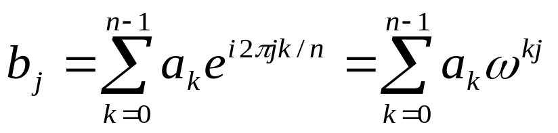
FFT algorithm when n=8
n=8, w=e^{i2π/8}, w⁸=1, w⁴=-1
b₀=a₀+a₁+a₂+a₃+a₄+a₅+a₆+a₇
b₁=a₀+a₁w+a₂w²+a₃w³+a₄w⁴+a₅w⁵+a₆w⁶+a₇w⁷
b₂=a₀+a₁w²+a₂w⁴+a₃w⁶+a₄w⁸+a₅w¹⁰+a₆w¹²+a₇w¹⁴
b₃=a₀+a₁w³+a₂w⁶+a₃w⁹+a₄w¹²+a₅w¹⁵+a₆w¹⁸+a₇w²¹
b₄=a₀+a₁w⁴+a₂w⁸+a₃w¹²+a₄w¹⁶+a₅w²⁰+a₆w²⁴+a₇w²⁸
b₅=a₀+a₁w⁵+a₂w¹⁰+a₃w¹⁵+a₄w²⁰+a₅w²⁵+a₆w³⁰+a₇w³⁵
b₆=a₀+a₁w⁶+a₂w¹²+a₃w¹⁸+a₄w²⁴+a₅w³⁰+a₆w³⁶+a₇w⁴²
b₇=a₀+a₁w⁷+a₂w¹⁴+a₃w²¹+a₄w²⁸+a₅w³⁵+a₆w⁴²+a₇w⁴⁹
4 -<number>

Slide 51
After reordering, we have
b₀=(a₀+a₂+a₄+a₆)+(a₁+a₃+a₅+a₇)
b₁=(a₀+a₂w²+a₄w⁴+a₆w⁶)+ w(a₁+a₃w²+a₅w⁴+a₇w⁶)
b₂=(a₀+a₂w⁴+a₄w⁸+a₆w¹²)+ w²(a₁+a₃w⁴+a₅w⁸+a₇w¹²)
b₃=(a₀+a₂w⁶+a₄w¹²+a₆w¹⁸)+ w³(a₁+a₃w⁶+a₅w¹²+a₇w¹⁸)
b₄=(a₀+a₂+a₄+a₆)-(a₁+a₃+a₅+a₇)
b₅=(a₀+a₂w²+a₄w⁴+a₆w⁶)-w(a₁+a₃w²+a₅w⁴+a₇w⁶)
b₆=(a₀+a₂w⁴+a₄w⁸+a₆w¹²)-w²(a₁+a₃w⁴+a₅w⁸+a₇w¹²)
b₇=(a₀+a₂w⁶+a₄w¹²+a₆w¹⁸)-w³(a₁+a₃w⁶+a₅w¹²+a₇w¹⁸)
Rewrite as
b₀=c₀+d₀ b₄=c₀-d₀=c₀+w⁴d₀
b₁=c₁+wd₁ b₅=c₁-wd₁=c₁+w⁵d₁
b₂=c₂+w²d₂ b₆=c₂-w²d₂=c₂+w⁶d₂
b₃=c₃+w³d₃ b₇=c₃-w³d₃=c₃+w⁷d₃
4 -<number>

Slide 52
c₀=a₀+a₂+a₄+a₆
c₁=a₀+a₂w²+a₄w⁴+a₆w⁶
c₂=a₀+a₂w⁴+a₄w⁸+a₆w¹²
c₃=a₀+a₂w⁶+a₄w¹²+a₆w¹⁸
Let x=w²=e^{i2π/4}
c₀=a₀+a₂+a₄+a₆
c₁=a₀+a₂x+a₄x²+a₆x³
c₂=a₀+a₂x²+a₄x⁴+a₆x⁶
c₃=a₀+a₂x³+a₄x⁶+a₆x⁹
Thus, {c₀,c₁,c₂,c₃} is FFT of {a₀,a₂,a₄,a₆}.
Similarly, {d₀,d₁,d₂,d₃} is FFT of {a₁,a₃,a₅,a₇}.
4 -<number>

Slide 53
General FFT
In general, let w=e^{i2π/n} (assume n is even.)
w^{n}=1, w^{n/2}=-1
  b_{j} =a₀+a₁w^{j}+a₂w^{2j}+…+a_{n-1}w^{(n-1)j},
  ={a₀+a₂w^{2j}+a₄w^{4j}+…+a_{n-2}w^{(n-2)j}}+
  w^{j}{a₁+a₃w^{2j}+a₅w^{4j}+…+a_{n-1}w^{(n-2)j}}
  =c_{j}+w^{j}d_{j}
  b_{j+n/2}=a₀+a₁w^{j+n/2}+a₂w^{2j+n}+a₃w^{3j+3n/2}+…
  +a_{n-1}w^{(n-1)j+n(n-1)/2}
  =a₀-a₁w^{j}+a₂w^{2j}-a₃w^{3j}+…+a_{n-2}w^{(n-2)j}-a_{n-1}w^{(n-1)j}
  =c_{j}-w^{j}d_{j}
  =c_{j}+w^{j+n/2}d_{j}
4 -<number>

Slide 54
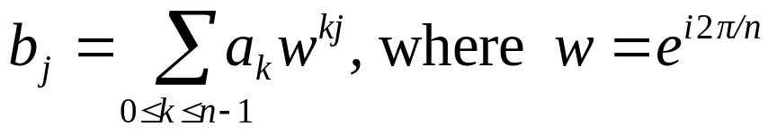
Divide-and-conquer (FFT)
Input: a₀, a₁, …, a_{n-1}, n = 2^{k}
Output: b_{j}, j=0, 1, 2, …, n-1
where
Step 1: If n=2, compute
b₀ = a₀ + a₁,
b₁ = a₀ - a₁, and return.
Step 2: Recursively find the Fourier transform of {a₀, a₂, a₄,…, a_{n-2}} and {a₁, a₃, a₅,…,a_{n-1}}, whose results are denoted as {c₀, c₁, c₂,…, c_{n/2-1}} and {d₀, d₁, d₂,…, d_{n/2-1}}.
4 -<number>

Slide 55
Step 3: Compute b_{j}:
b_{j} = c_{j} + w^{j}d_{j} for 0 ≤ j ≤ n/2 - 1
b_{j+n/2} = c_{j} - w^{j}d_{j} for 0 ≤ j ≤ n/2 - 1.
Time complexity:
T(n) = 2T(n/2) + O(n)
= O(n log n)
4 -<number>

Slide 56
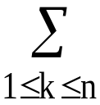
Matrix multiplication
Let A, B and C be n × n matrices
C = AB
C(i, j) = A(i, k)B(k, j)
The straightforward method to perform a matrix multiplication requires O(n³) time.
4 -<number>

Slide 57


Divide-and-conquer approach
C = AB
C₁₁ = A₁₁ B₁₁ + A₁₂ B₂₁
C₁₂ = A₁₁B₁₂ + A₁₂ B₂₂
C₂₁ = A₂₁ B₁₁ + A₂₂ B₂₁
C₂₂ = A₂₁ B₁₂ + A₂₂ B₂₂
Time complexity:
(# of additions : n²)
  We get T(n) = O(n³)
4 -<number>

Slide 58
Strassen’s matrix multiplicaiton
P = (A₁₁ + A₂₂)(B₁₁ + B₂₂)
Q = (A₂₁ + A₂₂)B₁₁
R = A₁₁(B₁₂ - B₂₂)
S = A₂₂(B₂₁ - B₁₁)
T = (A₁₁ + A₁₂)B₂₂
U = (A₂₁ - A₁₁)(B₁₁ + B₁₂)
V = (A₁₂ - A₂₂)(B₂₁ + B₂₂).
C₁₁ = P + S - T + V
C₁₂ = R + T
C₂₁ = Q + S
C₂₂ = P + R - Q + U
C₁₁ = A₁₁ B₁₁ + A₁₂ B₂₁
C₁₂ = A₁₁B₁₂ + A₁₂ B₂₂
C₂₁ = A₂₁ B₁₁ + A₂₂ B₂₁
C₂₂ = A₂₁ B₁₂ + A₂₂ B₂₂
4 -<number>

Slide 59

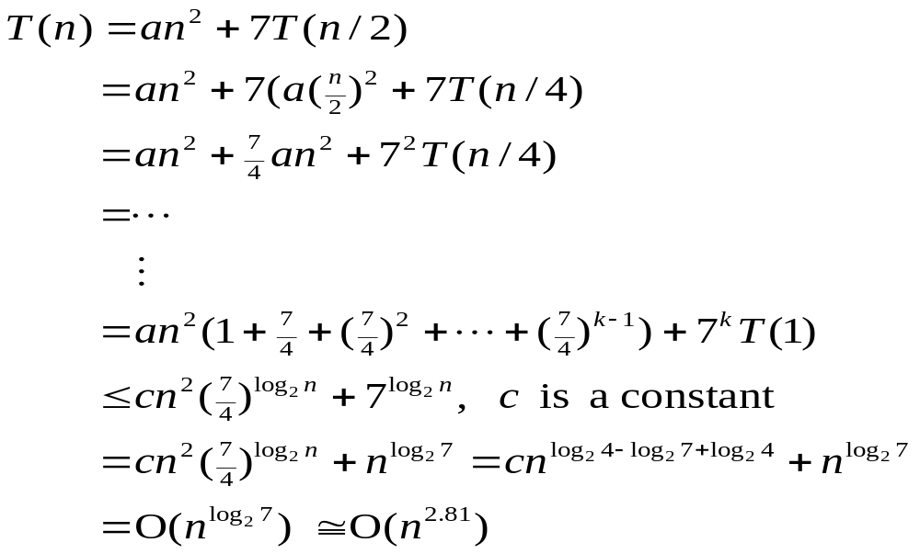
Time complexity
7 multiplications and 18 additions or subtractions
Time complexity:
4 -<number>

