Slide 1
Chapter 6
Prune-and-Search
6 -<number>

Slide 2
A simple example: Binary search
sorted sequence : (search 9)
1 4 5 7 9 10 12 15
step 1 ↑
step 2 ↑
step 3 ↑
After each comparison, a half of the data set are pruned away.
Binary search can be viewed as a special divide-and-conquer method, since there exists no solution in another half and then no merging is done.
6 -<number>

Slide 3

The selection problem
Input: A set S of n elements
Output: The kth smallest element of S
The median problem: to find the -th smallest element.
The straightforward algorithm:
  step 1: Sort the n elements
  step 2: Locate the kth element in the sorted list.
  Time complexity: O(nlogn)
6 -<number>

Slide 4
Prune-and-search concept for the selection problem
S={a₁, a₂, …, a_{n}}
Let p ∈ S, use p to partition S into 3 subsets S₁ , S₂ , S₃:
  S₁={ a_{i} | a_{i} < p , 1 ≤ i ≤ n}
  S₂={ a_{i} | a_{i} = p , 1 ≤ i ≤ n}
  S₃={ a_{i} | a_{i} > p , 1 ≤ i ≤ n}
3 cases:
  If |S₁| ≥ k , then the kth smallest element of S is in S₁, prune away S₂ and S₃.
  Else, if |S₁| + |S₂| ≥ k, then p is the kth smallest element of S.
  Else, the kth smallest element of S is the (k - |S₁| - |S₂|)-th smallest element in S₃, prune away S₁ and S₂.
6 -<number>

Slide 5

How to select P?
The n elements are divided into subsets. (Each subset has 5 elements.)
At least 1/4 of S known to be less than or equal to P.
Each 5-element subset is sorted in non-decreasing sequence.
P
M
At least 1/4 of S known to be greater than or equal to P.
6 -<number>

Slide 6
Prune-and-search approach
Input: A set S of n elements.
Output: The kth smallest element of S.
Step 1: Divide S into ⎡n/5⎤ subsets. Each subset contains five elements. Add some dummy ∞ elements to the last subset if n is not a net multiple of S.
Step 2: Sort each subset of elements.
Step 3: Recursively, find the element p which is the median of the medians of the ⎡n/5⎤ subsets..
6 -<number>

Slide 7
Step 4: Partition S into S₁, S₂ and S₃, which contain the elements less than, equal to, and greater than p, respectively.
Step 5: If |S₁|≥ k, then discard S₂ and S₃ and solve the problem that selects the kth smallest element from S₁ during the next iteration;
else if |S₁| + |S₂|≥ k then p is the kth smallest element of S;
otherwise, let k′ = k - |S₁| - |S₂|, solve the problem that selects the k’th smallest element from S₃ during the next iteration.
6 -<number>

Slide 8
Time complexity
At least n/4 elements are pruned away during each iteration.
The problem remaining in step 5 contains at most 3n/4 elements.
Time complexity: T(n) = O(n)
  step 1: O(n)
  step 2: O(n)
  step 3: T(n/5)
  step 4: O(n)
  step 5: T(3n/4)
  T(n) = T(3n/4) + T(n/5) + O(n)
6 -<number>

Slide 9
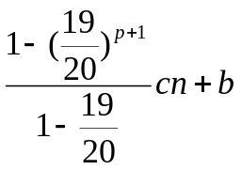
Let T(n) = a₀ + a₁n + a₂n² + … , a₁ ≠ 0
T(3n/4) = a₀ + (3/4)a₁n + (9/16)a₂n² + …
T(n/5) = a₀ + (1/5)a₁n + (1/25)a₂n² + …
T(3n/4 + n/5) = T(19n/20) = a₀ + (19/20)a₁n + (361/400)a₂n² + …
T(3n/4) + T(n/5) ≤ a₀ + T(19n/20)
⇒ T(n) ≤ cn + T(19n/20)
≤ cn + (19/20)cn +T((19/20)²n)

≤ cn + (19/20)cn + (19/20)²cn + … +(19/20)^{p}cn + T((19/20)^{p+1}n) , (19/20)^{p+1}n≤ 1 ≤ (19/20)^{p}n
=
≤ 20 cn +b
= O(n)
6 -<number>

Slide 10
The general prune-and-search
It consists of many iterations.
At each iteration, it prunes away a fraction, say f, 0<f<1, of the input data, and then it invokes the same algorithm recursively to solve the problem for the remaining data.
After p iterations, the size of input data will be q which is so small that the problem can be solved directly in some constant time c.
6 -<number>

Slide 11
Time complexity analysis
Assume that the time needed to execute the prune-and-search in each iteration is O(n^{k}) for some constant k and the worst case run time of the prune-and-search algorithm is T(n). Then
  T(n) = T((1−f ) n) + O(n^{k})
6 -<number>

Slide 12
We have
T(n) ≤ T((1 − f ) n) + cn^{k} for sufficiently large n.
≤ T((1 − f )²n) + cn^{k} + c(1 − f )^{k}n^{k}

≤ c’+ cn^{k} + c(1 − f )^{k}n^{k} + c(1 − f )^{2k}n^{k} + ... + c(1 − f )^{pk}n^{k}
= c’+ cn^{k}(1 + (1 − f )^{k} + (1 − f )^{2k} + ... + (1 − f ) ^{pk}).
Since 1 − f < 1, as n → ∞,
  ∴ T(n) = O(n^{k})
Thus, the time-complexity of the whole prune-and-search process is of the same order as the time-complexity in each iteration.
6 -<number>

Slide 13
Linear programming with two variables
Minimize ax + by
subject to a_{i}x + b_{i}y ≥ c_{i} , i = 1, 2, …, n
Simplified two-variable linear programming problem:
Minimize y
subject to y ≥ a_{i}x + b_{i}, i = 1, 2, …, n
6 -<number>

Slide 14
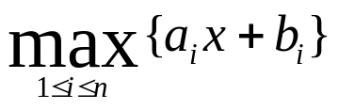
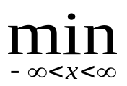
y
F(x)
a₂x + b₂
a₄x + b₄
a₃x + b₃
(x₀,y₀)
a₅x + b₅
a₆x + b₆
a₇x + b₇
a₈x + b₈
a₁x + b₁
x
The boundary F(x):
F(x) =
The optimum solution x₀:
F(x₀) = F(x)
6 -<number>

Slide 15
Constraints deletion
y
a₁x + b₁
If x₀ < x_{m} and the intersection of a₃x + b₃ and a₂x + b₂ is greater than x_{m}, then one of these two constraints is always smaller than the other for x < x_{m}. Thus, this constraint can be deleted.
It is similar for x₀ > x_{m}.
a₂x + b₂
a₄x + b₄
a₃x + b₃
a₅x + b₅
May be deleted
a₈x + b₈
a₆x + b₆
a₇x + b₇
x₀
x
x_{m}
6 -<number>

Slide 16

Determining the direction of the optimum solution
Let y_{m} = F(x_{m}) =
Case 1: y_{m} is on only one constraint.
  Let g denote the slope of this constraint.
  If g > 0, then x₀ < x_{m}.
  If g < 0, then x₀ > x_{m}.
Suppose an x_{m} is known. How do we know whether x₀ < x_{m} or x₀ > x_{m} ?
y
y'_{m}
x₀
x₀
y_{m}
The cases where x_{m} is on only one constrain.
x
6 -<number>
x'_{m}
x_{m}

Slide 17
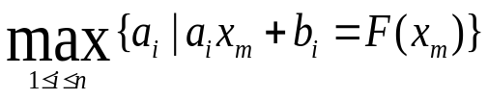
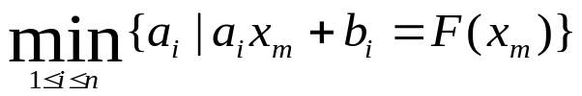
Case 2: y_{m} is the intersection of several constraints.
  g_{max}=
  max. slope
  g_{min} =
  min. slop
  If g_{min} > 0, g_{max} > 0, then x₀ < x_{m}
  If g_{min} < 0, g_{max} < 0, then x₀ > x_{m}
  If g_{min} < 0, g_{max} > 0 , then (x_{m}, y_{m}) is the optimum solution.
y
g_{max}
g_{min}
g_{max}
g_{min}
g_{max}
Case 2a: x_{m,3}
Case 2b: x_{m,1}
Case 2c: x_{m,2}
g_{min}
x
x_{m,1}
x_{m,2}
x_{m,3}
Cases of x_{m} on the intersection of several constraints.
6 -<number>

Slide 18
How to choose x_{m}?
We arbitrarily group the n constraints into n/2 pairs. For each pair, find their intersection. Among these n/2 intersections, choose the median of their x-coordinates as x_{m}.
6 -<number>

Slide 19
Prune-and-Search approach
Input: Constraints S: a_{i}x + b_{i}, i=1, 2, …, n.
Output: The value x₀ such that y is minimized at x₀ subject to the above constraints.
Step 1: If S contains no more than two constraints, solve this problem by a brute force method.
Step 2: Divide S into n/2 pairs of constraints randomly. For each pair of constraints a_{i}x + b_{i} and a_{j}x + b_{j}, find the intersection p_{ij} of them and denote its x-value as x_{ij}.
Step 3: Among the x_{ij}’s, find the median x_{m}.
6 -<number>

Slide 20
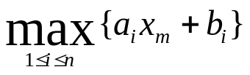


Step 4: Determine y_{m} = F(x_{m}) =
g_{min} =
g_{max} =
Step 5:
  Case 5a: If g_{min} and g_{max} are not of the same sign, y_{m} is the solution and exit.
  Case 5b: otherwise, x₀ < x_{m}, if g_{min} > 0, and x₀ >x_{m}, if g_{min} < 0.
6 -<number>

Slide 21
Step 6:
  Case 6a: If x₀ < x_{m}, for each pair of constraints whose x-coordinate intersection is larger than x_{m}, prune away the constraint which is always smaller than the other for x ≤ x_{m}.
  Case 6b: If x₀ > x_{m}, do similarly.
  Let S denote the set of remaining constraints. Go to Step 2.
There are totally ⎣n/2⎦ intersections. Thus, ⎣n/4⎦ constraints are pruned away for each iteration.
Time complexity:
T(n) = T(3n/4)+O(n)
= O(n)
6 -<number>

Slide 22
The general two-variable linear programming problem
Minimize ax + by
subject to a_{i}x + b_{i}y ≥ c_{i} , i = 1, 2, …, n
Let x’ = x
y’ = ax + by
⇓
Minimize y’
subject to a_{i}’x’ + b_{i}’y’ ≥ c_{i}’ , i = 1, 2, …, n
where a_{i}’ = a_{i} –b_{i}a/b, b_{i}’ = b_{i}/b, c_{i}’ = c_{i}
6 -<number>

Slide 23
Change the symbols and rewrite as:
Minimize y
subject to y ≥ a_{i}x + b_{i} ( i ∈ I₁ )
y ≤ a_{i}x + b_{i} ( i ∈ I₂ )
a ≤ x ≤ b
Define:
F₁(x) = max {a_{i}x + b_{i} , i ∈ I₁}
F₂(x) = min {a_{i}x + b_{i} , i ∈ I₂}
⇓
Minimize F₁(x)
subject to F₁(x) ≤ F₂(x), a ≤ x ≤ b
Let F(x) = F₁(x) - F₂(x)
y
F₂(x)
F₁(x)
a
b
x
6 -<number>

Slide 24
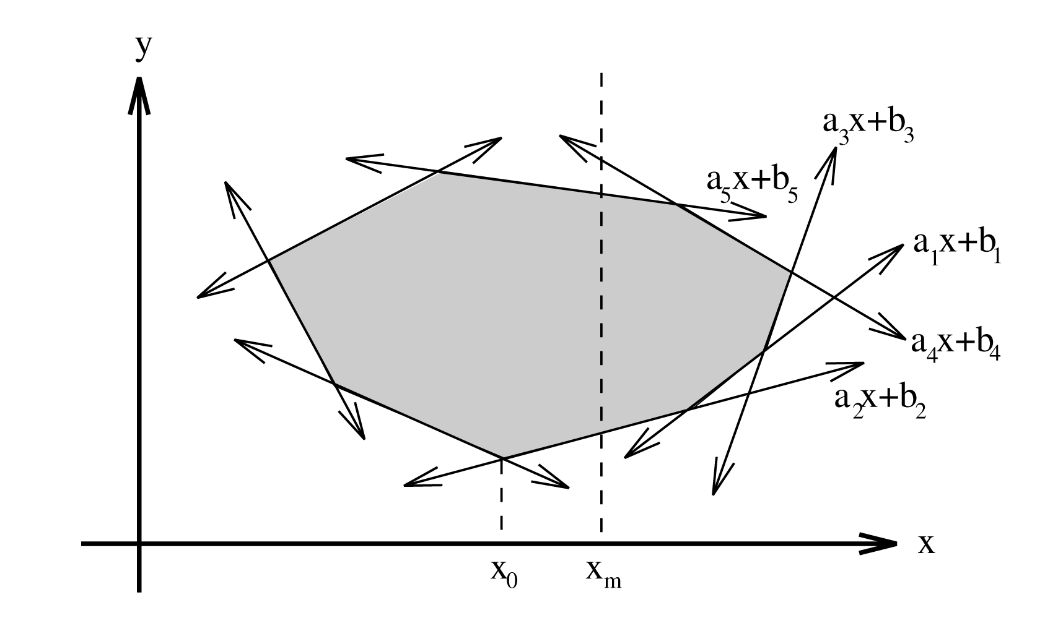
If we know x₀ < x_{m}, then a₁x + b₁ can be deleted because a₁x + b₁ < a₂x + b₂ for x< x_{m}.
Define:
  g_{min} = min {a_{i} | i ∈ I₁, a_{i}x_{m} + b_{i} = F₁(x_{m})}, min. slope
  g_{max} = max{a_{i} | i ∈ I₁, a_{i}x_{m} + b_{i} = F₁(x_{m})}, max. slope
  h_{min} = min {a_{i} | i ∈ I₂, a_{i}x_{m} + b_{i} = F₂(x_{m})}, min. slope
  h_{max} = max{a_{i} | i ∈ I₂, a_{i}x_{m} + b_{i} = F₂(x_{m})}, max. slope
6 -<number>

Slide 25
Determining the solution
Case 1: If F(x_{m}) ≤ 0, then x_{m} is feasible.
Case 1.a: If g_{min} > 0, g_{max} > 0, then x₀ < x_{m}.
Case 1.b: If g_{min} < 0, g_{max} < 0, then x₀ > x_{m}.
y
y
F₂(x)
F₂(x)
g_{max}
F₁(x)
F₁(x)
g_{min}
g_{max}
x₀ ← x_{m}
x
x
x_{m} →x₀
6 -<number>

Slide 26
  Case 1.c: If g_{min} < 0, g_{max} > 0, then x_{m} is the optimum solution.
y
F₂(x)
F₁(x)
g_{min}
g_{max}
x
x_{m} = x₀
6 -<number>

Slide 27
Case 2: If F(x_{m}) > 0, x_{m} is infeasible.
Case 2.a: If g_{min} > h_{max}, then x₀ < x_{m}.
Case 2.b: If g_{min} < h_{max}, then x₀ > x_{m}.
y
y
F₁(x)
F₁(x)
g_{min}
h_{max}
g_{max}
h_{min}
F₂(x)
F₂(x)
x
x
x₀ ←x_{m}
x_{m} → x₀
6 -<number>

Slide 28
  Case 2.c: If g_{min} ≤ h_{max}, and g_{max} ≥ h_{min}, then no feasible solution exists.
y
F₁(x)
g_{max}
g_{min}
h_{max}
F₂(x)
h_{min}
x
x_{m}
6 -<number>

Slide 29
Prune-and-search approach
Input: Constraints:
I₁: y ≥ a_{i}x + b_{i}, i = 1, 2, …, n₁
I₂: y ≤ a_{i}x + b_{i}, i = n₁+1, n₁+2, …, n.
a ≤ x ≤ b
Output: The value x₀ such that
y is minimized at x_{0­}
subject to the above constraints.
Step 1: Arrange the constraints in I₁ and I₂ into arbitrary disjoint pairs respectively. For each pair, if a_{i}x + b_{i} is parallel to a_{j}x + b_{j}, delete a_{i}x + b_{i} if b_{i} < b_{j} for i, j∈I₁ or b_{i} > b_{j} for i, j∈I₂. Otherwise, find the intersection p_{ij} of y = a_{i}x + b_{i} and y = a_{j}x + b_{j}. Let the x-coordinate of p_{ij} be x_{ij}.
6 -<number>

Slide 30

Step 2: Find the median x_{m} of x_{ij}’s (at most points).
Step 3:
  If x_{m} is optimal, report this and exit.
  If no feasible solution exists, report this and exit.
  Otherwise, determine whether the optimum solution lies to the left, or right, of x_{m}.
Step 4: Discard at least 1/4 of the constraints. Go to Step 1.
Time complexity:
T(n) = T(3n/4)+O(n)
= O(n)
6 -<number>

Slide 31
The 1-center problem
Given n planar points, find a smallest circle to cover these n points.
6 -<number>

Slide 32
The pruning rule
L₁ ₂: bisector of segment connecting p₁ and p₂ ,
L₃ ₄: bisector of segments connecting p₃ and p₄
P₁ can be eliminated without affecting our solution.
The area where the center of the optimum circle is located.
y
p₁
p₃
L₁₂
L₃₄
p₂
p₄
x
6 -<number>

Slide 33
The constrained 1-center problem
The center is restricted to lying on a straight line.
L_{ij}
P_{i}
P_{j}
y = 0
x_{ij}
x*
x_{m}
6 -<number>

Slide 34
Prune-and-search approach
Input : n points and a straight line y = y’.
Output: The constrained center on the straight line y = y’.
Step 1: If n is no more than 2, solve this problem by a brute-force method.
Step 2: Form disjoint pairs of points (p₁, p₂), (p₃, p₄), …,(p_{n-1}, p_{n}). If there are odd number of points, just let the final pair be (p_{n}, p₁).
Step 3: For each pair of points, (p_{i}, p_{i+1}), find the point x_{i,i+1} on the line y = y’ such that d(p_{i}, x_{i,i+1}) = d(p_{i+1}, x_{i,i+1}).
6 -<number>

Slide 35

Step 4: Find the median of the x_{i,i+1}’s. Denote it as x_{m}.
Step 5: Calculate the distance between p_{i} and x_{m} for all i. Let p_{j} be the point which is farthest from x_{m}. Let x_{j} denote the projection of p_{j} onto y = y’. If x_{j} is to the left (right) of x_{m}, then the optimal solution, x*, must be to the left (right) of x_{m}.
Step 6: If x* < x_{m}, for each x_{i,i+1} > x_{m}, prune the point p_{i} if p_{i} is closer to x_{m} than p_{i+1,} otherwise prune the point p_{i+1};
If x* > x_{m}, do similarly.
Step 7: Go to Step 1.
Time complexity
T(n) = T(3n/4)+O(n)
= O(n)
6 -<number>

Slide 36
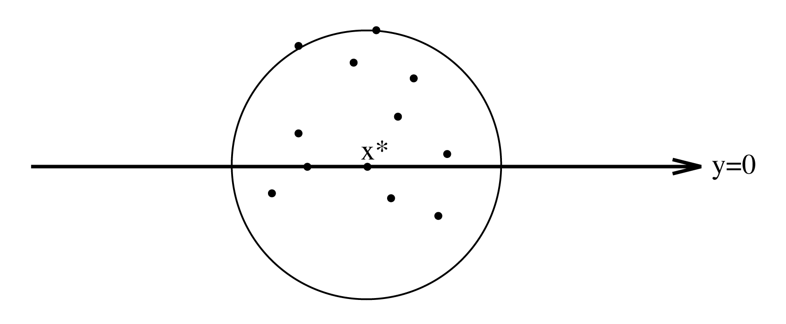
The general 1-center problem
By the constrained 1-center algorithm, we can determine the center (x*,0) on the line y=0.
We can do more
  Let (x_{s}, y_{s}) be the center of the optimum circle.
  We can determine whether y_{s} > 0, y_{s} < 0 or y_{s} = 0.
  Similarly, we can also determine whether x_{s} > 0, x_{s} < 0 or x_{s} = 0
6 -<number>

Slide 37
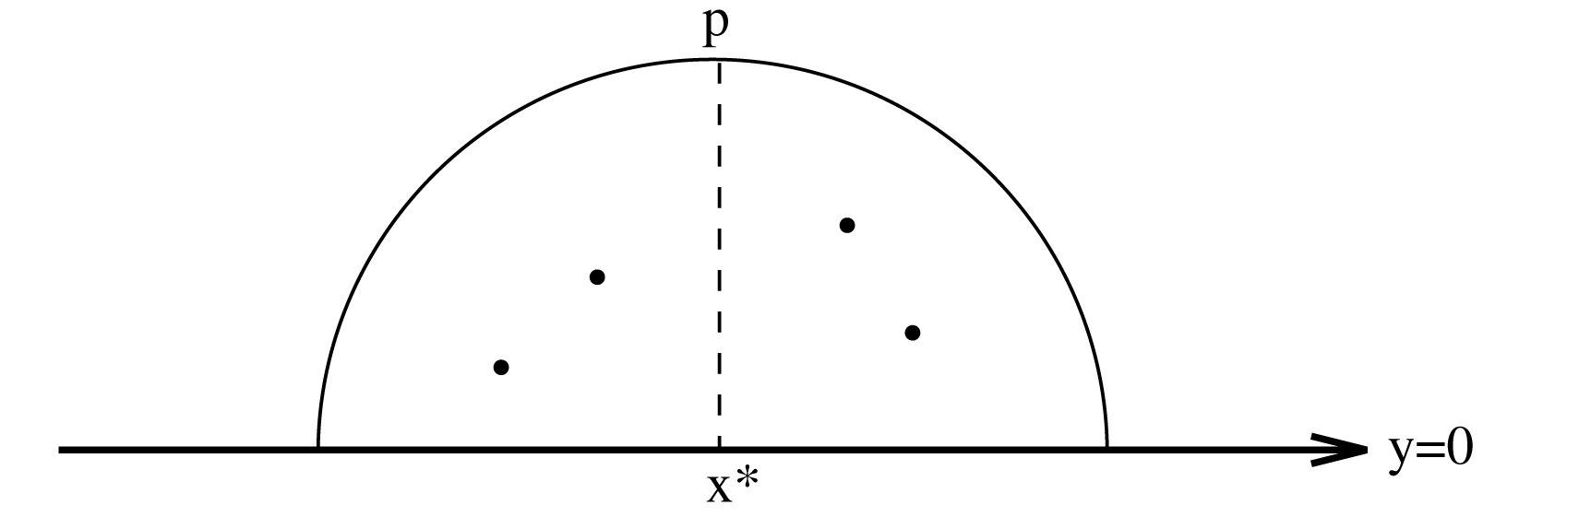
The sign of optimal y
Let I be the set of points which are farthest from (x*, 0).
Case 1: I contains one point P = (x_{p}, y_{p}).
y_{s} has the same sign as that of y_{p}.
6 -<number>

Slide 38
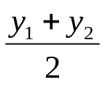
Case 2 : I contains more than one point.
  Find the smallest arc spanning all points in I.
  Let P₁ = (x₁, y₁) and P₂ = (x₂, y₂) be the two end points of the smallest spanning arc.
  If this arc ≥ 180º , then y_{s} = 0.
  else y_{s} has the same sign as that of .
P₁
P₁
P₃
P₄
P₂
(x*, 0)
y = 0
(x*, 0)
y = 0
P₃
P₂
(a)
(b)
(See the figure on the next page.)
6 -<number>

Slide 39
Optimal or not optimal
an acute triangle:
an obtuse triangle:
The circle is optimal.
The circle is not optimal.
6 -<number>

Slide 40
An example of 1-center problem
y
y_{m}
x
x_{m}
One point for each of n/4 intersections of L_{i+} and L_{i-} is pruned away.
Thus, n/16 points are pruned away in each iteration.
6 -<number>

Slide 41

Prune-and-search approach
Input: A set S = {p₁, p₂, …, p_{n}} of n points.
Output: The smallest enclosing circle for S.
Step 1: If S contains no more than 16 points, solve the problem by a brute-force method.
Step 2: Form disjoint pairs of points, (p₁, p₂), (p₃, p₄), …,(p_{n-1}, p_{n}). For each pair of points, (p_{i}, p_{i+1}), find the perpendicular bisector of line segment .Denote them as L_{i/2}, for i = 2, 4, …, n, and compute their slopes. Let the slope of L_{k} be denoted as s_{k}, for k = 1, 2, 3, …, n/2.
6 -<number>

Slide 42
Step 3: Compute the median of s_{k}’s, and denote it by s_{m}.
Step 4: Rotate the coordinate system so that the x-axis coincide with y = s_{m}x. Let the set of L_{k}’s with positive (negative) slopes be I⁺ (I⁻). (Both of them are of size n/4.)
Step 5: Construct disjoint pairs of lines, (L_{i+}, L_{i-}) for i = 1, 2, …, n/4, where L_{i+} ∈ I⁺ and L_{i-} ∈ I⁻. Find the intersection of each pair and denote it by (a_{i}, b_{i}), for i = 1, 2, …, n/4.
6 -<number>

Slide 43
Step 6: Find the median of b_{i}’s. Denote it as y*. Apply the constrained 1-center subroutine to S, requiring that the center of circle be located on y=y*. Let the solution of this constrained 1-center problem be (x’, y*).
Step 7: Determine whether (x’, y*) is the optimal solution. If it is, exit; otherwise, record y_{s} > y* or y_{s} < y*.
6 -<number>

Slide 44
Step 8: If y_{s} > y*, find the median of a_{i}’s for those (a_{i}, b_{i})’s where b_{i} < y*. If y_{s} < y*, find the median of a_{i}’s of those t hose (a_{i}, b_{i})’s where b_{i} > y*. Denote the median as x*. Apply the constrained 1-center algorithm to S, requiring that the center of circle be located on x = x*. Let the solution of this contained 1-center problem be (x*, y’).
Step 9: Determine whether (x*, y’) is the optimal solution. If it is, exit; otherwise, record x_{s} > x* and x_{s} < x*.
6 -<number>

Slide 45
Step 10:
  Case 1: x_{s} < x* and y_{s} < y*.
  Find all (a_{i}, b_{i})’s such that a_{i} > x* and b_{i} > y*. Let (a_{i}, b_{i}) be the intersection of L_{i+} and L_{i-}. Let L_{i-} be the bisector of p_{j} and p_{k}. Prune away p_{j}(p_{k}) if p_{j}(p_{k}) is closer to (x*, y*) than p_{k}(p_{j}).
  Case 2: x_{s} > x* and y_{s} > y*. Do similarly.
  Case 3: x_{s} < x* and y_{s} > y*. Do similarly.
  Case 4: x_{s} > x* and y_{s} < y*. Do similarly.
Step 11: Let S be the set of the remaining points. Go to Step 1.
Time complexity :
T(n) = T(15n/16)+O(n)
= O(n)
6 -<number>

