Slide 1
Chapter 7
Dynamic Programming

Slide 2
Fibonacci sequence (1)
0,1,1,2,3,5,8,13,21,34,...
Leonardo Fibonacci (1170 -1250)
用來計算兔子的數量
每對每個月可以生產一對
兔子出生後, 隔一個月才會生產, 且永不死亡
生產 0 1 1 2 3 ...
總數 1 1 2 3 5 8 ...
http://www.mcs.surrey.ac.uk/Personal/R.Knott/Fibonacci/fibnat.html

Slide 3




Fibonacci sequence (2)
0,1,1,2,3,5,8,13,21,34,...

Slide 4
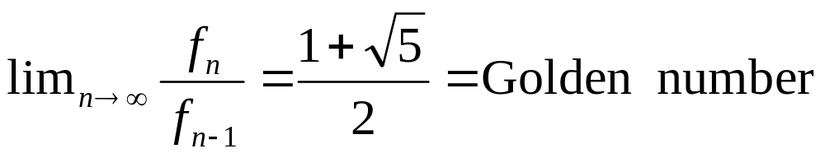
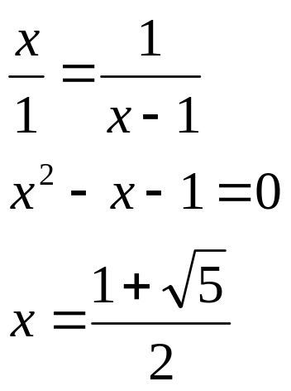
Fibonacci sequence and golden number
0,1,1,2,3,5,8,13,21,34,...
f_{n} = 0 if n = 0
f_{n} = 1 if n = 1
f_{n} = f_{n-1} + f_{n-2} if n ≥ 2
1
x-1
x

Slide 5
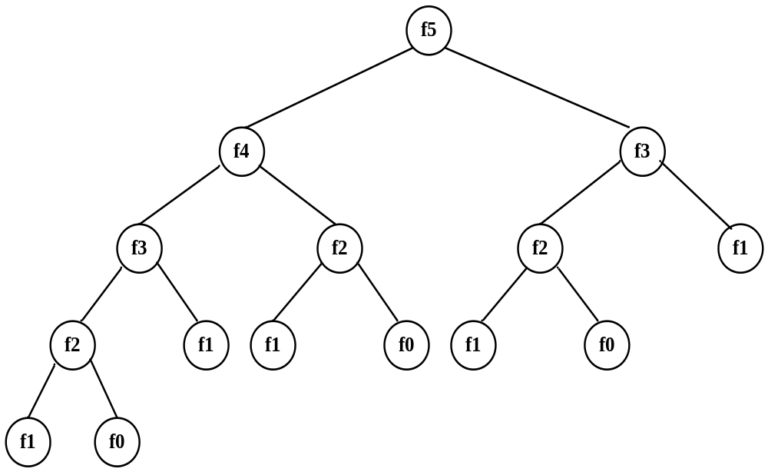
Computation of Fibonacci sequence
f_{n} = 0 if n = 0
f_{n} = 1 if n = 1
f_{n} = f_{n-1} + f_{n-2} if n ≥ 2
Solved by a recursive program:
Much replicated computation is done.
It should be solved by a simple loop.

Slide 6
Dynamic Programming
Dynamic Programming is an algorithm design method that can be used when the solution to a problem may be viewed as the result of a sequence of decisions

Slide 7
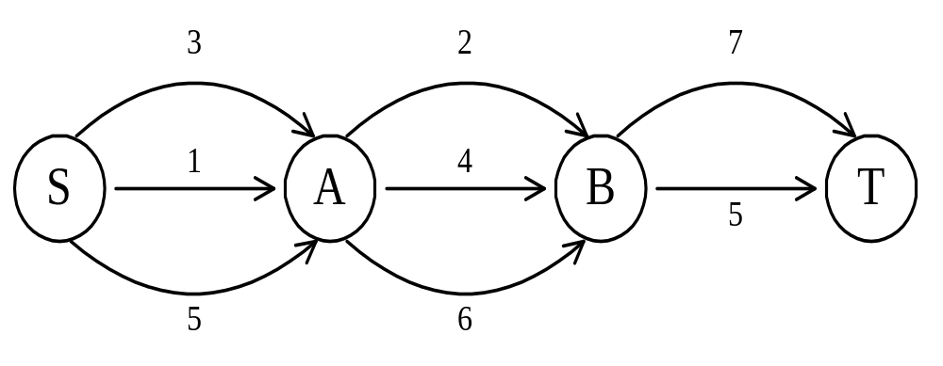
The shortest path
To find a shortest path in a multi-stage graph
Apply the greedy method :
the shortest path from S to T :
1 + 2 + 5 = 8

Slide 8
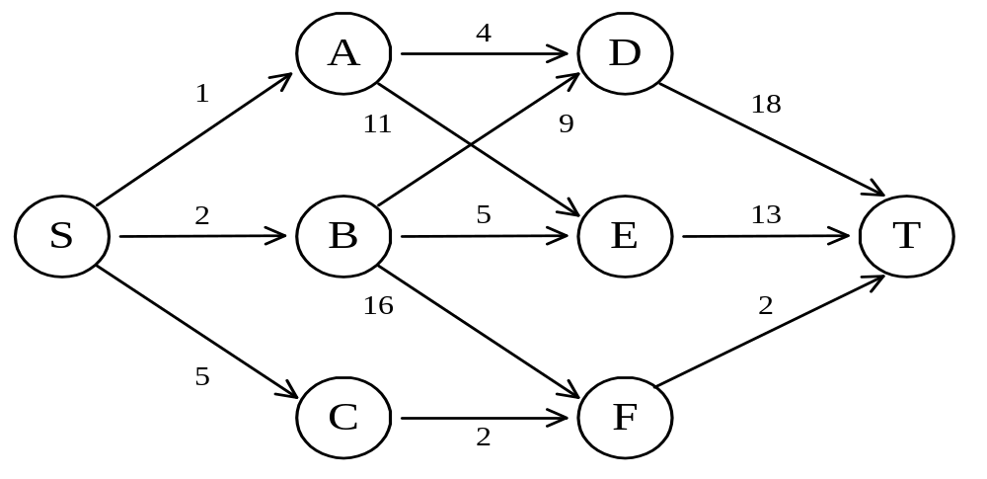
The shortest path in multistage graphs
e.g.
The greedy method can not be applied to this case: (S, A, D, T) 1+4+18 = 23.
The real shortest path is:
(S, C, F, T) 5+2+2 = 9.

Slide 9
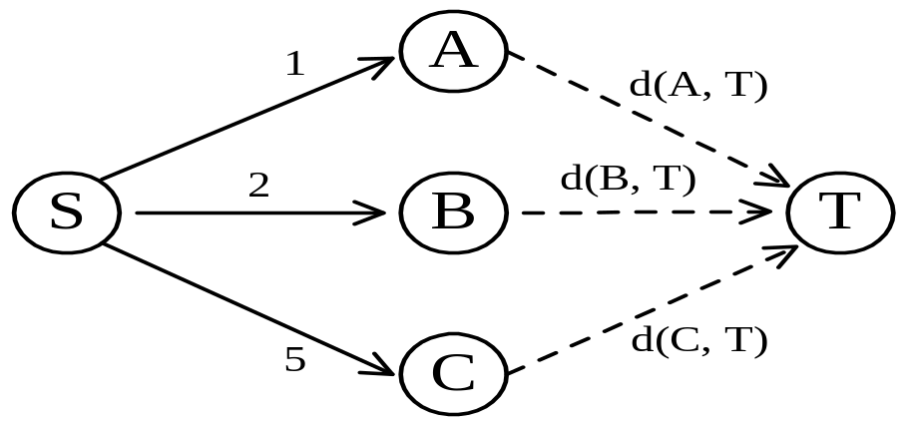
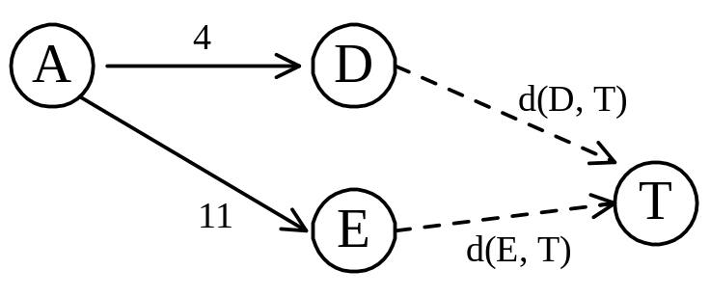
Dynamic programming approach
Dynamic programming approach (forward approach):
d(S, T) = min{1+d(A, T), 2+d(B, T), 5+d(C, T)}
d(A,T) = min{4+d(D,T), 11+d(E,T)}
= min{4+18, 11+13} = 22.

Slide 10
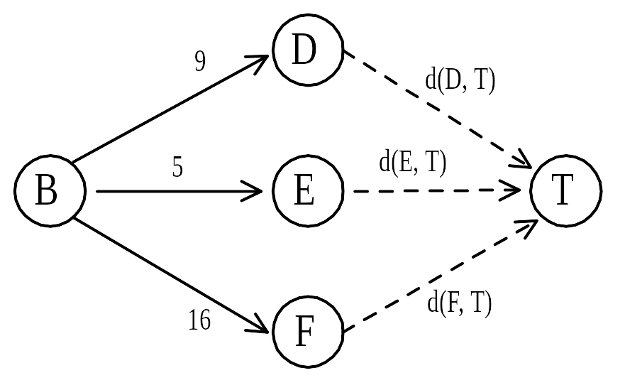
d(B, T) = min{9+d(D, T), 5+d(E, T), 16+d(F, T)}
= min{9+18, 5+13, 16+2} = 18.
d(C, T) = min{ 2+d(F, T) } = 2+2 = 4
d(S, T) = min{1+d(A, T), 2+d(B, T), 5+d(C, T)}
= min{1+22, 2+18, 5+4} = 9.
The above way of reasoning is called
backward reasoning.

Slide 11
Backward approach
(forward reasoning)
d(S, A) = 1
d(S, B) = 2
d(S, C) = 5
d(S,D)=min{d(S,A)+d(A,D), d(S,B)+d(B,D)}
= min{ 1+4, 2+9 } = 5
d(S,E)=min{d(S,A)+d(A,E), d(S,B)+d(B,E)}
= min{ 1+11, 2+5 } = 7
d(S,F)=min{d(S,B)+d(B,F), d(S,C)+d(C,F)}
= min{ 2+16, 5+2 } = 7

Slide 12
d(S,T) = min{d(S, D)+d(D, T), d(S,E)+
d(E,T), d(S, F)+d(F, T)}
= min{ 5+18, 7+13, 7+2 }
= 9

Slide 13
Principle of optimality
Principle of optimality: Suppose that in solving a problem, we have to make a sequence of decisions D₁, D₂, …, D_{n}. If this sequence is optimal, then the last k decisions, 1 < k < n must be optimal.
e.g. the shortest path problem
If i, i₁, i₂, …, j is a shortest path from i to j, then i₁, i₂, …, j must be a shortest path from i₁ to j
In summary, if a problem can be described by a multistage graph, then it can be solved by dynamic programming.

Slide 14
Dynamic programming
Forward approach and backward approach:
  Note that if the recurrence relations are formulated using the forward approach then the relations are solved backwards . i.e., beginning with the last decision
  On the other hand if the relations are formulated using the backward approach, they are solved forwards.
To solve a problem by using dynamic programming:
  Find out the recurrence relations.
  Represent the problem by a multistage graph.

Slide 15
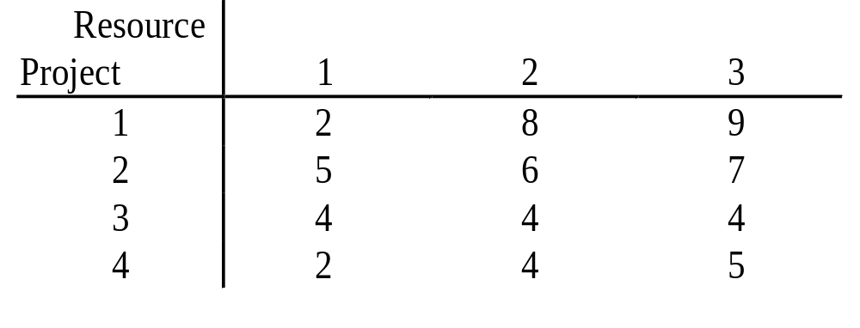
The resource allocation problem
m resources, n projects
profit P_{i, j} : j resources are allocated to project i.
maximize the total profit.

Slide 16
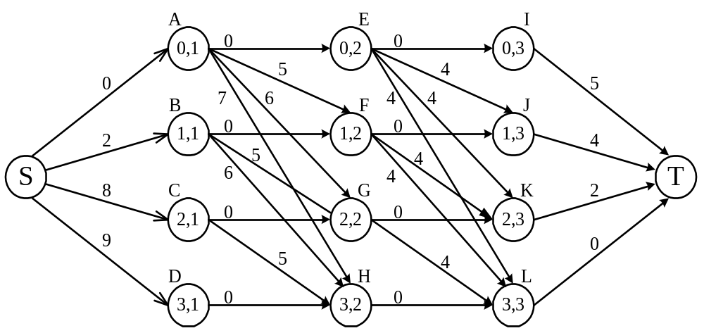
The multistage graph solution
The resource allocation problem can be described as a multistage graph.
(i, j) : i resources allocated to projects 1, 2, …, j
e.g. node H=(3, 2) : 3 resources allocated to projects 1, 2.

Slide 17
Find the longest path from S to T :
(S, C, H, L, T), 8+5+0+0=13
2 resources allocated to project 1.
1 resource allocated to project 2.
0 resource allocated to projects 3, 4.

Slide 18
The longest common subsequence (LCS) problem
A string : A = b a c a d
A subsequence of A: deleting 0 or more symbols from A (not necessarily consecutive).
e.g. ad, ac, bac, acad, bacad, bcd.
Common subsequences of A = b a c a d and
B = a c c b a d c b : ad, ac, bac, acad.
The longest common subsequence (LCS) of A and B:
a c a d.

Slide 19
The LCS algorithm
Let A = a₁ a₂ … a_{m} and B = b₁ b₂ … b_{n}
Let L_{i,j} denote the length of the longest common subsequence of a₁ a₂ … a_{i} and b₁ b₂ … b_{j.}
L_{i,j} = L_{i-1,j-1} + 1 if a_{i}=b_{j}
max{ L_{i-1,j}, L_{i,j-1} } if a_{i}≠b_{j}
L_{0,0} = L_{0,j} = L_{i,0} = 0 for 1≤i≤m, 1≤j≤n.

Slide 20
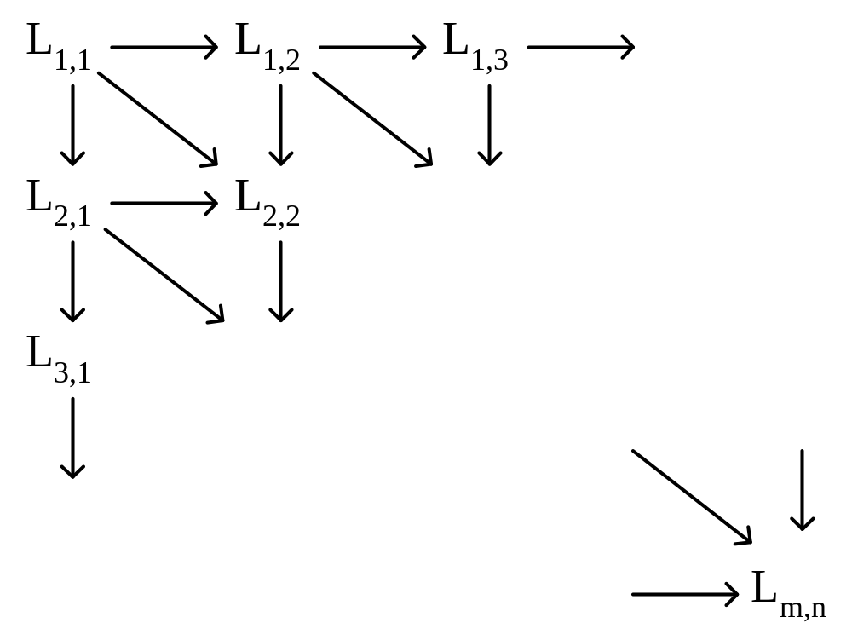
The dynamic programming approach for solving the LCS problem:
Time complexity: O(mn)

Slide 21
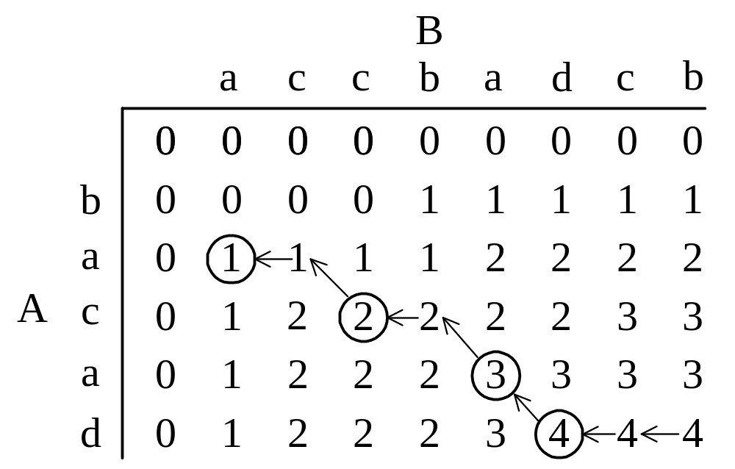
Tracing back in the LCS algorithm
e.g. A = b a c a d, B = a c c b a d c b
After all L_{i,j}’s have been found, we can trace back to find the longest common subsequence of A and B.

Slide 22
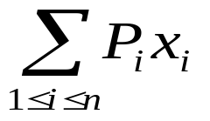
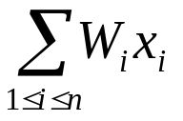
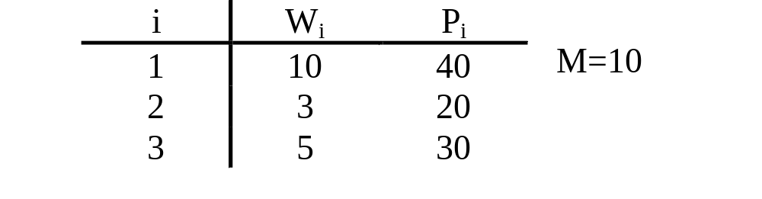
0/1 knapsack problem
n objects , weight W₁, W₂, …,W_{n}
profit P₁, P₂, …,P_{n}
capacity M
maximize
subject to ≤ M
x_{i} = 0 or 1, 1≤i≤n
e. g.

Slide 23
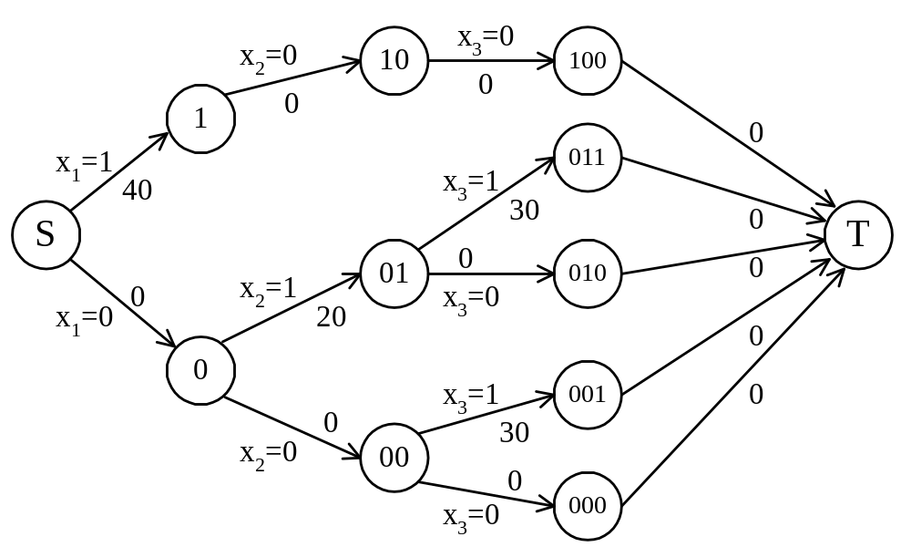
The multistage graph solution
The 0/1 knapsack problem can be described by a multistage graph.

Slide 24
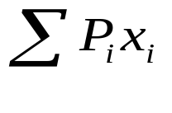
The dynamic programming approach
The longest path represents the optimal solution:
x₁=0, x₂=1, x₃=1
= 20+30 = 50
Let f_{i}(Q) be the value of an optimal solution to objects 1,2,3,…,i with capacity Q.
f_{i}(Q) = max{ f_{i-1}(Q), f_{i-1}(Q-W_{i})+P_{i} }
The optimal solution is f_{n}(M).

Slide 25
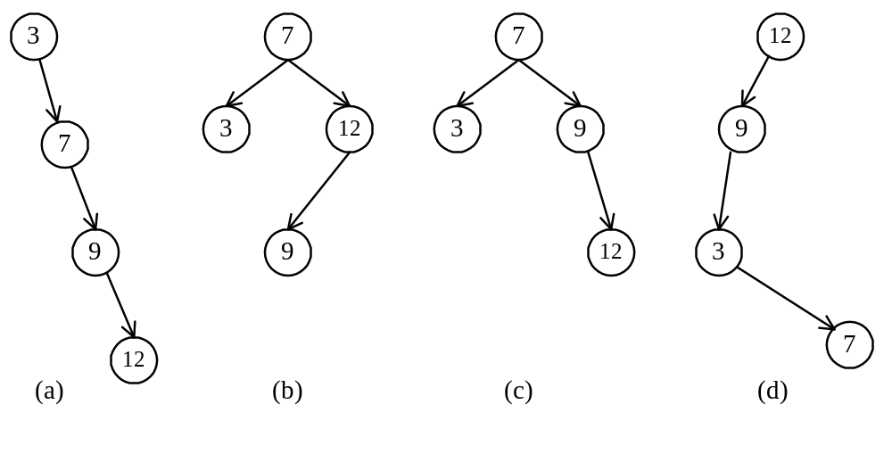
Optimal binary search trees
e.g. binary search trees for 3, 7, 9, 12;

Slide 26
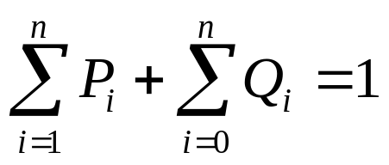
Optimal binary search trees
n identifiers : a₁ <a₂ <a₃ <…< a_{n}
P_{i}, 1≤i≤n : the probability that a_{i} is searched.
Q_{i}, 0≤i≤n : the probability that x is searched
where a_{i} < x < a_{i+1} (a₀=-∞, a_{n+1}=∞).

Slide 27
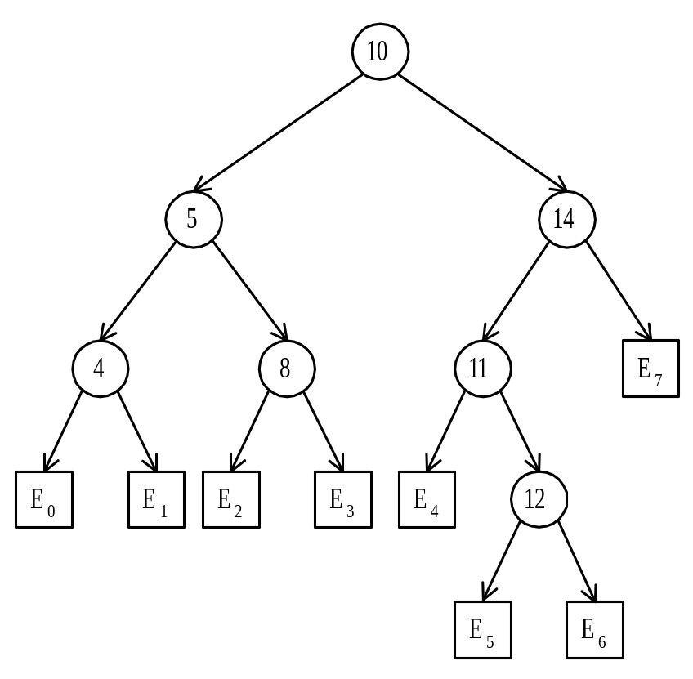
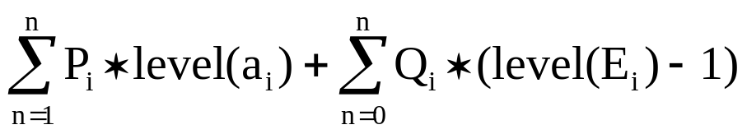
Identifiers : 4, 5, 8, 10, 11, 12, 14
Internal node : successful search, P_{i}
External node : unsuccessful search, Q_{i}
The expected cost of a binary tree:
The level of the root : 1

Slide 28
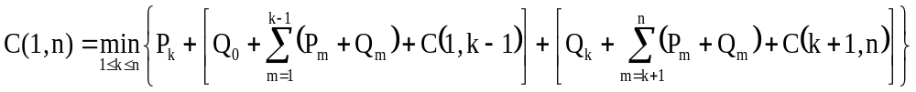
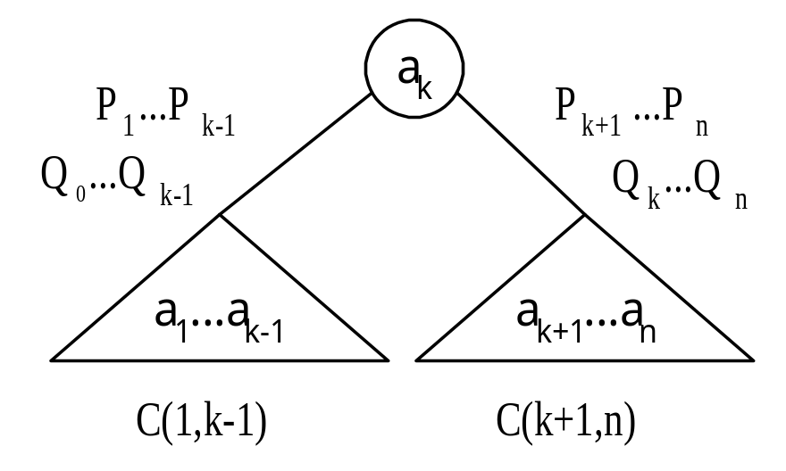
The dynamic programming approach
Let C(i, j) denote the cost of an optimal binary search tree containing a_{i},…,a_{j} .
The cost of the optimal binary search tree with a_{k} as its root :

Slide 29
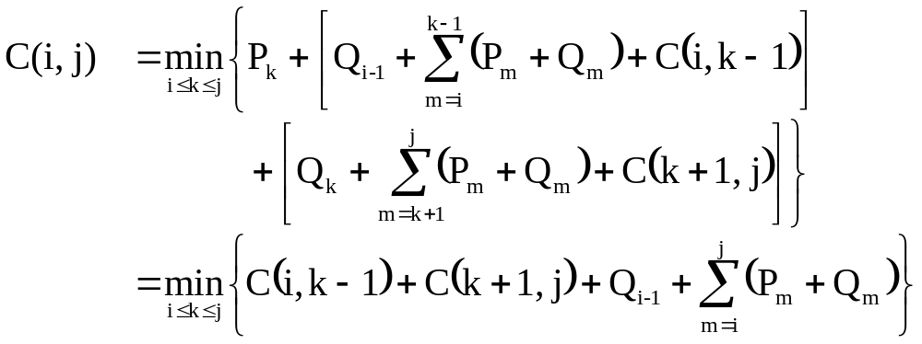
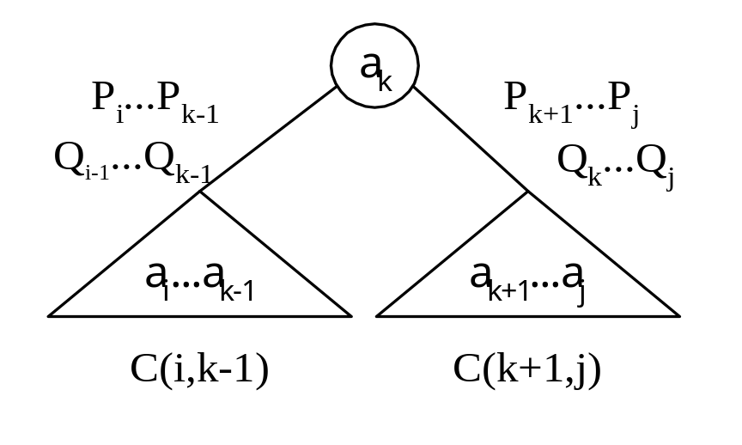
General formula

Slide 30
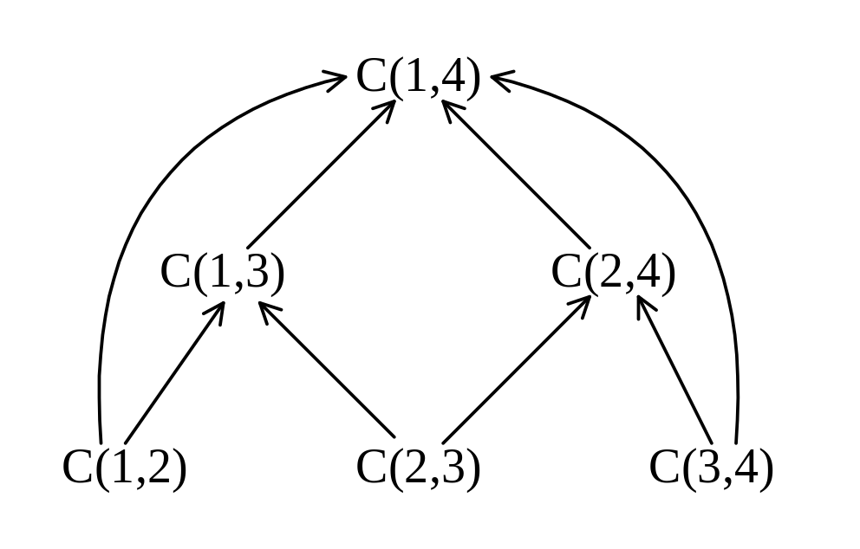
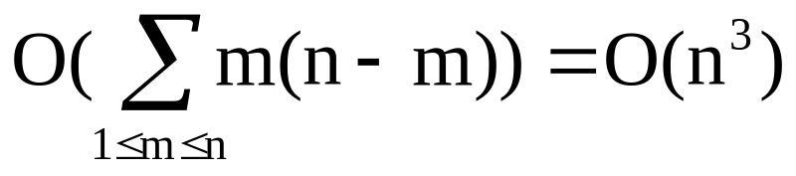
Computation relationships of subtrees
e.g. n=4
Time complexity : O(n³)
(n-m) C(i, j)’s are computed when j-i=m.
Each C(i, j) with j-i=m can be computed in O(m) time.

Slide 31
Matrix-chain multiplication
n matrices A₁, A₂, …, A_{n} with size
p₀ × p₁, p₁ × p₂, p₂ × p₃, …, p_{n-1} × p_{n}
To determine the multiplication order such that # of scalar multiplications is minimized.
To compute A_{i} × A_{i+1}, we need p_{i-1}p_{i}p_{i+1} scalar multiplications.
e.g. n=4, A₁: 3 × 5, A₂: 5 × 4, A₃: 4 × 2, A₄: 2 × 5
((A₁ × A₂) × A₃) × A₄, # of scalar multiplications:
3 * 5 * 4 + 3 * 4 * 2 + 3 * 2 * 5 = 114
(A₁ × (A₂ × A₃)) × A₄, # of scalar multiplications:
3 * 5 * 2 + 5 * 4 * 2 + 3 * 2 * 5 = 100
(A₁ × A₂) × (A₃ × A₄), # of scalar multiplications:
3 * 5 * 4 + 3 * 4 * 5 + 4 * 2 * 5 = 160

Slide 32
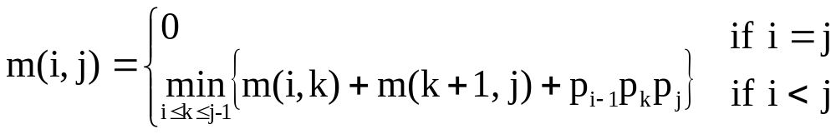
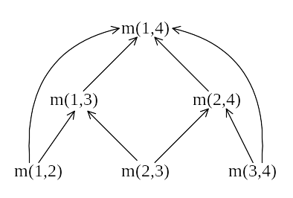
Let m(i, j) denote the minimum cost for computing
A_{i} × A_{i+1} × … × A_{j}
Computation sequence :
Time complexity : O(n³)

Slide 33
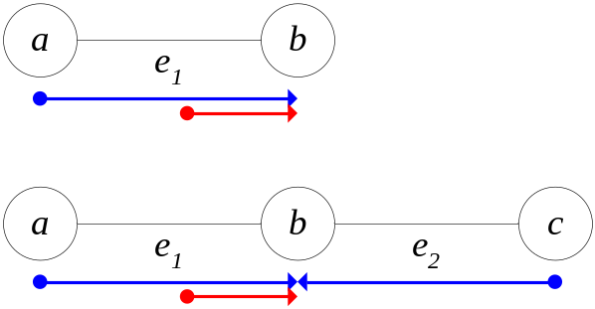
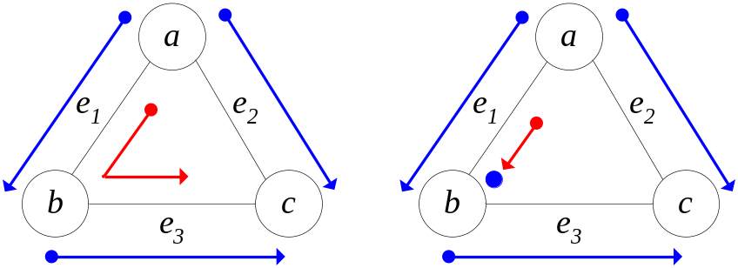
Single step graph edge searching
fugitive: can move in any speed and is hidden in some edge of an undirected graph G=(V,E)
edge searcher(guard): search an edge (u, v) from u to v, or stay at vertex u to prevent the fugitive passing through u
Goal: to capture the fugitive in one step.
no extra guards needed extra guards needed

Slide 34
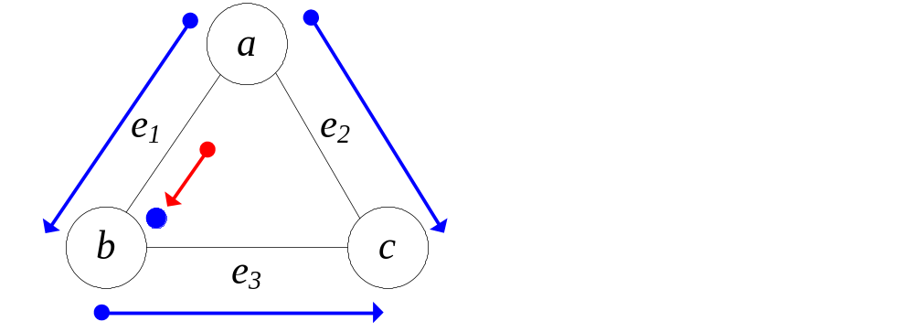
cost of a searcher from u to v: wt(u)
a guard staying at u: wt(u)
Cost of the following: 2wt(a)+wt(b)+wt(b)
(one extra guard stays at b)
Problem definition: To arrange the searchers with the minimal cost to capture the fugitive in one step.
NP-hard for general graphs; P for trees.

Slide 35
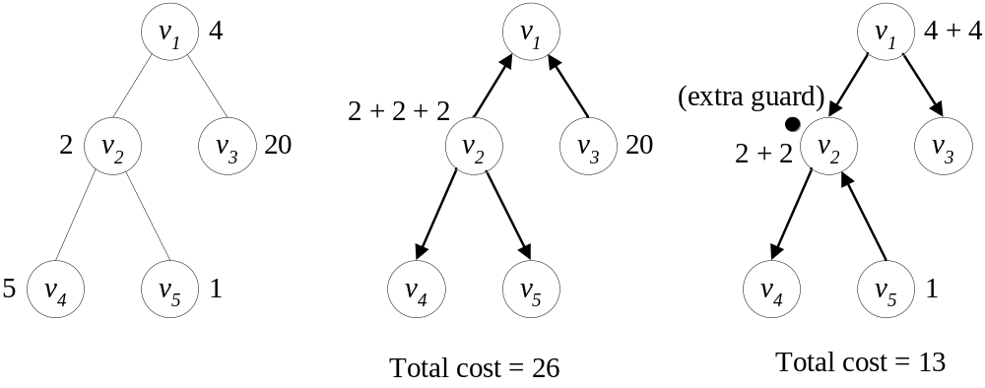
The weighted single step graph edge searching problem on trees
T(v_{i}): the tree includes v_{i} , v_{j} (parent of v_{i}) and all descendant nodes of v_{i}.
C(T(v_{i}), v_{i} , v_{j} ): cost of an optimal searching plan with searching from v_{i} to v_{j}.
C(T(v₄), v₄ , v₂ )=5 C(T(v₄), v₂ , v₄ )=2
C(T(v₂), v₂ , v₁ )=6 C(T(v₂), v₁ , v₂ )=9

Slide 36
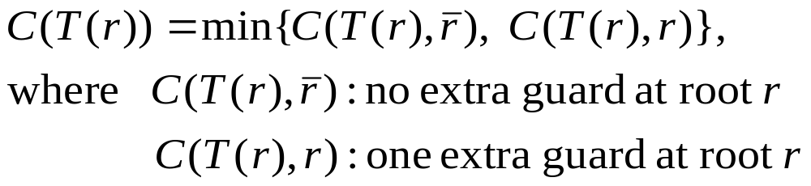
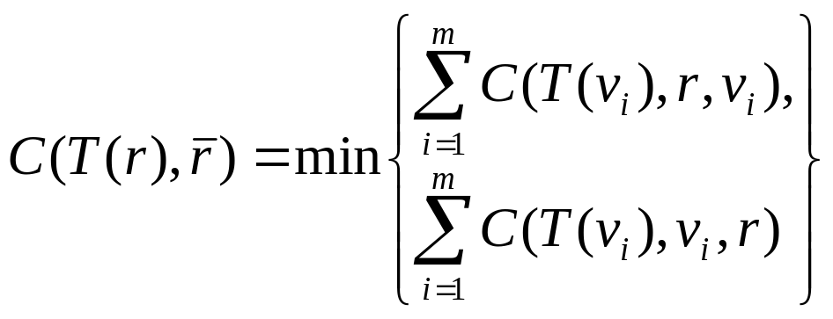
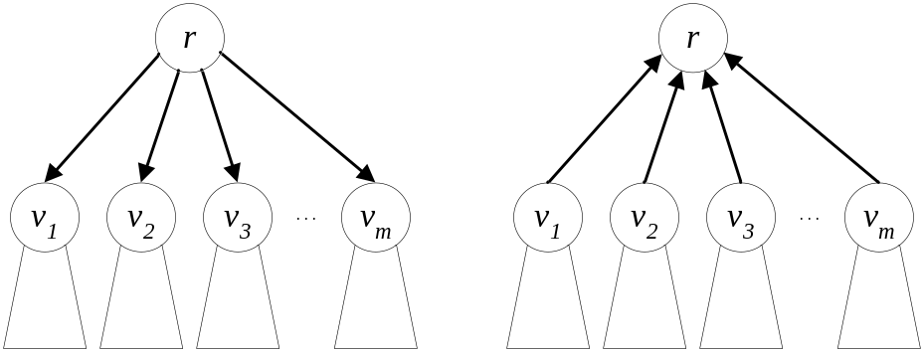
The dynamic programming approach
Rule 1: optimal total cost
Rule 2.1 : no extra guard at root r: All children must have the same searching direction.

Slide 37
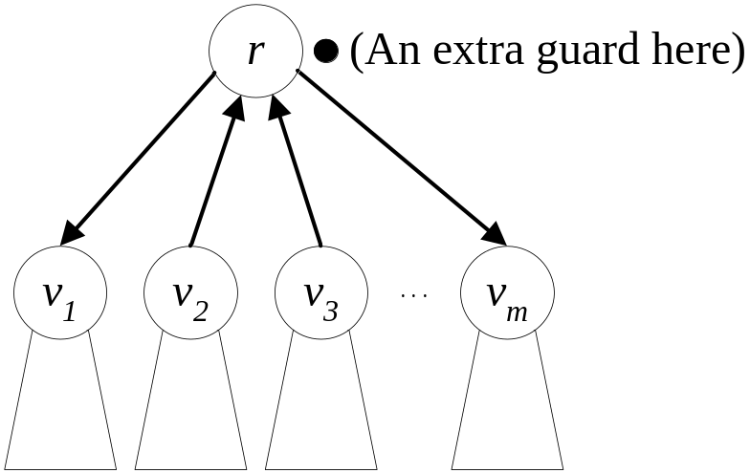
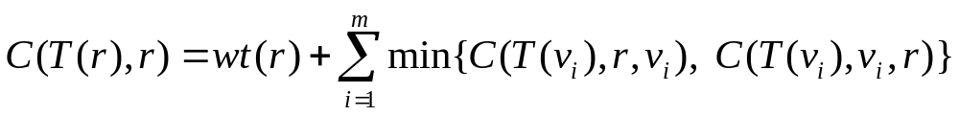
Rule 2.2: one extra guard at root r: Each child can choose its best direction independently.

Slide 38
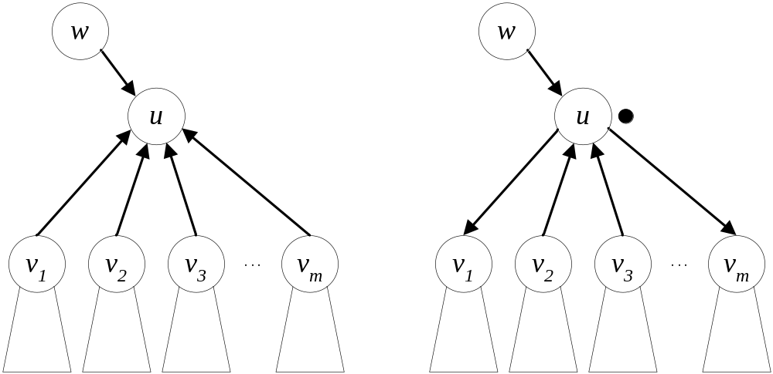
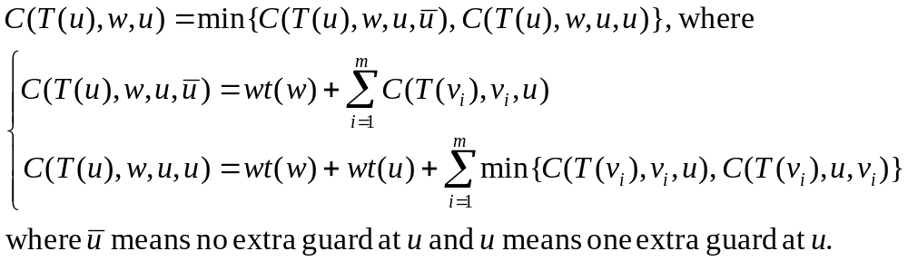
Rule 3.1 : Searching to an internal node u from its parent node w

Slide 39
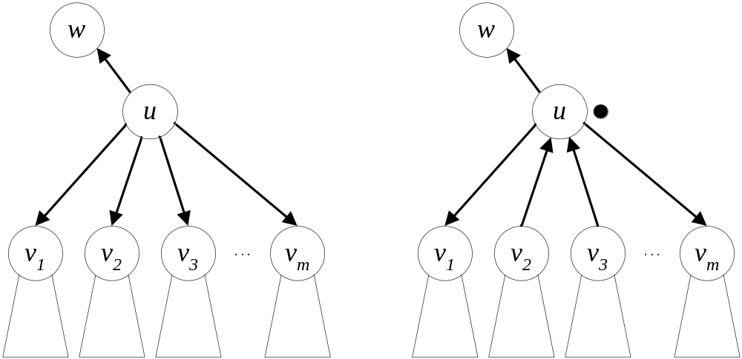
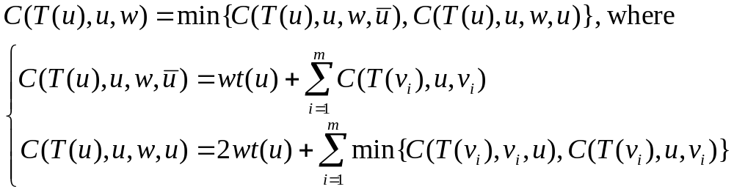
Rule 3.2 : Searching from an internal node u to its parent node w

Slide 40
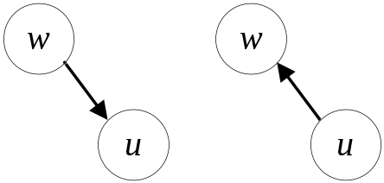
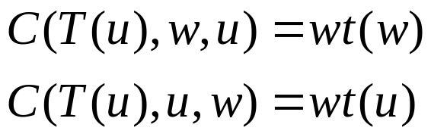
Rule 4: A leaf node u and its parent node w.
the dynamic programming approach: working from the leaf nodes and gradually towards the root
Time complexity : O(n)
computing minimal cost of each sub-tree and determining searching directions for each edge

