Slide 1
Chapter 8
The Theory of NP-Completeness
8- <number>

Slide 2
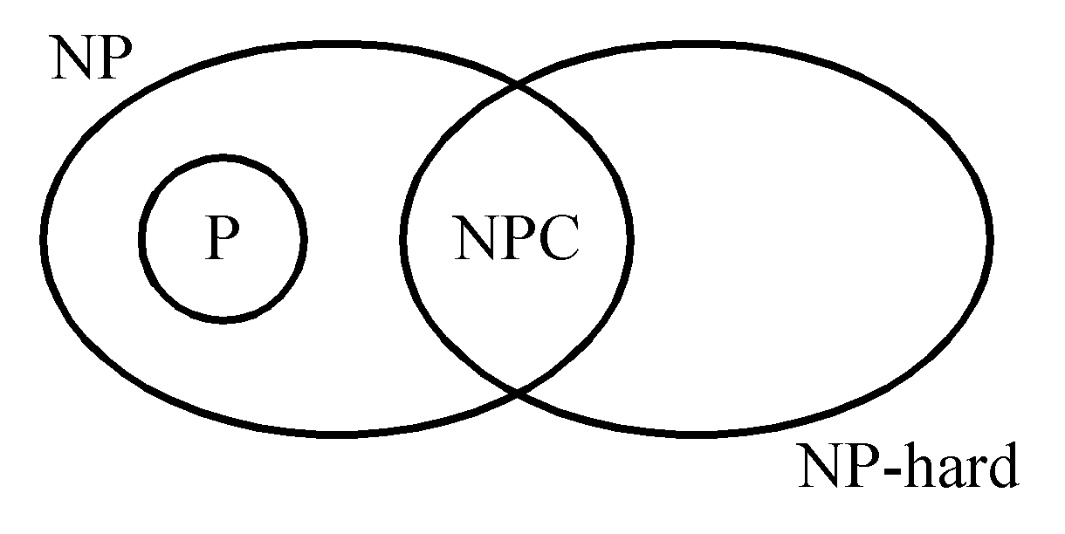
P: the class of problems which can be solved by a deterministic polynomial algorithm.
NP : the class of decision problem which can be solved by a non-deterministic polynomial algorithm.
NP-hard: the class of problems to which every NP problem reduces.
NP-complete (NPC): the class of problems which are NP-hard and belong to NP.
8- <number>

Slide 3
Some concepts of NPC
Definition of reduction: Problem A reduces to problem B (A ∝ B) iff A can be solved by a deterministic polynomial time algorithm using a deterministic algorithm that solves B in polynomial time.
Up to now, none of the NPC problems can be solved by a deterministic polynomial time algorithm in the worst case.
It does not seem to have any polynomial time algorithm to solve the NPC problems.
8- <number>

Slide 4
The theory of NP-completeness always considers the worst case.
The lower bound of any NPC problem seems to be in the order of an exponential function.
Not all NP problems are difficult. (e.g. the MST problem is an NP problem.)
If A, B ∈ NPC, then A ∝ B and B ∝ A.
Theory of NP-completeness:
If any NPC problem can be solved in polynomial time, then all NP problems can be solved in polynomial time. (NP = P)
8- <number>

Slide 5
Decision problems
The solution is simply “Yes” or “No”.
Optimization problems are more difficult.
e.g. the traveling salesperson problem
  Optimization version:
  Find the shortest tour
  Decision version:
  Is there a tour whose total length is less than or equal to a constant c ?
8- <number>

Slide 6
Solving an optimization problem by a decision algorithm :
Solving TSP optimization problem by a decision algorithm :
  Give c₁ and test (decision algorithm)
Give c₂ and test (decision algorithm)

Give c_{n} and test (decision algorithm)
  We can easily find the smallest c_{i}
8- <number>

Slide 7
The satisfiability problem
The satisfiability problem
  The logical formula :
x₁ v x₂ v x₃
& - x₁
& - x₂
  the assignment :
x₁ ← F , x₂ ← F , x₃ ← T
  will make the above formula true .
(-x₁, -x₂ , x₃) represents x₁ ← F , x₂ ← F , x₃ ← T
8- <number>

Slide 8
If there is at least one assignment which satisfies a formula, then we say that this formula is satisfiable; otherwise, it is unsatisfiable.
An unsatisfiable formula :
  x₁ v x₂
  & x₁ v -x₂
  & -x₁ v x₂
  & -x₁ v -x₂
8- <number>

Slide 9
Definition of the satisfiability problem: Given a Boolean formula, determine whether this formula is satisfiable or not.
A literal : x_{i} or -x_{i}
A clause : x₁ v x₂ v -x₃ ≡ C_{i}
A formula : conjunctive normal form (CNF)
C₁& C₂ & … & C_{m}
8- <number>

Slide 10
The resolution principle
Resolution principle
C₁ : x₁ v x₂
C₂ : -x₁ v x₃
⇒ C₃ : x₂ v x₃
From C₁ & C₂, we can obtain C₃, and C₃ can be added into the formula.
The formula becomes:
C₁ & C₂ & C₃
x₁ | x₂ | x₃ | C₁ & C₂ | C₃
0 | 0 | 0 | 0 | 0
0 | 0 | 1 | 0 | 1
0 | 1 | 0 | 1 | 1
0 | 1 | 1 | 1 | 1
1 | 0 | 0 | 0 | 0
1 | 0 | 1 | 1 | 1
1 | 1 | 0 | 0 | 1
1 | 1 | 1 | 1 | 1
8- <number>

Slide 11
Another example of resolution principle
C₁ : -x₁ v -x₂ v x₃
C₂ : x₁ v x₄
⇒ C₃ : -x₂ v x₃ v x₄
If no new clauses can be deduced, then it is satisfiable.
-x₁ v -x₂ v x₃ (1)
x₁ (2)
x₂ (3)
(1) & (2) -x₂ v x₃ (4)
(4) & (3) x₃ (5)
(1) & (3) -x₁ v x₃ (6)
8- <number>

Slide 12
If an empty clause is deduced, then it is unsatisfiable.
- x₁ v -x₂ v x₃ (1)
x₁ v -x₂ (2)
x₂ (3)
- x₃ (4)
⇓ deduce
(1) & (2) -x₂ v x₃ (5)
(4) & (5) -x₂ (6)
(6) & (3) □ (7)
8- <number>

Slide 13
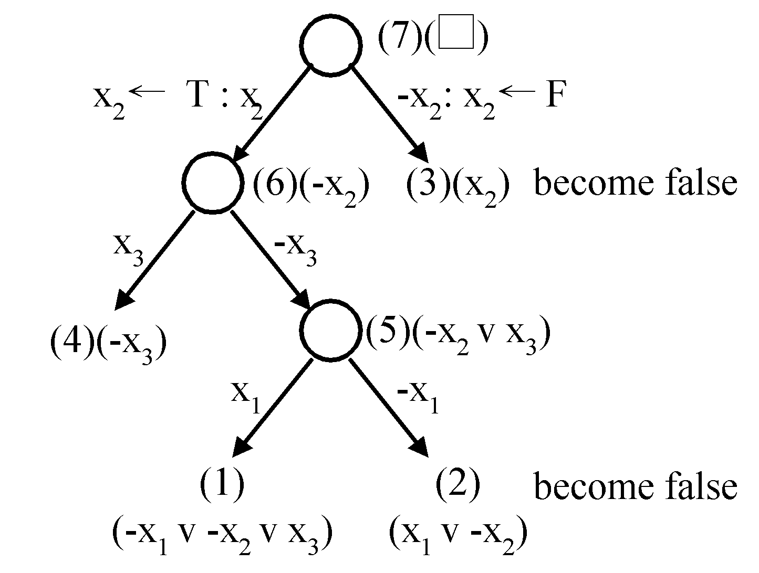
Semantic tree
In a semantic tree, each path from the root to a leaf node represents a class of assignments.
If each leaf node is attached with a clause, then it is unsatisfiable.
- x₁ v -x₂ v x₃ (1)
x₁ v -x₂ (2)
x₂ (3)
- x₃ (4)
8- <number>

Slide 14
Nondeterministic algorithms
A nondeterminstic algorithm consists of
phase 1: guessing
phase 2: checking
If the checking stage of a nondeterministic algorithm is of polynomial time-complexity, then this algorithm is called an NP (nondeterministic polynomial) algorithm.
NP problems : (must be decision problems)
  e.g. searching, MST
    sorting
    satisfiability problem (SAT)
    traveling salesperson problem (TSP)
8- <number>

Slide 15
Decision problems
Decision version of sorting:
Given a₁, a₂,…, a_{n} and c, is there a permutation of a_{i}′s ( a₁′, a₂′ , … ,a_{n}′ ) such that∣a₂′–a₁′∣+∣a₃′–a₂′∣+ … +∣a_{n}′–a_{n-1}′∣＜ c ?
Not all decision problems are NP problems
  E.g. halting problem :
    Given a program with a certain input data, will the program terminate or not?
    NP-hard
    Undecidable
8- <number>

Slide 16
Nondeterministic operations and functions
[Horowitz 1998]
Choice(S) : arbitrarily chooses one of the elements in set S
Failure : an unsuccessful completion
Success : a successful completion
Nonderministic searching algorithm:
j ← choice(1 : n) /* guessing */
if A(j) = x then success /* checking */
else failure
8- <number>

Slide 17
A nondeterministic algorithm terminates unsuccessfully iff there does not exist a set of choices leading to a success signal.
The time required for choice(1 : n) is O(1).
A deterministic interpretation of a non-deterministic algorithm can be made by allowing unbounded parallelism in computation.
8- <number>

Slide 18
Nondeterministic sorting
B ← 0
/* guessing */
for i = 1 to n do
j ← choice(1 : n)
if B[j] ≠ 0 then failure
B[j] = A[i]
/* checking */
for i = 1 to n-1 do
if B[i] > B[i+1] then failure
success
8- <number>

Slide 19
Nondeterministic SAT
/* guessing */
for i = 1 to n do
x_{i} ← choice( true, false )
/* checking */
if E(x₁, x₂, … ,x_{n}) is true then success
else failure
8- <number>

Slide 20
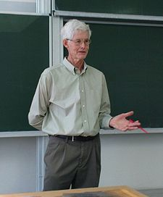
Cook’s theorem
NP = P iff the satisfiability problem is a P problem.
SAT is NP-complete.
It is the first NP-complete problem.
Every NP problem reduces to SAT.
Stephen Arthur Cook
(1939~)
8- <number>

Slide 21
Transforming searching to SAT
Does there exist a number in { x(1), x(2), …, x(n) }, which is equal to 7?
Assume n = 2.
nondeterministic algorithm:
i = choice(1,2)
if x(i)=7 then SUCCESS
else FAILURE
8- <number>

Slide 22
  i=1 v i=2
  & i=1 → i≠2
  & i=2 → i≠1
  & x(1)=7 & i=1 → SUCCESS
  & x(2)=7 & i=2 → SUCCESS
  & x(1)≠7 & i=1 → FAILURE
  & x(2)≠7 & i=2 → FAILURE
  & FAILURE → -SUCCESS
  & SUCCESS (Guarantees a successful termination)
  & x(1)=7 (Input Data)
  & x(2)≠7
8- <number>

Slide 23
CNF (conjunctive normal form) :
  i=1 v i=2 (1)
  i≠1 v i≠2 (2)
  x(1)≠7 v i≠1 v SUCCESS (3)
  x(2)≠7 v i≠2 v SUCCESS (4)
  x(1)=7 v i≠1 v FAILURE (5)
  x(2)=7 v i≠2 v FAILURE (6)
  -FAILURE v -SUCCESS (7)
  SUCCESS (8)
  x(1)=7 (9)
  x(2)≠7 (10)
8- <number>

Slide 24
Satisfiable at the following assignment :
  i=1 satisfying (1)
  i≠2 satisfying (2), (4) and (6)
  SUCCESS satisfying (3), (4) and (8)
  −FAILURE satisfying (7)
  x(1)=7 satisfying (5) and (9)
  x(2)≠7 satisfying (4) and (10)
8- <number>

Slide 25
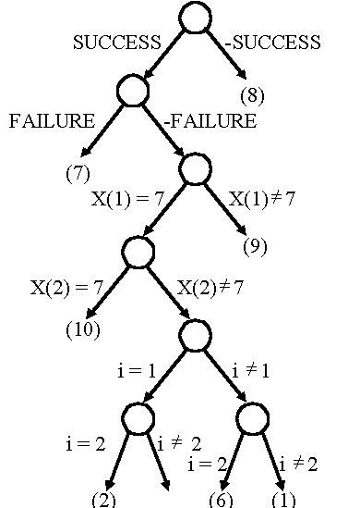
The semantic tree
  i=1 v i=2 (1)
  i≠1 v i≠2 (2)
  x(1)≠7 v i≠1 v SUCCESS (3)
  x(2)≠7 v i≠2 v SUCCESS (4)
  x(1)=7 v i≠1 v FAILURE (5)
  x(2)=7 v i≠2 v FAILURE (6)
  -FAILURE v -SUCCESS (7)
  SUCCESS (8)
  x(1)=7 (9)
  x(2)≠7 (10)
8- <number>

Slide 26
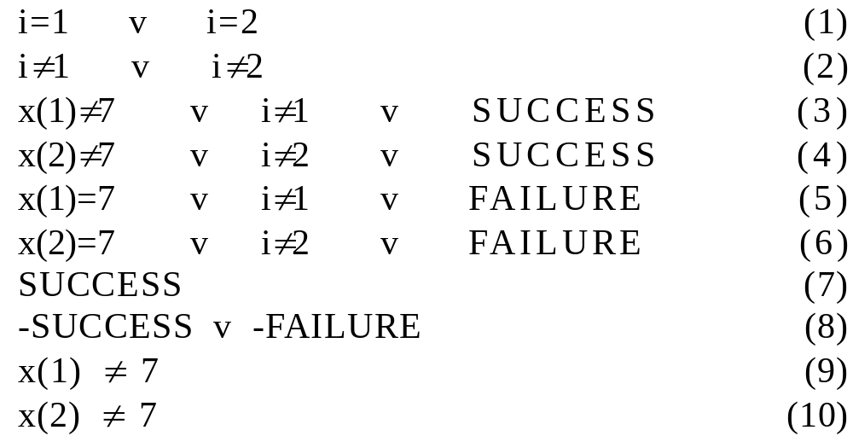
Searching for 7, but x(1)≠7, x(2)≠7
CNF (conjunctive normal form) :
8- <number>

Slide 27
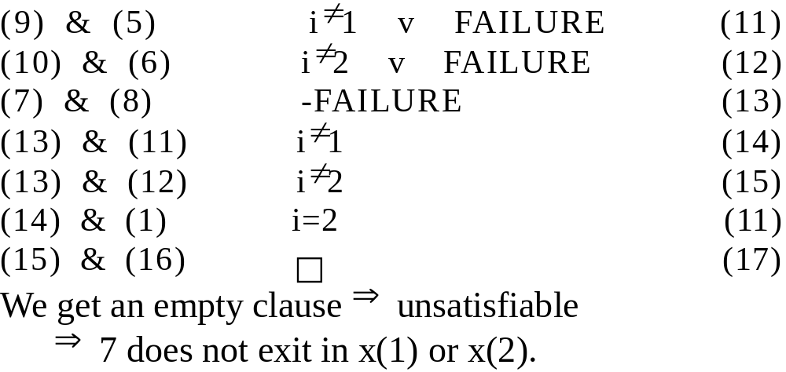
Apply resolution principle :
8- <number>

Slide 28
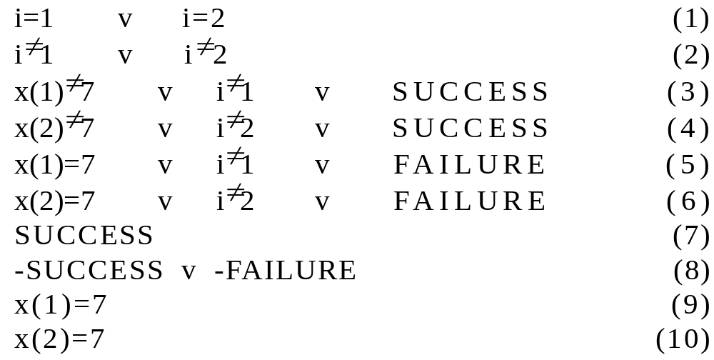
Searching for 7, where x(1)=7, x(2)=7
CNF:
8- <number>

Slide 29
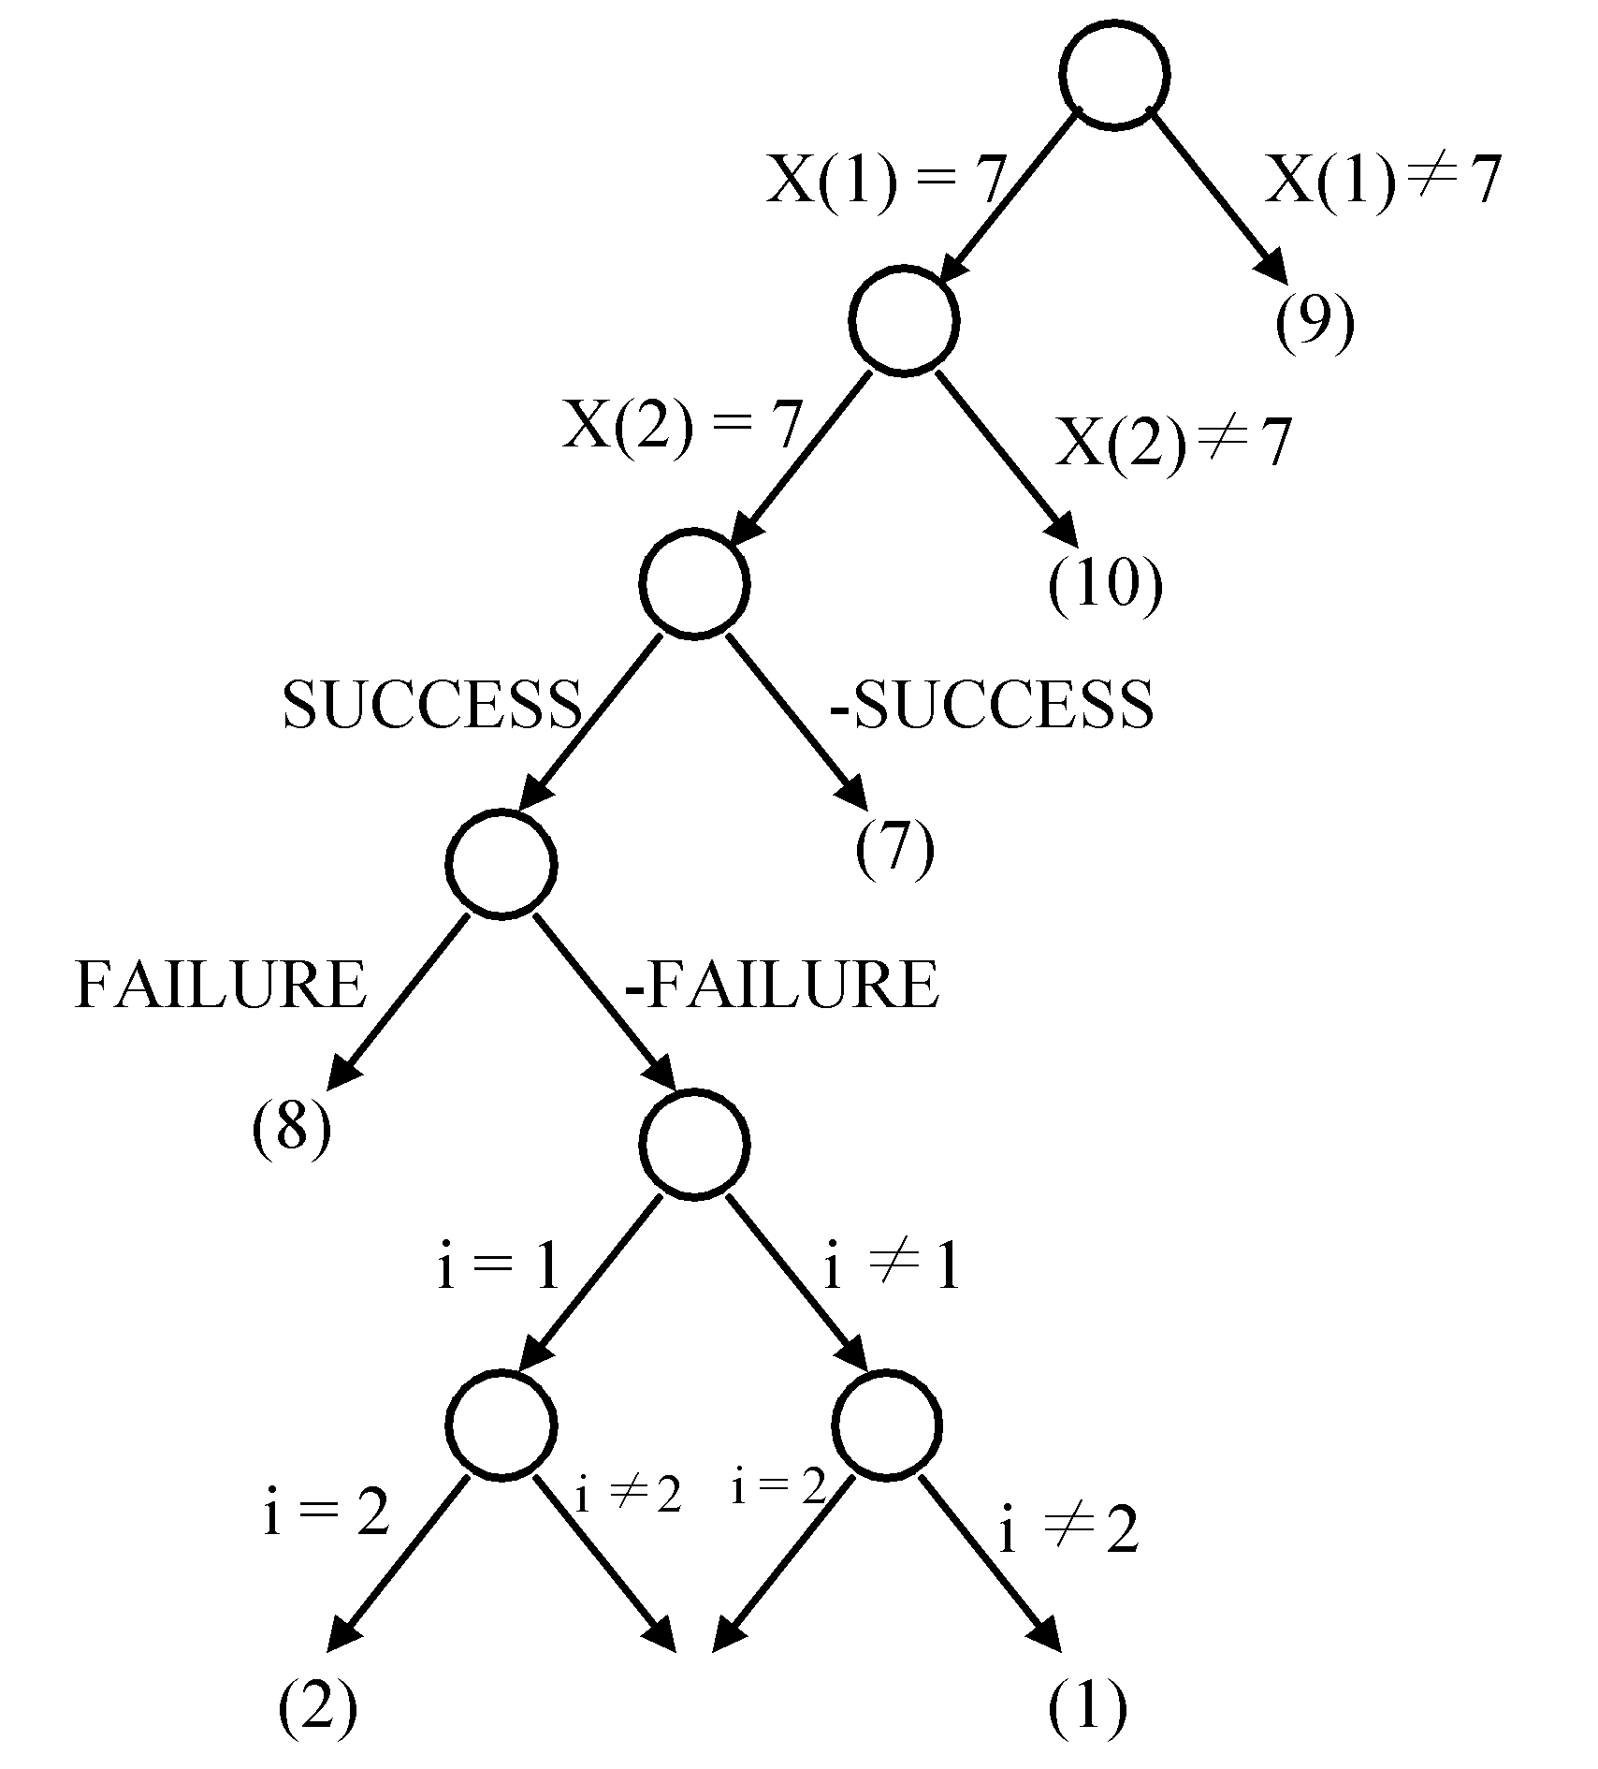
The semantic tree
It implies that both assignments (i=1, i=2) satisfy the clauses.
8- <number>

Slide 30
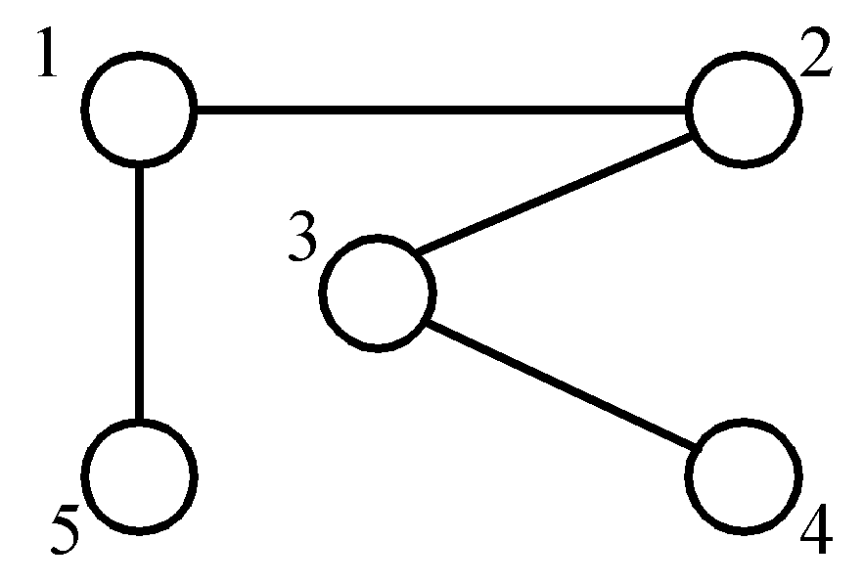
The node cover problem
Def: Given a graph G=(V, E), S is the node cover if S ⊆ V and for every edge (u, v) ∈ E, either u ∈ S or v ∈ S.
node cover :
{1, 3}
{5, 2, 4}
Decision problem : ∃ S ∋ | S | ≤ K ?
8- <number>

Slide 31
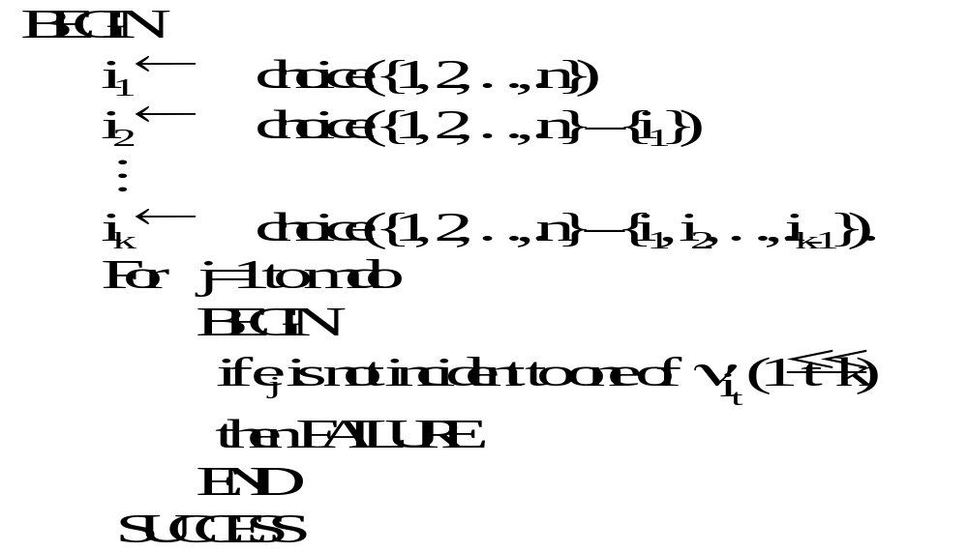
Transforming the node cover problem to SAT
8- <number>

Slide 32
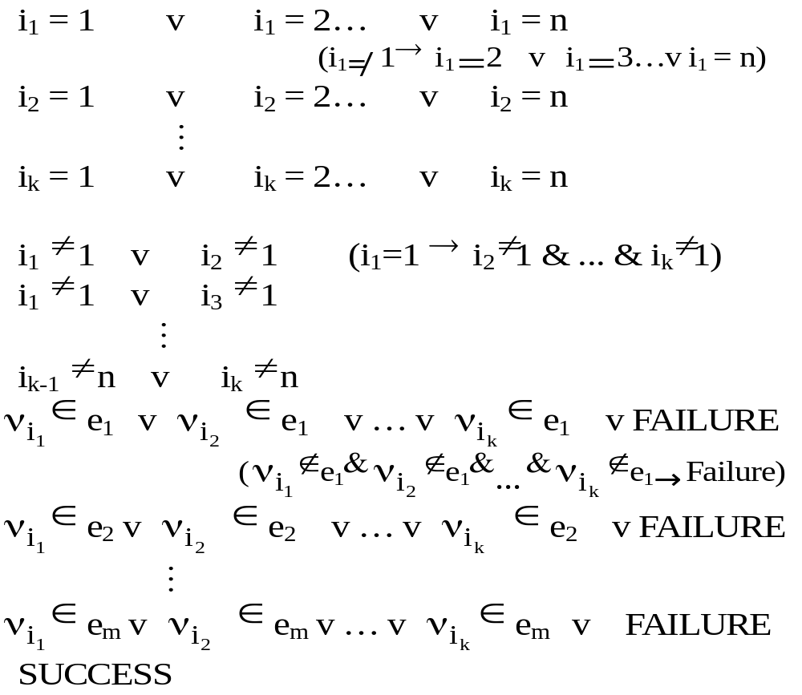
CNF:
(To be continued)
8- <number>

Slide 33
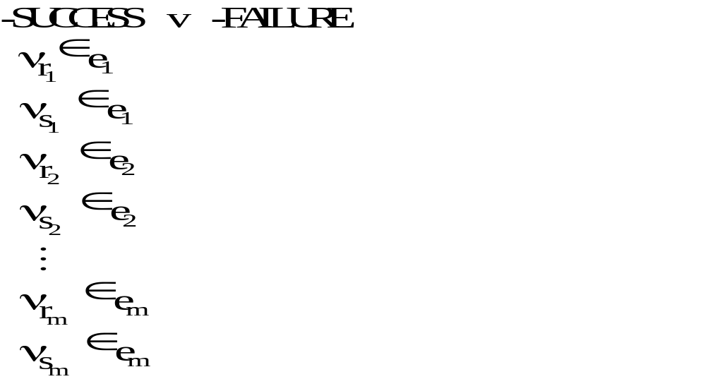
8- <number>

Slide 34
SAT is NP-complete
(1) SAT has an NP algorithm.
(2) SAT is NP-hard:
  Every NP algorithm for problem A can be transformed in polynomial time to SAT [Horowitz 1998] such that SAT is satisfiable if and only if the answer for A is “YES”.
  That is, every NP problem ∝ SAT .
By (1) and (2), SAT is NP-complete.
8- <number>

Slide 35
Proof of NP-Completeness
To show that A is NP-complete
(I) Prove that A is an NP problem.
(II) Prove that ∃ B ∈ NPC, B ∝ A.
⇒ A ∈ NPC
Why ?
8- <number>

Slide 36
3-satisfiability problem (3-SAT)
Def: Each clause contains exactly three literals.
(I) 3-SAT is an NP problem (obviously)
(II) SAT ∝ 3-SAT
Proof:
  (1) One literal L₁ in a clause in SAT :
    in 3-SAT :
L₁ v y₁ v y₂
L₁ v -y₁ v y₂
L₁ v y₁ v -y₂
L₁ v -y₁ v -y₂
8- <number>

Slide 37
  (2) Two literals L₁, L₂ in a clause in SAT :
  in 3-SAT :
  L₁ v L₂ v y₁
  L₁ v L₂ v -y₁
  (3) Three literals in a clause : remain unchanged.
  (4) More than 3 literals L₁, L₂, …, L_{k} in a clause :
  in 3-SAT :
  L₁ v L₂ v y₁
  L₃ v -y₁ v y₂
  
  L_{k-2} v -y_{k-4} v y_{k-3}
  L_{k-1} v L_{k} v -y_{k-3}
8- <number>

Slide 38
Example of transforming SAT to 3-SAT
An instance S in SAT :
x₁ v x₂
-x₃
x₁ v -x₂ v x₃ v -x₄ v x₅ v x₆
The instance S′ in 3-SAT :
  x₁ v x₂ v y₁
  x₁ v x₂ v -y₁
  -x₃ v y₂ v y₃
  -x₃ v -y₂ v y₃
  -x₃ v y₂ v -y₃
  -x₃ v -y₂ v -y₃
  x₁ v -x₂ v y₄
  x₃ v -y₄ v y₅
  -x₄ v -y₅ v y₆
  x₅ v x₆ v -y₆
SAT ^{transform} 3-SAT
S S′
8- <number>

Slide 39
  Proof : S is satisfiable ⇔ S′ is satisfiable
  “⇒”
  ≤ 3 literals in S (trivial)
  consider ≥ 4 literals
  S : L₁ v L₂ v … v L_{k}
  S′: L₁ v L₂ v y₁
  L₃ v -y₁ v y₂
  L₄ v -y₂ v y₃
  
  L_{k-2} v -y_{k-4} v y_{k-3}
  L_{k-1} v L_{k} v -y_{k-3}
8- <number>

Slide 40
  S is satisfiable ⇒ at least L_{i} = T
  Assume : L_{j} = F ∀ j ≠ i
  assign : y_{i-1} = F
  y_{j} = T ∀ j < i-1
  y_{j} = F ∀ j > i-1
  ( L_{i} v -y_{i-2} v y_{i-1} )
  ⇒ S′ is satisfiable.
  “⇐”
  If S′ is satisfiable, then assignment satisfying
  S′ can not contain y_{i}’s only.
  ⇒ at least one L_{i} must be true.
  (We can also apply the resolution principle).
Thus, 3-SAT is NP-complete.
8- <number>

Slide 41
Comment for 3-SAT
If a problem is NP-complete, its special cases may or may not be NP-complete.
8- <number>

Slide 42
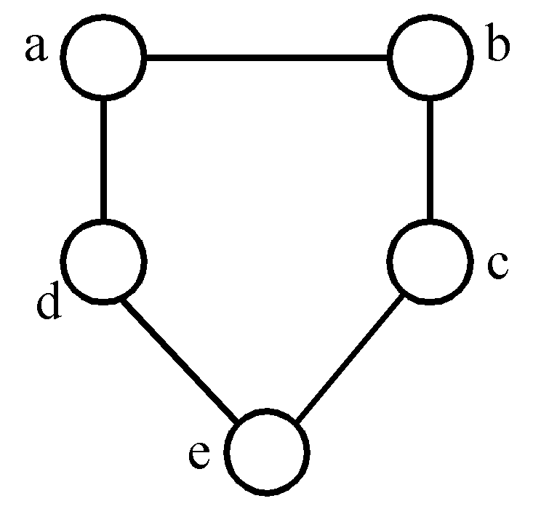
Chromatic number decision problem (CN)
Def: A coloring of a graph G=(V, E) is a function
f : V → { 1, 2, 3,…, k } such that if (u, v) ∈ E, then f(u)≠f(v). The CN problem is to determine if G has a coloring for k.
<Theorem> Satisfiability with at most 3 literals per clause (SATY) ∝ CN.
3-colorable
f(a)=1, f(b)=2, f(c)=1
f(d)=2, f(e)=3
8- <number>

Slide 43
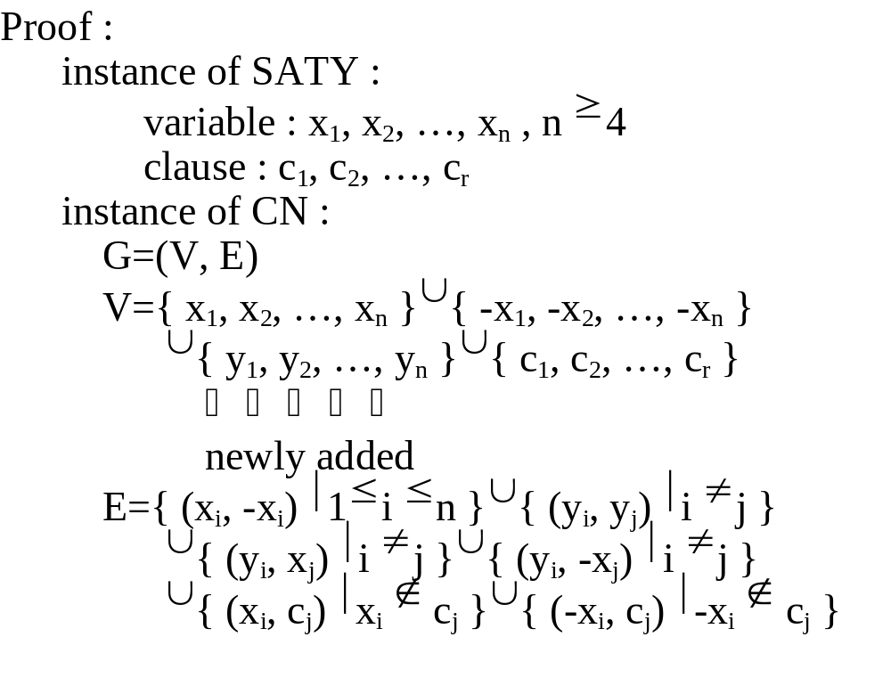
SATY ∝ CN
8- <number>

Slide 44
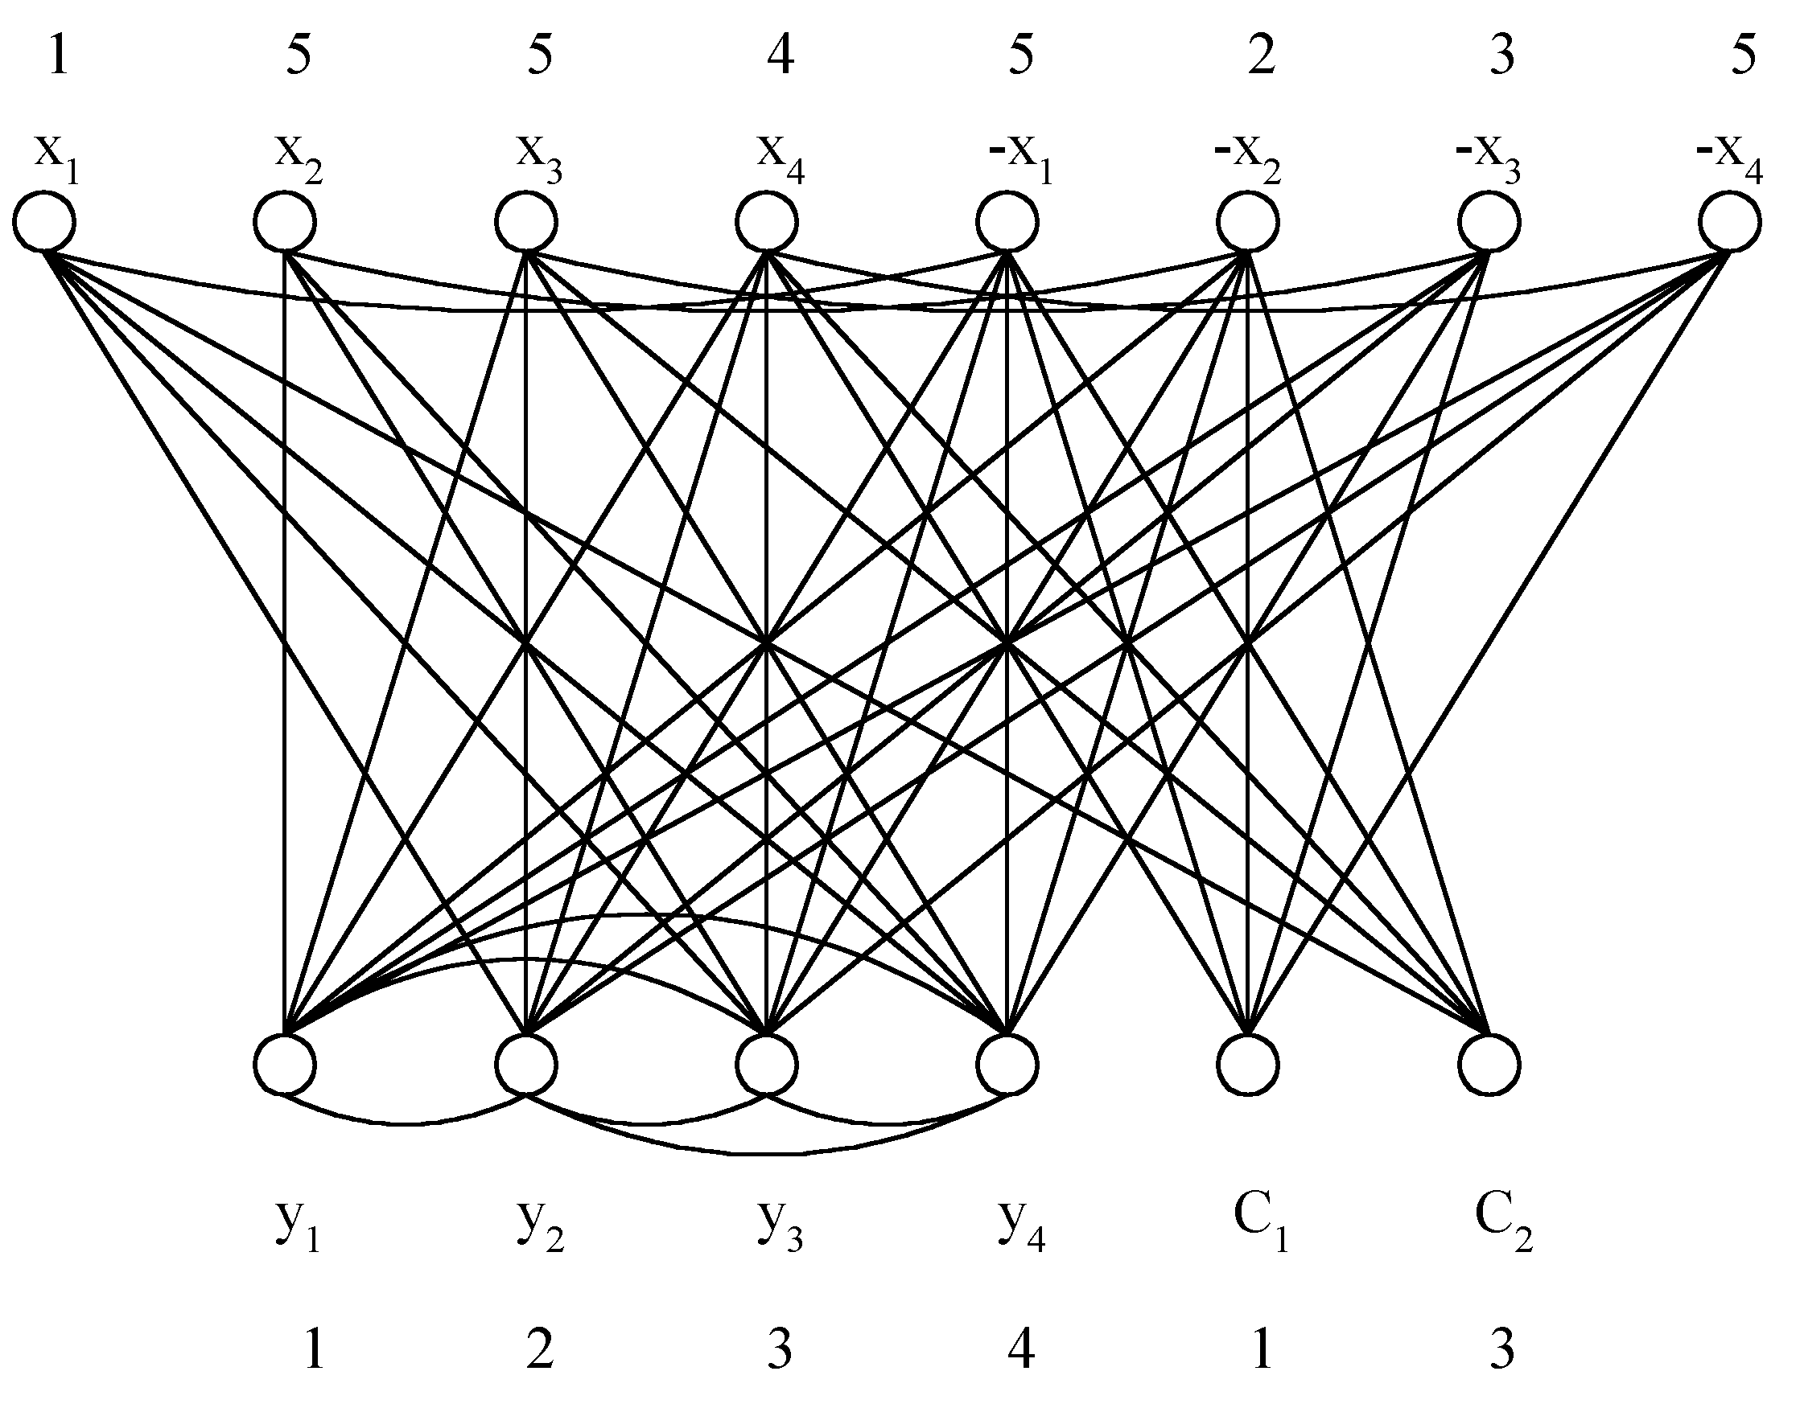
Example of SATY ∝ CN
x₁ v x₂ v x₃ (1)
-x₃ v -x₄ v x₂ (2)
⇓
True assignment:
x₁=T
x₂=F
x₃=F
x₄=T
E={ (x_{i}, -x_{i}) | 1≤ i ≤ n }∪{ (y_{i}, y_{j}) | i ≠ j }
∪{ (y_{i}, x_{j}) | i ≠ j }∪{ (y_{i}, -x_{j}) | i ≠ j }
∪{ (x_{i}, c_{j}) | x_{i} ∉ c_{j} }∪{ (-x_{i}, c_{j}) | -x_{i} ∉ c_{j} }
8- <number>

Slide 45
Proof of SATY ∝ CN
Satisfiable ⇔ n+1 colorable
  “⇒”
  (1) f(y_{i}) = i
  (2) if x_{i} = T, then f(x_{i}) = i, f(-x_{i}) = n+1
  else f(x_{i}) = n+1, f(-x_{i}) = i
  (3)if x_{i} in c_{j} and x_{i} = T, then f(c_{j}) = f(x_{i})
  if -x_{i} in c_{j} and -x_{i} = T, then f(c_{j}) = f(-x_{i})
  ( at least one such x_{i} )
8- <number>

Slide 46
“⇐”
  (1) y_{i} must be assigned with color i.
  (2) f(x_{i}) ≠ f(-x_{i})
  either f(x_{i}) = i and f(-x_{i}) = n+1
  or f(x_{i}) = n+1 and f(-x_{i}) = i
  (3) at most 3 literals in c_{j} and n ≥ 4
  ⇒ at least one x_{i}, ∋ x_{i} and -x_{i} are not in c_{j}
  ⇒ f(c_{j}) ≠ n+1
  (4) if f(c_{j}) = i = f(x_{i}), assign x_{i} to T
  if f(c_{j}) = i = f(-x_{i}), assign -x_{i} to T
  (5) if f(c_{j}) = i = f(x_{i}) ⇒ (c_{j}, x_{i}) ∉ E
  ⇒ x_{i} in c_{j} ⇒ c_{j} is true
  if f(c_{j}) = i = f(-x_{i}) ⇒ similarly
8- <number>

Slide 47
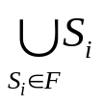
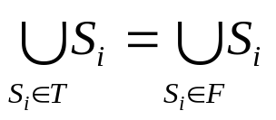
Set cover decision problem
Def: F = {S_{i}} = { S₁, S₂, …, S_{k} }
= { u₁, u₂, …, u_{n} }
T is a set cover of F if T ⊆ F and
The set cover decision problem is to determine if F has a cover T containing no more than c sets.
Example
F = {(u₁, u₃), (u₂, u₄), (u₂, u₃), (u₄), (u₁, u₃ , u₄)}
s₁ s₂ s₃ s₄ s₅
T = { s₁, s₃, s₄ } set cover
T = { s₁, s₂ } set cover, exact cover
8- <number>

Slide 48
Exact cover problem
(Notations same as those in set cover.)
Def: To determine if F has an exact cover T, which is a cover of F and the sets in T are pairwise disjoint.
<Theorem> CN ∝ exact cover
(No proof here.)
8- <number>

Slide 49
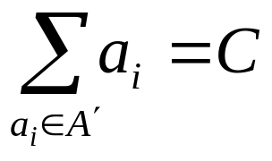
Sum of subsets problem
Def: A set of positive numbers A = { a₁, a₂, …, a_{n} }
  a constant C
  Determine if ∃ A′ ⊆ A ∋
e.g. A = { 7, 5, 19, 1, 12, 8, 14 }
  C = 21, A′ = { 7, 14 }
  C = 11, no solution
<Theorem> Exact cover ∝ sum of subsets.
8- <number>

Slide 50
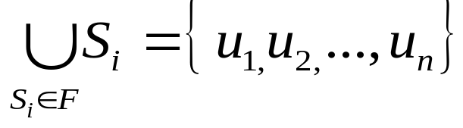
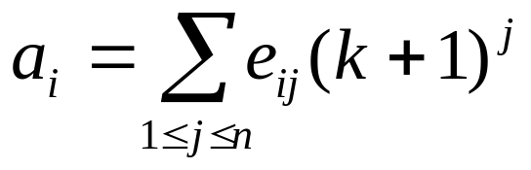
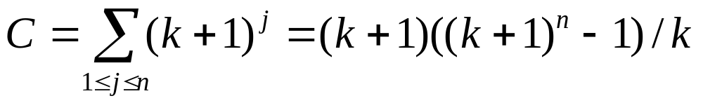
Exact cover ∝ sum of subsets
Proof :
instance of exact cover :
F = { S₁, S₂, …, S_{k} }
instance of sum of subsets :
A = { a₁, a₂, …, a_{k} } where
where e_{ij} = 1 if u_{j} ∈ S_{i}
e_{ij} = 0 if otherwise.
Why k+1? (See the example on the next page.)
8- <number>

Slide 51
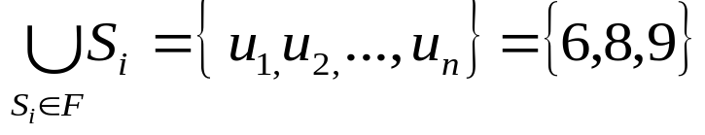
Example of Exact cover ∝ sum of subsets
Valid transformation:
  u₁=6, u₂=8, u₃=9, n=3
  EC: S₁={6,8}, S₂={9}, S₃={6,9}, S₄={8,9}
  k=4
  SS: a₁=5¹+5²=30
  a₂=5³=125
  a₃=5¹+5³=130
  a₄=5²+5³=150
  C=5¹+5² +5³ =155
Invalid transformation:
EC: S₁={6,8}, S₂={8}, S₃={8}, S₄={8,9}. K=4
Suppose k-2=2 is used.
SS: a₁=2¹+2²=6
a₂=2²=4
a₃=2²=4
a₄=2²+2³=12
C=2¹+2²+2³=14
8- <number>

Slide 52
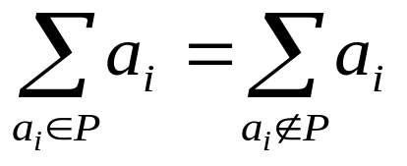
Partition problem
Def: Given a set of positive numbers A = { a₁,a₂,…,a_{n} },
determine if ∃ a partition P, ∋
e. g. A = {3, 6, 1, 9, 4, 11}
partition : {3, 1, 9, 4} and {6, 11}
<Theorem> sum of subsets ∝ partition
8- <number>

Slide 53
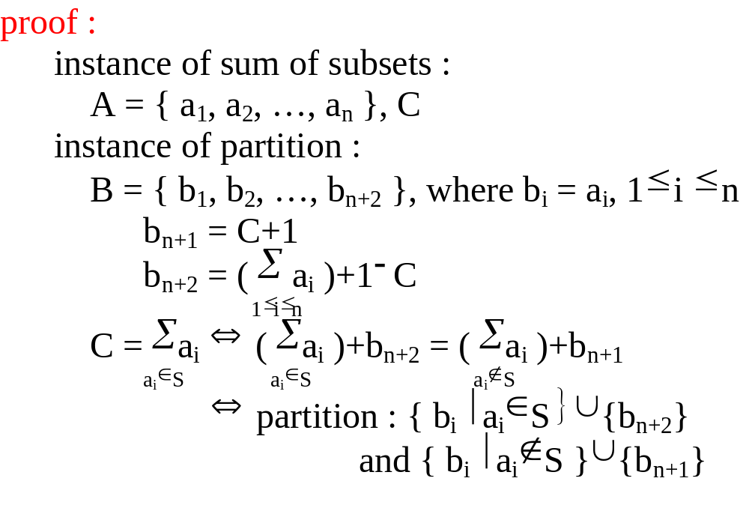




Sum of subsets ∝ partition
8- <number>

Slide 54
Why b_{n+1} = C+1 ? why not b_{n+1} = C ?
  To avoid b_{n+1} and b_{n+2} to be partitioned into the same subset.
8- <number>

Slide 55
Bin packing problem
Def: n items, each of size c_{i} , c_{i} > 0
Each bin capacity : C
Determine if we can assign the items into
k bins, ∋ ∑c_{i} ≤ C , 1≤j≤k.
i∈bin_{j}
<Theorem> partition ∝ bin packing.
8- <number>

Slide 56
VLSI discrete layout problem
Given: n rectangles, each with height h_{i} (integer)
width w_{i}
and an area A
Determine if there is a placement of the n rectangles within the area A according to the rules :
  Boundaries of rectangles parallel to x axis or y axis.
  Corners of rectangles lie on integer points.
  No two rectangles overlap.
  Two rectangles are separated by at least a unit distance.
  (See the figure on the next page.)
8- <number>

Slide 57
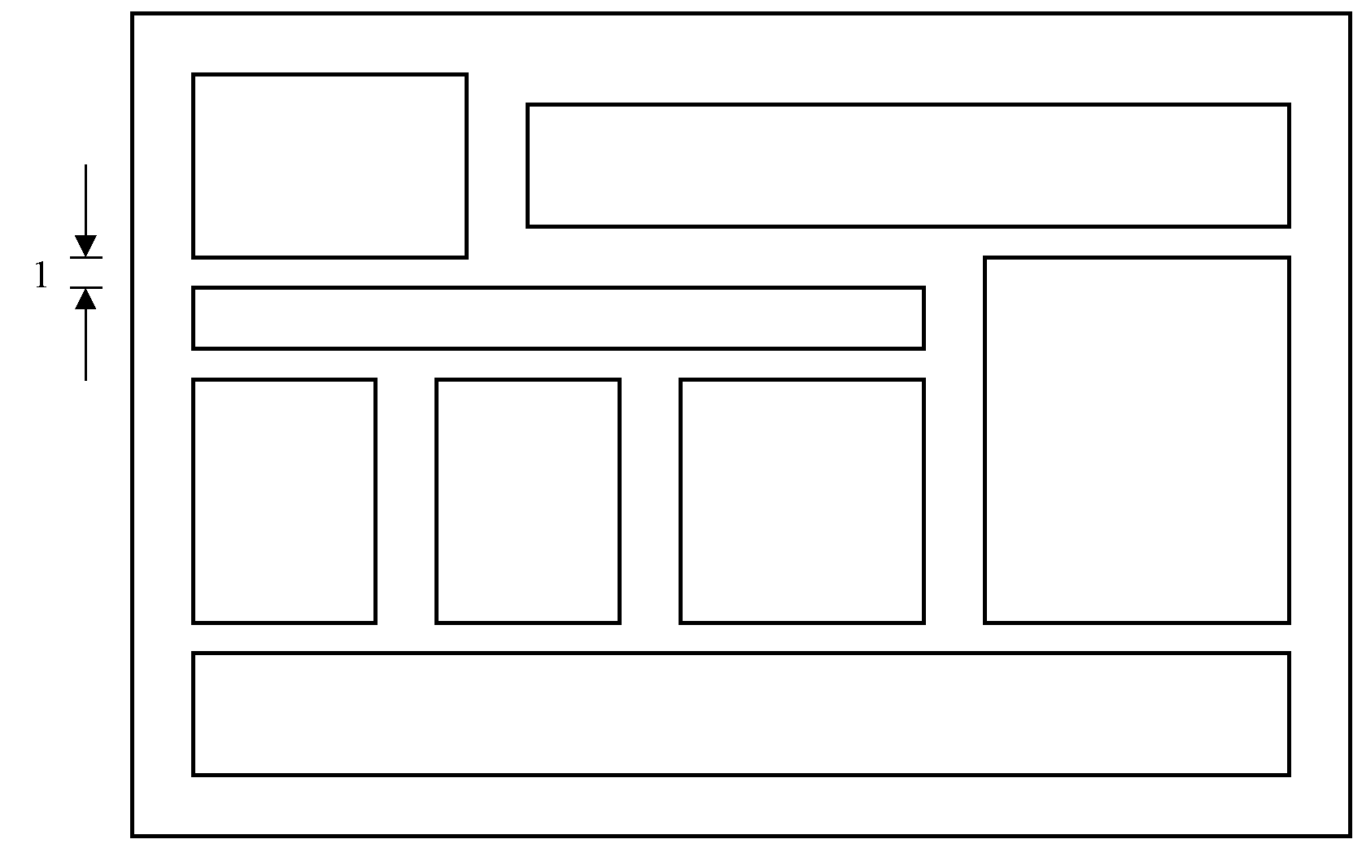
A Successful Placement
<Theorem> bin packing ∝ VLSI discrete layout.
8- <number>

Slide 58
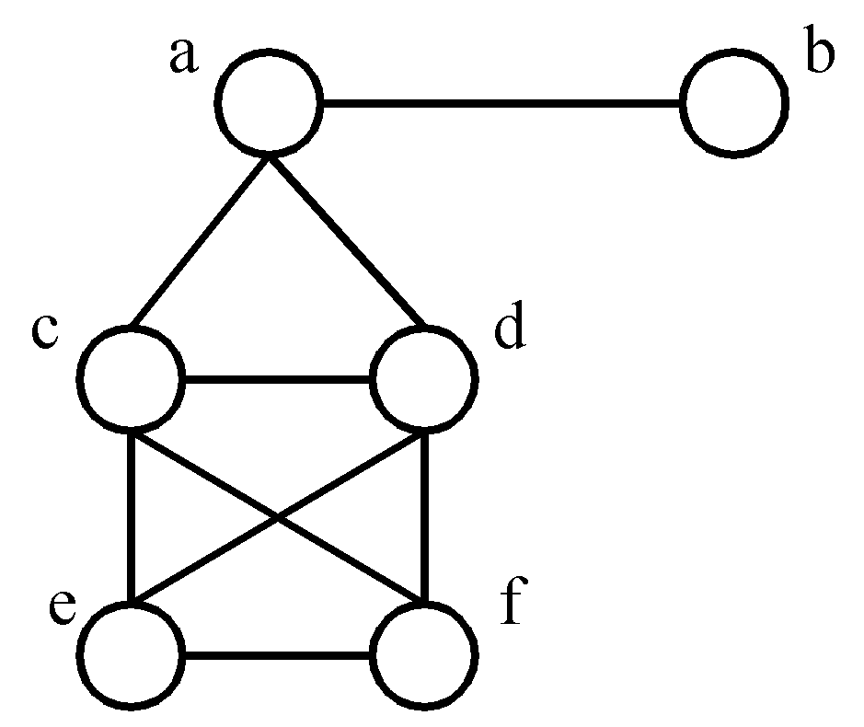
Max clique problem
Def: A maximal complete subgraph of a graph G=(V,E) is a clique. The max (maximum) clique problem is to determine the size of a largest clique in G.
e. g.
<Theorem> SAT ∝ clique decision problem.
maximal cliques :
{a, b}, {a, c, d}
{c, d, e, f}
maximum clique :
(largest)
{c, d, e, f}
8- <number>

Slide 59
Node cover decision problem
Def: A set S ⊆ V is a node cover for a graph G = (V, E) iff all edges in E are incident to at least one vertex in S. ∃ S, ∋ |S| ≤ K ?
<Theorem> clique decision problem ∝ node cover decision problem.
(See proof on the next page.)
8- <number>

Slide 60
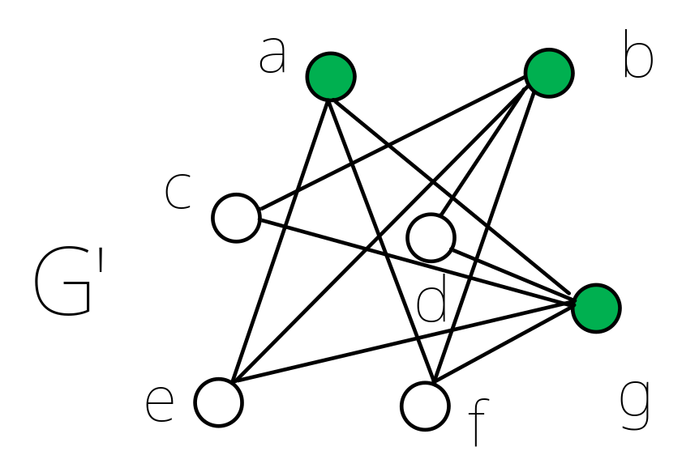
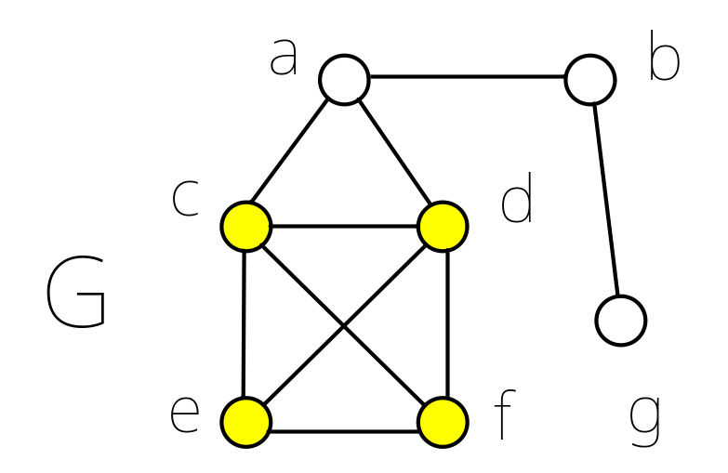
Clique decision ∝ node cover decision
G=(V,E) : clique Q of size k (Q⊆V)
G’=(V,E’) : node cover S of size n-k, S=V-Q
where E’={(u,v)|u∈V, v ∈V and (u,v)∉E}
8- <number>

Slide 61
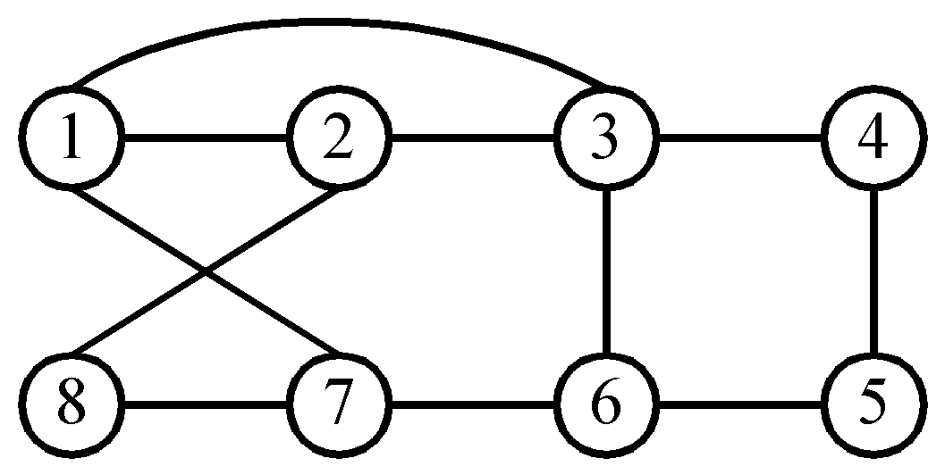
Hamiltonian cycle problem
Def: A Hamiltonian cycle is a round trip path along n edges of G which visits every vertex once and returns to its starting vertex.
e.g.
Hamiltonian cycle : 1, 2, 8, 7, 6, 5, 4, 3, 1.
<Theorem> SAT ∝ directed Hamiltonian cycle ( in a directed graph )
8- <number>

Slide 62
Traveling salesperson problem
Def: A tour of a directed graph G=(V, E) is a directed cycle that includes every vertex in V. The problem is to find a tour of minimum cost.
<Theorem> Directed Hamiltonian cycle ∝ traveling salesperson decision problem.
(See proof on the next page.)
8- <number>

Slide 63
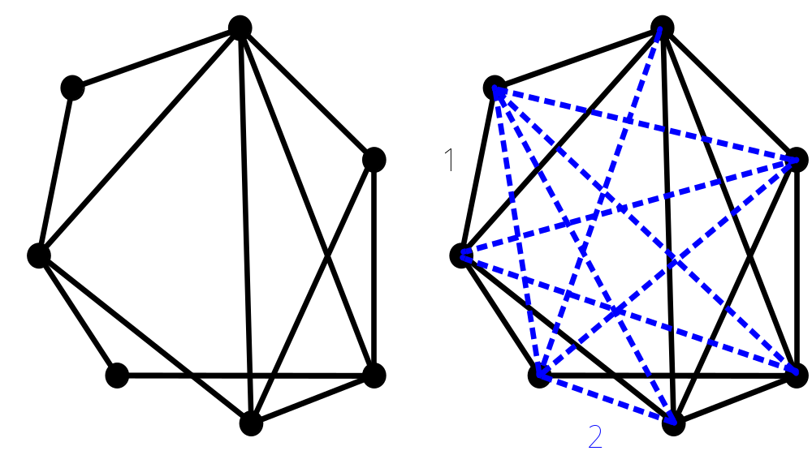
Proof of Hamiltonian ∝ TSP
8- <number>

Slide 64
0/1 knapsack problem
Def: n objects, each with a weight w_{i} > 0
a profit p_{i} > 0
capacity of knapsack : M
Maximize ∑p_{i}x_{i}
1≤i≤n
Subject to ∑w_{i}x_{i} ≤ M
1≤i≤n
x_{i} = 0 or 1, 1≤ i ≤n
Decision version :
Given K, ∃ ∑p_{i}x_{i} ≥ K ?
1≤i≤n
Knapsack problem : 0 ≤ x_{i} ≤ 1, 1≤ i ≤n.
<Theorem> partition ∝ 0/1 knapsack decision problem.
8- <number>

Slide 65
Refer to Sec. 11.3, Sec. 11.4 and its exercises of [Horowitz 1998] for the proofs of more NP-complete problems.
  [[Horowitz 1998] E. Howowitz, S. Sahni and S. Rajasekaran, Computer Algorithms, Computer Science Press, New York, 1998,「台北圖書」代理, 02-23625376
8- <number>

