Slide 1
Chapter 9
Approximation Algorithms

Slide 2
Approximation algorithm
Up to now, the best algorithm for solving an NP-complete problem requires exponential time in the worst case. It is too time-consuming.
To reduce the time required for solving a problem, we can relax the problem, and obtain a feasible solution “close” to an optimal solution

Slide 3
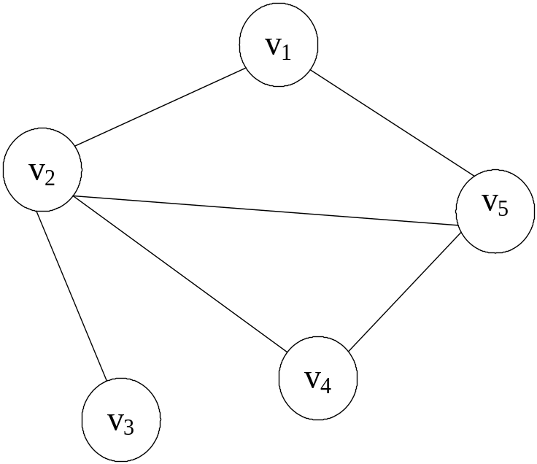
The node cover problem
Def: Given a graph G=(V, E), S is the node cover if S ⊆ V and for every edge (u, v) ∈ E, either u ∈ S or v ∈ S.
The node cover problem is NP-complete.
The optimal solution:
{v₂,v₅}

Slide 4
An approximation algorithm
Input: A graph G=(V,E).
Output: A node cover S of G.
Step 1: S=φ and E’=E.
Step 2: While E’ ≠ φ
Pick an arbitrary edge (a,b) in E’.
S=S∪{a,b}.
E’=E’-{e| e is incident to a or b}
Time complexity: O(|E|)

Slide 5
Example:
First: pick (v₂,v₃)
then S={v₂,v₃ }
E’={(v₁,v₅), (v₄,v₅)}
second: pick (v₁,v₅)
then S={v₁,v₂,v₃ ,v₅}
E’=φ

Slide 6
How good is the solution ?
|S| is at most two times the minimum size of a node cover of G.
L: the number of edges we pick
M*: the size of an optimal solution
(1) L ≤ M*, because no two edges picked in Step 2 share any same vertex.
(2) |S| = 2L ≤ 2M*

Slide 7
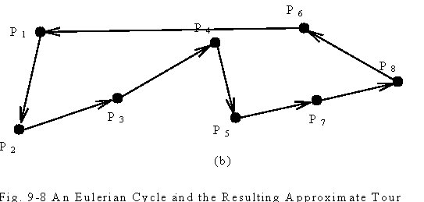
The Euclidean traveling salesperson problem (ETSP)
The ETSP is to find a shortest closed path through a set S of n points in the plane.
The ETSP is NP-hard.

Slide 8
An approximation algorithm for ETSP
Input: A set S of n points in the plane.
Output: An approximate traveling salesperson tour of S.
Step 1: Find a minimal spanning tree T of S.
Step 2: Find a minimal Euclidean weighted matching M on the set of vertices of odd degrees in T. Let G=M∪T.
Step 3: Find an Eulerian cycle of G and then traverse it to find a Hamiltonian cycle as an approximate tour of ETSP by bypassing all previously visited vertices.

Slide 9
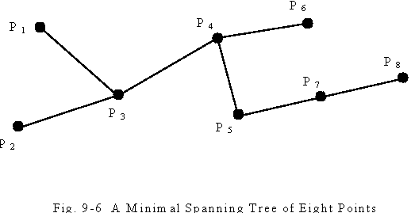
An example for ETSP algorithm
Step1: Find a minimal spanning tree.

Slide 10
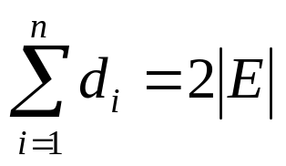
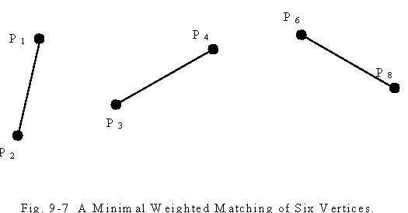
Step2: Perform weighted matching. The number of points with odd degrees must be even because is even.

Slide 11
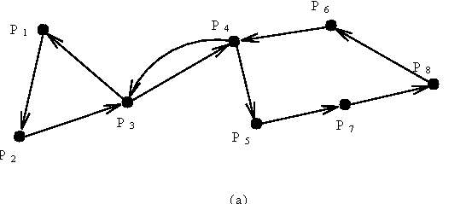
Step3: Construct the tour with an Eulerian cycle and a Hamiltonian cycle.

Slide 12
Time complexity: O(n³)
Step 1: O(nlogn)
Step 2: O(n³)
Step 3: O(n)
How close the approximate solution to an optimal solution?
  The approximate tour is within 3/2 of the optimal one. (The approximate rate is 3/2.)
(See the proof on the next page.)

Slide 13
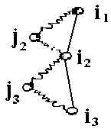
Proof of approximate rate
optimal tour L: j₁…i₁j₂…i₂j₃…i_{2m}
{i₁,i₂,…,i_{2m}}: the set of odd degree vertices in T.
2 matchings: M₁={[i₁,i₂],[i₃,i₄],…,[i_{2m-1},i_{2m}]}
M₂={[i₂,i₃],[i₄,i₅],…,[i_{2m},i₁]}
length(L)≥ length(M₁) + length(M₂) (triangular inequality)
≥ 2 length(M )
⇒ length(M)≤ 1/2 length(L )
G = T∪M
⇒ length(T) + length(M) ≤ length(L) + 1/2 length(L)
= 3/2 length(L)

Slide 14
The bottleneck traveling salesperson problem (BTSP)
Minimize the longest edge of a tour.
This is a mini-max problem.
This problem is NP-hard.
The input data for this problem fulfill the following assumptions:
  The graph is a complete graph.
  All edges obey the triangular inequality rule.

Slide 15
An algorithm for finding an optimal solution
Step1: Sort all edges in G = (V,E) into a nondecresing sequence |e₁|≤|e₂|≤…≤|e_{m}|. Let G(e_{i}) denote the subgraph obtained from G by deleting all edges longer than e_{i}.
Step2: i←1
Step3: If there exists a Hamiltonian cycle in G(e_{i}), then this cycle is the solution and stop.
Step4: i←i+1 . Go to Step 3.

Slide 16
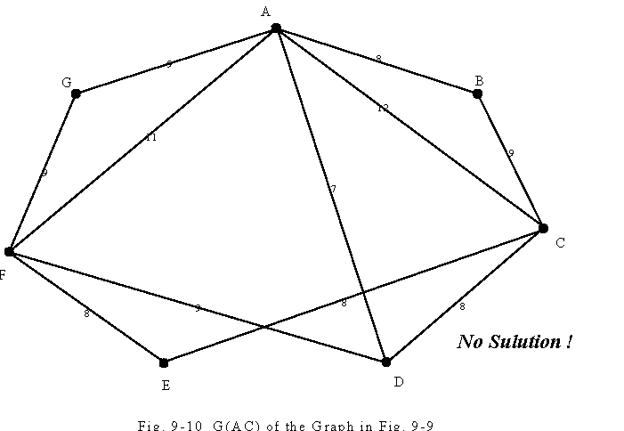
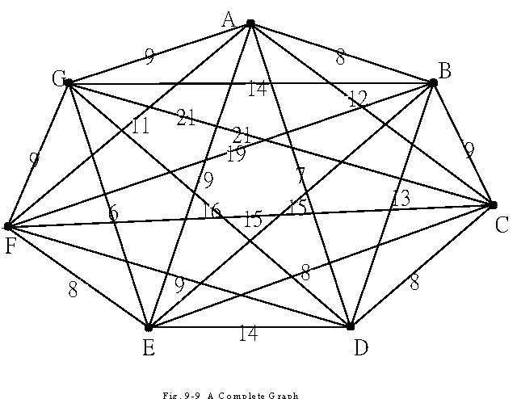
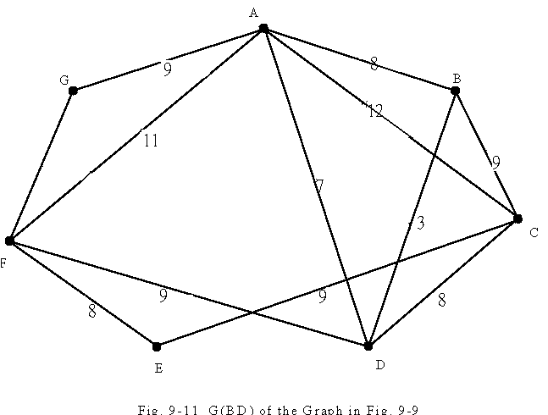
An example for BTSP algorithm
e.g.
1
There is a Hamiltonian cycle, A-B-D-C-E-F-G-A, in G(BD).
The optimal solution is 13.

Slide 17
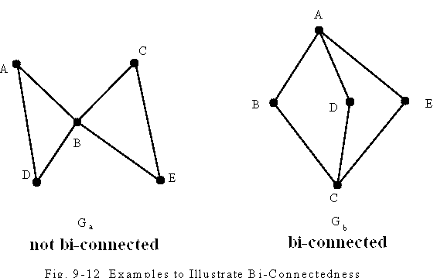
Theorem for Hamiltonian cycles
Def : The t-th power of G=(V,E), denoted as G^{t}=(V,E^{t}), is a graph that an edge (u,v)∈E^{t} if there is a path from u to v with at most t edges in G.
Theorem: If a graph G is bi-connected, then G² has a Hamiltonian cycle.

Slide 18
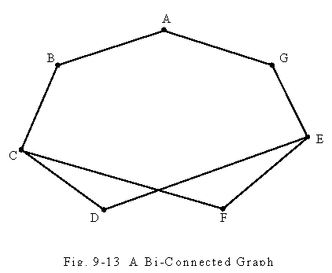
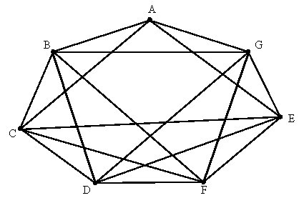
An example for the theorem
G²
A Hamiltonian cycle:
A-B-C-D-E-F-G-A

Slide 19
An approximation algorithm for BTSP
Input: A complete graph G=(V,E) where all edges satisfy triangular inequality.
Output: A tour in G whose longest edges is not greater than twice of the value of an optimal solution to the special bottleneck traveling salesperson problem of G.
Step 1: Sort the edges into |e₁|≤|e₂|≤…≤|e_{m}|.
Step 2: i := 1.
Step 3: If G(e_{i}) is bi-connected, construct G(e_{i})², find a Hamiltonian cycle in G(e_{i})² and return this as the output.
Step 4: i := i + 1. Go to Step 3.

Slide 20
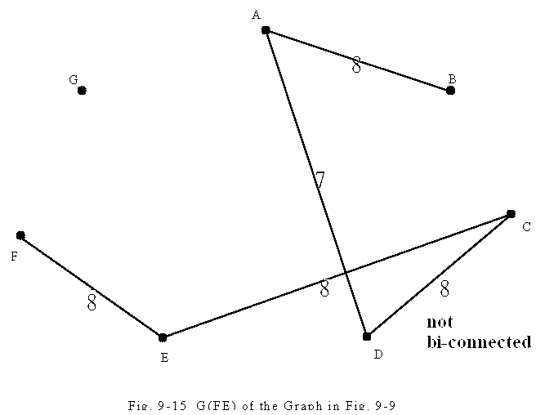
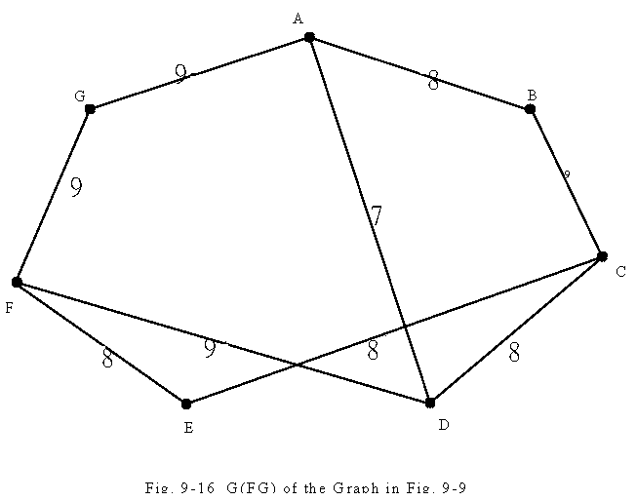
An example
Add some more edges. Then it becomes bi-connected.

Slide 21
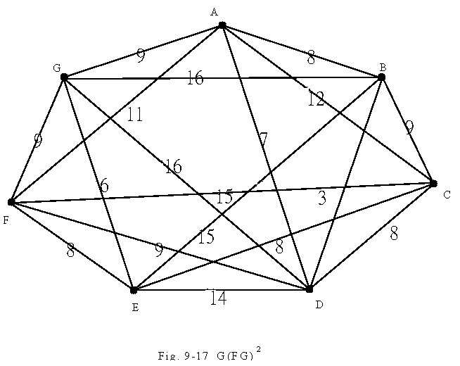
A Hamiltonian cycle: A-G-F-E-D-C-B-A.
The longest edge: 16
Time complexity: polynomial time
1

Slide 22
How good is the solution ?
The approximate solution is bounded by two times an optimal solution.
Reasoning:
A Hamiltonian cycle is bi-connected.
e_{op}: the longest edge of an optimal solution
G(e_{i}): the first bi-connected graph
|e_{i}|≤|e_{op}|
The length of the longest edge in G(e_{i})²≤2|e_{i}|
(triangular inequality) ≤2|e_{op}|

Slide 23
NP-completeness
Theorem: If there is a polynomial approximation algorithm which produces a bound less than two, then NP=P.
(The Hamiltonian cycle decision problem reduces to this problem.)
Proof:
For an arbitrary graph G=(V,E), we expand G to a complete graph G_{c}:
C_{ij} = 1 if (i,j) ∈ E
C_{ij} = 2 if otherwise
(The definition of C_{ij} satisfies the triangular inequality.)

Slide 24
Let V* denote the value of an optimal solution of the bottleneck TSP of G_{c}.
V* = 1 ⇔ G has a Hamiltonian cycle
Because there are only two kinds of edges, 1 and 2 in G_{c}, if we can produce an approximate solution whose value is less than 2V*, then we can also solve the Hamiltonian cycle decision problem.

Slide 25
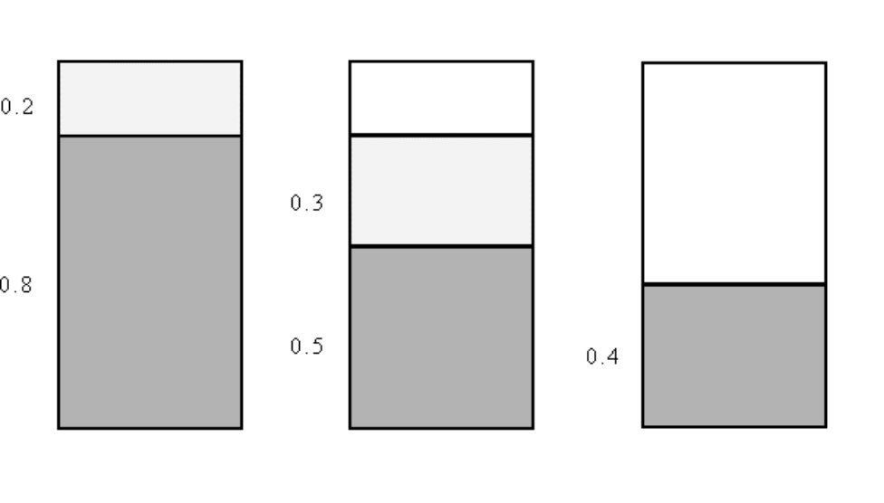
The bin packing problem
n items a₁, a₂, …, a_{n}, 0< a_{i} ≤ 1, 1 ≤ i ≤ n, to determine the minimum number of bins of unit capacity to accommodate all n items.
E.g. n = 5, {0.8, 0.5, 0.2, 0.3, 0.4}
The bin packing problem is NP-hard.

Slide 26
An approximation algorithm for the bin packing problem
An approximation algorithm:
(first-fit) place a_{i} into the lowest-indexed bin which can accommodate a_{i}.
Theorem: The number of bins used in the first-fit algorithm is at most twice of the optimal solution.

Slide 27
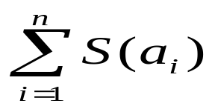
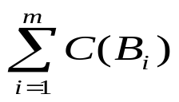

Proof of the approximate rate
Notations:
  S(a_{i}): the size of item a_{i}
  OPT: # of bins used in an optimal solution
  m: # of bins used in the first-fit algorithm
  C(B_{i}): the sum of the sizes of a_{j}’s packed in bin B_{i} in the first-fit algorithm
OPT ≥
C(B_{i}) + C(B_{i+1}) > 1
C(B₁)+C(B₂)+…+C(B_{m}) > m/2
⇒ m < 2 = 2 ≤ 2 OPT
m < 2 OPT

Slide 28
The rectilinear m-center problem
The sides of a rectilinear square are parallel or perpendicular to the x-axis of the Euclidean plane.
The problem is to find m rectilinear squares covering all of the n given points such that the maximum side length of these squares is minimized.
This problem is NP-complete.
This problem for the solution with error ratio < 2 is also NP-complete.
(See the example on the next page.)

Slide 29
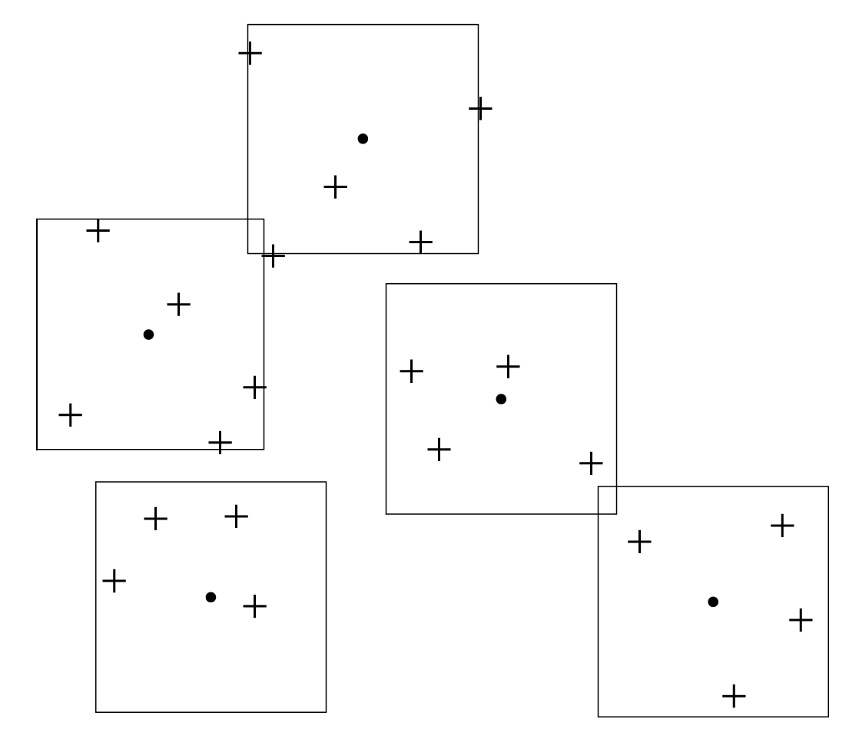
Input: P={P₁, P₂, …, P_{n}}
The size of an optimal solution must be equal to one of the L ∞(P_{i},P_{j})’s, 1 ≤ i < j ≤ n, where
L ∞((x₁,y₁),(x₂,y₂)) = max{|x₁-x₂|,|y₁-y₂|}.

Slide 30
An approximation algorithm
Input: A set P of n points, number of centers: m
Output: SQ[1], …, SQ[m]: A feasible solution of the rectilinear m-center problem with size less than or equal to twice of the size of an optimal solution.
Step 1: Compute rectilinear distances of all pairs of two points and sort them together with 0 into an ascending sequence D[0]=0, D[1], …, D[n(n-1)/2].
Step 2: LEFT := 1, RIGHT := n(n-1)/2 //* Binary search
Step 3: i := ⎡(LEFT + RIGHT)/2⎤.
Step 4: If Test(m, P, D[i]) is not “failure” then
RIGHT := i-1
else LEFT := i+1
Step 5: If RIGHT = LEFT then
return Test(m, P, D[RIGHT])
else go to Step 3.

Slide 31
Algorithm Test(m, P, r)
Input: point set: P, number of centers: m, size: r.
Output: “failure”, or SQ[1], …, SQ[m] m squares of size 2r covering P.
Step 1: PS := P
Step 2: For i := 1 to m do
If PS ≠ ∅ then
p := the point is PS with the smallest
x-value
SQ[i] := the square of size 2r with center
at p
PS := PS -{points covered by SQ[i]}
else SQ[i] := SQ[i-1].
Step 3: If PS = ∅ then return SQ[1], …, SQ[m]
else return “failure”. (See the example on the next page.)

Slide 32
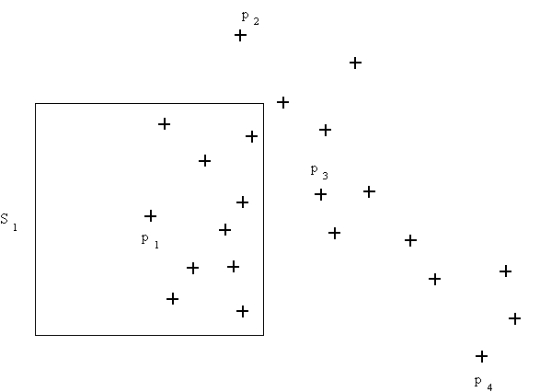
An example for the algorithm
The first application of the relaxed test subroutine.

Slide 33
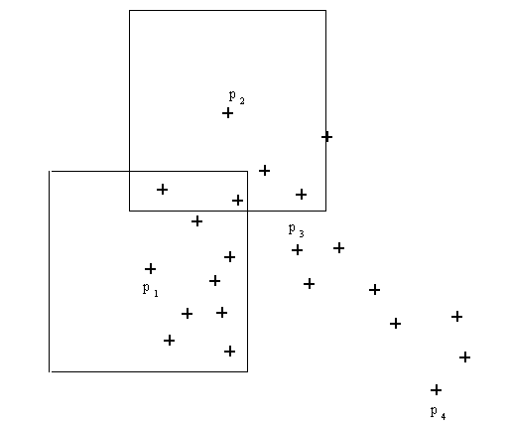
The second application of the test subroutine.

Slide 34
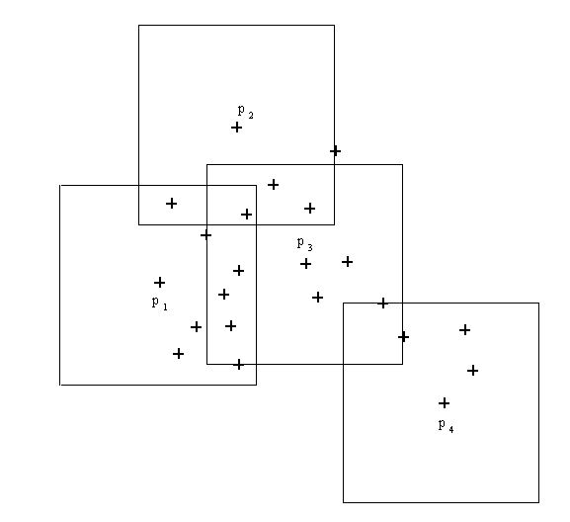
A feasible solution of the rectilinear 5-center problem.

Slide 35
Time complexity
Time complexity: O(n²logn)
  Step 1: O(n)
  Step 2: O(1)
  Step 3 ~ Step 5:
  O(logn)* O(mn) = O(n²logn)

Slide 36
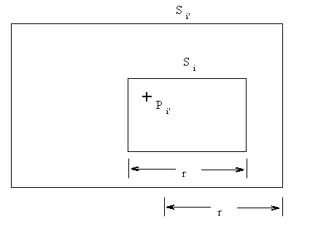
How good is the solution ?
The approximation algorithm is of error ratio 2.
Reasoning: If r is feasible, then Test(m, P, r) returns a feasible solution of size 2r.
The explanation of S_{i} ⊂ S_{i}’

