Slide 1
Finding Maximal Repetitions in a Word in Linear Time
Roman Kolpakov and Gregory Kucherov
Proceedings of the 40th Annual Symposium on Foundations of
Computer Science (FOCS ‘99) pp. 596 - 604 (1999)
Presenter: Tzu-Chiang Hsu (徐子強)
2016/04/12

Slide 2
Abstract (1/2)
A repetition in a word w is a subword with the period of at most half of the subword length. We study maximal repetitions occurring in w, that is those for which any extended subword of w has a bigger period. The set of such repetitions represents in a compact way all repetitions in w.

Slide 3
Abstract (2/2)
We first prove a combinatorial result asserting that the sum of exponents of all maximal repetitions of a word of length n is bounded by a linear function in n. This implies, in particular that there is only a linear number of maximal repetitions in a word. This allows us to construct a linear-time algorithm for finding all maximal repetitions. Some consequences and applications of these results are discussed, as well as related works.

Slide 4
O(n log n)
{
Square-free Detection
Squares
Primitively Rooted Squares
Non-extendable Primitively Rooted Integer Powers
Detecting Leftmost Maximal Periodicities
Michael G. Main, Discrete Applied Mathematics (1989)
Finding Maximal Repetitions in a Word in Linear Time
Kolpakov and Kucherov (1999)
O(n)
{

Slide 5
S-factorization
a | b | a | a | b | a | b | a
LZ77
a | b | a | a | b | a | b | a
LZ78
a | b | a | a | b | a | b | a

Slide 6
S-factorization
abcbcbbcbaba
a, b, c, bcb, bcb, ab, a

Slide 7
S-factorization
abcbcbbcbaba
a, b, c, bcb, bcb, ab, a

Slide 8
S-factorization
abcbcbbcbaba
a, b, c, bcb, bcb, ab, a

Slide 9
S-factorization
abcbcbbcbaba
a, b, c, bcb, bcb, ab, a

Slide 10
S-factorization
abcbcbbcbaba
a, b, c, bcb, bcb, ab, a

Slide 11
S-factorization
abcbcbbcbaba
a, b, c, bcb, bcb, ab, a

Slide 12
S-factorization
aaaaa
a, aaaa

Slide 13
Properties of runs (1/2)
Theorem (Fine and Wilf, 1965)
If word w has periods p₁, p₂,
and |w| ≥ p₁ + p₂ – gcd(p₁, p₂),
then gcd(p₁, p₂) is also a period of w.

Slide 14

Properties of runs (2/2)

Slide 15
}
Case 1:
Case 2:
Detecting Leftmost Maximal Periodicities
Michael G. Main, Discrete Applied Mathematics (1989)
Finding Maximal Repetitions in a Word in Linear Time
Kolpakov and Kucherov (1999)
}
O(n)
{

Slide 16
}
Case 1:
Case 2:
}
}
abcbcbbcbaba
a, b, c, bcb, bcb, ab, a

Slide 17
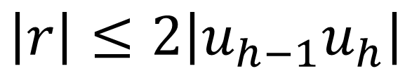
}
r
Case 1:
Case 2:
 |  | h-1 | h
}
$$\left|r\right|≤2\left|u_{h−1}u_{h}\right|$$

Slide 18
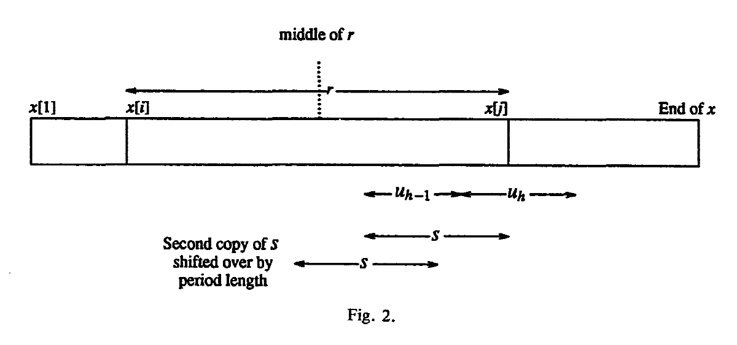

}
r
Case 1:
 |  | h-1 | h
$$\left|r\right|≤2\left|u_{h−1}u_{h}\right|$$

Slide 19
}
Case 1:
Detecting Leftmost Maximal Periodicities
Michael G. Main, Discrete Applied Mathematics (1989)
An O(n log n) Algorithm for Finding All Repetitions in a String
Michael G. Main, Journal of Algorithms (1984)

Slide 20
1 | 2 | 3 | 4 | 5 | 6 | 7 | 8 | 9 | 0 | 1 | 2 | 3 | 4 | 5 | 6
a | b | c | b | c | b | b | c | b | b | c | b | b | b | b | b
ˇ
(begin, end, period)
(2, 6, 2)
(4, 13, 3)
(6, 7, 1)
(9, 10, 1)
(12, 16, 1)
(12, 16, 2)
LS[4] = 0
LP[5] = 0

Slide 21
1 | 2 | 3 | 4 | 5 | 6 | 7 | 8 | 9 | 0 | 1 | 2 | 3 | 4 | 5 | 6
a | b | c | b | c | b | b | c | b | b | c | b | b | b | b | b
ˇ
?
(begin, end, period)
(2, 6, 2)
(4, 13, 3)
(6, 7, 1)
(9, 10, 1)
(12, 16, 1)
(12, 16, 2)
ˇ
LS[5] = 2
LP[6] = 1

Slide 22
1 | 2 | 3 | 4 | 5 | 6 | 7 | 8 | 9 | 0 | 1 | 2 | 3 | 4 | 5 | 6
a | b | c | b | c | b | b | c | b | b | c | b | b | b | b | b
ˇ
(begin, end, period)
(2, 6, 2)
(4, 13, 3)
(6, 7, 1)
(9, 10, 1)
(12, 16, 1)
(12, 16, 2)
ˇ
LS[7] = 1
LP[8] = 0
ˇ

Slide 23
1 | 2 | 3 | 4 | 5 | 6 | 7 | 8 | 9 | 0 | 1 | 2 | 3 | 4 | 5 | 6
a | b | c | b | c | b | b | c | b | b | c | b | b | b | b | b
ˇ
(begin, end, period)
(2, 6, 2)
(4, 13, 3)
(6, 7, 1)
(9, 10, 1)
(12, 16, 1)
(12, 16, 2)
ˇ
ˇ
LS[9] = 3
LP[10] = 4
ˇ

Slide 24
1 | 2 | 3 | 4 | 5 | 6 | 7 | 8 | 9 | 0 | 1 | 2 | 3 | 4 | 5 | 6
a | b | c | b | c | b | b | c | b | b | c | b | b | b | b | b
ˇ
(begin, end, period)
(2, 6, 2)
(4, 13, 3)
(6, 7, 1)
(9, 10, 1)
(12, 16, 1)
(12, 16, 2)
ˇ
ˇ
LS[14] = 2
LP[15] = 2
ˇ
ˇ

Slide 25
1 | 2 | 3 | 4 | 5 | 6 | 7 | 8 | 9 | 0 | 1 | 2 | 3 | 4 | 5 | 6
a | b | c | b | c | b | b | c | b | b | c | b | b | b | b | b
ˇ
(begin, end, period)
(2, 6, 2)
(4, 13, 3)
(6, 7, 1)
(9, 10, 1)
(12, 16, 1)
(12, 16, 2)
ˇ
ˇ
LS[15] = 2
LP[16] = 1
ˇ
ˇ
ˇ

Slide 26
}
Case 1:
Case 2:
Detecting Leftmost Maximal Periodicities
Michael G. Main, Discrete Applied Mathematics (1989)
Finding Maximal Repetitions in a Word in Linear Time
Kolpakov and Kucherov (1999)
}
O(n)
{

Slide 27
1 | 2 | 3 | 4 | 5 | 6 | 7 | 8 | 9 | 0 | 1 | 2 | 3 | 4 | 5 | 6
a | b | c | b | c | b | b | c | b | b | c | b | b | b | b | b
(2, 6, 2)
(6, 7, 1)
(12, 16, 1)
(12, 16, 2)
(4, 13, 3)
(9, 10, 1)
ˇ

