Slide 1
An Improved Algorithm for Matching Biological Sequences
OSAMU GOTOH
Department of Biochemistry Saitama Cancer Center Research Institute Ina-machi , Saitama 362, Japan
J. Mol. Biol. (1982) 162, 705-708
Presenter: Chong-Xuan Lo
Date:2016/4/12

Slide 2
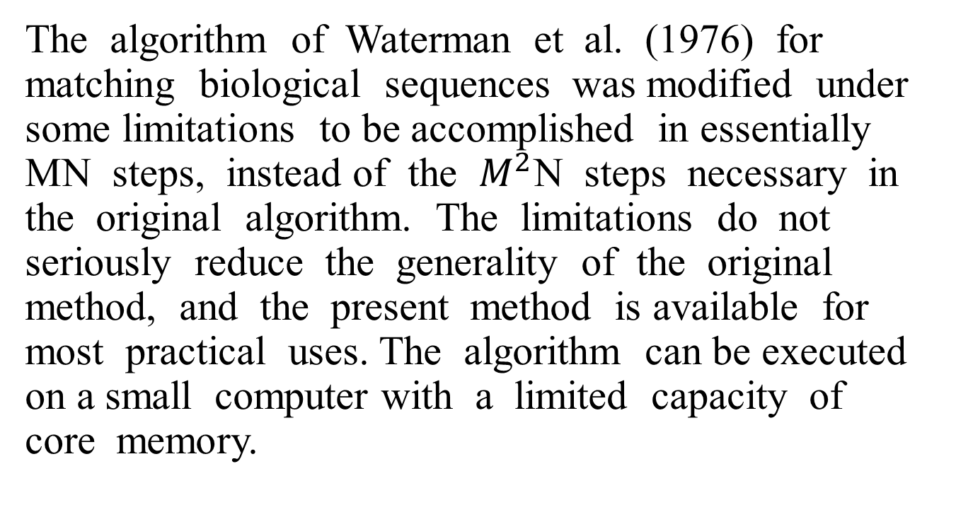
Abstract
The algorithm of Waterman et al. (1976) for matching biological sequences was modified under some limitations to be accomplished in essentially MN steps, instead of the $M^{2}$N steps necessary in the original algorithm. The limitations do not seriously reduce the generality of the original method, and the present method is available for most practical uses. The algorithm can be executed on a small computer with a limited capacity of core memory.

Slide 3




Affine gap penalty
The affine gap penalty combines the components in both the constant and linear gap penalty, taking the form α+(kβ).
α - gap opening penalty
β - gap extension penalty
k - the length of the gap

Slide 4
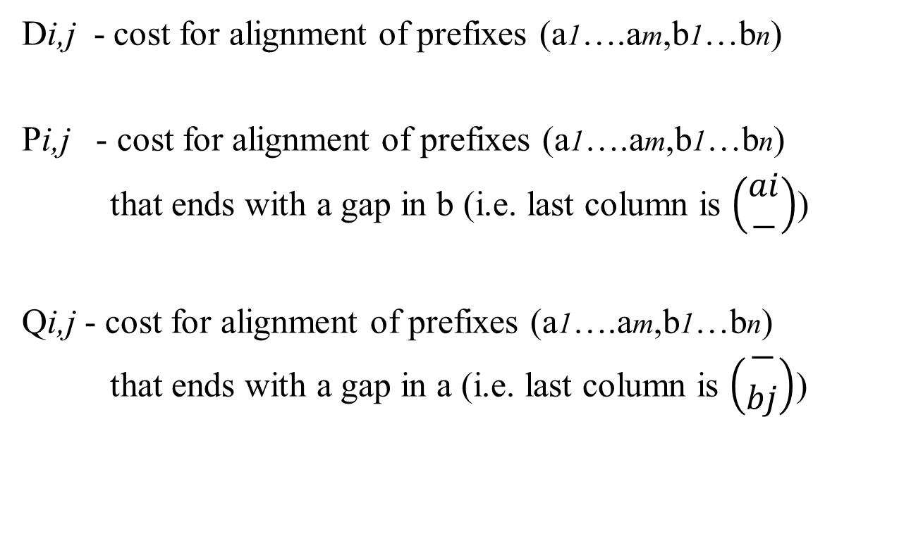
Gotoh’s algorithm
A = a1a2…ai…am
B = b1b2…bj…bn
Di,j - cost for alignment of prefixes (a1….am,b1…bn)
Pi,j - cost for alignment of prefixes (a1….am,b1…bn)
that ends with a gap in b (i.e. last column is $\left(\begin{aligned}ai \\ −\end{aligned}\right)$)
Qi,j - cost for alignment of prefixes (a1….am,b1…bn)
that ends with a gap in a (i.e. last column is $\left(\begin{aligned}− \\ bj\end{aligned}\right)$)

Slide 5
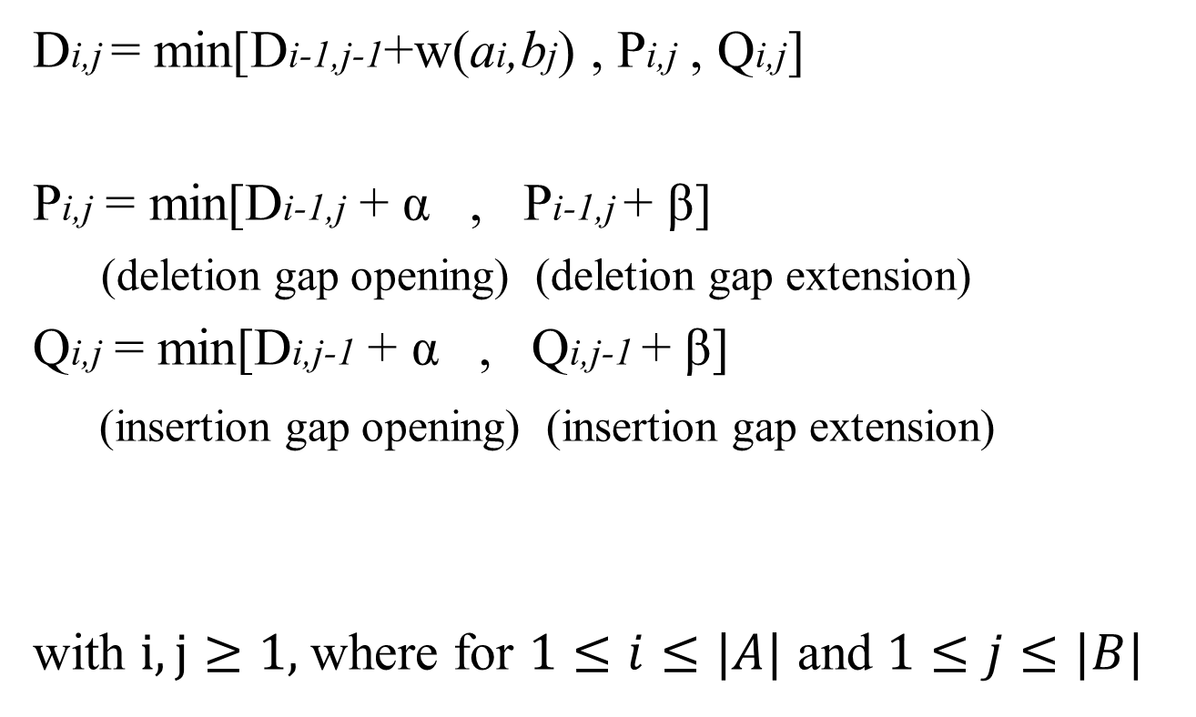
Gotoh’s algorithm
A = a1a2…ai…am
B = b1b2…bj…bn
Di,j = min[Di-1,j-1+w(ai,bj) , Pi,j , Qi,j]
Pi,j = min[Di-1,j + α , Pi-1,j + β]
(deletion gap opening) (deletion gap extension)
Qi,j = min[Di,j-1 + α , Qi,j-1 + β]
(insertion gap opening) (insertion gap extension)
with $i,j≥1,$where for $1≤i≤|A|$ and $1≤j≤|B|$

Slide 6

Gotoh’s algorithm
Example:
A = CC and B = GCCT
Cost functions:
Match : w(ai,bj) = $\left\{\begin{aligned}0 if ai=bj \\ 1 else \end{aligned}\right.$
gap penalty : g(k)=7 + 2k

Slide 7
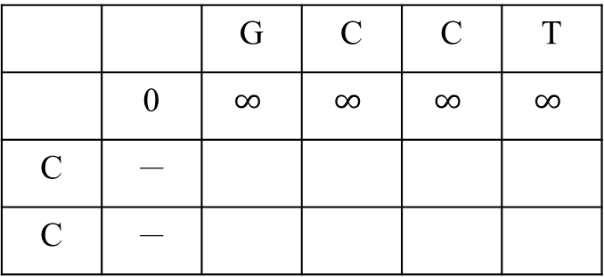
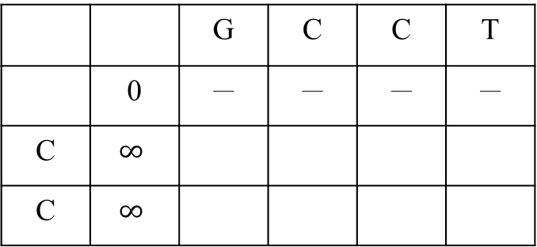

Gotoh’s algorithm
Match : w(ai,bj) = $\left\{\begin{aligned}0 if ai=bj \\ 1 else \end{aligned}\right.$
gap penalty : g(k)=7 + 2k
 |  | G | C | C | T
 | 0 | 7 | 9 | 11 | 13
C | 7
C | 9
Di,j
1
7
9
12
8
1
7
10
(Match)
Di,j = min[Di-1,j-1+w(ai,bj) , Pi,j , Qi,j]
 |  | G | C | C | T
 | 0 | － | － | － | －
C | $$∞$$
C | $$∞$$
Qi,j = min[Di,j-1 + α , Qi,j-1 + β]
Pi,j = min[Di-1,j + α , Pi-1,j + β]
Qi,j
14
8
10
12
16
15
8
10
(Inserion)
Traceback:
C C - -
G C C T
 |  | G | C | C | T
 | 0 | $$∞$$ | $$∞$$ | $$∞$$ | $$∞$$
C | －
C | －
- - C C
G C C T
Pi,j
14
16
18
20
8
14
16
19
(deletion)

Slide 8
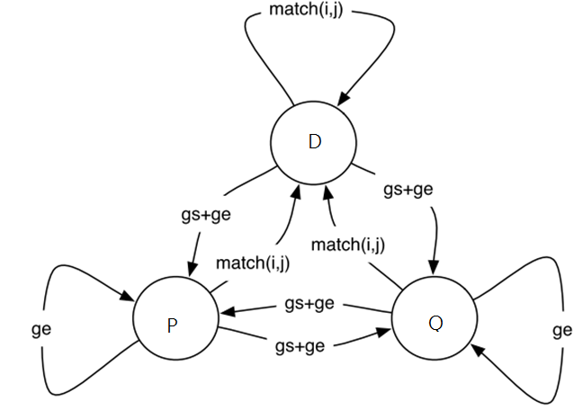
Gotoh’s algorithm
Affine gap as finite state machine

Slide 9
Gotoh’s algorithm
Time complexity : O (mn)

