Slide 1
Efficient algorithms for the longest common subsequence problem with sequential substring constraints
Chiou-Ting Tseng, Chang-Biau Yang, Hsing-Yen Ann
Journal of Complexity 29 (2013) 44–52
Presenter：Siang-Huai Hung
Date：2016/05/31

Slide 2
Abstract(1/2)
In this paper, we generalize the inclusion constrained longest common subsequence (CLCS) problem to the hybrid CLCS problem which is the combination of the sequence inclusion CLCS and the string inclusion CLCS, called the sequential substring constrained longest common subsequence (SSCLCS) problem. In the SSCLCS problem, we are given two strings A and B of lengths m and n, respectively, formed by alphabet Σ and a constraint sequence C formed by ordered strings (C¹, C², C³, . . . , C^{l}) with total length r.

Slide 3
Abstract(2/2)
The problem is that of finding the longest common subsequence D of A and B containing C¹, C², C³, . . . , C^{l} as substrings and with the order of the C’s retained. This problem has two variants, depending on whether the strings in C cannot overlap or may overlap. We propose algorithms with O(mnl+(m+n)(|Σ|+r)) and O(mnr + (m+n)|Σ|) time for the two variants. For the special case with one or two constraints, our algorithm runs in O(mn+(m+n)(|Σ|+r)) or O(mnr + (m + n)|Σ|) time, respectively—an order faster than the algorithm proposed by Chen and Chao.

Slide 4
SSCLCS
Two strings A and B of lengths m and n, respectively
A constraint sequence C formed by ordered strings (C1, C2, C3, . . . , Cl) of total length r
A = atcatatgag, B = atcatctagg, C = (acat, tag)
SSCLCS = acatagg

Slide 5
An improved algorithm for the string inclusion CLCS problem

Slide 6
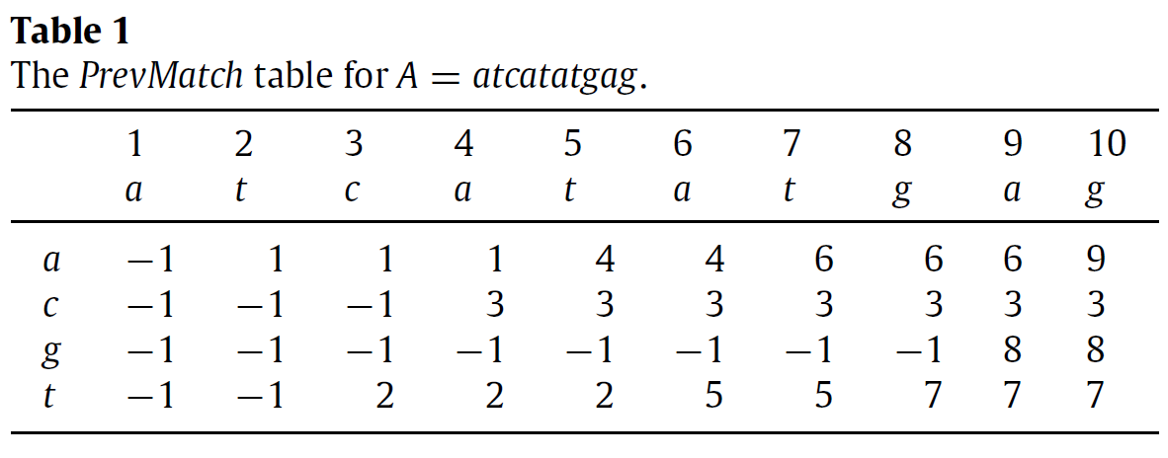
StartPos table:
A = atcatatgag, C = acat
ζA = [−1,−1,−1,−1, 1,−1, 1,−1,−1,−1]
A = atcatatgag, C = tag
ζA =[−1,−1,−1,−1,−1,−1,−1, 5,−1, 7]

Slide 7
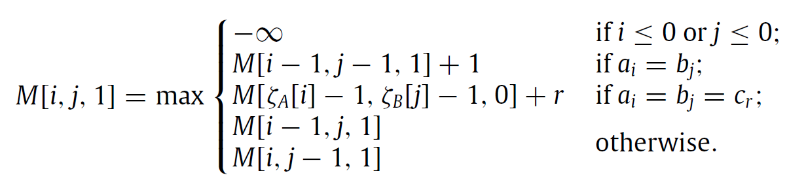
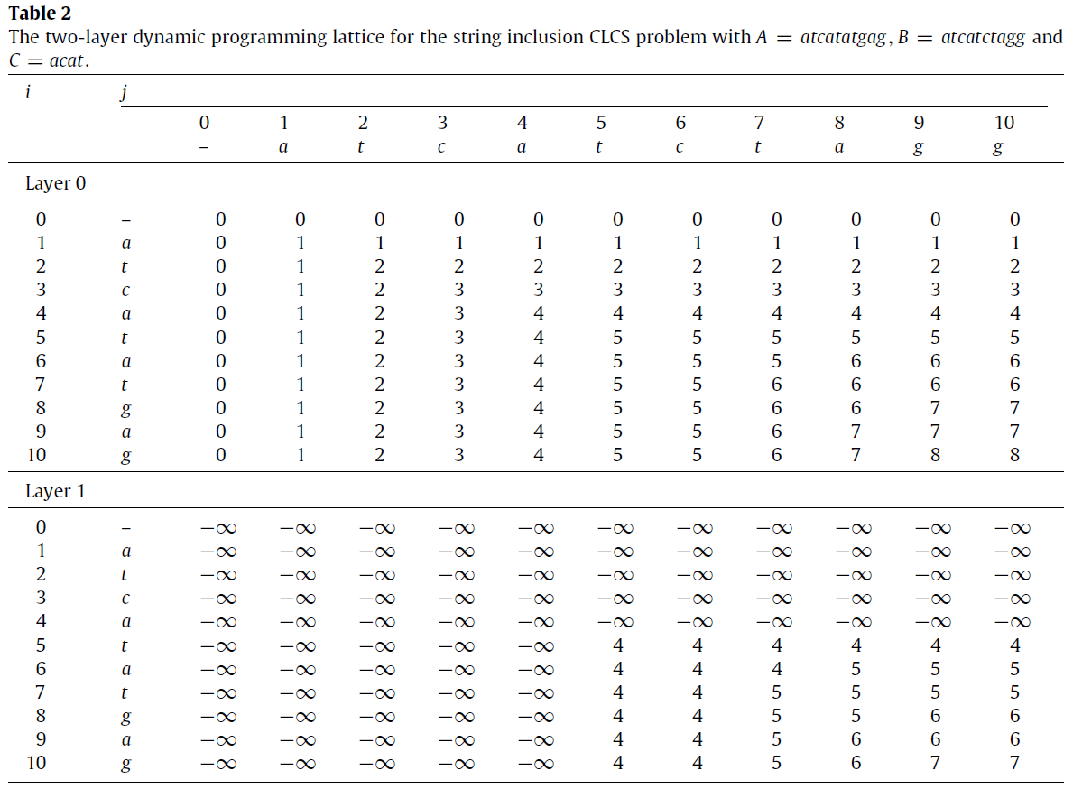

Slide 8
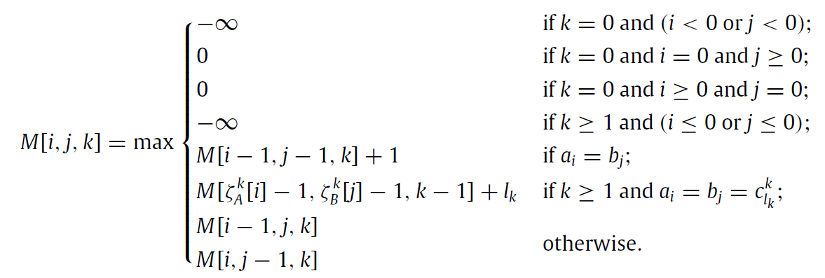

Algorithms for non-overlapping partitions
StartPos tables for two partitions are denoted as ζ¹, ζ²
${\text{ζ}}_{A}^{k}$and ${\text{ζ}}_{\text{B}}^{\text{k}}$denote the StartPos tables for C^{k} on A and B

Slide 9
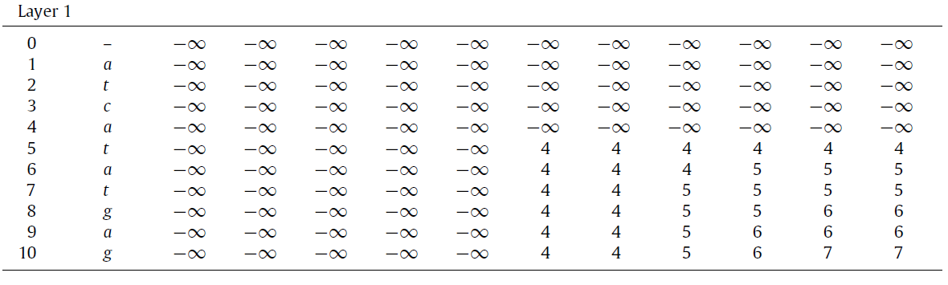
Algorithms for overlapping partitions
An algorithm for two partitions:
w = overlapping length, 1 ≤ w ≤ min(l₁, l₂) – 1
M₁[i,j,1] be the lattice same as layer 1
M₂[i, j, 1] is the lattice for recording the SSCLCS length

Slide 10
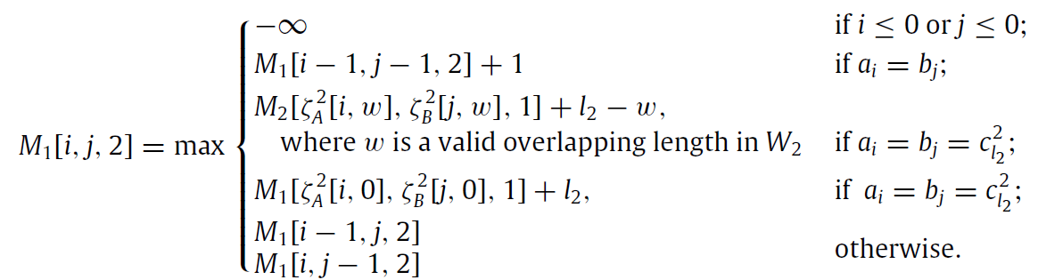
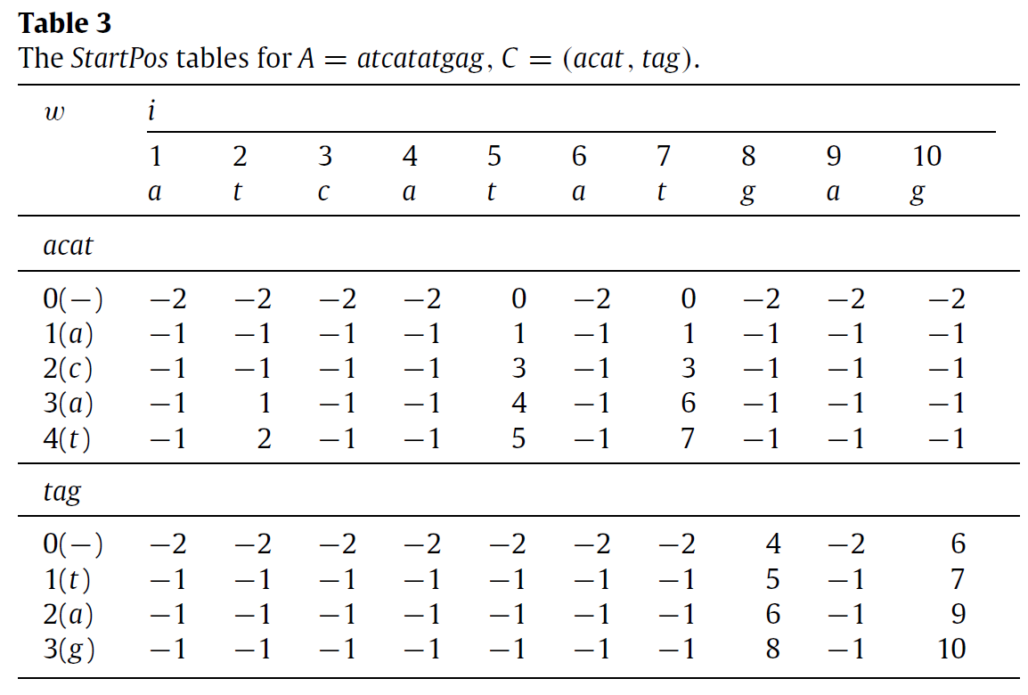

Slide 11
An algorithm for an arbitrary number of partitions:
First, construct the PrevMatch tables for A and B.
Second, use the PrevMatch tables to construct the StartPos tables for all partitions with all overlapping lengths.
Third, find all valid lengths of overlap for every two consecutive partitions C^{k−1} and C^{k} to form the set W_{k}

Slide 12
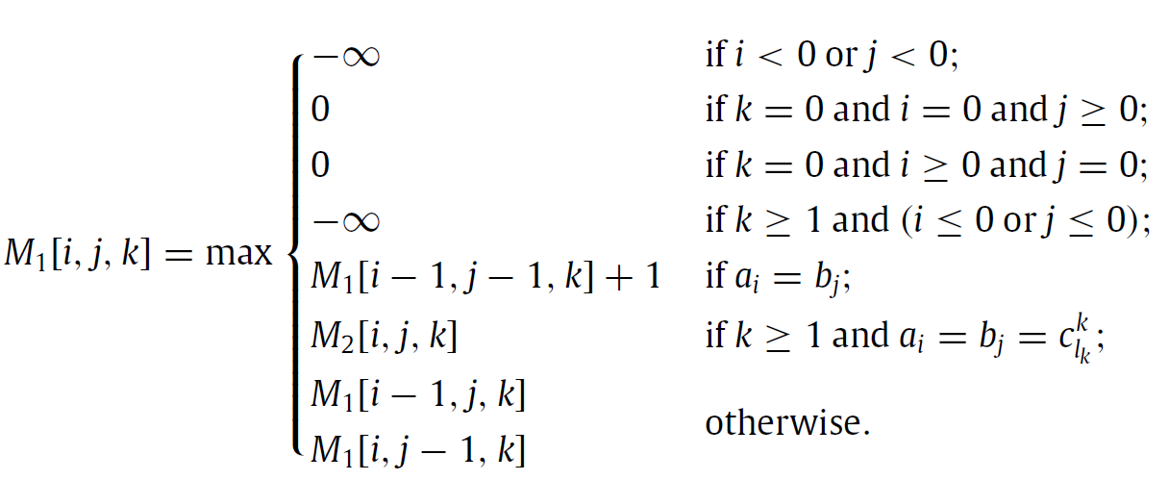
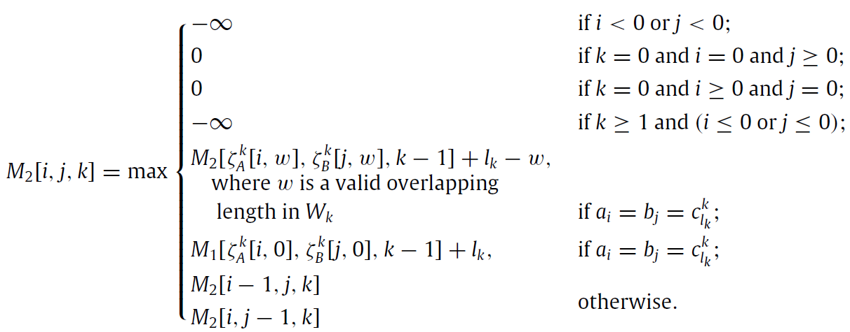
M₁[i, j, k] record the SSCLCS length.
M₂[i, j, k] store the SSCLCS length with matching Ck exactly at the end.

Slide 13
Thanks for listening

