Slide 1
Constructing Optimal Binary Decision Trees is NP-Complete
Information Processing Letters, Vol. 5, pp.15-17 (1976)
Presenter: Shiou-Zong Chiou
Date:2016/06/27

Slide 2
Abstract
We demonstrate that constructing optimal binary decision trees is np-complete problem, where an optimal tree is one which minimizes the expected number of tests required to identify the unknown object.

Slide 3

Decision Tree Problem
$X=\left\{x_{1}{,x}_{2},{…,x}_{n}\right\}$ is a finite set of objects.
$𝒯=\{T_{1},T_{2},…,T_{t}\}$ is a finite set of tests.
$p\left(x_{i}\right)$ is the length of the path from root to $x_{i}$.
The cost of the tree is $\sum{p\left(x_{i}\right)}$.

Slide 4
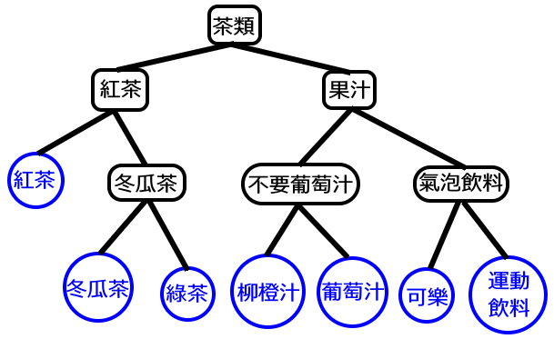
Decision Tree Problem

Slide 5
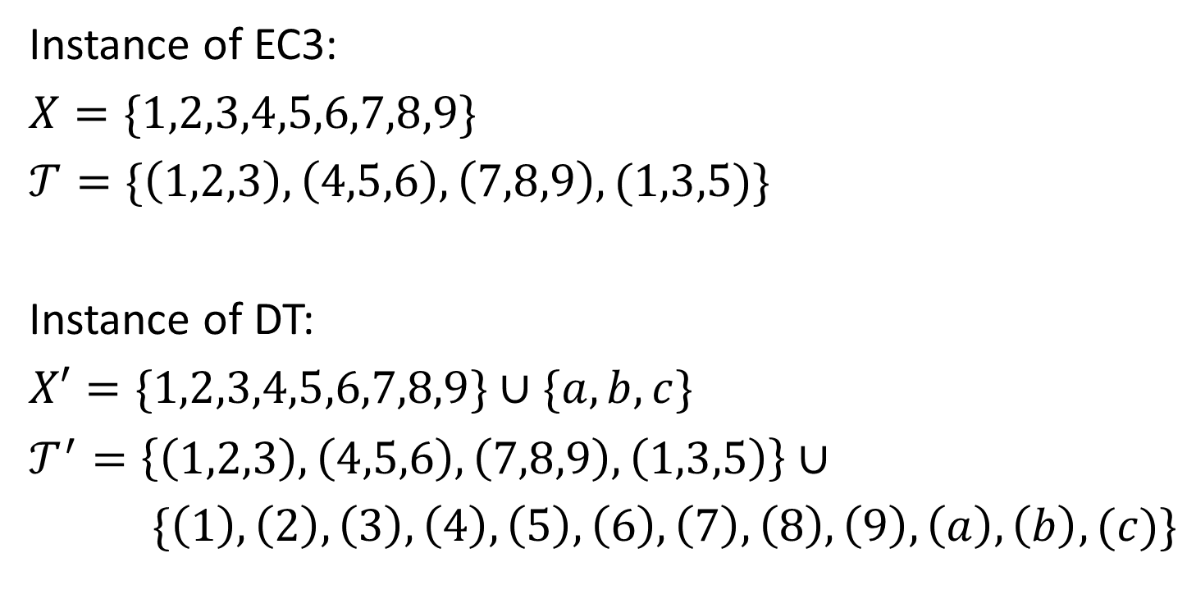

EC3$∝$DT
Instance of EC3:
$X=\{1,2,3,4,5,6,7,8,9\}$
$𝒯=\{\left(1,2,3\right),\left(4,5,6\right),\left(7,8,9\right),(1,3,5)\}$
Instance of DT:
$X′=\{1,2,3,4,5,6,7,8,9\}∪\{a,b,c\}$
$𝒯^{′}=\left\{\left(1,2,3\right),\left(4,5,6\right),\left(7,8,9\right),\left(1,3,5\right)\right\}∪$
$\{\left(1\right),\left(2\right),\left(3\right),\left(4\right),\left(5\right),\left(6\right),\left(7\right),\left(8\right),\left(9\right),\left(a\right),\left(b\right),(c)\}$

Slide 6
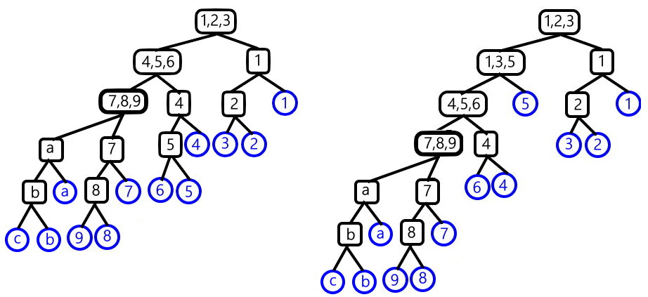
EC3$∝$DT

Slide 7

$f\left(1\right)=0$
$f\left(2\right)=2$
$f\left(3\right)=5$
$f\left(n\right)=\min_{1≤i≤3}\left[f\left(n−i\right)+f\left(i\right)+n\right] for n≥4$

