Slide 1
Fast Algorithm for the Constrained Longest Common Subsequence Problem
Theoretical and Applied Informatics
Vol. 19 (2007), no. 2 pp. 91–102
Sebastian Deorowicz
Presenter：Siang-Huai Hung
Date：2016/06/27

Slide 2
Abstract
The problem of finding the constrained longest common subsequence (CLCS) for the sequences A and B with respect to the sequence P was introduced recently. Its goal is to find the longest subsequence of A and B such that P is a subsequence of it. The best known algorithms for its solving require time of order of a product of the sequence lengths. We introduce a novel approach in which time and space complexities depend also on the number of matches between A, B, and P. The time complexity is better for typical parameter settings and never worse.

Slide 3
CLCS
A = a₁a₂…a_{n} = ABAADACBAABC , n = 12
B = b₁b₂…b_{m} = CBCBDAADCDBA, m = 12
C = LCS(A, B) = B A A D C B A, | C | = 7
P = p₁p₂…p_{r} = CBB, r = 3
P is not a subsequence of C

Slide 4
CLCS
A = a₁a₂…a_{n} = ABAADACBAABC , n = 12
B = b₁b₂…b_{m} = CBCBDAADCDBA, m = 12
P = CBB
C = CLCS(A, B) = B C B A A B, | C | = 6

Slide 5
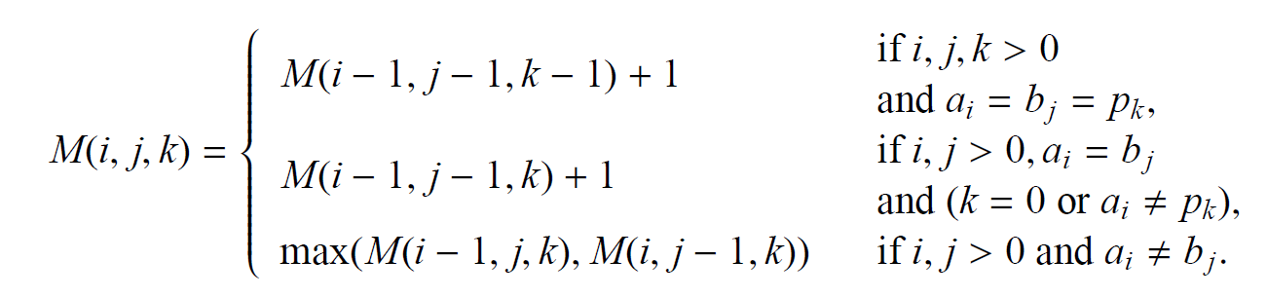
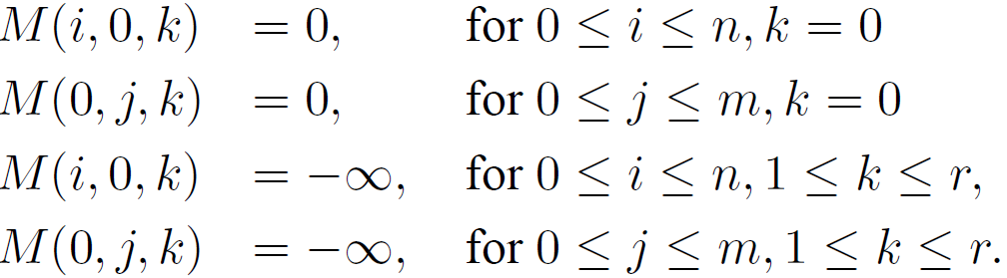
Chin et al. [2004]
O( rmn )
A_{i} = B_{j} = P_{k} : strong match

Slide 6
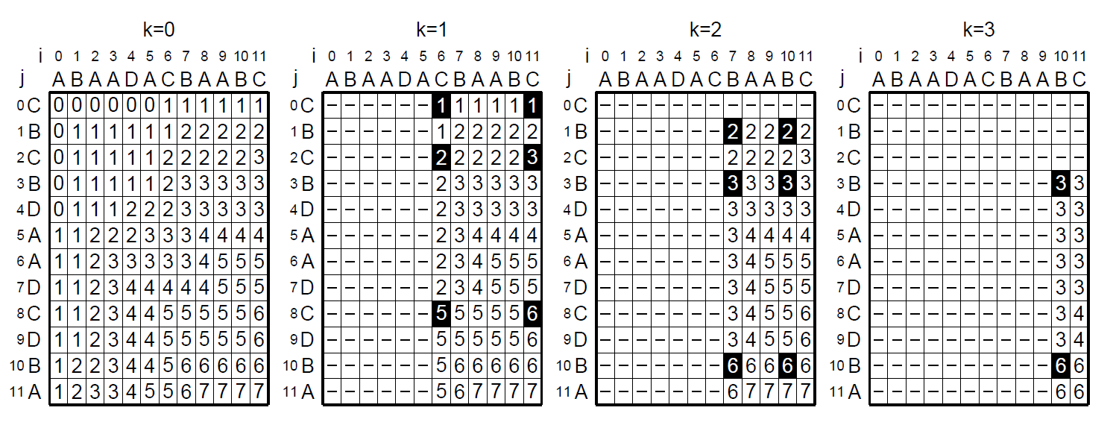
A = ABAADACBAABC
B = CBCBDAADCDBA
P = CBB
Notes:
Grayed cells denote strong matches and ‘–’ symbols denote −∞ values.

Slide 7
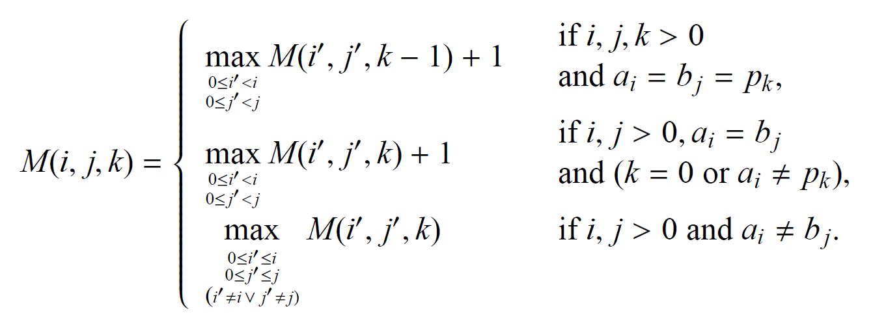
Our algorithm

Slide 8
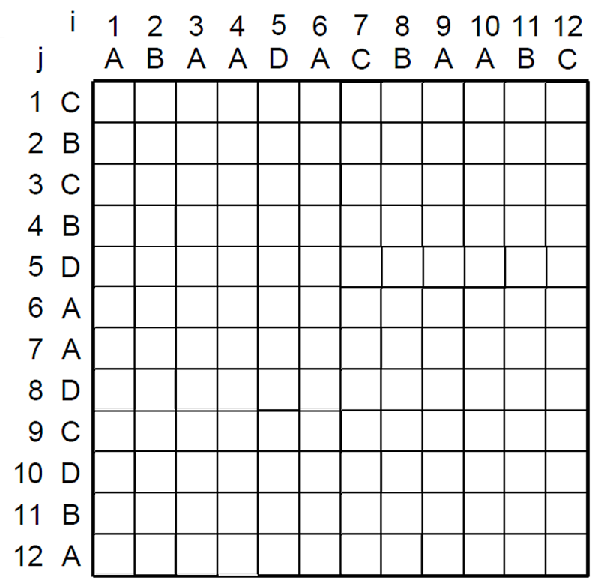
case1
case2
case3
K-1
K
Case1:

Slide 9
case1
case2
case3
Case2:
Case3:

Slide 10
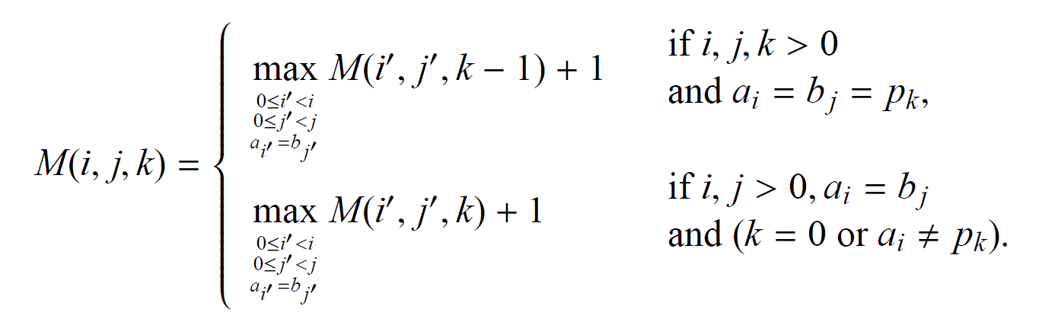

Slide 11
case1
case2
K-1
K
Case1:

Slide 12
case1
case2
Case2:

Slide 13
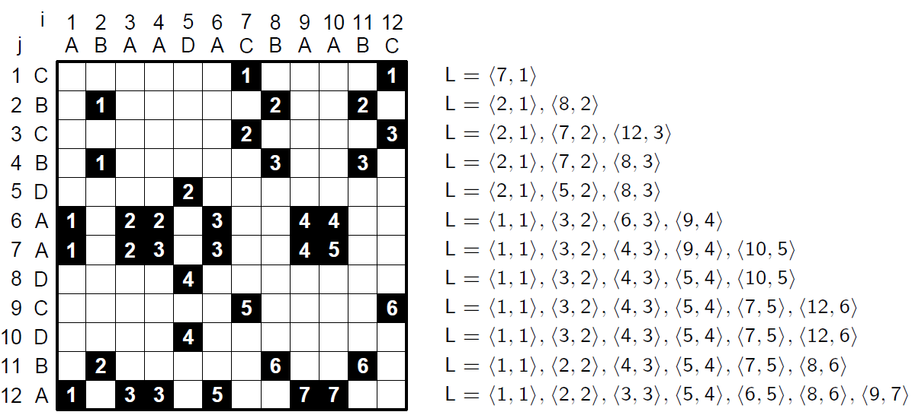
Variant of the Hunt-Szymanski

Slide 14
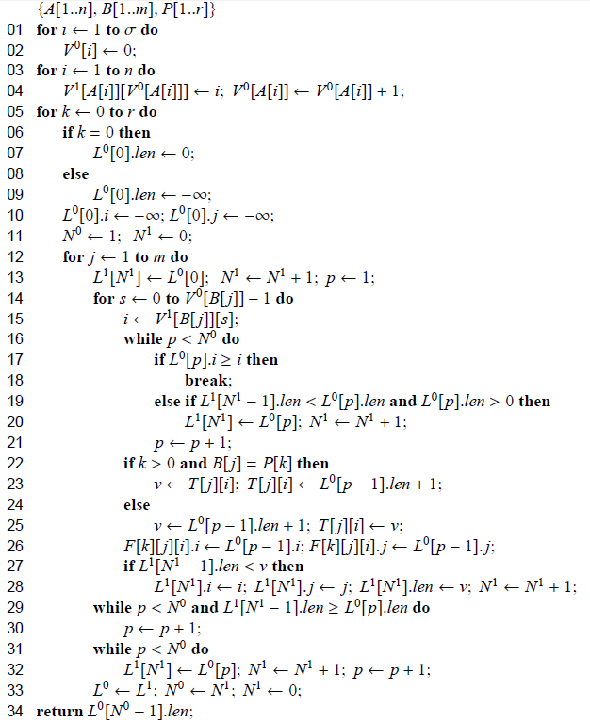
Algorithm computing the length of the CLCS

Slide 15
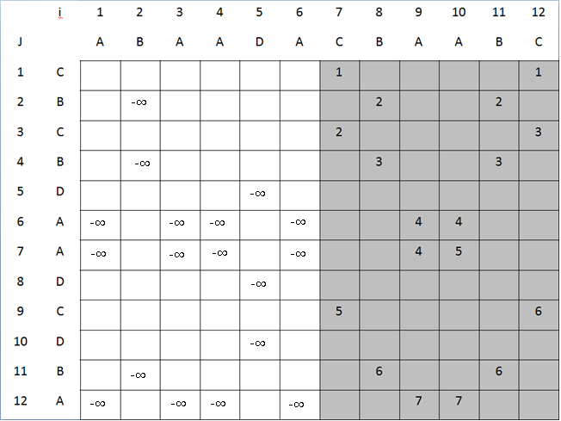
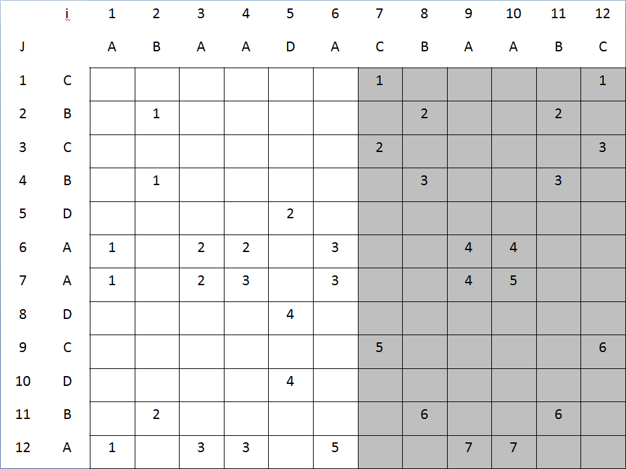
<7,1>
<7,1>,<8,2>
<7,2>,<12,3>
<7,2>,<8,3>
<7,2>,<8,3>
<7,2>,<8,3>,<9,4>
<7,2>,<8,3>,<9,4>,<10,5>
<7,2>,<8,3>,<9,4>,<10,5>
<7,5>,<12,6>
<7,5>,<12,6>
<7,5>,<8,6>
<7,5>,<8,6>,<9,7>

Slide 16
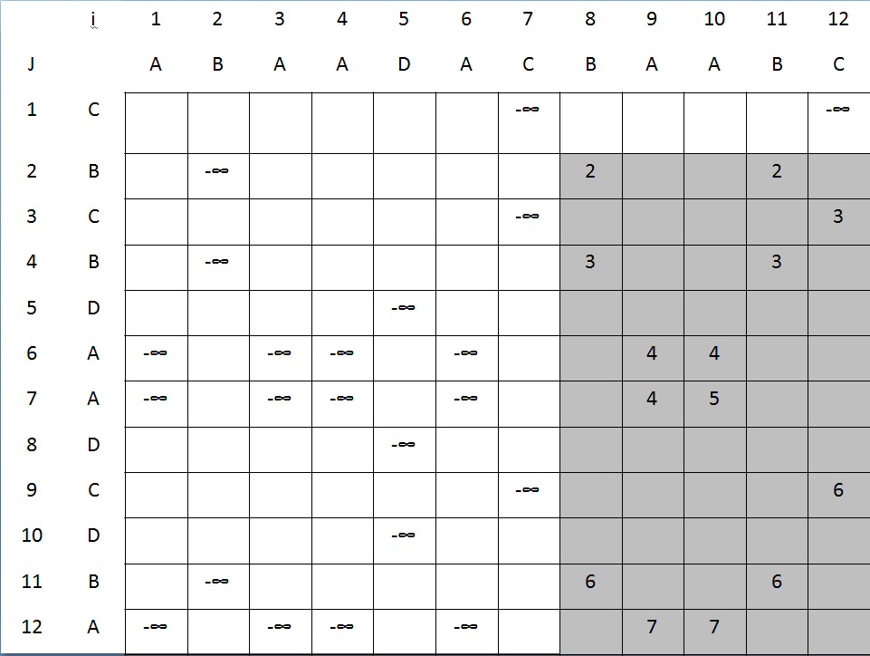
<8,2>
<8,2>,<12,3>
<8,3>
<8,3>
<8,3>,<9,4>
<8,3>,<9,4>,<10,5>
<8,3>,<9,4>,<10,5>
<8,3>,<9,4>,<10,5><12,6>
<8,3>,<9,4>,<10,5><12,6>
<8,6>
<8,6>,<9,7>

Slide 17
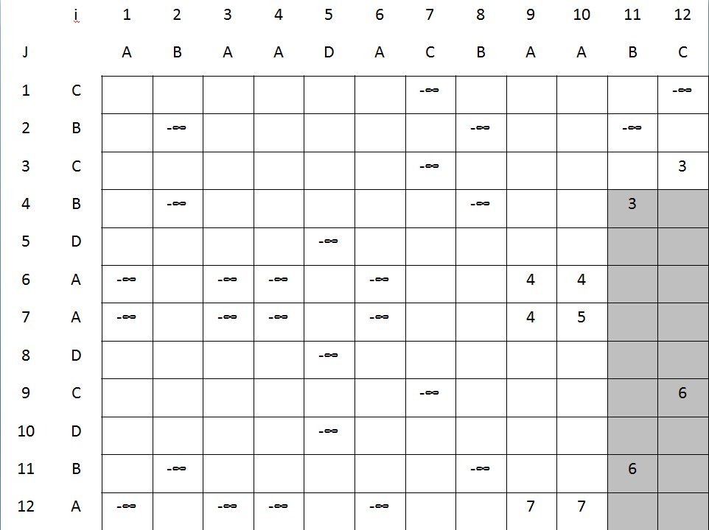
<11,3>
<11,3>
<11,3>
<11,3>
<11,3>
<11,3>,<12,6>
<11,3>,<12,6>
<11,6>
<11,6>

Slide 18
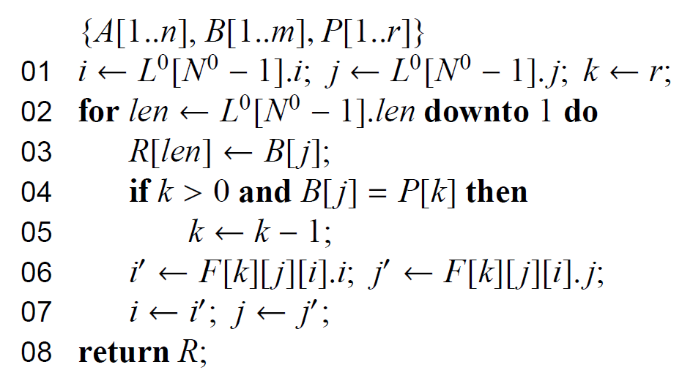
Algorithm computing the CLCS

Slide 19
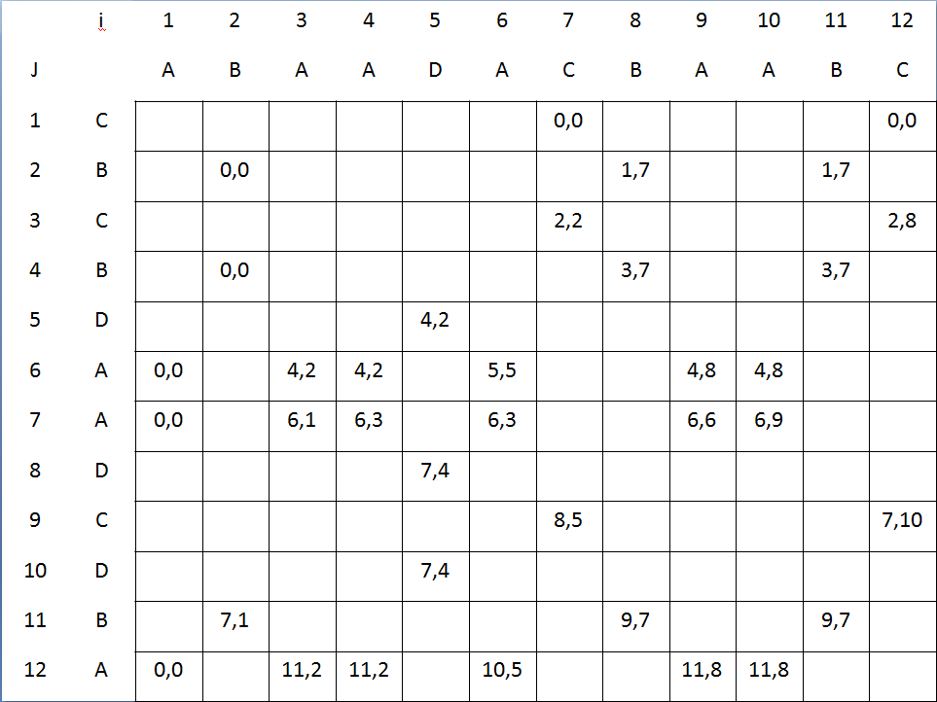
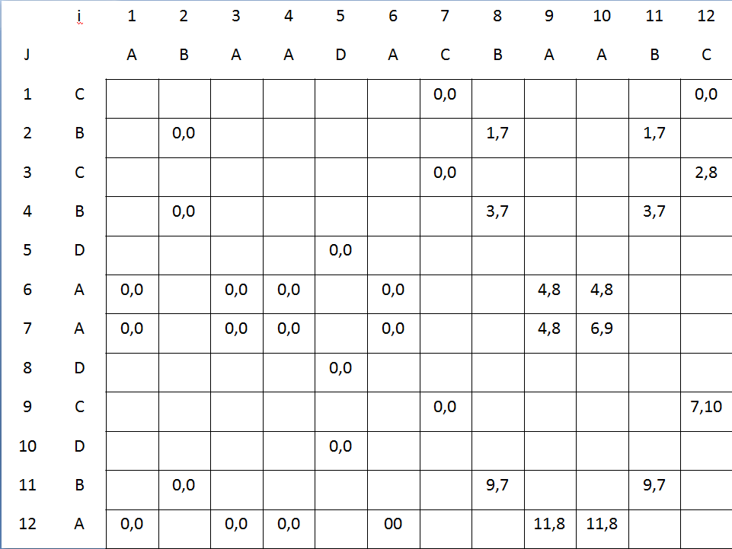
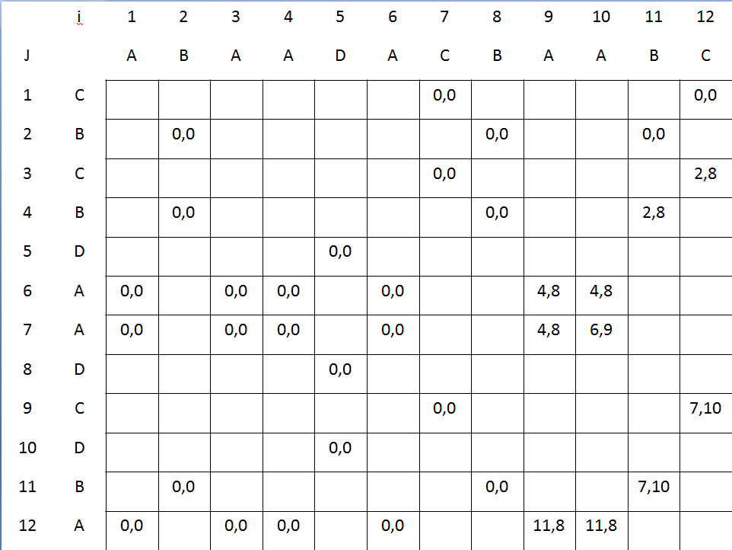
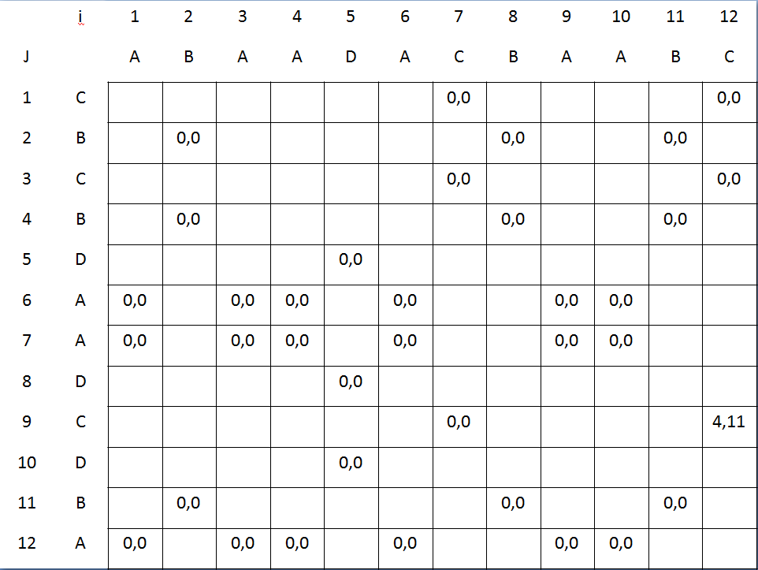
K=1
K=0
B
C
K=2
K=3
B
A
B
A

Slide 20
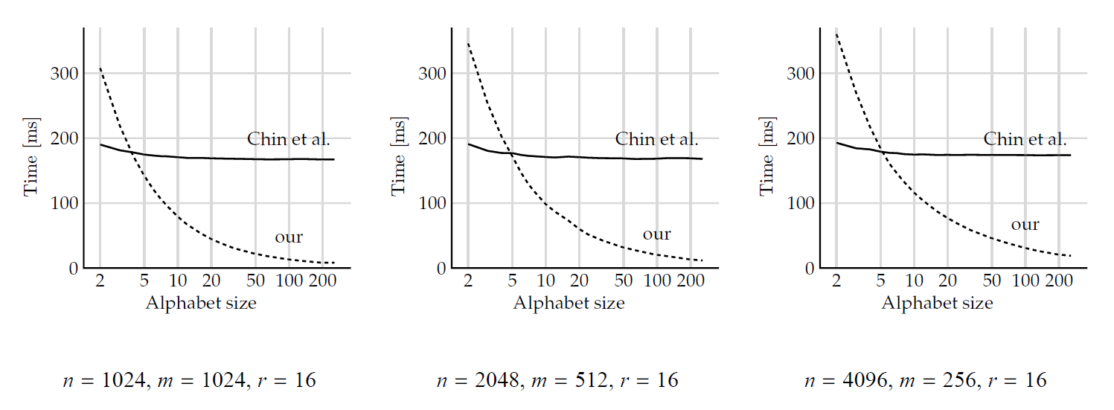
Experimental results(1/2)

Slide 21
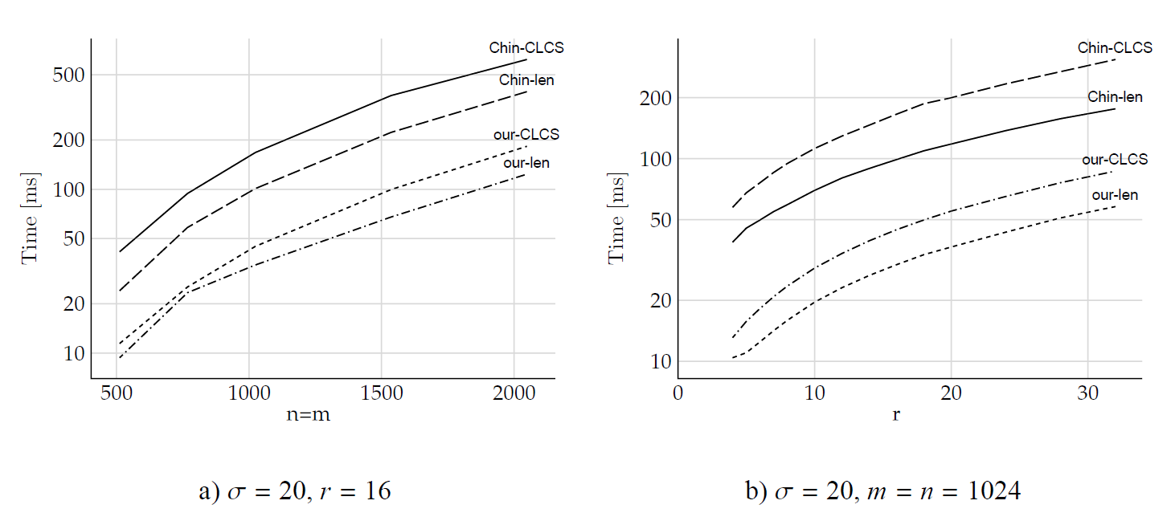
Experimental results(2/2)

Slide 22
Conclusions
The time complexity of the method is
O(r(ml + d) + n), where l is the LCS length for A and B and d is the number of matches between A and B.
The memory requirements of our algorithm is O(dr +max(n, σ)), where σ is the alphabet size.

Slide 23
Thanks for listening

