Slide 1
Maria-Elena Nilsback and Andrew Zisserman Proceedings of the IEEE Conference on Computer Vision and Pattern Recognition, 2006
Automated flower classification over a large number of classes
Presenter：Wei-Hao Fu
Date：2016/ 09/ 06
Notes:
1

Slide 2
Abstract(1/2)
We investigate to what extent combinations of features can improve classification performance on a large dataset of similar classes. To this end we introduce a 103 class flower dataset. We compute four different features for the flowers, each describing different aspects, namely the local shape/texture, the shape of the boundary, the overall spatial distribution of petals, and the colour. We combine the features using a multiple kernel framework with a SVM classifier.

Slide 3
Abstract(2/2)
The weights for each class are learnt using the method of Varma and Ray [16], which has achieved state of the art performance on other large dataset, such as Caltech 101/256. Our dataset has a similar challenge in the number of classes, but with the added difficulty of large between class similarity and small within class similarity. Results show that learning the optimum kernel combination of multiple features vastly improves the performance, from 55.1% for the best single feature to 72.8% for the combination of all features.

Slide 4
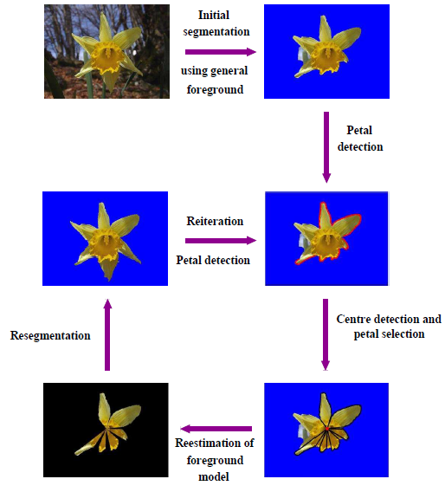
Segmentation

Slide 5
Features-Colour
Using HSV space: because it is less sensitive to variations in illumination and should be able to cope better with pictures of flowers taken in different weather conditions and at different time of the day.
The HSV values for each pixel in an image clustered using k-means.

Slide 6
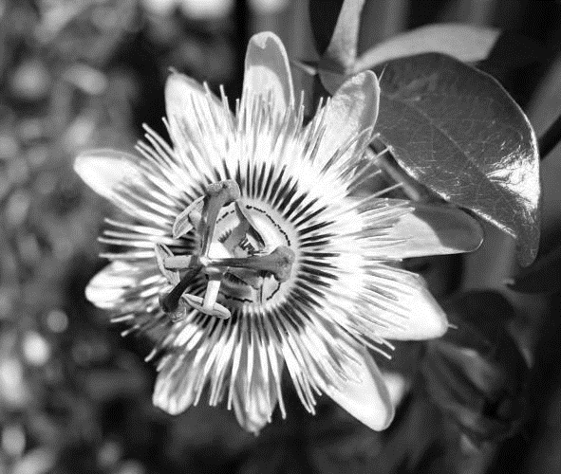
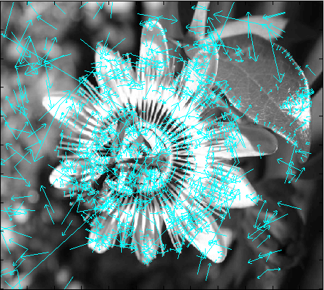
Features-SIFT(1/2)
目的：偵測與描述影像中的局部性特徵，它在空間尺度中尋找極值點，並提取出其位置、尺度、旋轉不變數。
特點：
與影像的大小和旋轉無關。
對於光線、雜訊及些微視角的改變容忍度高。

Slide 7
Features-SIFT(2/2)
SIFT on the foreground region:
The SIFT features describe both the texture and the local shape of the flower.
SIFT on the foreground boundary:
Give greater emphasis to the local shape of the boundary.

Slide 8
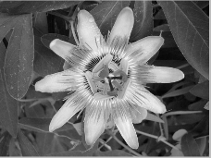
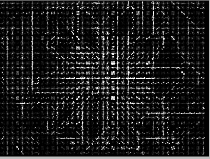
Features-HOG(1/2)
目的：計算局部圖像梯度方向訊息的統計值。
特點：
對於圖像幾何和光學的形變都能保持良好的不變性。
允許細微的動作。（例如：人保持站立時，手腳可以稍微伸展、彎曲，並不會影響到檢測的效果。）

Slide 9
Features-HOG(2/2)
It captures the more global spatial distribution of the flower, such as the overall arrangement of petals.

Slide 10
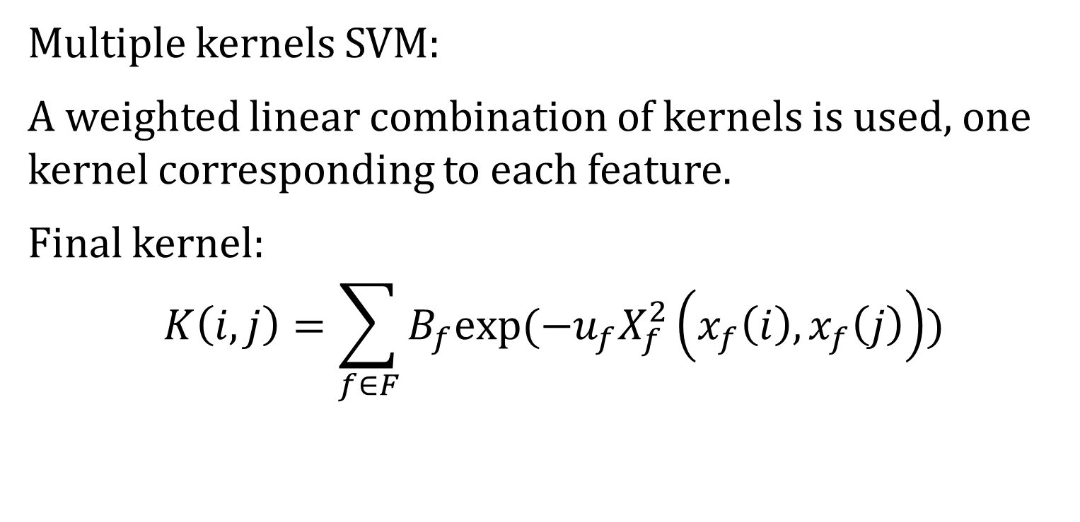
Classification
Multiple kernels SVM:
A weighted linear combination of kernels is used, one kernel corresponding to each feature.
Final kernel:
$$K\left(i, j\right)=\sum_{f∈F}{B_{f}exp⁡(−u_{f}X_{f}^{2}\left(x_{f}\left(i\right), x_{f}\left(j\right)\right))}$$

Slide 11
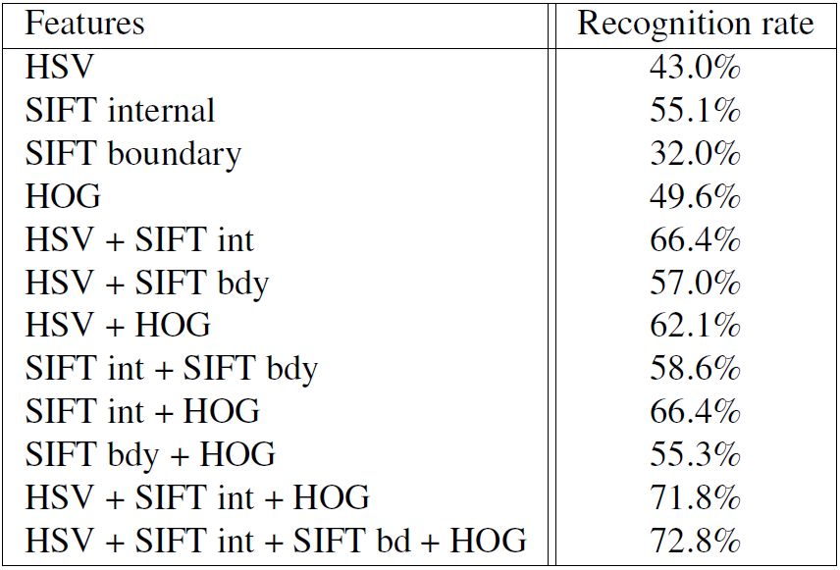
Result

