Slide 1
Learning DTW-Shapelets for Time-Series Classification
Mit Shah,
Josif Grabocka,
Nicolas Schilling,
Martin Wistuba,
Lars Schmidt-Thieme,
CODS '16 Proceedings of the 3rd IKDD Conference on Data Science, 2016
Presenter : Presenter: Shu-Kai Hung Date:2016/11/15
Notes:
希爾德斯海姆大學 德國

Slide 2
Abstract(1/3)
Shapelets are discriminative patterns in time series, that best predict the target variable when their distances to the respective time series are used as features for a classier. Since the shapelet is simply any time series of some length less than or equal to the length of the shortest time series in our data set, there is an enormous amount of possible shapelets present in the data. Initially, shapelets were found by extracting numerous candidates and evaluating them for their prediction quality. Then, Grabocka et al. [2] proposed a novel approach of learning time series shapelets called LTS.

Slide 3
Abstract(2/3)
A new mathematical formalization of the task via a classication objective function was proposed and a tailored stochastic gradient learning was applied. It enabled learning near-to-optimal shapelets without the overhead of trying out lots of candidates. The Euclidean distance measure was used as distance metric in the proposed approach. As a limitation, it is not able to learn a single shapelet, that can be representative of dierent subsequences of time series, which are just warped along time axis.

Slide 4
Abstract(3/3)
To consider these cases, we propose to use Dynamic Time Warping (DTW) as a distance measure in the framework of LTS. The proposed approach was evaluated on 11 real world data sets from the UCR repository and a synthetic data set created by ourselves. The experimental results show that the proposed approach outperforms the existing methods on these data sets.

Slide 5
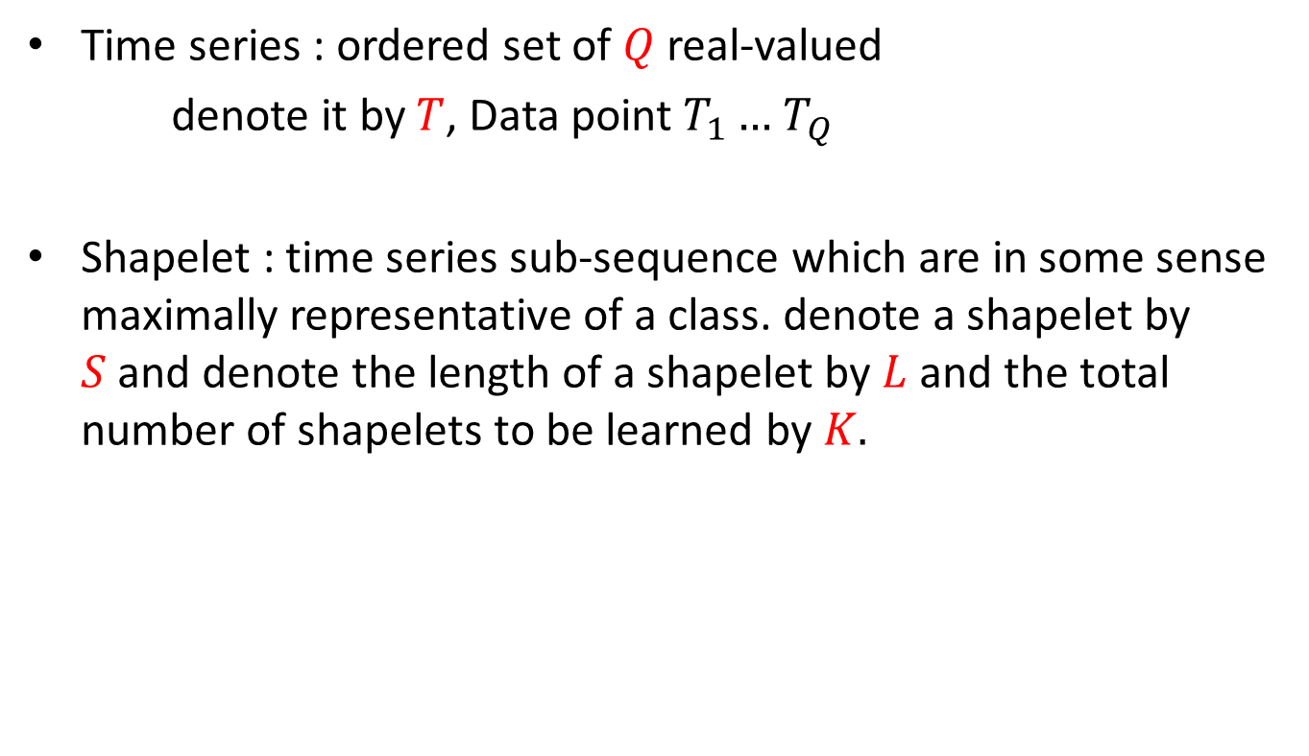
Definition
Time series : ordered set of $Q$ real-valued
denote it by $T$, Data point $T_{1}…$ $T_{Q}$
Shapelet : time series sub-sequence which are in some sense maximally representative of a class. denote a shapelet by $S$and denote the length of a shapelet by $L$ and the total number of shapelets to be learned by $K.$

Slide 6
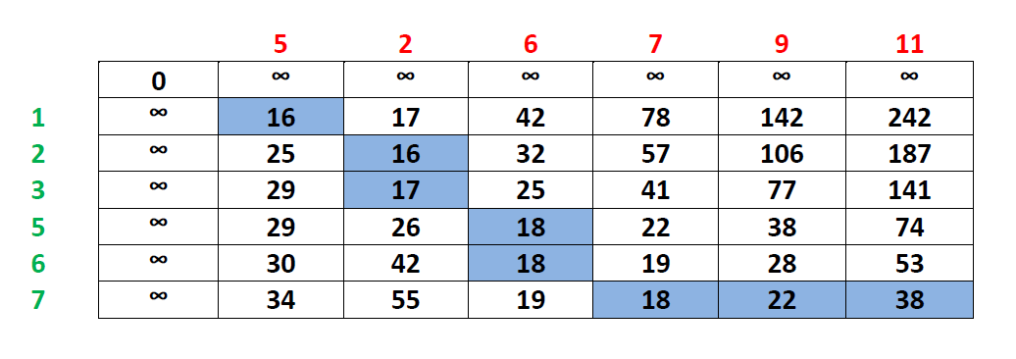

DTW distance :
Two time series $T$ and $T^{′}$ with length $q$ and $q^{′}$

Slide 7

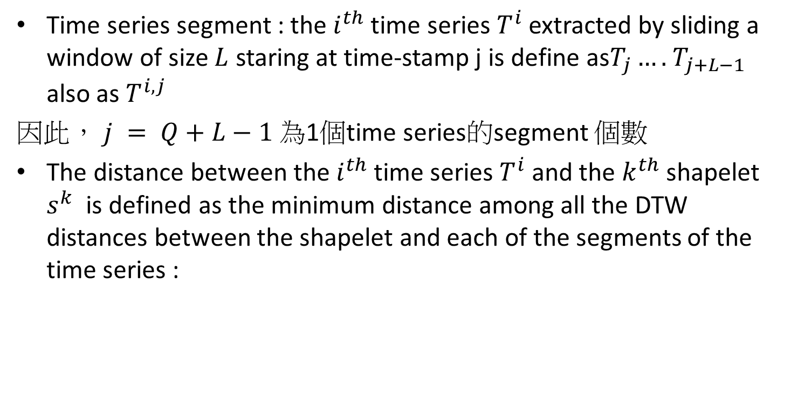
Time series segment and shapelet
Time series segment : the $i^{th}$ time series $T^{i}$ extracted by sliding a window of size $L$ staring at time-stamp j is define as$T_{j}….$ $T_{j+L−1}$ also as $T^{i,j}$
因此， $j = Q+L−1$為1個time series的segment 個數
The distance between the $i^{th}$ time series $T^{i}$ and the $k^{th}$shapelet $s^{k}$ is defined as the minimum distance among all the DTW distances between the shapelet and each of the segments of the time series :

Slide 8
Learning Time Series Shapelets withDTW (LTSD)
LTS distance measure 方式變為 DTW (原為Euclidean distance)
LTSD 步驟
1. 利用minimum distance among all the DTW distances between the shapelet and each of the segments of the time series 建立model
2. 利用邏輯回歸分析模型讓預測目標為概率性
3.導出損失函數及正則化表示正則化目標函數
4. 隨機梯度下降法
Notes:
损失函数（loss function）是用来估量你模型的预测值f(x)与真实值Y的不一致程度
正則化中我們將保留所有的特徵變量，但是會減小特徵變量的數量級（參數數值的大小θ(j)）。
這個方法非常有效，當我們有很多特徵變量時，其中每一個變量都能對預測產生一點影響。正如我們在房價預測的例子中看到的那樣，我們可以有很多特徵變量，其中每一個變量都是有用的，因此我們不希望把它們刪掉，這就導致了正則化概念的發生。
接下來我們會討論怎樣應用正則化和什麼叫做正則化均值，然後將開始討論怎樣使用正則化來使學習算法正常工作，並避免過擬合。

Slide 9


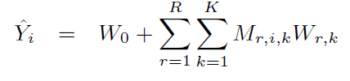
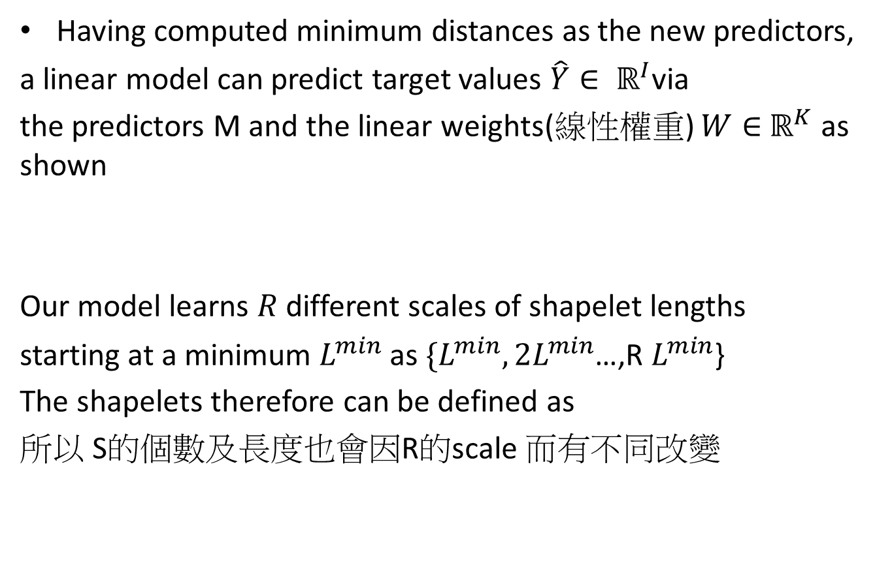
MODEL
Having computed minimum distances as the new predictors,
a linear model can predict target values $\hat{Y}∈ ℝ^{I}$via
the predictors M and the linear weights(線性權重) $W∈$ $ℝ^{K}$ as shown
Our model learns $R$ different scales of shapelet lengths
starting at a minimum $L^{min}$ as $\{L^{min},2L^{min}$…,R $L^{min}$}
The shapelets therefore can be defined as
所以 S的個數及長度也會因R的scale 而有不同改變
Notes:
Linear weight http://www.ibm.com/support/knowledgecenter/zh-tw/SSLVMB_20.0.0/com.ibm.spss.statistics.help/idh_wlsq.htm
權重也是通過專家給出和曆史資料獲得的。

Slide 10

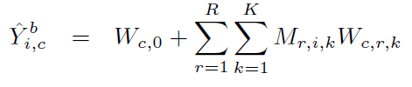
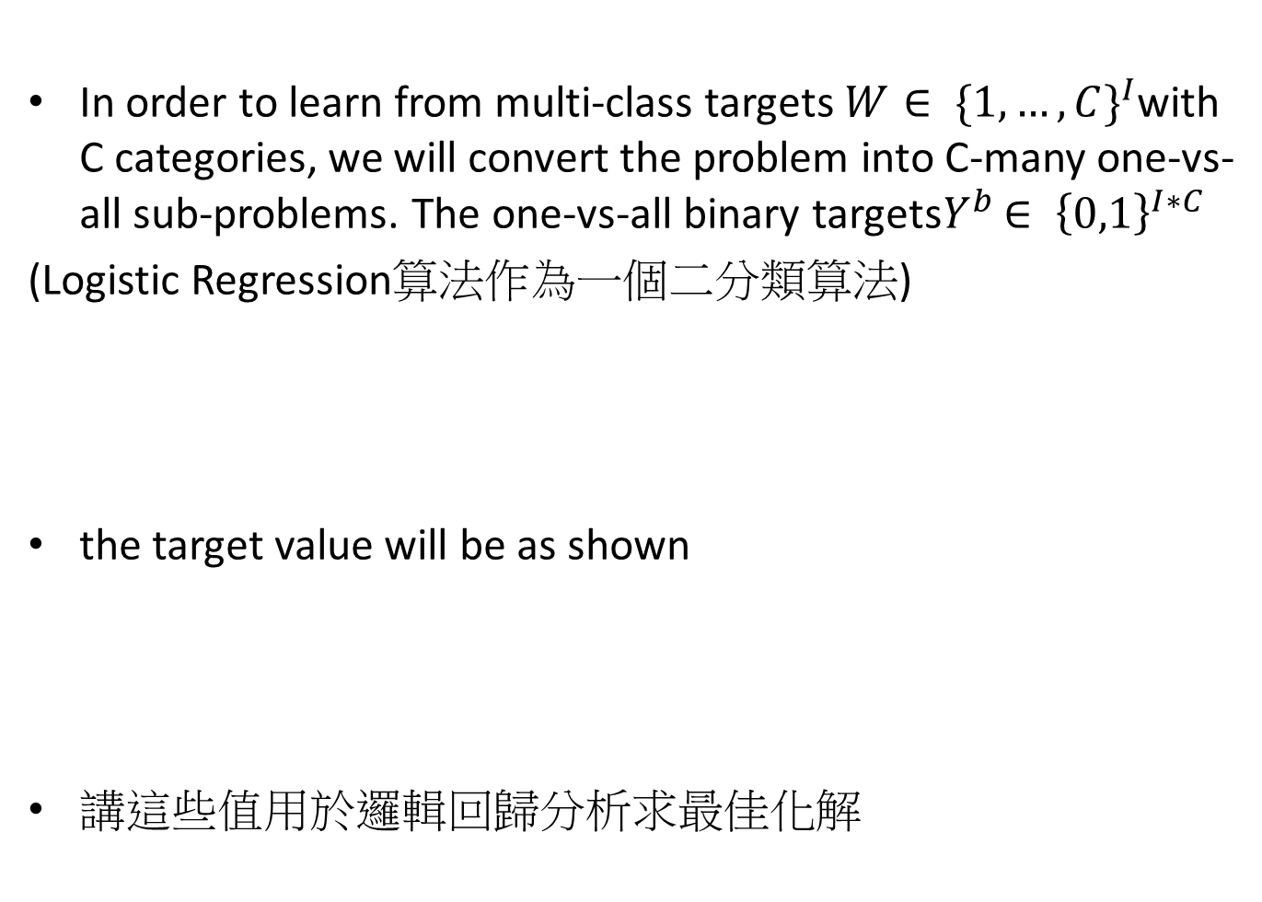
In order to learn from multi-class targets $W∈ {\{1,…,C\}}^{I}$with C categories, we will convert the problem into C-many one-vs-all sub-problems. The one-vs-all binary targets$Y^{b}$ $∈ {\left\{0,1\right\}}^{I∗C}$
(Logistic Regression算法作為一個二分類算法)
the target value will be as shown
講這些值用於邏輯回歸分析求最佳化解
Notes:
http://www.ibm.com/support/knowledgecenter/zh-tw/SSLVMB_20.0.0/com.ibm.spss.statistics.help/idh_wlsq.htm

Slide 11
邏輯回歸分析
線性回歸分析(OLS):在一組資料中找尋最有代表性的一條線
原理 : 最小平方和
受限於很多假設與前提=>Limit Dependent variable(LDV)
最常遇到之LDV =>2元選擇 example : 你是男或女?
非線性 : 邏輯回歸 為其中一種
原理 : 最大可能性 並且最小平方和原理也符合邏輯回歸的原理
邏輯回歸為電腦迭代找出參數值
本篇所用為邏輯回歸

Slide 12
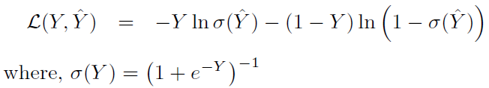
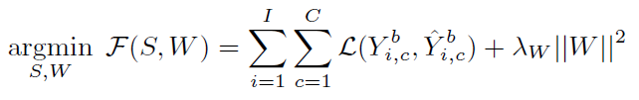
logistic loss function
損失函数（loss function）是用来估量你模型的預測值f(x)與真實值Y的不一致程度 (評估含數好壞)
正則化 : 解決過多特徵且每個特徵都會影響預測時，又不想刪除特徵 所採取的減小特徵量數量級的方法(解決過度擬合問題)
對數損失函數用於估計數據類型
Notes:
https://read01.com/GGDg03.html

Slide 13
對數損失(Log Loss)
log損失函数的標準形式 :L(Y,P(Y|X))=−logP(Y|X)
邏輯回歸推導中 Y 服從 0-1分布(伯努利分布)
求得滿足該分布的預測函數
取對數求極值

Slide 14
邏輯回歸分析流程
邏輯回歸的預測函數
評估函數:評估函數好壞
評估含數利用隨機梯度下降法 求得最小值
推導過程為對預測函數求偏導數

Slide 15

Classification of Test Instances
For multi-class classification, once the model is learned, a test instance indexed t is classified using the one-vs-all classifier which yields maximum confidence,

Slide 16
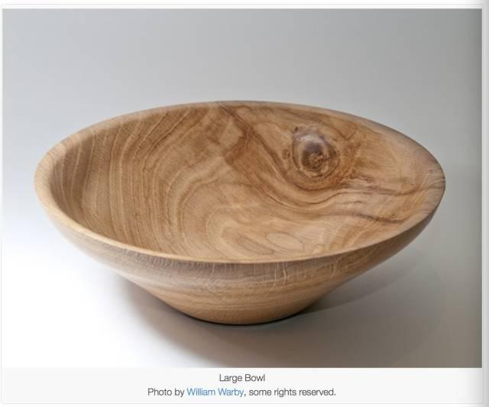
Gradients for Shapelets
尤於為一次一個的去分類，會有分類錯誤
需用隨機梯度下降(stochastic gradient descent)來補償
梯度下降: 尤Hill climbing 衍生，往山上爬時直接走梯度(傾斜程度,DTW梯度)方向找最佳解
方法: 設定參數初始值 (通常為0) 計算成本函數(碗的造型) 然後 導函數(計算資料某點的斜率) 並設定學習效率參數(alpha)的值。
coefficient=0
cost=f(coefficient)
coefficient=coefficient−(alpha∗delta)
當參數收斂，即能獲得最優解
Notes:
coefficient=coefficient−(alpha∗delta)
碗表面上的任一隨機位置表示當前係數對應的成本值，碗的底部則表示最優解集對應的成本函數值。梯度下降法的目標就是不斷地嘗試不同的係數值，然後評估成本函數並選擇能夠降低成本函數的參數值。重複疊代計算上述步驟直到收斂，我們就能獲得最小成本函數值對應的最優解 原文網址：https://read01.com/0kaKGB.html 原文網址：https://read01.com/0kaKGB.html

Slide 17
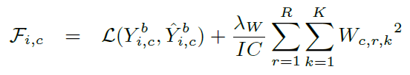
隨機梯度下降(stochastic gradient descent)
通常用於大資料量，給予隨機訓練樣本每次去更新參數，評估成本函數，然後找到最佳解
對於大規模數據來說，收斂速度明顯高於其他算法
所有梯度下降法 都有區域極值的問題

Slide 18
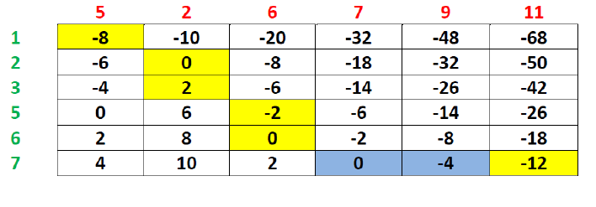
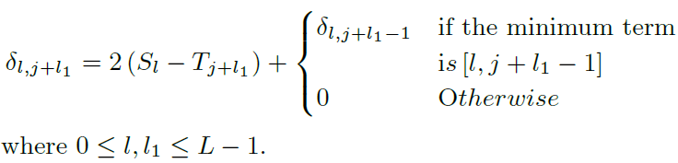
DTW Gradient

Slide 19
