Slide 1
The String-to-String Correction Problem with Block Moves
Walter F. Tichy
ACM Transactions on Computer Systems (TOCS)
Volume 2 Issue 4, Nov. 1984, Pages 309-321
Presenter: Chong-Xuan Lo
Date:2016/11/15

Slide 2
Abstract(1/2)
The string-to-string correction problem is to find a minimal sequence of edit operations for changing a given string into another given string. Extant algorithms compute a longest common subsequence (LCS) of the two strings and then regard the characters not included in the LCS as the differences. However, an LCS does not necessarily include all possible matches, and therefore does not produce the shortest edit sequence. An algorithm that produces the shortest edit sequence transforming one string into another is presented. The algorithm is optimal in the sense that it generates a minimal covering set of common substrings of one string with respect to another.

Slide 3
Abstract(2/2)
Two improvements of the basic algorithm are developed. The first improvement performs well on strings with few replicated symbols. The second improvement runs in time and space linear to the size of the input. Efficient algorithms for regenerating a string from an edit sequence are also presented.

Slide 4
Edit distance
S = shanghai T = sakhalin
The following edit script, based on the LCS sahai , would
construct the target string sakhalin from shanghai:
M 0 , 1 - s
M 2 , 1 - sa
A "k" - sak
M 5 , 2 - sakha
A "l" - sakhal
M 7 , 1 - sakhali
A "n" - sakhalin

Slide 5
Block move
A block move is a triple (p, q, l) such that
S [ p . . . . , p + l - 1 ] = T [ q . . . . , q + l - 1 ]
( 0 ≦ p ≦ n - l + l , 0 ≦ q ≦ m - l + l , l > 0).
A block move represents a nonempty , common substring of S and T with length l
S= abda ,T = abcab is { (0,0,2) , (0,3,2) }

Slide 6

Block move
Wagner（1974）did not permit crossing block moves, and
required a one-to-one correspondence between characters of
source and target strings.
傳統LCS 與 解除限制後的字串
Notes:
WAGNER, R. A., AND FISHER, M.J. The string-to-string correction problem. J. ACM 21, 1 (Jan. 1973), 168-173.

Slide 7
Basic algorithm
The problem is to find a minimal covering set (set of block moves)
S = vwvwxy T = zvwxw
Step 1:
S = v w v w x y
T = | z v w x w longest block move starting with T[0]: none
Step 2:
S = v w v w x y
T = z | v w x w longest block move starting with T[1]: (2, 1, 3)
Step 3:
S = v w v w x y
T = z v w x | w longest block move starting with T[4]: (1, 4, 1)

Slide 8
First improvement of the basic algorithm
We prepare an index that , for each symbol ‘v’ in the alphabet ,lists the positions of all occurrences of ‘v’ and S.
Assume T[q] = ‘v’ is the first symbol of the unmatched tail of T. Lookup the list L of occurrences of symbol ‘v’ in S, using the above index.
S = v w v w x y
T = z v w x w
The run time of the algorithm is O ( m n / α) .

Slide 9
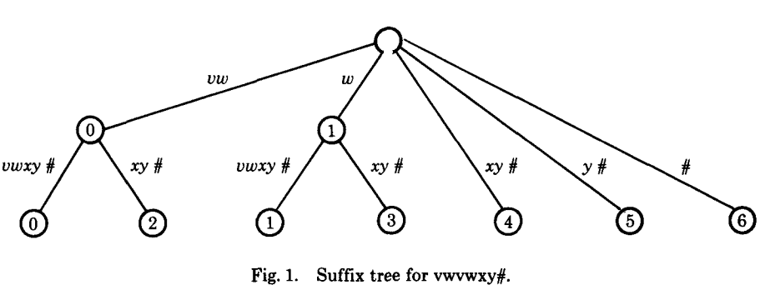
Second improvement of the basic algorithm
An adequate data structure for this purpose is a suffix tree. Given the
source string S, append a unique character # to it and build a tree for
all suffixes of S#.
S = v w v w x y
T = z v w x w
Tracing T[1, . . . ] terminates on the arc to the leaf labeled 2,
producing the block move (2, 1, 3).

Slide 10
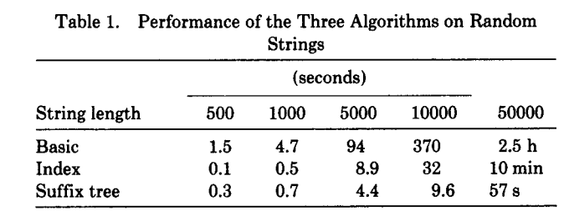
Discussion of the three algorithms

Slide 11
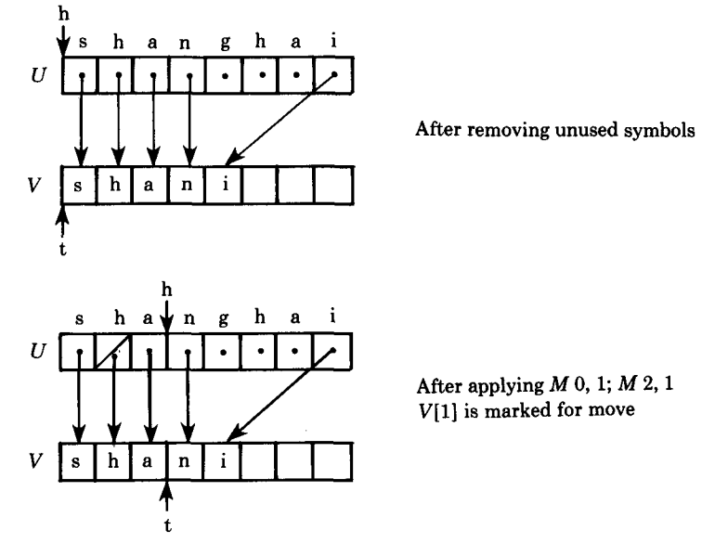
In-place reconstruction
S = shanghai T = sakhalin
Notes:
一個原地算法（in-place algorithm）是一種使用小的，固定數量的額外之空間來轉換資料的算法。當算法執行時，輸入的資料通常會被要輸出的部份覆蓋掉。

Slide 12
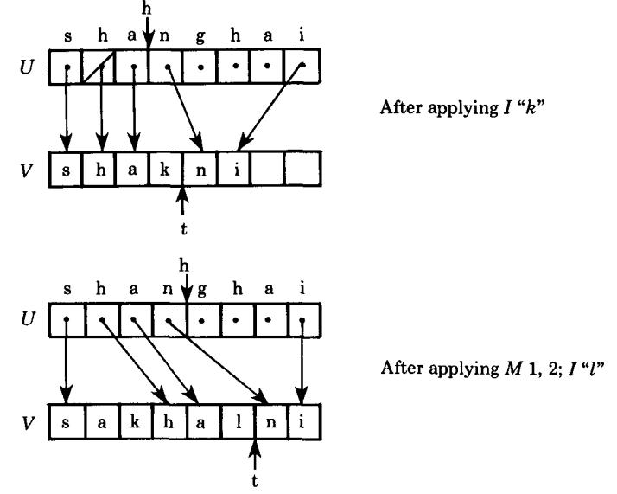
In-place reconstruction
S = shanghai T = sakhalin

Slide 13
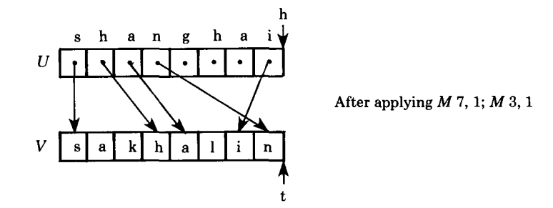
In-place reconstruction
S = shanghai T = sakhalin

Slide 14
Conclusion
The block move algorithm presented here runs in linear time and space.
Reconstructing the target string is equally efficient for both methods, provided that the source string can be accessed randomly.

