Slide 1
Recurrent Convolutional Neural Networks for Text Classification
Proceedings of the Twenty-Ninth AAAI Conference on Artificial Intelligence pp.2267-2273, January, 25–30, 2015, Austin, Texas, USA
Siwei Lai, Liheng Xu, Kang Liu, Jun Zhao
Present: Chia-Lin, Chen
Date: Mar. 10th , 2020
Notes:
作者皆為中國科學院自動化研究所(http://www.ia.cas.cn/kygz/yjly/)研究員
查無AAAI2015的會議論文集，只查到Proceedings of 29th AAAI

Slide 2
Abstract(1/2)
Text classification is a foundational task in many NLP applications. Traditional text classifiers often rely on many human-designed features, such as dictionaries, knowledge bases and special tree kernels. In contrast to traditional methods, we introduce a recurrent convolutional neural network for text classification without human-designed features.

Slide 3
Abstract(2/2)
In our model, we apply a recurrent structure to capture contextual information as far as possible when learning word representations, which may introduce considerably less noise compared to traditional window-based neural networks. We also employ a max-pooling layer that automatically judges which words play key roles in text classification to capture the key components in texts. We conduct experiments on four commonly used datasets. The experimental results show that the proposed method outperforms the state-of-the-art methods on several datasets, particularly on document-level datasets.

Slide 4
Text classification
Applications: web searching, information filtering, sentiment analysis
Key problem:
Feature representation
Bag-of-Words(BoW)→unigrams, bigrams, n-grams
Feature selection
Frequency, MI(2012), pLSA(2003), LDA(2013)
The above don’t capture semantics of the sentences.
E.g. “A sunset stroll along the South Bank affords an array of stunning vantage points.”
→Unigrams(“Bank”), bigrams(“South Bank”), 5-grams(stroll along the South Bank )
->Data Sparsity problem ->Accuracy problem
Notes:
sentiment analysis情感分析

Slide 5
Pre-trained word embedding and deep neural networks
Word embedding is a distributed representation of words and greatly alleviates the data sparsity problem
Mikolov, Yih, and Zweig (2013) shows that pre-trained word embeddings can capture meaningful syntactic and semantic regularities.
Recursive Neural Network (RecursiveNN)
Construct a textual tree
Time compexity: O(n^2)
Relationship between two sentences can hardly be represented by a tree structure.
Therefore, RecursiveNN is unsuitable for modeling long sentences or documents.

Slide 6
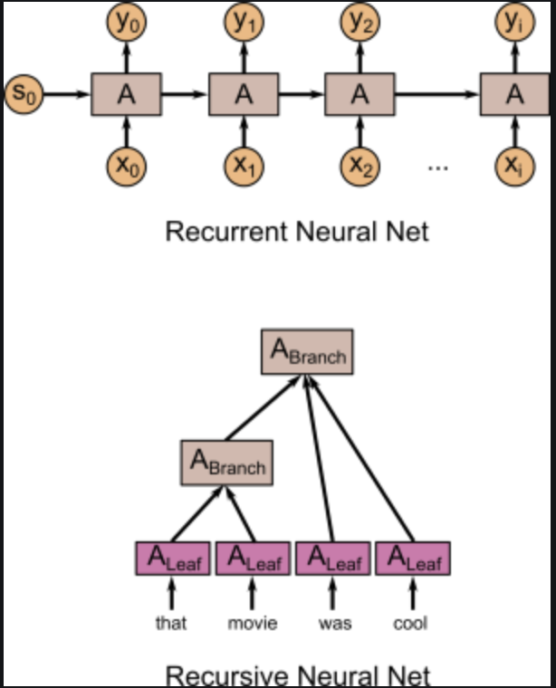
RecursiveNN V.S. RecurrentNN(RNN)

Slide 7
To tackle the bias problem, the Convolutional Neural Network (CNN)
Time Complexity:O(n)
Max-pooling layer: fairly determine discriminative phrases in a text
However, previous study with CNN need fixed window
small window sizes: loss of some critical information
large windows sizes: enormous parameter space → difficult to train

Slide 8
Recurrent Convolutional Neural Network (RCNN)
First: Bi-directional recurrent structure
less noise
capture the contextual information to the greatest extent possible
Second: Max-pooling layer
play key roles to capture key component in the text
Advantage of both recurrent neural models and convolutional neural models
Time Complexity: O(n)

Slide 9
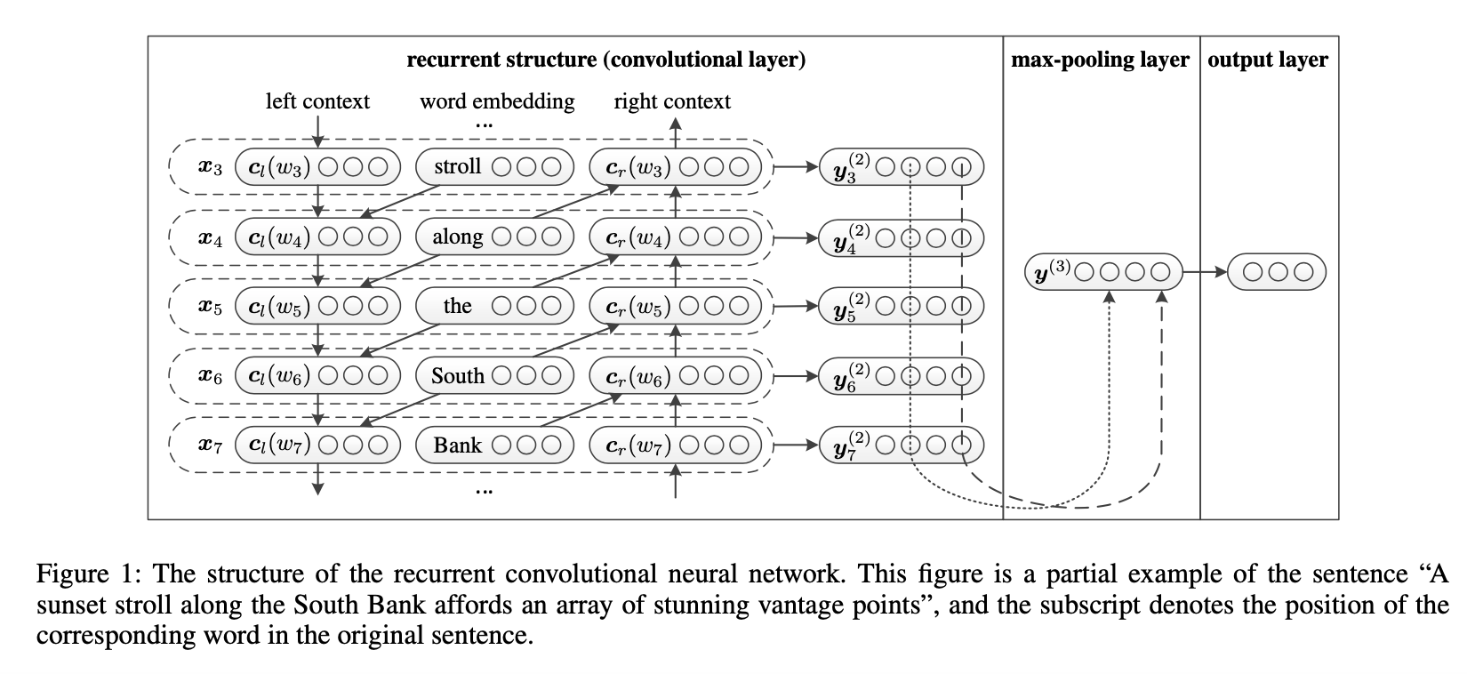

Slide 10
Pre-training Word Embedding
Traditional: one-hot encoding
In this work, they use default word2vec with the Skip-gram model.

Slide 11
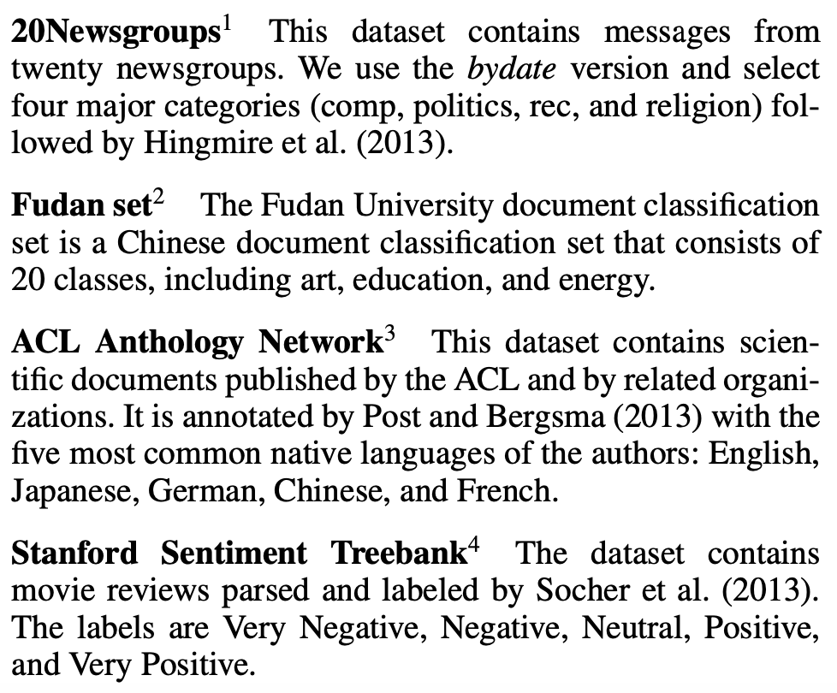
Experiment(1/5)
Datasets: 20Newsgroups, Fudan Set, ACL Anthology Net- work, and Sentiment Treebank.
Segment: English(Stanford), Chinese(ICTCLAS)
Notes:
第一篇20Newsgroups連結失效
Fudan(復旦)大學
ACL(association of computational linguistic) Anthology: 搜集54087篇自然語言處理論文

Slide 12
Experiment(2/5)
Details about the experiment:
Set the learning rate of the stochastic gradient descent α as 0.01,
the hidden layer size as H = 100,
the vector size of the word embedding as |e| = 50
and the size of the context vector as |c| = 50.
Train word embeddings using the default parameter in word2vec with the Skip-gram algorithm.

Slide 13
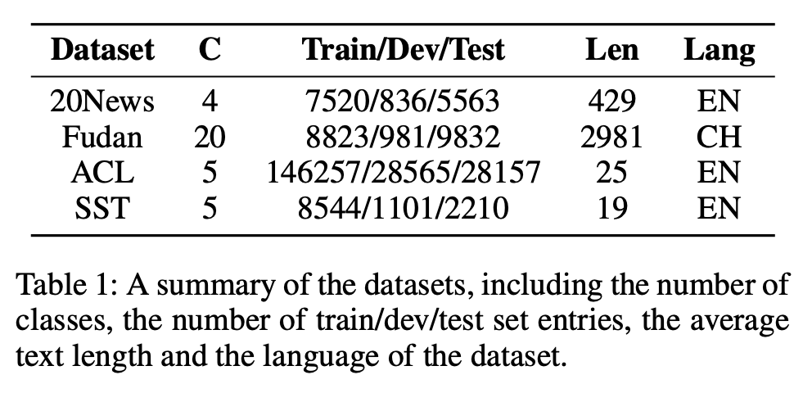
Experiment(3/5)
train
dev
test

Slide 14
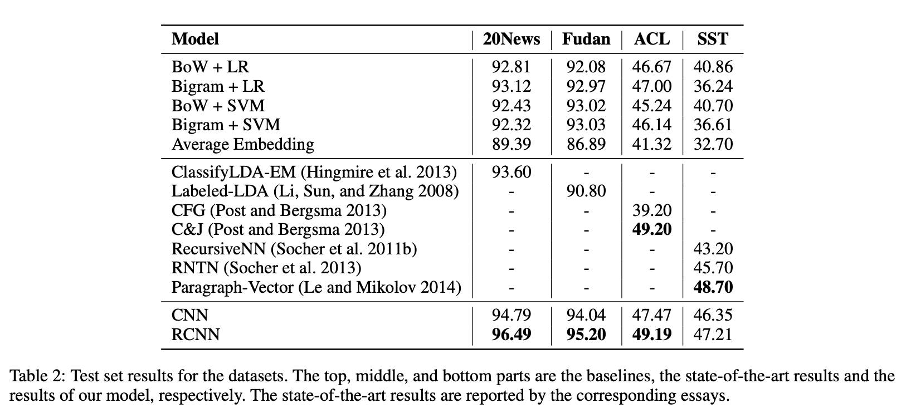
Experiment(4/5)
Notes:
LDA相較於kNN, 每一類的機率都算，並取最高者 亦即，一篇新聞可能政治類機率0.9,體育類0.1,娛樂類0.1

Slide 15
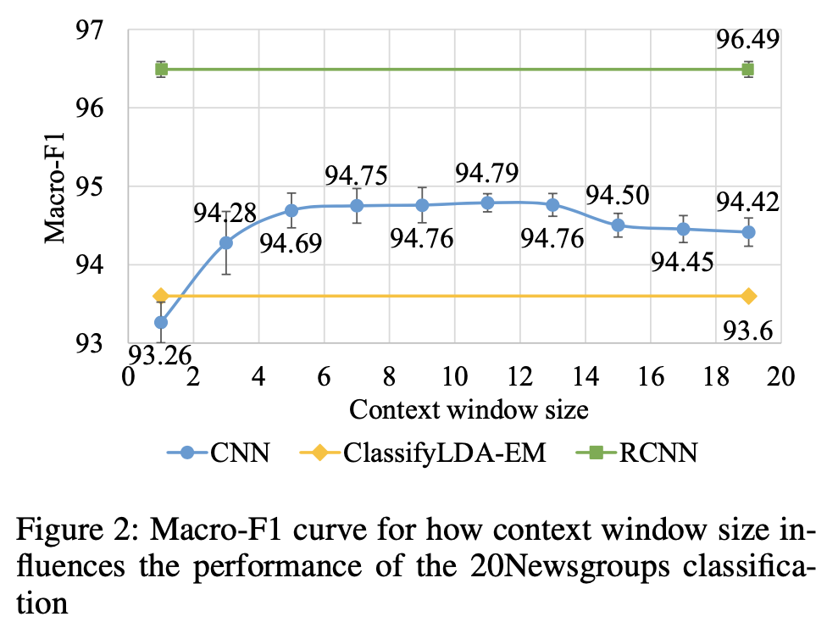
Experiment(5/5)

Slide 16
Conclusion
Recurrent Convolutional Neural Network (RCNN)
Time Complexity: O(n)
No fixed window problem
State-of-the-art(2015) in text classification

Slide 17
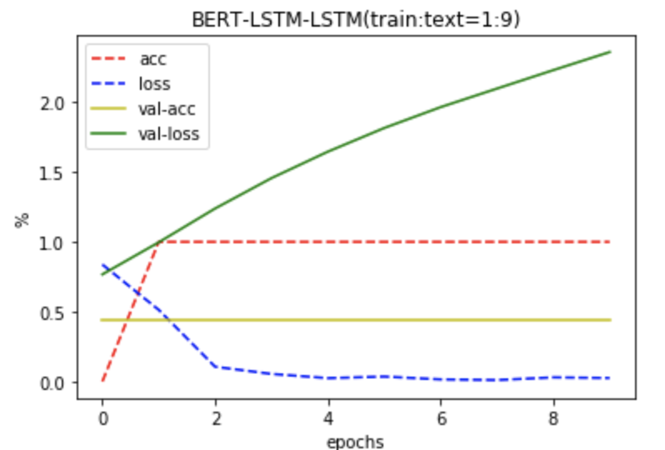
我的實驗進度(跟本篇論文無關)
Dataset: 儒林外史,(2回:18回)
發現:Dataset太小->四條線不正常

Slide 18
Thank you!

