Slide 1
Speed Up Similarity Search of Time Series Under Dynamic Time Warping
ZHENGXIN LI, JIANSHENG GUO, HAILIN LI, TAO WU, SHENG MAO, FEIPING NIE
IEEE Access ( Volume: 7 ), 28 October 2019
Presenter: EN-AN SONG
Date: March 10, 2020

Slide 2
ABSTRACT
Similarity search is a foundational task in time series data mining. Although there are many ways to measure the similarity of time series, a lot of evidence indicates that dynamic time warping (DTW) has the best robustness in many applications. Unfortunately, the expensive computational cost limits its application in large-scale databases. To speed up similarity search under DTW, we design a framework of two-stage similarity search for time series. In the ﬁrst stage, we propose an improved lower bounding distance, which can be used to discard plenty of dissimilar series to get a set of candidate sequences. In the second stage, to efﬁciently get the retrieval result from the set of candidate sequences, we explore early abandoning strategy to avoid the full calculation of DTW. Extensive experiments are conducted on real-world data sets. The experimental results indicate that the proposed method can improve the retrieval efﬁciency of similarity search under DTW and guarantee no false dismissals.

Slide 3
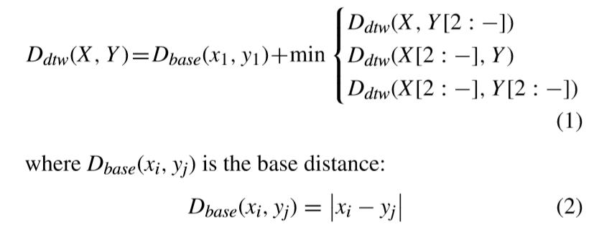
DYNAMIC TIME WARPING
DTW distance between two sequences X =x₁,x₂,··· ,x_{n} and
Y =y₁,y₂,··· ,y_{m}

Slide 4

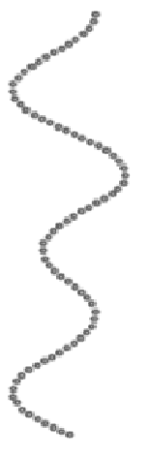
DYNAMIC TIME WARPING
 | 2 | 4 | 2 | 3 | 1 | 4 | 2 | 4
2
5
1
3
2
4 | 2
2 | 0 | 2
 | 2 | 4 | 2 | 3 | 1 | 4 | 2 | 4
2
5
1
3
2
4 | 2
2 | 0
 | 2 | 4 | 2 | 3 | 1 | 4 | 2 | 4
2
5
1
3
2
4
2
 | 2 | 4 | 2 | 3 | 1 | 4 | 2 | 4
2
5
1
3
2
4
2
 | 2 | 4 | 2 | 3 | 1 | 4 | 2 | 4
2
5
1
3
2
4 | 2 | 0
2 | 0 | 2
 | 2 | 4 | 2 | 3 | 1 | 4 | 2 | 4
2
5
1
3
2
4
2 | 0
 | 2 | 4 | 2 | 3 | 1 | 4 | 2 | 4
2 | 7 | 7 | 5 | 5 | 5 | 3 | 1 | 3
5 | 7 | 5 | 5 | 4 | 4 | 1 | 4 | 5
1 | 4 | 6 | 2 | 2 | 0 | 3 | 4 | 7
3 | 3 | 3 | 1 | 0 | 2 | 3 | 4 | 5
2 | 2 | 2 | 0 | 1 | 2 | 4 | 4 | 6
4 | 2 | 0 | 2 | 3 | 6 | 4 | 6 | 6
2 | 0 | 2 | 2 | 3 | 4 | 6 | 6 | 8
 | 2 | 4 | 2 | 3 | 1 | 4 | 2 | 4
2
5
1
3
2
4
2 | 0

Slide 5
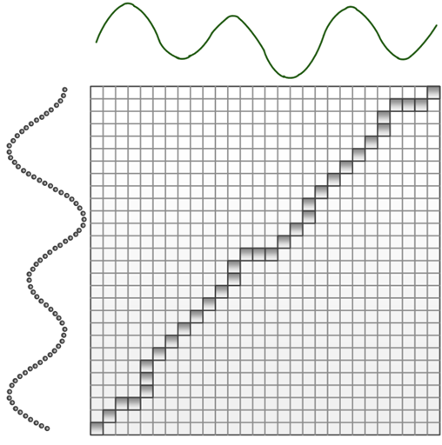
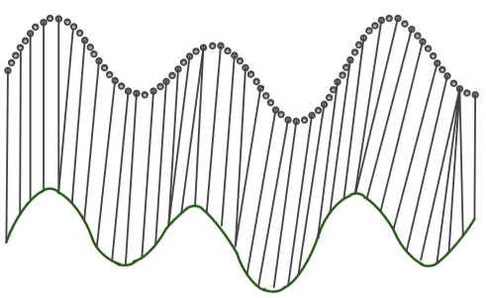
DYNAMIC TIME WARPING
The warping path
The result alignment

Slide 6
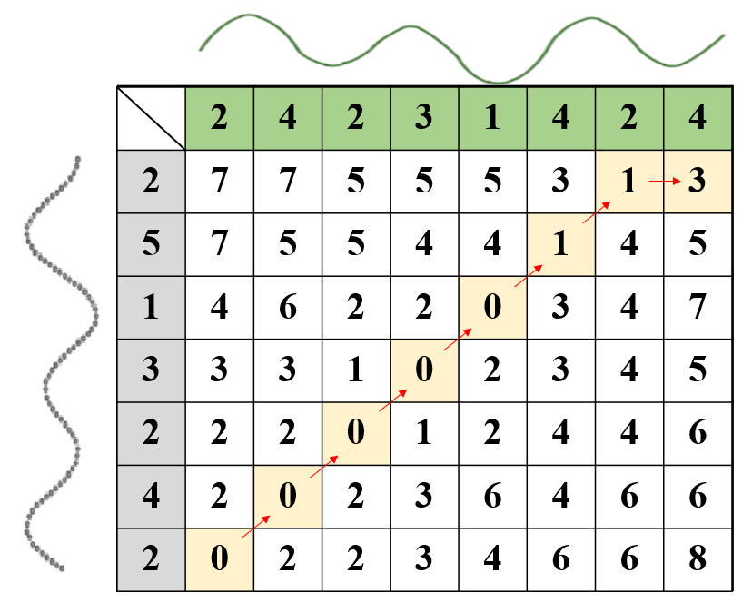
WARPING PATH
W =w₁,w₂,...,w_{K}
The k-th element of W is denoted as w_{k} = (i,j)_{k}
w₁ =(1,1) ₁
w₂ =(2,2) ₂
w₃ =(3,3) ₃
w₄ =(4,4) ₄
w₅ =(5,5) ₅
w₆ =(6,6) ₆
w₇ =(7,7) ₇
w₈ =(7,8) ₈

Slide 7
EARLY ABANDONING STRATEGY
. . . | . . . | . . . | . . . | . . . | . . .
. . . | . . . | . . . | . . . | . . . | . . .
No need to calculate
Larger than threshold

Slide 8
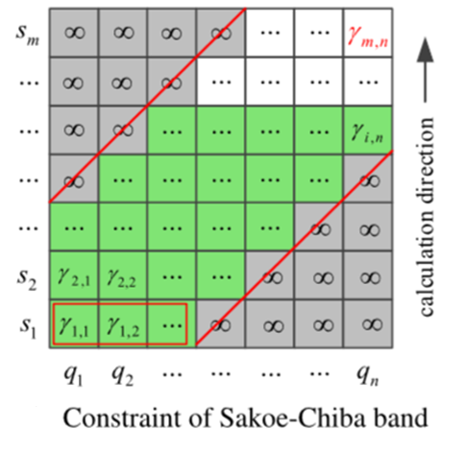
GLOBAL CONSTRAINTS
The warping path w_{k} = (i,j)_{k} is
subject to j − r ≤ i ≤ j + r
r

Slide 9
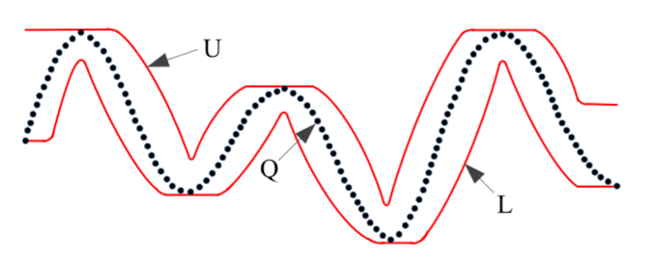
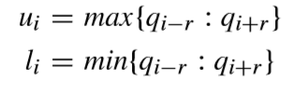
PROPOSED LOWER BOUNDING DISTANCE
Upper bound U =u₁,u₂,··· ,u_{n} and lower bound L =l₁,l₂,··· ,l_{m}
r
r

Slide 10
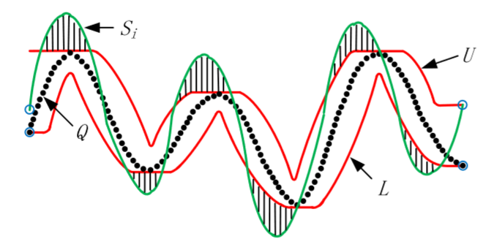
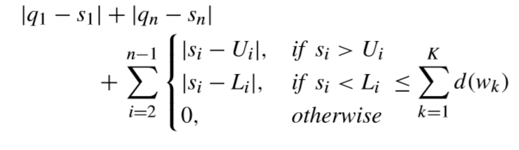
PROPOSED LOWER BOUNDING DISTANCE

Slide 11
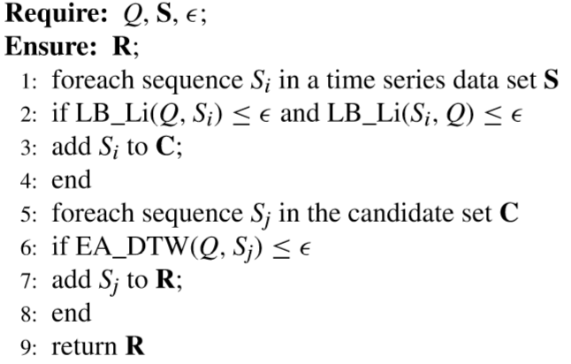
PROPOSED METHOD

Slide 12
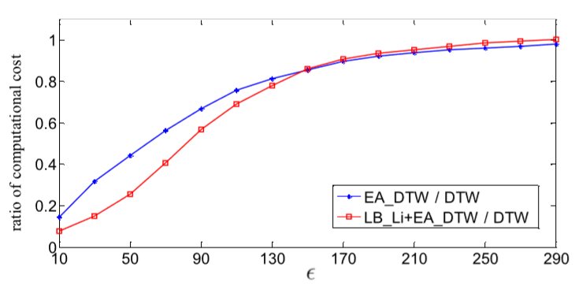
EXPERIMENTAL EVALUATION
In our experiments ,the global constraint r of the Sakoe-Chiba band equals 10 percent of the length of sequences.
Execute experiments on Yoga data set.

