Slide 1
On the generalized constrained longest common subsequence problems
Yi-Ching Chen ·Kun-Mao Chao
Journal of Combinatorial Optimization volume 21, pages383–392(2011)
Presenter: Du-Cheng Wu
Date: Mar. 10, 2020

Slide 2
Abstract
We investigate four variants of the longest common subsequence problem. Given two sequences X, Y and a constrained pattern P of lengths m, n, and ρ, respectively, the generalized constrained longest common subsequence (GC-LCS) problems are to find a longest common subsequence of X and Y including (or excluding) P as a subsequence (or substring). We propose new dynamic programming algorithms for solving the GC-LCS problems in O(mnρ) time. We also consider the case where the number of constrained patterns is arbitrary.

Slide 3
LCS
X = atctgt
Y = attcgt
LCS = attgt

Slide 4
SEQ-EC-LCS
X = atctgt
Y = attcgt
P = tt
LCS = attgt
SEQ-EC-LCS = atcg

Slide 5
STR-EC-LCS
X = atctgt
Y = attcgt
P = tt
LCS = attgt
STR-EC-LCS = atcgt

Slide 6
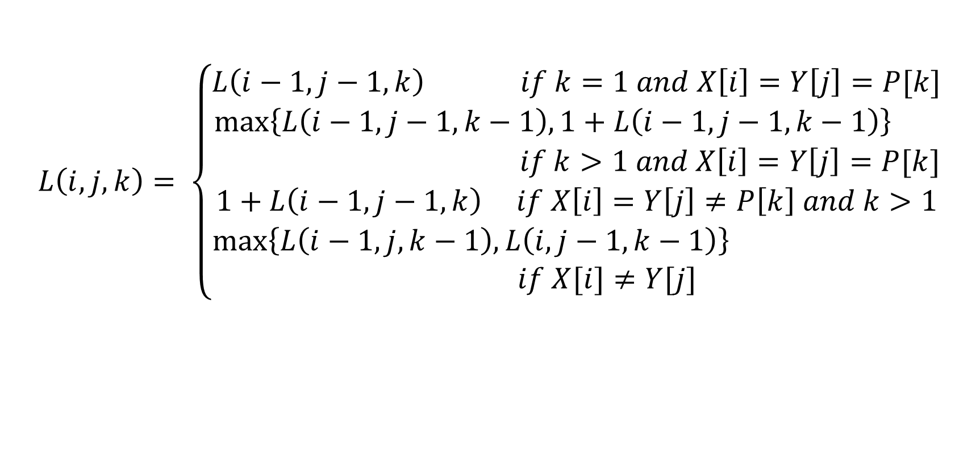
SEQ-EC-LCS
$$L\left(i,j,k\right)= \left\{\begin{aligned}L\left(i−1,j−1,k\right) if k=1 and X\left[i\right]=Y\left[j\right]=P[k] \\ \max\left\{L\left(i−1,j−1,k−1\right), 1+L\left(i−1,j−1,k−1\right)\right\} \\ if k>1 and X\left[i\right]=Y\left[j\right]=P[k] \\ 1+L\left(i−1,j−1,k\right) if X\left[i\right]=Y\left[j\right]≠P\left[k\right] and k>1 \\ \max\left\{L\left(i−1,j,k−1\right), L\left(i,j−1,k−1\right)\right\} \\ if X[i]≠Y[j]\end{aligned}\right.$$

Slide 7
SEQ-EC-LCS
k = 0 k = 1, P = t k = 2, P = t
 | 0 | a | t | t | c | g | t
0 | 0 | 0 | 0 | 0 | 0 | 0 | 0
a | 0 | 1 | 1 | 1 | 1 | 1 | 1
t | 0 | 1 | 2 | 2 | 2 | 2 | 2
c | 0 | 1 | 2 | 2 | 3 | 3 | 3
t | 0 | 1 | 2 | 3 | 3 | 3 | 3
g | 0 | 1 | 2 | 3 | 3 | 4 | 4
t | 0 | 1 | 2 | 3 | 3 | 4 | 5
 | 0 | a | t | t | c | g | t
0 | 0 | 0 | 0 | 0 | 0 | 0 | 0
a | 0 | 1 | 1 | 1 | 1 | 1 | 1
t | 0 | 1 | 1 | 1 | 1 | 1 | 1
c | 0 | 1 | 1 | 1 | 2 | 2 | 2
t | 0 | 1 | 1 | 1 | 2 | 2 | 2
g | 0 | 1 | 1 | 1 | 2 | 3 | 3
t | 0 | 1 | 1 | 1 | 2 | 3 | 3
 | 0 | a | t | t | c | g | t
0 | 0 | 0 | 0 | 0 | 0 | 0 | 0
a | 0 | 1 | 1 | 1 | 1 | 1 | 1
t | 0 | 1 | 2 | 2 | 2 | 2 | 2
c | 0 | 1 | 2 | 2 | 3 | 3 | 3
t | 0 | 1 | 2 | 2 | 3 | 3 | 3
g | 0 | 1 | 2 | 2 | 3 | 4 | 4
t | 0 | 1 | 2 | 2 | 3 | 4 | 4

Slide 8
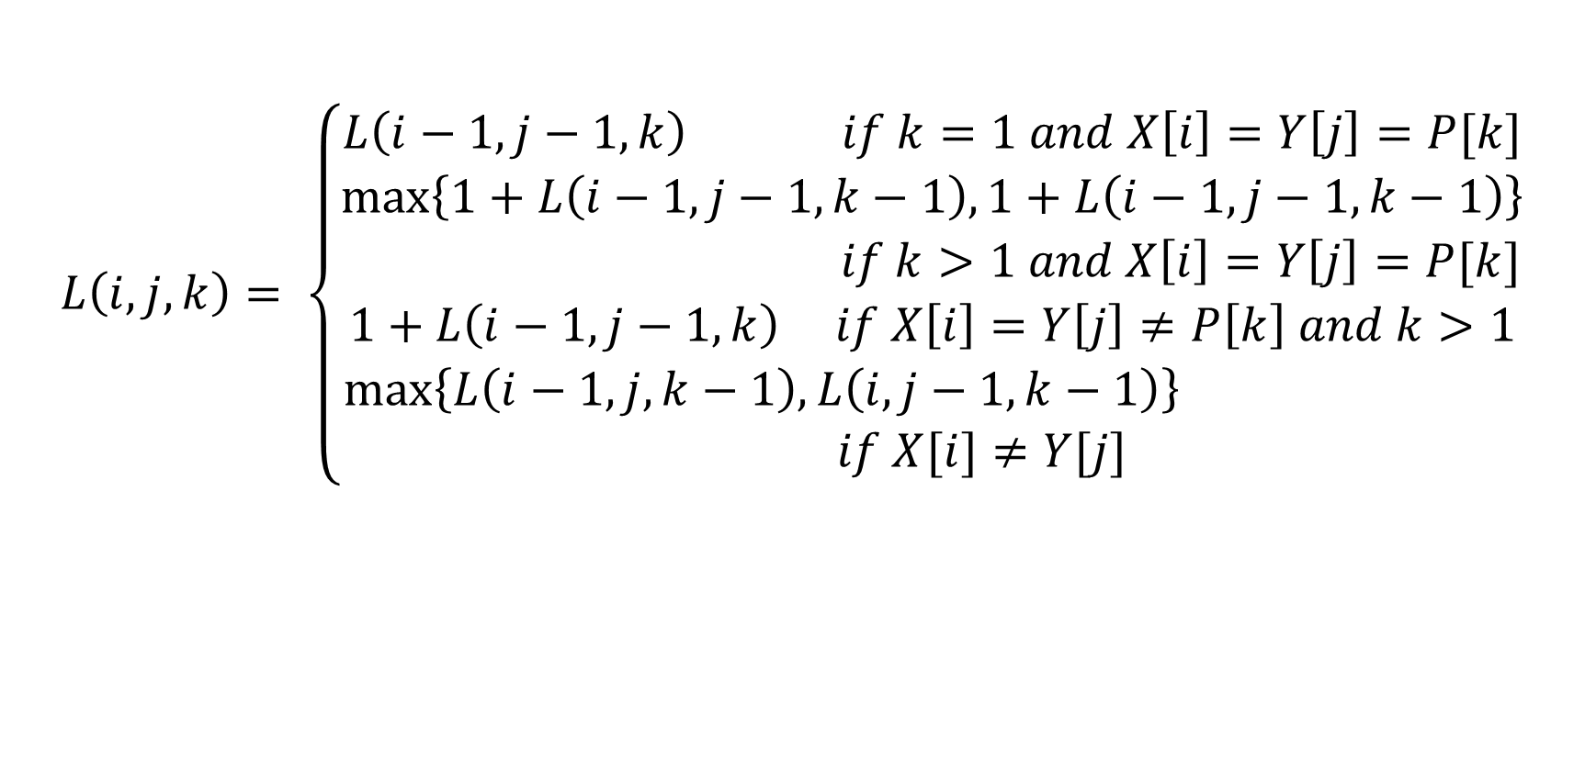
STR-EC-LCS
$$L\left(i,j,k\right)= \left\{\begin{aligned}L\left(i−1,j−1,k\right) if k=1 and X\left[i\right]=Y\left[j\right]=P[k] \\ \max\left\{1+L\left(i−1,j−1,k−1\right), 1+L\left(i−1,j−1,k−1\right)\right\} \\ if k>1 and X\left[i\right]=Y\left[j\right]=P[k] \\ 1+L\left(i−1,j−1,k\right) if X\left[i\right]=Y\left[j\right]≠P\left[k\right] and k>1 \\ \max\left\{L\left(i−1,j,k−1\right), L\left(i,j−1,k−1\right)\right\} \\ if X[i]≠Y[j]\end{aligned}\right.$$

Slide 9
STR-EC-LCS
k = 0 k = 1, P = t k = 2, P = t
 | 0 | a | t | t | c | g | t
0 | 0 | 0 | 0 | 0 | 0 | 0 | 0
a | 0 | 1 | 1 | 1 | 1 | 1 | 1
t | 0 | 1 | 2 | 2 | 2 | 2 | 2
c | 0 | 1 | 2 | 2 | 3 | 3 | 3
t | 0 | 1 | 2 | 3 | 3 | 3 | 3
g | 0 | 1 | 2 | 3 | 3 | 4 | 4
t | 0 | 1 | 2 | 3 | 3 | 4 | 5
 | 0 | a | t | t | c | g | t
0 | 0 | 0 | 0 | 0 | 0 | 0 | 0
a | 0 | 1 | 1 | 1 | 1 | 1 | 1
t | 0 | 1 | 1 | 1 | 1 | 1 | 1
c | 0 | 1 | 1 | 1 | 2 | 2 | 2
t | 0 | 1 | 1 | 1 | 2 | 2 | 2
g | 0 | 1 | 1 | 1 | 2 | 3 | 3
t | 0 | 1 | 1 | 1 | 2 | 3 | 3
 | 0 | a | t | t | c | g | t
0 | 0 | 0 | 0 | 0 | 0 | 0 | 0
a | 0 | 1 | 1 | 1 | 1 | 1 | 1
t | 0 | 1 | 2 | 2 | 2 | 2 | 2
c | 0 | 1 | 2 | 2 | 3 | 3 | 3
t | 0 | 1 | 2 | 3 | 3 | 3 | 3
g | 0 | 1 | 2 | 3 | 3 | 4 | 4
t | 0 | 1 | 2 | 3 | 3 | 4 | 5

Slide 10
CLCS
|A| = m, |B| = n, |P| = r, p = constrain patterns,
problem | DP time complexity
SEQ-IC-LCS | O(mnr)
STR-IC-LCS | O(mn)
Generalized STR-IC-LCS | O(mnp)
SEQ-EC-LCS | O(mnr)
STR-EC-LCS | O(mnr)

