Slide 1
Efficient Computation of Longest Common Subsequences with Multiple Substring Inclusive Constraints
XIAODONG WANG, LEI WANG, and DAXIN ZHU
JOURNAL OF COMPUTATIONAL BIOLOGY
Volume 26, Number 9, 2019. P. 938-947
Presenter：Yu-Cheng Chang
Date：Mar. 17, 2020

Slide 2
Abstract
In this article, we consider a generalized longest common subsequence (LCS) problem with multiple substring inclusive constraints. For the two input sequences X and Y of lengths n and m, and a set of d constraints P = {P₁‚ … ‚ P_{d}} of total length r, the problem is to find a common subsequence Z of X and Y including each of constraint string in P as a substring and the length of Z is maximized. A new dynamic programming solution to this problem is presented in this article. The correctness of the new algorithm is proved. The time complexity of our algorithm is O(d2^{d}nmr). In the case of the number of constraint strings is fixed, our new algorithm for the generalized LCS problem with multiple substring inclusive constraints requires O(nmr) time and space.

Slide 3
Keyword Tree - Aho–Corasick
Constraint set P = {aab,aba,ba}, P₁ = aab, P₂ = aba, P₃ = ba
N₃ = aab
suffix of N₃：{ab,b,””}
Pre(i) 表 N_{i} 的 longest proper suffix
且必須存在 Keyword Tree
Pre(3) = 4 → N₄ = ab
Aho–Corasick 稱之 failure function.
For example

Slide 4
Keyword Tree - Aho–Corasick
Constraint set P = {aab,aba,ba}, P₁ = aab, P₂ = aba, P₃ = ba
Aho–Corasick-Next Function
δ | 0 | 1 | 2 | 3 | 4 | 5 | 6 | 7
a | 1 | 2 | 1 | 4 | 5 | 1 | 7 | 1
b | 6 | 4 | 3 | 0 | 0 | 1 | 0 | 1
Ex：δ(0,a) = 1
failure list of N₅ ：{ 7 → 1 → 0 }

Slide 5
M-STR-IC-LCS
State(0,0) ~ State(r,2^{d})
X Y |  | B | A | A | B | A | C | A
 | 0 | 0 | 0 | 0 | 0 | 0 | 0 | 0
A | 0
C | 0
A | 0
B | 0
B | 0
A | 0
C | 0
……
r * 2^{d}
n
m

Slide 6
M-STR-IC-LCS
δ | 0 | 1 | 2 | 3 | 4 | 5 | 6 | 7
a | 1 | 2 | 1 | 4 | 5 | 1 | 7 | 1
b | 6 | 4 | 3 | 0 | 0 | 1 | 0 | 1
c | 0 | 0 | 0 | 0 | 0 | 0 | 0 | 0
δ(0,A) = 1
γ(0,0,A) = 0
State(0,0)
X Y |  | B | A | A | B | A | C | A
 | 0 | 0 | 0 | 0 | 0 | 0 | 0 | 0
A | 0 | 0
C | 0
A | 0
B | 0
B | 0
A | 0
C | 0
State(1,0)
X Y |  | B | A | A | B | A | C | A
 | 0 | 0 | 0 | 0 | 0 | 0 | 0 | 0
A | 0 |  | 1
C | 0
A | 0
B | 0
B | 0
A | 0
C | 0
+1
S = { (0,0) , (1,0) }

Slide 7
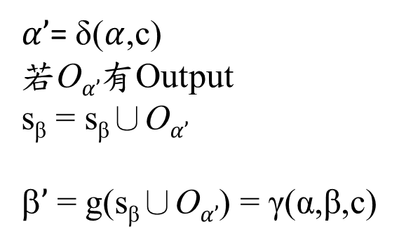
γ(α,β,c)
Constraint set P = {aab,aba,ba}, P₁ = aab, P₂ = aba, P₃ = ba
$α’$= δ($α$,c)
若O$α’$有Output
s_{β} = s_{β}∪O$α’$
β$’$ = g(s_{β}∪O$α’$) = γ(α,β,c)
γ(0,0,A)：
δ(0,A) = A
但N₁沒有Output
因此 γ(0,0,A) = 0
γ(4,0,A)：
δ(4,A) = 5
N₅的Output = aba、ba = P₂、P₃
因此 γ(4,0,A) = 110₂ = 6₁₀

Slide 8
M-STR-IC-LCS
δ | 0 | 1 | 2 | 3 | 4 | 5 | 6 | 7
a | 1 | 2 | 1 | 4 | 5 | 1 | 7 | 1
b | 6 | 4 | 3 | 0 | 0 | 1 | 0 | 1
c | 0 | 0 | 0 | 0 | 0 | 0 | 0 | 0
δ(1,A) = 2
γ(1,0,A) = 0
State(1,0)
X Y |  | B | A | A | B | A | C | A
 | 0 | 0 | 0 | 0 | 0 | 0 | 0 | 0
A | 0 |  | 1
C | 0
A | 0
B | 0
B | 0
A | 0
C | 0
State(2,0)
X Y |  | B | A | A | B | A | C | A
 | 0 | 0 | 0 | 0 | 0 | 0 | 0 | 0
A | 0 |  | 1
C | 0
A | 0
B | 0
B | 0
A | 0
C | 0
+1
S = { (0,0) , (1,0) , (2,0) }

Slide 9
M-STR-IC-LCS
State(2,0)
X Y |  | B | A | A | B | A | C | A
 | 0 | 0 | 0 | 0 | 0 | 0 | 0 | 0
A | 0 |  | 1 | 1
C | 0
A | 0
B | 0
B | 0
A | 0
C | 0
State(0,0)
X Y |  | B | A | A | B | A | C | A
 | 0 | 0 | 0 | 0 | 0 | 0 | 0 | 0
A | 0 | 0
C | 0
A | 0
B | 0
B | 0
A | 0
C | 0
+1
State(1,0)
X Y |  | B | A | A | B | A | C | A
 | 0 | 0 | 0 | 0 | 0 | 0 | 0 | 0
A | 0 |  | 1 | 1
C | 0
A | 0
B | 0
B | 0
A | 0
C | 0
+1
S = { (0,0) , (1,0) , (2,0) }

Slide 10
M-STR-IC-LCS
δ | 0 | 1 | 2 | 3 | 4 | 5 | 6 | 7
a | 1 | 2 | 1 | 4 | 5 | 1 | 7 | 1
b | 6 | 4 | 3 | 0 | 0 | 1 | 0 | 1
c | 0 | 0 | 0 | 0 | 0 | 0 | 0 | 0
δ(1,C) = 0
γ(1,0,C) = 0
State(1,0)
X Y |  | B | A | A | B | A | C | A
 | 0 | 0 | 0 | 0 | 0 | 0 | 0 | 0
A | 0 |  | 1 | 1 | 1 | 1 | 1 | 1
C | 0 | 0 | 1 | 1 | 1 | 1
A | 0
B | 0
B | 0
A | 0
C | 0
State(0,0)
X Y |  | B | A | A | B | A | C | A
 | 0 | 0 | 0 | 0 | 0 | 0 | 0 | 0
A | 0 | 0 |  |  | 0 |  | 0
C | 0 | 0 | 0 | 0 | 0 | 0 | 2
A | 0
B | 0
B | 0
A | 0
C | 0
+1
S = { (0,0) , (1,0) , (2,0) }

Slide 11
M-STR-IC-LCS
δ | 0 | 1 | 2 | 3 | 4 | 5 | 6 | 7
a | 1 | 2 | 1 | 4 | 5 | 1 | 7 | 1
b | 6 | 4 | 3 | 0 | 0 | 1 | 0 | 1
c | 0 | 0 | 0 | 0 | 0 | 0 | 0 | 0
δ(1,A) = 2
γ(1,0,A) = 0
State(1,0)
X Y |  | B | A | A | B | A | C | A
 | 0 | 0 | 0 | 0 | 0 | 0 | 0 | 0
A | 0 |  | 1 | 1 | 1 | 1 | 1 | 1
C | 0 | 0 | 1 | 1 | 1 | 1 |  | 1
A | 0 | 0 | 1 | 1 | 1 | 1 | 1 | 3
B | 0
B | 0
A | 0
C | 0
State(2,0)
X Y |  | B | A | A | B | A | C | A
 | 0 | 0 | 0 | 0 | 0 | 0 | 0 | 0
A | 0 |  | 1 | 1 | 1 | 1 | 1 | 1
C | 0 | 0 | 1 | 1 | 1 | 1 |  | 1
A | 0 | 0 | 1 | 2 | 2 | 2 | 2 | 1
B | 0
B | 0
A | 0
C | 0
+1
S = { (0,0) , (1,0) , (2,0) }

Slide 12
M-STR-IC-LCS
δ | 0 | 1 | 2 | 3 | 4 | 5 | 6 | 7
a | 1 | 2 | 1 | 4 | 5 | 1 | 7 | 1
b | 6 | 4 | 3 | 0 | 0 | 1 | 0 | 1
c | 0 | 0 | 0 | 0 | 0 | 0 | 0 | 0
δ(0,B) = 6
γ(0,0,B) = 0
State(0,0)
X Y |  | B | A | A | B | A | C | A
 | 0 | 0 | 0 | 0 | 0 | 0 | 0 | 0
A | 0 | 0 |  |  | 0 |  | 0
C | 0 | 0 | 0 | 0 | 0 | 0 | 2 | 2
A | 0 | 0 |  |  | 0 |  | 2
B | 0
B | 0
A | 0
C | 0
State(6,0)
X Y |  | B | A | A | B | A | C | A
 | 0 | 0 | 0 | 0 | 0 | 0 | 0 | 0
A | 0
C | 0
A | 0
B | 0 | 1
B | 0
A | 0
C | 0
+1
S = { (0,0) , (1,0) , (2,0) , (6,0) }

Slide 13
M-STR-IC-LCS
δ | 0 | 1 | 2 | 3 | 4 | 5 | 6 | 7
a | 1 | 2 | 1 | 4 | 5 | 1 | 7 | 1
b | 6 | 4 | 3 | 0 | 0 | 1 | 0 | 1
c | 0 | 0 | 0 | 0 | 0 | 0 | 0 | 0
δ(1,B) = 4
γ(1,0,B) = 0
State(1,0)
X Y |  | B | A | A | B | A | C | A
 | 0 | 0 | 0 | 0 | 0 | 0 | 0 | 0
A | 0 | 0 |  |  | 0 |  | 0
C | 0 | 0 | 0 | 0 | 0 | 0 | 2 | 2
A | 0 | 0 |  |  | 0 |  | 2
B | 0
B | 0
A | 0
C | 0
State(4,0)
X Y |  | B | A | A | B | A | C | A
 | 0 | 0 | 0 | 0 | 0 | 0 | 0 | 0
A | 0
C | 0
A | 0
B | 0 | 1
B | 0
A | 0
C | 0
+1
S = { (0,0) , (1,0) , (2,0) , (6,0) , (4,0) }

Slide 14
M-STR-IC-LCS
δ | 0 | 1 | 2 | 3 | 4 | 5 | 6 | 7
a | 1 | 2 | 1 | 4 | 5 | 1 | 7 | 1
b | 6 | 4 | 3 | 0 | 0 | 1 | 0 | 1
c | 0 | 0 | 0 | 0 | 0 | 0 | 0 | 0
δ(2,B) = 3
γ(2,0,B) = 1
State(2,0)
X Y |  | B | A | A | B | A | C | A
 | 0 | 0 | 0 | 0 | 0 | 0 | 0 | 0
A | 0 |  | 1 | 1 | 1 | 1 | 1 | 1
C | 0 | 0 | 1 | 1 | 1 | 1 |  | 1
A | 0 | 0 | 1 | 2 | 2 | 2 | 2 | 1
B | 0
B | 0
A | 0
C | 0
State(3,1)
X Y |  | B | A | A | B | A | C | A
 | 0 | 0 | 0 | 0 | 0 | 0 | 0 | 0
A | 0
C | 0
A | 0
B | 0 | 1
B | 0
A | 0
C | 0
+1
S = { (0,0) , (1,0) , (2,0) , (6,0) , (4,0) , (3,1) }

Slide 15
M-STR-IC-LCS
State(i,7)
X Y |  | B | A | A | B | A | C | A
A
C
A
B
B
A
C |  |  |  |  |  |  |  | 5
……
Len(M-STR-IC-LCS) = 5
M-STR-IC-LCS = AABAC
……
……
……
S = { (0,0) , (1,0) , (2,0) , (6,0) , (4,0) , (3,1) , (7,4) , … }

Slide 16
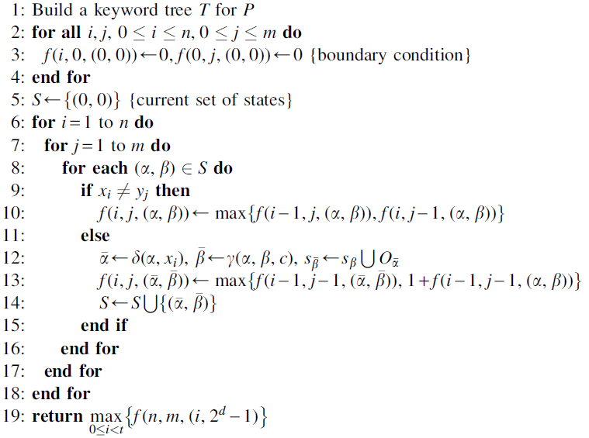

Complexity
Space Complexity：O(2^{d}mnr)
Time Complexity：
1) δ(i,c)：O(1)
2) γ(α,β,c)：O(d)
∴ Time Complexity = O(d2^{d}mnr)
r = $Σ_{k=1}^{d}P_{k}$

Slide 17
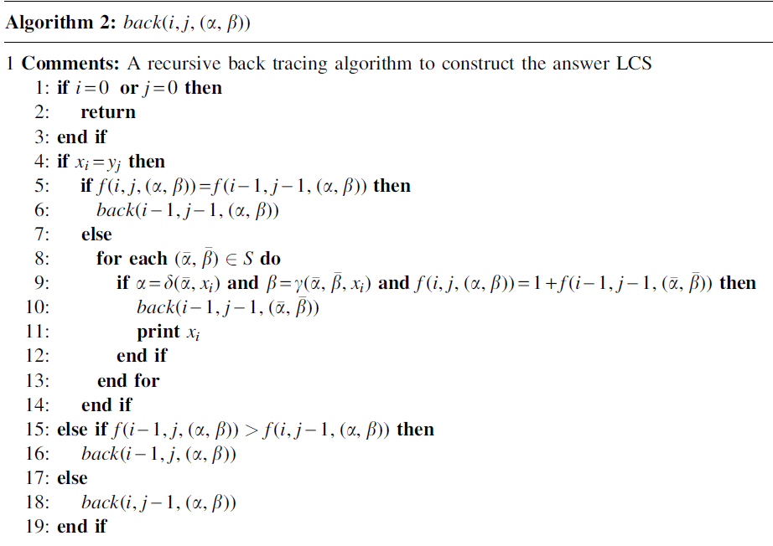
Trace Back
Time Complexity：
O(n+m)

Slide 18
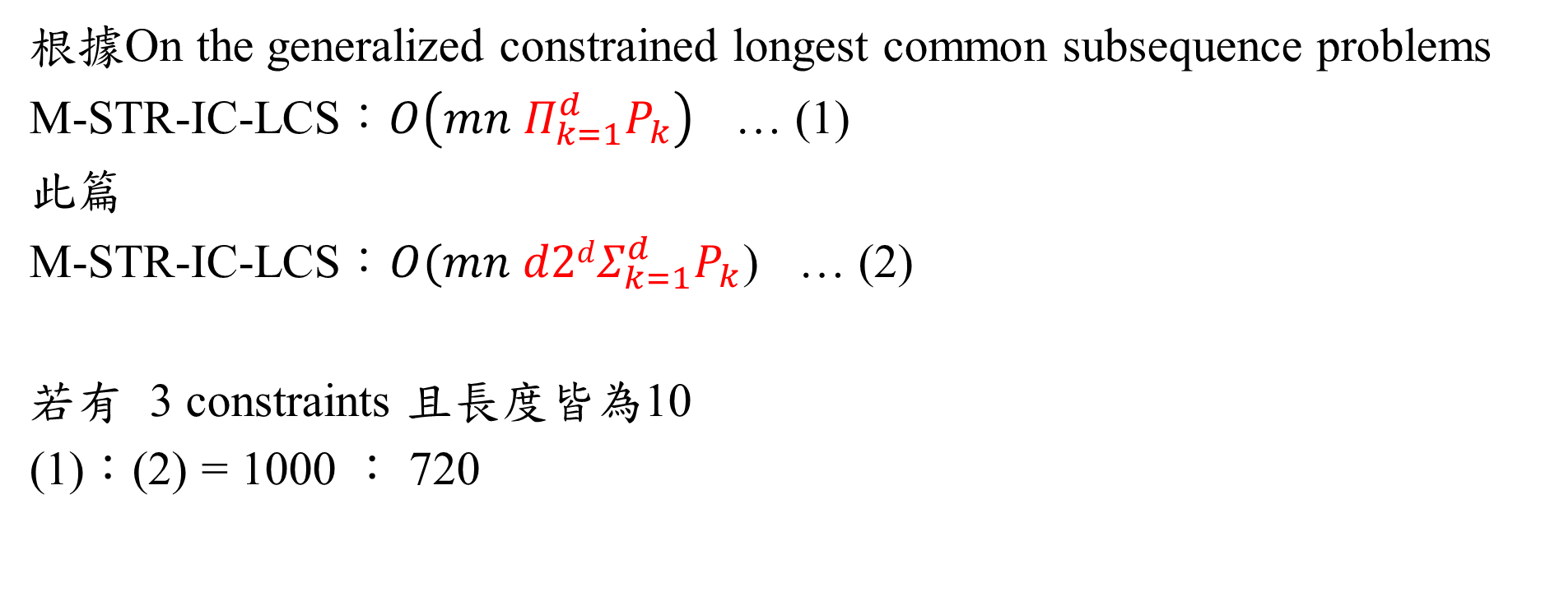
Comparison
根據On the generalized constrained longest common subsequence problems
M-STR-IC-LCS：$O\left(mn{ Π}_{k=1}^{d}P_{k}\right)$ … (1)
此篇
M-STR-IC-LCS：$O(mn d2dΣ_{k=1}^{d}P_{k}$) … (2)
若有 3 constraints 且長度皆為10
(1)：(2) = 1000 ： 720

