Slide 1
An Introduction to Protein Alignment Algorithms
Presenter: Yuan-Hsiu Tsai
Date: May 5, 2020

Slide 2
Index
A Novel Structure of the Smith-Waterman Algorithm for efficient sequence alignment ---- 3
Optimal alignments of biological sequences on a microcomputer ---- 13
Efficient Alignment of Very Long Sequences ---- 17

Slide 3
A novel structure of the Smith-Waterman Algorithm for efficient sequence alignment
Saad Khan Zahid, Laiq Hasan, Asif Ali Khan, Salim Ullah
2015 Third International Conference on Digital Information,
Networking, and Wireless Communications (DINWC)
Presenter: Yuan-Hsiu Tsai
Date: May. 5, 2020

Slide 4
Abstract(1/2)
The emergence of bioinformatics has led to many new discoveries in living organisms. These discoveries would not have been possible without the developments made in the sequence alignment techniques. Many sequence alignment algorithms were developed to make the alignment process fast and accurate. However, the more precise algorithms take longer than their less precise counterparts. Researchers came with innovative approaches to combat the time consuming constraint. Their aim was to speed up the computational process by using more efficient implementations of the algorithms using state-of-the-art hardware platforms.

Slide 5
Abstract(2/2)
Smith Waterman (SW) algorithm, being the most accurate in the alignment process, has been implemented on various high performance computing platforms for the same purpose. However, the intrinsic structure of the algorithm has got little attention. In this paper, we present a novel structure of the SW algorithm that takes less number of cycles at the cost of utilizing a minimal amount of extra hardware resources as compared to its existing form. The newly proposed architecture achieves up to 25% performance gain.

Slide 6
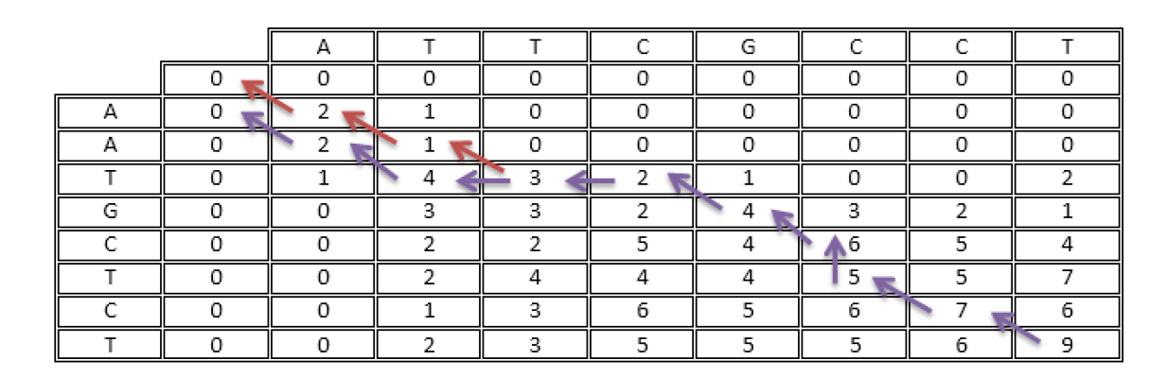
Protein Alignment

Slide 7
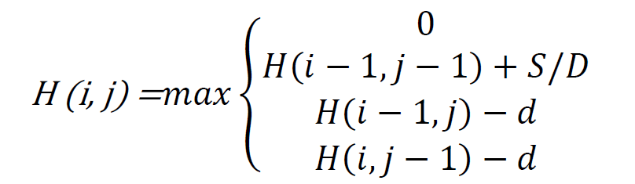
Protein Alignment

Slide 8
Protein Alignment
Two structure 1. 4 – cycle 2. 3 – cycle

Slide 9
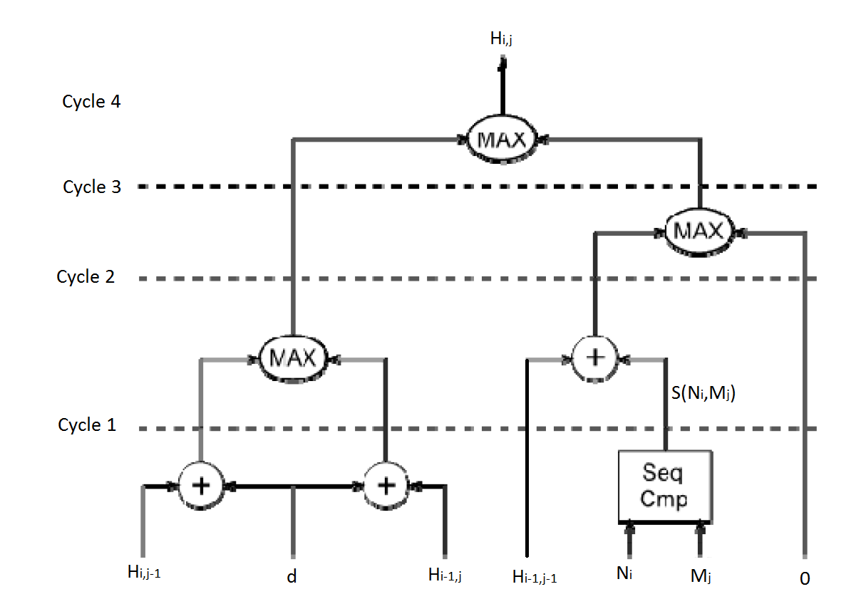
Protein Alignment

Slide 10
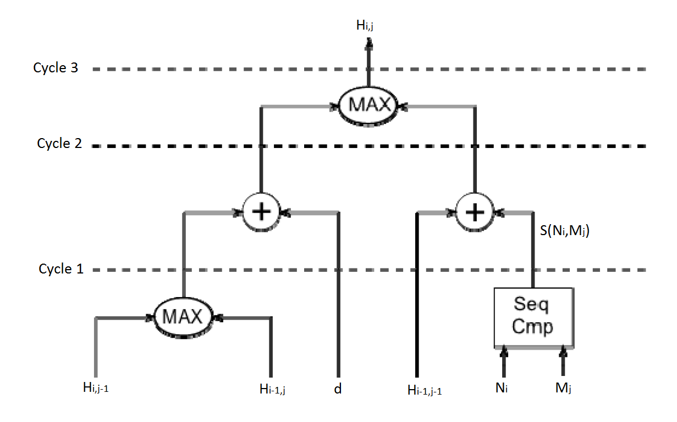
Protein Alignment

Slide 11
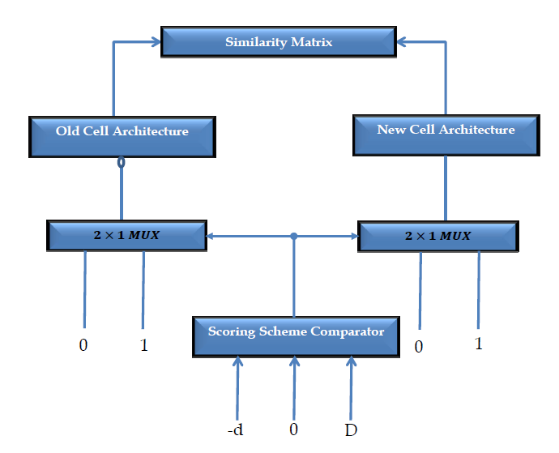
Protein Alignment

Slide 12
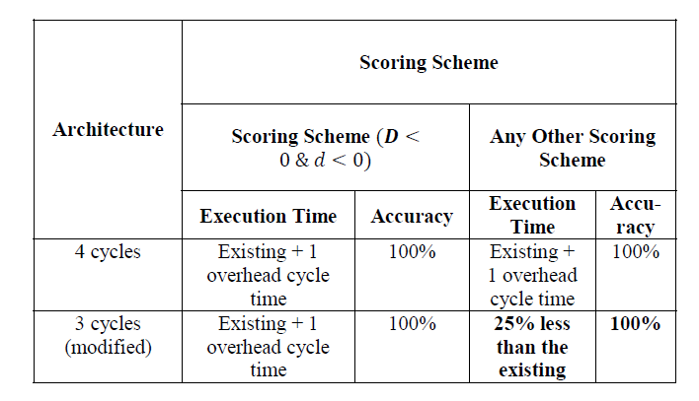
Protein Alignment

Slide 13
Optimal alignments of biological sequences on a microcomputer
Kazutada Watanabe, Yoshio Urano, Taiki Tamaoki
Bioinformatics, Volume 1, Issue 2, 1985, Pages 83–87
Presenter: Yuan-Hsiu Tsai
Date: May. 5, 2020

Slide 14
Abstract
An algorithm and a program have been developed which enable optimal alignments of biological sequences on an 8–bit microcomputer. The compiled program can process sequences up to 1000 residues on a Commodore 64. Since this program was written originally in the BASIC language, it may readily be adapted to other microcomputers with small changes.

Slide 15
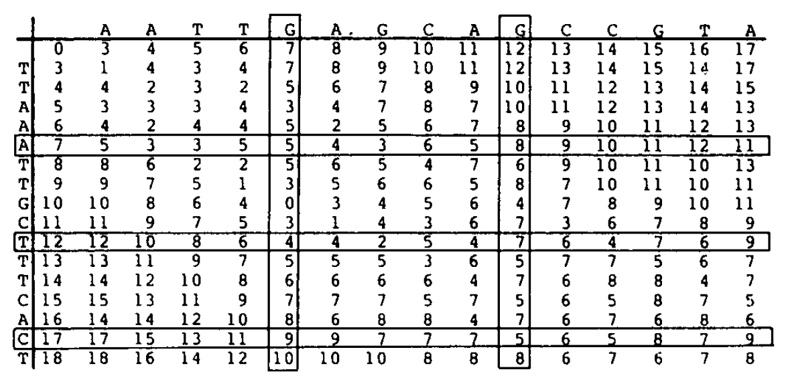
Protein Alignment

Slide 16
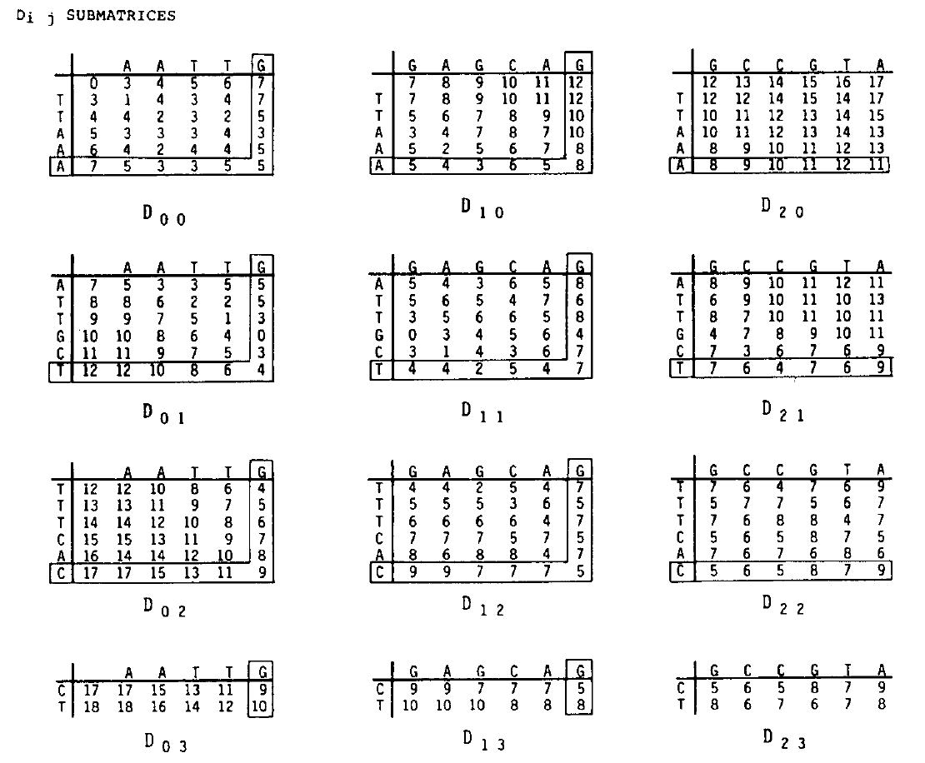
Protein Alignment

Slide 17
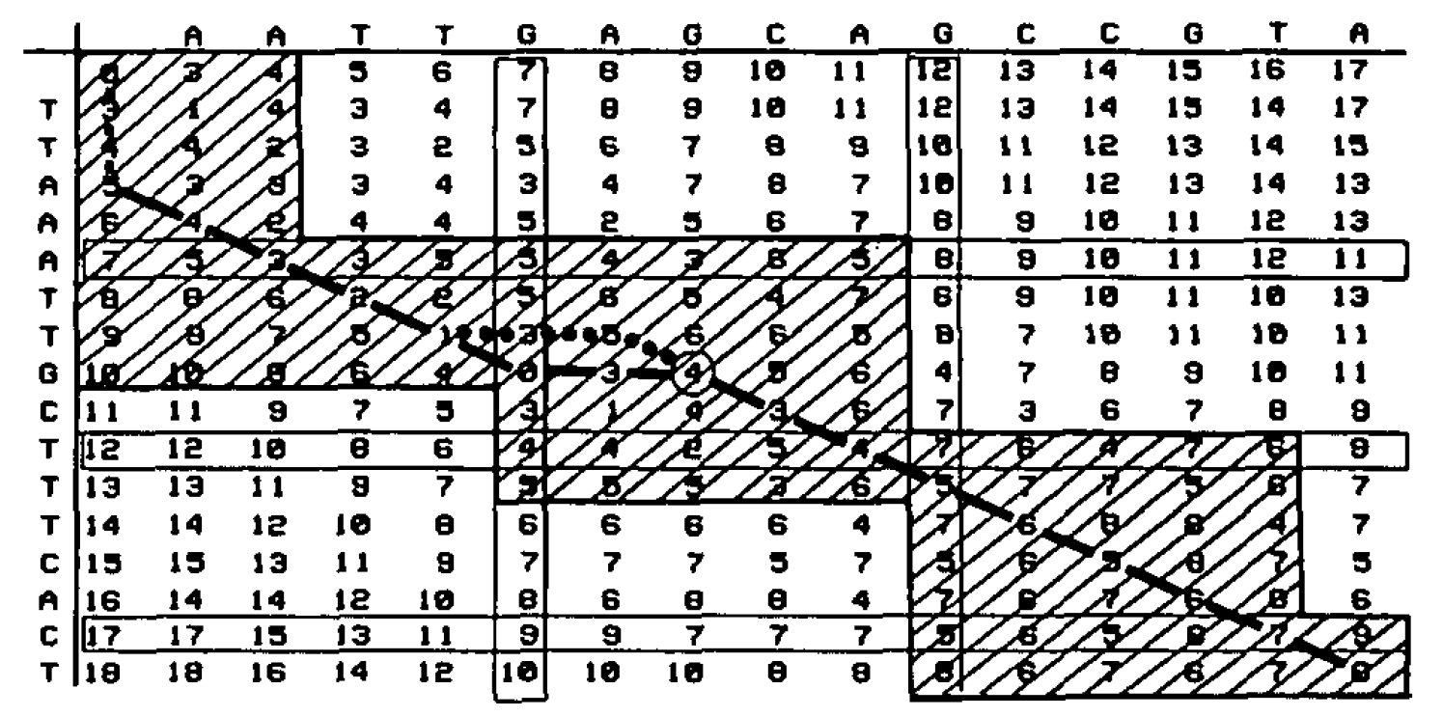
Protein Alignment

Slide 18
Efficient Alignment of Very Long Sequences
Chunchun Zhao, Sartaj Sahni
Advances in Science, Technology and Engineering Systems Journal
Vol. 3, No. 2, 329-345 (2018)
Presenter: Yuan-Hsiu Tsai
Date: May. 5, 2020

Slide 19
Abstract(1/2)
We consider the problem of aligning two very long biological sequences. The score for the best alignment may be found using the Smith-Waterman scoring algorithm while the best alignment itself maybe determined using Myers and Miller’s alignment algorithm. Neither of these algorithms takes advantage of computer caches to obtain high efficiency. We propose cache-efficient algorithms to determine the score of the best alignment as well as the best alignment itself. All algorithms were implemented using C and OpenMP, and benchmarked using real data sets from the National Center for Biotechnology In-formation (NCBI) database.

Slide 20
Abstract(2/2)
The test computational platforms were Xeon E5 2603, I7-x980 and Xeon E5 2695. Our best single-core cache-efficient scoring algorithm reduces the running time by as much as19.7% relative to the Smith-Waterman scoring algorithm and our bestcache-efficient alignment algorithm reduces the running time by as much as 17.1% relative to the Myers and Miller alignment algorithm. Multicore versions of our cache-efficient algorithms scale quite wellup to the 24 cores we tested; achieving a speedup of 22 with 24 cores. Our multi-core scoring and alignment algorithms reduce the running time by as much as 61.4% and 47.3% relative to multi-core versions of the Smith-Waterman scoring algorithm and Myers and Miller’salignment algorithm, respectively.

Slide 21
Algortithm
Five algorithm 1. Needleman-Wunsch(NW) Algorithm 2. Smith-Waterman(SW) Algorithm 3. Hirschberg algorithm 4. Strip Algorithm 5. Diagonal Algorithm

Slide 22
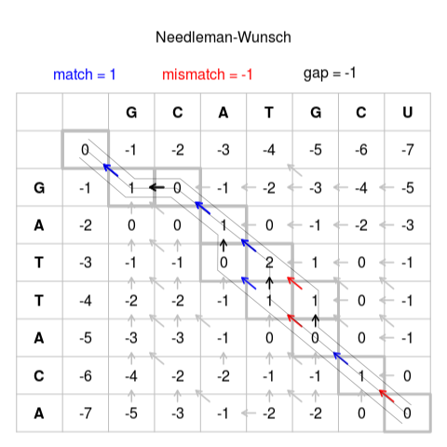
Needleman-Wunsch(NW) Algorithm

Slide 23
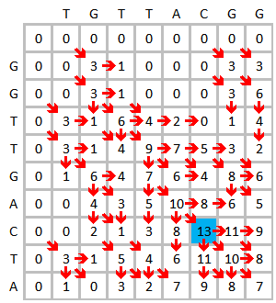
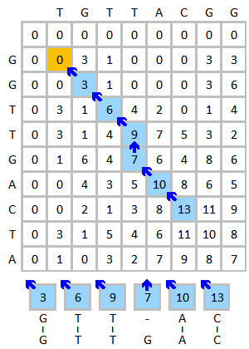
Smith-Waterman(SW) Algorithm

Slide 24
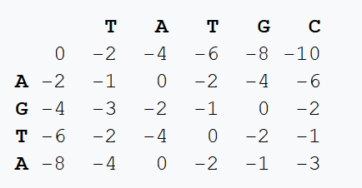
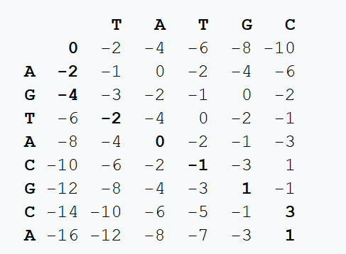
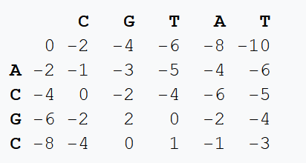
Hirschberg algorithm
這個序列是inversion的

Slide 25
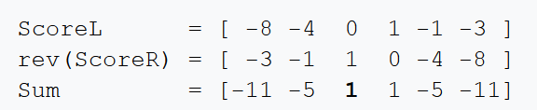
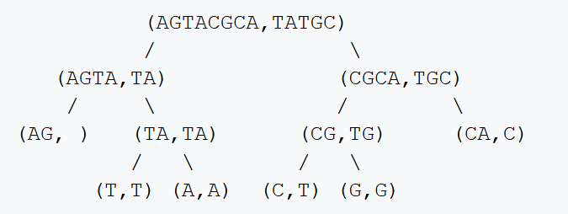
Hirschberg algorithm
得出切點在第2個字母位置

Slide 26
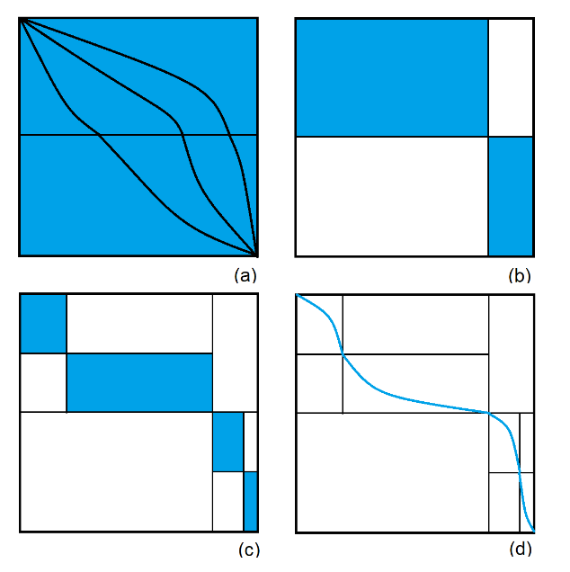
Myers and Miller’s algorithm

Slide 27
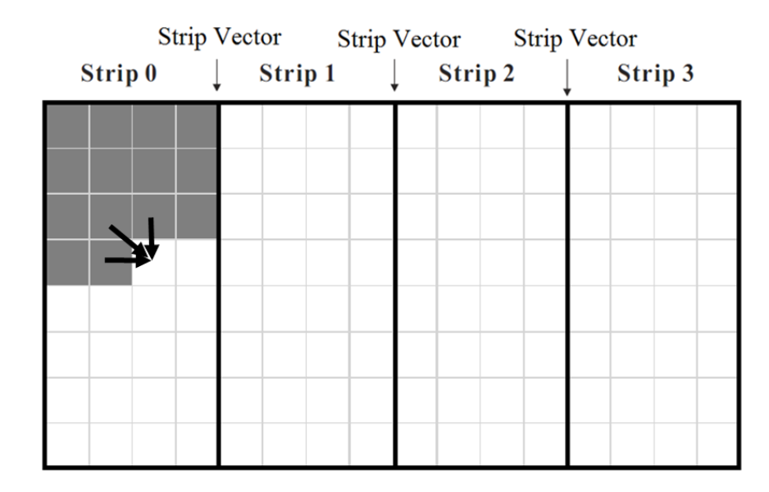
Strip Algorithm

Slide 28
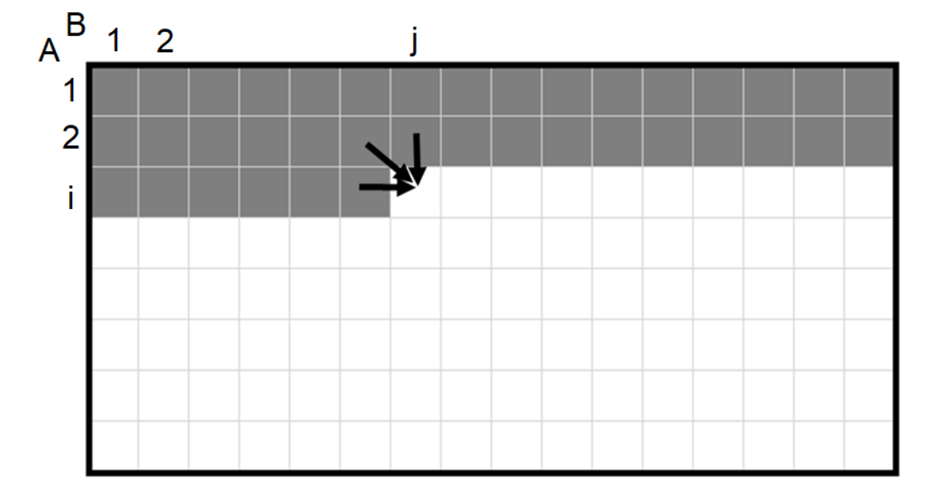
Diagonal Algorithm

Slide 29
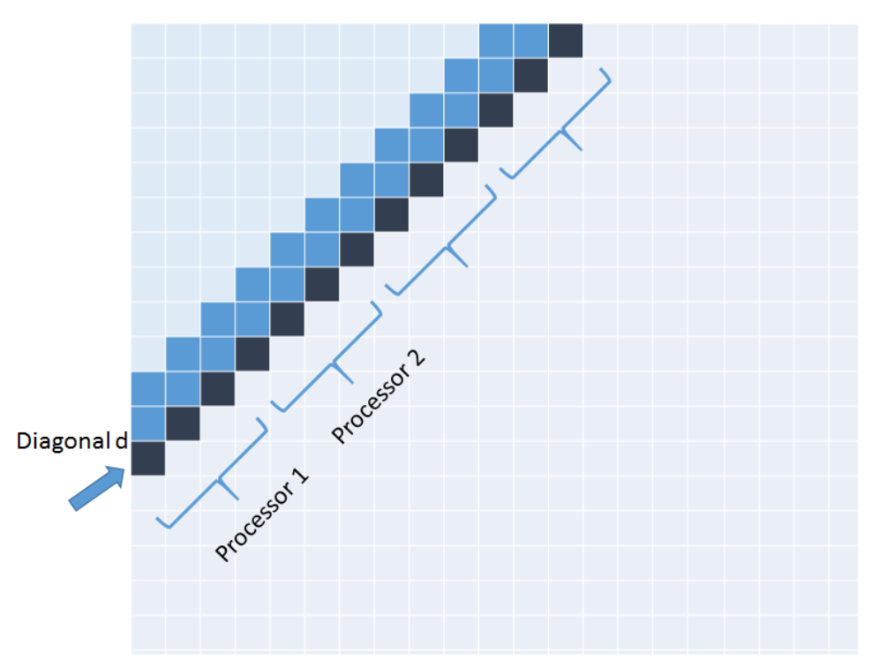
Diagonal Algorithm

Slide 30
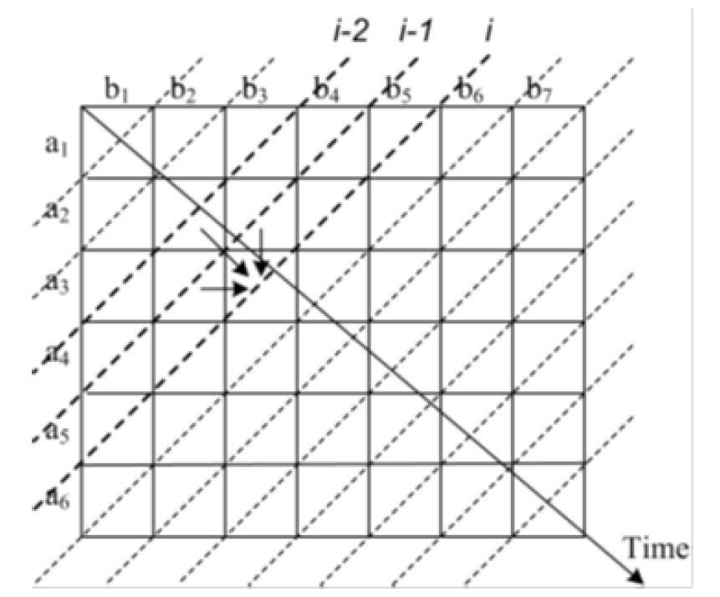
Diagonal Algorithm

Slide 31
THANK you for Listening

