Slide 1
Using millions of emoji occurrences to learn any-domain representations for detecting sentiment, emotion and sarcasm
Proceedings of the 2017 Conference on Empirical Methods in Natural Language Processing, pp. 1615–1625
Copenhagen, Denmark, September 7–11, 2017
Bjarke Felbo, Alan Mislove, Anders Søgaard, Iyad Rahwan, Sune Lehmann
Present: Chia-Lin, Chen
Date: May. 12th , 2020
Notes:
第一二位作者來自MIT和Northeastern大學，相差一條河(開車七分鐘)
第三四位作者來自丹麥的哥本哈根大學與丹麥技術大學

Slide 2
Abstract
NLP tasks are often limited by scarcity of manually annotated data. In social media sentiment analysis and related tasks, researchers have therefore used binarized emoticons and specific hashtags as forms of distant supervision. Our paper shows that by extending the distant supervision to a more diverse set of noisy labels, the models can learn richer representations. Through emoji prediction on a dataset of 1246 million tweets containing one of 64 common emojis we obtain state-of-the-art performance on 8 benchmark datasets within emotion, sentiment and sarcasm detection using a single pretrained model. Our analyses confirm that the diversity of our emotional labels yield a performance improvement over previous distant supervision approaches.

Slide 3
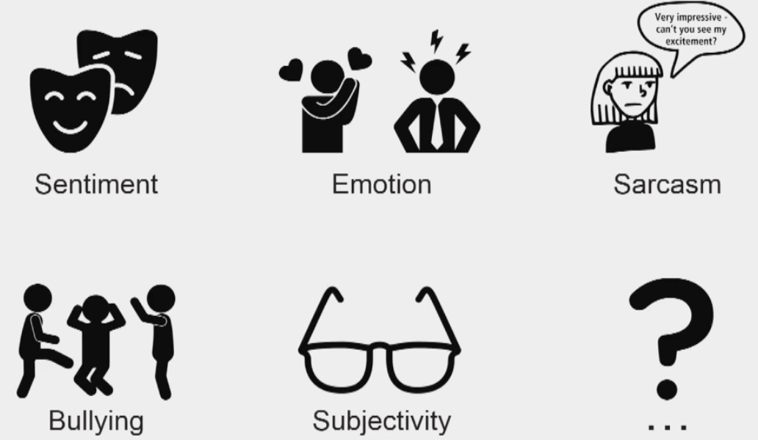

Slide 4
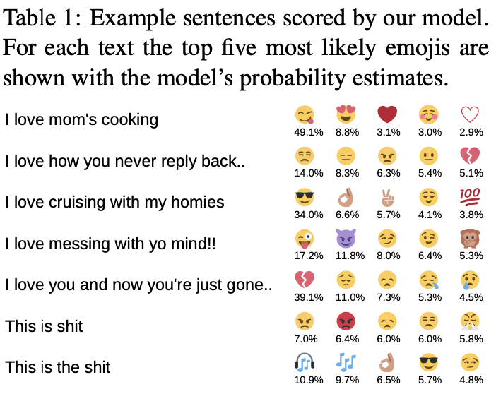
Notes:
資料集來自2013/1/1到2017/1/1的推特文章

Slide 5
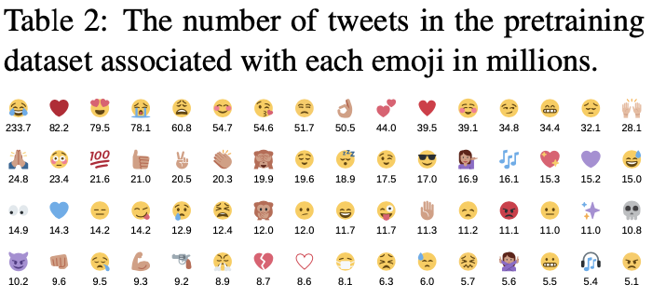

Slide 6
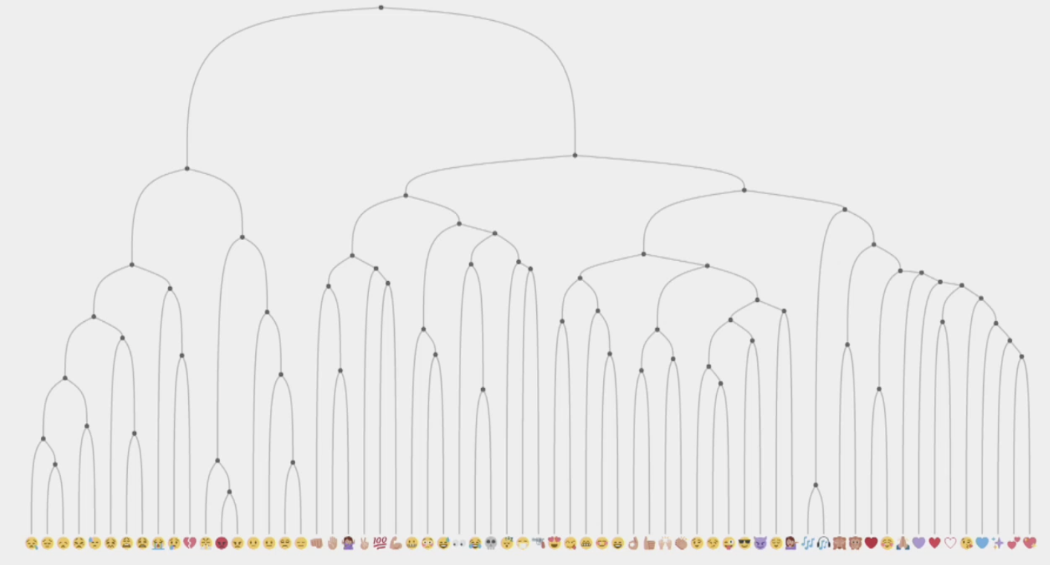

Slide 7
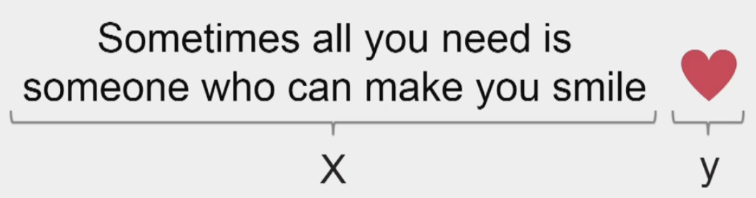

Slide 8
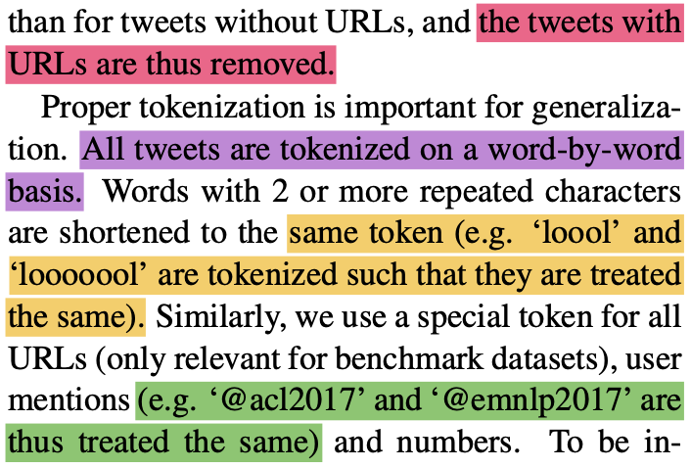

Slide 9
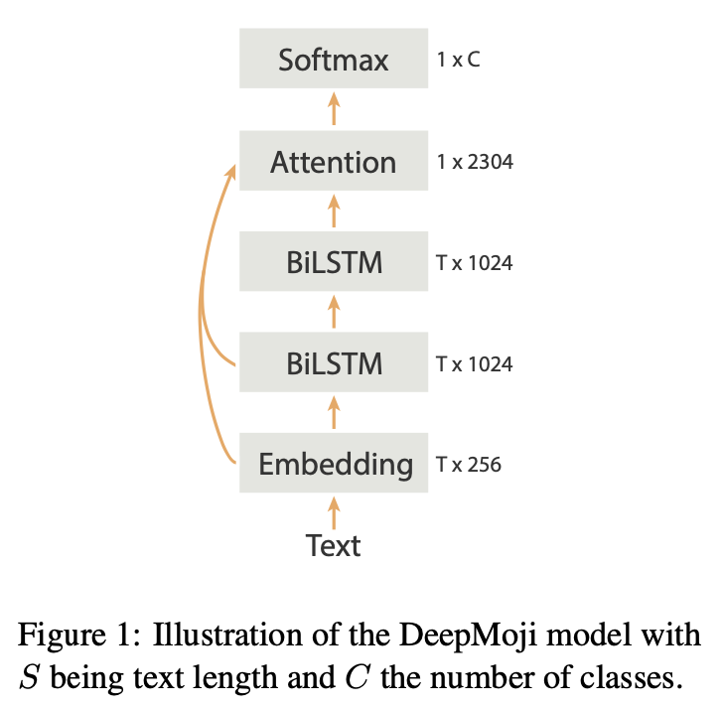
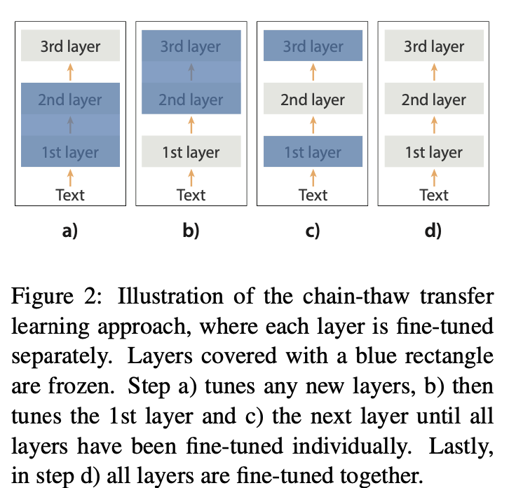
Notes:
Attention管字在句子的重要度，但沒有詞序性(可以同時做) LSTM(RNN特例)不管字在句子的重要性，但有詞序性(缺點耗時:得等前面算完才能算後面)

Slide 10

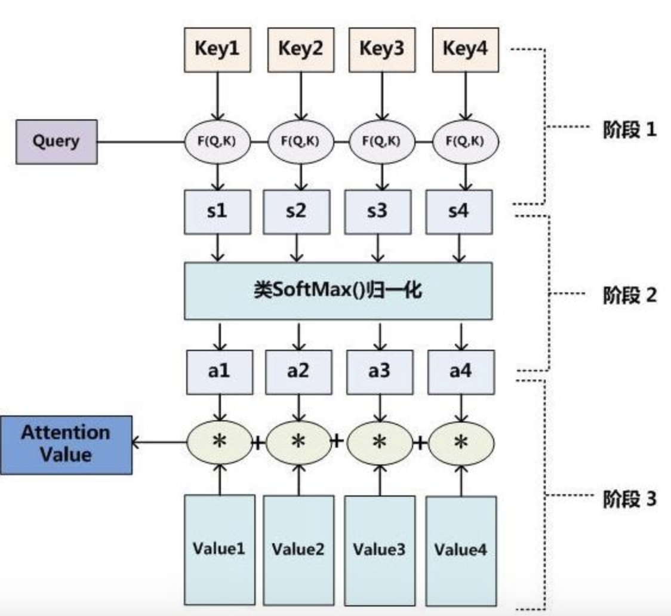
Notes:
Query,Key,Value都是等長的向量，才能相加
對應到前一頁(向量長度為T)，假設取某字為Query，取出前後各二字，
與之Similarity為Embedding和BiLSTM的相似度。
再與第二層的BiLSTM的Value向量相加，得到此Query的Attention Value

Slide 11
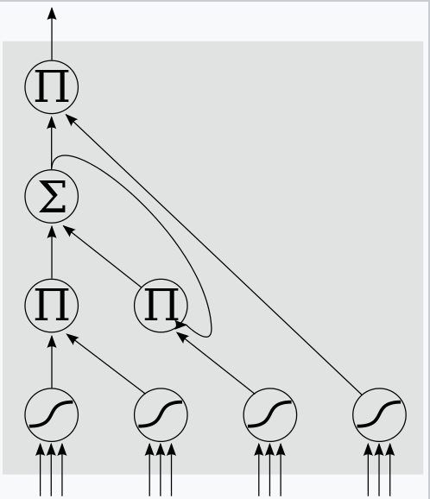
LSTM

Slide 12
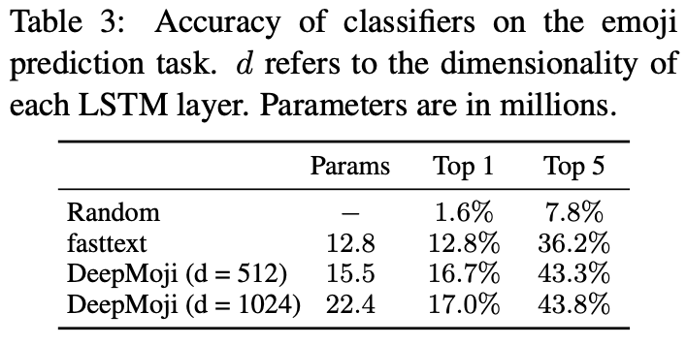
Experiment(1/3)

Slide 13
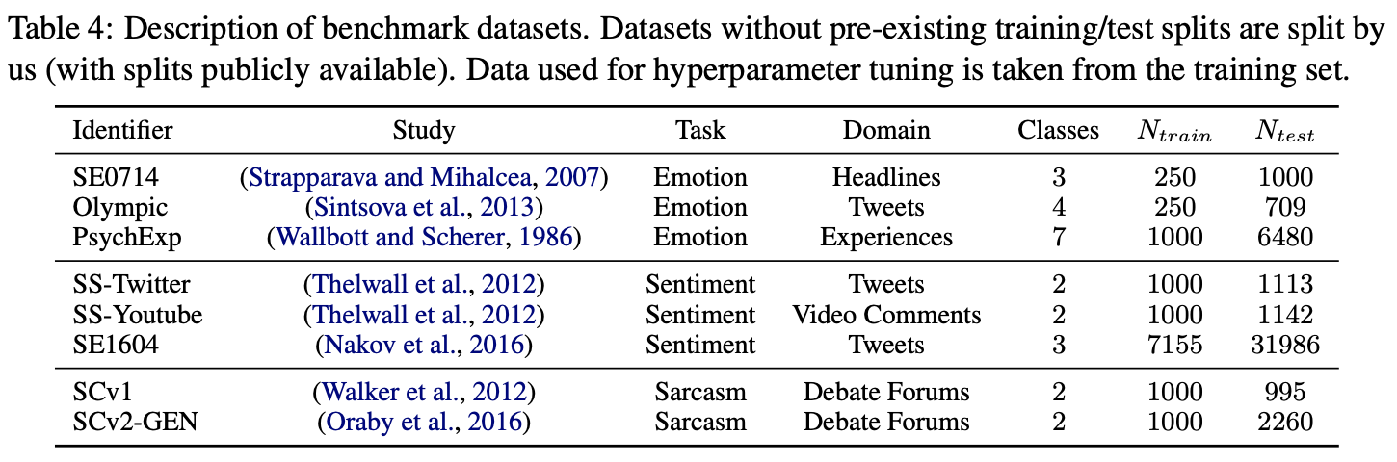
Experiment(2/3)

Slide 14
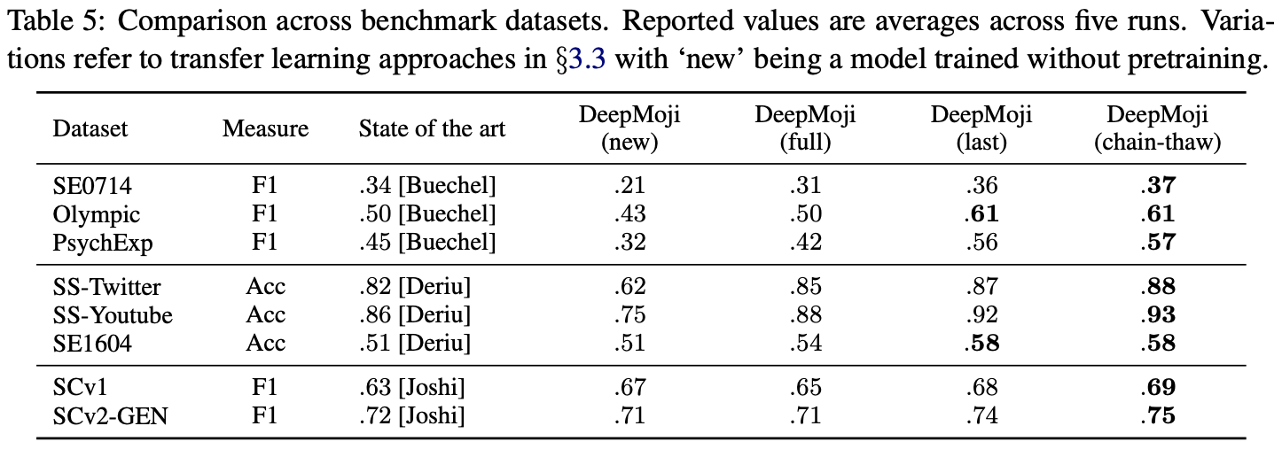
Experiment(3/3)

Slide 15
Thank you!

