Slide 1
Associated Disease Frequency-based Measure for Finding Candidate Target Genes from the Biomedical Literature
Yeondae Kwon, Hideaki Sugawara, Shogo Shimizu, Satoru Miyazaki
2011 International Conference on Complex, Intelligent, and Software Intensive Systems, 2011, Pages 524 - 529, Seoul, South Korea
Speaker: Jheng-Yan Lyu
Date: May 12, 2020

Slide 2
Abstract (1/2)
The identification of the side-effects of chemicals is the serious and costly stage in the drug development. Most side-effects are caused by their toxicity and also their correlation with other diseases than target diseases. We present a novel measure that identifies disease-associated genes from the biomedical literature in terms of causing less side-effects. This enables the identification of specific disease-associated genes, the decreased expression of which would result in a lower probability of side-effects, thus contributing to efficient drug development. Our method evaluates the specificity of a gene to a particular disease based on the number of associated diseases with the gene. In addition, we consider transitive gene-disease associations, that is, indirect gene-disease associations via intermediate genes.

Slide 3
Abstract (2/2)
Gene-disease associations are extracted from the PubMed abstracts based on term co-occurrences. Also, we discuss the ranking results for Alzheimer disease and various cancers to verify the effectiveness of our measure.

Slide 4
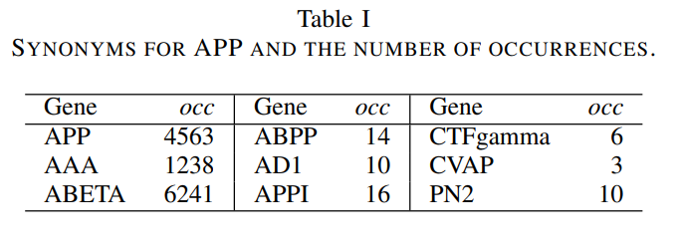
Term Dictionaries
Gene dictionary
Disease dictionary
APP(Amyloid Precursor Protein)(前類澱粉蛋白質)

Slide 5
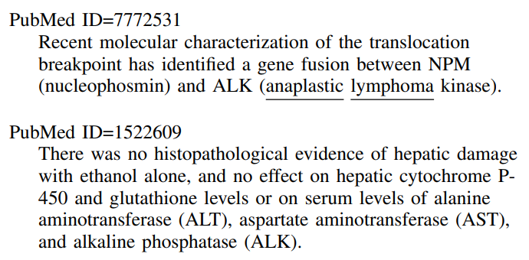
Term Dictionaries
IMPACT (imprinted and ancient gene protein homolog)
LARGE (like-acetylglucosaminyltransferase)

Slide 6
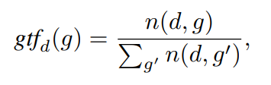
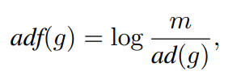

Measuring Associations
n(d, g) denotes the number of documents in which d and g co-occur
ad(g) be the number of diseases sufficiently associated with gene g.

Slide 7
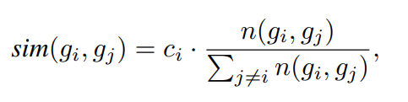
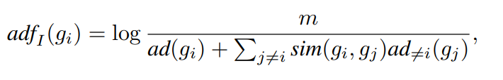
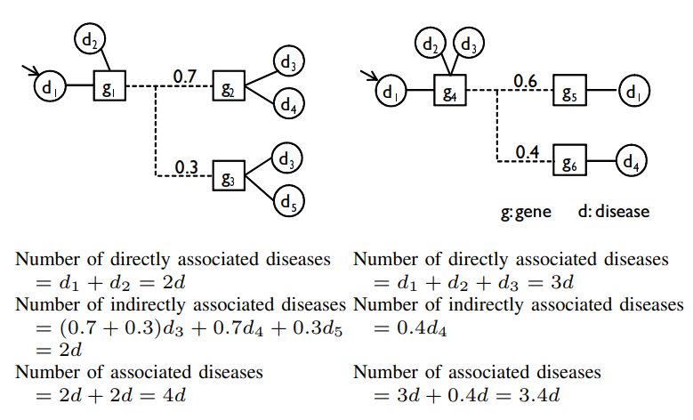
Indirect Associations via Intermediate Genes

Slide 8
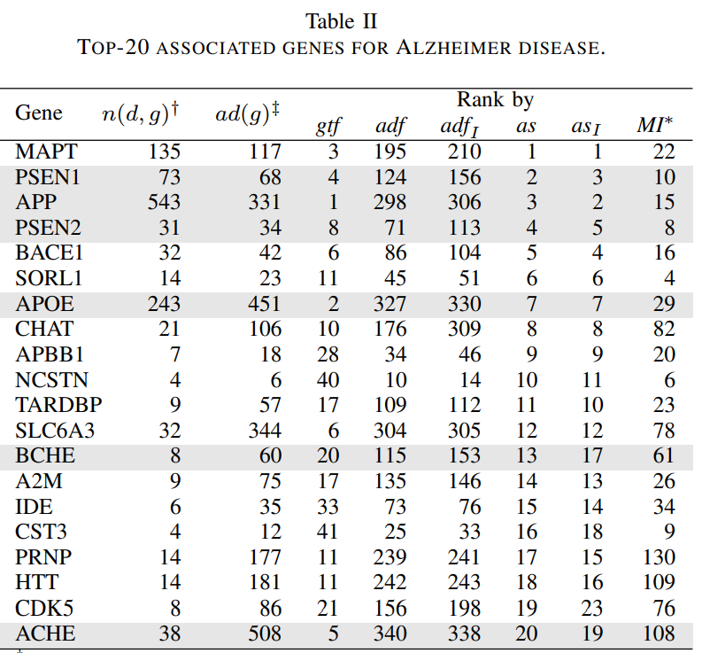
Results

