Slide 1
The Origin of SARS-CoV-2
Kristian G. Andersen, Andrew Rambaut, W. Ian Lipkin, Edward C. Holmes & Robert F. Garry - 【The Proximal Origin of SARS-CoV-2】 - Nature Medicine volume 26, pages450–452(2020)
Xiaolu Tang, Changcheng Wu, Xiang Li, Yuhe Song, Xinmin Yao, Xinkai Wu, Yuange Duan, Hong Zhang, Yirong Wang, Zhaohui Qian, Jie Cui, Jian Lu - 【On the Origin and Continuing Evolution of SARS-CoV-2】 - National Science Review, nwaa036
Presenter：Yu-Cheng Chang
Date：May 20, 2020

Slide 2
The Proximal Origin of SARS-CoV-2
Kristian G. Andersen, Andrew Rambaut, W. Ian Lipkin, Edward C. Holmes & Robert F. Garry
aNature Medicine volume 26, pages450–452(2020)
Presenter：Yu-Cheng Chang
Date：May 20, 2020

Slide 3
Similarity
 | SARS-CoV-2
RaTG13 | 96.2%
SARS-CoV | ~79%
MERS-CoV | ~50%
蝙蝠→

Slide 4
But…
SARS-CoV-2並非由蝙蝠體內的病毒(RaTG13)演化而來，而可能是從馬來西亞穿山甲(Malayan pangolins)體內的相關病毒演化。
SARS-CoV-2並非實驗室人為操作之病毒。 (但有可能為SARS-CoV逃出研究室後，進行演化或重組)
SARS-CoV-2擁有較SARS-CoV高的ACE2親和力，其為自然演化(Natural Selection)結果。

Slide 5
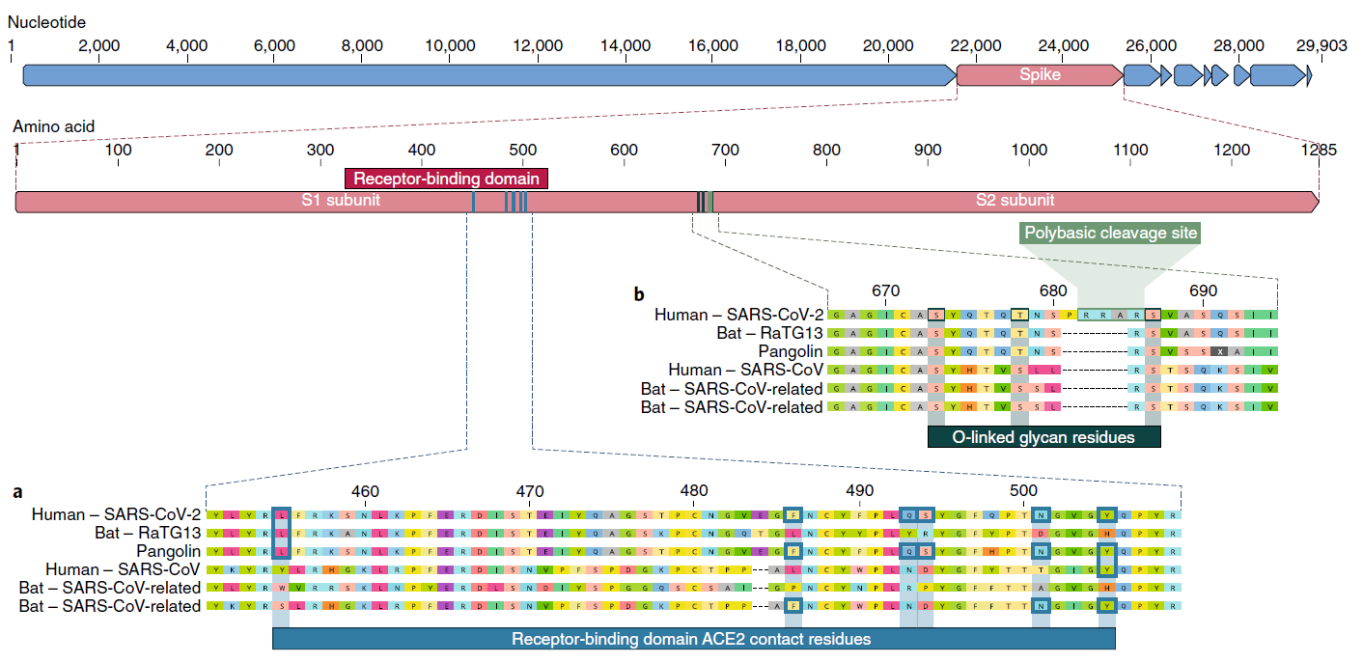
Main

Slide 6
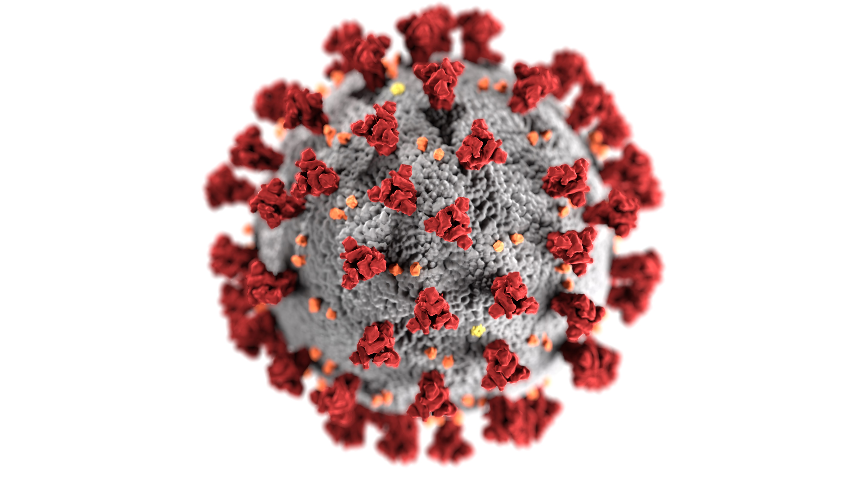
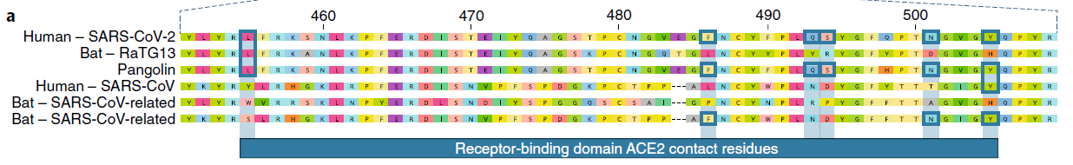
Receptor-binding Domain (RBD)
SARS-CoV
Y442 | L472 | N479 | D480 | T487 | Y491
SARS-CoV-2
L455 | F486 | Q493 | S494 | N501 | Y505
L L L Y W S
FLFLPF
QYQNRN
SRSDPD
NDNTAN
YHYYHY
Notes:
https://zh.wikipedia.org/wiki/%E8%A1%80%E7%AE%A1%E7%B4%A7%E5%BC%A0%E7%B4%A0%E8%BD%AC%E5%8C%96%E9%85%B62

Slide 7
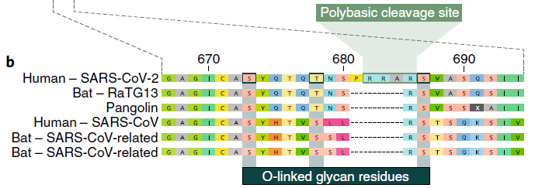
O-linked glycan (O-醣基化)
多鹼基分裂位
SARS-CoV-2 的O-linked glycan目前功能未知。
SARS-CoV 的O-linked glycan功能為強化細胞融合且不影響病毒進入。
O-linked的演化需有免疫系統介入，因此該特徵也為有力證據。 (否定SARS-CoV-2為人為介入或有意操作之實驗室產品)

Slide 8
Evolution
Natural selection in an animal host before zoonotic transfer.
Natural selection in humans following zoonotic transfer.
Selection during passage.

Slide 9
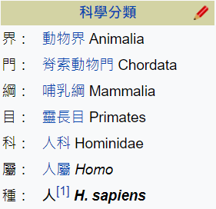
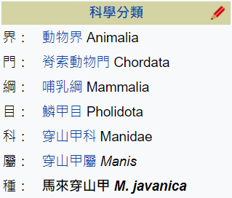
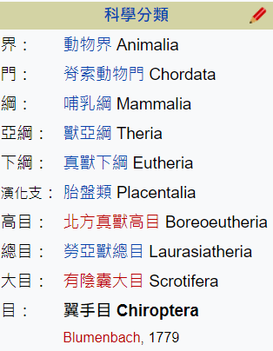
Evolution – In Animal
For a precursor virus to acquire both the polybasic cleavage site and mutations in the spike protein suitable for binding to human ACE2, an animal host would probably have to have a high population density
蝙蝠→

Slide 10
Evolution – In Humans
???
從馬來西亞偷渡穿山甲至廣東 (中藥材)
SARS-CoV-2祖先進入人體
SARS-CoV-2逐漸演化 (RBD、polybasic cleavage site、O-linked)
2019/11 ~ 2019/12
0號確診病患出現
爆發

Slide 11
Evolution – During Passage
RBD(Receptor-binding Domain)： SARS-CoV由實驗室培養過程中演化出不同的RBD => 已經發現穿山甲體內之病毒擁有近乎一樣的RBD，因此上述不太可能
Polybasic Cleavage Site： 已有高相似度的祖先，並人為培養加速，否則需要相當長時間的演化。 如禽流感，低致命率，經長時間才演化出新的Polybasic Cleavage Site。
O-linked： 不太可能人為培養，因需要免疫系統介入。

Slide 12
On the Origin and Continuing Evolution of SARS-CoV-2
Xiaolu Tang, Changcheng Wu, Xiang Li, Yuhe Song, Xinmin Yao, Xinkai Wu, Yuange Duan, Hong Zhang, Yirong Wang, Zhaohui Qian, Jie Cui, Jian Lu
National Science Review, nwaa036
Presenter：Yu-Cheng Chang
Date：May 20, 2020

Slide 13
Abstract(1/3)
The SARS-CoV-2 epidemic started in late December 2019 in Wuhan, China, and has since impacted a large portion of China and raised major global concern. Herein, we investigated the extent of molecular divergence between SARS-CoV-2 and other related coronaviruses. Although we found only 4% variability in genomic nucleotides between SARS-CoV-2 and a bat SARS-related coronavirus (SARSr-CoV; RaTG13), the difference at neutral sites was 17%, suggesting the divergence between the two viruses is much larger than previously estimated. Our results suggest that the development of new variations in functional sites in the receptor-binding domain (RBD) of the spike seen in SARS-CoV-2 and viruses from pangolin SARSr-CoVs are likely caused by mutations and natural selection besides recombination.

Slide 14
Abstract(2/3)
Population genetic analyses of 103 SARS-CoV-2 genomes indicated that these viruses evolved into two major types (designated L and S), that are well defined by two different SNPs that show nearly complete linkage across the viral strains sequenced to date. Although the L type (~70%) is more prevalent than the S type (~30%), the S type was found to be the ancestral version. Whereas the L type was more prevalent in the early stages of the outbreak in Wuhan, the frequency of the L type decreased after early January 2020.

Slide 15
Abstract(3/3)
Human intervention may have placed more severe selective pressure on the L type, which might be more aggressive and spread more quickly. On the other hand, the S type, which is evolutionarily older and less aggressive, might have increased in relative frequency due to relatively weaker selective pressure. These findings strongly support an urgent need for further immediate, comprehensive studies that combine genomic data, epidemiological data, and chart records of the clinical symptoms of patients with coronavirus disease 2019 (COVID-19).

Slide 16
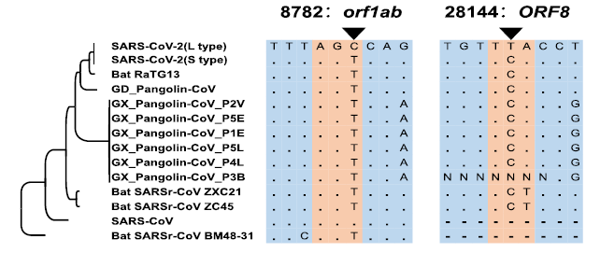
L and S types of SARS-CoV-2
S type (~30%)：
傳染率及複製率較低，與其他冠狀病毒更為相似，推測為祖病毒。
L type (~70%)：
推測由S type突變而來，其傳染率及複製率較高。

Slide 17
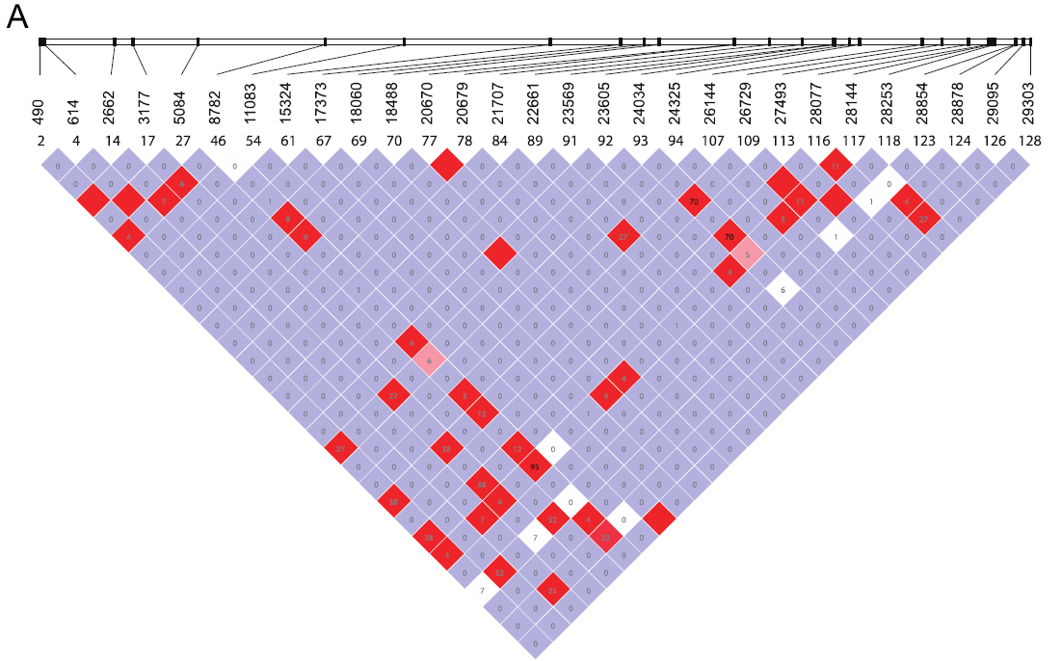
Linkage Disequilibrium (LD)
95

Slide 18
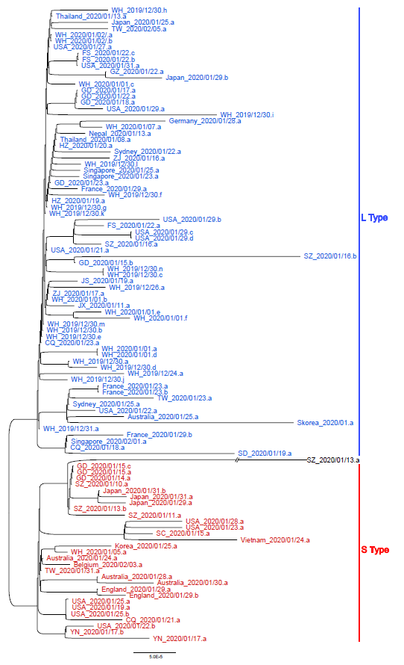
SZ_2020/01/13.a
特殊案例，不屬於L或S
因為其 8782 及 28144 都為 C鹼基
圖中每一個分支都代表著一株病毒(共103)，且已發現149處突變

Slide 19
演化推測
若SARS-CoV-2由Pangolin-CoV重組而來，其關鍵RBD附近應當相似，但…
根據 synonymous substitution rate (u) of 1.67 ~ 4.67 x 10⁻³/site/year ( from SARS-CoV ) 則 GD Pangolin-CoV 重組(滲入)為SARS-CoV-2，估計約於19.8 ~ 55.4年前即開始。
因此，SARS-CoV-2不太可能短期內由Pangolin-CoV重組而來，推測：
RaTG13 有可能才是從 SARS-CoV-2 突變的
隨機突變 (因 Spike Protein 突變率極高) 加上 天擇
Notes:
https://zh.wikipedia.org/wiki/%E9%81%BA%E5%82%B3%E9%87%8D%E7%B5%84 (recombination)
https://zh.wikipedia.org/wiki/%E5%9F%BA%E5%9B%A0%E6%BB%B2%E5%85%A5 (Introgression)

Slide 20
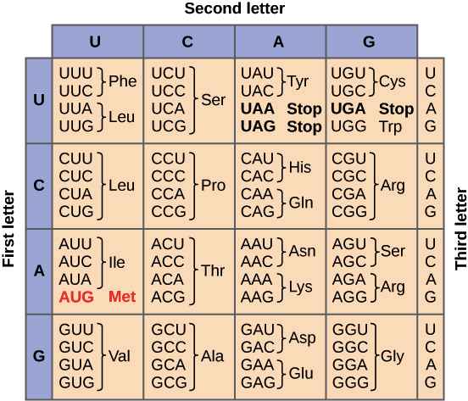
dN/dS Ratio (ω)
28144 8782
Non-synonymous mutation (異義突變)：
通常導致有害結果
Synonymous mutation (同義突變)：
無害亦無幫助
ω > 1 ： positive selection 突變對自身有利
ω < 1 ： negative selection 突變對自身有害，並純化(修復)
ω ≒1： neutral selection

Slide 21
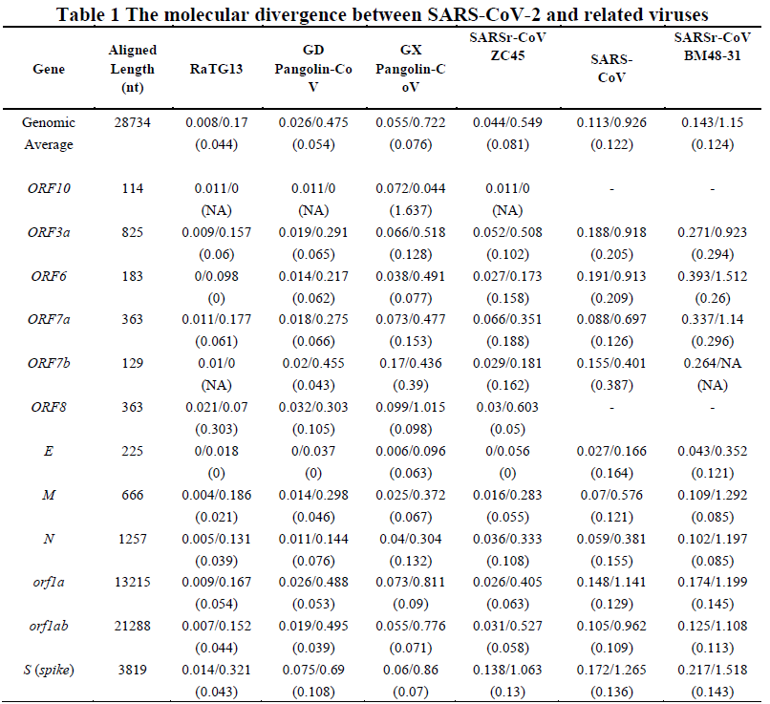

Slide 22
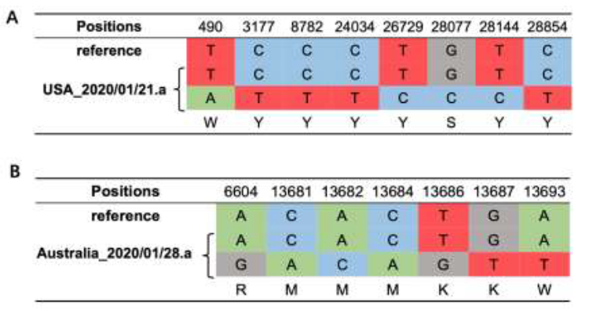
突變? 同時感染?

Slide 23
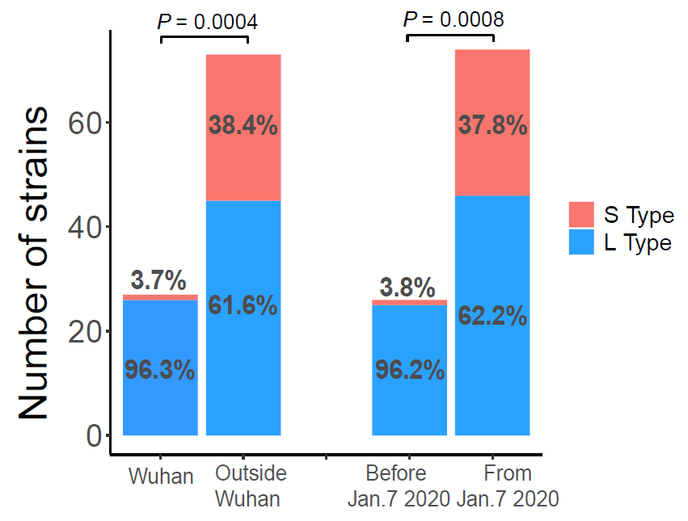
Summary
SARS-CoV-2 為實驗室人為產品機率不高
SARS-CoV-2 由穿山甲內的病毒演化而來的機率較高。
SARS-CoV-2 現存兩種主流亞種(L type、S type，約7:3)， 其中 S type 較為古老，可能為 L type 的祖病毒。
19.3%
40.0%
60.0%

