Slide 1
Task Scheduling Algorithms for Heterogeneous Processors
Haluk Topcuoglu, Salim Hariri, Min-You Wu
Eighth Heterogeneous Computing Workshop 1999, April 12, San Juan, Puerto Rico, USA
Presenter : Chih-Kai Wu
Date: MAY.20, 2020.
Notes:
聖胡安是美國自治領地波多黎各的首府和最大城市

Slide 2
Abstract
Scheduling computation tasks on processors is the key issue for high-performance computing. Although a large number of scheduling heuristics have been presented in the literature, most of them target only homogeneous resources. The existing algorithms for heterogeneous domains are not generally efficient because of their high complexity and/or the quality of the results. We present two low-complexity efficient heuristics, the Heterogeneous Earliest-Finish-Time (HEFT) algorithm and the Critical-Path-on-a-Processor (CPOP) algorithm for scheduling directed acyclic weighted task graphs (DAGs) on a bounded number of heterogeneous processors. We compared the performances of these algorithms against three previously proposed heuristics. The comparison study showed that our algorithms outperform previous approaches in terms of performance (schedule length ratio and speedup) and cost (time-complexity).

Slide 3
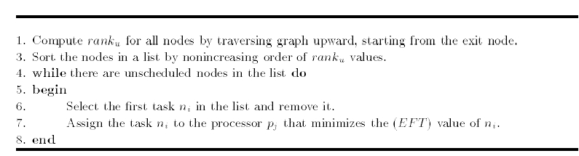



The HEFT Algorithm
time-complexity = O( $v^{2}$p )

Slide 4
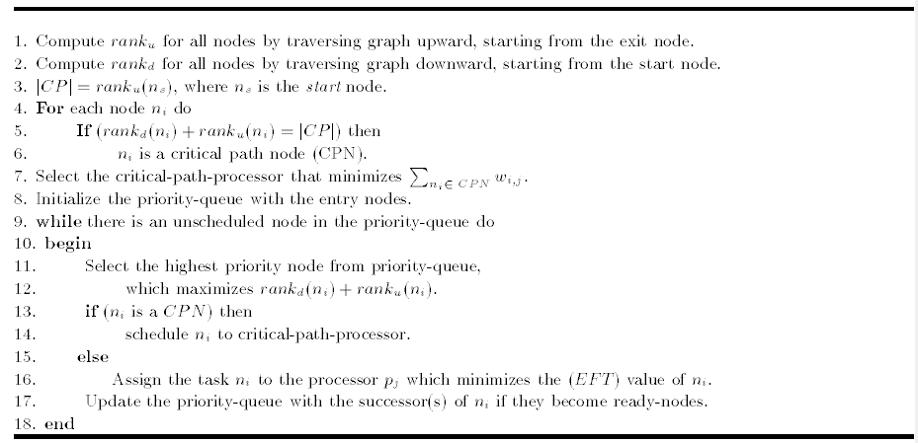

The CPOP Algorithm
time-complexity = O( $v^{2}$p )

Slide 5
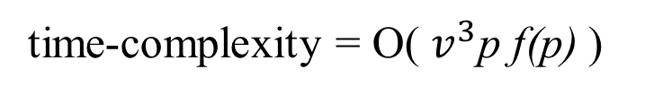
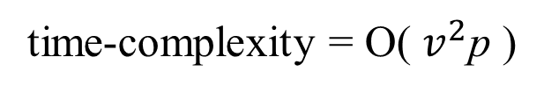
Mapping Heuristic (MH) Algorithm
time-complexity = O( $v^{2}$p )
Dynamic-Level Scheduling (DLS) Algorithm
time-complexity = O( $v^{3}$p f(p) )
The complexity of the function used for data routing to calculate the earliest start time is O(f(p))

Slide 6
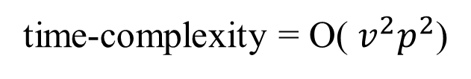
Levelized-Min Time Algorithm
time-complexity = O( $v^{2}p^{2}$)

Slide 7



Slide 8
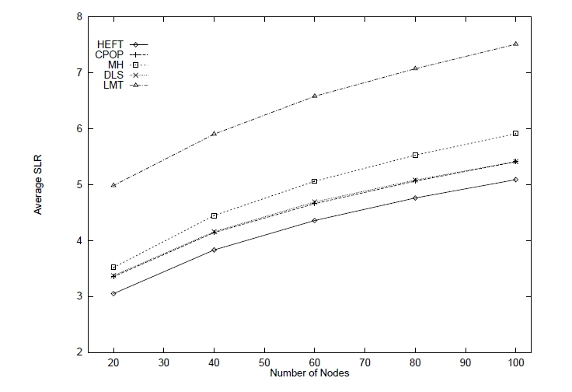

Slide 9
