Slide 1
An almost-linear time and linear space algorithm for the longest common subsequence problem
J.Y. Guo and F.K. Hwang
Information Processing Letters 94(2005) 131-135

Slide 2
Abstract
There are two general approaches to the longest common subsequence problem. The dynamic programming approach takes quadratic time but linear space, while the nondynamic-programming approach takes less time but more space. We propose a new implementation of the latter approach which seems to get the best for both time and space for the DNA application.

Slide 3
Example
I: TGCATA, J: ATCTGAT
Table X: 紀錄J從位置j看下去該元素第一次出現的位置。
Table X:
j | 0 | 1 | 2 | 3 | 4 | 5 | 6 | 7
A | 1 | 6 | 6 | 6 | 6 | 6 | - | -
C | 3 | 3 | 3 | - | - | - | - | -
G | 5 | 5 | 5 | 5 | 5 | - | - | -
T | 2 | 2 | 4 | 4 | 7 | 7 | 7 | -

Slide 4
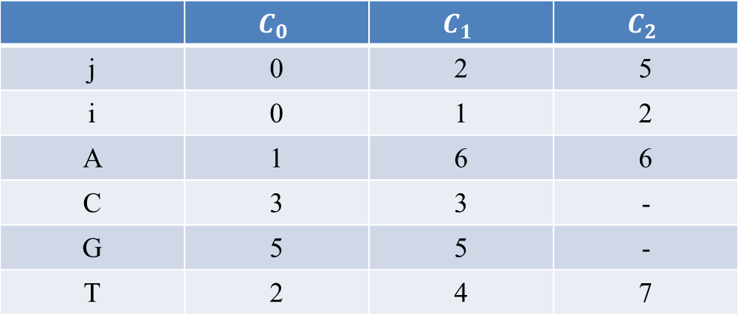
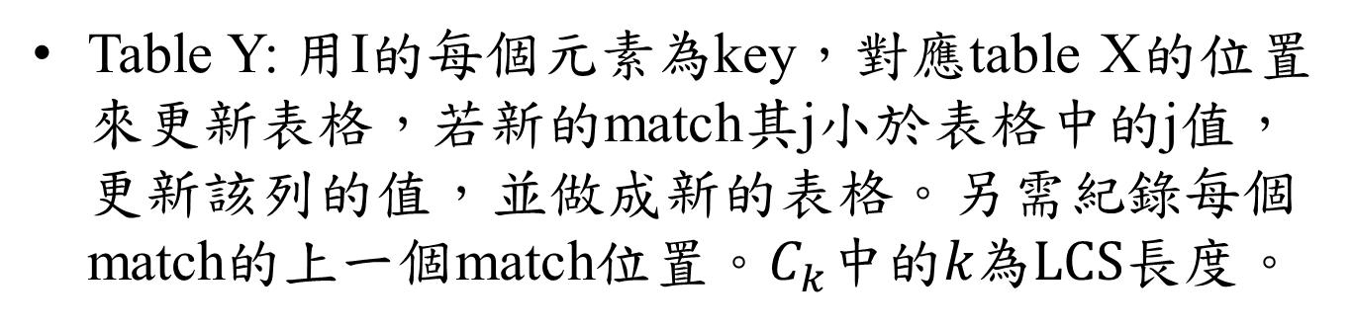
Example
Table Y: 用I的每個元素為key，對應table X的位置來更新表格，若新的match其j小於表格中的j值，更新該列的值，並做成新的表格。另需紀錄每個match的上一個match位置。$C_{k}中的k為LCS長度$。
Table Y: when i = 2
 | $$C_{0}$$ | $$C_{1}$$ | $$C_{2}$$
j | 0 | 2 | 5
i | 0 | 1 | 2
A | 1 | 6 | 6
C | 3 | 3 | -
G | 5 | 5 | -
T | 2 | 4 | 7

Slide 5
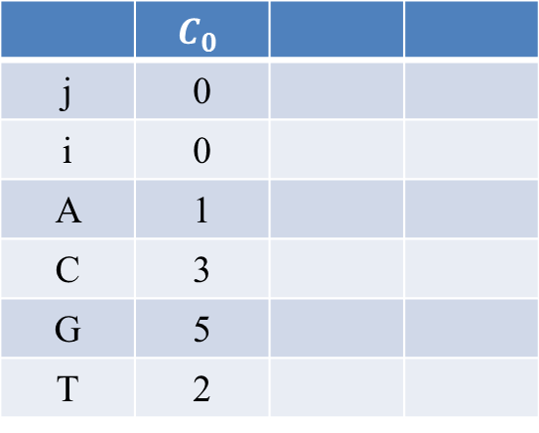
Example
Table X:
I: TGCATA, J: ATCTGAT
j | 0 | 1 | 2 | 3 | 4 | 5 | 6 | 7
A | 1 | 6 | 6 | 6 | 6 | 6 | - | -
C | 3 | 3 | 3 | - | - | - | - | -
G | 5 | 5 | 5 | 5 | 5 | - | - | -
T | 2 | 2 | 4 | 4 | 7 | 7 | 7 | -
Table Y: when i = 0
 | $$C_{0}$$
j | 0
i | 0
A | 1
C | 3
G | 5
T | 2

Slide 6

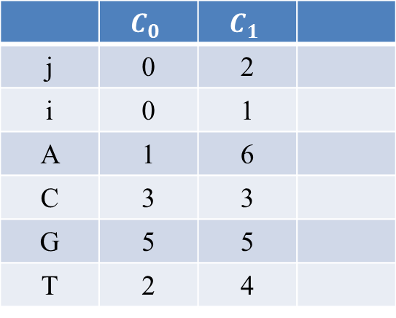
Example
Table X:
I: TGCATA, J: ATCTGAT
j | 0 | 1 | 2 | 3 | 4 | 5 | 6 | 7
A | 1 | 6 | 6 | 6 | 6 | 6 | - | -
C | 3 | 3 | 3 | - | - | - | - | -
G | 5 | 5 | 5 | 5 | 5 | - | - | -
T | 2 | 2 | 4 | 4 | 7 | 7 | 7 | -
Table Y: when i = 1, $I_{1}$ = T
 | $$C_{0}$$ | $$C_{1}$$
j | 0 | 2
i | 0 | 1
A | 1 | 6
C | 3 | 3
G | 5 | 5
T | 2 | 4
b(2, 1) = (0, 0)

Slide 7

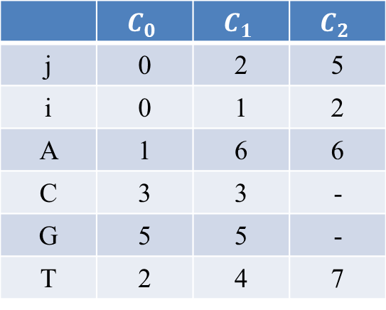
Example
Table X:
I: TGCATA, J: ATCTGAT
j | 0 | 1 | 2 | 3 | 4 | 5 | 6 | 7
A | 1 | 6 | 6 | 6 | 6 | 6 | - | -
C | 3 | 3 | 3 | - | - | - | - | -
G | 5 | 5 | 5 | 5 | 5 | - | - | -
T | 2 | 2 | 4 | 4 | 7 | 7 | 7 | -
Table Y: when i = 2, $I_{2}$ = G
 | $$C_{0}$$ | $$C_{1}$$ | $$C_{2}$$
j | 0 | 2 | 5
i | 0 | 1 | 2
A | 1 | 6 | 6
C | 3 | 3 | -
G | 5 | 5 | -
T | 2 | 4 | 7
b(1, 2) = (0, 0), b(2, 5) = (1, 2)

Slide 8

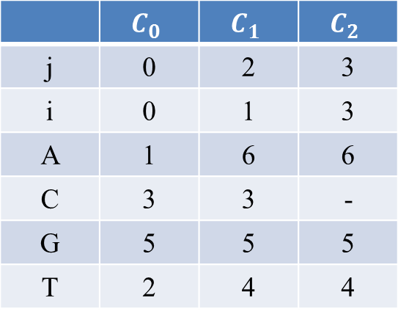
Example
Table X:
I: TGCATA, J: ATCTGAT
j | 0 | 1 | 2 | 3 | 4 | 5 | 6 | 7
A | 1 | 6 | 6 | 6 | 6 | 6 | - | -
C | 3 | 3 | 3 | - | - | - | - | -
G | 5 | 5 | 5 | 5 | 5 | - | - | -
T | 2 | 2 | 4 | 4 | 7 | 7 | 7 | -
Table Y: when i = 3, $I_{3}$ = C
 | $$C_{0}$$ | $$C_{1}$$ | $$C_{2}$$
j | 0 | 2 | 5
i | 0 | 1 | 2
A | 1 | 6 | 6
C | 3 | 3 | -
G | 5 | 5 | -
T | 2 | 4 | 7
 | $$C_{0}$$ | $$C_{1}$$ | $$C_{2}$$
j | 0 | 2 | 3
i | 0 | 1 | 3
A | 1 | 6 | 6
C | 3 | 3 | -
G | 5 | 5 | 5
T | 2 | 4 | 4
3 < 5
更新該列
畫新表格
b(1, 2) = (0, 0), b(2, 5) = (1, 2)
b(3, 3) = (1, 2)

Slide 9

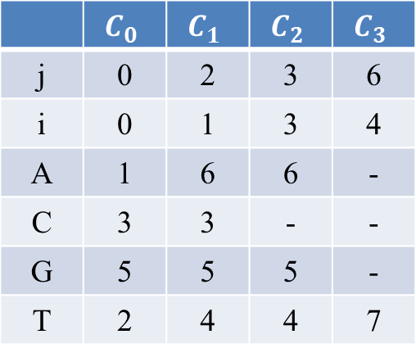
Example
Table X:
I: TGCATA, J: ATCTGAT
j | 0 | 1 | 2 | 3 | 4 | 5 | 6 | 7
A | 1 | 6 | 6 | 6 | 6 | 6 | - | -
C | 3 | 3 | 3 | - | - | - | - | -
G | 5 | 5 | 5 | 5 | 5 | - | - | -
T | 2 | 2 | 4 | 4 | 7 | 7 | 7 | -
Table Y: when i = 4, $I_{4}$ = A
 | $$C_{0}$$ | $$C_{1}$$ | $$C_{2}$$ | $$C_{3}$$
j | 0 | 2 | 3 | 6
i | 0 | 1 | 3 | 4
A | 1 | 6 | 6 | -
C | 3 | 3 | - | -
G | 5 | 5 | 5 | -
T | 2 | 4 | 4 | 7
b(1, 2) = (0, 0), b(3, 3) = (1, 2), b(6, 4) = (3, 3)

Slide 10
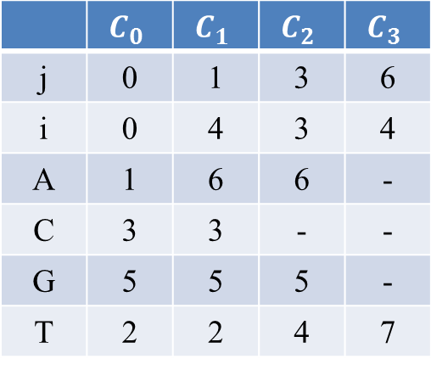
Example
Table X:
I: TGCATA, J: ATCTGAT
j | 0 | 1 | 2 | 3 | 4 | 5 | 6 | 7
A | 1 | 6 | 6 | 6 | 6 | 6 | - | -
C | 3 | 3 | 3 | - | - | - | - | -
G | 5 | 5 | 5 | 5 | 5 | - | - | -
T | 2 | 2 | 4 | 4 | 7 | 7 | 7 | -
Table Y: when i = 4, $I_{4}$ = A
 | $$C_{0}$$ | $$C_{1}$$ | $$C_{2}$$ | $$C_{3}$$
j | 0 | 2 | 3 | 6
i | 0 | 1 | 3 | 4
A | 1 | 6 | 6 | -
C | 3 | 3 | - | -
G | 5 | 5 | 5 | -
T | 2 | 4 | 4 | 7
 | $$C_{0}$$ | $$C_{1}$$ | $$C_{2}$$ | $$C_{3}$$
j | 0 | 1 | 3 | 6
i | 0 | 4 | 3 | 4
A | 1 | 6 | 6 | -
C | 3 | 3 | - | -
G | 5 | 5 | 5 | -
T | 2 | 2 | 4 | 7
1 < 2
更新該列
畫新表格
b(1, 2) = (0, 0), b(3, 3) = (1, 2), b(6, 4) = (3, 3)
b(4, 1) = (0, 0)

Slide 11

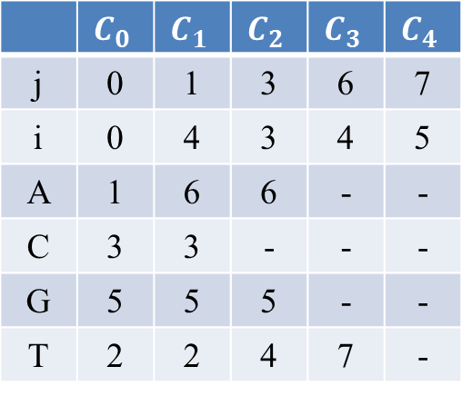
Example
Table X:
I: TGCATA, J: ATCTGAT
j | 0 | 1 | 2 | 3 | 4 | 5 | 6 | 7
A | 1 | 6 | 6 | 6 | 6 | 6 | - | -
C | 3 | 3 | 3 | - | - | - | - | -
G | 5 | 5 | 5 | 5 | 5 | - | - | -
T | 2 | 2 | 4 | 4 | 7 | 7 | 7 | -
Table Y: when i = 5, $I_{5}$ = T
 | $$C_{0}$$ | $$C_{1}$$ | $$C_{2}$$ | $$C_{3}$$ | $$C_{4}$$
j | 0 | 1 | 3 | 6 | 7
i | 0 | 4 | 3 | 4 | 5
A | 1 | 6 | 6 | - | -
C | 3 | 3 | - | - | -
G | 5 | 5 | 5 | - | -
T | 2 | 2 | 4 | 7 | -
b(4, 1) = (0, 0), b(3, 3) = (1, 2), b(6, 4) = (3, 3), b(5, 7) = (6, 4)

Slide 12
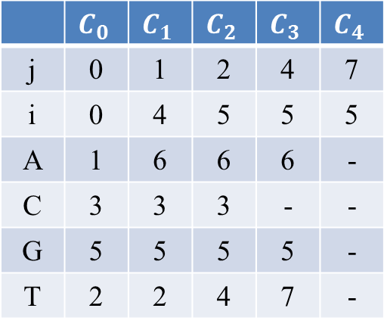
Example
Table X:
I: TGCATA, J: ATCTGAT
j | 0 | 1 | 2 | 3 | 4 | 5 | 6 | 7
A | 1 | 6 | 6 | 6 | 6 | 6 | - | -
C | 3 | 3 | 3 | - | - | - | - | -
G | 5 | 5 | 5 | 5 | 5 | - | - | -
T | 2 | 2 | 4 | 4 | 7 | 7 | 7 | -
Table Y: when i = 5, $I_{5}$ = T
 | $$C_{0}$$ | $$C_{1}$$ | $$C_{2}$$ | $$C_{3}$$ | $$C_{4}$$
j | 0 | 1 | 3 | 6 | 7
i | 0 | 4 | 3 | 4 | 5
A | 1 | 6 | 6 | - | -
C | 3 | 3 | - | - | -
G | 5 | 5 | 5 | - | -
T | 2 | 2 | 4 | 7 | -
 | $$C_{0}$$ | $$C_{1}$$ | $$C_{2}$$ | $$C_{3}$$ | $$C_{4}$$
j | 0 | 1 | 2 | 4 | 7
i | 0 | 4 | 5 | 5 | 5
A | 1 | 6 | 6 | 6 | -
C | 3 | 3 | 3 | - | -
G | 5 | 5 | 5 | 5 | -
T | 2 | 2 | 4 | 7 | -
4 < 6 2 < 3
更新該列
畫新表格
b(4, 1) = (0, 0), b(3, 3) = (1, 2), b(4, 6) = (3, 3), b(5, 7) = (4, 6), b(5, 2) = (4, 1), b(5, 4) = (3, 3)

Slide 13

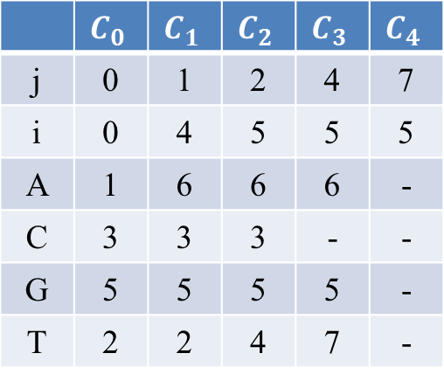
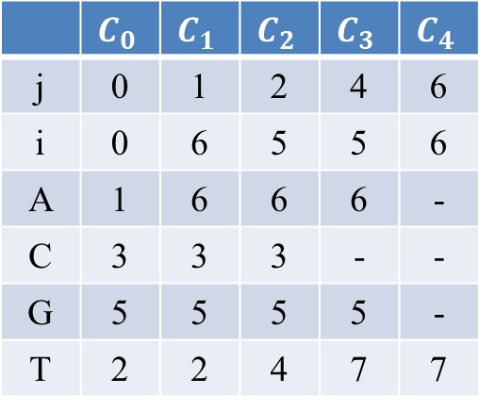
Example
Table X:
I: TGCATA, J: ATCTGAT
j | 0 | 1 | 2 | 3 | 4 | 5 | 6 | 7
A | 1 | 6 | 6 | 6 | 6 | 6 | - | -
C | 3 | 3 | 3 | - | - | - | - | -
G | 5 | 5 | 5 | 5 | 5 | - | - | -
T | 2 | 2 | 4 | 4 | 7 | 7 | 7 | -
Table Y: when i = 6, $I_{6}$ = A
 | $$C_{0}$$ | $$C_{1}$$ | $$C_{2}$$ | $$C_{3}$$ | $$C_{4}$$
j | 0 | 1 | 2 | 4 | 7
i | 0 | 4 | 5 | 5 | 5
A | 1 | 6 | 6 | 6 | -
C | 3 | 3 | 3 | - | -
G | 5 | 5 | 5 | 5 | -
T | 2 | 2 | 4 | 7 | -
 | $$C_{0}$$ | $$C_{1}$$ | $$C_{2}$$ | $$C_{3}$$ | $$C_{4}$$
j | 0 | 1 | 2 | 4 | 6
i | 0 | 6 | 5 | 5 | 6
A | 1 | 6 | 6 | 6 | -
C | 3 | 3 | 3 | - | -
G | 5 | 5 | 5 | 5 | -
T | 2 | 2 | 4 | 7 | 7
1 < 2 6 < 7
更新該列
畫新表格
b(4, 1) = (0, 0), b(5, 2) = (4, 1), b(5, 4) = (3, 3), b(5, 7) = (4, 6), b(6, 1) = (0, 0), b(6, 6) = (5, 4)

Slide 14
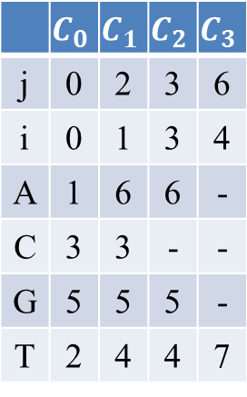
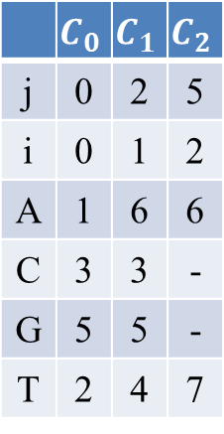
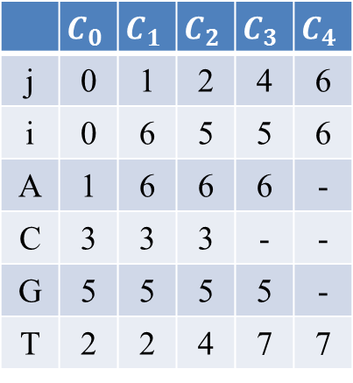
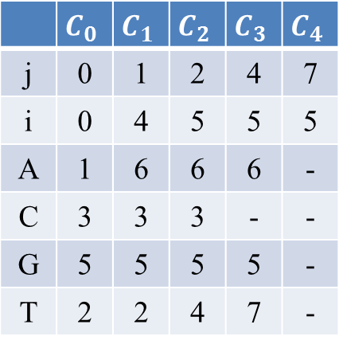
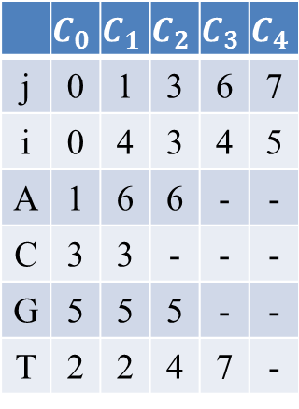
I: TGCATA, J: ATCTGAT
 | $$C_{0}$$ | $$C_{1}$$ | $$C_{2}$$
j | 0 | 2 | 5
i | 0 | 1 | 2
A | 1 | 6 | 6
C | 3 | 3 | -
G | 5 | 5 | -
T | 2 | 4 | 7
 | $$C_{0}$$ | $$C_{1}$$ | $$C_{2}$$ | $$C_{3}$$
j | 0 | 2 | 3 | 6
i | 0 | 1 | 3 | 4
A | 1 | 6 | 6 | -
C | 3 | 3 | - | -
G | 5 | 5 | 5 | -
T | 2 | 4 | 4 | 7
 | $$C_{0}$$ | $$C_{1}$$ | $$C_{2}$$ | $$C_{3}$$ | $$C_{4}$$
j | 0 | 1 | 3 | 6 | 7
i | 0 | 4 | 3 | 4 | 5
A | 1 | 6 | 6 | - | -
C | 3 | 3 | - | - | -
G | 5 | 5 | 5 | - | -
T | 2 | 2 | 4 | 7 | -
b(2, 5) =
(1, 2)
b(1, 2) =
(0, 0)
b(4, 6) =
(3, 3)
b(3, 3) =
(1, 2)
b(1, 2) =
(0, 0)
b(5, 7) =
(4, 6)
b(4, 6) =
(3, 3)
b(3, 3) =
(1, 4)
b(1, 4) =
(0, 0)
 | $$C_{0}$$ | $$C_{1}$$ | $$C_{2}$$ | $$C_{3}$$ | $$C_{4}$$
j | 0 | 1 | 2 | 4 | 7
i | 0 | 4 | 5 | 5 | 5
A | 1 | 6 | 6 | 6 | -
C | 3 | 3 | 3 | - | -
G | 5 | 5 | 5 | 5 | -
T | 2 | 2 | 4 | 7 | -
 | $$C_{0}$$ | $$C_{1}$$ | $$C_{2}$$ | $$C_{3}$$ | $$C_{4}$$
j | 0 | 1 | 2 | 4 | 6
i | 0 | 6 | 5 | 5 | 6
A | 1 | 6 | 6 | 6 | -
C | 3 | 3 | 3 | - | -
G | 5 | 5 | 5 | 5 | -
T | 2 | 2 | 4 | 7 | 7
b(5, 7) =
(4, 6)
b(5, 4) =
(3, 3)
b(5, 2) =
(4, 1)
b(4, 1) =
(0, 0)
b(6, 6) = (5, 4)
b(5, 4) = (3, 3)
b(5, 2) = (4, 1)
b(6, 1) = (0, 0)
LCS = ACTA

Slide 15
Time and Space Complexity
Time complexity:
建立Table X: O(n)
更新Table Y: O(nL)
Space complexity:
建立兩個表格都是O(n)

