Slide 1
The statistical distribution of nucleic acid similarities
Nucleic Acids Research
Volume 13 Number 2 1985
Temple F.Smith, Michael S.Waterman and Christian Burks
Prensenter: Cheng-Yi Fang
Date: 2014/05/06

Slide 2
Abstract
All pairs of a large set of known vertebrate DNA sequences were searched by computer for most similar segments. Analysis of this data shows that the computed similarity scores are distributed proportionally to the logarithm of the product of the lengths of the sequences involved.
This distribution is closely related to recent results of Erdos and others on the longest run of heads in coin tossing. A simple rule is derived for determination of statistical significance of the similarity scores and to assist in relating statistical and biological significance.

Slide 3
Methods
利用Needleman and Wunsch 的sequences alignment 找出相似度最高的配對by DP
參數
Matchs: 1.0
Mismatches: -0.9
Gaps: -2.0

Slide 4
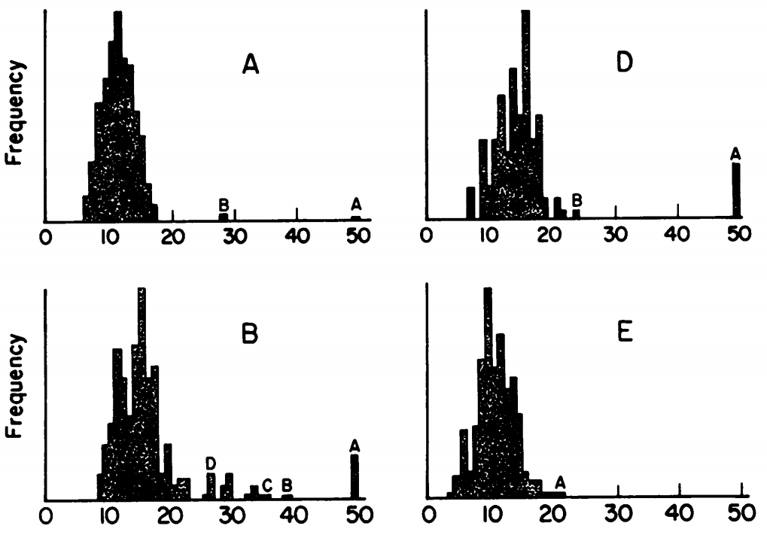
Experiments
All sequence data were from GenBank
We used the method to generate a frequency distribution.

Slide 5
Experiments
目地: 找出據統計顯著性的alignment
分析時去除分數大於40的數據
將 the length of the longest run of matches 的問題轉為the longest run of heads of n independent coin tosses.
作法:
Match: Head
Else : Tail
Example
ACCTG > THTHH
TCATG > THTHH
再利用一些數學公式推導得到下圖

Slide 6
Experiments

Slide 7
Cases
分布中，大於平均兩倍標準差的資料為具有統計的顯著性的資料。
根據以上的數據算出(n,m為兩字串長度)
平均:
標準差: 1.78
所以若兩序列長度，分數，match機率分別為(1441, 600, 27, 0.248)
則mean為 2.55*log(600*1441)/log(1/0.248) – 8.99 = 16.01
27 - 16.01 = 10.99 = 1.78*(6.17) = 6.17個標準差

Slide 8
Conclusion
These examples illustrate the fact that statistical significance and biological significance are closely related but not identical.
Statistically significant similarity scores may not reflect true homology.

