Slide 1
Comparative Biosequence Metrics
Author: T.F. Smith, M.S. Waterman, and W.M. Fitch
Source: Journal of Molecular Evolution 1981, pp.38-46
Presenter：Guan-Cheng Guo Date：2014/5/6

Slide 2
Abstract
The sequence alignment algorithms of Needleman and Wunsch (1970) and Sellers (1974) are compared. Although the former maximizes similarity and the latter minimizes differences, the two procedures are proven to be equivalent. The equivalence relations necessary for each procedure to give the same result are: 1, the weight assigned to gaps in the Sellers algorithm exceed that in the Needleman-Wunsch algorithm by exactly half the length of the gap times the maximum match value; and 2, for any pair of aligned elements, the degree of similarity assigned by the Needleman-Wunsch algorithm plus the degree of dissimilarity assigned by the Sellers algorithm equal a constant. The utility of the algorithms is independent of the nature of the elements in the sequence and could include anything from geological sequences to the amino acid sequences of proteins. Examples are provided using known nucleotide sequences, one of which shows two sequences to be analogous rather than homologous.

Slide 3
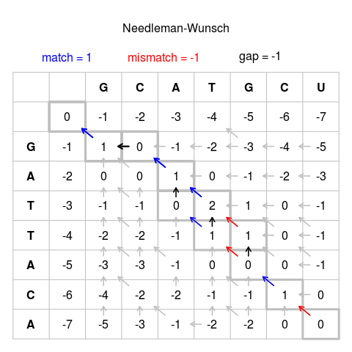
Needleman–Wunsch algorithm

Slide 4
Needleman–Wunsch algorithm vs. Sellers algorithm
Major differences between the Needleman-Wunsch and the Sellers algorithms:
Needleman-Wunsch algorithm results in alignments having a maximum similarity measure.
Sellers algorithm results in alignments having a minimal distance or metric measure of dissimilarity.

Slide 5
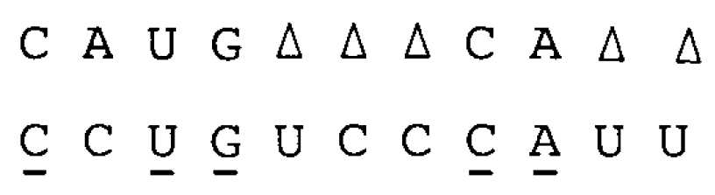
Analysis
Consider two sequences A and B of length n and m respectively, where A= a1 a2 a3 ... an and B = b1 b2 b3 ... bm.
Example:

Slide 6
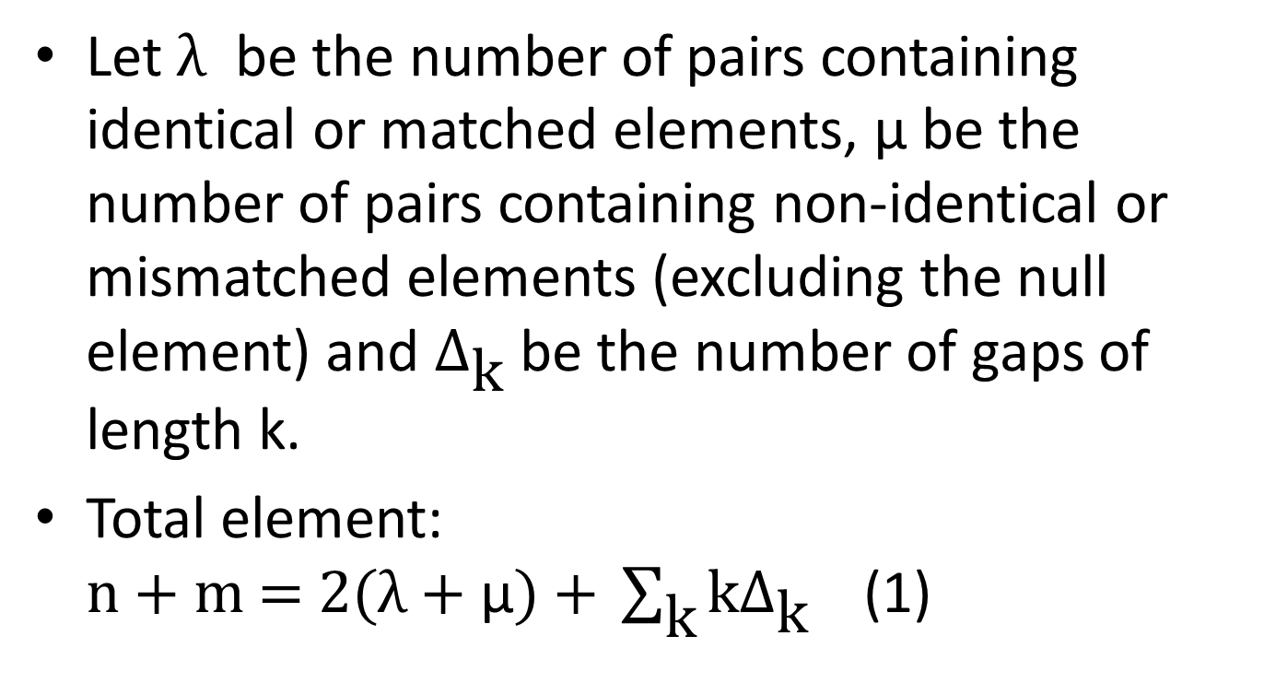
Analysis
Let $\text{λ}$ be the number of pairs containing identical or matched elements, μ be the number of pairs containing non-identical or mismatched elements (excluding the null element) and $Δ_{\text{k}}$ be the number of gaps of length k.
Total element: $\text{n}\text{ + }\text{m}\text{ = 2(}\text{λ}\text{ + }\text{μ}\text{) + }\sum_{\text{k}}{\text{k}Δ_{\text{k}}}$ (1)

Slide 7
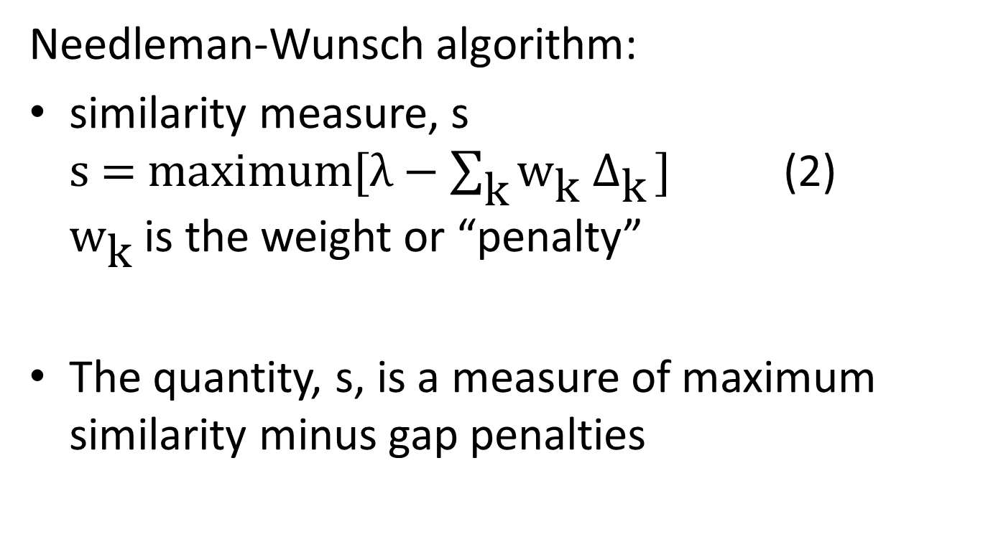
Analysis
Needleman-Wunsch algorithm:
similarity measure, s $\text{s}\text{ = }\text{maximum}\text{[}λ−\sum_{\text{k}}{{\text{w}}_{\text{k}}{ Δ}_{\text{k}}}\text{]}$ (2) ${\text{w}}_{\text{k}}$ is the weight or “penalty”
The quantity, s, is a measure of maximum similarity minus gap penalties

Slide 8
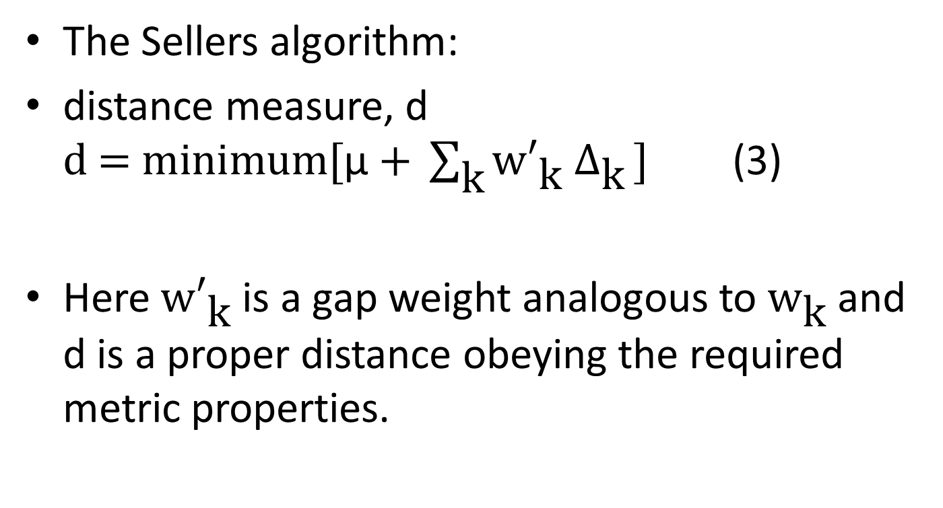
Analysis
The Sellers algorithm:
distance measure, d $\text{d}\text{ = }\text{minimum}\text{[}\text{μ} \text{+ }\sum_{\text{k}}{{\text{w}′}_{\text{k}}{ Δ}_{\text{k}}}\text{]}$ (3)
Here ${\text{w}′}_{\text{k}}$ is a gap weight analogous to ${\text{w}}_{\text{k}}$ and d is a proper distance obeying the required metric properties.

Slide 9
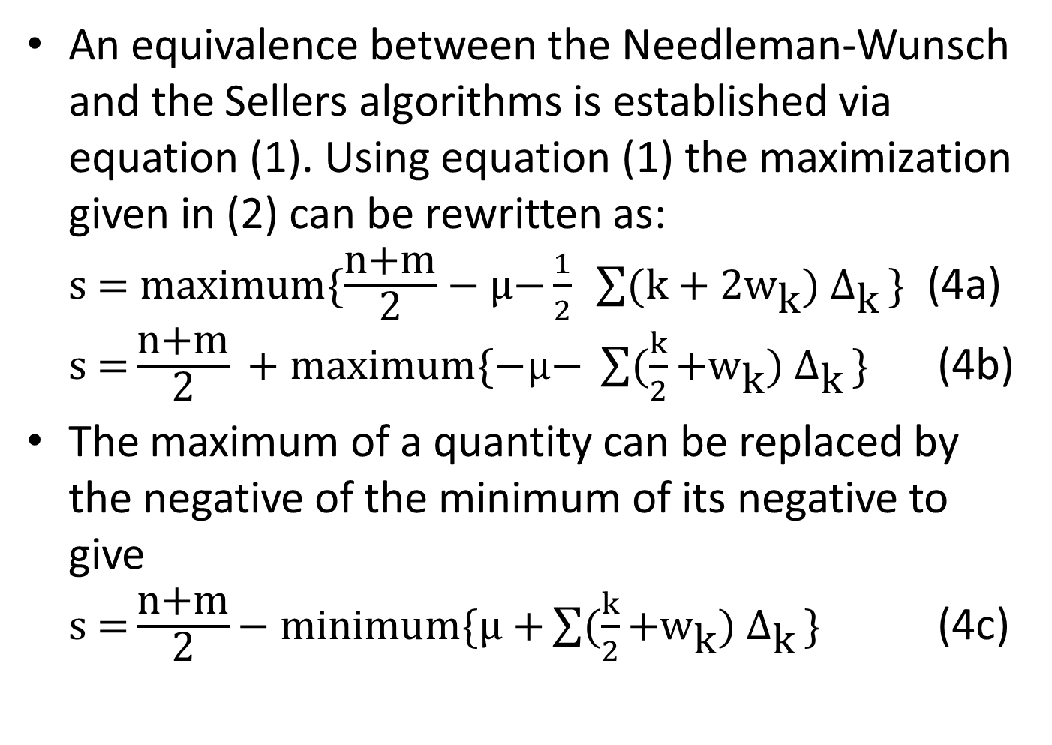
Analysis
An equivalence between the Needleman-Wunsch and the Sellers algorithms is established via equation (1). Using equation (1) the maximization given in (2) can be rewritten as: $\text{s}\text{ = }\text{maximum}\{\frac{\text{n}\text{+}\text{m}}{\text{2}}−\text{μ}\text{−}\frac{1}{2} \sum{(\text{k}\text{ + 2}{\text{w}}_{\text{k}}){ Δ}_{\text{k}}}\text{\}}$ (4a) $\text{s}\text{ =}\frac{\text{n}\text{+}\text{m}}{\text{2}} \text{+ }\text{maximum}\{−\text{μ}\text{− }\sum{(\frac{k}{2}\text{+}{\text{w}}_{\text{k}}){ Δ}_{\text{k}}}\text{\}}$ (4b)
The maximum of a quantity can be replaced by the negative of the minimum of its negative to give $\text{s}\text{ =}\frac{\text{n}\text{+}\text{m}}{\text{2}}\text{− }\text{minimum}\{\text{μ}\text{ +}\sum{(\frac{k}{2}\text{+}{\text{w}}_{\text{k}}){ Δ}_{\text{k}}}\text{\}}$ (4c)

Slide 10
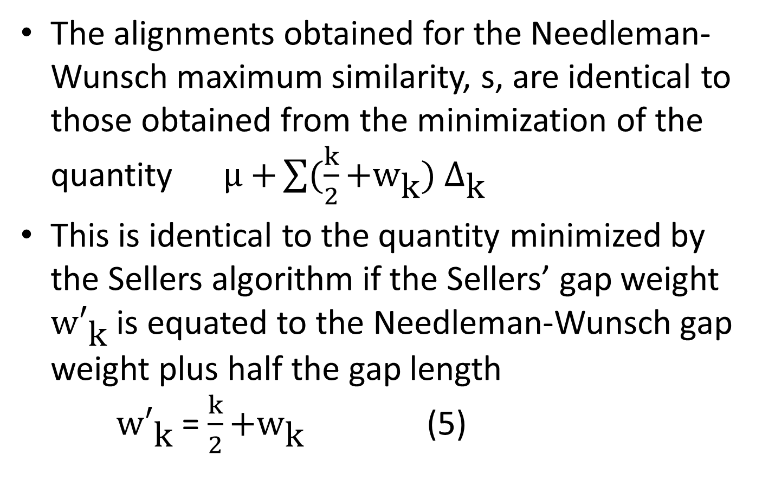
Analysis
The alignments obtained for the Needleman-Wunsch maximum similarity, s, are identical to those obtained from the minimization of the quantity $\text{μ}\text{ +}\sum{(\frac{k}{2}\text{+}{\text{w}}_{\text{k}}){ Δ}_{\text{k}}}$
This is identical to the quantity minimized by the Sellers algorithm if the Sellers’ gap weight ${\text{w}′}_{\text{k}}$ is equated to the Needleman-Wunsch gap weight plus half the gap length ${\text{w}′}_{\text{k}}$ = $\frac{k}{2}\text{+}{\text{w}}_{\text{k}}$ (5)

Slide 11
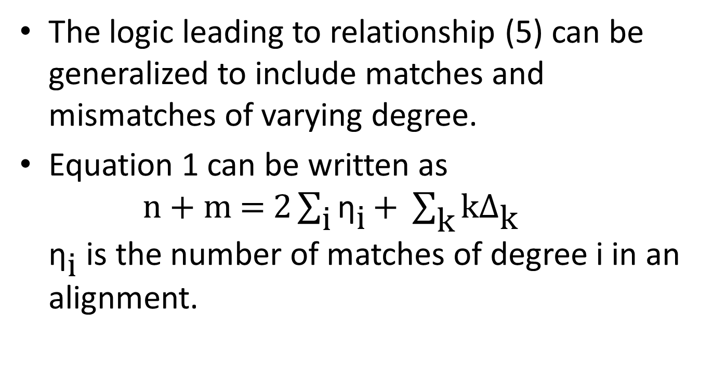
Analysis
The logic leading to relationship (5) can be generalized to include matches and mismatches of varying degree.
Equation 1 can be written as $\text{n}\text{ + }\text{m}\text{ = 2}\sum_{\text{i}}{{\text{η}}_{\text{i}}}\text{+ }\sum_{\text{k}}{\text{k}Δ_{\text{k}}}$ ${\text{η}}_{\text{i}}$ is the number of matches of degree i in an alignment.

Slide 12
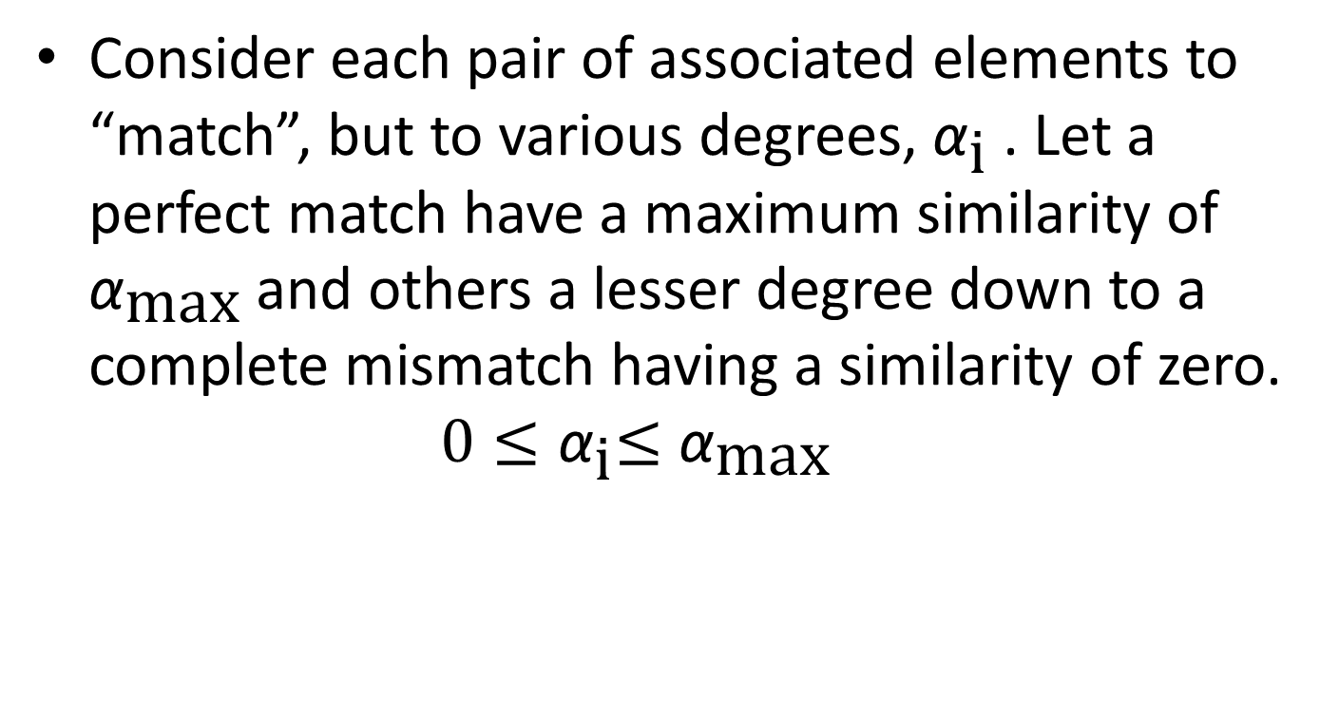
Analysis
Consider each pair of associated elements to “match”, but to various degrees, ${\text{α}}_{\text{i}}$ . Let a perfect match have a maximum similarity of ${\text{α}}_{\text{max}}$ and others a lesser degree down to a complete mismatch having a similarity of zero. $0{≤\text{α}}_{\text{i}}≤{\text{α}}_{\text{max}}$

Slide 13
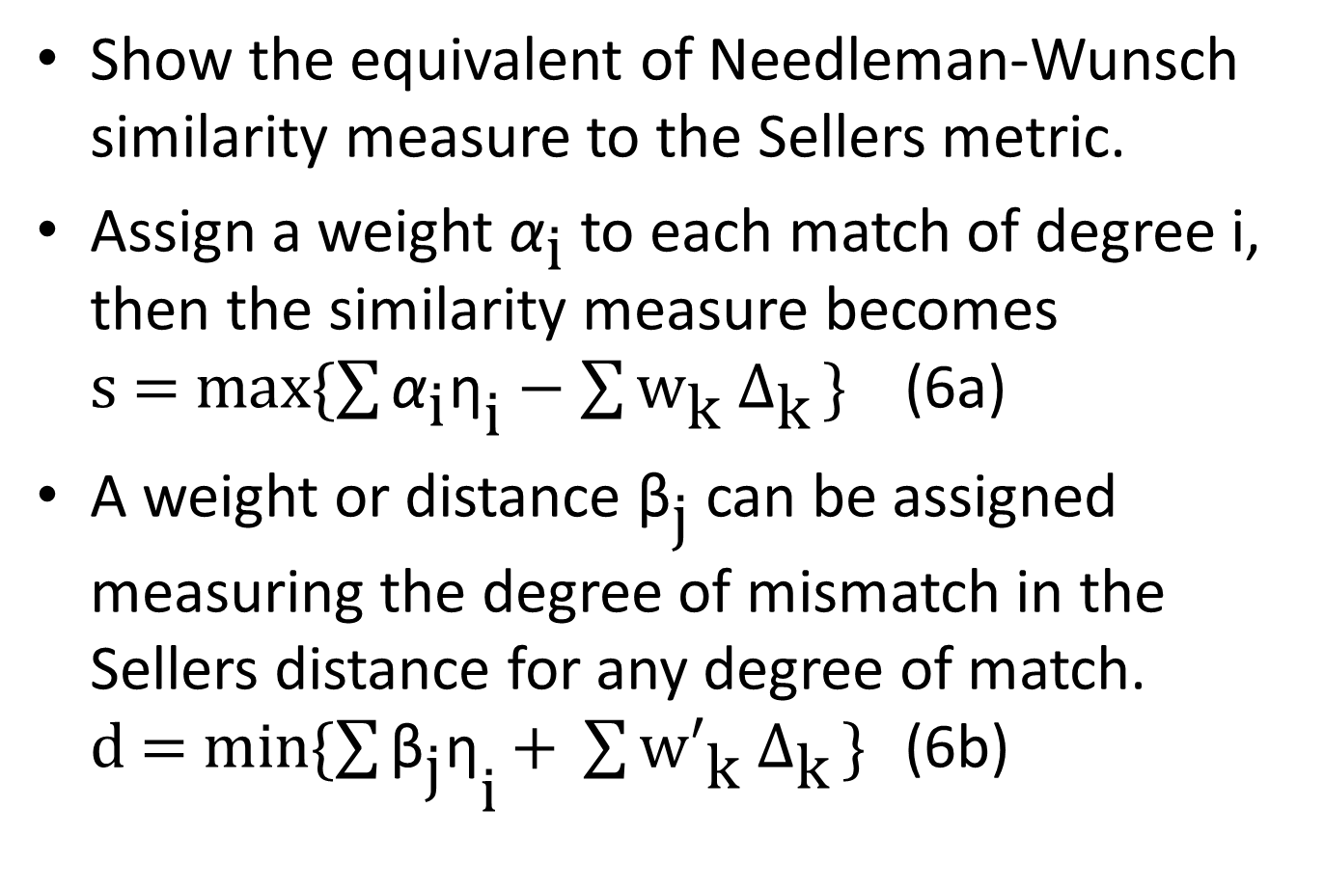
Analysis
Show the equivalent of Needleman-Wunsch similarity measure to the Sellers metric.
Assign a weight ${\text{α}}_{\text{i}}$ to each match of degree i, then the similarity measure becomes $\text{s}\text{ = }\text{max}\{\sum{{{\text{α}}_{\text{i}}\text{η}}_{\text{i}}}−\sum{{\text{w}}_{\text{k}}{ Δ}_{\text{k}}}\text{\}}$ (6a)
A weight or distance ${\text{β}}_{\text{j}}$ can be assigned measuring the degree of mismatch in the Sellers distance for any degree of match. $\text{d}\text{ = }\text{min}\{\sum{{{\text{β}}_{\text{j}}\text{η}}_{\text{i}}}\text{+ }\sum{{\text{w}′}_{\text{k}}{ Δ}_{\text{k}}}\text{\}}$ (6b)

Slide 14
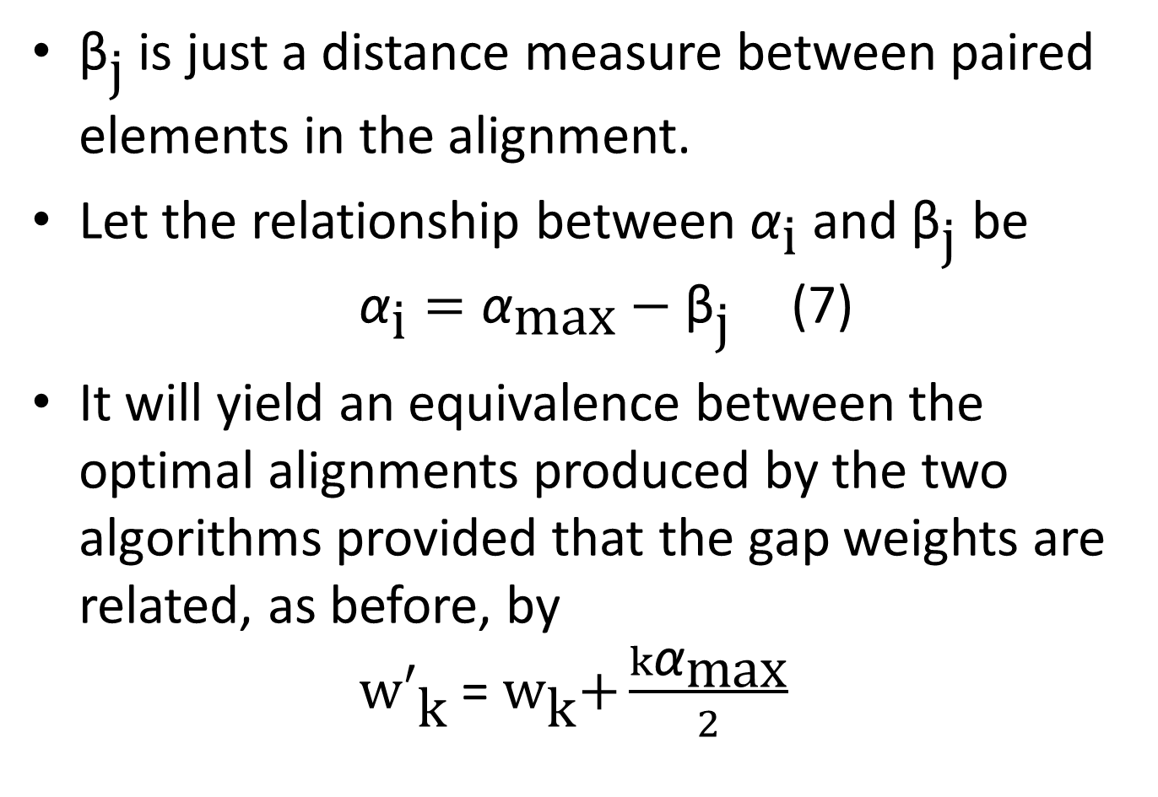
Analysis
${\text{β}}_{\text{j}}$is just a distance measure between paired elements in the alignment.
Let the relationship between ${\text{α}}_{\text{i}}$ and ${\text{β}}_{\text{j}}$ be ${\text{α}}_{\text{i}}={\text{α}}_{\text{max}}−{\text{β}}_{\text{j}}$ (7)
It will yield an equivalence between the optimal alignments produced by the two algorithms provided that the gap weights are related, as before, by ${\text{w}′}_{\text{k}}$ = ${\text{w}}_{\text{k}}\text{+}\frac{k{\text{α}}_{\text{max}}}{2}$

Slide 15
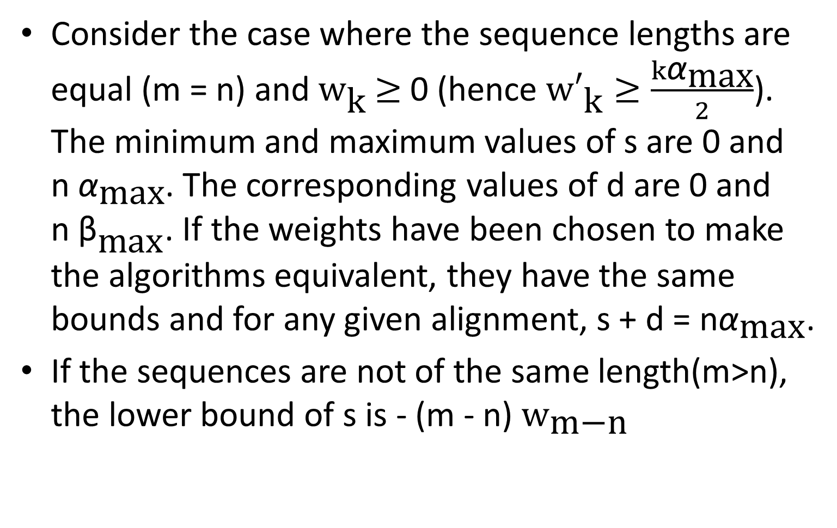
Analysis ─ conclusion
Consider the case where the sequence lengths are equal (m = n) and ${\text{w}}_{\text{k}}$ $≥$ 0 (hence ${\text{w}′}_{\text{k}}≥\frac{k{\text{α}}_{\text{max}}}{2}$). The minimum and maximum values of s are 0 and n${ \text{α}}_{\text{max}}$. The corresponding values of d are 0 and n ${\text{β}}_{\text{max}}$. If the weights have been chosen to make the algorithms equivalent, they have the same bounds and for any given alignment, s + d = n${\text{α}}_{\text{max}}$.
If the sequences are not of the same length(m>n), the lower bound of s is - (m - n) ${\text{w}}_{\text{m}\text{−}\text{n}}$

