Slide 1
A General Method Applicable to the Search for Similarities in the Amino Acid Sequence of Two Proteins
SAUL B. NEEDLEMAN AND CHRISTIAN D. WUNSCH
Journal of Molecular Biology(1970) 48, pp. 443-453
Presenter：Guan-Cheng Guo Date：2014/5/14

Slide 2
Abstract
A computer adaptable method for finding similarities in the amino acid sequences of two proteins has been developed. From these findings it is possible to determine whether significant homology exists between the proteins. This information is used to trace their possible evolutionary development.
The maximum match is a number dependent upon the similarity of the sequences. One of its definitions is the largest number of amino acids of one protein that can be matched with those of a second protein allowing for all possible interruptions in either of the sequences. While the interruptions give rise to a very large number of comparisons, the method efficiently excludes from consideration those comparisons that cannot contribute to the maximum match.

Slide 3
Abstract
Comparisons are made from the smallest unit of significance, a pair of amino acids, one from each protein. All possible pairs are represented by a two-dimensional array, and all possible comparisons are represented by pathways through the array. For this maximum match only certain of the possible pathways must be evaluated. A numerical value, one in this case, is assigned to every cell in the array representing like amino acids. The maximum match is the largest number that would result from summing the cell values of every pathway.

Slide 4
Algorithm
 | A | B | C | A
A | 1 |  |  | 1
C |  |  | 1
B |  | 1
B |  | 1
A | 1 |  |  | 1
s(A,A) = s(B,B) = s(C,C) = 1 , else = 0
Gap penalty = 0

Slide 5
Algorithm
 | A | B | C | A
A | 1 | 0 | 0 | 1
C | 0 | 1 | 2 | 1
B | 0 | 2 | 1 | 2
B | 0 | 2
A | 1 |  |  | 1

Slide 6
Algorithm
 | A | B | C | A
A | 1 | 0 | 0 | 1
C | 0 | 1 | 2 | 1
B | 0 | 2 | 1 | 2
B | 0 | 2 | 2
A | 1 |  |  | 1

Slide 7
Algorithm
 | A | B | C | A
A | 1 | 0 | 0 | 1
C | 0 | 1 | 2 | 1
B | 0 | 2 | 1 | 2
B | 0 | 2 | 2 | 2
A | 1 | 1 | 2 | 3

Slide 8
Algorithm
 | A | B | C | A
A | 1 | 0 | 0 | 1
C | 0 | 1 | 2 | 1
B | 0 | 2 | 1 | 2
B | 0 | 2 | 2 | 2
A | 1 | 1 | 2 | 3

Slide 9
Algorithm
 | A | B | C | A
A | 1 | 0 | 0 | 1
C | 0 | 1 | 2 | 1
B | 0 | 2 | 1 | 2
B | 0 | 2 | 2 | 2
A | 1 | 1 | 2 | 3

Slide 10
Algorithm
 | A | B | C | A
A | 1 | 0 | 0 | 1
C | 0 | 1 | 2 | 1
B | 0 | 2 | 1 | 2
B | 0 | 2 | 2 | 2
A | 1 | 1 | 2 | 3

Slide 11
Algorithm
 | A | B | C | A
A | 1 | 0 | 0 | 1
C | 0 | 1 | 2 | 1
B | 0 | 2 | 1 | 2
B | 0 | 2 | 2 | 2
A | 1 | 1 | 2 | 3

Slide 12
Algorithm
 | A | B | C | A
A | 1 | 0 | 0 | 1
C | 0 | 1 | 2 | 1
B | 0 | 2 | 1 | 2
B | 0 | 2 | 2 | 2
A | 1 | 1 | 2 | 3

Slide 13
Algorithm
 | A | B | C | A
A | 1 | 0 | 0 | 1
C | 0 | 1 | 2 | 1
B | 0 | 2 | 1 | 2
B | 0 | 2 | 2 | 2
A | 1 | 1 | 2 | 3

Slide 14
Algorithm
 | A | B | C | A
A | 1 | 0 | 0 | 1
C | 0 | 1 | 2 | 1
B | 0 | 2 | 1 | 2
B | 0 | 2 | 2 | 2
A | 1 | 1 | 2 | 3

Slide 15
Algorithm
 | A | B | C | A
A | 1 | 0 | 0 | 1
C | 0 | 1 | 2 | 1
B | 0 | 2 | 1 | 2
B | 0 | 2 | 2 | 2
A | 1 | 1 | 2 | 3

Slide 16
Algorithm
 | A | B | C | A
A | 1 | 0 | 0 | 1
C | 0 | 1 | 2 | 1
B | 0 | 2 | 1 | 2
B | 0 | 2 | 2 | 2
A | 1 | 1 | 2 | 3
ABC_ _A
A_CBBA

Slide 17
Algorithm
 | A | B | C | A
A | 1 | 0 | 0 | 1
C | 0 | 1 | 2 | 1
B | 0 | 2 | 1 | 2
B | 0 | 2 | 2 | 2
A | 1 | 1 | 2 | 3
A_BCA
ACBBA

Slide 18
Algorithm
 | A | B | C | A
A | 1 | 0 | 0 | 1
C | 0 | 1 | 2 | 1
B | 0 | 2 | 1 | 2
B | 0 | 2 | 2 | 2
A | 1 | 1 | 2 | 3
A_ _BCA
ACBB _A

Slide 19
ON THE THEORY AND COMPUTATION OF EVOLUTIONARY DISTANCES
Peter H. Sellers
SIAM J. APPL. MATH. Vol. 26, No. 4, June 1974, pp. 787-793

Slide 20
Abstract
This paper gives a formal definition of the biological concept of evolutionary distance and an algorithm to compute it. For any set S of finite sequences of varying lengths this distance is a real-valued function on S x S, and it is shown to be a metric under conditions which are wide enough to include the biological application. The algorithm, introduced here, lends itself to computer programming and provides a method to compute evolutionary distance which is shorter than the other methods currently in use.

Slide 21
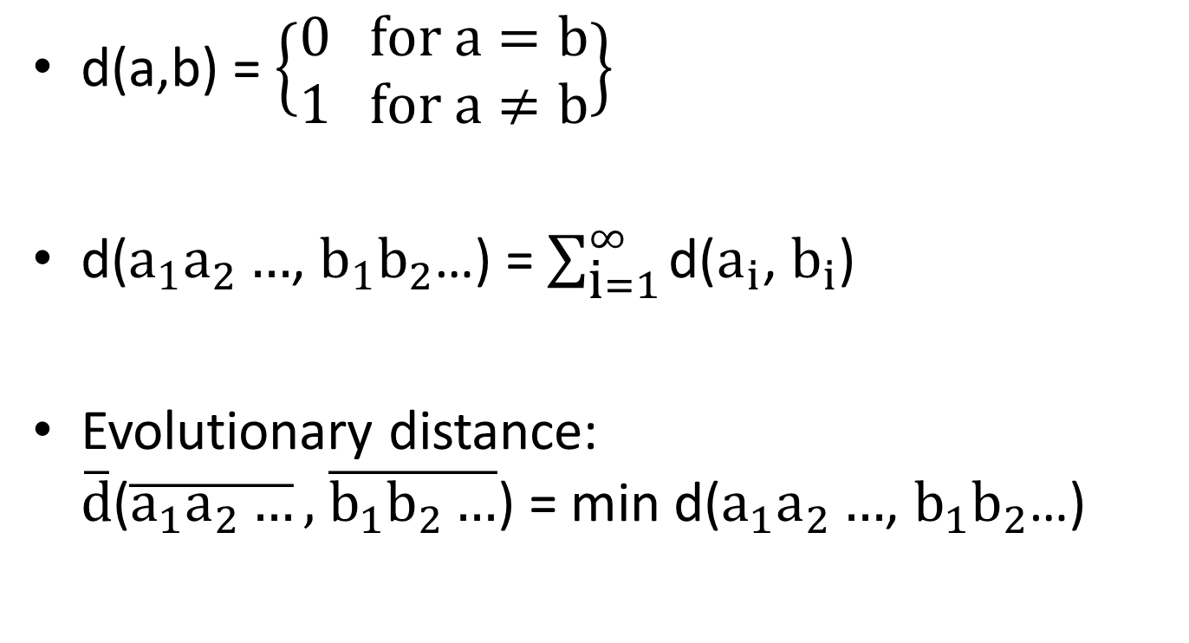
Algorithm
d(a,b) = $\left\{\begin{aligned}0 for a=b \\ 1 for a≠b\end{aligned}\right\}$
d($a_{1}a_{2}…$, $b_{1}b_{2}$…) = $\sum_{\text{i}=1}^{∞}{\text{d}\text{(}a_{i}\text{, }b_{i}\text{)}}$
Evolutionary distance: $\overline{\text{d}}$($\overline{a_{1}a_{2}…},$ $\overline{b_{1}{\text{b}}_{2}…}$) = min d($a_{1}a_{2}…$, $b_{1}b_{2}$…)

Slide 22
Algorithm
 | 1 | A | B | C | A
1
A
C
B
B
A
assumption that d is given by
1 = d(1,a) = d(1,b) = d(1,c) = d(a,b) = d(a,c) = d(b,c)

Slide 23
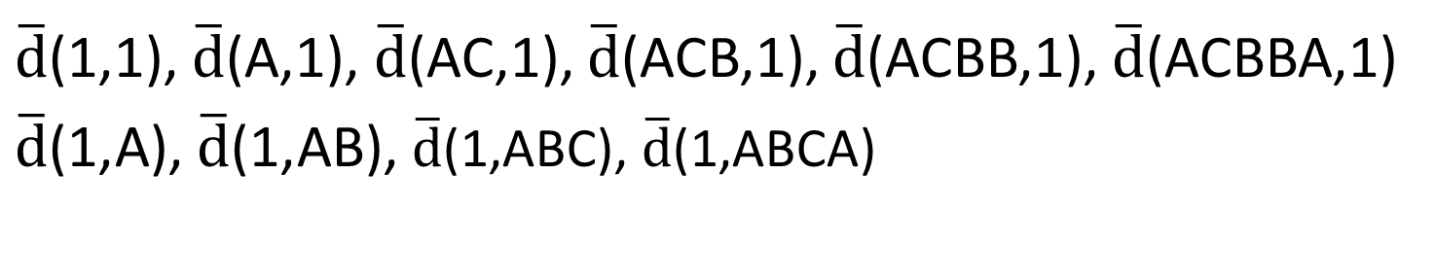
Algorithm
 | 1 | A | B | C | A
1 | 0 | 1 | 2 | 3 | 4
A | 1
C | 2
B | 3
B | 4
A | 5
$\overline{\text{d}}$(1,1), $\overline{\text{d}}$(A,1), $\overline{\text{d}}$(AC,1), $\overline{\text{d}}$(ACB,1), $\overline{\text{d}}$(ACBB,1), $\overline{\text{d}}$(ACBBA,1)
$\overline{\text{d}}$(1,A), $\overline{\text{d}}$(1,AB), $\overline{\text{d}}$(1,ABC), $\overline{\text{d}}$(1,ABCA)

Slide 24
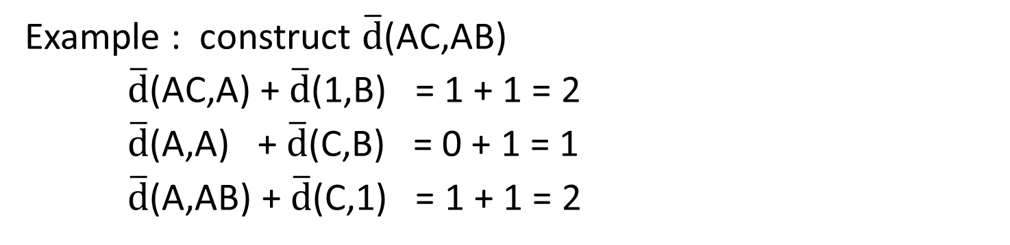
Algorithm
 | 1 | A | B | C | A
1 | 0 | 1 | 2 | 3 | 4
A | 1 | 0 | 1 | 2 | 3
C | 2 | 1 | 1
B | 3
B | 4
A | 5
Example : construct $\overline{\text{d}}$(AC,AB)
$\overline{\text{d}}$(AC,A) + $\overline{\text{d}}$(1,B) = 1 + 1 = 2
$\overline{\text{d}}$(A,A) +$\overline{\text{d}}$(C,B) = 0 + 1 = 1
$\overline{\text{d}}$(A,AB) + $\overline{\text{d}}$(C,1) = 1 + 1 = 2

Slide 25
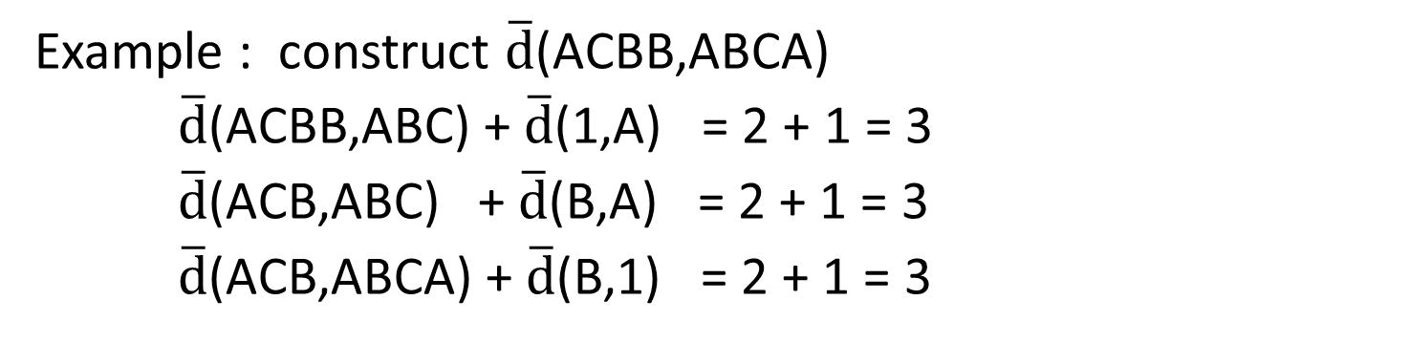
Algorithm
 | 1 | A | B | C | A
1 | 0 | 1 | 2 | 3 | 4
A | 1 | 0 | 1 | 2 | 3
C | 2 | 1 | 1 | 1 | 2
B | 3 | 2 | 1 | 2 | 2
B | 4 | 3 | 2 | 2 | 3
A | 5
Example : construct $\overline{\text{d}}$(ACBB,ABCA)
$\overline{\text{d}}$(ACBB,ABC) + $\overline{\text{d}}$(1,A) = 2 + 1 = 3
$\overline{\text{d}}$(ACB,ABC) +$\overline{\text{d}}$(B,A) = 2 + 1 = 3
$\overline{\text{d}}$(ACB,ABCA) + $\overline{\text{d}}$(B,1) = 2 + 1 = 3

Slide 26
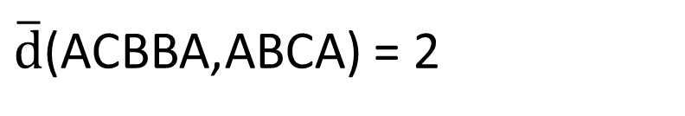
Algorithm
 | 1 | A | B | C | A
1 | 0 | 1 | 2 | 3 | 4
A | 1 | 0 | 1 | 2 | 3
C | 2 | 1 | 1 | 1 | 2
B | 3 | 2 | 1 | 2 | 2
B | 4 | 3 | 2 | 2 | 3
A | 5 | 4 | 3 | 3 | 2
$\overline{\text{d}}$(ACBBA,ABCA) = 2

Slide 27
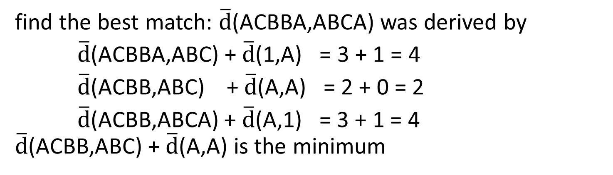
Algorithm
 | 1 | A | B | C | A
1 | 0 | 1 | 2 | 3 | 4
A | 1 | 0 | 1 | 2 | 3
C | 2 | 1 | 1 | 1 | 2
B | 3 | 2 | 1 | 2 | 2
B | 4 | 3 | 2 | 2 | 3
A | 5 | 4 | 3 | 3 | 2
find the best match: $\overline{\text{d}}$(ACBBA,ABCA) was derived by
$\overline{\text{d}}$(ACBBA,ABC) + $\overline{\text{d}}$(1,A) = 3 + 1 = 4
$\overline{\text{d}}$(ACBB,ABC) +$\overline{\text{d}}$(A,A) = 2 + 0 = 2
$\overline{\text{d}}$(ACBB,ABCA) + $\overline{\text{d}}$(A,1) = 3 + 1 = 4 $\overline{\text{d}}$(ACBB,ABC) +$\overline{\text{d}}$(A,A) is the minimum

Slide 28
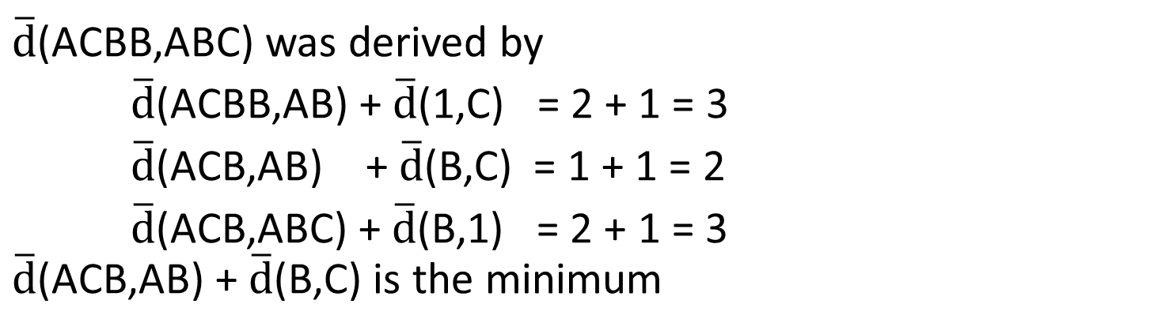
Algorithm
 | 1 | A | B | C | A
1 | 0 | 1 | 2 | 3 | 4
A | 1 | 0 | 1 | 2 | 3
C | 2 | 1 | 1 | 1 | 2
B | 3 | 2 | 1 | 2 | 2
B | 4 | 3 | 2 | 2 | 3
A | 5 | 4 | 3 | 3 | 2
$\overline{\text{d}}$(ACBB,ABC) was derived by
$\overline{\text{d}}$(ACBB,AB) + $\overline{\text{d}}$(1,C) = 2 + 1 = 3
$\overline{\text{d}}$(ACB,AB) +$\overline{\text{d}}$(B,C) = 1 + 1 = 2
$\overline{\text{d}}$(ACB,ABC) + $\overline{\text{d}}$(B,1) = 2 + 1 = 3 $\overline{\text{d}}$(ACB,AB) +$\overline{\text{d}}$(B,C) is the minimum

Slide 29
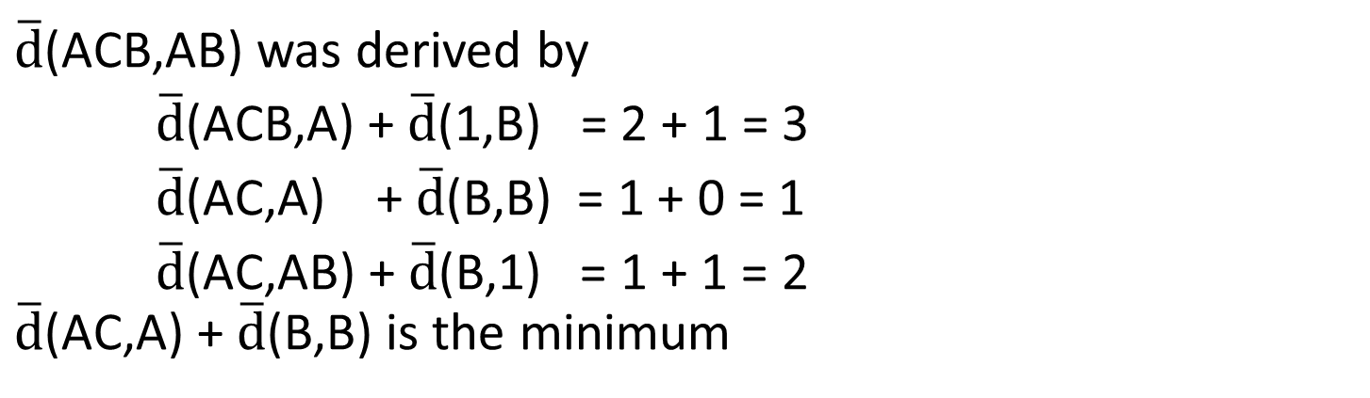
Algorithm
 | 1 | A | B | C | A
1 | 0 | 1 | 2 | 3 | 4
A | 1 | 0 | 1 | 2 | 3
C | 2 | 1 | 1 | 1 | 2
B | 3 | 2 | 1 | 2 | 2
B | 4 | 3 | 2 | 2 | 3
A | 5 | 4 | 3 | 3 | 2
$\overline{\text{d}}$(ACB,AB) was derived by
$\overline{\text{d}}$(ACB,A) + $\overline{\text{d}}$(1,B) = 2 + 1 = 3
$\overline{\text{d}}$(AC,A) +$\overline{\text{d}}$(B,B) = 1 + 0 = 1
$\overline{\text{d}}$(AC,AB) + $\overline{\text{d}}$(B,1) = 1 + 1 = 2 $\overline{\text{d}}$(AC,A) +$\overline{\text{d}}$(B,B) is the minimum

Slide 30
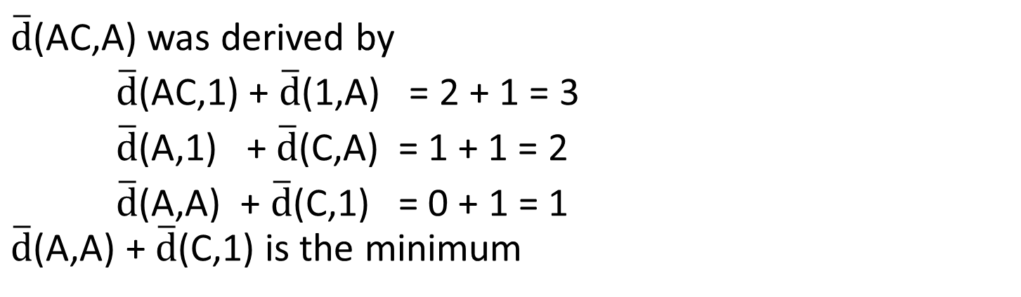
Algorithm
 | 1 | A | B | C | A
1 | 0 | 1 | 2 | 3 | 4
A | 1 | 0 | 1 | 2 | 3
C | 2 | 1 | 1 | 1 | 2
B | 3 | 2 | 1 | 2 | 2
B | 4 | 3 | 2 | 2 | 3
A | 5 | 4 | 3 | 3 | 2
$\overline{\text{d}}$(AC,A) was derived by
$\overline{\text{d}}$(AC,1) + $\overline{\text{d}}$(1,A) = 2 + 1 = 3
$\overline{\text{d}}$(A,1) +$\overline{\text{d}}$(C,A) = 1 + 1 = 2
$\overline{\text{d}}$(A,A) + $\overline{\text{d}}$(C,1) = 0 + 1 = 1 $\overline{\text{d}}$(A,A) +$\overline{\text{d}}$(C,1) is the minimum

Slide 31
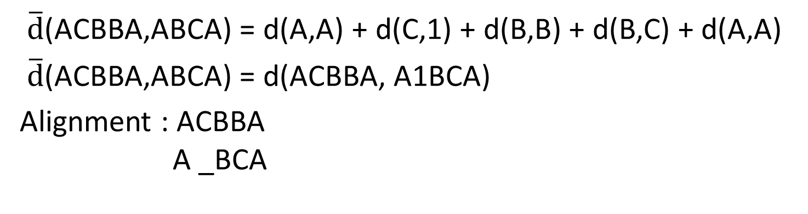
Algorithm
 | 1 | A | B | C | A
1 | 0 | 1 | 2 | 3 | 4
A | 1 | 0 | 1 | 2 | 3
C | 2 | 1 | 1 | 1 | 2
B | 3 | 2 | 1 | 2 | 2
B | 4 | 3 | 2 | 2 | 3
A | 5 | 4 | 3 | 3 | 2
$\overline{\text{d}}$(ACBBA,ABCA) = d(A,A) + d(C,1) + d(B,B) + d(B,C) + d(A,A)
$\overline{\text{d}}$(ACBBA,ABCA) = d(ACBBA, A1BCA)
Alignment : ACBBA A _BCA

Slide 32
Comparative Biosequence Metrics
T.F. Smith, M.S. Waterman, and W.M. Fitch
Journal of Molecular Evolution 1981, pp.38-46

Slide 33
Abstract
The sequence alignment algorithms of Needleman and Wunsch (1970) and Sellers (1974) are compared. Although the former maximizes similarity and the latter minimizes differences, the two procedures are proven to be equivalent. The equivalence relations necessary for each procedure to give the same result are: 1, the weight assigned to gaps in the Sellers algorithm exceed that in the Needleman-Wunsch algorithm by exactly half the length of the gap times the maximum match value; and 2, for any pair of aligned elements, the degree of similarity assigned by the Needleman-Wunsch algorithm plus the degree of dissimilarity assigned by the Sellers algorithm equal a constant. The utility of the algorithms is independent of the nature of the elements in the sequence and could include anything from geological sequences to the amino acid sequences of proteins. Examples are provided using known nucleotide sequences, one of which shows two sequences to be analogous rather than homologous.

Slide 34
Needleman–Wunsch algorithm vs. Sellers algorithm
Major differences between the Needleman-Wunsch and the Sellers algorithms:
Needleman-Wunsch algorithm results in alignments having a maximum similarity measure.
Sellers algorithm results in alignments having a minimal distance or metric measure of dissimilarity.

Slide 35
Analysis
Consider two sequences A and B of length n and m respectively, where a= a1 a2 a3 ... an and b = b1 b2 b3 ... bm.
Example:
a = ACBBA, b = ABCA, n = 5, m = 4
ACBBA A_BCA match : 3, mismatch : 1, gap : 1(length = 1)

Slide 36
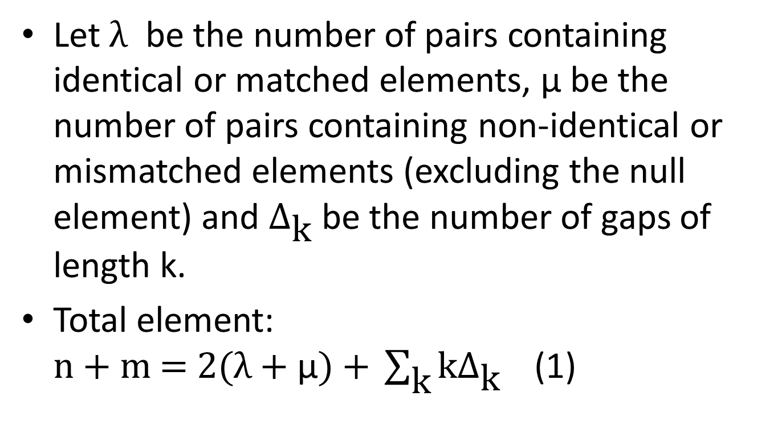
Analysis
Let $\text{λ}$ be the number of pairs containing identical or matched elements, μ be the number of pairs containing non-identical or mismatched elements (excluding the null element) and $Δ_{\text{k}}$ be the number of gaps of length k.
Total element: $\text{n}\text{ + }\text{m}\text{ = 2(}\text{λ}\text{ + }\text{μ}\text{) + }\sum_{\text{k}}{\text{k}Δ_{\text{k}}}$ (1)

Slide 37
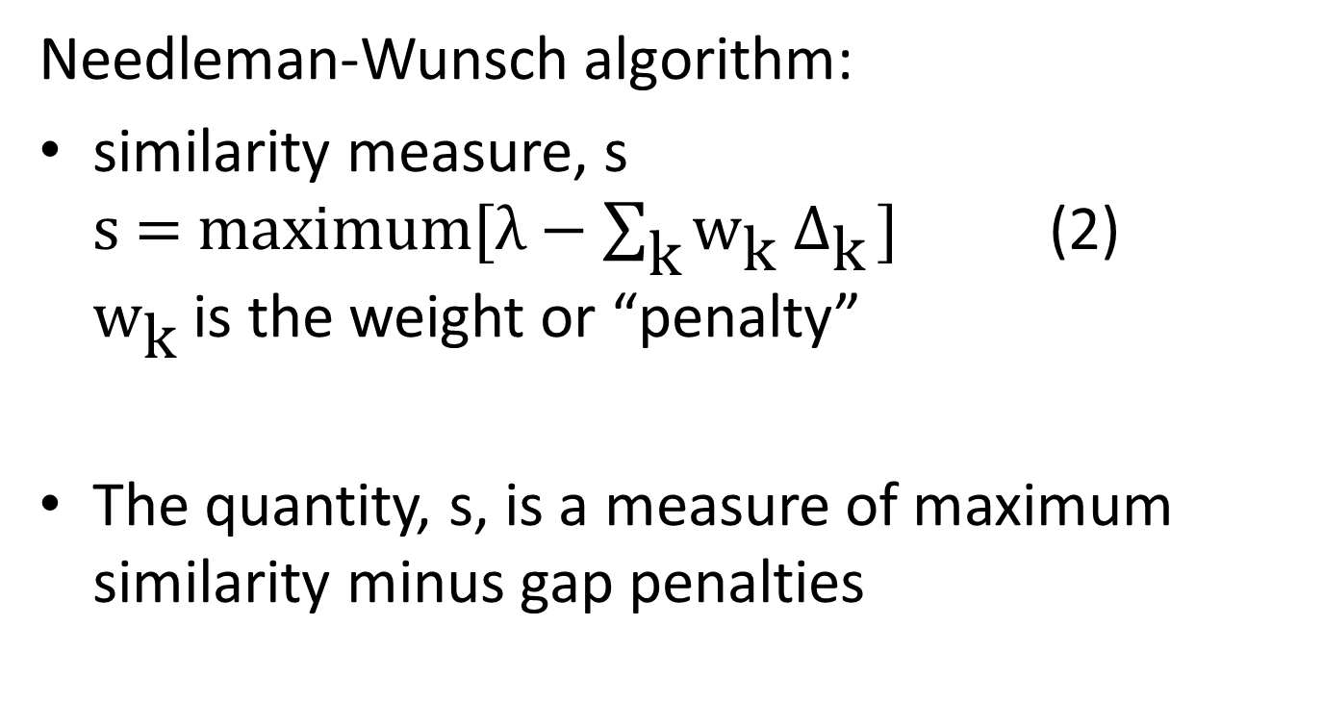
Analysis
Needleman-Wunsch algorithm:
similarity measure, s $\text{s}\text{ = }\text{maximum}\text{[}λ−\sum_{\text{k}}{{\text{w}}_{\text{k}}{ Δ}_{\text{k}}}\text{]}$ (2) ${\text{w}}_{\text{k}}$ is the weight or “penalty”
The quantity, s, is a measure of maximum similarity minus gap penalties

Slide 38
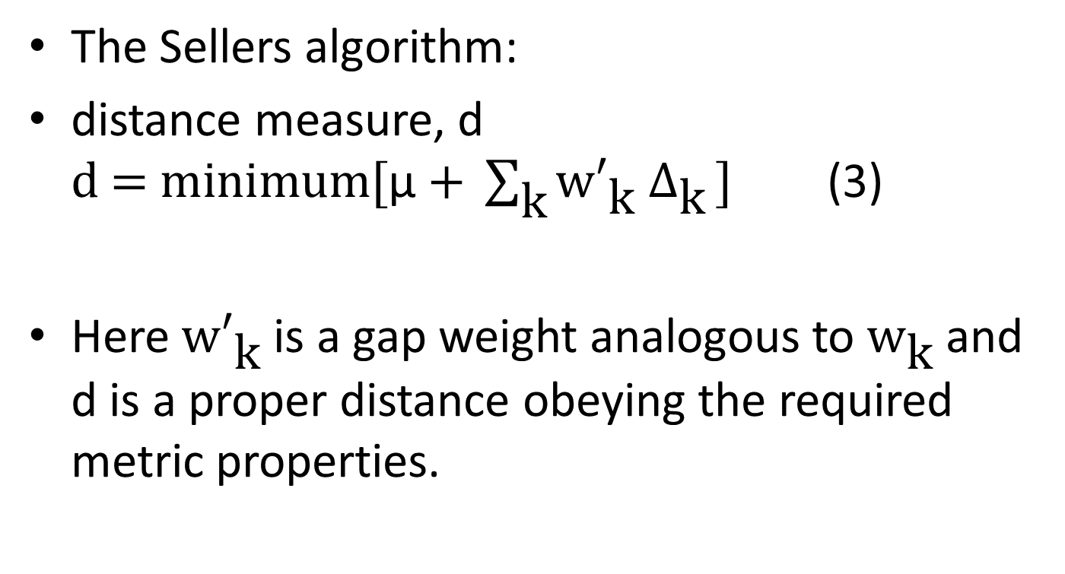
Analysis
The Sellers algorithm:
distance measure, d $\text{d}\text{ = }\text{minimum}\text{[}\text{μ} \text{+ }\sum_{\text{k}}{{\text{w}′}_{\text{k}}{ Δ}_{\text{k}}}\text{]}$ (3)
Here ${\text{w}′}_{\text{k}}$ is a gap weight analogous to ${\text{w}}_{\text{k}}$ and d is a proper distance obeying the required metric properties.

Slide 39
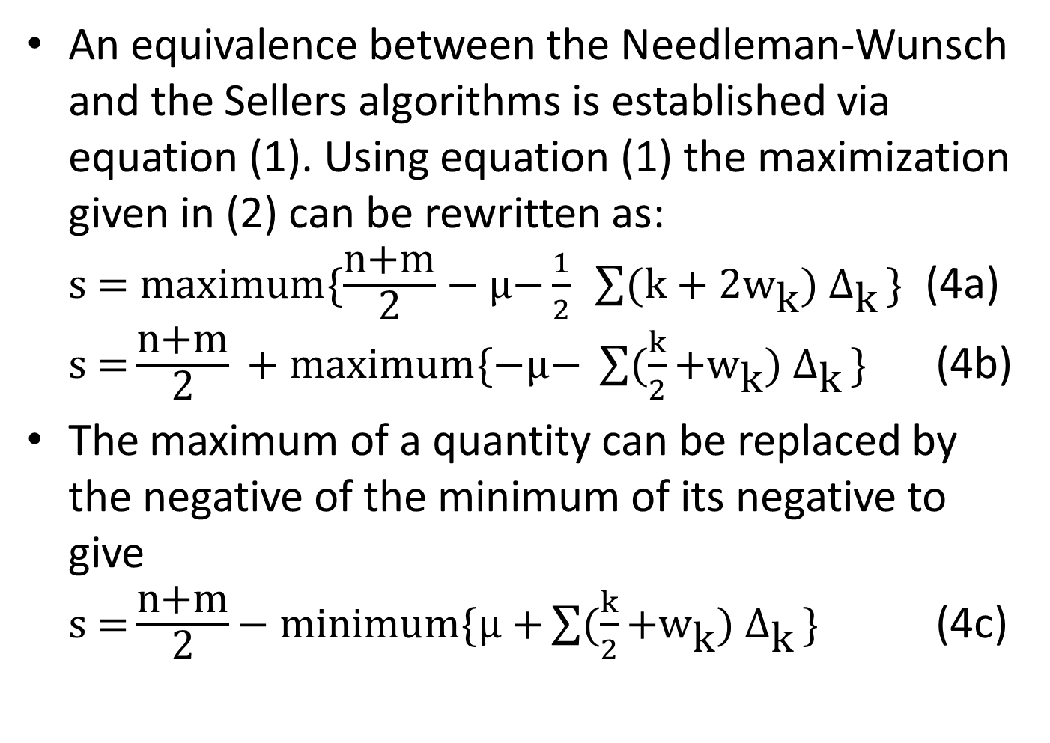
Analysis
An equivalence between the Needleman-Wunsch and the Sellers algorithms is established via equation (1). Using equation (1) the maximization given in (2) can be rewritten as: $\text{s}\text{ = }\text{maximum}\{\frac{\text{n}\text{+}\text{m}}{\text{2}}−\text{μ}\text{−}\frac{1}{2} \sum{(\text{k}\text{ + 2}{\text{w}}_{\text{k}}){ Δ}_{\text{k}}}\text{\}}$ (4a) $\text{s}\text{ =}\frac{\text{n}\text{+}\text{m}}{\text{2}} \text{+ }\text{maximum}\{−\text{μ}\text{− }\sum{(\frac{k}{2}\text{+}{\text{w}}_{\text{k}}){ Δ}_{\text{k}}}\text{\}}$ (4b)
The maximum of a quantity can be replaced by the negative of the minimum of its negative to give $\text{s}\text{ =}\frac{\text{n}\text{+}\text{m}}{\text{2}}\text{− }\text{minimum}\{\text{μ}\text{ +}\sum{(\frac{k}{2}\text{+}{\text{w}}_{\text{k}}){ Δ}_{\text{k}}}\text{\}}$ (4c)

Slide 40
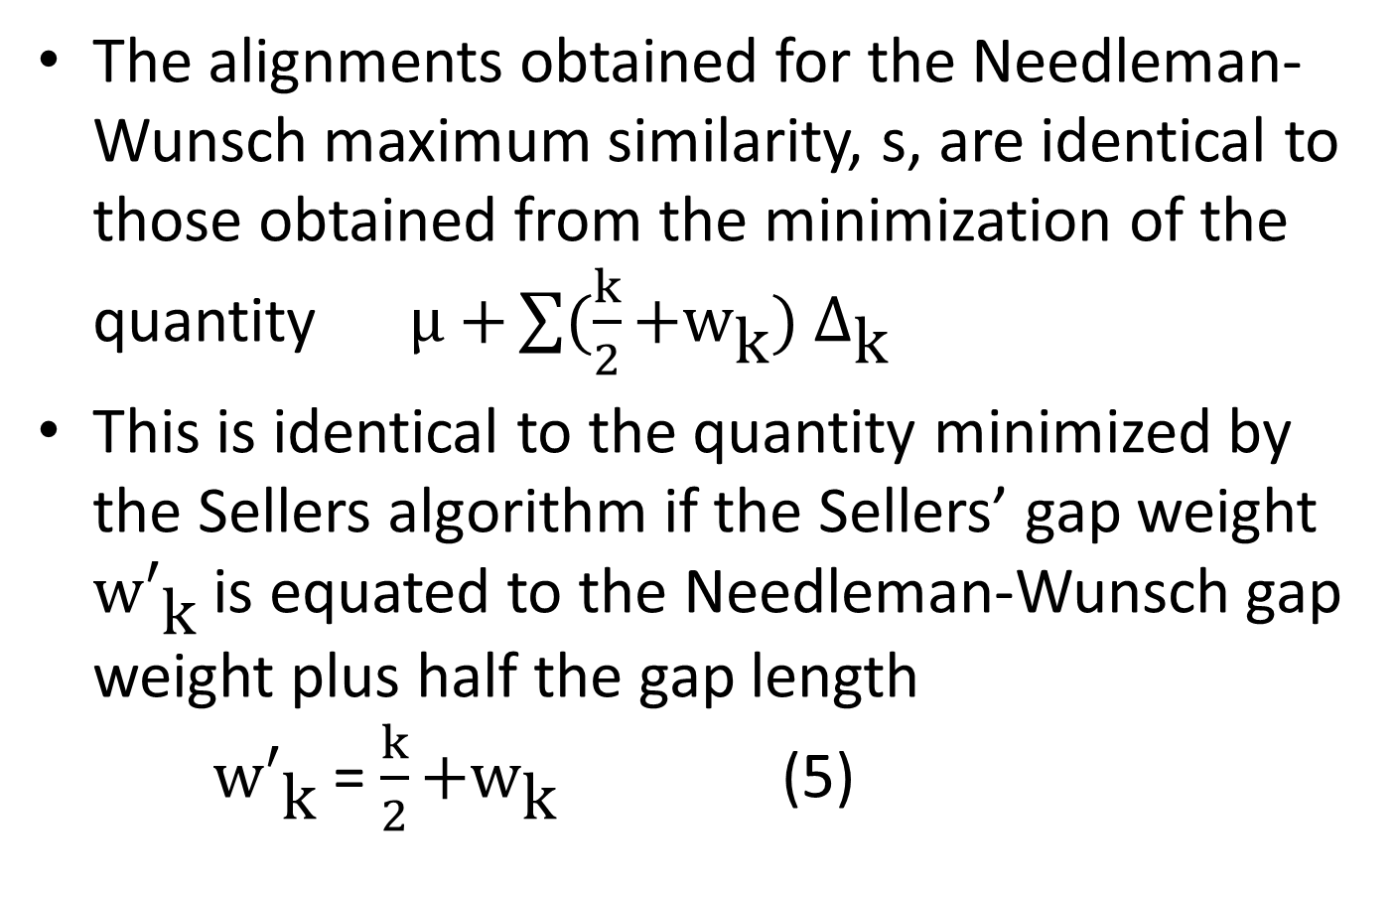
Analysis
The alignments obtained for the Needleman-Wunsch maximum similarity, s, are identical to those obtained from the minimization of the quantity $\text{μ}\text{ +}\sum{(\frac{k}{2}\text{+}{\text{w}}_{\text{k}}){ Δ}_{\text{k}}}$
This is identical to the quantity minimized by the Sellers algorithm if the Sellers’ gap weight ${\text{w}′}_{\text{k}}$ is equated to the Needleman-Wunsch gap weight plus half the gap length ${\text{w}′}_{\text{k}}$ = $\frac{k}{2}\text{+}{\text{w}}_{\text{k}}$ (5)

