Slide 1
protr: Protein Sequence Descriptor Calculation and
Similarity Computation with R
Nan Xiao [蕭南], Qingsong Xu [徐青松], Dongsheng Cao [曹東升], Yizeng Liang [梁逸曾]
Central South University [中南大學，位於湖南省長沙市]

Slide 2
Abstract
The protr package aims for protein sequence feature extraction, which could be easily applied in Bioinforamtics and Chemogenomics research. The descriptors listed in this package include Amino Acid Composition (Amino Acid Composition/Dipeptide Compo- sition/Tripeptide Composition), Autocorrelation (Normalized Moreau-Broto Autocorrelation / Moran Autocorrelation / Geary Autocorrelation), CTD (Composition/Transition/Distribution), Conjoint Traid, Quasi-Sequence Order (Sequence Order Coupling Number/Quasi-sequence Order Descriptors), and Pseudo Amino Acid Composition (Pseudo Amino Acid Composi- tion/Amphiphilic Pseudo Amino Acid Composition). Total 14 descriptors in 6 categories. The package is collaboratively developed by Computational Biology and Drug Design Group, Central South University.

Slide 3
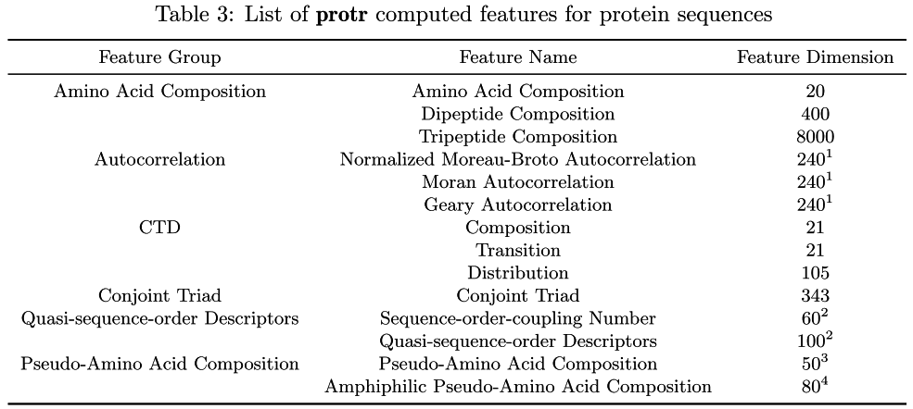
Feature List

Slide 4
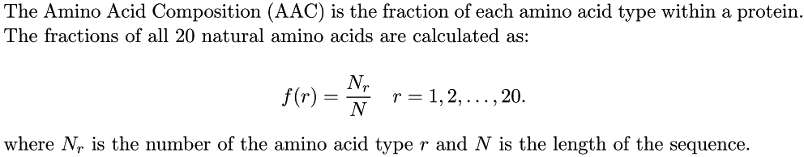
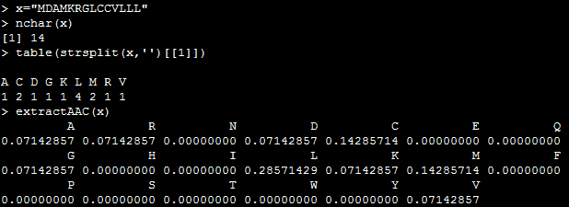
Amino Acid Composition (AAC)
Notes:
x="MDAMKRGLCCVLLL"
table(strsplit(x,'')[[1]])
extractAAC(x)

Slide 5
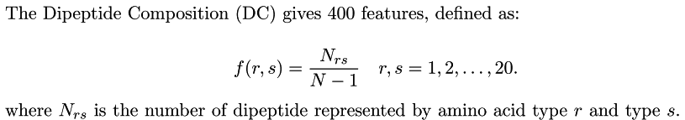
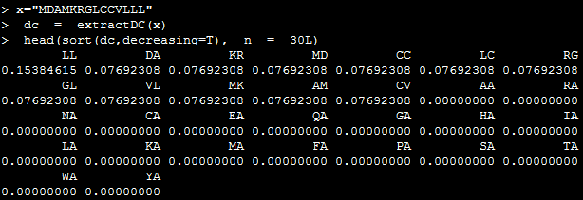
Dipeptide Composition (DC)
Notes:
x="MDAMKRGLCCVLLL"
dc= extractDC(x)
head(sort(dc,decreasing=T),n=30L)

Slide 6
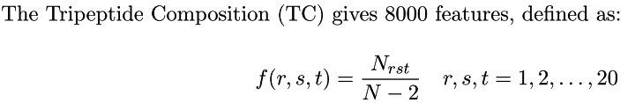
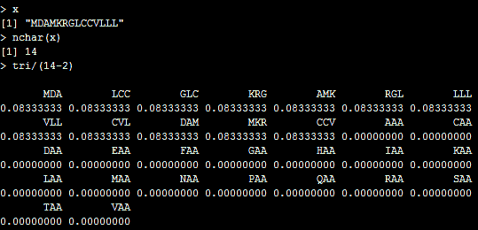
Tripeptide Composition (TC)
Notes:
Lv1 = c("A","C","D","E","F","G","H","I","K","L","M","N","P","Q","R","S","T","V","W","Y")
Lv2 <- apply(expand.grid(Lv1 ,Lv1),1,paste,collapse='')
Lv3 = apply(expand.grid(Lv2 ,Lv1),1,paste,collapse='')
x="MDAMKRGLCCVLLL"
seq1 <- toupper(x)
seq2 <- seq1
seq3 <- seq1
seq1 <- strsplit(substring(seq1,1,nchar(seq1)-2),'')[[1]]
seq2 <- strsplit(substring(seq2,2,nchar(seq2)-1),'')[[1]]
seq3 <- strsplit(substring(seq3,3,nchar(seq3)-0),'')[[1]]
tri <- apply(rbind(seq1,seq2,seq3),2,paste,collapse='')
tri <- head(sort(table(factor(tri,levels=Lv3)),decreasing=T),30)
tri

Slide 7
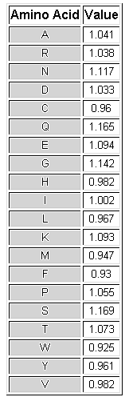
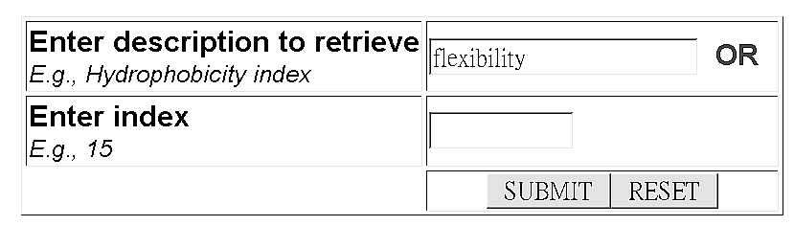
Amino acid Physical-chemical properties
Example:
http://www.rfdn.org/bioinfo/APDbase/APDbase.php

Slide 8
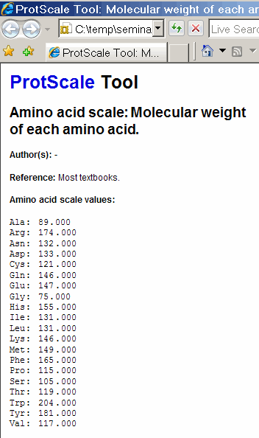
Amino acid Physical-chemical properties
Example:
http://au.expasy.org/tools/protscale.html

Slide 9
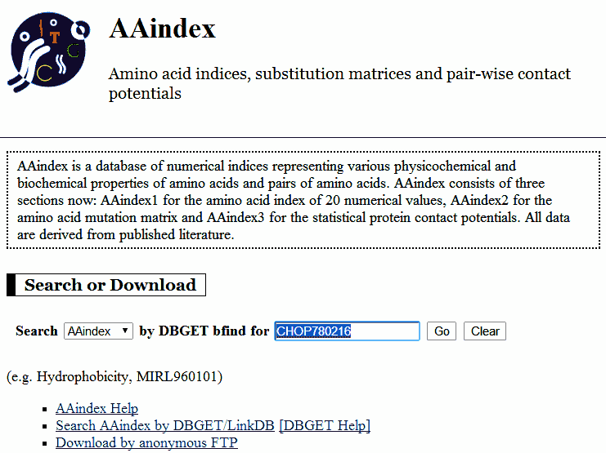
Amino acid Physical-chemical properties
http://www.genome.jp/dbget/aaindex.html

Slide 10
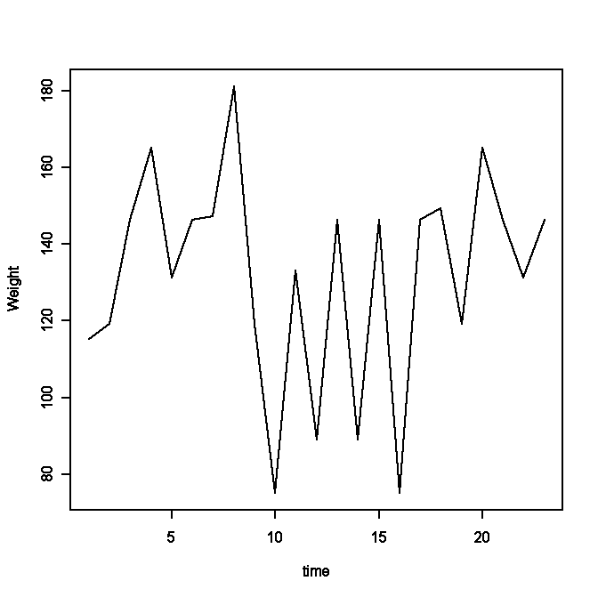
Amino acid Physical-chemical properties
Molecular weight
Amino Acid
A
R
N
D
C
Q
E
G
H
I
L
K
M
F
P
S
T
W
Y
V
Value
089.089996
174.199997
132.119995
133.100006
121.150002
146.149994
147.130005
075.070000
155.160004
131.169998
131.169998
146.190002
149.210007
165.190002
115.129997
105.089996
119.120003
204.240005
181.190002
117.150002
PTKFLKEYTGDAKAKGKMTFKLK
(115.129997,119.120003,146.190002,
165.190002,131.169998,146.190002,
147.130005,181.190002,119.120003,
75.07,133.100006,89.089996,
146.190002,89.089996,146.190002,
75.07,146.190002,149.210007,
119.120003,165.190002,146.190002,
131.169998,146.190002)

Slide 11
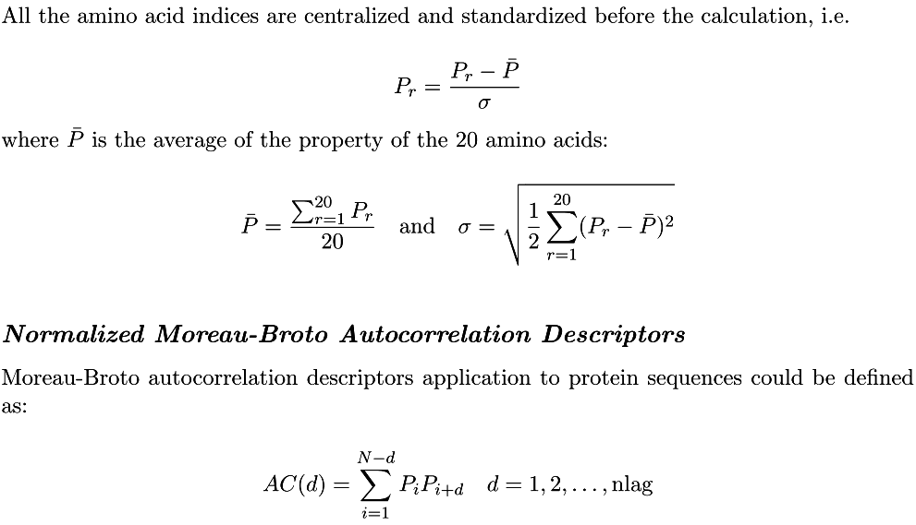
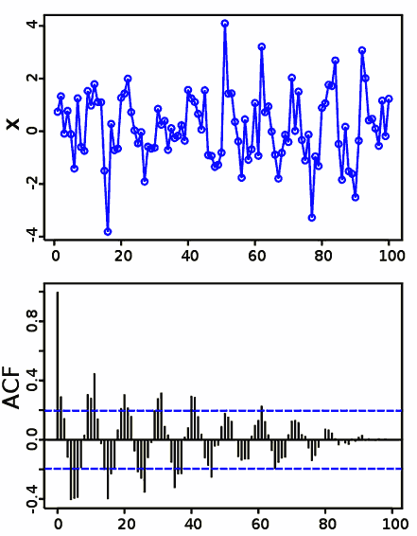
Autocorrelation Descriptors

Slide 12
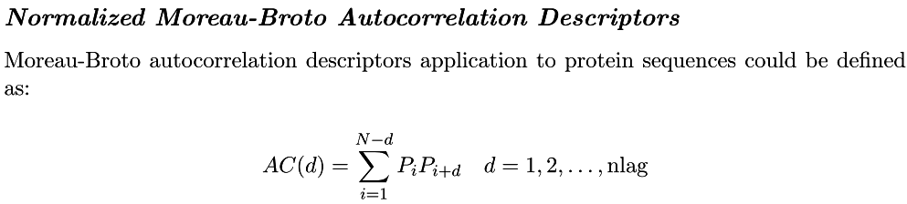
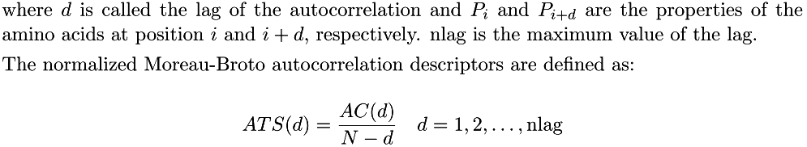
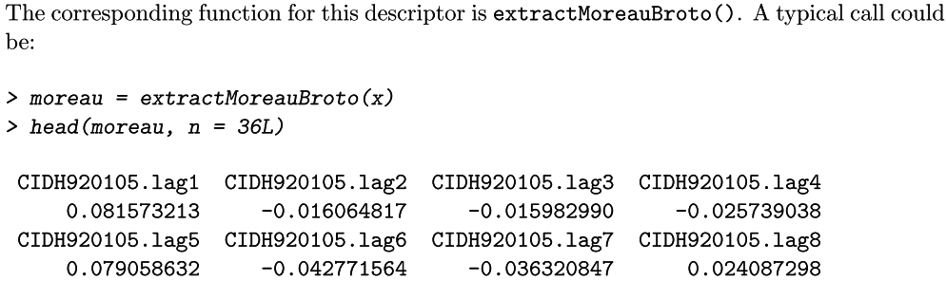

Slide 13
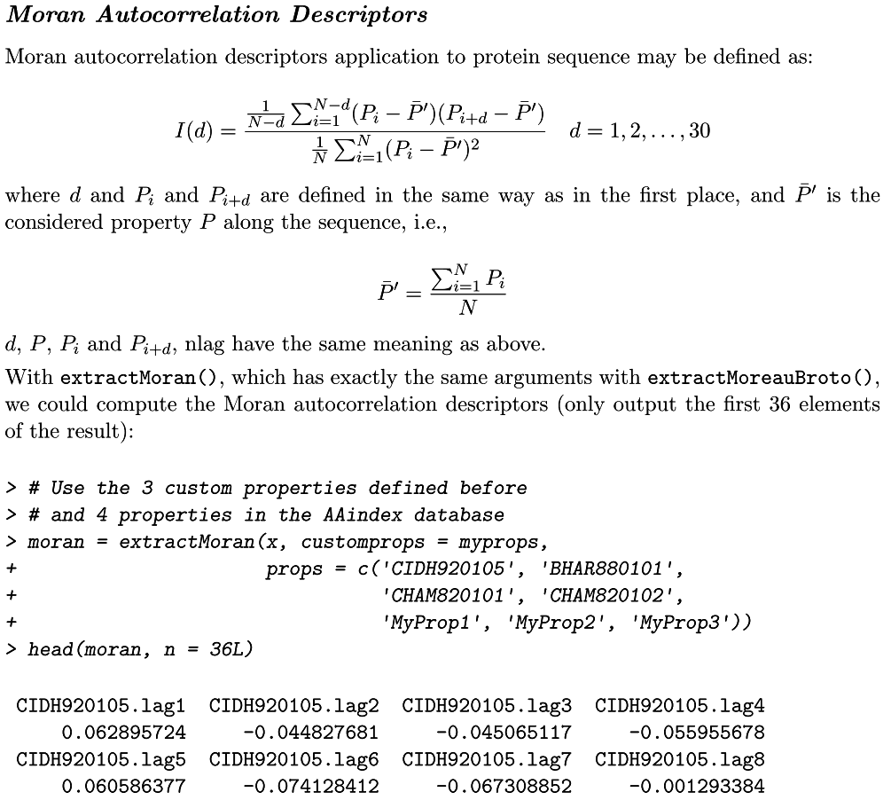

Slide 14
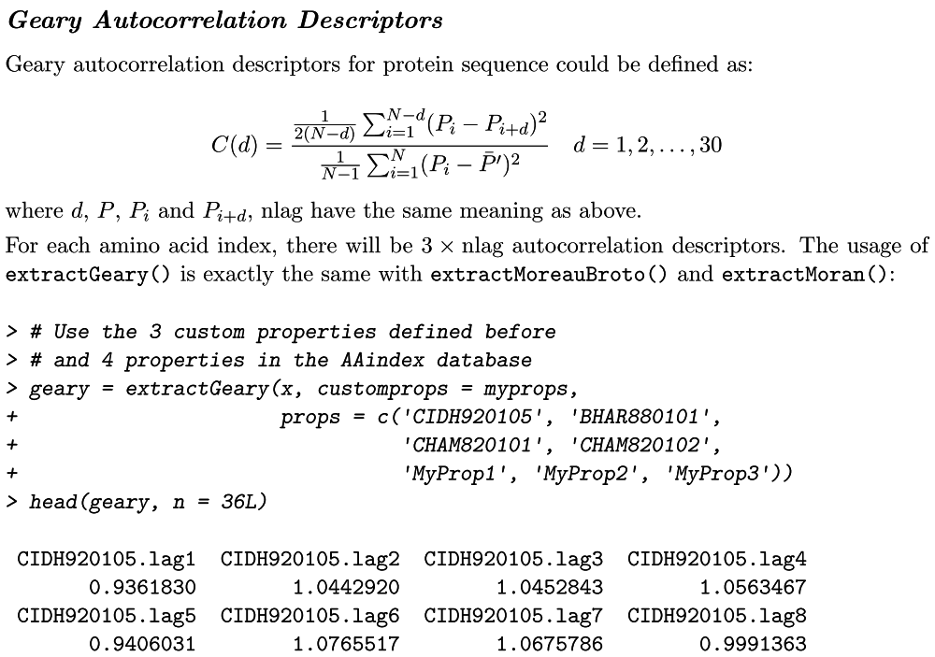

Slide 15
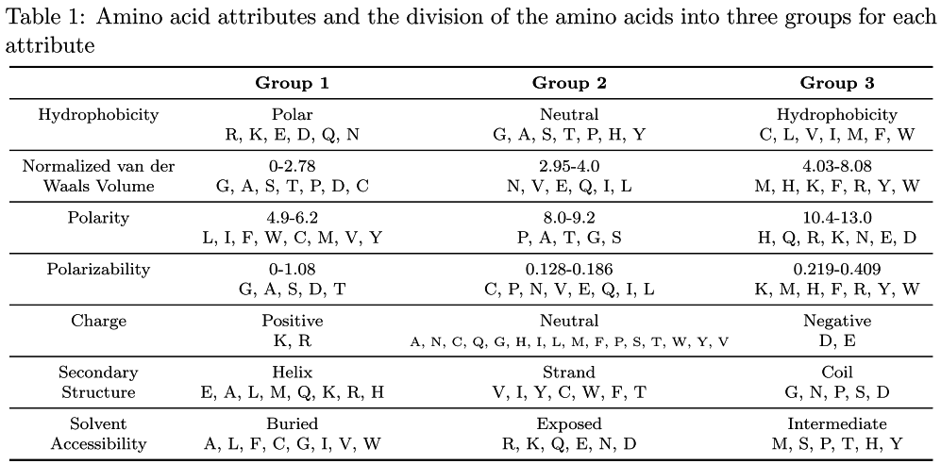
Composition / Transition / Distribution

Slide 16
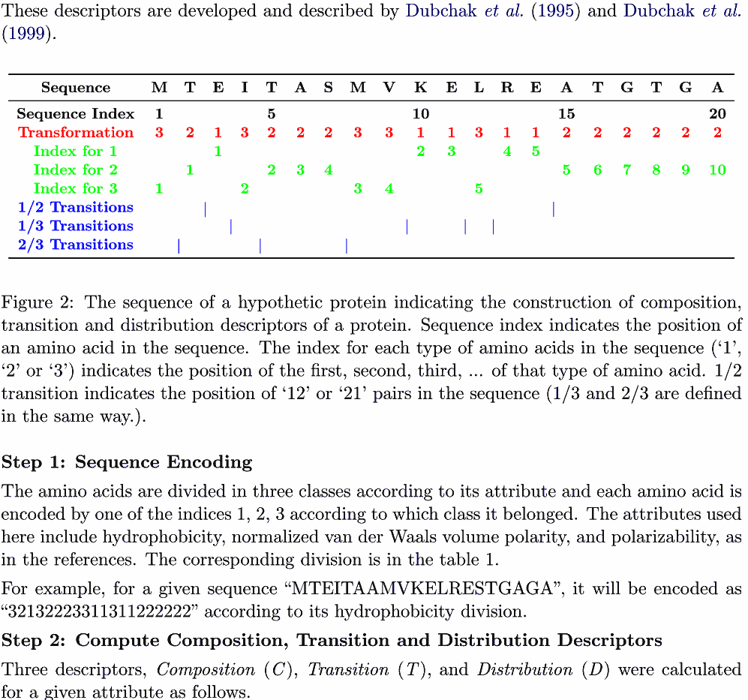

Slide 17
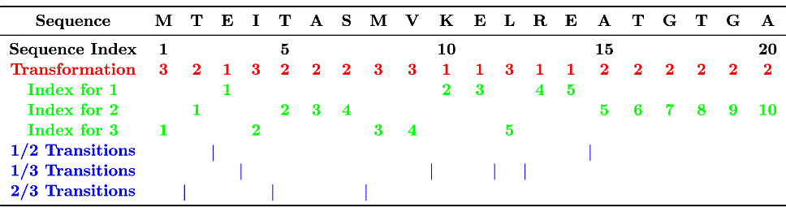
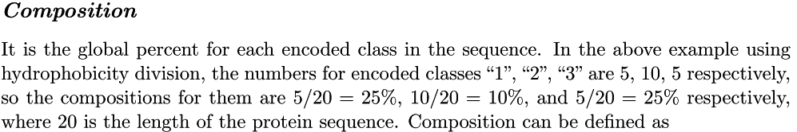
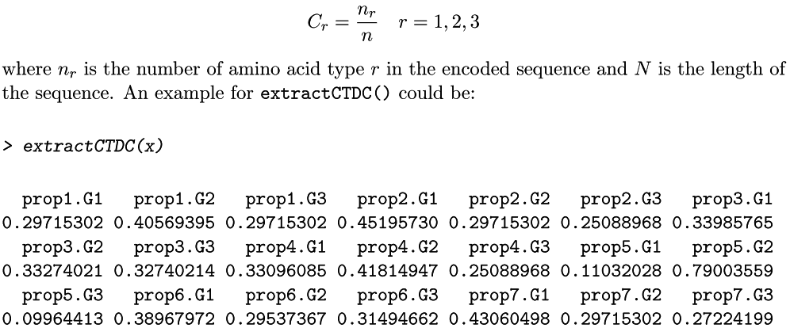

Slide 18
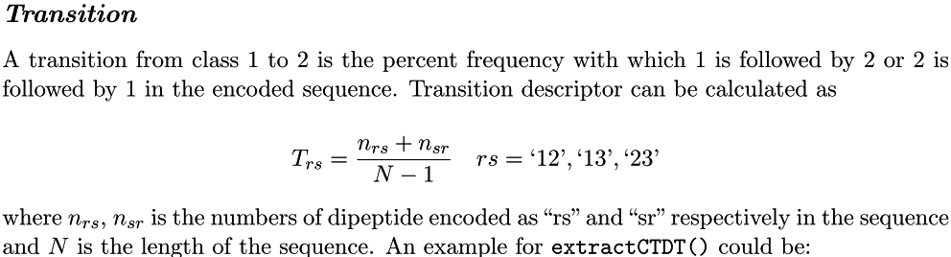
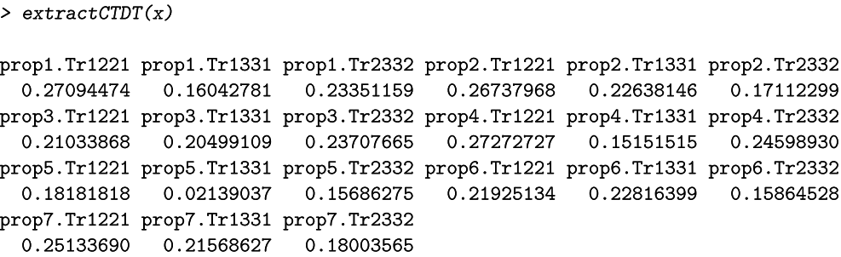

Slide 19
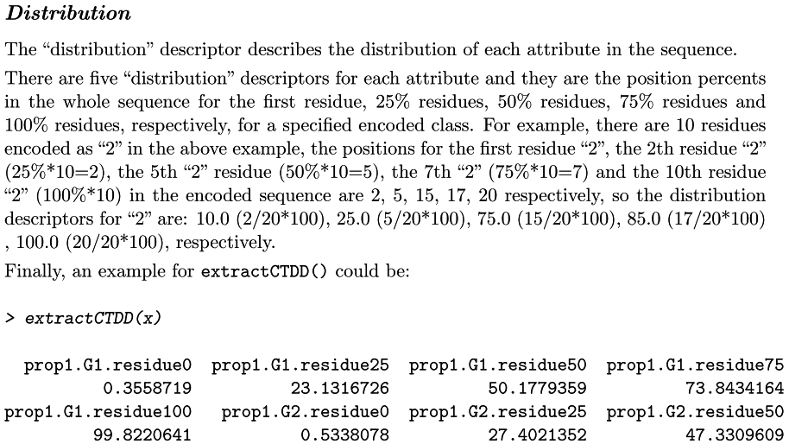

Slide 20
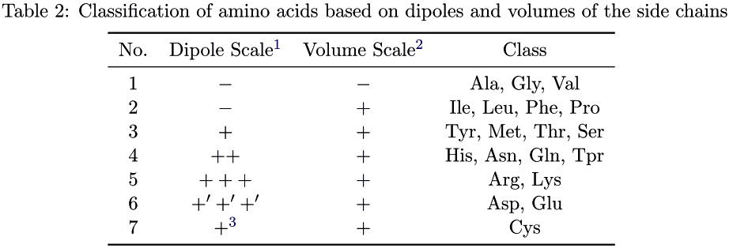
Conjoint Triad Descriptors
The triads can be diﬀerentiated according to the classes of amino acids, i.e., triads composed by three amino acids belonging to the same classes. For the amino acids that have been catogorized into seven classes, the number of possible triads should be 7 × 7 × 7; thus i = 1, 2, . . . , 343.

Slide 21
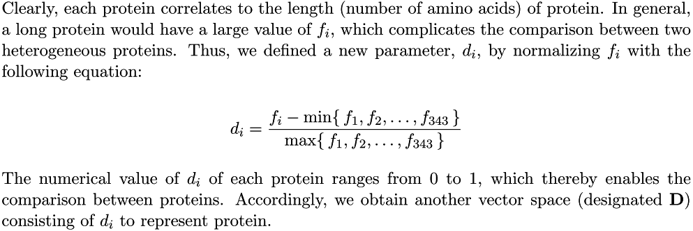
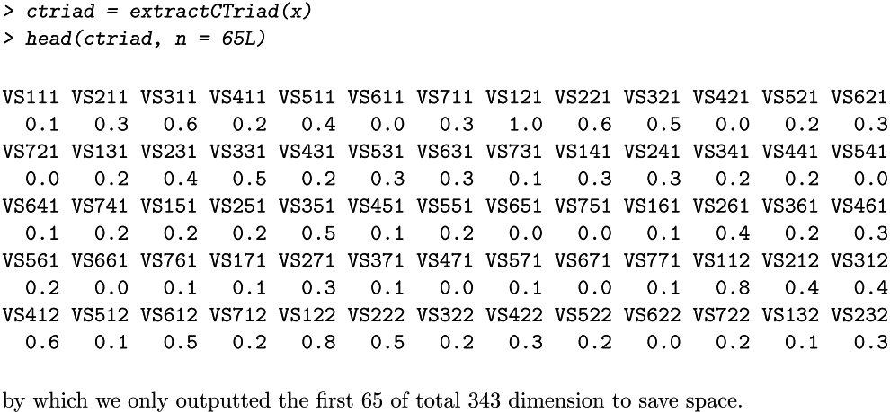

Slide 22
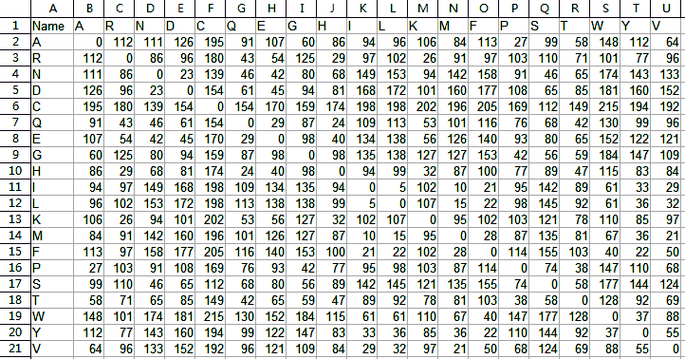
Amino acid distance matrix - Grantham

Slide 23
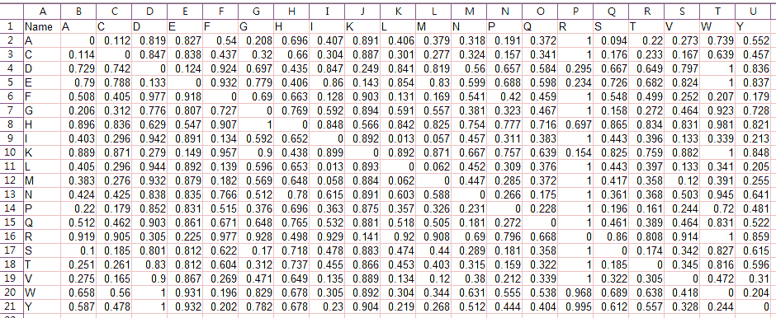
Amino acid distance matrix - Schneider-Wrede

Slide 24
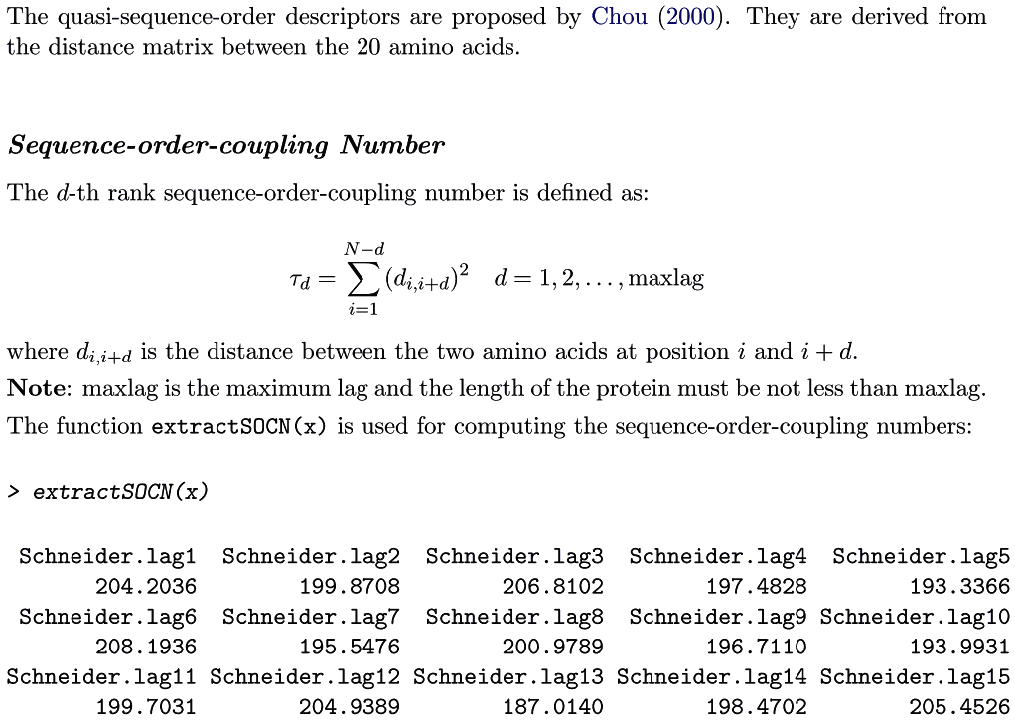
Sequence-order-coupling Number

Slide 25
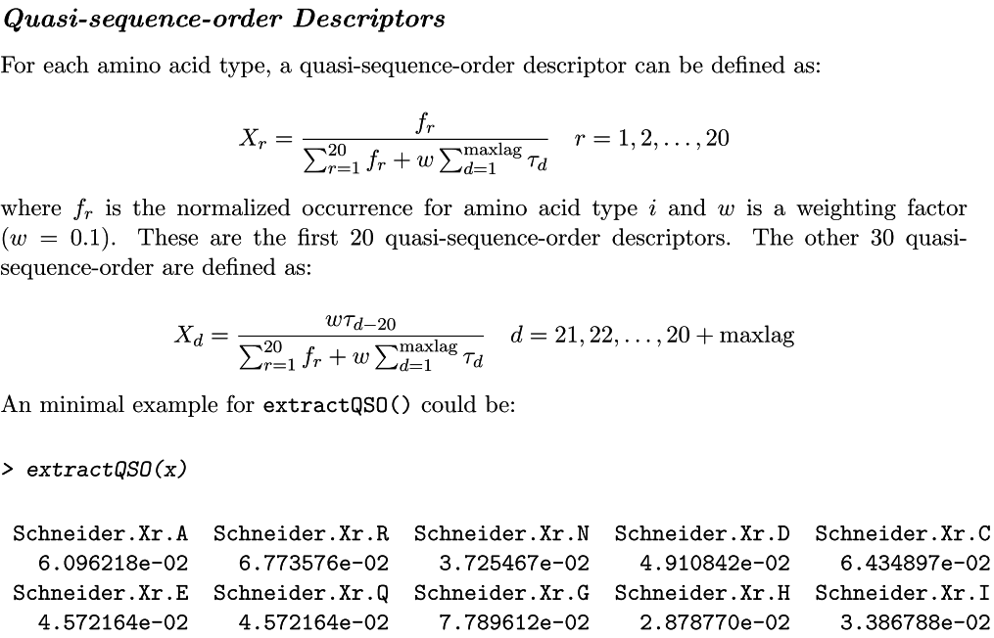
Quasi-sequence-order Descriptors

Slide 26
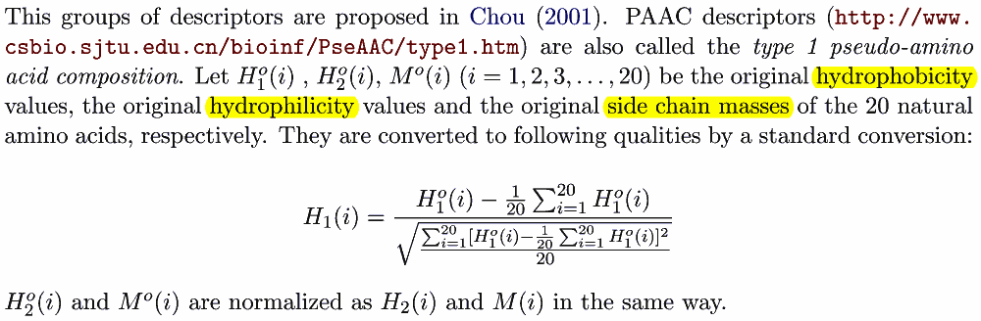
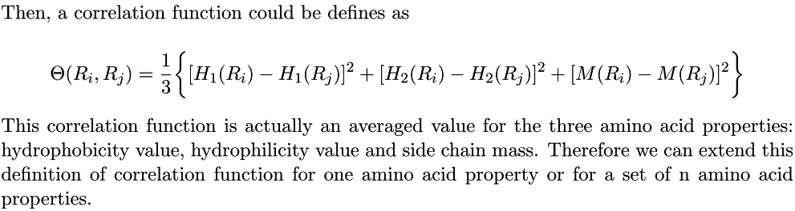
Pseudo-Amino Acid Composition (PAAC)

Slide 27
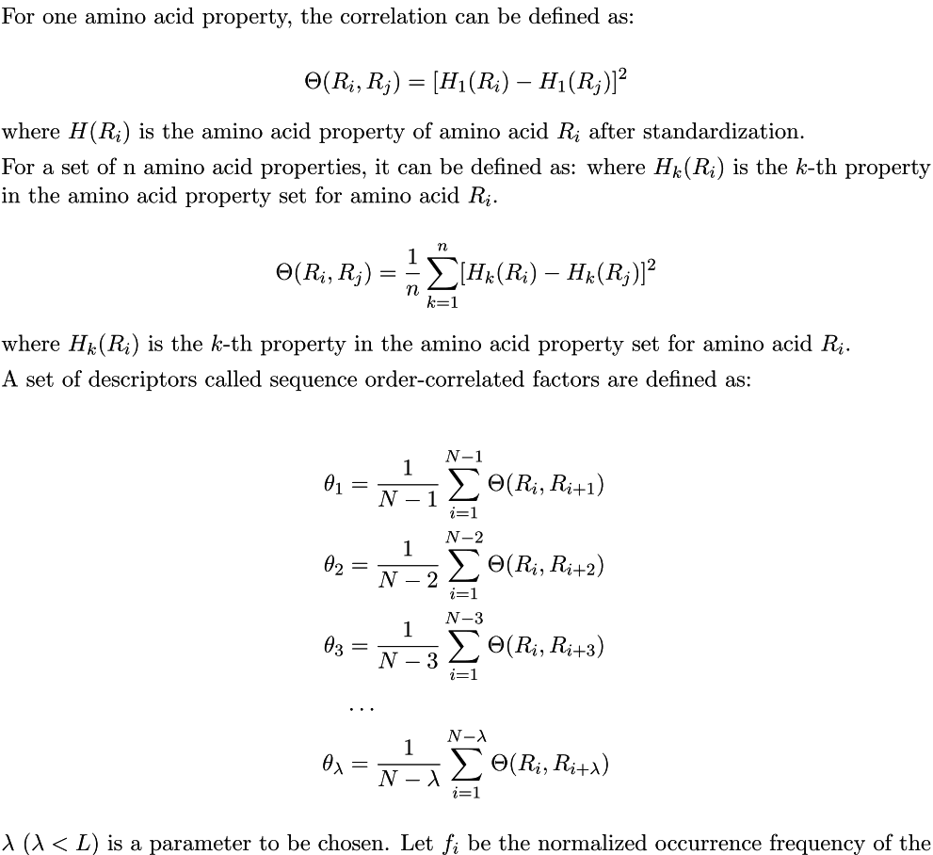

Slide 28
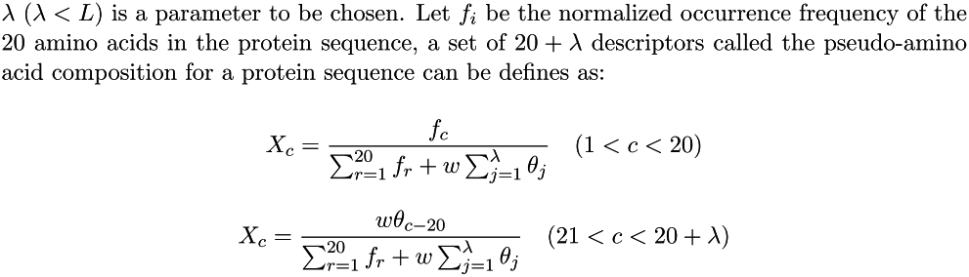
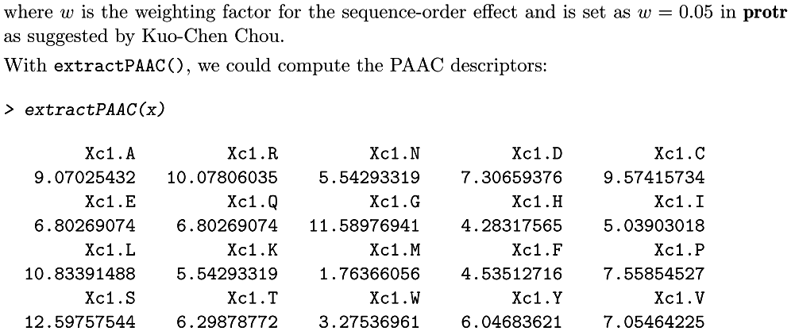

Slide 29
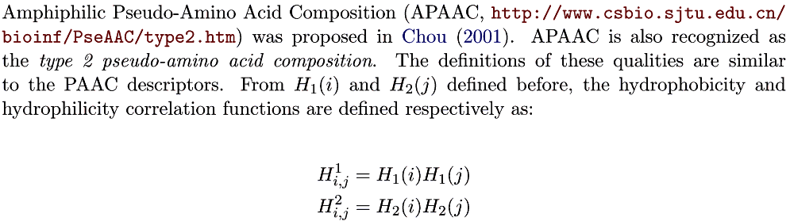
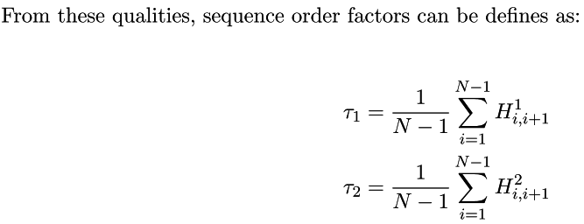
Amphiphilic Pseudo-Amino Acid Composition (APAAC)

Slide 30
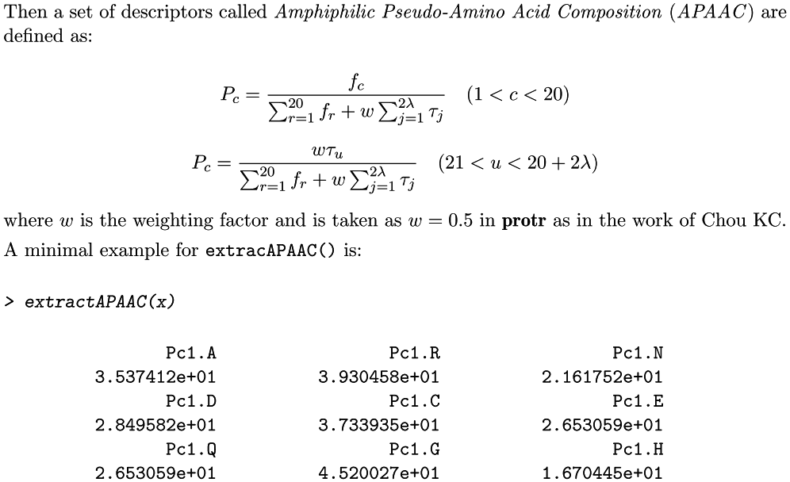

Slide 31
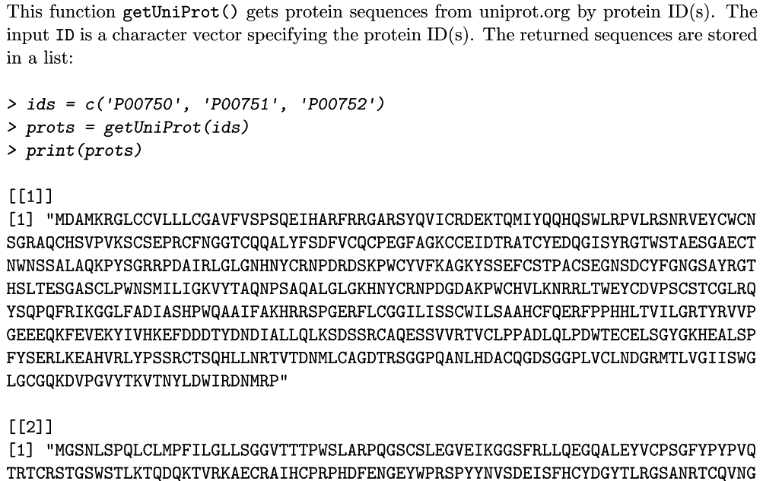
Retrieve Protein Sequences from UniProt

Slide 32
Practical statistical network analysis (with R and igraph)
G´abor Cs´ardi
http://statmath.wu.ac.at/research/friday/resources_WS0708_SS08/igraph.pdf

Slide 33

igraph
http://igraph.org/redirect.html
Notes:
library(igraph)
DMNC <- function(g,node_i,Epsilon=1.7){
#example graph:
# 1 2
# 1 8
# 2 8
# 3 8
# 4 8
# 5 8
# 7 8
# 4 5
# 4 6
# 4 7
# 5 6
# 6 8
# lists = c(1,2,1,8,2,8,3,8,4,8,5,8,7,8,4,5,4,6,4,7,5,6,6,8) - 1
# g = graph(lists, directed=F)
# plot(g, layout=layout.kamada.kawai)
# DMNC(g,7)
neighbors = V(g)[nei(node_i)]
g2 = subgraph(g,neighbors)
length(E(g2)) / MNC(g,node_i)**Epsilon
}
BN <- function(g){
#example graph:
# 1 8
# 2 8
# 3 8
# 4 8
# 5 3
# 7 8
# 4 6
# 5 9
# lists = c(1,8,2,8,3,8,4,8,5,3,7,8,4,6,5,9) - 1
# g = graph(lists, directed=F)
# plot(g, layout=layout.kamada.kawai)
vs = as.integer(V(g))
cbns = combn(vs,2)
wh = which(apply(cbns,2,diff)!=0)
if(0==length(wh)) return(rep(0,length(vs)))
cbns = cbns[,wh]
all_shortest_paths = apply(cbns,2,function(x) get.shortest.paths(g,x[1],x[2]))
all_shortest_paths = unlist(all_shortest_paths,recursive=F)
all_shortest_paths_by_nodes = lapply(vs,function(v){
wh2 = which(sapply(1:length(all_shortest_paths),function(ipath){
path = all_shortest_paths[[ipath]]
len = length(path)
len>2 && v!=path[1] && v!=path[len] && v %in% path
}))
all_shortest_paths[wh2]
})
#sapply(all_shortest_paths_by_nodes,length)
#Output:
if(!is.null(V(g)$label)){
Vglabel = V(g)$label; names(Vglabel) = paste(vs)
all_shortest_paths_by_nodes2 = lapply(all_shortest_paths_by_nodes,function(aspbn){
lapply(aspbn,function(asp){
unname(Vglabel[paste(asp)])
})
})
bn = paste('Node',V(g)$label,',',sapply(all_shortest_paths_by_nodes2,length),' paths: ',as.character(all_shortest_paths_by_nodes2),sep='')
}else{
bn = paste('Node',V(g),',',sapply(all_shortest_paths_by_nodes,length),' paths: ',as.character(all_shortest_paths_by_nodes),sep='')
}
write(bn,file='C:\\Inetpub\\wwwroot\\bn.txt')
}
get_tree_descendents <- function(tree,root,node){
leaves = V(tree)[degree(tree)==1]
all_shortest_paths = sapply(leaves,function(leave) get.shortest.paths(tree,root,leave))
descendents = c()
for(path in all_shortest_paths){
whe_in = node %in% path
wh = which(path==node)
if(length(wh)>0){
descendents = c(descendents,path[(wh+1):length(path)])
}
}
descendents
}
all_shortest_paths_by_nodes <- function(g,fact=0.25){
#example graph:
# 1 8
# 2 8
# 3 8
# 4 8
# 5 3
# 7 8
# 4 6
# 5 9
# lists = c(1,8,2,8,3,8,4,8,5,3,7,8,4,6,5,9) - 1
# g = graph(lists, directed=F)
# plot(g, layout=layout.kamada.kawai)
vs = as.integer(V(g))
N = length(vs)
thr = N * fact
bns0 = rep(0,length(vs)); names(bns0) = paste(vs)
all_shortest_paths_by_nodes = lapply(vs,function(v){
tr = unfold.tree(g,roots=v)$tree
leaves = V(tr)[degree(tr)==1]
all_shortest_paths = sapply(leaves,function(leave) get.shortest.paths(tr,v,leave))
bns = bns0
for(path in all_shortest_paths){
for(v_ in setdiff(vs,v)){
whe_in = v_ %in% path
wh = which(path==v_)
wh = ifelse(length(wh)>0,length(path)-wh,-1)
if(whe_in && wh>=round(thr+0.5)){
cat('Node',paste(v_),'is a bottleneck (#descendents>',thr,') in path',path,'\n')
bns[paste(v_)] = bns[paste(v_)] + 1
}
}
}
list(root=v,all_shortest_paths=all_shortest_paths,bottleneck=bns)
})
all_shortest_paths_by_nodes
}
BN_loop <- function(g,fact=0.25){
#example graph:
# 0 1
# 2 1
# 1 3
# 1 4
# 5 6
# 7 8
# 9 10
# 9 11
# 12 13
# 14 13
# 15 13
# 13 16
# 3 11
# 0 5
# 0 8
# 7 15
# 9 16
# lists = c(0,1,2,1,1,3,1,4,5,6,7,8,9,10,9,11,12,13,14,13,15,13,13,16,3,11,0,5,0,8,7,15,9,16)
# g = graph(lists, directed=F)
# plot(g, layout=layout.kamada.kawai)
vs = as.integer(V(g))
N = length(vs)
thr = N * fact
bns0 = rep(0,length(vs)); names(bns0) = paste(vs)
all_shortest_paths_by_nodes = lapply(vs,function(v){
bns = bns0
tr = unfold.tree(g,roots=v)$tree
added=setdiff(V(tr),V(g))
if(length(added)>0) tr = delete.vertices(tr, added)
leaves = V(tr)[degree(tr)==1]
all_shortest_paths = sapply(leaves,function(leave) get.shortest.paths(tr,v,leave))
for(v_ in setdiff(vs,v)){
descendents = get_tree_descendents(tr,v,v_)
if(length(descendents) >= round(thr+0.5)){
cat('Node',paste(v_),'is a bottleneck (#descendents>',thr,') from root',v,'\n')
bns[paste(v_)] = bns[paste(v_)] + 1
}
}
list(root=v,all_shortest_paths=all_shortest_paths,bottleneck=bns)
})
bns = sapply(all_shortest_paths_by_nodes,function(b) b$bottleneck)
apply(bns,1,sum)
}
BN_loop_onenode <- function(g,i,fact=0.25){
#example graph:
# 0 1
# 2 1
# 1 3
# 1 4
# 5 6
# 7 8
# 9 10
# 9 11
# 12 13
# 14 13
# 15 13
# 13 16
# 3 11
# 0 5
# 0 8
# 7 15
# 9 16
# lists = c(0,1,2,1,1,3,1,4,5,6,7,8,9,10,9,11,12,13,14,13,15,13,13,16,3,11,0,5,0,8,7,15,9,16)
# g = graph(lists, directed=F)
# plot(g, layout=layout.kamada.kawai)
vs = as.integer(V(g))
N = length(vs)
thr = N * fact
bns0 = rep(0,length(vs)); names(bns0) = paste(vs)
v = i
bns = bns0
tr = unfold.tree(g,roots=v)$tree
added=setdiff(V(tr),V(g))
if(length(added)>0) tr = delete.vertices(tr, added)
leaves = V(tr)[degree(tr)==1]
all_shortest_paths = sapply(leaves,function(leave) get.shortest.paths(tr,v,leave))
for(v_ in setdiff(vs,v)){
descendents = get_tree_descendents(tr,v,v_)
if(length(descendents) >= round(thr+0.5)){
cat('Node',paste(v_),'is a bottleneck (#descendents>',thr,') from root',v,'\n')
bns[paste(v_)] = bns[paste(v_)] + 1
}
}
if(!is.null(V(g)$label)) V(tr)$label = V(g)$label
V(tr)[which(unodenames=='V')-1]$color='red'
E(tr)$color='black'
list(root=v,all_shortest_paths=all_shortest_paths,bottleneck=bns,BN=sum(bns),tree=tr)
}
NID <- function(g, norm=F){
#Neighbors’ Intra-degree (NID) if norm = F
#Clustering Coefficient (CCo) if norm = T
#number of edges of neighbors of Node_i connecting with each other
#example graph:
# 1 2
# 1 8
# 2 8
# 3 8
# 4 8
# 5 8
# 7 8
# 4 5
# 4 6
# 4 7
# 5 6
# 6 8
# lists = c(1,2,1,8,2,8,3,8,4,8,5,8,7,8,4,5,4,6,4,7,5,6,6,8) - 1
# g = graph(lists, directed=F)
# plot(g, layout=layout.kamada.kawai)
t1<- proc.time()
nids = rep(0,length(V(g)))
sp = shortest.paths(g)
nbn = apply(sp,1,function(s) length(which(s==1)))
if(!norm) facts = rep(1,length(nids)) else facts = ifelse(nbn<=1,1,2 / nbn / (nbn-1))
for(i in 1:length(nids)){
wh = which(sp[i,]==1)
spn = sp[wh,wh]
nids[i] = length(which(spn==1)) /2 * facts[i]
}
print(proc.time()-t1)
return(nids)
#OLD routines
vs = as.integer(V(g))
neighbors_by_nodes = lapply(vs,function(v) as.integer(V(g)[nei(v)]))
sapply(neighbors_by_nodes,function(nbn){
fact = ifelse(norm && length(nbn) > 1, length(nbn) * (length(nbn)-1) / 2, 1)
length(E(g) [ nbn %--% nbn ]) / fact
})
}
KL <- function(g, min_=NULL, max_=NULL){
# Clique Level (KL)
t1<- proc.time()
CLs = cliques(g, min=min_, max=max_)
vs = as.integer(V(g))
# Node_in_CL = sapply(vs,function(v){
# sapply(CLs,function(CL){
# ifelse(v %in% CL, length(CL),0)
# })
# })
KLs = rep(0,length(vs))
for(i in 1:length(CLs)){
inds = CLs[[i]] + 1
KLs[inds] = KLs[inds] + length(inds)
}
names(KLs) = paste(vs)
print(proc.time()-t1)
KLs
}
#table in Latex format
m2l <- function(X, fname = "m2l.out", rowlabel = 0, collabel = 0, caption = " "){
# Prints a matrix as latex table into a file
# https://stat.ethz.ch/pipermail/r-help/2000-September/008150.html
# by
# E-Mail: Winfried Theis <theis at statistik.uni-dortmund.de>
# Date: 07-Sep-00
# Tel.: +49-231-755-5903 Room: Mathematikgebaude, M832
# Dipl.-Math. Winfried Theis, Graduiertenkolleg "Angewandte Statistik",
# Universitat Dortmund, 44221 Dortmund
# Input:
# X: a matrix
# fname: a filename as String
# rowlabel: a string array of labels, dim = nrow
# collabel: a string array of labels, dim = ncol
# caption: a string for caption field
# Example: m2l(X=as.matrix(spt),fname="",rowlabel = rownames(spt), collabel = colnames(spt), caption = "Imbalanced data")
if (!(is.matrix(X)))
{
stop("X is not a matrix");
}
row <- nrow(X);
col <- ncol(X);
if (length(rowlabel) < 2)
{
rowlabel <- c(1:row);
}
if (length(collabel) < 2)
{
collabel <- c(1:col);
}
if ((length(rowlabel) != row) || (length(collabel) != col))
{
error("wrong label dimensions");
stop;
}
cat("\\begin{table}\n", file=fname);
cat("\\caption{", file=fname, append=TRUE);
cat(caption, file=fname, append=TRUE);
cat("} \n", file=fname, append=TRUE);
cat("\\begin{center}\n", file=fname, append=TRUE);
cat("\\begin{tabular}{", file=fname, append=TRUE);
for (j in c(1:(col+1)))
{
cat("|c", file=fname, append=TRUE);
}
cat("|} \\hline \n", file=fname, append=TRUE);
for (j in c(1:col))
{
cat("&", file=fname, append=TRUE);
cat(collabel[j], file=fname, append=TRUE);
}
cat("\\\\ \\hline \n", file=fname, append=TRUE);
for (i in c(1:row))
{
cat(rowlabel[i], file=fname, append=TRUE);
for (j in c(1:col))
{
cat("&", file=fname, append=TRUE);
cat(X[i,j], file=fname,append=TRUE);
}
if (i < row)
{
cat("\\\\ \n", file=fname, append=TRUE);
} else {
cat("\\\\ \\hline \n", file=fname, append=TRUE);
}
}
cat("\\end{tabular} \n", file=fname, append=TRUE);
# cat("\\caption{", file=fname, append=TRUE);
# cat(caption, file=fname, append=TRUE);
# cat("} \n", file=fname, append=TRUE);
cat("\\end{center} \n", file=fname, append=TRUE);
cat("\\end{table} \n", file=fname, append=TRUE);
}

Slide 34
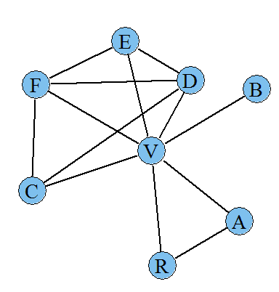

Graph Visualization
unodenames = c('A','B','C','D','E','F','R','V')
f = 0:(length(unodenames)-1)
names(f) = unodenames
print(f)
connections = c('A','R','A','V','B','V','C','D','C','F','C','V','D','E','D','F','D','V','E','F','E','V','R','V','V','F')
lists = f[connections]
g = graph(lists, directed=F)
Notes:
bToEPS = F
unodenames = c('A','B','C','D','E','F','R','V')
#f = 1:(length(unodenames))
f = 0:(length(unodenames)-1)
names(f) = unodenames
print(f)
connections = c('A','R','A','V','B','V','C','D','C','F','C','V','D','E','D','F','D','V','E','F','E','V','R','V','V','F')
lists = f[connections]
g = graph(lists, directed=F)
V(g)$label = unodenames
V(g)$label.cex=1.8
V(g)$label.color=1
if(F){
tkid=tkplot(g, layout=layout.kamada.kawai)
paste('coords=c(',paste(round(tkplot.getcoords(tkid),1),collapse=','),')',sep='')
}else{
coords=c(398.6,430,20,310,190,27,257.5,238.3,102,342.7,157.6,359,430,351.2,20,229.7)
coords = matrix(coords,length(coords)/2)
}
E(g)$color='black'
V(g)$size=25
E(g)$width =2
if(bToEPS) postscript("network.eps", fonts=c("serif", "Palatino"))
plot(g, layout=coords)
if(bToEPS) dev.off()

Slide 35
Degree
degrees = igraph::degree(g)
[1] "A,B,C,D,E,F,R,V"
[1] "2,1,3,4,3,4,2,7"
Notes:
bToEPS = F
unodenames = c('A','B','C','D','E','F','R','V')
#f = 1:(length(unodenames))
f = 0:(length(unodenames)-1)
names(f) = unodenames
print(f)
connections = c('A','R','A','V','B','V','C','D','C','F','C','V','D','E','D','F','D','V','E','F','E','V','R','V','V','F')
lists = f[connections]
g = graph(lists, directed=F)
V(g)$label = unodenames
V(g)$label.cex=1.8
V(g)$label.color=1
if(F){
tkid=tkplot(g, layout=layout.kamada.kawai)
paste('coords=c(',paste(round(tkplot.getcoords(tkid),1),collapse=','),')',sep='')
}else{
coords=c(398.6,430,20,310,190,27,257.5,238.3,102,342.7,157.6,359,430,351.2,20,229.7)
coords = matrix(coords,length(coords)/2)
}
E(g)$color='black'
V(g)$size=25
E(g)$width =2
if(bToEPS) postscript("network.eps", fonts=c("serif", "Palatino"))
plot(g, layout=coords)
if(bToEPS) dev.off()

Slide 36
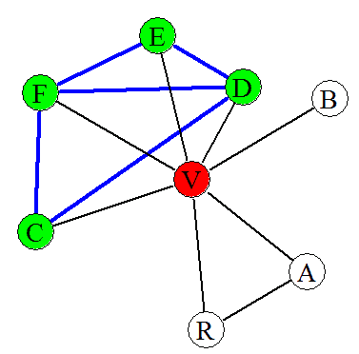
MNC / DMNC
找鄰居
找connected component
node_i = which(unodenames=='V')-1
neighbors = V(g)[nei(node_i)]
g2 = subgraph(g,neighbors)
connected = clusters(g2)
maxCLid = as.integer(names(which.max(table(connected$membership))))
MaxCL = V(g2)$label[which(connected$membership==maxCLid)]
MNC = length(MaxCL)
Edges = get.edges(g,0:(length(E(g))-1))
wh_edges = apply(Edges,1,function(edge){all(edge %in% f[MaxCL])})
DMNC = sum(wh_edges) / MNC**1.7
Notes:
bToEPS = F
unodenames = c('A','B','C','D','E','F','R','V')
#f = 1:(length(unodenames))
f = 0:(length(unodenames)-1)
names(f) = unodenames
print(f)
connections = c('A','R','A','V','B','V','C','D','C','F','C','V','D','E','D','F','D','V','E','F','E','V','R','V','V','F')
lists = f[connections]
g = graph(lists, directed=F)
V(g)$label = unodenames
V(g)$label.cex=1.8
V(g)$label.color=1
if(F){
tkid=tkplot(g, layout=layout.kamada.kawai)
paste('coords=c(',paste(round(tkplot.getcoords(tkid),1),collapse=','),')',sep='')
}else{
coords=c(398.6,430,20,310,190,27,257.5,238.3,102,342.7,157.6,359,430,351.2,20,229.7)
coords = matrix(coords,length(coords)/2)
}
E(g)$color='black'
V(g)$size=25
E(g)$width =2
if(bToEPS) postscript("network.eps", fonts=c("serif", "Palatino"))
plot(g, layout=coords)
if(bToEPS) dev.off()

Slide 37
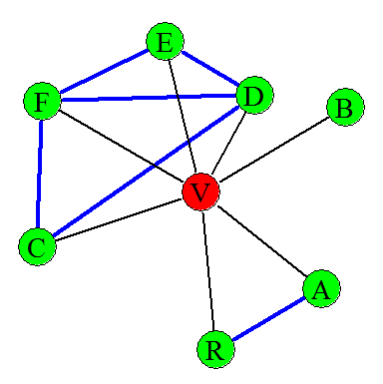
Neighbors' Intra-degree (NID) / Clustering Coefficient (CCo)
v = which(unodenames=='V')-1
nbn = as.integer(V(g)[nei(v)])
wh_edges = c(E(g) [ nbn %--% nbn ]
NID = length(wh_edges)
Deg = degree(g)[which(unodenames=='V')]
CCo = 2 * NID / Deg / (Deg-1)
Notes:
bToEPS = F
unodenames = c('A','B','C','D','E','F','R','V')
#f = 1:(length(unodenames))
f = 0:(length(unodenames)-1)
names(f) = unodenames
print(f)
connections = c('A','R','A','V','B','V','C','D','C','F','C','V','D','E','D','F','D','V','E','F','E','V','R','V','V','F')
lists = f[connections]
g = graph(lists, directed=F)
V(g)$label = unodenames
V(g)$label.cex=1.8
V(g)$label.color=1
if(F){
tkid=tkplot(g, layout=layout.kamada.kawai)
paste('coords=c(',paste(round(tkplot.getcoords(tkid),1),collapse=','),')',sep='')
}else{
coords=c(398.6,430,20,310,190,27,257.5,238.3,102,342.7,157.6,359,430,351.2,20,229.7)
coords = matrix(coords,length(coords)/2)
}
E(g)$color='black'
V(g)$size=25
E(g)$width =2
if(bToEPS) postscript("network.eps", fonts=c("serif", "Palatino"))
plot(g, layout=coords)
if(bToEPS) dev.off()

Slide 38
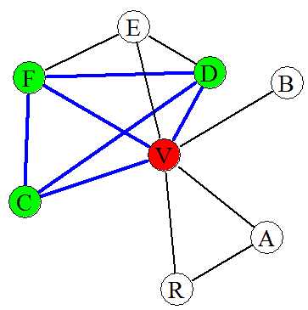
Clique Level (KL)
找3~10之cliques
CLs = cliques(g, min=3, max=10)
v = which(unodenames=='V')-1
wh.contain = sapply(CLs,function(CL) v %in% CL)
CLs = CLs[wh.contain]
wh.max = which.max(sapply(CLs,length))
CL = CLs[[wh.max]]
KL = length(CL)
Notes:
bToEPS = F
unodenames = c('A','B','C','D','E','F','R','V')
#f = 1:(length(unodenames))
f = 0:(length(unodenames)-1)
names(f) = unodenames
print(f)
connections = c('A','R','A','V','B','V','C','D','C','F','C','V','D','E','D','F','D','V','E','F','E','V','R','V','V','F')
lists = f[connections]
g = graph(lists, directed=F)
V(g)$label = unodenames
V(g)$label.cex=1.8
V(g)$label.color=1
if(F){
tkid=tkplot(g, layout=layout.kamada.kawai)
paste('coords=c(',paste(round(tkplot.getcoords(tkid),1),collapse=','),')',sep='')
}else{
coords=c(398.6,430,20,310,190,27,257.5,238.3,102,342.7,157.6,359,430,351.2,20,229.7)
coords = matrix(coords,length(coords)/2)
}
E(g)$color='black'
V(g)$size=25
E(g)$width =2
if(bToEPS) postscript("network.eps", fonts=c("serif", "Palatino"))
plot(g, layout=coords)
if(bToEPS) dev.off()

Slide 39
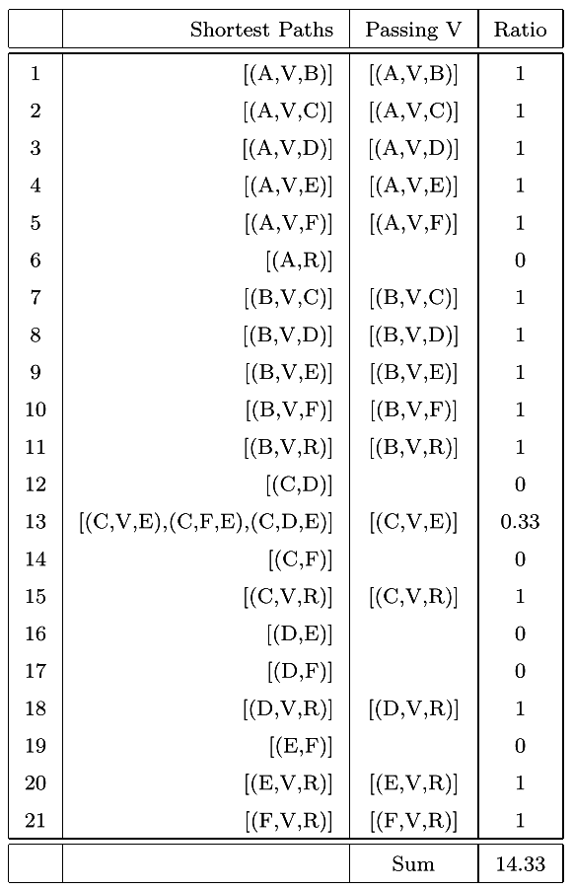
Betweenness
找最短路徑
betweenness(g)
Notes:
bToEPS = F
unodenames = c('A','B','C','D','E','F','R','V')
#f = 1:(length(unodenames))
f = 0:(length(unodenames)-1)
names(f) = unodenames
print(f)
connections = c('A','R','A','V','B','V','C','D','C','F','C','V','D','E','D','F','D','V','E','F','E','V','R','V','V','F')
lists = f[connections]
g = graph(lists, directed=F)
V(g)$label = unodenames
V(g)$label.cex=1.8
V(g)$label.color=1
if(F){
tkid=tkplot(g, layout=layout.kamada.kawai)
paste('coords=c(',paste(round(tkplot.getcoords(tkid),1),collapse=','),')',sep='')
}else{
coords=c(398.6,430,20,310,190,27,257.5,238.3,102,342.7,157.6,359,430,351.2,20,229.7)
coords = matrix(coords,length(coords)/2)
}
E(g)$color='black'
V(g)$size=25
E(g)$width =2
if(bToEPS) postscript("network.eps", fonts=c("serif", "Palatino"))
plot(g, layout=coords)
if(bToEPS) dev.off()

Slide 40
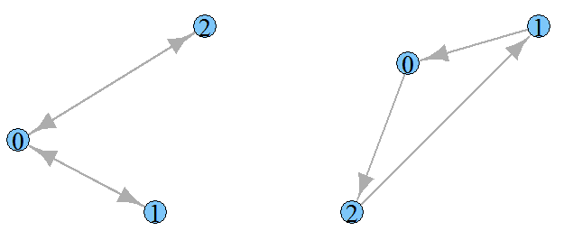
Graph Isomorphism
> graph.isomorphic(g1, g2)
[1] FALSE
Notes:
# create some non-isomorphic graphs
g1 <- graph.isocreate(3, 10)
g2 <- graph.isocreate(3, 11)
graph.isoclass(g1)
graph.isoclass(g2)
graph.isomorphic(g1, g2)
V(g1)$size=25
E(g1)$width =2
V(g2)$size=25
E(g2)$width =2
V(g1)$label.cex=1.8
V(g1)$label.color=1
V(g2)$label.cex=1.8
V(g2)$label.color=1
op <- par(mfrow = c(1, 2))
plot(g1); plot(g2)
par(op)

Slide 41
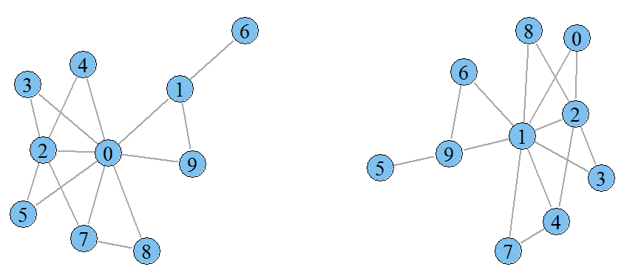
Graph Isomorphism
> graph.isomorphic.vf2(g1, g2)
$iso
[1] TRUE
$map12
[1] 1 9 2 0 3 8 5 4 7 6
$map21
[1] 3 0 2 4 7 6 9 8 5 1
Notes:
# create two isomorphic graphs, by
# permuting the vertices of the first
g1 <- simplify(barabasi.game(10, m=2, directed=FALSE))
g2 <- permute.vertices(g1, sample(vcount(g1))-1)
# should be TRUE
graph.isomorphic(g1, g2)
graph.isomorphic.bliss(g1, g2)
graph.isomorphic.vf2(g1, g2)
# draw
V(g1)$size=25
E(g1)$width =2
V(g2)$size=25
E(g2)$width =2
V(g1)$label.cex=1.8
V(g1)$label.color=1
V(g2)$label.cex=1.8
V(g2)$label.color=1
op <- par(mfrow = c(1, 2))
plot(g1,layout=layout.kamada.kawai); plot(g2,layout=layout.kamada.kawai)
par(op)

