Slide 1
A Strategy for the Rapid Multiple Alignment of Protein Sequences Confidence Levels from Tertiary Structure Comparisons
Geoffrey J. Barton and Michael J. E. Sternberg
J. Mol. Biol. (1987)198,327-337
Presenter:Ding-Yao Huang
Date:2014/5/19
Notes:
提出一個策略，讓multiple alignment 更快，利用三維結構比較數進行分析

Slide 2
Abstract
An algorithm is presented for the multiple alignment of protein sequences that is both accurate and rapid computationally. The approach is based on the conventional dynamic programming method of pairwise alignment. Initially, two sequences are aligned, then the third sequence is aligned against the alignment of both sequences one and two. Similarly, the fourth sequence is aligned against one, two and three. This is repeated until all sequences have been aligned. Iteration is then performed to yield a final alignment.
The accuracy of sequence alignment is evaluated from alignment of the secondary structures in a family of proteins. For the globins, the multiple alignment was on average 99% accurate compared to 90% for pairwise comparison of sequences. For the alignment of immunoglobulin constant and variable domains, the use of many sequences yielded an alignment of 63 % average accuracy compared to 41% average for individual variable/constant alignments. The multiple alignment algorithm yields an assignment of disulphide connectivity in mammalian serotransferrin that is consistent with crystallographic data, whereas pairwise alignments give an alternative assignment

Slide 3
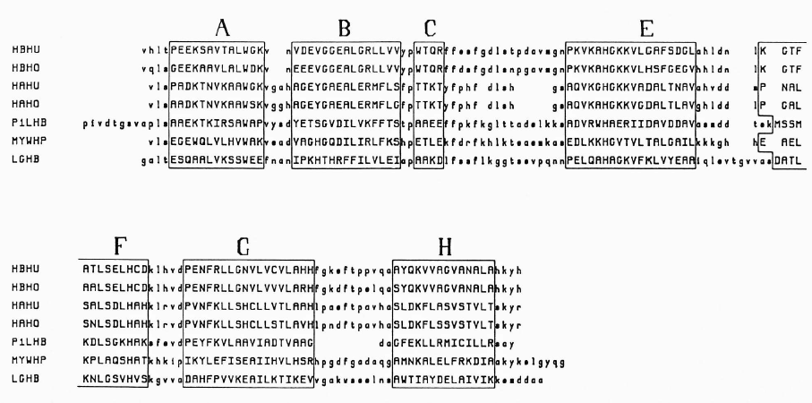
Notes:
每個region 代表著二級結構

Slide 4
Procedure
(a)Needleman & Wunsch algorithm
(b)Multiple alignment
(c)Criteria for assessing the quality of alignment
(d)Order of alignment
(e)Reducing calculation time
(f)Test sequences and reference alignments

Slide 5
Needleman & Wunsch algorithm
F_{i-1,j-1}+S(A_{i},B_{j})
F_{ij}=max
F_{i,j-1}+s(A_{i},─)
F_{i-1,j}+s(─, B_{j})
 |  | P | R | C | L | C
 | 0 | 0 | 0 | 0 | 0 | 0
P | 0 | 1 | 0 | 0 | 0 | 0
A | 0 | 1 | 1 | 1 | 1 | 1
R | 0 | 1
C | 0 | 1
K | 0 | 1
C | 0 | 1
Match=1
Mismatch=0
Gap penalty d= 0
2

Slide 6
Needleman & Wunsch algorithm
F_{i-1,j-1}+S(A_{i},B_{j})
F_{ij}=max
F_{i,j-1}+s(A_{i},─)
F_{i-1,j}+s(─, B_{j})
 |  | P | R | C | L | C
 | 0 | 0 | 0 | 0 | 0 | 0
P | 0 | 1 | 0 | 0 | 0 | 0
A | 0 | 1 | 1 | 1 | 1 | 1
R | 0 | 1 | 2 | 2 | 2 | 2
C | 0 | 1 | 2 | 3 | 3 | 3
K | 0 | 1 | 2 | 3 | 3 | 3
C | 0 | 1 | 2 | 3 | 3 | 4
Match=1
Mismatch=0
Gap penalty d= 0
Sequnce1: P _RCL_C
Sequnce2: P ARC_KC

Slide 7
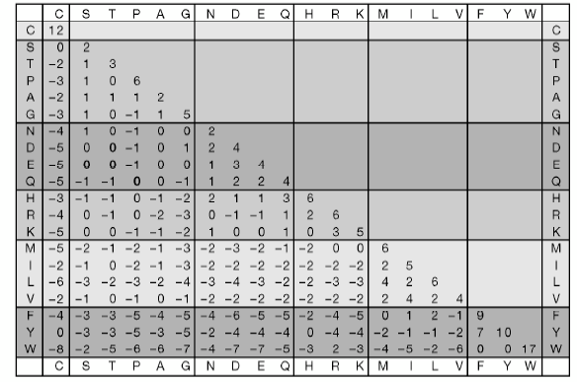

Slide 8
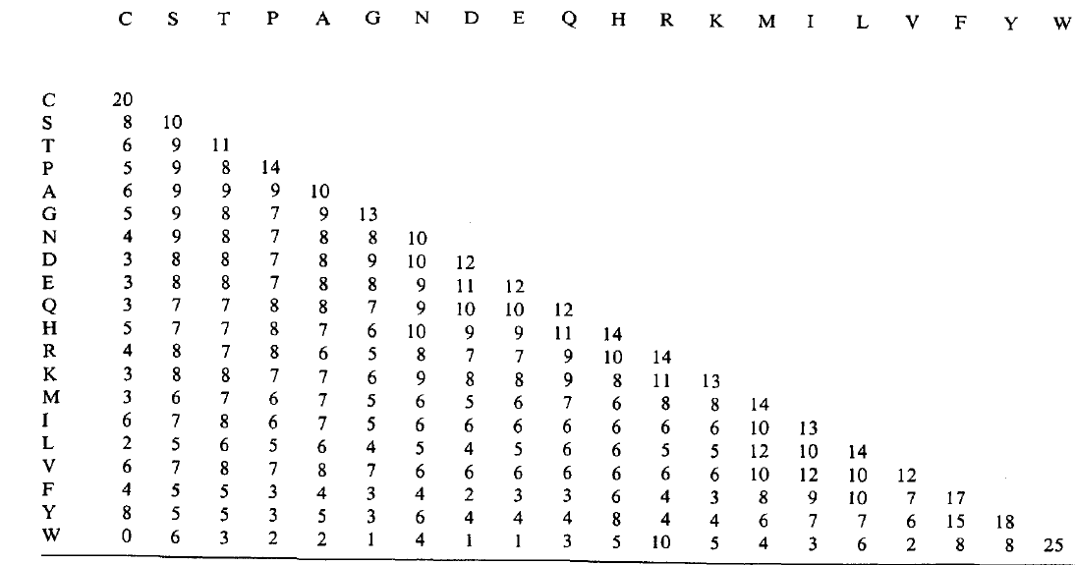
Needleman & Wunsch algorithm
Dayhoff MDM₇₈ (1978)

Slide 9
Needleman & Wunsch algorithm
F_{i-1,j-1}+S(A_{i},B_{j})
F_{ij}=max
F_{i,j-1}+d
F_{i-1,j}+d
 |  | P | R | C | L | C
 | 0 | 0 | 0 | 0 | 0 | 0
P | 0 | 14 | 14 | 14 | 14 | 14
A | 0 | 14 | 20 | 20 | 20 | 20
R | 0 | 14 | 28 | 28 | 28 | 28
C | 0 | 14 | 28 | 48 | 48 | 48
K | 0 | 14 | 28 | 48 | 53 | 53
C | 0 | 14 | 28 | 48 | 53 | 73
Gap penalty d= 0
Sequnce1: P _ RCLC
Sequnce2: P ARCKC

Slide 10
Multiple alignment
Sequnce1
Sequnce2
Alignment 12
Sequnce3
Alignment 123
…
Sequnce(K-1)
Alignment 123…K-1
Sequnce(K)
Final Alignment

Slide 11
Multiple alignment
Sequnce1: P_RCLC
Sequnce2: PARCKC
Sequnce3: PARC_C
…
SequnceK-1: FP_RCKC
SequnceK: GF_ARPQC

Slide 12

Multiple alignment
Sequnce1: P_RCLC
Sequnce2: PARCKC
Sequnce3: PARC_C
(P-P)+(P-P)/2= 24
(P-A)+(P-_)/2= 4.5
…
…
SequnceK-1: FP_RCKC
SequnceK: GF_ARPQC

Slide 13
Multiple alignment
Sequnce1: M P_RCL_
Sequnce2: _ PARC_K
Sequnce3: F _ARTL_
…
SequnceK-1: F P_RC__
SequnceK: GF_ARPQ_

Slide 14
Multiple alignment
Sequnce1: M P_RCL
Sequnce2: _ PARCK
Sequnce3: F _ARTL
Realign each sequences
…
SequnceK-1: F P_RC_
SequnceK-1: GF_ARPQ

Slide 15
Multiple alignment
Sequnce1: M P_RCL
Sequnce2: _ PARCK
Sequnce3: F _ARTL
Highlight conserved regions in the alignment
…
SequnceK-1: F P_RC_
SequnceK : GF_ARPQ

Slide 16
Criteria for assessing the quality of alignment
When 2 or more protein sequences are aligned it is of crucial importance that residues defining a common tertiary fold are correctly equivalence.
We define the accuracy of an alignment of 2 sequences as the percentage of residues within these zones that are aligned in the same way as in the reference alignment.
Notes:
在region 內的排法就是reference alignment

Slide 17
Criteria for assessing the quality of alignment
Notes:
有個大家都認為不錯的alignment 當作reference alignment

Slide 18
Order of alignment
For N sequences there are N! alternative orders, so it is important to have a systematic approach to selecting the single order.
Our previous findings suggested that a pairwise sequence comparison that gives a significance score of >6.0 S.D. may be aligned to >75%accuracy within regions of secondary structure (1987)
our strategy for determining the alignment order first identifies the pair of sequences that have the highest pairwise significance score.

Slide 19
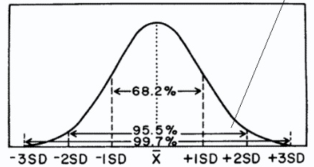
Significance score
m
V
Significance score is
(V-m)/S.D.
V alignment score
m average random score
S.D. random sequence S.D.

Slide 20
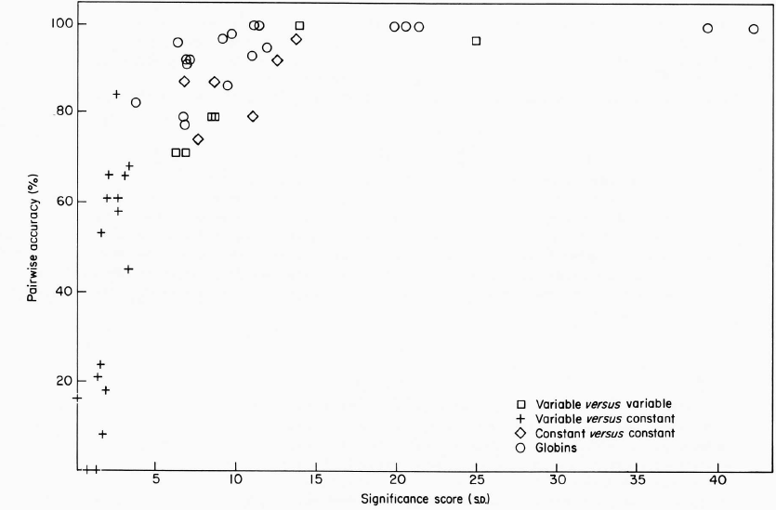
Notes:
透過這張圖 利用significance score

Slide 21
Reducing calculation time
The calculation of significance scores for all pairwise alignments of N sequences is an expensive procedure since if M randomizations per pair are performed then N x (N -1) x M /2 comparisons must be carried out.
For groups of proteins where randomization procedures would be too expensive, NASs values or the slightly more expensive NASa (match score divided by the number of residues not aligned with gaps), may be used to generate systematically a rational order for multiple alignment

Slide 22
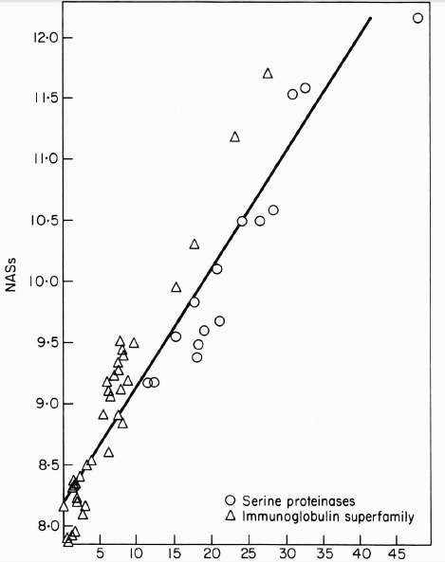

Slide 23
Test sequences and reference alignments

Slide 24
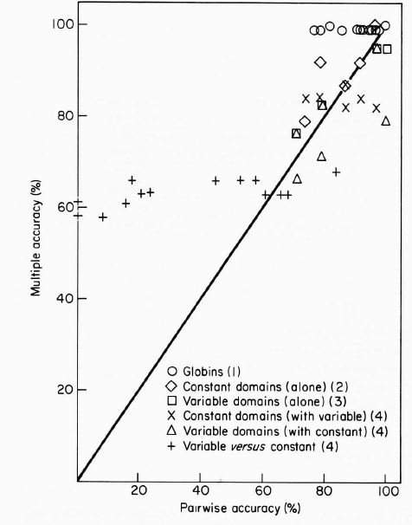
Results(Pairwise comparisons)

Slide 25
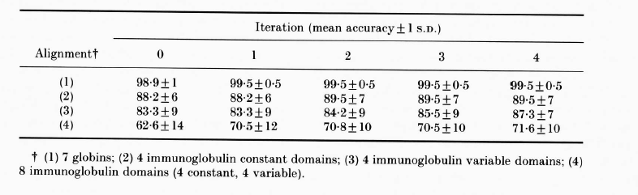
Results (Effect of iteration and order of alignment)

Slide 26
Results

Slide 27
Conclusions
One advantage of the algorithm described here is its speed.
The algorithm presented in this paper represents a practical solution to the problem of automatically aligning more than two protein sequences when only sequence information is available.
It has been suggested that a few key residues can be sufficient to define a tertiary fold

