Slide 1
Remark on Hsu-Du New Algorithm for the LCS Problem
A. Apostolico, Information Processing Letters, Volume 25, Issue 4, 17 June 1987, Pages 235–236

Slide 2
Abstract
One of the time bounds claimed by Hsu and Du for the
modification of Hirschberg's strategy set up by them is not correct. This is of some consequence, notably, it voids the claim, made else-where in the same paper, that the proposed algorithm performs better than the Hunt-Szymanski's strategy in cases of sparse matches. In fact it is pointed out here that just the opposite is true. In addition, there are other cases in which the new algorithm fails to achieve the superior performance that the authors claim, namely, all cases where the number of matches is large compared to the length of the shorter input string.

Slide 3
Hirschberg’s Algorithm
A = “abcdbb”, B = “cbacbaaba”
A[i] = B[j] 以 * 表示
 | c | b | a | c | b | a | a | b | a
a |  |  | * |  |  | * | * |  | *
b |  | * |  |  | * |  |  | *
c | * |  |  | *
d
b |  | * |  |  | * |  |  | *
b |  | * |  |  | * |  |  | *

Slide 4

Hirschberg’s Algorithm
A = “abcdbb”, B = “cbacbaaba”
n = max($\left|A\right|$, $\left|B\right|$) = 9
Thresh[0: n]
Thresh[k-1] ＜ j ≦ Thresh[k] => Thresh[k] = j
index | 0 | 1 | 2 | 3 | 4 | 5 | 6
value | 0 | n+1 | n+1 | n+1 | n+1 | n+1 | n+1
index | 0 | 1 | 2 | 3 | 4 | 5 | 6
value | 0 | 10 | 10 | 10 | 10 | 10 | 10

Slide 5
Hirschberg’s Algorithm
index | 0 | 1 | 2 | 3 | 4 | 5 | 6
value | 0 | 10 | 10 | 10 | 10 | 10 | 10
index | 0 | 1 | 2 | 3 | 4 | 5 | 6
value | 0 | 9 | 10 | 10 | 10 | 10 | 10
 | c | b | a | c | b | a | a | b | a
a |  |  | * |  |  | * | * |  | 1
b |  | * |  |  | * |  |  | *
c | * |  |  | *
d
b |  | * |  |  | * |  |  | *
b |  | * |  |  | * |  |  | *
Point(i, j) = (1, 9)
Thresh[0] ＜ 9 ≦ Thresh[1]
Thresh[1] = 9
rank of point(1, 9) = 1

Slide 6
Hirschberg’s Algorithm
index | 0 | 1 | 2 | 3 | 4 | 5 | 6
value | 0 | 9 | 10 | 10 | 10 | 10 | 10
index | 0 | 1 | 2 | 3 | 4 | 5 | 6
value | 0 | 7 | 10 | 10 | 10 | 10 | 10
 | c | b | a | c | b | a | a | b | a
a |  |  | * |  |  | * | 1 |  | 1
b |  | * |  |  | * |  |  | *
c | * |  |  | *
d
b |  | * |  |  | * |  |  | *
b |  | * |  |  | * |  |  | *
Point(i, j) = (1, 7)
Thresh[0] ＜ 7 ≦ Thresh[1]
Thresh[1] = 7
rank of point(1, 7) = 1

Slide 7
Hirschberg’s Algorithm
index | 0 | 1 | 2 | 3 | 4 | 5 | 6
value | 0 | 3 | 10 | 10 | 10 | 10 | 10
index | 0 | 1 | 2 | 3 | 4 | 5 | 6
value | 0 | 3 | 8 | 10 | 10 | 10 | 10
 | c | b | a | c | b | a | a | b | a
a |  |  | 1 |  |  | 1 | 1 |  | 1
b |  | * |  |  | * |  |  | 2
c | * |  |  | *
d
b |  | * |  |  | * |  |  | *
b |  | * |  |  | * |  |  | *
Point(i, j) = (2, 8)
Thresh[0] ＜ 8 ≦ Thresh[2]
Thresh[1] = 8
rank of point(2, 8) = 2

Slide 8
Hirschberg’s Algorithm
index | 0 | 1 | 2 | 3 | 4 | 5 | 6
value | 0 | 1 | 2 | 5 | 8 | 10 | 10
 | c | b | a | c | b | a | a | b | a
a |  |  | 1 |  |  | 1 | 1 |  | 1
b |  | 1 |  |  | 2 |  |  | 2
c | 1 |  |  | 2
d
b |  | 2 |  |  | 3 |  |  | 3
b |  | 2 |  |  | 3 |  |  | 4
Length of LCS = 4

Slide 9
Hsu-Du’s Algorithm
 | c | b | a | c | b | a | a | b | a
a |  |  | 1 |  |  | 1 | 1 |  | 1
b |  | 1 |  |  | 2 |  |  | 2
c | * |  |  | *
d
b |  | * |  |  | * |  |  | *
b |  | * |  |  | * |  |  | *
index | 0 | 1 | 2 | 3 | 4 | 5 | 6
value | 0 | 2 | 5 | 10 | 10 | 10 | 10
binary search
j = 4

Slide 10
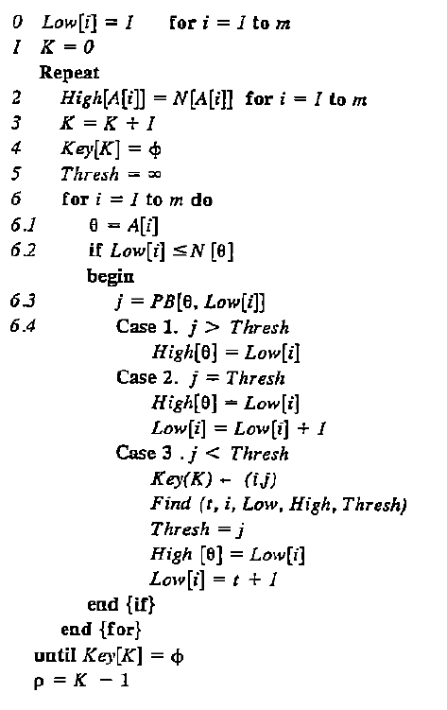

Hsu-Du’s Algorithm
N[θ]: B中θ的總數
PB[θ, N[θ]]: B中θ 的位置列表
K = rank
ρ = length of LCS
$O(mρ\log\left(\frac{n}{ρ}\right)+mρ)$

Slide 11
Dense Example
A = B = aaaaa
 | a | a | a | a | a
a | * | * | * | * | *
a | * | * | * | * | *
a | * | * | * | * | *
a | * | * | * | * | *
a | * | * | * | * | *
 | a | a | a | a | a
a | 1 | 1 | 1 | 1 | 1
a | 1 | 2 | 2 | 2 | 2
a | 1 | 2 | 3 | 3 | 3
a | 1 | 2 | 3 | 4 | 4
a | 1 | 2 | 3 | 4 | 5

Slide 12
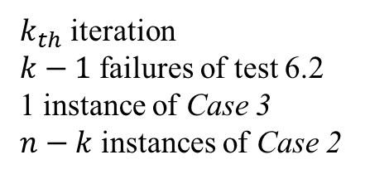

Dense Example
A = B = aaaaa
$O(mρ+K\log{(\frac{ρn}{K})}+K)$
K = 4
3 failures of test 6.2
1 instance of Case 3
1 instances of Case 2
 | a | a | a | a | a
a | 1 | 1 | 1 | 1 | 1
a | 1 | 2 | 2 | 2 | 2
a | 1 | 2 | 3 | 3 | 3
a | 1 | 2 | 3 | 4 | 4
a | 1 | 2 | 3 | 4 | 5
$k_{th}$ iteration
$k−1$ failures of test 6.2
1 instance of Case 3
$n−k$ instances of Case 2
K = 6
5 failures of test 6.2

Slide 13
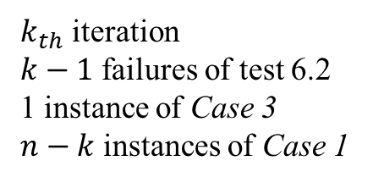

Sparse Example
A = B = abcde
$O(mρ+K\log{(\frac{ρn}{K})}+K)$
K = 4
3 failures of test 6.2
1 instance of Case 3
1 instances of Case 1
 | a | b | c | d | e
a | 1
b |  | 2
c |  |  | 3
d |  |  |  | 4
e |  |  |  |  | 5
$k_{th}$ iteration
$k−1$ failures of test 6.2
1 instance of Case 3
$n−k$ instances of Case 1
K = 6
5 failures of test 6.2

