Slide 1
The Department Score Forecast and Analysis of the College Entrance Examination
Presentator :Chun-Chieh Hsu
Date: 2014/05/26

Slide 2
Admission Pipeline
Star recommendation (less than 15%)
The application for admission to a school(less than 45%)
College Entrance Advanced Subjects Test (greater than 40%)

Slide 3

College Entrance Examination (CEE) Prediction System
College Entrance Advanced Subjects Test
Minimum required test score(MRTS)
${MRTS}_{s,d,j}=\sum_{i}^{|SUB|}{{score}_{i,j}×{weight}_{s,d,i,j}}$

Slide 4
The Forward Method
We make two assumptions that the preferences of students to schools are not changed in two consecutive years, and that a student has equal rank to all subjects.

Slide 5
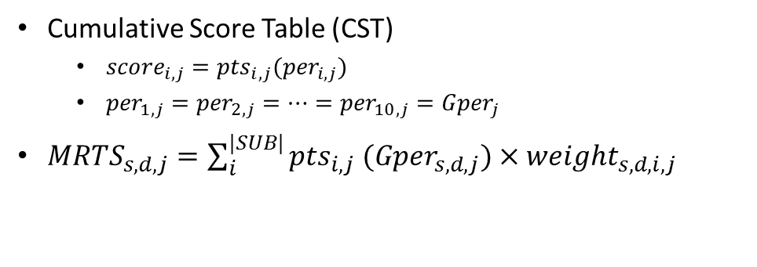
The Forward Method
Cumulative Score Table (CST)
${score}_{i,j}={pts}_{i,j}({per}_{i,j})$
${per}_{1,j}={per}_{2,j}=…={per}_{10,j}={Gper}_{j}$
${MRTS}_{s,d,j}=\sum_{i}^{|SUB|}{{pts}_{i,j} ({Gper}_{s,d,j})×{weight}_{s,d,i,j}}$
國文 (2012)
分數 | 人數 | 百分比 | 自高分往低分累計 |  | 自低分往高分累計 |  | 分數 | 人數 | 百分比 | 自高分往低分累計 |  | 自低分往高分累計
 |  |  | 累計 | 累計 | 累計 | 累計 |  |  |  | 累計 | 累計 | 累計 | 累計
 |  |  | 人數 | 百分比 | 人數 | 百分比 |  |  |  | 人數 | 百分比 | 人數 | 百分比
73.00 - 73.99 | 1175 | 1.87% | 7806 | 12.40% | 56336 | 89.47% | 22.00 - 22.99 | 72 | 0.11% | 62473 | 99.22% | 566 | 0.90%
72.00 - 72.99 | 1329 | 2.11% | 9135 | 14.51% | 55161 | 87.60% | 21.00 - 21.99 | 78 | 0.12% | 62551 | 99.34% | 494 | 0.78%
71.00 - 71.99 | 1478 | 2.35% | 10613 | 16.85% | 53832 | 85.49% | 20.00 - 20.99 | 68 | 0.11% | 62619 | 99.45% | 416 | 0.66%
70.00 - 70.99 | 1463 | 2.32% | 12076 | 19.18% | 52354 | 83.15% | 19.00 - 19.99 | 58 | 0.09% | 62677 | 99.54% | 348 | 0.55%

Slide 6

The Forward Method
Prediction:
$${MRTS}_{s,d,j}=\sum_{i}^{|SUB|}{{pts}_{i,j} ({Gper}_{s,d,j−1})×{weight}_{s,d,i,j}}$$

Slide 7
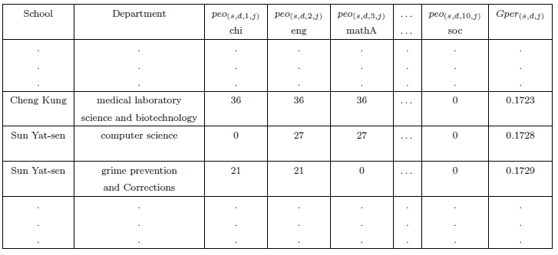
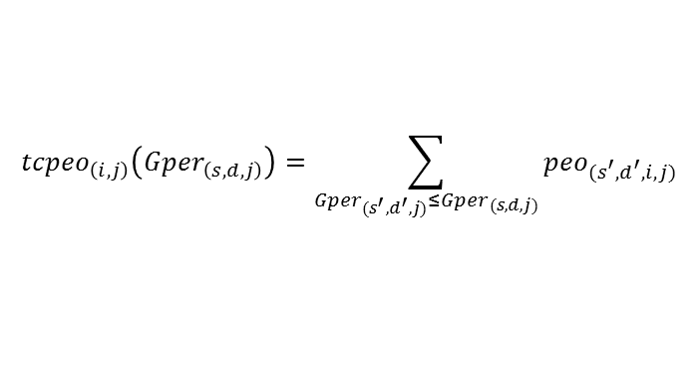
Forward Method with School Ranking
$${tcpeo}_{\left(i,j\right)}\left({Gper}_{\left(s,d,j\right)}\right)=\sum_{{Gper}_{(s^{′},d^{′},j)}≤{Gper}_{(s,d,j)}}{{peo}_{(s^{′},d^{′},i,j)}}$$

Slide 8
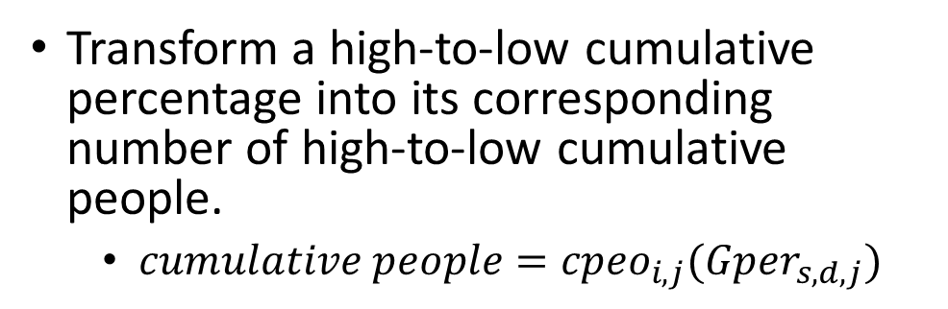
Forward Method with School Ranking
Transform a high-to-low cumulative percentage into its corresponding number of high-to-low cumulative people.
$cumulative people={cpeo}_{i,j}({Gper}_{s,d,j})$
國文 (2012)
分數 | 人數 | 百分比 | 自高分往低分累計 |  | 自低分往高分累計 |  | 分數 | 人數 | 百分比 | 自高分往低分累計 |  | 自低分往高分累計
 |  |  | 累計 | 累計 | 累計 | 累計 |  |  |  | 累計 | 累計 | 累計 | 累計
 |  |  | 人數 | 百分比 | 人數 | 百分比 |  |  |  | 人數 | 百分比 | 人數 | 百分比
73.00 - 73.99 | 1175 | 1.87% | 7806 | 12.40% | 56336 | 89.47% | 22.00 - 22.99 | 72 | 0.11% | 62473 | 99.22% | 566 | 0.90%
72.00 - 72.99 | 1329 | 2.11% | 9135 | 14.51% | 55161 | 87.60% | 21.00 - 21.99 | 78 | 0.12% | 62551 | 99.34% | 494 | 0.78%
71.00 - 71.99 | 1478 | 2.35% | 10613 | 16.85% | 53832 | 85.49% | 20.00 - 20.99 | 68 | 0.11% | 62619 | 99.45% | 416 | 0.66%
70.00 - 70.99 | 1463 | 2.32% | 12076 | 19.18% | 52354 | 83.15% | 19.00 - 19.99 | 58 | 0.09% | 62677 | 99.54% | 348 | 0.55%

Slide 9

Forward Method with School Ranking
$\frac{{cpeo}_{i,j−1({Gper}_{s,d,j−1})}}{{tcpeo}_{i,j−1({Gper}_{s,d,j−1})}}=\frac{{cpeo}_{i,j ({Gper′}_{s,d,j})}}{{tcpeo}_{i,j ({Gper}_{s,d,j−1})}}$
${MRTS′}_{s,d,j}=\sum_{i}^{|SUB|}{{pts}_{i,j} ({Gper′}_{s,d,j})×{weight}_{s,d,i,j}}$

Slide 10
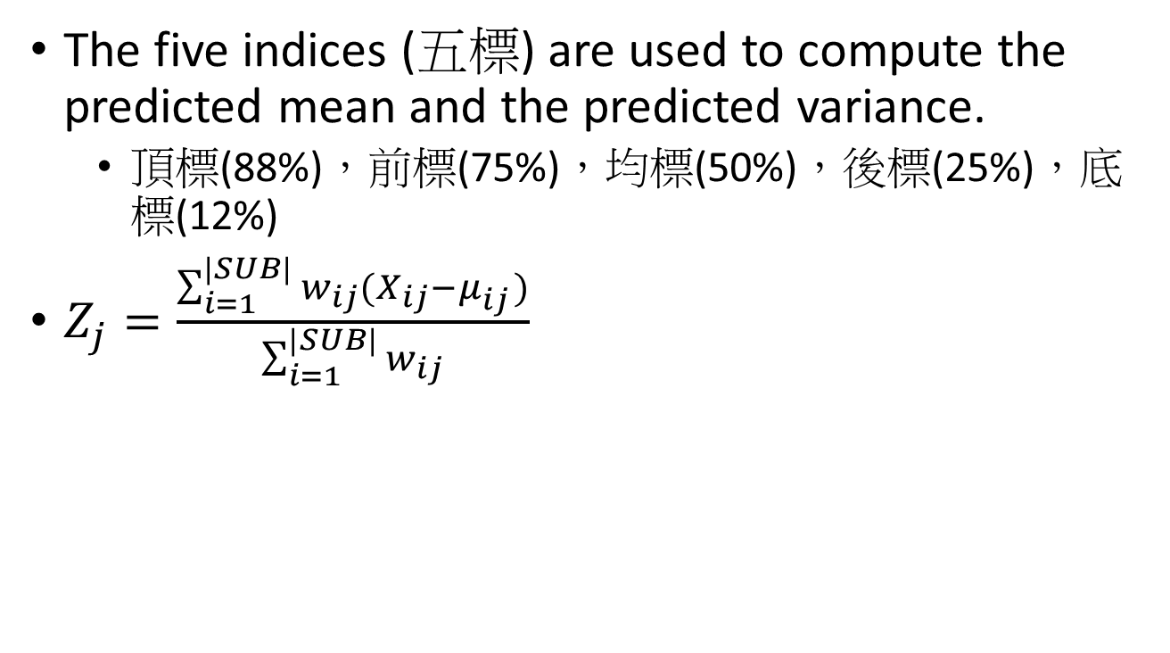
Lin’s Method
The five indices (五標)are used to compute the predicted mean and the predicted variance.
頂標(88%)，前標(75%)，均標(50%)，後標(25%)，底標(12%)
$Z_{j}=\frac{\sum_{i=1}^{|SUB|}{w_{ij}(X_{ij}−μ_{ij}^{})}}{\sum_{i=1}^{|SUB|}{w_{ij}}}$

Slide 11
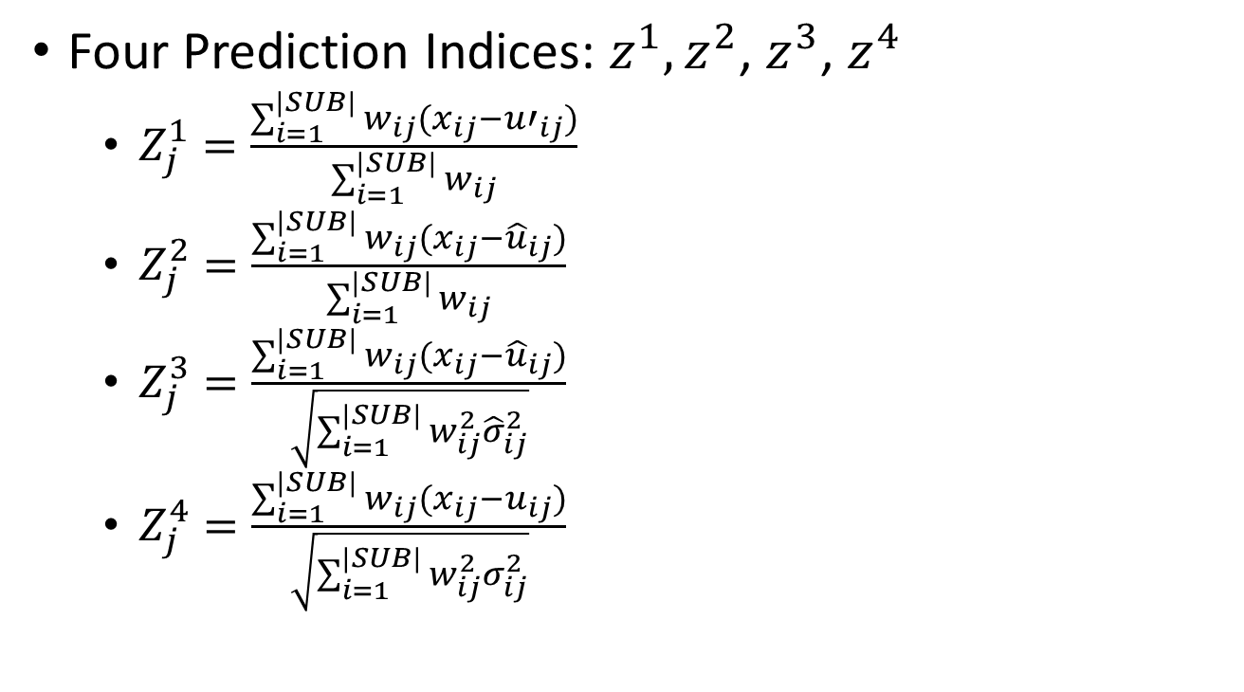
Lin’s Method
Four Prediction Indices: $z^{1},z^{2}$,$z^{3}$,$z^{4}$
$Z_{j}^{1}=\frac{\sum_{i=1}^{|SUB|}{w_{ij}(x_{ij}−{u′}_{ij})}}{\sum_{i=1}^{|SUB|}{w_{ij}}}$
$Z_{j}^{2}=\frac{\sum_{i=1}^{|SUB|}{w_{ij}(x_{ij}−{\hat{u}}_{ij})}}{\sum_{i=1}^{|SUB|}{w_{ij}}}$
$Z_{j}^{3}=\frac{\sum_{i=1}^{|SUB|}{w_{ij}(x_{ij}−{\hat{u}}_{ij})}}{\sqrt{\sum_{i=1}^{|SUB|}{w_{ij}^{2}{\hat{σ}}_{ij}^{2}}}}$
$Z_{j}^{4}=\frac{\sum_{i=1}^{|SUB|}{w_{ij}(x_{ij}−u_{ij})}}{\sqrt{\sum_{i=1}^{|SUB|}{w_{ij}^{2}σ_{ij}^{2}}}}$

Slide 12
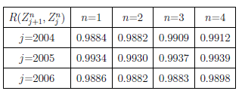
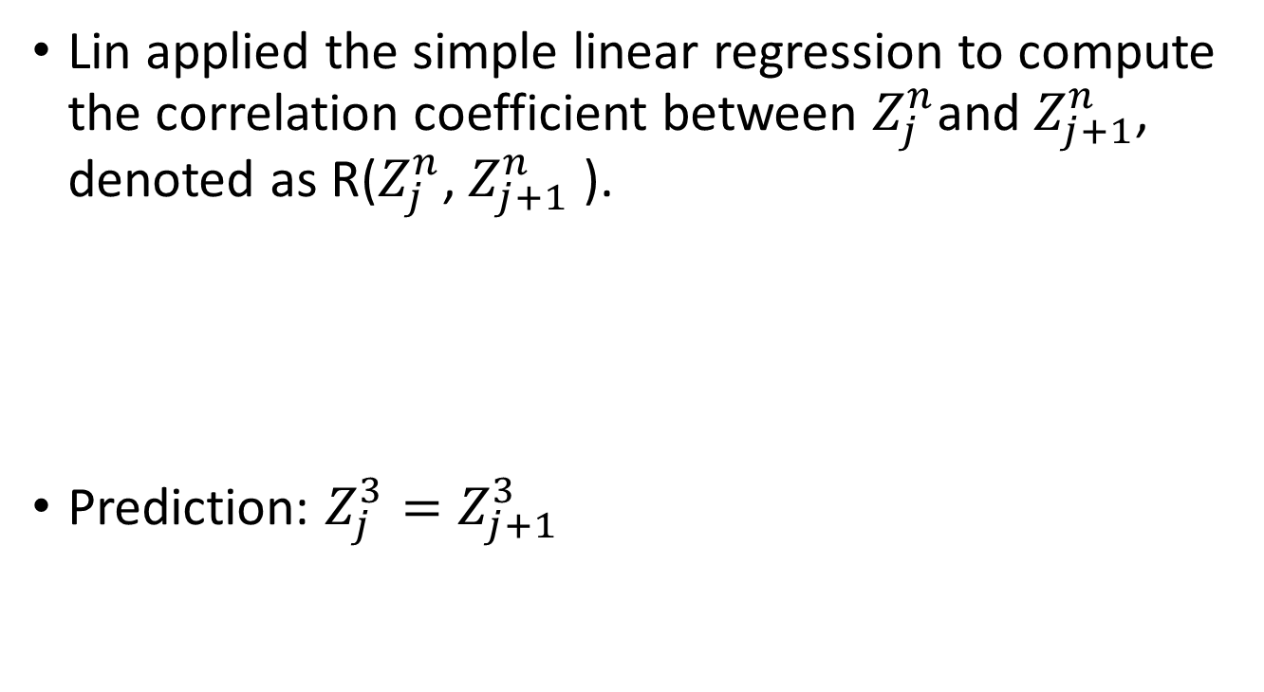
Lin’s Method
Lin applied the simple linear regression to compute the correlation coefficient between $Z_{j}^{n}$and $Z_{j+1}^{n}$, denoted as R($Z_{j}^{n}$,$Z_{j+1}^{n}$ ).
Prediction: $Z_{j}^{3}=Z_{j+1}^{3}$

Slide 13
The Admission Rate
over-estimation (OE)
under-estimation (UE)
ratio of admission rates (RAR)
 | 2004 | 2005 | 2006 | 2007 | 2008 | 2009 | 2010 | 2011 | 2012 | 2013
H or L |  | H | H | H | H | H | L | L | L | H
OE |  | 72.02% | 78.62% | 88.20% | 87.74% | 77.40% | 32.60% | 16.86% | 30.00% | 85.69%
UE |  | 27.98% | 21.38% | 11.81% | 12.25% | 22.60% | 67.40% | 83.14% | 70.00% | 14.31%
Admission rate | 75.60% | 76.32% rise | 80.94% rise | 85.86% rise | 91.02% rise | 94.01% rise | 86.50% fall | 80.29% fall | 77.49% fall | 82.95% rise
RAR |  | 1.0095 | 1.0606 | 1.0607 | 1.0601 | 1.0329 | 0.9202 | 0.9281 | 0.9652 | 1.0705

Slide 14
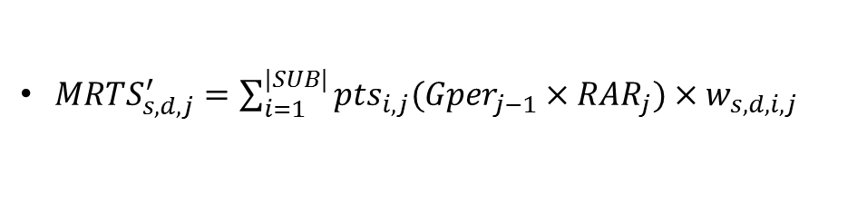
The Admission Rate
${MRTS}_{s,d,j}^{′}=\sum_{i=1}^{|SUB|}{{pts}_{i,j}({Gper}_{j−1}×{RAR}_{j})×w_{s,d,i,j}}$

Slide 15
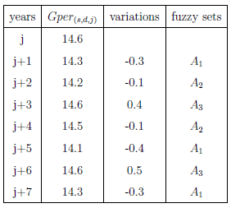
Prediction with Fuzzy Time Series
U=[-0.6, 0.6]
u₁=[-0.6,-0.2], u₂=[-0.2,0.2], u₃=[0.2,0.6]
A₁ (decreasing), A₂(unchanged), and A₃ (increasing).
A₁ ={1/u₁,0.5/u₂,0/u₃}
A₂ ={0.5/u₁,1/u₂,0.5/u₃}
A₃ ={0/u₁,0.5/u₂,1/u₃}

Slide 16
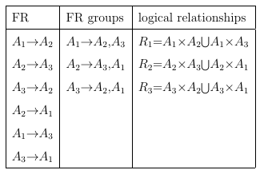
Prediction with Fuzzy Time Series
Combine fuzzy relationships (FR) into FR groups and obtain logical relationships from each FR group.

Slide 17
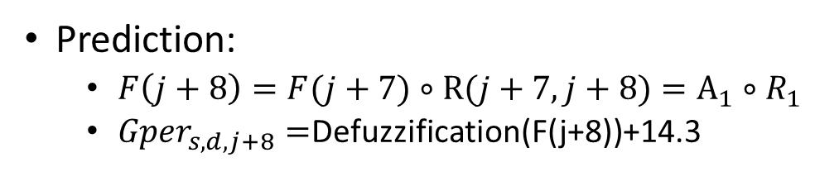
Prediction with Fuzzy Time Series
Prediction:
$F\left(j+8\right)=F(j+7)∘R(j+7,j+8)=A_{1}∘R_{1}$
${Gper}_{s,d,j+8}=$Defuzzification(F(j+8))+14.3

Slide 18

Prediction with Fuzzy Time Series
$${Gper}_{j}={Gper}_{j−1}∗{RAR}_{j}+∆_{2}$$
year | Gper | *RAR | variation | Fuzzy set
2004
2005 | 10 | 10.095 | 0.055
2006 | 10.15 | 10.765 | -0.265
2007 | 10.5 | 11.137 | ?
2008 | predict

Slide 19

Experimental Results
 | 2004 | 2005 | 2006 | 2007 | 2008 | 2009 | 2010 | 2011 | 2012 | 2013
forward | Rmse1 Rmse2 Rmse3 | 12.46 5.73 5.24 | 12.43 5.77 5.15 | 24.99 35.93 12.23 | 25.12 36.49 13.26 | 26.28 18.35 12.45 | 23.60 14.41 11.15 | 23.22 7.92 7.89 | 20.54 6.28 6.28 | 20.01 6.49 5.73
Fuzzy set | Rmse1 Rmse2 Rmse3 |  |  |  | 20.06 26.04 13.68 | 26.86 17.74 15.61 | 32.25 27.42 14.19 | 16.7 6.22 5.51 | 20.27 6.08 6.07 | 14.16 4.42 4.31
RAR | Rmse1 Rmse2 Rmse3 | 11.95 5.40 5.00 | 8.39 3.36 3.20 | 17.30 27.05 9.64 | 19.46 26.04 13.66 | 26.71 18.23 15.49 | 34.05 29.14 14.82 | 14.46 5.80 4.68 | 13.34 3.89 3.87 | 12.62 3.95 3.75
$$fuzzy set=2, number ofintervals=5$$

Slide 20

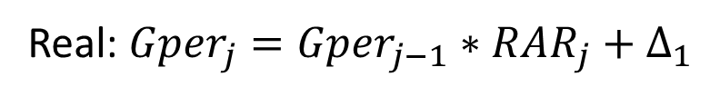
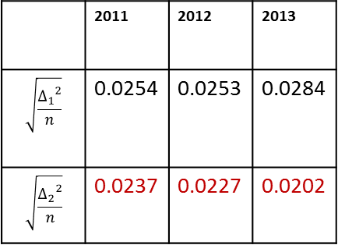
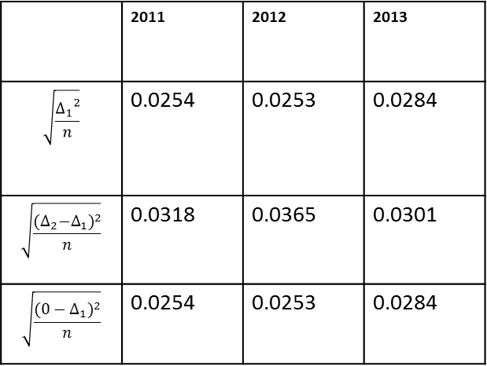

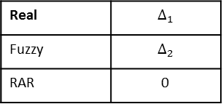

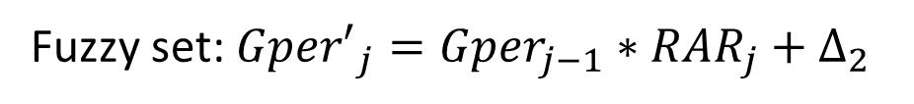

Experimental Results
Real: ${Gper}_{j}={Gper}_{j−1}∗{RAR}_{j}+∆_{1}$
Real | $$∆_{1}$$
Fuzzy | $$∆_{2}$$
RAR | 0
Fuzzy set: ${Gper′}_{j}={Gper}_{j−1}∗{RAR}_{j}+∆_{2}$
RAR: ${Gper′}_{j}={Gper}_{j−1}∗{RAR}_{j}+0$
 | 2011 | 2012 | 2013
$$\sqrt{\frac{{∆_{1}}^{2}}{n}}$$ | 0.0254 | 0.0253 | 0.0284
$$\sqrt{\frac{{{(∆}_{2}−∆_{1})}^{2}}{n}}$$ | 0.0318 | 0.0365 | 0.0301
$$\sqrt{\frac{({0−∆_{1})}^{2}}{n}}$$ | 0.0254 | 0.0253 | 0.0284
 | 2011 | 2012 | 2013
$$\sqrt{\frac{{∆_{1}}^{2}}{n}}$$ | 0.0254 | 0.0253 | 0.0284
$$\sqrt{\frac{{∆_{2}}^{2}}{n}}$$ | 0.0237 | 0.0227 | 0.0202
$$∆_{2}$$
$$∆_{2}$$
0
$$∆_{1}$$

