Slide 1
A Linear Space Algorithm for the LCS Problem
S. Kiran Kumar* and C. Pandu Rangan
Acta Informatica 24, 353-362 (1987)
Presenter:De-Sheng Jhan
2014/06/16

Slide 2
Abstract
The LCS problem is to determine the longest common subsequence(LCS) of two strings. A new linear-space algorithm to solve the LCS problem is presented. The only other algorithm with linear-space complexity is by Hirschberg and has runtime complexity O(mn). Our algorithm, based on the divide and conquer technique, has runtime complexity O(n(m-p)), where p is the length of the LCS.

Slide 3
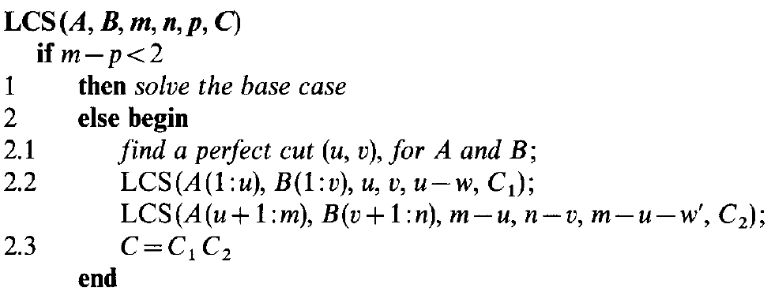
Algorithm

Slide 4
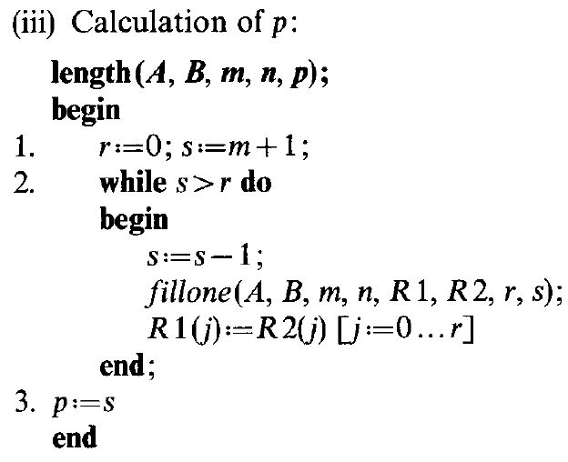
Calculation length of LCS(A, B)(1/14)

Slide 5
Calculation length of LCS(A, B)(2/14)
A[1:m] = “aadcbcada”
B[1:n] = “cabdacbc”
R1[] =
index | 0 | 1 | 2 | 3 | 4 | 5 | 6 | 7 | 8 | 9
value

Slide 6
Calculation length of LCS(A, B)(3/14)
index | 0 | 1 | 2 | 3 | 4 | 5 | 6 | 7 | 8 | 9
value | 9 | 5
R1[] =
A:
a a d c b c a d a
c a b d a c b c
B:

Slide 7
Calculation length of LCS(A, B)(4/14)
index | 0 | 1 | 2 | 3 | 4 | 5 | 6 | 7 | 8 | 9
value | 9 | 5 | 4
R1[] =
A:
a a d c b c a d a
c a b d a c b c
B:

Slide 8
Calculation length of LCS(A, B)(5/14)
index | 0 | 1 | 2 | 3 | 4 | 5 | 6 | 7 | 8 | 9
value | 9 | 5 | 4 | 2 | 1
R1[] =
A:
a a d c b c a d a
c a b d a c b c
B:

Slide 9
Calculation length of LCS(A, B)(6/14)
index | 0 | 1 | 2 | 3 | 4 | 5 | 6 | 7 | 8 | 9
value | 9 | 5 | 4 | 2 | 1
R1[] =
A:
a a d c b c a d a
c a b d a c b c
B:

Slide 10
Calculation length of LCS(A, B)(7/14)
index | 0 | 1 | 2 | 3 | 4 | 5 | 6 | 7 | 8 | 9
value | 9 | 5 | 4 | 2 | 1
R1[] =
A:
a a d c b c a d a
c a b d a c b c
B:

Slide 11
Calculation length of LCS(A, B)(8/14)
index | 0 | 1 | 2 | 3 | 4 | 5 | 6 | 7 | 8 | 9
value | 9 | 5 | 4 | 2 | 1
R1[] =
A:
a a d c b c a d a
c a b d a c b c
B:

Slide 12
Calculation length of LCS(A, B)(9/14)
index | 0 | 1 | 2 | 3 | 4 | 5 | 6 | 7 | 8 | 9
value | 9 | 5 | 4 | 2 | 1
R1[] =
A:
a a d c b c a d a
c a b d a c b c
B:

Slide 13
Calculation length of LCS(A, B)(10/14)
index | 0 | 1 | 2 | 3 | 4 | 5 | 6 | 7 | 8 | 9
value | 9 | 5 | 4 | 2 | 1
R1[] =
A:
a a d c b c a d a
c a b d a c b c
B:

Slide 14
Calculation length of LCS(A, B)(11/14)
index | 0 | 1 | 2 | 3 | 4 | 5 | 6 | 7 | 8 | 9
value | 9 | 5 | 4 | 2 | 1
R1[] =
A:
a a d c b c a d a
c a b d a c b c
B:

Slide 15
Calculation length of LCS(A, B)(12/14)
index | 0 | 1 | 2 | 3 | 4 | 5 | 6 | 7 | 8 | 9
value | 9 | 5 | 4 | 2 | 1
R1[] =
A:
a a d c b c a d a
c a b d a c b c
B:

Slide 16
Calculation length of LCS(A, B)(13/14)
index | 0 | 1 | 2 | 3 | 4 | 5 | 6 | 7 | 8 | 9
value | 9 | 5 | 4 | 3 | 1
R1[] =
A:
a a d c b c a d a
c a b d a c b c
B:

Slide 17
Calculation length of LCS(A, B)(14/14)
index | 0 | 1 | 2 | 3 | 4 | 5 | 6 | 7 | 8 | 9
value | 9 | 8 | 7 | 6 | 4 | 2
R1[] =
A:
a a d c b c a d a
c a b d a c b c
B:
|LCS(A, B)| = 5

Slide 18
Perfect Cut (u, v)(1/4)
W(A, B) = m - |LCS(A, B)|
A = “aadcbcada” ,m = 9
B = “cabdacbc” ,n = 8
|LCS(A, B)| = 5
W(A, B) = 9 – 5 = 4 A = “aadcbcada”

Slide 19
Perfect Cut (u, v)(2/4)
W(A[1:u], B[1:v]) = w
= u - |LCS(A[1:u], B[1:v]) )|
= (m - |LCS(A, B)|)/2
W(A[u+1:m], B[v+1:n]) = w’
=m - u - |LCS(A[u+1:m], B[v+1:n]) )|
= (m - |LCS(A, B)|)/2
w = w’ = (m - |LCS(A, B)|)/2

Slide 20
Perfect Cut (u, v)(3/4)
A = “aadcbcada” ,m = 9
B = “cabdacbc” ,n = 8
|LCS(A, B)| = 5 , (m - |LCS(A, B)|)/2 = 2
(7, 8) is a prefect cut
aadcbca da
cabdacbc #
w = w’ = (m - |LCS(A, B)|)/2 = 2

Slide 21
Perfect Cut (u, v)(4/4)
A = “aadcbcada” ,m = 9
B = “cabdacbc” ,n = 8
LCS(A, B) = adcbc , (m - |LCS(A, B)|)/2 = 2
(4, 6) is not a prefect cut
aadc bcada
cabdac bc
w ≠ w’(1 ≠ 3)

Slide 22
Find the Perfect Cut (u, v)(1/3)
: denotes the largest h such that A(i:m) and B(h:n)
have a LCS of length k.
: denotes the smallest h such that A(1:i) and B(1:h)
have a LCS of length k.
A = “aadcbcada”
B = “cabdacbc”
= 4 , LCS(A(7:9), B(4:8)) = LCS(“ada”, “dacbc”) = 2
= 4 , LCS(A(1:3), B(1:4)) = LCS(“aad”, “cabd”) = 2

Slide 23
Find the Perfect Cut (u, v)(2/3)
Lemma 4.
Theorem 2. An ordered pair (u,v) us a perfect cut if and only if

Slide 24
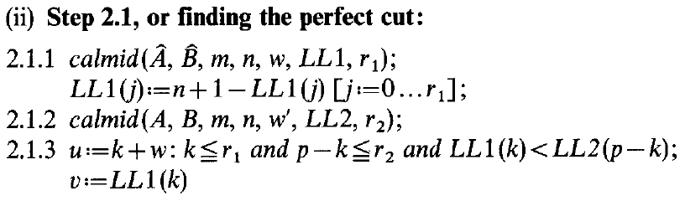
Find the Perfect Cut (u, v)(3/3)

Slide 25
example
A[1:m] = “aadcbcada”
B[1:n] = “cabdacbc”
|LCS(A, B)| = p = 5

Slide 26
example
A[1:m] = “aadcbcada”
B[1:n] = “cabdacbc”
aadcbcada perfect cut:(7, 8) cabdacbc
aadcbca (1,0),(2,2),(3,4) cabdacbc (4,6),(5,7),(6,8) |  | da (1,0) #
aad cabd | cbca acbc | d # | a #

Slide 27
Time-Space Analysis of LCS
Time:T(m, n, p)
O(n(w + 1)) + O(n(w’ + 1)) + O(m + n)
=O(n(m – p + 2)) + O(m + n)
=O(n(m - p)), where m – p ≧ 2
w = w’ = (m – p)/2
p = |LCS(A, B)|
T(m, n, p) = O(n(m - p)) + T(u, v, u – w)
+ T(m – u, n – v, m – u – w’)
= O(n(m - p))

Slide 28
Space Analysis of LCS
Space:O(m + n)

Slide 29
Thanks for listening

