Slide 1
Ngila: global pairwise alignments with logarithmic and affine gap costs
Reed A. Cartwright
Bioinformatics Applications Note Vol. 23 no. 11 2007, pp. 1427–1428
Presenter：Guan-Cheng Guo Date：2014/6/16

Slide 2
Abstract
Ngila is an application that will find the best alignment of a pair of sequences using log-affine gap costs, which are the most biologically realistic gap costs.

Slide 3
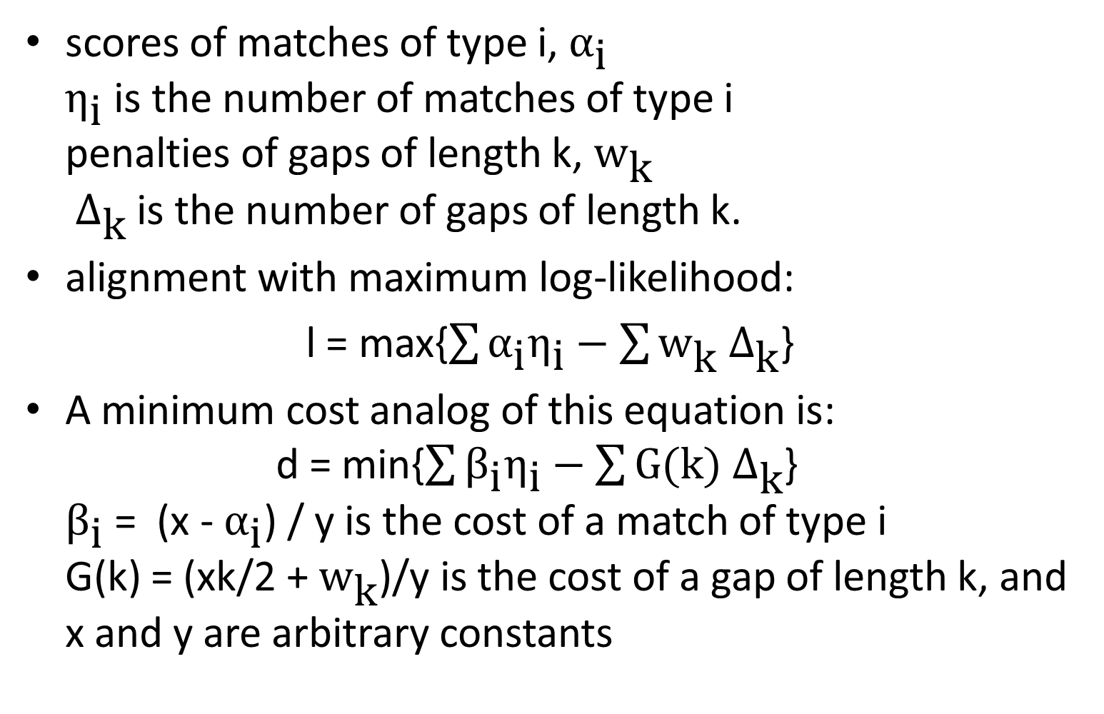
Statistical Alignment
scores of matches of type i, $α_{\text{i}}$ $η_{\text{i}}$ is the number of matches of type i penalties of gaps of length k, ${\text{w}}_{\text{k}}$ ${ Δ}_{\text{k}}$ is the number of gaps of length k.
alignment with maximum log-likelihood:
l = max{$\sum{{\text{α}}_{\text{i}}η_{\text{i}}}−\sum{{\text{w}}_{\text{k}}{ Δ}_{\text{k}}}$}
A minimum cost analog of this equation is: d = min{$\sum{{\text{β}}_{\text{i}}η_{\text{i}}}−\sum{G(k){ Δ}_{\text{k}}}$} ${\text{β}}_{\text{i}}$ = (x - ${\text{α}}_{\text{i}}$) / y is the cost of a match of type i G(k) = (xk/2 + ${\text{w}}_{\text{k}}$)/y is the cost of a gap of length k, and x and y are arbitrary constants

Slide 4
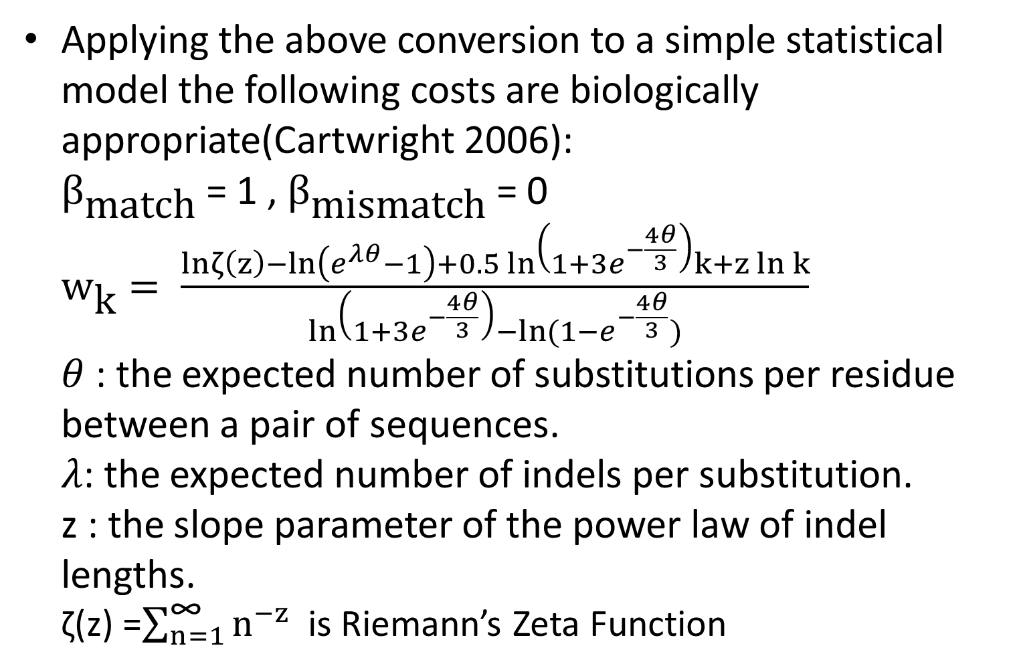
Statistical Alignment
Applying the above conversion to a simple statistical model the following costs are biologically appropriate(Cartwright 2006): ${\text{β}}_{\text{match}}$ = 1 , ${\text{β}}_{\text{mismatch}}$ = 0 ${\text{w}}_{\text{k}}= \frac{lnζ\left(z\right)−ln\left(e^{λθ}−1\right)+0.5 ln\left(1+3e^{−\frac{4θ}{3}}\right)k+z ln k}{ln\left(1+3e^{−\frac{4θ}{3}}\right)−ln⁡(1−e^{−\frac{4θ}{3}})}$ $θ$ : the expected number of substitutions per residue between a pair of sequences. $λ$: the expected number of indels per substitution. z : the slope parameter of the power law of indel lengths. ζ(z) =$\sum_{n=1}^{\text{∞}}{n^{−z}}$ is Riemann’s Zeta Function

Slide 5
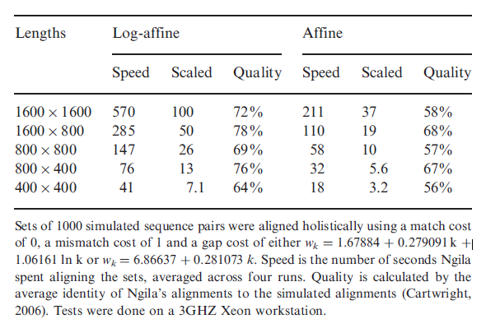
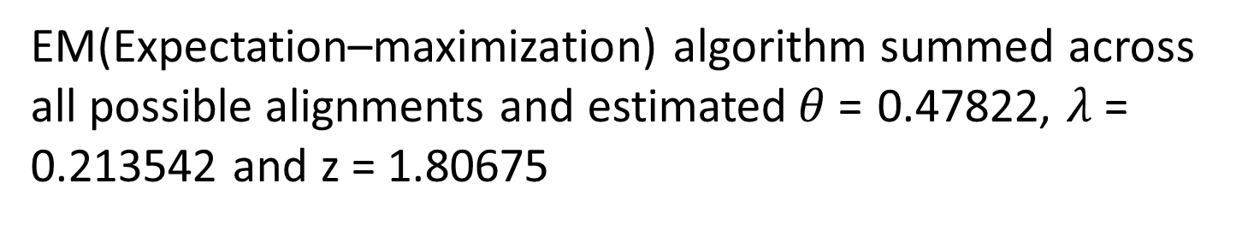
Performance
EM(Expectation–maximization) algorithm summed across all possible alignments and estimated$θ$= 0.47822, $λ$= 0.213542 and z = 1.80675

Slide 6
Conclusion
Ngila is an application that will calculate the best alignment between a pair of sequences using log-affine gap costs, which are very accurate and biologically realistic. It has the potential to advance research into alignment algorithms and provide more biologically accurate alignments.

