Slide 1
Computing Longest Common Substring and All Palindromes from Compressed Strings
Wataru Matsubara, Shunsuke Inenaga, Akira Ishino,
Ayumi Shinohara,Tomoyuki Nakamura, and Kazuo Hashimoto
34th Conference on Current Trends in Theory and Practice of Computer Science, Nový Smokovec, Slovakia,
SOFSEM 2008: Theory and Practice of Computer Science
pp. 364-375
Presenter: Shou-Fu Lo
Date:2017/05/02

Slide 2
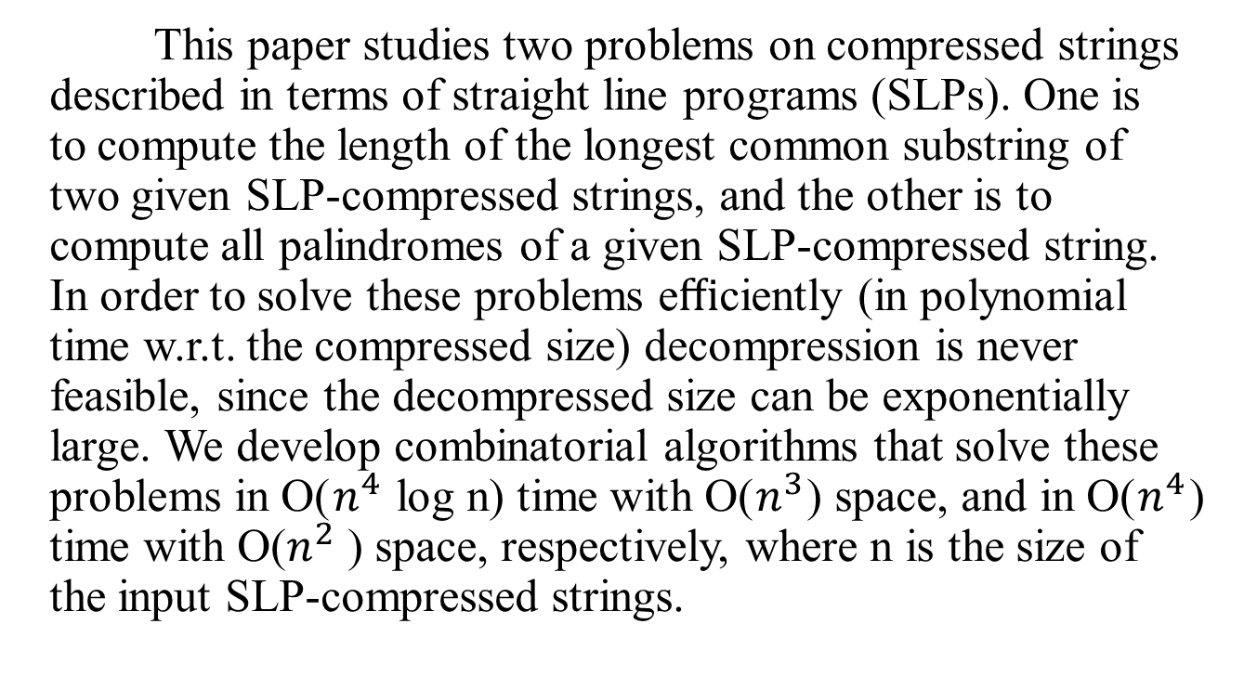
Abstract
This paper studies two problems on compressed strings described in terms of straight line programs (SLPs). One is to compute the length of the longest common substring of two given SLP-compressed strings, and the other is to compute all palindromes of a given SLP-compressed string. In order to solve these problems eﬃciently (in polynomial time w.r.t. the compressed size) decompression is never feasible, since the decompressed size can be exponentially large. We develop combinatorial algorithms that solve these problems in O($n^{4}$ log n) time with O($n^{3}$) space, and in O($n^{4}$) time with O($n^{2}$ ) space, respectively, where n is the size of the input SLP-compressed strings.

Slide 3
Efficient algorithms for SLP-compressed strings
substring matching
Karpinski et al (1996) O(n⁴logn) time
Miyazaki et al (1997) O(n⁴) time
Lifshits (2006) O(n³) time
minimum period
Karpinski et al (1996) O(n⁴logn) time
Lifshits (2006) O(n³logN) time
all squares
Gasieniec et al (1994) O(n⁶log⁵N) time

Slide 4
Hardness results
Subsequence pattern matching
Lifshits and Lohrey (2006) NP-hard
Longest common subsequence
Lifshits and Lohrey (2006) NP-hard
Hamming distance
Lifshits (2007) #P-complete

Slide 5
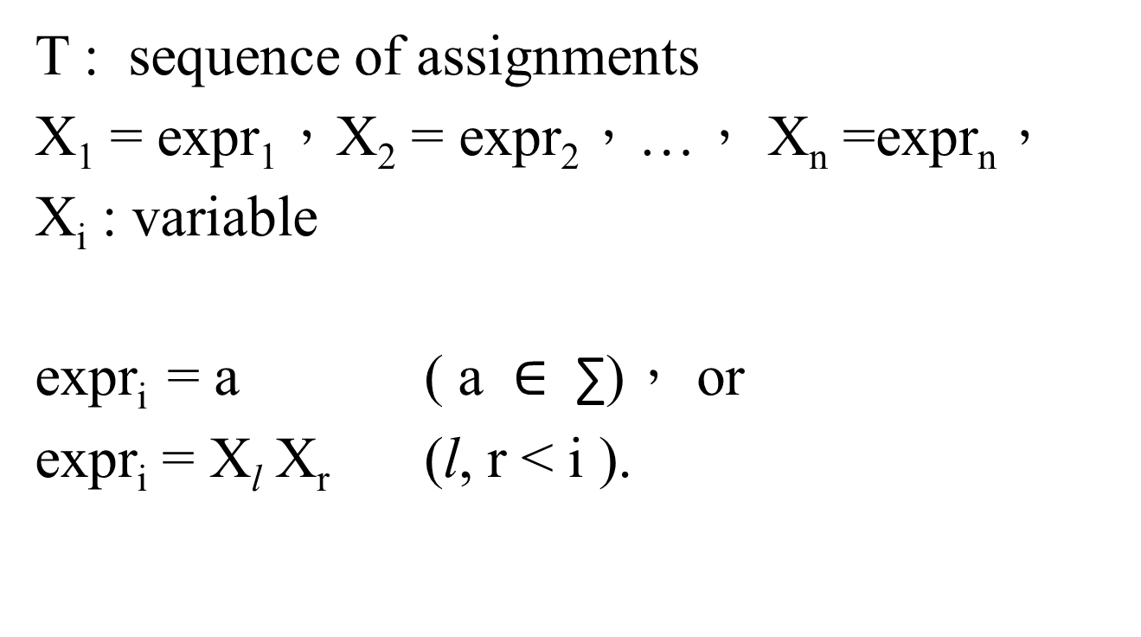
Straight Line Program (SLP)
T : sequence of assignments
X₁ = expr₁，X₂ = expr₂，…， X_{n} =expr_{n}，
X_{i} : variable
expr_{i} = a ( a ∈ $\text{∑}$)， or
expr_{i} = X$\text{l}$ X_{r} ($\text{l}$, r < i ).

Slide 6
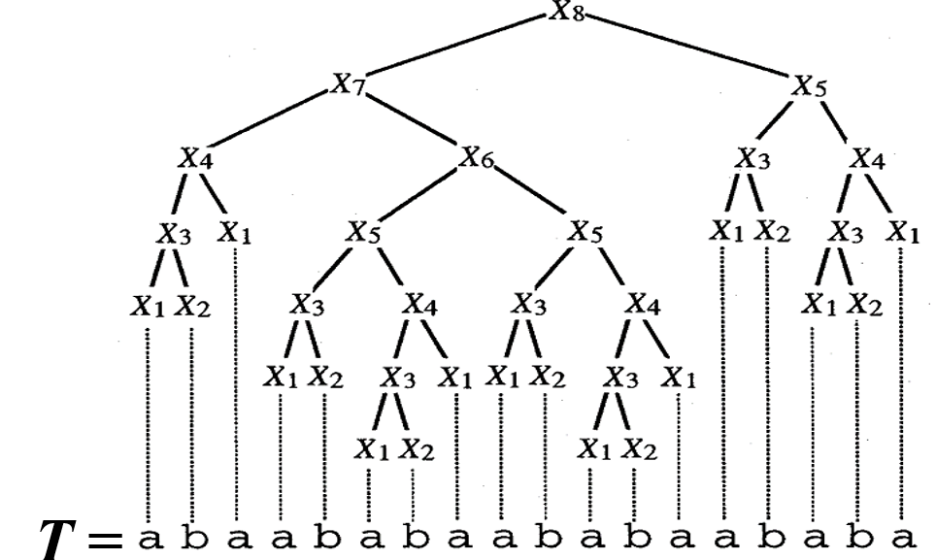
Straight Line Program (SLP)
SLP:
X₁ = a
X₂ = b
X₃ = X₁X₂
X₄ = X₃X₁
X₅ = X₃X₄
X₆ = X₅X₅
X₇ = X₄X₆
X₈ = X₇X₅
n
N
N = O(2^{n})

Slide 7
Straight Line Program (SLP)
SLP:
X₁ = a
X₂ = b
X₃ = X₁X₂
X₄ = X₃X₁
X₅ = X₃X₄
X₆ = X₅X₅
X₇ = X₄X₆
X₈ = X₇X₅
X₈
n
X₇
X₅
N
N = O(2^{n})

Slide 8
Algorithm for Longest Common Subsrting of Two SLP-Compress Strings
Let T and S be the SLPs of sizes n and m, which describe strings T and S
Problem 1:
Given two SLPs T and S, compute LCStr(T,S)

Slide 9
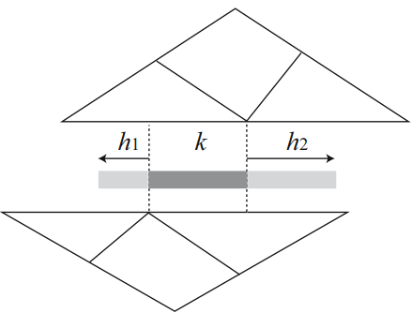
Algorithm for Longest Common Subsrting of Two SLP-Compress Strings
For each common substring Z of string S and T, there always exists a variable X_{i} = X_{l}X_{r} and Y_{j} = Y_{L}Y_{R} such that:
Z is a common substring of X_{i} and Y_{j}
Z contains an overlap between X_{l} and Y_{R}
X_{i}
X_{l}
X_{r}
Z:
Y_{L}
Y_{R}
Y_{j}

Slide 10
Algorithm for Longest Common Subsrting of Two SLP-Compress Strings
Karpinski et al. [9] gave the following results for computation of OL for strings described by SLPs.
Lemma [9] :
For any variables X_{i} and X_{j} of SLP T, OL(X_{i}, X_{j}) can be
represented by O(n) arithmetic progressions.
Lemma [9] :
For any variables X_{i}, Y_{j} and integer k, FM (X_{i}, Y_{j} , k) can be
computed in O(n log n) time, provided that OL(X_{i′} , X_{j′} ) is
already computed for any 1 ≤ i′ ≤ i and 1 ≤ j′ ≤ j.
Karpinski, M., Rytter, W., Shinohara, A.: An eﬃcient pattern-matching algorithmfor strings with short descriptions. Nordic Journal of Computing 4, 172–186 (1997)

Slide 11
Algorithm for Longest Common Subsrting of Two SLP-Compress Strings
For any two strings X and Y, we define the set OL(X, Y)
Namely, OL(X, Y) is the set of lengths of overlaps of suffixes of X and prefixes of Y
OL(“aabaaba”, “abaababb”) = {1, 3, 6}
X_{l}
a a b a a b a
a b a a b a a b a b
Y_{R}
a b a a b a a b a b
Y_{R}
a b a a b a a b a b

Slide 12
Algorithm for Longest Common Subsrting of Two SLP-Compress Strings
First-mismatch function
input：SLP variables X_{i} and Y_{j} , integer k
output ：position of first mismatch
X_{i}
a b a b a a b a b a a b
k
h
a b a b a b a a b a
Y_{j}

Slide 13
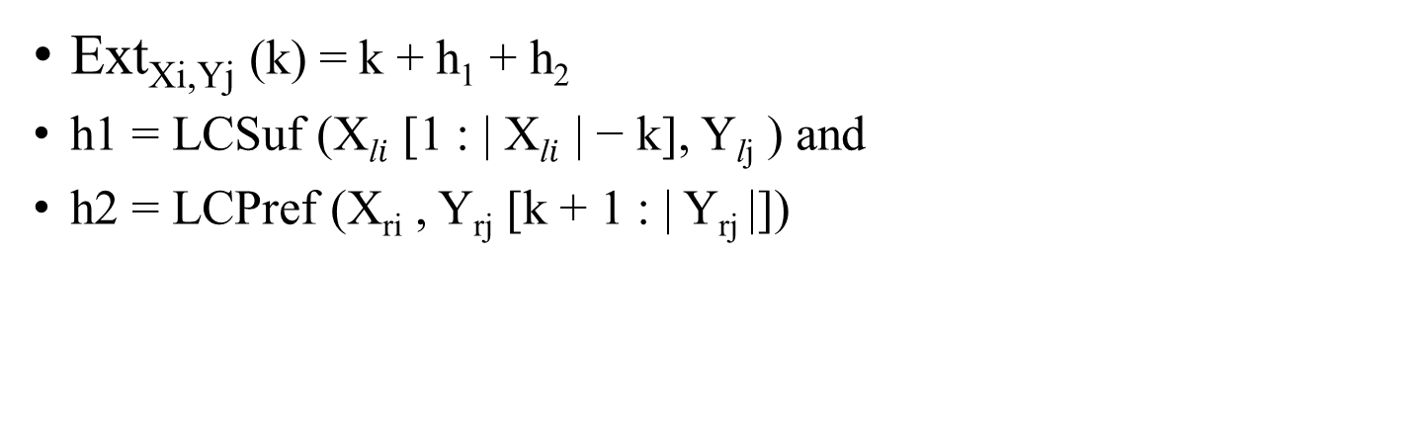
Algorithm for Longest Common Subsrting of Two SLP-Compress Strings
Ext_{Xi,Yj} (k) = k + h₁ + h₂
h1 = LCSuf (X$\text{l}i$ [1 : | X$\text{l}i$ | − k], Y$\text{l}$_{j} ) and
h2 = LCPref (X_{ri} , Y_{rj} [k + 1 : | Y_{rj} |])
X_{i}
X_{l}
X_{r}
Z:
Y_{L}
Y_{R}
Y_{j}

Slide 14
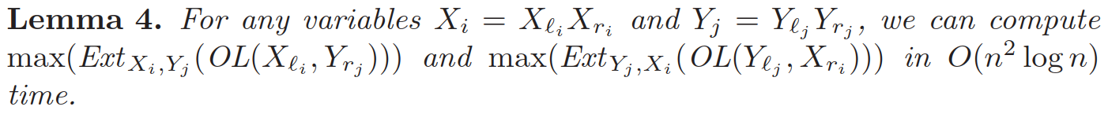
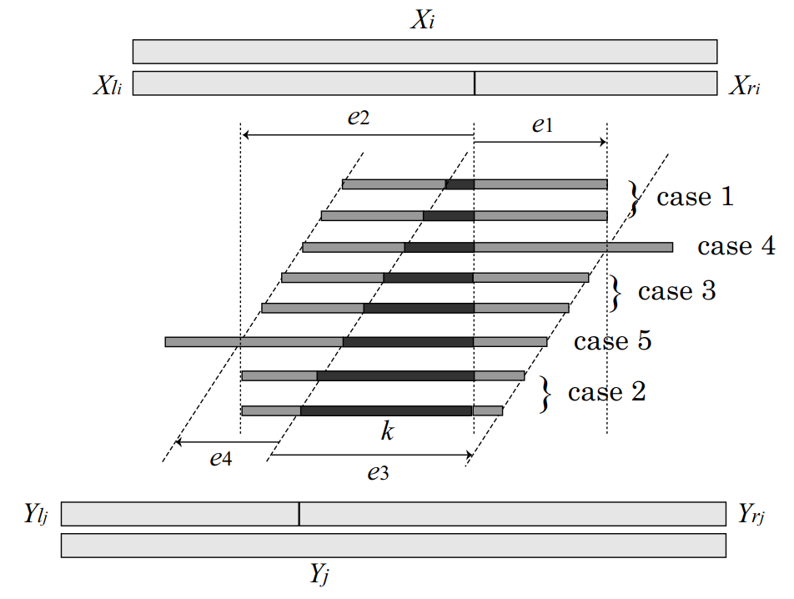
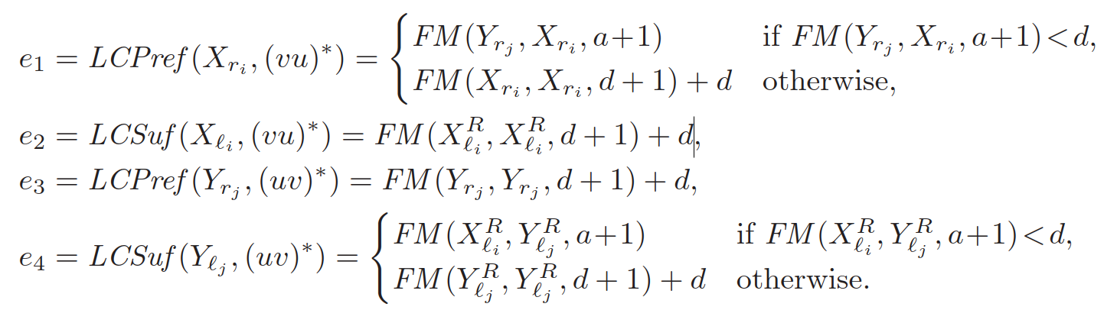
Algorithm for Longest Common Subsrting of Two SLP-Compress Strings

Slide 15
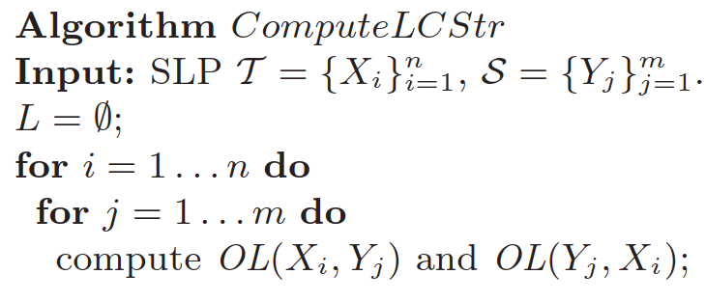
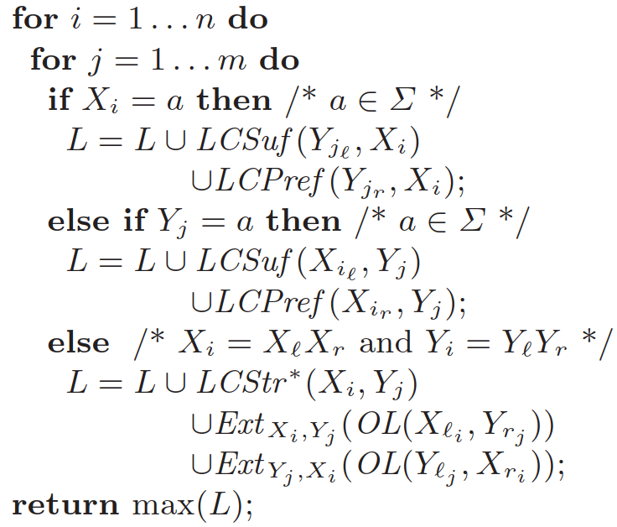
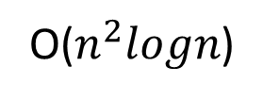
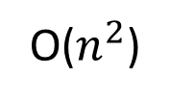
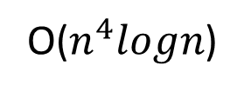
Pseudo code
O($n^{4}logn$)
O($n^{2}$)
Computing longest common substring from compressed string
O(n⁴logn) time and O(n³) space
O($n^{2}logn$)

Slide 16

Algorithm for Palindromes of SLP-Compress Strings
let ${\text{Pals}}^{Δ}$(X_{i}) be the set of pairs of beginning and ending positions of maximal palindromes of X_{i} that cover or touch the boundary between X_{l} and X_{r} .

Slide 17
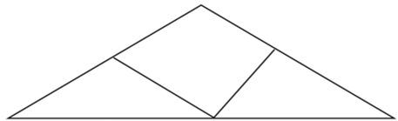
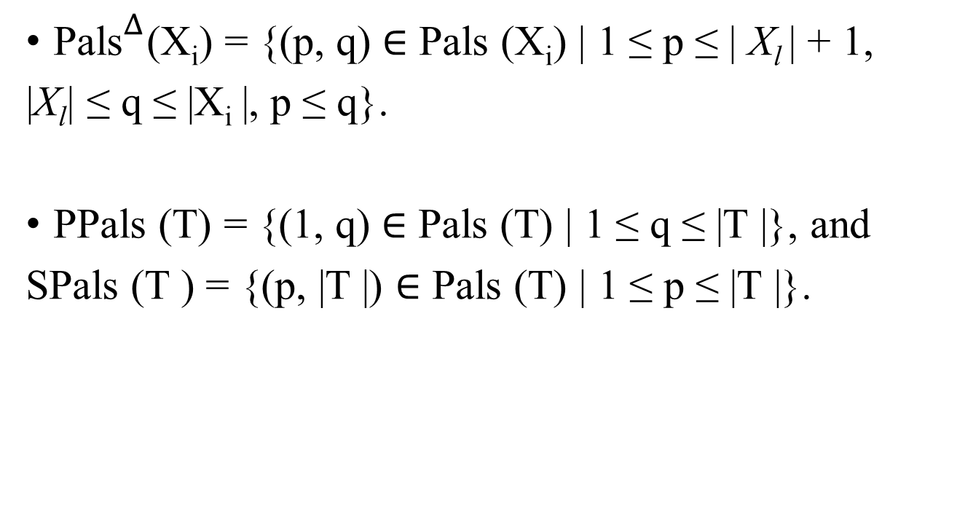
Algorithm for Palindromes of SLP-Compress Strings
${\text{Pals}}^{Δ}$(X_{i}) = {(p, q) ∈ Pals (X_{i}) | 1 ≤ p ≤ | X_{l} | + 1,
|X_{l}| ≤ q ≤ |X_{i} |, p ≤ q}.
PPals (T) = {(1, q) ∈ Pals (T) | 1 ≤ q ≤ |T |}, and
SPals (T ) = {(p, |T |) ∈ Pals (T) | 1 ≤ p ≤ |T |}.
X_{i}
X_{l}
X_{r}
1 p q |T|

Slide 18

Algorithm for Palindromes of SLP-Compress Strings
Problem 2 : Given an SLP T of size n, compute ${\text{\{}{\text{Pals}}^{Δ}\text{(}\text{Xi}\text{)\}}}_{i=1}^{n}$, ${\text{\{}\text{PPals}\text{ (}\text{Xi}\text{)}\}}_{i=1}^{n}$and ${\text{\{}\text{SPals}\text{(}\text{Xi}\text{)\}}}_{i=1}^{n}$
Compute ${\text{Pals}}^{Δ}$ (X_{i}) from SPals(X_{l}) and PPals (X_{r} )
X_{i}
X_{l}
X_{r}

Slide 19
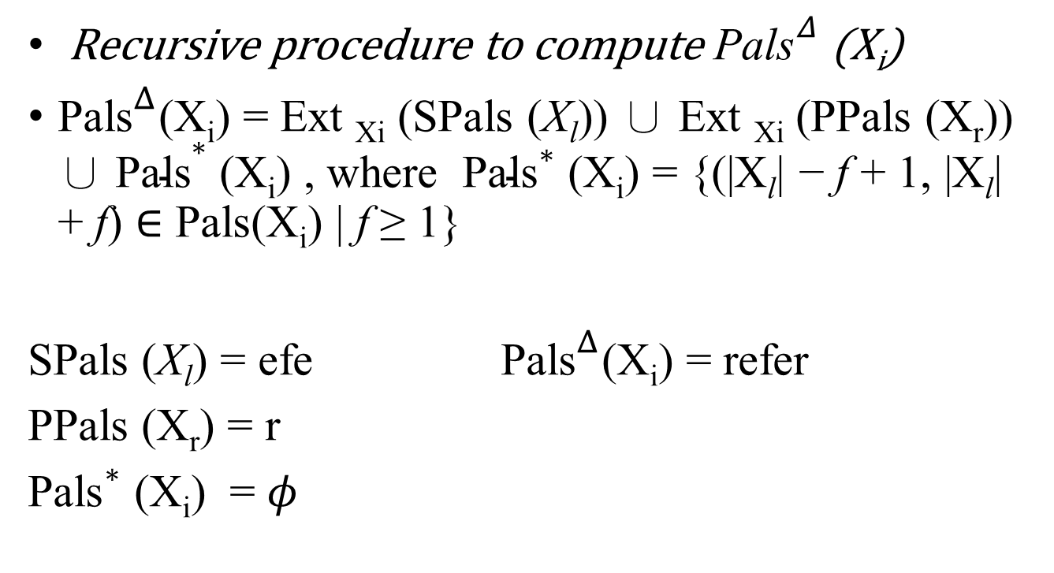
Algorithm for Palindromes of SLP-Compress Strings
Recursive procedure to compute ${\text{Pals}}^{Δ}$(X_{i})
${\text{Pals}}^{Δ}$(X_{i}) = Ext _{Xi} (SPals (X_{l})) ∪ Ext _{Xi} (PPals (X_{r})) ∪ ${\text{Pals}}^{∗}$ (X_{i}) , where ${\text{Pals}}^{∗}$ (X_{i}) = {(|X_{l}| − f + 1, |X_{l}| + f) ∈ Pals(X_{i}) | f ≥ 1}
SPals (X_{l}) = efe ${\text{Pals}}^{Δ}$(X_{i}) = refer
PPals (X_{r}) = r
${\text{Pals}}^{∗}$ (X_{i}) = $φ$
X_{i}
X_{l}
X_{r}
p r e f e r

Slide 20
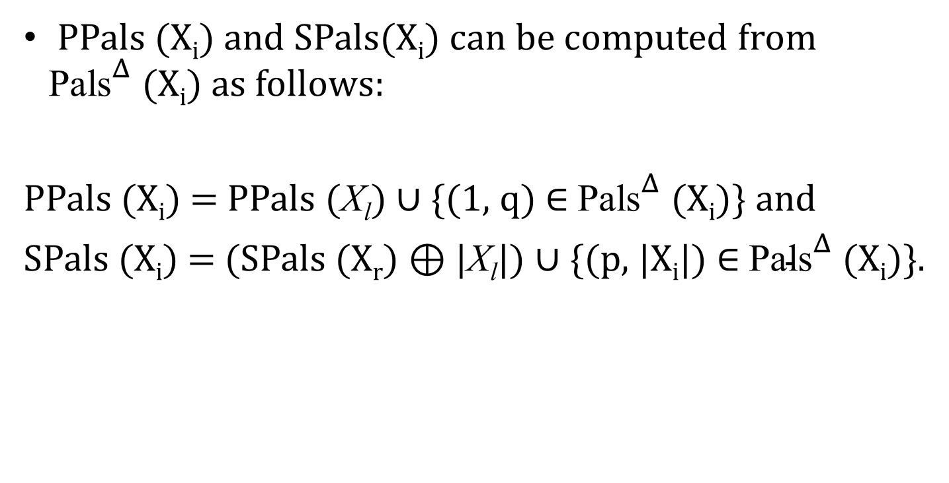
Algorithm for Palindromes of SLP-Compress Strings
PPals (X_{i}) and SPals(X_{i}) can be computed from ${\text{Pals}}^{Δ}$(X_{i}) as follows:
PPals (X_{i}) = PPals (X_{l}) ∪ {(1, q) ∈ ${\text{Pals}}^{Δ}$(X_{i})} and
SPals (X_{i}) = (SPals (X_{r}) ⊕ |X_{l}|) ∪ {(p, |X_{i}|) ∈ ${\text{Pals}}^{Δ}$(X_{i})}.
X_{i}
X_{l}
X_{r}
p r e f e r

Slide 21
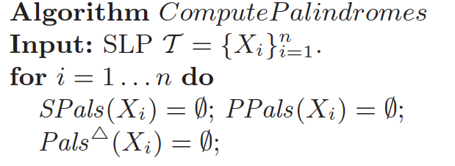
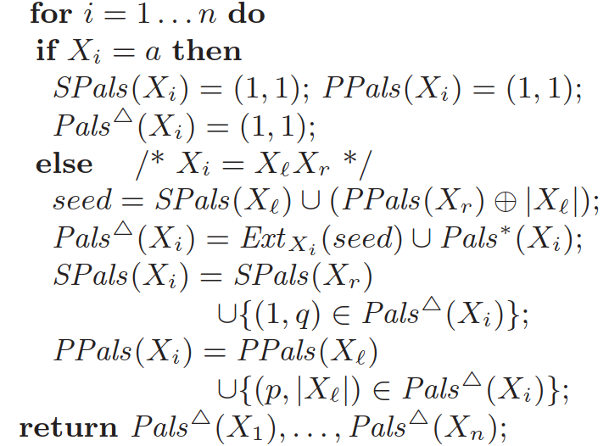
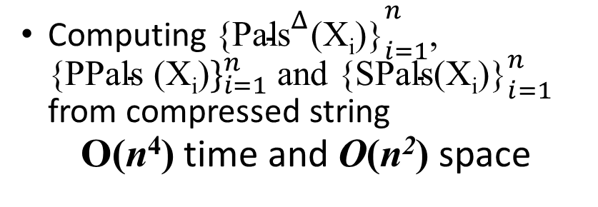
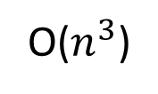
Pseudo code
Computing ${\text{\{}{\text{Pals}}^{Δ}\text{(}\text{Xi}\text{)\}}}_{i=1}^{n}$, ${\text{\{}\text{PPals}\text{ (}\text{Xi}\text{)}\}}_{i=1}^{n}$and ${\text{\{}\text{SPals}\text{(}\text{Xi}\text{)\}}}_{i=1}^{n}$ from compressed string
O(n⁴) time and O(n²) space
O(n)
O($n^{3}$)
O(n)

