Slide 1
Faster Algorithm for Computing the Edit Distance between SLP-Compressed Strings
Paweł Gawrychowski
19th International Symposium, SPIRE 2012
SPIRE Vol. 12, pp. 229-236.
Presenter : Shie-Yan Lee
2017/11/14

Slide 2
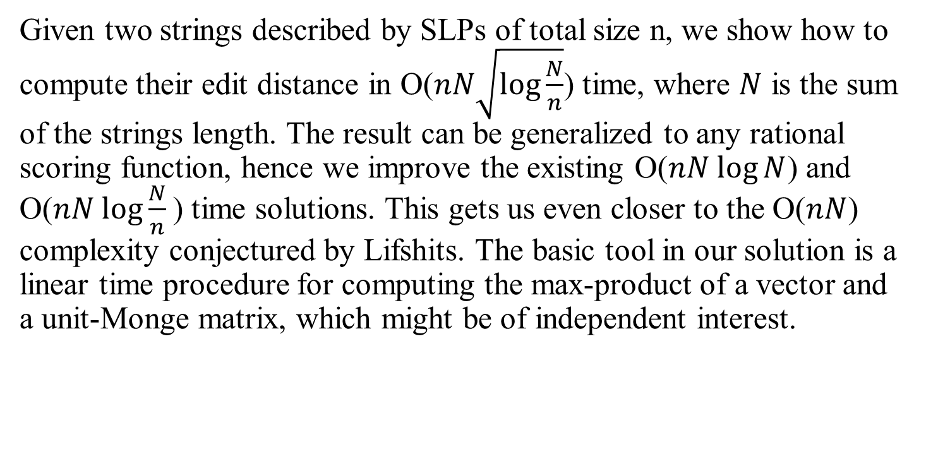
Abstract
Given two strings described by SLPs of total size n, we show how to compute their edit distance in O($nN\sqrt{\log{\frac{N}{n}}}$) time, where $N$ is the sum of the strings length. The result can be generalized to any rational scoring function, hence we improve the existing O($nN log⁡N$) and O($nN log⁡\frac{N}{n}$) time solutions. This gets us even closer to the O($nN$) complexity conjectured by Lifshits. The basic tool in our solution is a linear time procedure for computing the max-product of a vector and a unit-Monge matrix, which might be of independent interest.

Slide 3
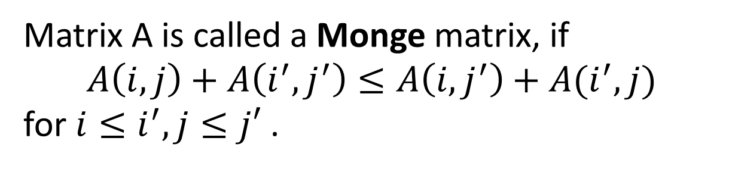
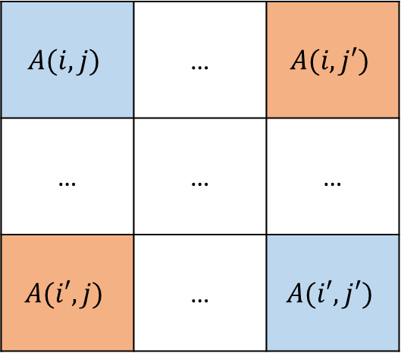
Matrix definitions
Matrix A is called a Monge matrix, if
$$A\left(i,j\right)+A\left(i^{′},j^{′}\right)≤A\left(i,j^{′}\right)+A(i^{′},j)$$
for $i≤i^{′},j≤j′$ .
$$A(i,j)$$ | … | $$A(i,j′)$$
… | … | …
$$A(i′,j)$$ | … | $$A(i′,j′)$$

Slide 4
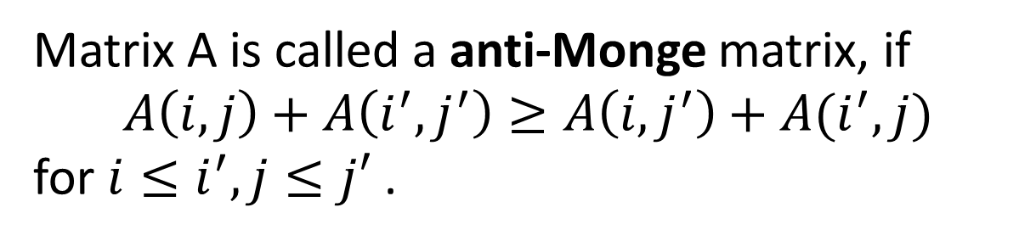

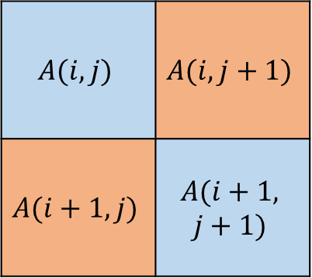
Matrix definitions
Matrix A is called a anti-Monge matrix, if
$$A\left(i,j\right)+A\left(i^{′},j^{′}\right)≥A\left(i,j^{′}\right)+A(i^{′},j)$$
for $i≤i^{′},j≤j′$ .
$$A(i,j)$$ | … | $$A(i,j′)$$
… | … | …
$$A(i′,j)$$ | … | $$A(i′,j′)$$
Unit-anti-Monge :
$$A(i,j)$$ | $$A(i,j+1)$$
$$A(i+1,j)$$ | $$A(i+1,$$ $$j+1)$$
$1≥$藍色相加 - 橘色相加$≥0$

Slide 5
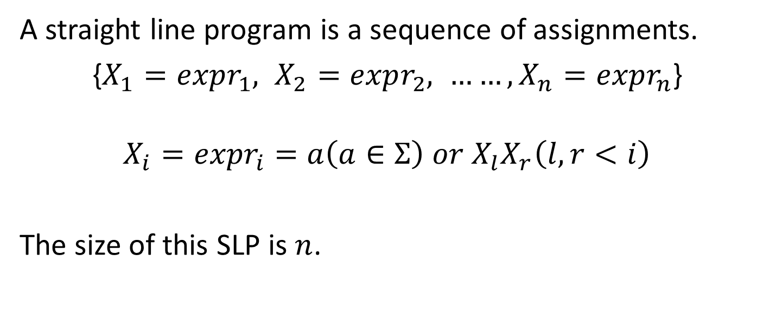
Straight line program (SLP)
A straight line program is a sequence of assignments.
{$X_{1}=expr_{1}, X_{2}=expr_{2}, ……, X_{n}=expr_{n}$}
$$X_{i}={expr}_{i}=a\left(a∈Σ\right) or X_{l}X_{r}\left(l,r<i\right)$$
The size of this SLP is $n$.

Slide 6
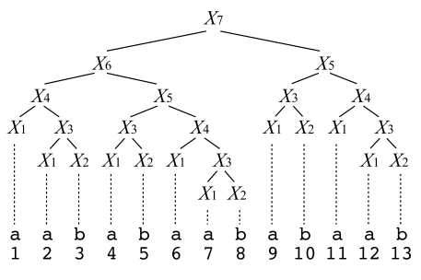

Straight line program (SLP)
$X_{1}=$ a
$X_{2}=$ b
$X_{3}=X_{1}X_{2}$
$X_{4}=X_{1}X_{3}$
$X_{5}=X_{3}X_{4}$
$X_{6}=X_{4}X_{5}$
$X_{7}=X_{6}X_{5}$
Size $n$ = 7

Slide 7





















Problem Definition
Computing the edit distance between two strings $a$ and $b$ of total length $N$ defined by SLPs of total size $n$.
size = $n$
$$X_{?}$$
$$X_{?}$$
$$X_{?}$$
$$X_{?}$$
$$X_{?}$$
$$X_{?}$$
$$X_{?}$$
$$X_{?}$$
$$X_{?}$$
$$X_{?}$$
$$X_{?}$$
……
$$X_{?}$$
$$X_{?}$$
$$X_{?}$$
$$X_{?}$$
……
$$X_{?}$$
$$a$$
$$b$$
length = $N$

Slide 8
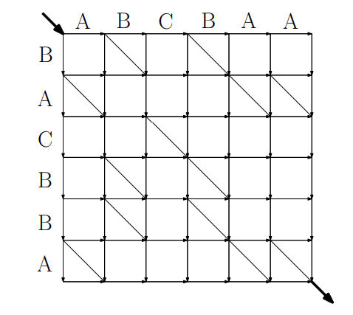

Edit distance and LCS
Basic method : $O\left(\left|a\right|\left|b\right|\right)$
LCS : BCBA

Slide 9
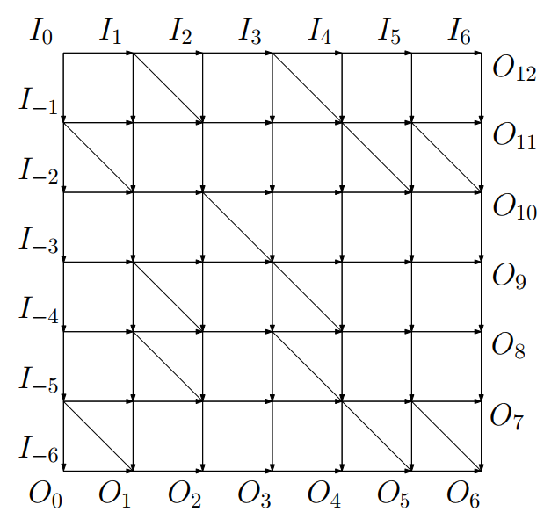

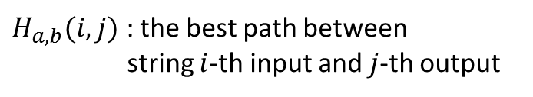


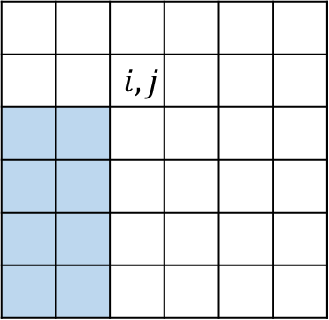
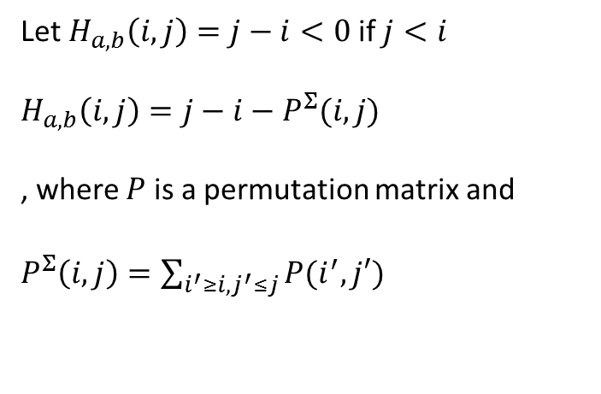
Edit distance and LCS
$H_{a,b}(i,j)$ : the best path between
string $i$-th input and $j$-th output
Let $H_{a,b}\left(i,j\right)=j−i<0$if $j<i$
$H_{a,b}\left(i,j\right)=j−i−P^{Σ}(i,j)$
, where $P$ is a permutation matrix and
$P^{Σ}\left(i,j\right)=\sum_{i^{′}≥i,j^{′}≤j}{P(i^{′},j′)}$
$$P$$
$$j$$
 |  | $$i,j$$
$$i$$

Slide 10
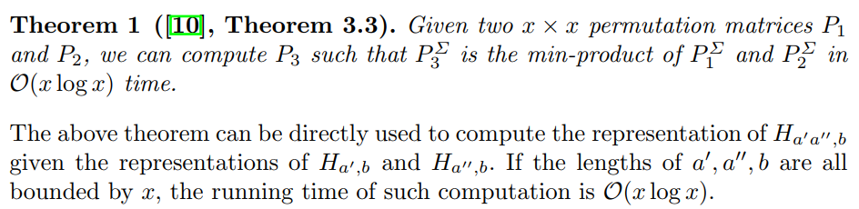
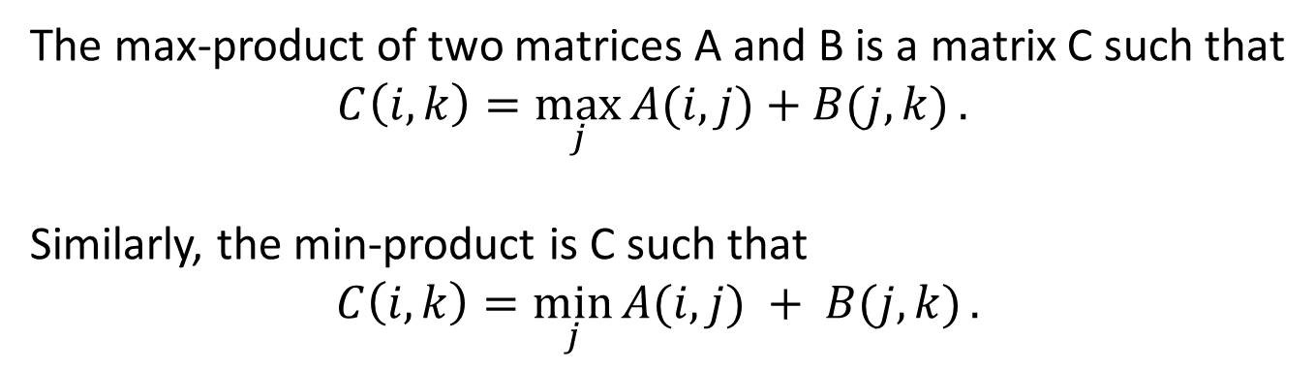
Max-product of two matrices
The max-product of two matrices A and B is a matrix C such that
$$C\left(i, k\right)=\max_{j}{A(i, j)+B(j, k)}.$$
Similarly, the min-product is C such that
$$C\left(i, k\right)=\min_{j}{A(i, j) + B(j, k)}.$$

Slide 11


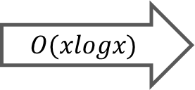

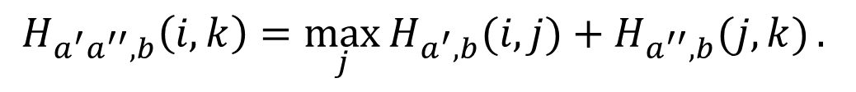




Max-product of two matrices
$$H_{a^{′}a^{′′},b}\left(i, k\right)=\max_{j}{H_{a^{′},b}(i, j)+H_{a^{′′},b}(j, k)}.$$
$$b$$
$$b$$
$$a′$$
$$a′$$
$$O(xlogx)$$
$$b$$
$$a′′$$
$$a′′$$

Slide 12
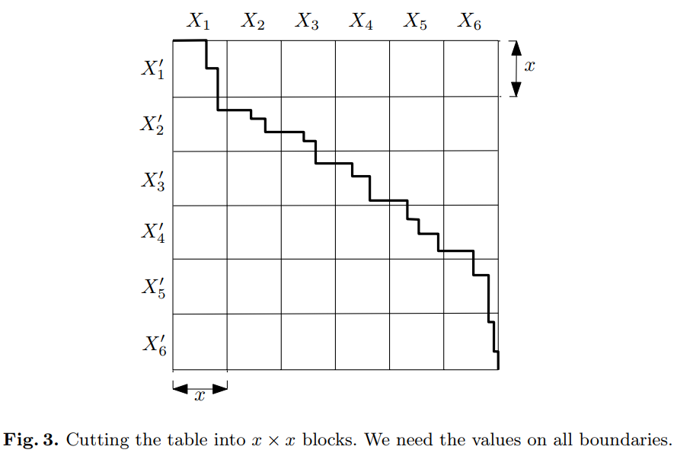
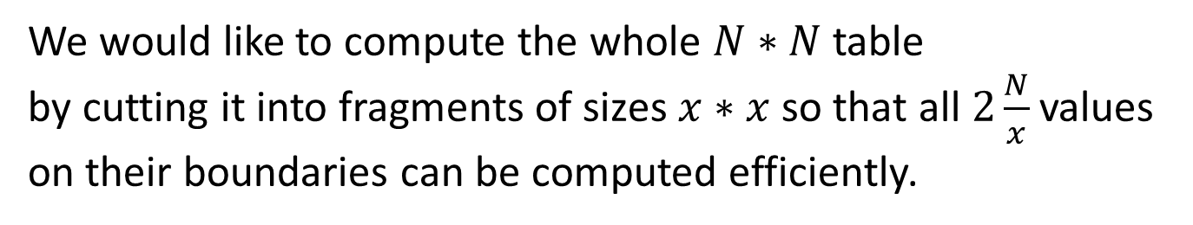
The algorithm
We would like to compute the whole $N∗N$ table
by cutting it into fragments of sizes $x∗x$ so that all$2\frac{N}{x}$ values
on their boundaries can be computed efficiently.

Slide 13











The algorithm
Transform the SLP which presents the original string
Compute all the best path $H$ for every pair of fragments
Go through the fragments one-by-one
$$X_{?}$$
$$X_{?}$$
$$X_{?}$$
$$X_{?}$$
$$X_{?}$$
$$X_{?}′$$
$X_{?}$’
$X_{?}$’
$X_{?}$’
$X_{?}$’

Slide 14
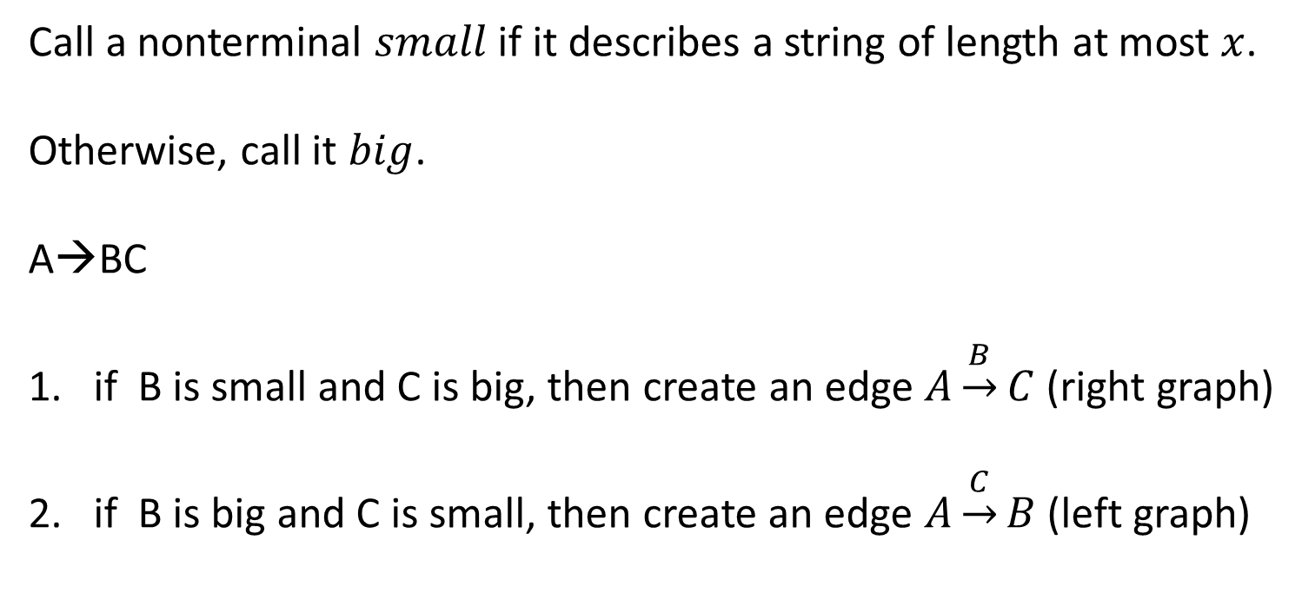
Transform the SLP
Call a nonterminal $small$ if it describes a string of length at most $x$.
Otherwise, call it $big$.
A→BC
if B is small and C is big, then create an edge $A\underset{→}{B}C$ (right graph)
if B is big and C is small, then create an edge $A\underset{→}{C}B$ (left graph)

Slide 15
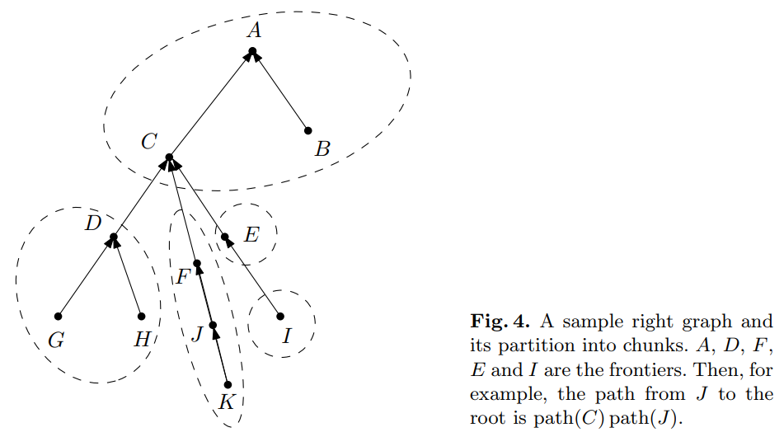
Transform the SLP

Slide 16










Transform the SLP
$$I→HG$$
$$G→FC$$
$$C→BA$$
$$I→HFBA$$
$$A$$
$$B$$
$$D$$
$$C$$
$$E$$
$$F$$
$$G$$
$$H$$
$$I$$

Slide 17
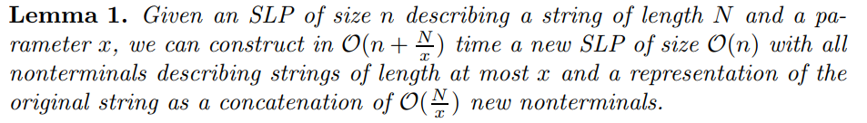
Transform the SLP

Slide 18

Transform the SLP
$$x=4$$

Slide 19











Compute the matrix for each pair
Now, we have a new SLP of size $O\left(n\right).$
We can compute the best path $H$ of each pair of fragments.
Time complexity : $O\left(n\right)∗O\left(n\right)∗O\left(xlogx\right)=O(n^{2}xlogx)$
$$X_{?}$$
$$X_{?}$$
$$X_{?}$$
$$X_{?}$$
$$X_{?}$$
$$X_{?}′$$
$X_{?}$’
$X_{?}$’
$X_{?}$’
$X_{?}$’

Slide 20

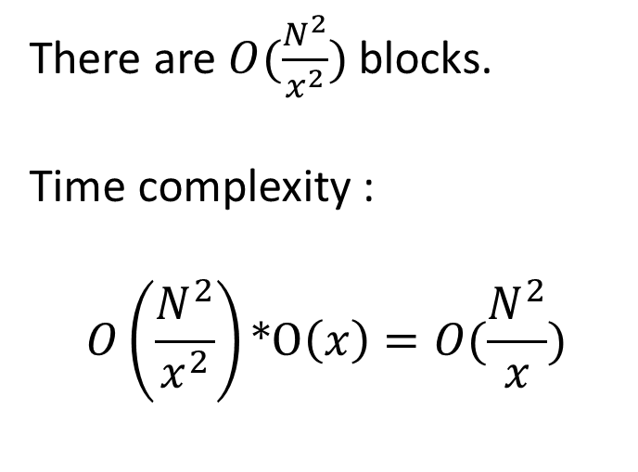
Compute the edit distance matrix
There are $O(\frac{N^{2}}{x^{2}})$ blocks.
Time complexity :
$$O\left(\frac{N^{2}}{x^{2}}\right)∗O\left(x\right)=O(\frac{N^{2}}{x})$$

Slide 21
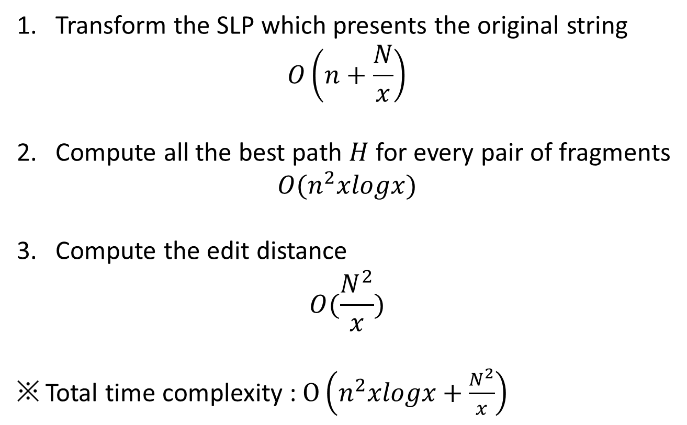
Time complexity of the algorithm
1. Transform the SLP which presents the original string
$$O\left(n+\frac{N}{x}\right)$$
2. Compute all the best path $H$ for every pair of fragments
$$O(n^{2}xlogx)$$
3. Compute the edit distance
$$O(\frac{N^{2}}{x})$$
※ Total time complexity : $O\left(n^{2}xlogx+\frac{N^{2}}{x}\right)$

Slide 22
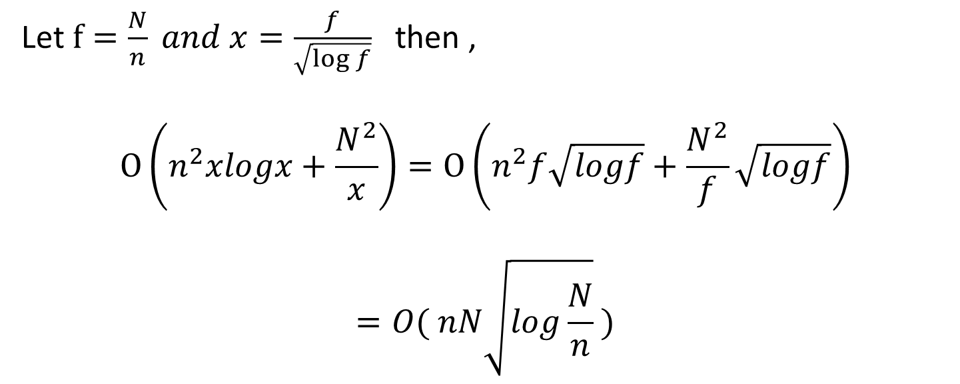
Time complexity of the algorithm
Let $f=\frac{N}{n} and x=\frac{f}{\sqrt{\log{f}}}$then ,
$$O\left(n^{2}xlogx+\frac{N^{2}}{x}\right)=O\left(n^{2}f\sqrt{logf}+\frac{N^{2}}{f}\sqrt{logf}\right)$$
$$=O( nN\sqrt{log\frac{N}{n}} )$$

