Slide 1
A hardness result and new algorithm for the longest common palindromic subsequence problem
Shunsuke Inenaga , Heikki Hyyrö
Department of Informatics, Kyushu University, Japan
Faculty of Natural Sciences, University of Tampere, Finland
Information Processing Letters,Volume 129 (2018), Pages 11–15
Presenter: Ting-Wei Liang
Date:2017/12/05

Slide 2
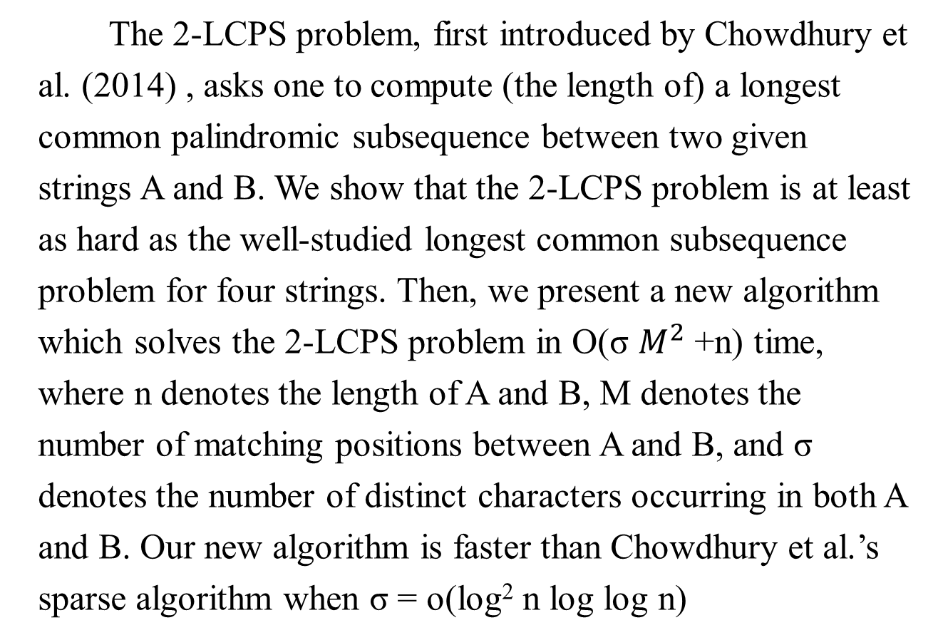
Abstract
The 2-LCPS problem, first introduced by Chowdhury et al. (2014) , asks one to compute (the length of) a longest common palindromic subsequence between two given strings A and B. We show that the 2-LCPS problem is at least as hard as the well-studied longest common subsequence problem for four strings. Then, we present a new algorithm which solves the 2-LCPS problem in O(σ $M^{2}$ +n) time, where n denotes the length of A and B, M denotes the number of matching positions between A and B, and σ denotes the number of distinct characters occurring in both A and B. Our new algorithm is faster than Chowdhury et al.’s sparse algorithm when σ = o(log² n log log n)

Slide 3
Longest common palindromic subsequence (LCPS)
S₁ = a₁a₂…a_{n} = CCCBBAAAABBCAA , n = 14
S₂ = b₁b₂…b_{n} = CCCBAAAABCBBBB
lcps = LCPS(S₁, S₂) = C B A A B C , | lcps | = 6

Slide 4
4-LCS problem
S₁ = AABBCCC
S₂ = AABBCAA
S₃ = AAABCCC
S₄ = ABCBBBB
4-lcs = 4-LCS(S₁, S₂ , S₃ , S₄) = A B C , | 4-lcs | = 3

Slide 5
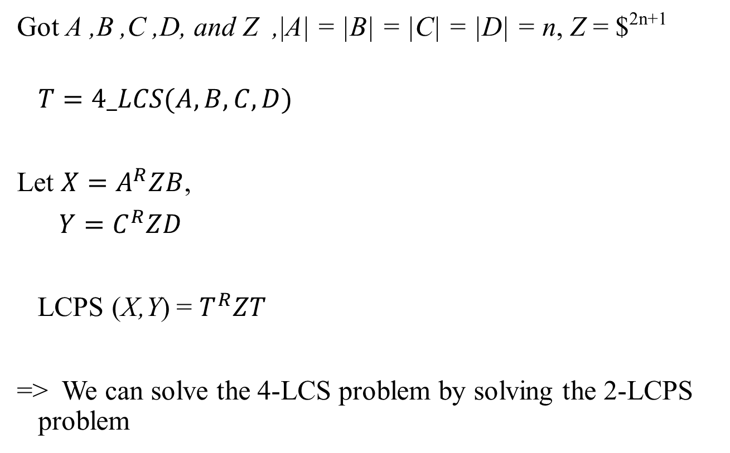
Reduction from 4-LCS to 2-LCPS
Got A ,B ,C ,D, and Z ,|A| = |B| = |C| = |D| = n, Z = $^{2n+1}
$$T=4_LCS(A,B,C,D)$$
Let ${X=A}^{R}ZB$,
$Y=C^{R}ZD$
LCPS (X,Y) = $T^{R}ZT$
=> We can solve the 4-LCS problem by solving the 2-LCPS problem

Slide 6
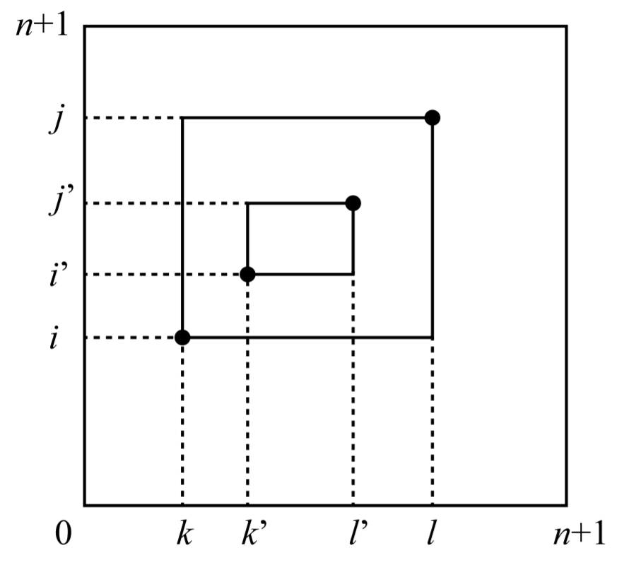
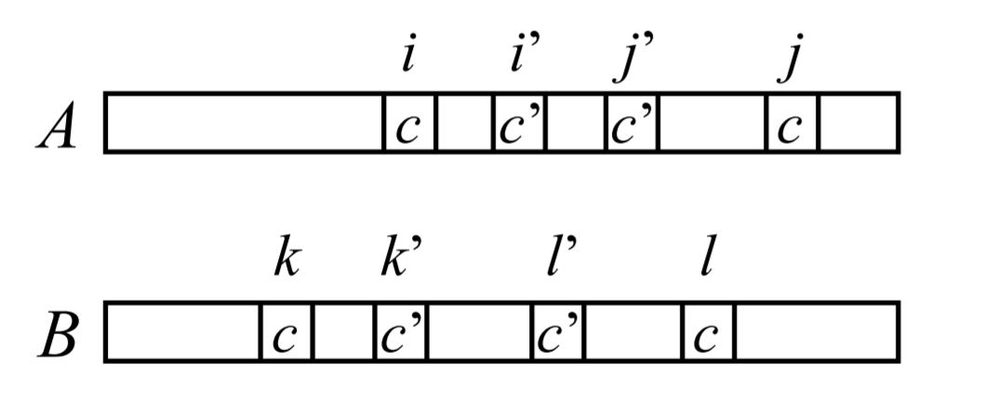
Maximum depth nesting rectangle structure problem (MDNRS)

Slide 7
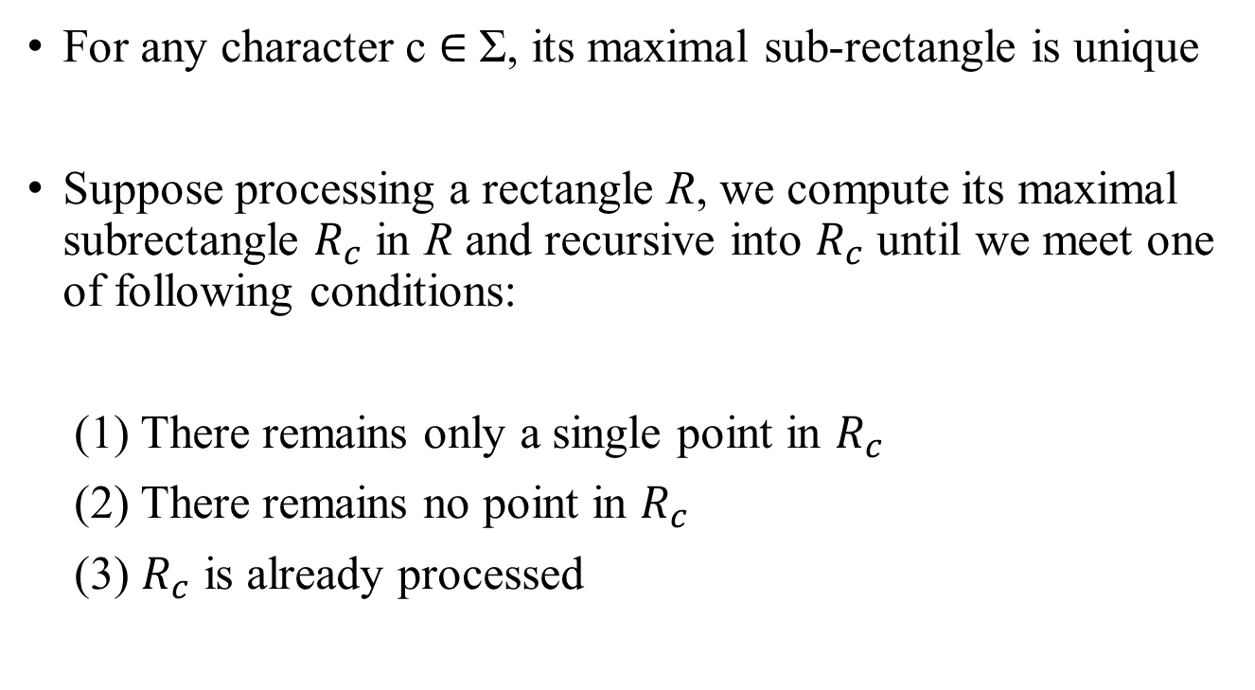
Maximum depth nesting rectangle structure problem (MDNRS)
For any character c ∈ Σ, its maximal sub-rectangle is unique
Suppose processing a rectangle R, we compute its maximal subrectangle $R_{c}$ in R and recursive into $R_{c}$ until we meet one of following conditions:
(1) There remains only a single point in $R_{c}$
(2) There remains no point in $R_{c}$
(3) $R_{c}$ is already processed

Slide 8

Alphabet reduction
Σ = {A,B,C,D,E}
A = ABBCDCCBA
B = AABCECBBA
$\hat{A}$= ABBCCCBA
$\hat{B}$ = AABCCBBA
$\hat{\text{Σ}}$ = {A,B,C}
|$\hat{\text{Σ}}|$ = $σ$

Slide 9
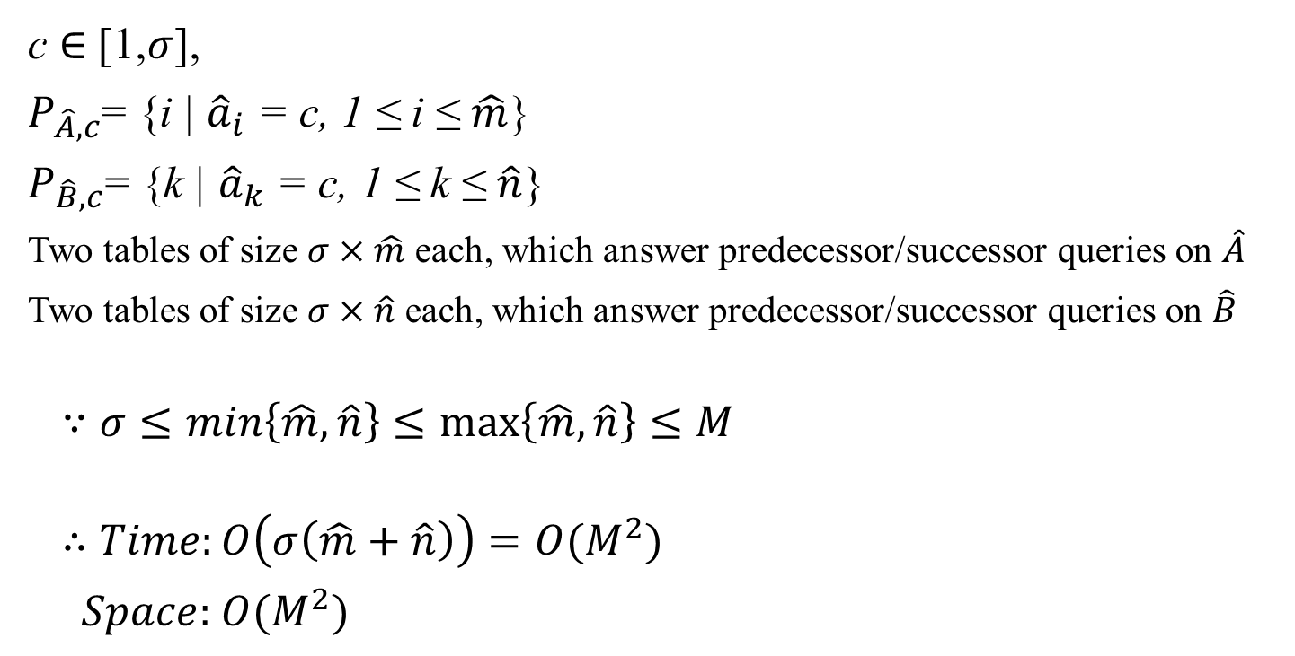
Tables
c ∈ [1,$σ$],
$P_{\hat{A},c}$= {i | ${\hat{a}}_{i}$ = c, 1 ≤ i ≤ $\hat{m}$}
$P_{\hat{B},c}$= {k | ${\hat{a}}_{k}$ = c, 1 ≤ k ≤ $\hat{n}$}
Two tables of size $σ×\hat{m}$ each, which answer predecessor/successor queries on $\hat{A}$
Two tables of size $σ×\hat{n}$ each, which answer predecessor/successor queries on $\hat{B}$
$$∵σ≤min\left\{\hat{m},\hat{n}\right\}≤\max\left\{\hat{m},\hat{n}\right\}≤M$$
$$∴Time:O\left(σ\left(\hat{m}+\hat{n}\right)\right)=O(M^{2})$$
$Space:$ $O(M^{2})$

Slide 10
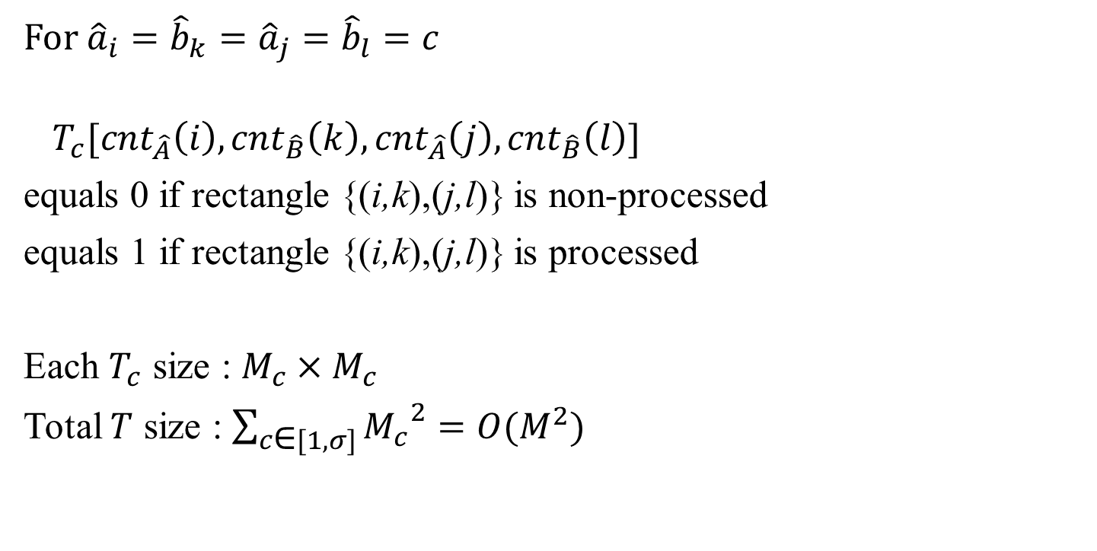
Tables
For ${\hat{a}}_{i}={\hat{b}}_{k}={\hat{a}}_{j}={\hat{b}}_{l}=c$
$$T_{c}[{cnt}_{\hat{A}}\left(i\right),{cnt}_{\hat{B}}\left(k\right),{cnt}_{\hat{A}}\left(j\right),{cnt}_{\hat{B}}\left(l\right)]$$
equals 0 if rectangle {(i,k),(j,l)} is non-processed
equals 1 if rectangle {(i,k),(j,l)} is processed
Each $T_{c}$ size : $M_{c}×M_{c}$
Total $T$ size : $\sum_{c\text{∈} [1,σ]}^{ }{{M_{c}}^{2}}=O(M^{2})$

Slide 11
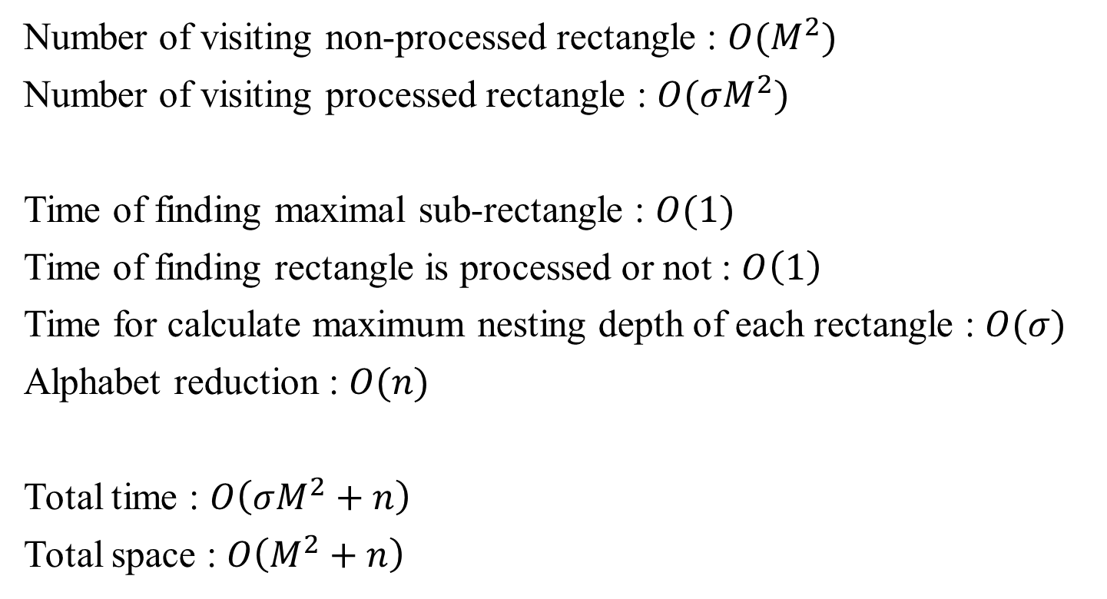
Complexities
Number of visiting non-processed rectangle : $O(M^{2})$
Number of visiting processed rectangle : $O(σM^{2})$
Time of finding maximal sub-rectangle : $O(1)$
Time of finding rectangle is processed or not : $O\left(1\right)$
Time for calculate maximum nesting depth of each rectangle : $O(σ)$
Alphabet reduction : $O(n)$
Total time : $O\left(σM^{2}+n\right)$
Total space : $O\left(M^{2}+n\right)$

