Slide 1
Dynamic time warping-based imputation for univariate time series data
Thi-Thu-Hong Phan, Émilie Poisson Caillault, Alain Lefebvre, André Bigand
Pattern Recognition Letters, 2017
Presenter : Bo-Xian Chen
Date : 2017/12/20

Slide 2
Abstract(1/2)
Time series with missing values occur in almost any domain of applied sciences. Ignoring missing values can lead to a loss of efficiency and unreliable results, especially for large missing sub-sequence(s). This paper proposes an approach to fill in large gap(s) within time series data under the assumption of effective information. To obtain the imputation of missing values, we find the most similar sub-sequence to the sub-sequence before (resp. after) the missing values, then complete the gap by the next (resp. previous) sub-sequence of the most similar one. Dynamic Time Warping algorithm is applied to compare sub-sequences, and combined with the shape-feature extraction algorithm for reducing insignificant solutions. Eight well-known and real-world data sets are used for evaluating the performance of the proposed approach in comparison with five other methods on different indicators.
Notes:
Neighbour
【英】= neighbor

Slide 3
Abstract(2/2)
The obtained results proved that the performance of our approach is the most robust one in case of time series data having high auto-correlation and cross-correlation, strong seasonality, large gap(s), and complex distribution.

Slide 4


Dynamic Time Warping(DTW)
$$D_{i, j}=d_{i, j}+\min\left\{\begin{aligned}&D_{i, j−1} \\ &D_{i−1, j} i=2, …, M j=2, …, N \\ &D_{i−1, j−1}\end{aligned}\right.$$
Warping Path
$$φ_{xy}=\left\{\begin{aligned}\left[1;K\right]→\left[1;M\right]×[1;N] \\ k→φ_{xy}\left(k\right)=(φ_{xy}^{x}\left(k\right),φ_{xy}^{y}\left(k\right))\end{aligned}\right.$$
$$\max\left(M, N\right)≤K≤M+N−1$$
Distance
$$DTW\left(Q, C\right)=min\left\{\begin{aligned}\sqrt{\sum_{k=1}^{K}{φ_{k}}}\end{aligned}\right.$$

Slide 5
0 4 5 6
1 2 4 5

Slide 6
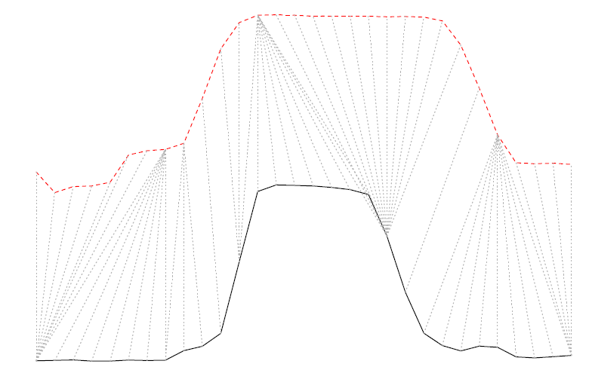
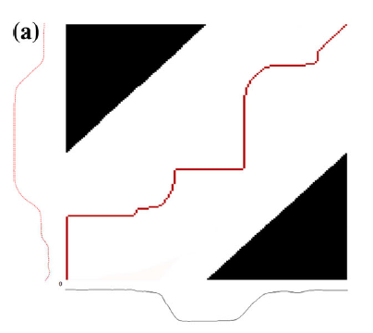
Dynamic Time Warping(DTW)

Slide 7


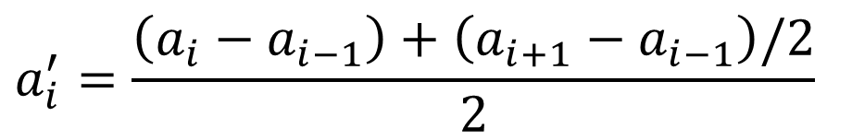





Derivative Dynamic Time Warping(DDTW)
Series
$$a=\{a_{1}, a_{2}, …, a_{m}\}$$
$$a′=\{{a′}_{1}, {a′}_{2}, …, {a′}_{m−1}\}$$
$${a′}_{i} is average of the slope between a_{i−1}, a_{i} and a_{i} and a_{i+1}$$
$$a_{i}^{′}=\frac{\left(a_{i}−a_{i−1}\right)+\left(a_{i+1}−a_{i−1}\right)/2}{2}$$
$$a_{i−1}$$
$$a_{i}$$
$$Derivative DTW→mitigate noise$$
$$1$$
$$a_{i+1}$$
$$2$$

Slide 8
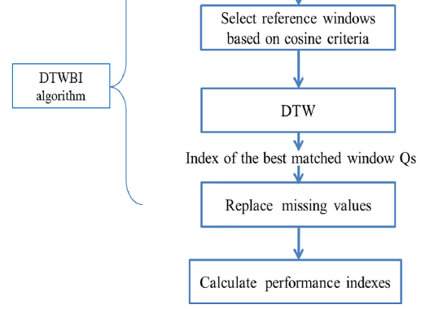
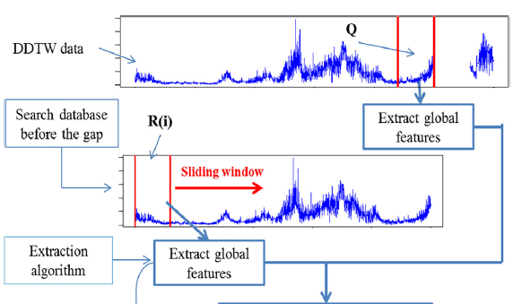
DTWBI(DTW-Based Imputation)

Slide 9
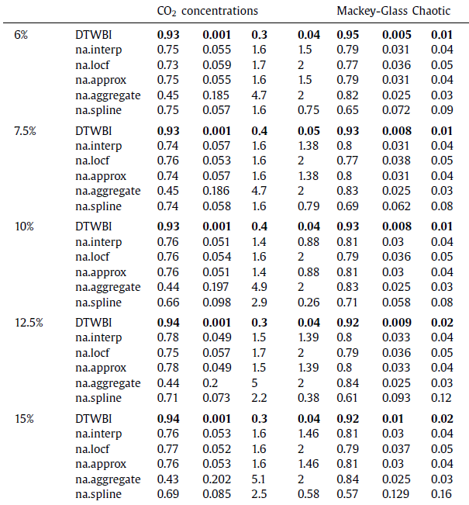
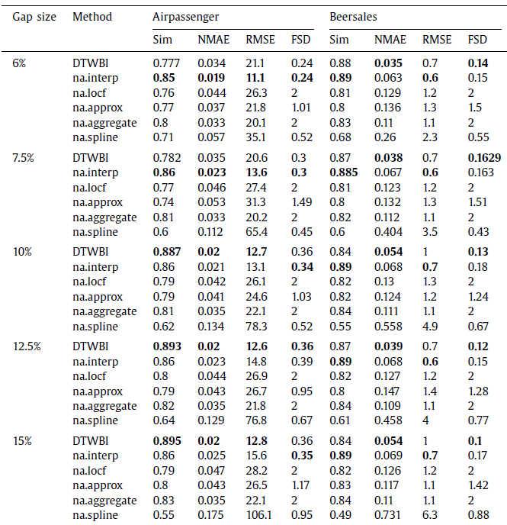
Experimental Result

