Slide 1
A linear algorithm for 3-letter longest common weakly increasing subsequence
Lech Duraj
Information Processing Letters 113 (2013) 94–99
Presenter: Shou-Fu Lo
Date: 2017/12/20

Slide 2
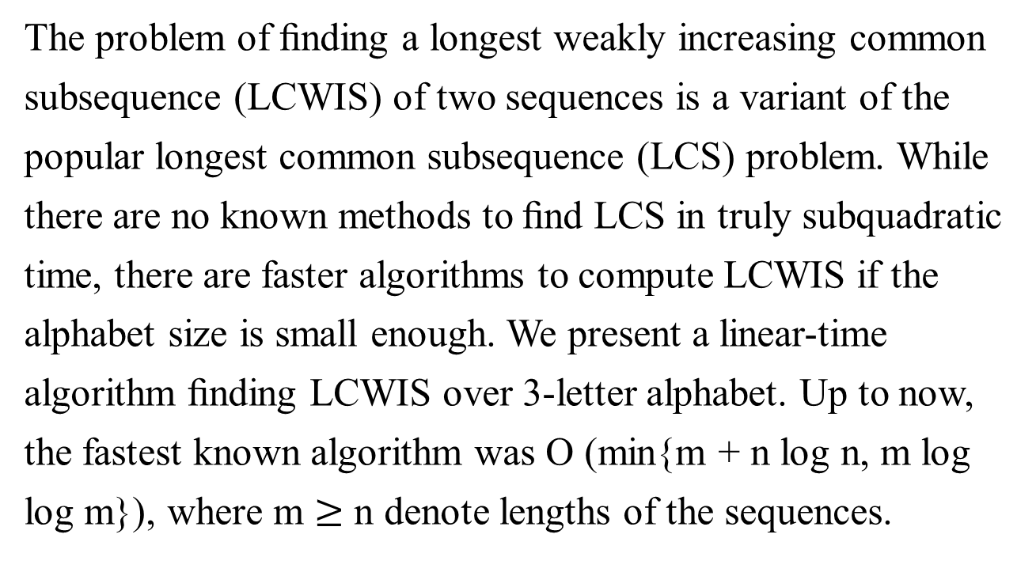
Abstract
The problem of ﬁnding a longest weakly increasing common
subsequence (LCWIS) of two sequences is a variant of the
popular longest common subsequence (LCS) problem. While
there are no known methods to ﬁnd LCS in truly subquadratic
time, there are faster algorithms to compute LCWIS if the
alphabet size is small enough. We present a linear-time
algorithm ﬁnding LCWIS over 3-letter alphabet. Up to now,
the fastest known algorithm was O (min{m + n log n, m log
log m}), where m $≥$ n denote lengths of the sequences.

Slide 3
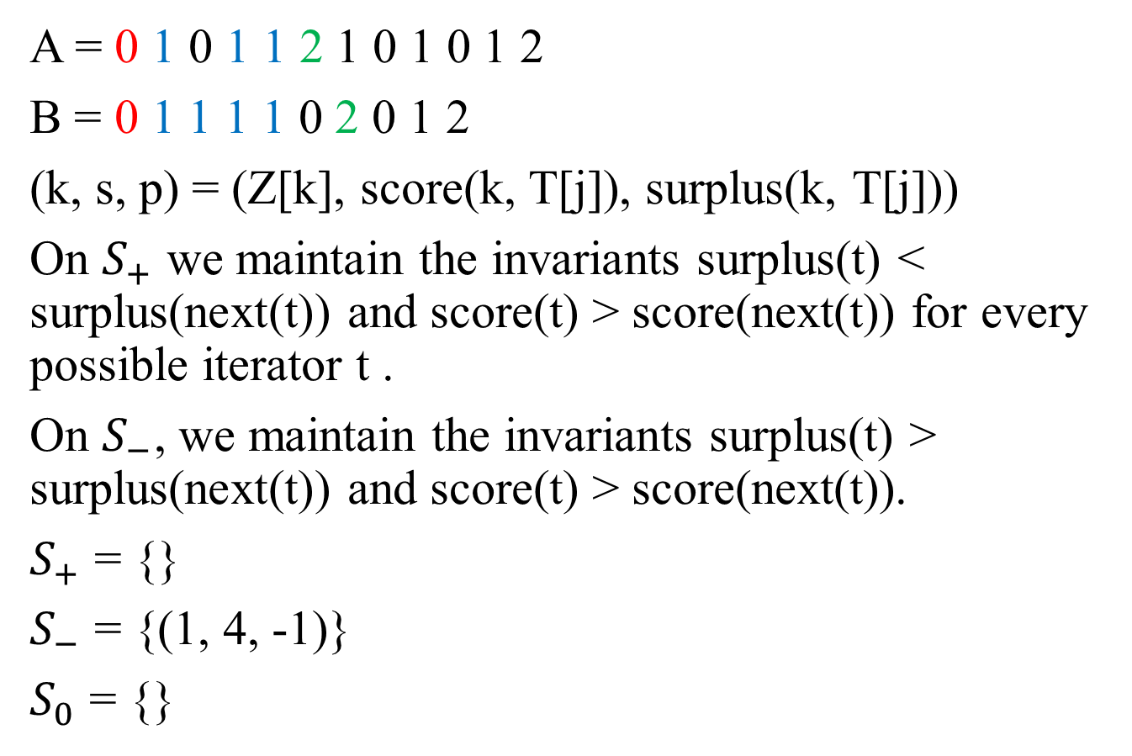
Add_Algorithm
A = $\text{0} \text{1} \text{0} \text{1 1} \text{2}\text{ 1 0 1 0 1 2 }$
B = 0 1 1 1 1 0 2 0 1 2
(k, s, p) = (Z[k], score(k, T[j]), surplus(k, T[j]))
On $S_{+}$ we maintain the invariants surplus(t) < surplus(next(t)) and score(t) > score(next(t)) for every possible iterator t .
On $S_{−}$, we maintain the invariants surplus(t) > surplus(next(t)) and score(t) > score(next(t)).
$S_{+}$ = {}
$S_{−}$ = {(1, 4, -1)}
$S_{0}$ = {}

Slide 4
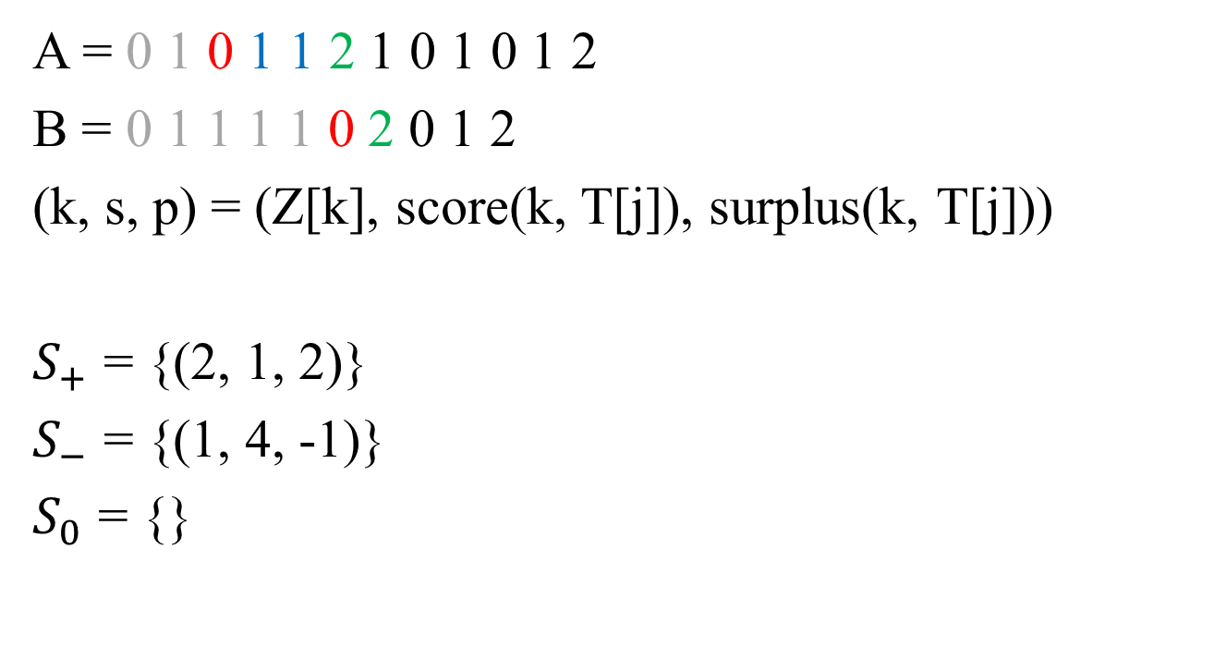
Add_Algorithm
A = $\text{0 1} \text{0} \text{1 1} \text{2}\text{ 1 0 1 0 1 2 }$
B = 0 1 1 1 1 0 2 0 1 2
(k, s, p) = (Z[k], score(k, T[j]), surplus(k, T[j]))
$S_{+}$ = {(2, 1, 2)}
$S_{−}$ = {(1, 4, -1)}
$S_{0}$ = {}

Slide 5

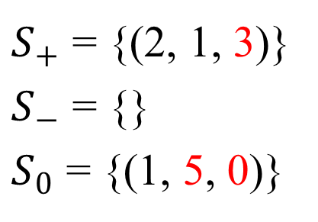
Update_Algorithm
A = $\text{0 1} \text{0 1 1 2 }\text{1}\text{ 0 1 0 1 }\text{2}$
B = 0 1 1 1 1 0 2 0 1 2
$S_{+}$ = {(2, 1, 2)}
$S_{−}$ = {(1, 4, -1)}
$S_{0}$ = {}
$S_{+}$ = {(2, 1, 3)}
$S_{−}$ = {}
$S_{0}$ = {(1, 5, 0)}

Slide 6

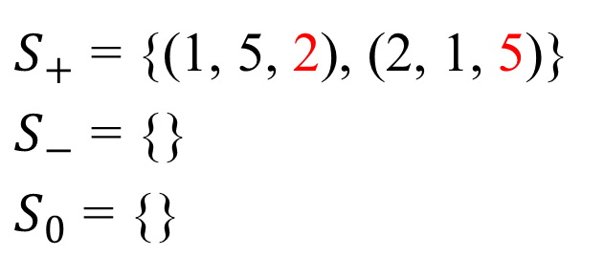
Update_Algorithm
A = $\text{0 1} \text{0 1 1 2 }\text{1}\text{ 0 }\text{1}\text{ 0 }\text{1} \text{2}$
B = 0 1 1 1 1 0 2 0 1 2
$S_{+}$ = {(2, 1, 3)}
$S_{−}$ = {}
$S_{0}$ = {(1, 5, 0)}
$S_{+}$ = {(1, 5, 2), (2, 1, 5)}
$S_{−}$ = {}
$S_{0}$ = {}

Slide 7
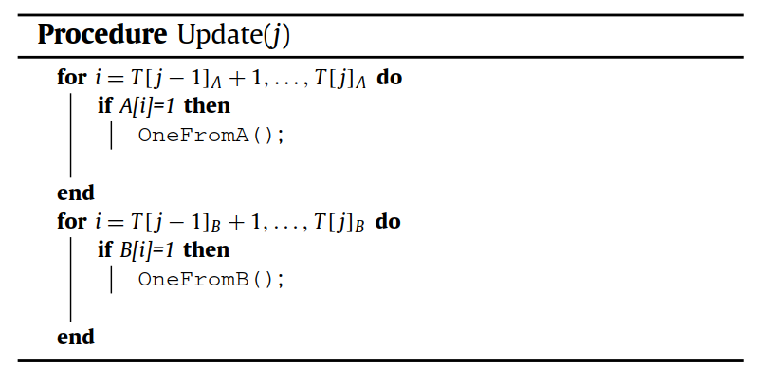
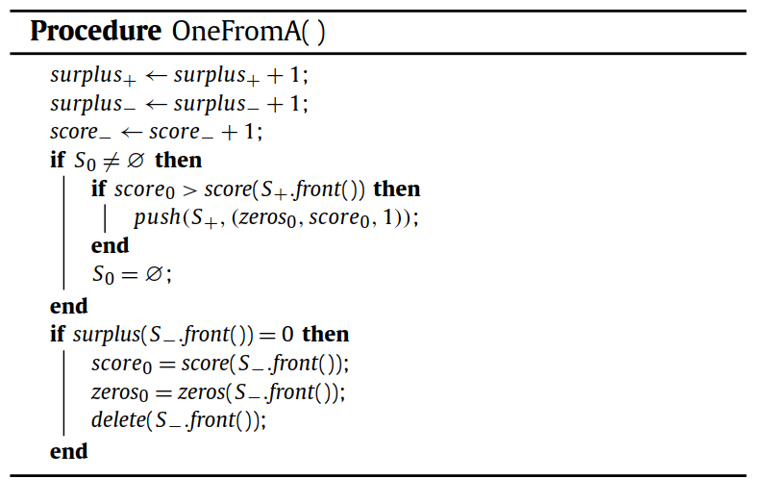
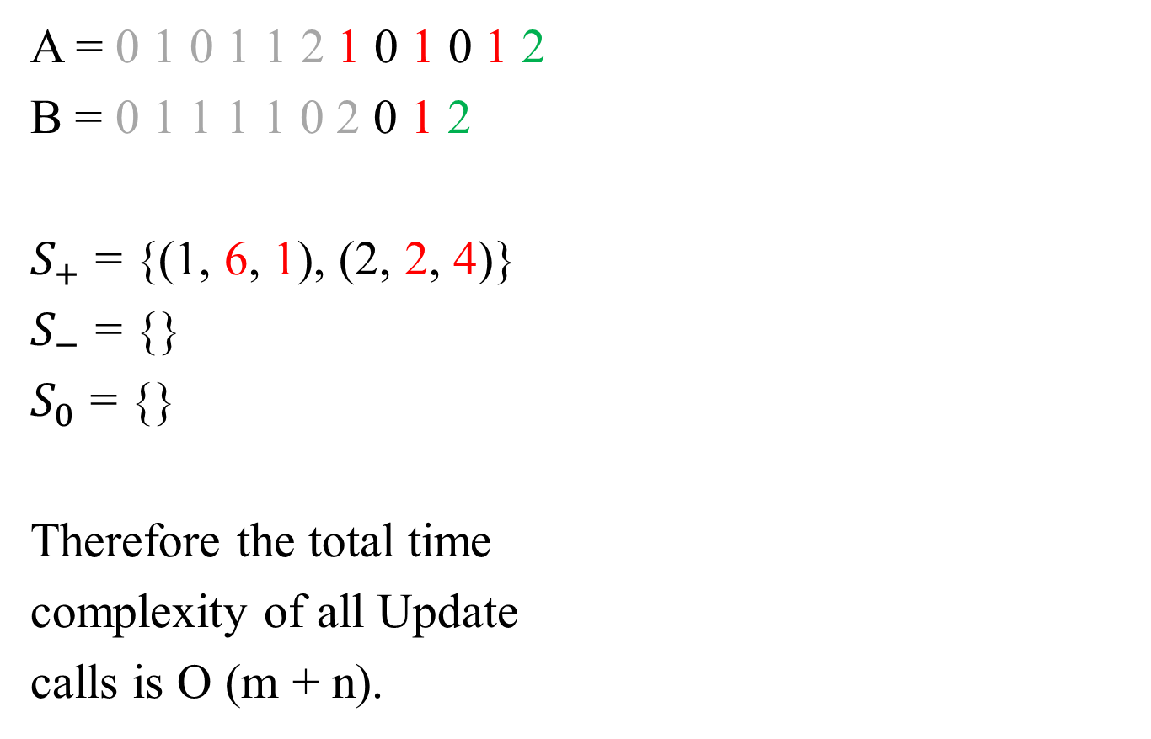
Update_Algorithm
A = $\text{0 1} \text{0 1 1 2 }\text{1}\text{ 0 }\text{1}\text{ 0 }\text{1} \text{2}$
B = 0 1 1 1 1 0 2 0 1 2
$S_{+}$ = {(1, 6, 1), (2, 2, 4)}
$S_{−}$ = {}
$S_{0}$ = {}
Therefore the total time
complexity of all Update
calls is O (m + n).

Slide 8
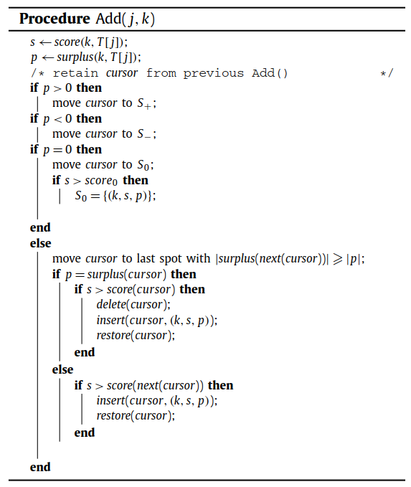
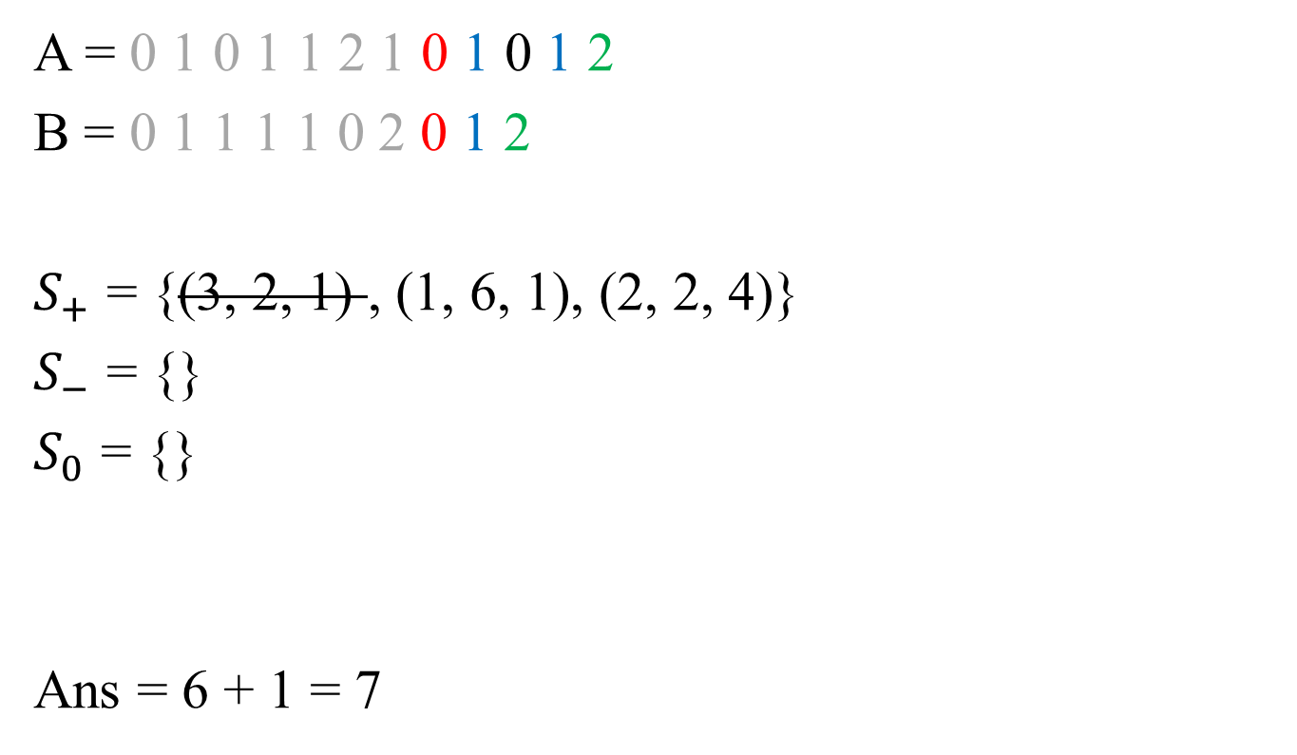
Add_Algorithm
A = $\text{0 1} \text{0 1 1 2 1} \text{0} \text{1}\text{ 0 }\text{1} \text{2}$
B = 0 1 1 1 1 0 2 0 1 2
$S_{+}$ = {(3, 2, 1) , (1, 6, 1), (2, 2, 4)}
$S_{−}$ = {}
$S_{0}$ = {}
Ans = 6 + 1 = 7

Slide 9
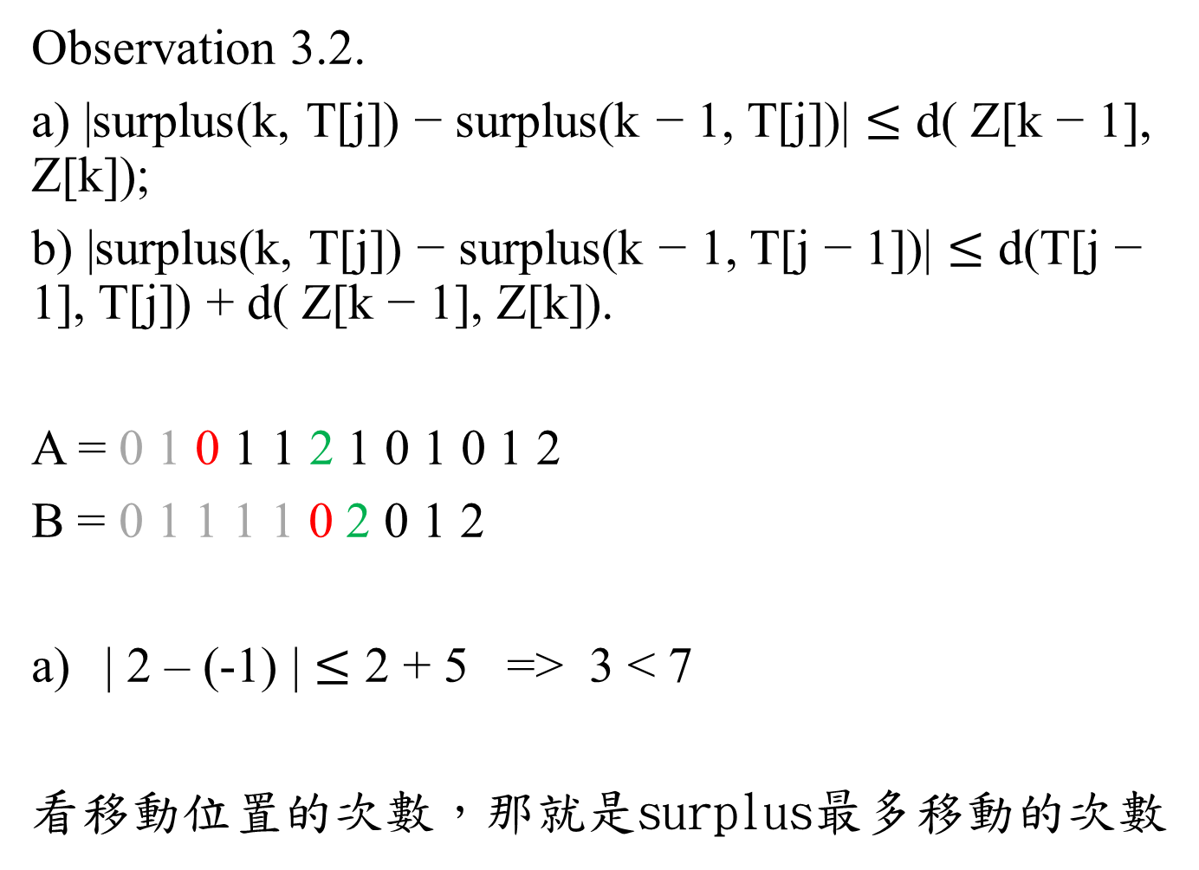
Time complexity
Observation 3.2.
a) |surplus(k, T[j]) − surplus(k − 1, T[j])| $≤$ d( Z[k − 1], Z[k]);
b) |surplus(k, T[j]) − surplus(k − 1, T[j − 1])| $≤$ d(T[j − 1], T[j]) + d( Z[k − 1], Z[k]).
A = $\text{0 1} \text{0}\text{ 1 1 }\text{2}\text{ 1 0 1 0 1 2}$
B = 0 1 1 1 1 0 2 0 1 2
| 2 – (-1) | $≤$ 2 + 5 => 3 < 7
看移動位置的次數，那就是surplus最多移動的次數
Z[k–1]
Z[k]
T[j]

Slide 10
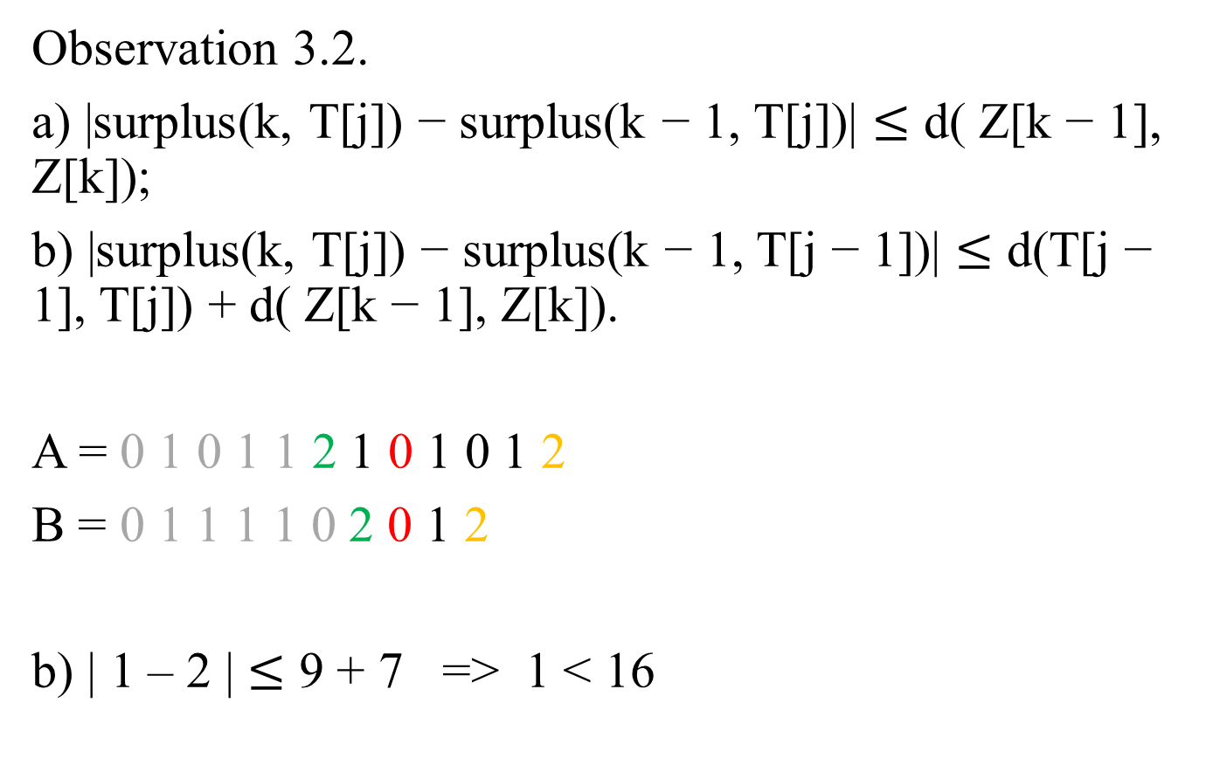
Time complexity
Observation 3.2.
a) |surplus(k, T[j]) − surplus(k − 1, T[j])| $≤$ d( Z[k − 1], Z[k]);
b) |surplus(k, T[j]) − surplus(k − 1, T[j − 1])| $≤$ d(T[j − 1], T[j]) + d( Z[k − 1], Z[k]).
A = $\text{0 1} \text{0 1 1 }\text{2}\text{ 1 }\text{0}\text{ 1 0 1 }\text{2}$
B = 0 1 1 1 1 0 2 0 1 2
b) | 1 – 2 | $≤$ 9 + 7 => 1 < 16
Z[k–1]
Z[k]
T[j]
T[j-1]

Slide 11
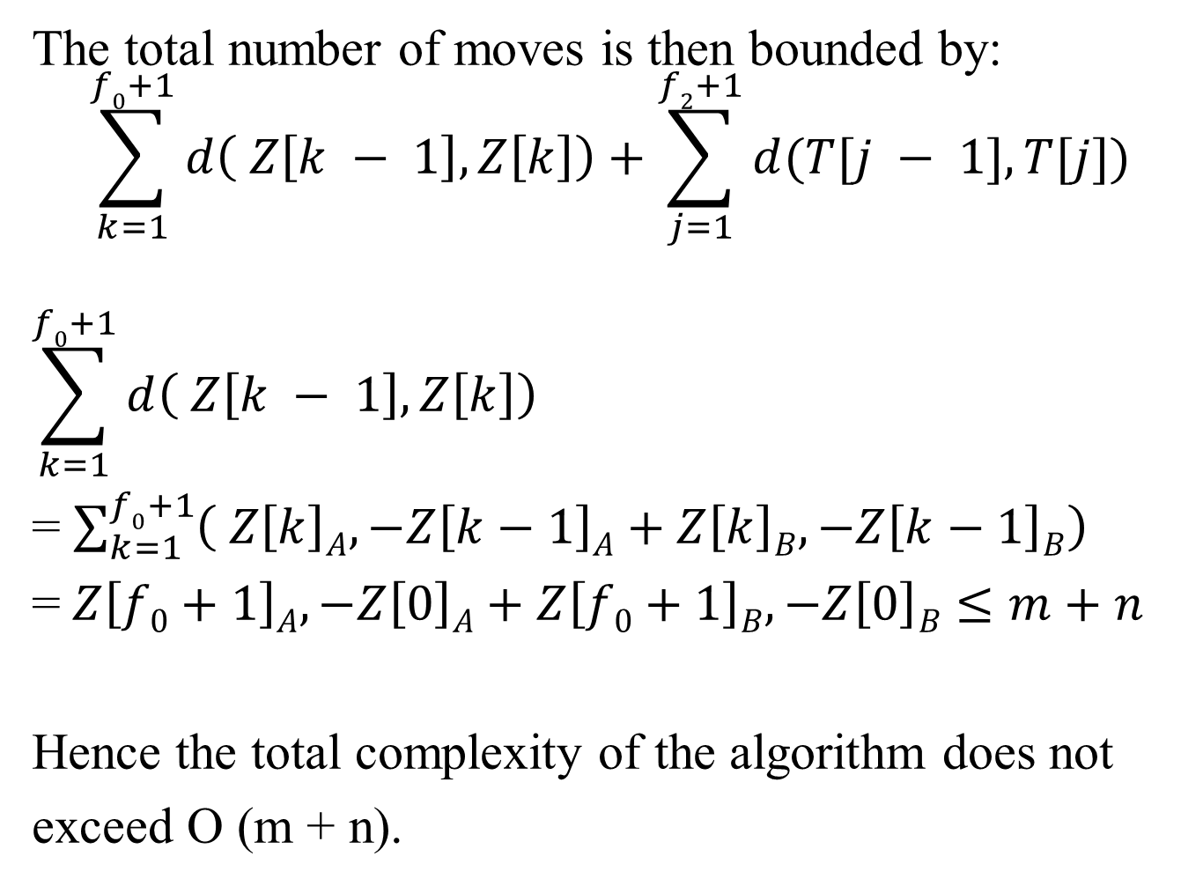
Time complexity
The total number of moves is then bounded by:
$$\sum_{k=1}^{f0+1}{d\left( Z\left[k − 1\right], Z\left[k\right]\right)}+\sum_{j=1}^{f2+1}{d(T[j − 1], T[j])}$$
$$\sum_{k=1}^{f0+1}{d\left( Z\left[k − 1\right], Z\left[k\right]\right)}$$
= $\sum_{k=1}^{f0+1}{\left( Z\left[k\right]A,−Z\left[k−1\right]A+Z\left[k\right]B,−Z\left[k−1\right]B\right)}$
= $Z\left[f0+1\right]A,−Z\left[0\right]A+Z\left[f0+1\right]B,−Z\left[0\right]B$ $≤m+n$
Hence the total complexity of the algorithm does not
exceed O (m + n).

