Slide 1
Attribute-Based Classification for Zero-Shot Visual Object Categorization
Christoph H. Lampert, Hannes Nickisch and Stefan Harmeling
IEEE Transactions on Pattern Analysis and Machine Intelligence, Volume: 36, pp 453 - 465, July 2014
Presenter: Kuo-Feng Huang
Date: 2017/12/26

Slide 2
Abstract (1/2)
We study the problem of object recognition for categories for which we have no training examples, a task also called zerodata or zero-shot learning. This situation has hardly been studied in computer vision research, even though it occurs frequently: the world contains tens of thousands of different object classes and for only few of them image collections have been formed and suitably annotated. To tackle the problem we introduce attribute-based classification: objects are identified based on a high-level description that is phrased in terms of semantic attributes,

Slide 3
Abstract (2/2)
such as the object’s color or shape. Because the identification of each such property transcends the specific learning task at hand, the attribute classifiers can be pre-learned independently, e.g. from existing image datasets unrelated to the current task. Afterwards, new classes can be detected based on their attribute representation, without the need for a new training phase. In this paper we also introduce a new dataset, Animals with Attributes, of over 30,000 images of 50 animal classes, annotated with 85 semantic attributes. Extensive experiments on this and two more datasets show that attribute-based classification indeed is able to categorize images without access to any training images of the target classes.

Slide 4
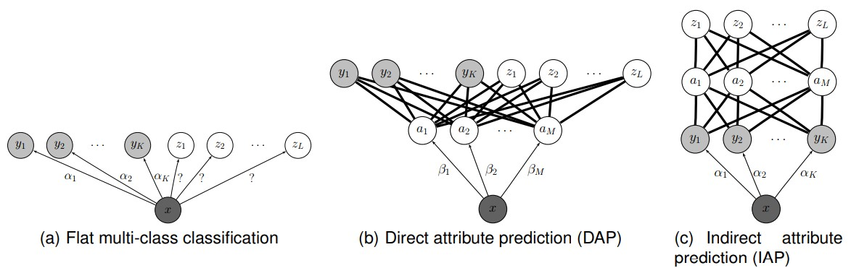
Classification

Slide 5
Dataset
30,475 images
Collected images by querying the image search engines of Google, Microsoft, Yahoo and Flickr for each of the 50 animals classes.
85 semantic attributes and 48 mammals

Slide 6
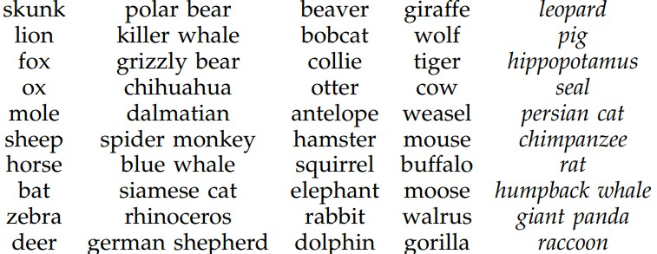
Dataset: animal classes

Slide 7
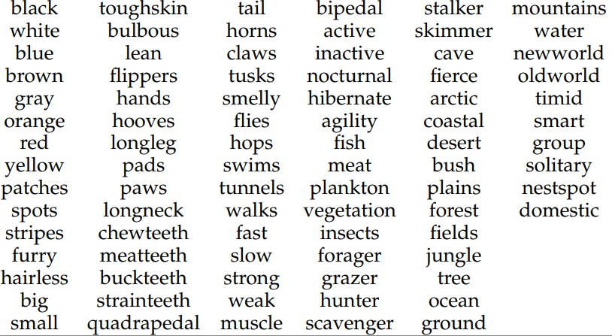
Dataset: semantic attributes

Slide 8
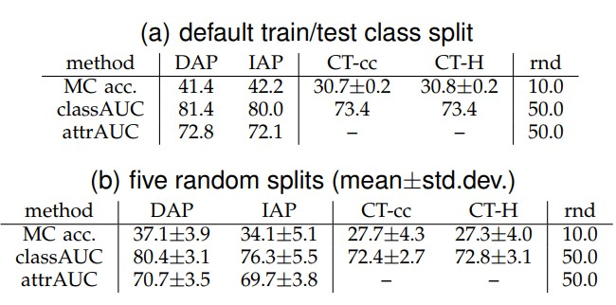
Results

Slide 9
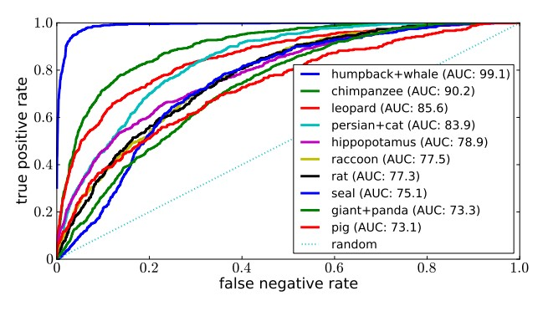
Results

Slide 10
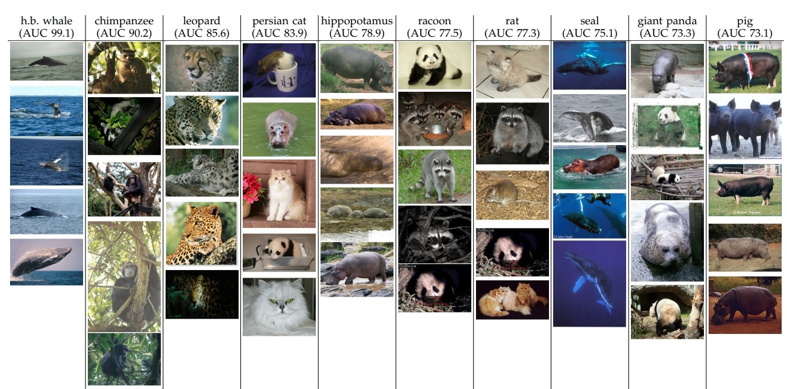
Results

Slide 11
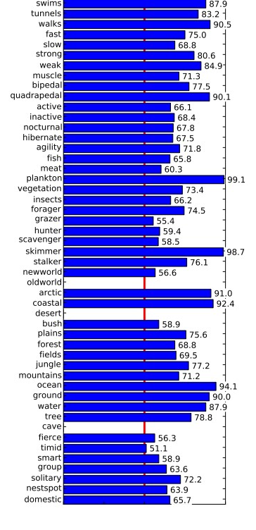
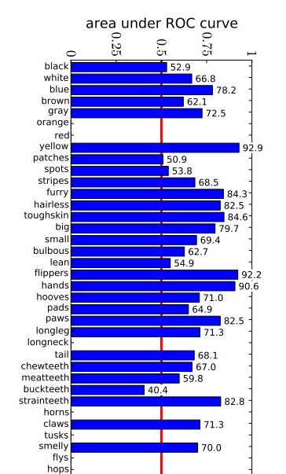
Results

