Slide 1
New Tabulation and Sparse Dynamic Programming Based Techniques for Sequence Similarity Problems
Szymon Grabowski
Discrete Applied Mathematics, Vol. 212, pp. 96-103, October, 2016.
Presenter : Shie-Yan Lee
2017/12/26

Slide 2
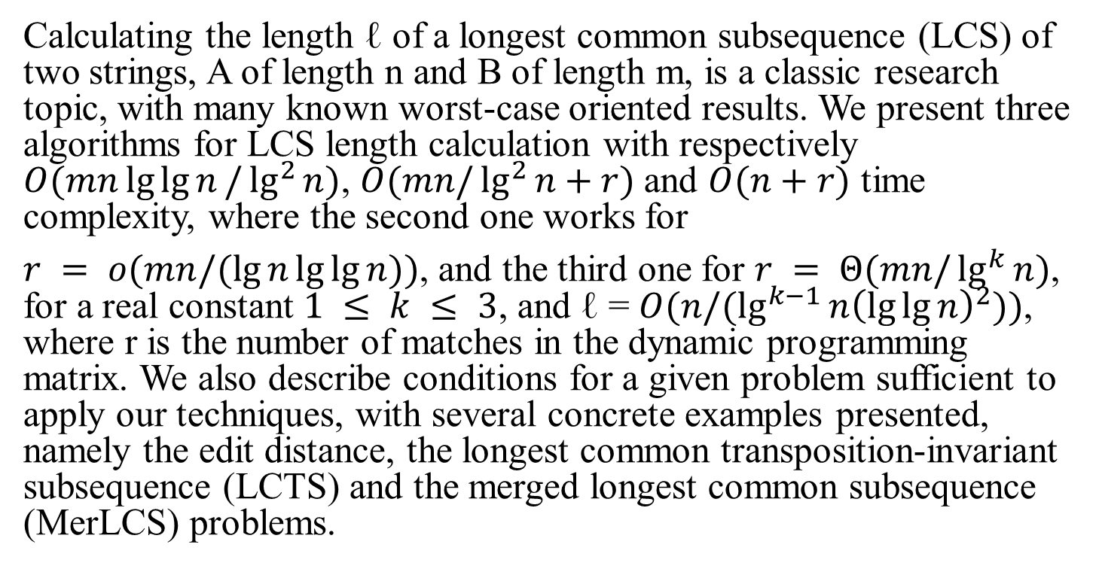
Abstract
Calculating the length ℓ of a longest common subsequence (LCS) of two strings, A of length n and B of length m, is a classic research topic, with many known worst-case oriented results. We present three algorithms for LCS length calculation with respectively $O(mn\lg{\lg{n}}/\lg^{2}{n})$, $O(mn/\lg^{2}{n+r})$and $O(n+r)$ time complexity, where the second one works for
$r = o(mn/(\lg{n}\lg{\lg{n}}))$, and the third one for $r = Θ(mn/\lg^{k}{n})$, for a real constant $1 ≤ k ≤ 3$, and ℓ = $O(n/(\lg^{k−1}{n{\left(\lg{\lg{n}}\right)}^{2}}))$, where r is the number of matches in the dynamic programming matrix. We also describe conditions for a given problem sufficient to apply our techniques, with several concrete examples presented, namely the edit distance, the longest common transposition-invariant subsequence (LCTS) and the merged longest common subsequence (MerLCS) problems.

Slide 3
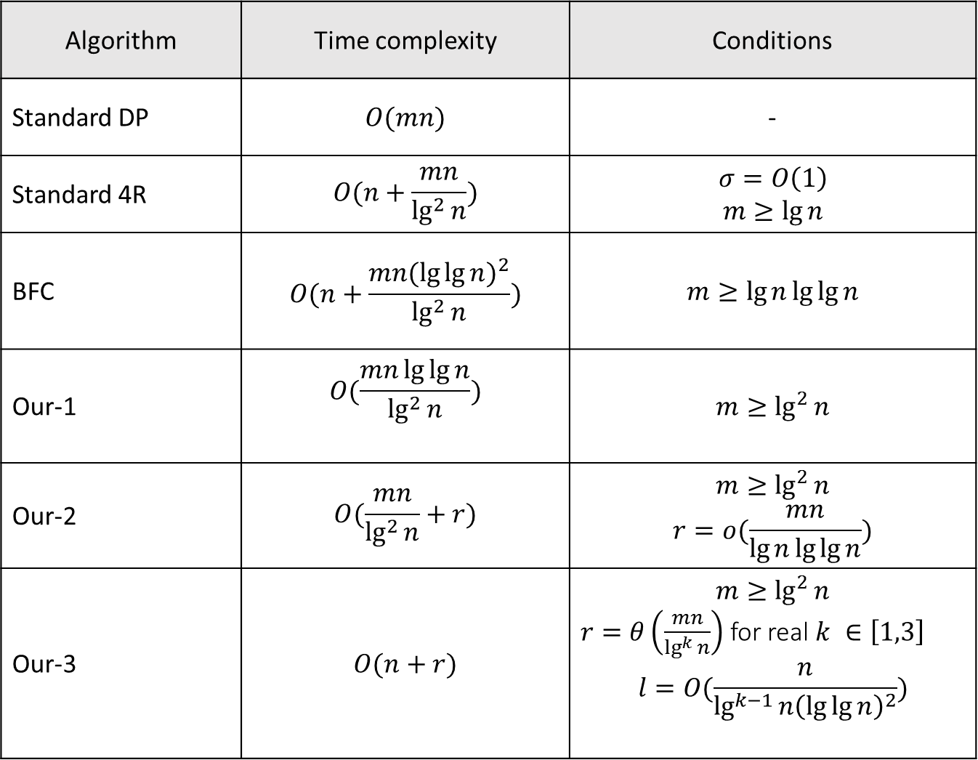
Algorithm | Time complexity | Conditions
Standard DP | $$O(mn)$$ | -
Standard 4R | $$O(n+\frac{mn}{\lg^{2}{n}})$$ | $$σ=O\left(1\right)$$ $$m≥\lg{n}$$
BFC | $$O(n+\frac{mn{(\lg{\lg{n}})}^{2}}{\lg^{2}{n}})$$ | $$m≥\lg{n}\lg{\lg{n}}$$
Our-1 | $$O(\frac{mn\lg{\lg{n}}}{\lg^{2}{n}})$$ | $$m≥\lg^{2}{n}$$
Our-2 | $$O(\frac{mn}{\lg^{2}{n}}+r)$$ | $$m≥\lg^{2}{n}$$ $$r=o(\frac{mn}{\lg{n}\lg{\lg{n}}})$$
Our-3 | $$O(n+r)$$ | $$m≥\lg^{2}{n}$$ $r=θ\left(\frac{mn}{\lg^{k}{n}}\right)$ for real $k ∈\left[1,3\right]$ $$l=O(\frac{n}{\lg^{k−1}{n{\left(\lg{\lg{n}}\right)}^{2}}})$$

Slide 4




Bille and Farach-Colton’s algorithm (BFC)
The dynamic matrix $M[0…n, 0…m]$ is divided into rectangular blocks with shared borders,
of size ($x_{1}+1)∗\left(x_{2}+1\right).$
$$m$$
$$x_{2}$$
$$x_{1}$$
$$n$$

Slide 5

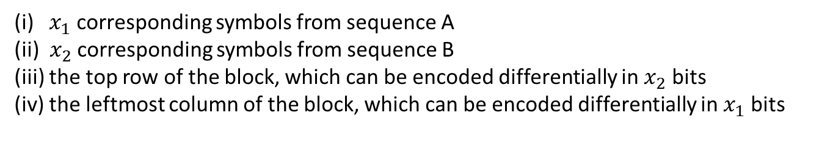

Values inside each block depend on
(i) $x_{1}$ corresponding symbols from sequence A
(ii) $x_{2}$ corresponding symbols from sequence B
(iii) the top row of the block, which can be encoded differentially in $x_{2}$ bits
(iv) the leftmost column of the block, which can be encoded differentially in $x_{1}$ bits
$$x_{2}$$
$$x_{1}$$
The output of each block will be found via
a lookup table built in a preprocessing stage.

Slide 6
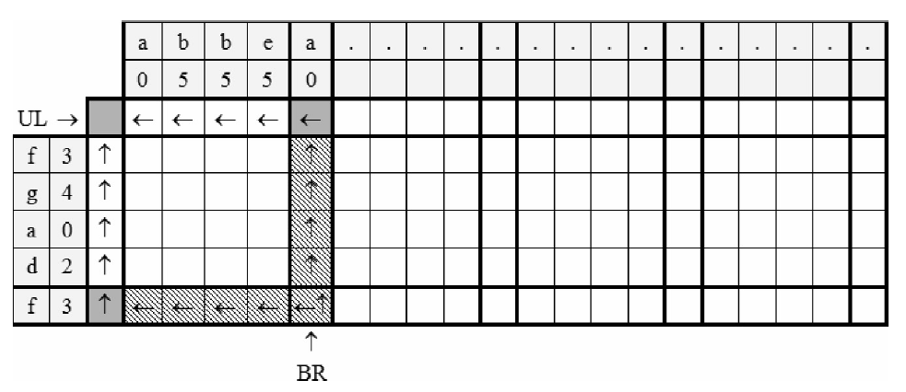

Slide 7


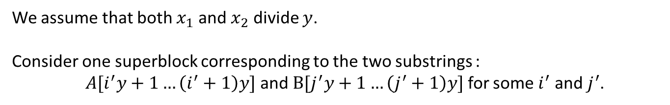


Alphabet remapping in superblocks
We assume that both $x_{1}$ and $x_{2}$ divide $y$.
Consider one superblock corresponding to the two substrings :
$A[i^{′}y+1…\left(i^{′}+1\right)y]$ and $B[j^{′}y+1…\left(j^{′}+1\right)y]$ for some $i^{′}$ and $j^{′}$.
$$y$$
$$x_{2}$$
$$x_{1}$$
$$y$$

Slide 8


























$$y$$
$$y$$
$$y$$
$$x_{2}$$
$$x_{2}$$
$$x_{2}$$
$$x_{2}$$
$$x_{2}$$
$$x_{2}$$
$$x_{2}$$
$$x_{2}$$
$$x_{2}$$
$$x_{1}$$
$$y$$
$$x_{1}$$
$$x_{2}$$
LUT
$$x_{1}$$
$$x_{1}$$
$$x_{1}$$
$$y$$
$$x_{1}$$
$$x_{1}$$
$$x_{1}$$
$$y$$
$$x_{1}$$
$$x_{1}$$

Slide 9
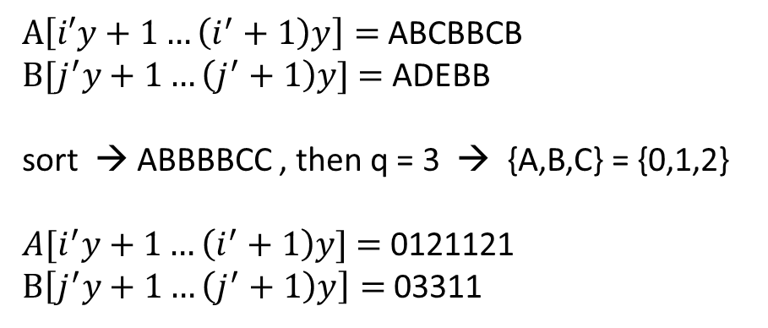
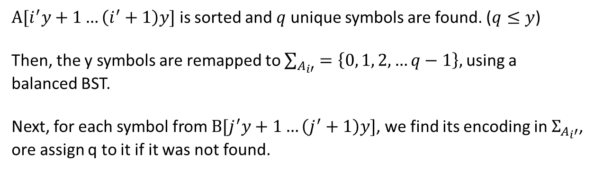
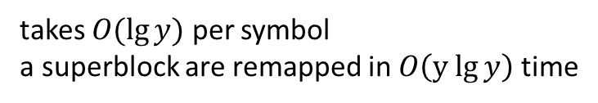
Alphabet remapping in superblocks
$A[i^{′}y+1…\left(i^{′}+1\right)y]$ is sorted and $q$ unique symbols are found. ($q≤y$)
Then, the y symbols are remapped to $\sum_{A_{i′}}{=\left\{0, 1, 2, …q−1\right\},}$using a balanced BST.
Next, for each symbol from $B[j^{′}y+1…\left(j^{′}+1\right)y]$, we find its encoding in $Σ_{A_{i}′}$,
ore assign q to it if it was not found.
$A\left[i′y+1…\left(i^{′}+1\right)y\right]=$ ABCBBCB
$B[j^{′}y+1…\left(j^{′}+1\right)y]$ = ADEBB
sort → ABBBBCC , then q = 3 → {A,B,C} = {0,1,2}
$A[i^{′}y+1…\left(i^{′}+1\right)y]$ = 0121121
$B\left[j^{′}y+1…\left(j^{′}+1\right)y\right]=$ 03311
takes $O(\lg{y})$ per symbol
a superblock are remapped in $O\left(y lg{y}\right)$ time

Slide 10
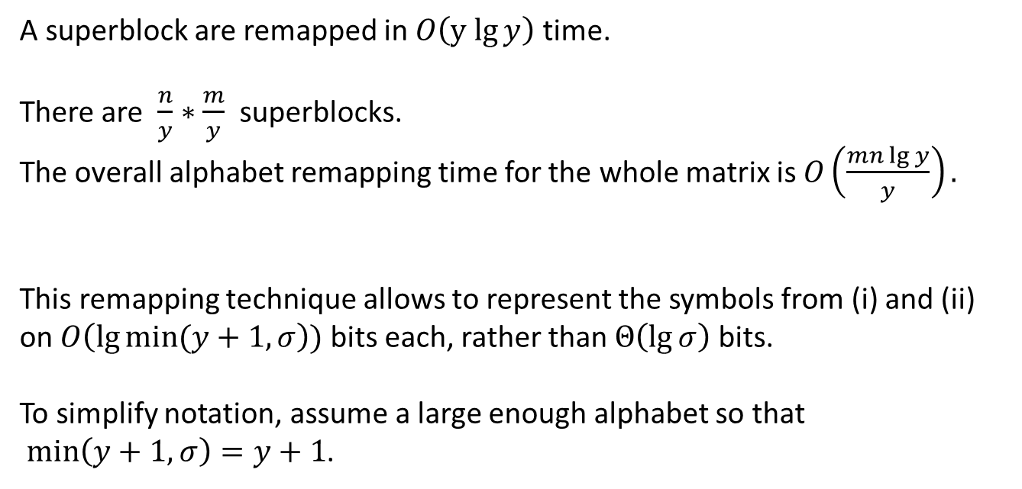
Alphabet remapping in superblocks
A superblock are remapped in $O\left(y lg{y}\right)$ time.
There are $\frac{n}{y}∗\frac{m}{y}$ superblocks.
The overall alphabet remapping time for the whole matrix is $O\left(\frac{mn\lg{y}}{y}\right).$
This remapping technique allows to represent the symbols from (i) and (ii)
on $O\left(\lg{min⁡(y+1,σ}\right))$ bits each, rather than $Θ\left(\lg{σ}\right)$ bits.
To simplify notation, assume a large enough alphabet so that
$\min\left(y+1,σ\right)=y+1$.

Slide 11
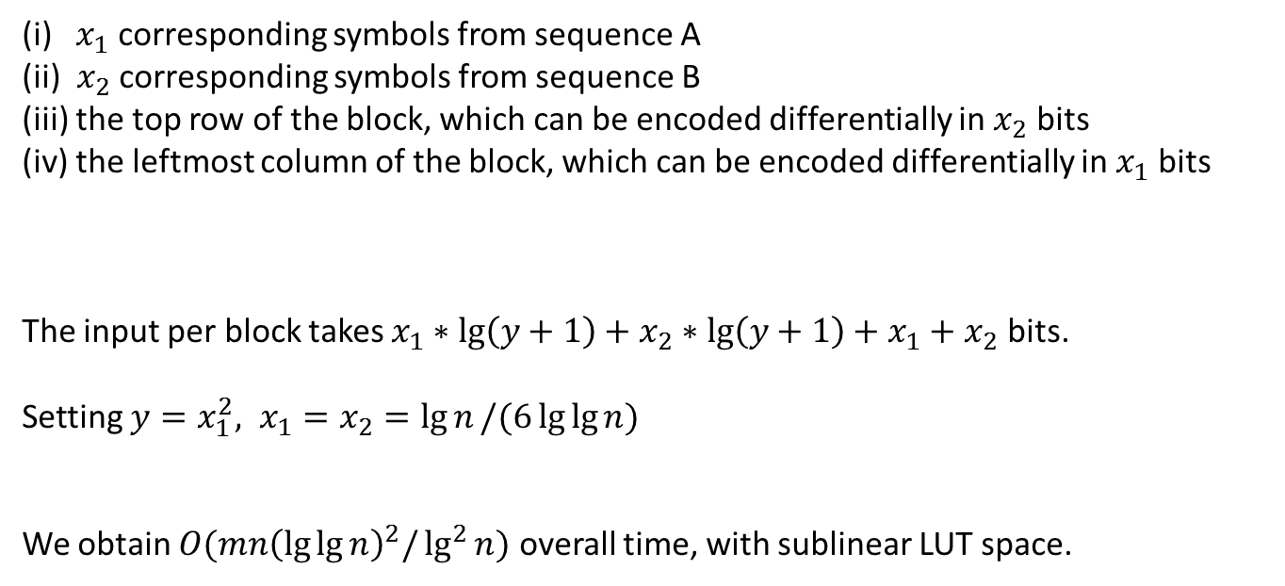
Values inside each block depend on
(i) $x_{1}$ corresponding symbols from sequence A
(ii) $x_{2}$ corresponding symbols from sequence B
(iii) the top row of the block, which can be encoded differentially in $x_{2}$ bits
(iv) the leftmost column of the block, which can be encoded differentially in $x_{1}$ bits
The input per block takes $x_{1}∗\lg\left(y+1\right)+x_{2}∗\lg\left(y+1\right)+x_{1}+x_{2}$ bits.
Setting $y=x_{1}^{2}, x_{1}=x_{2}=\lg{n}/(6\lg{\lg{n)}}$
We obtain $O(mn{\left(\lg{\lg{n}}\right)}^{2}/\lg^{2}{n)}$ overall time, with sublinear LUT space.

Slide 12

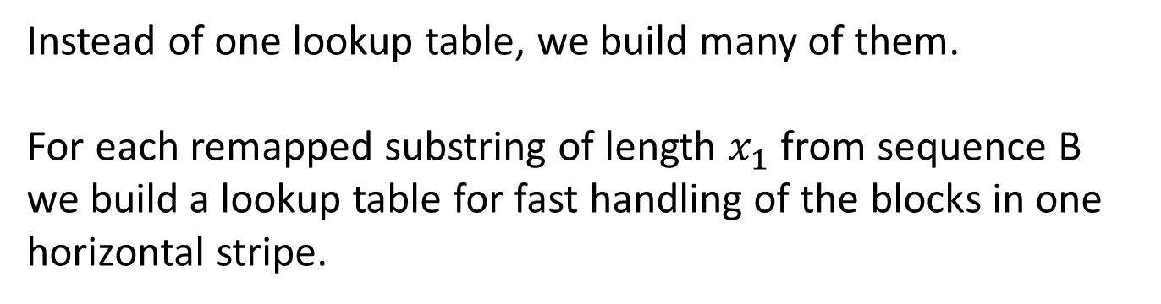
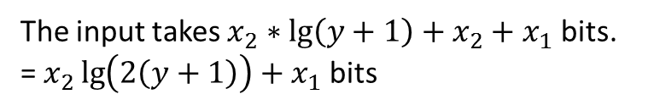

Grabowski’s idea
Instead of one lookup table, we build many of them.
For each remapped substring of length $x_{1}$ from sequence B
we build a lookup table for fast handling of the blocks in one horizontal stripe.
Lookup Table
$$x_{1}$$
Lookup Table
$$x_{1}$$
Lookup Table
The input takes $x_{2}∗\lg\left(y+1\right)+x_{2}+x_{1}$ bits.
= $x_{2}\lg\left(2\left(y+1\right)\right)+x_{1}$ bits

Slide 13
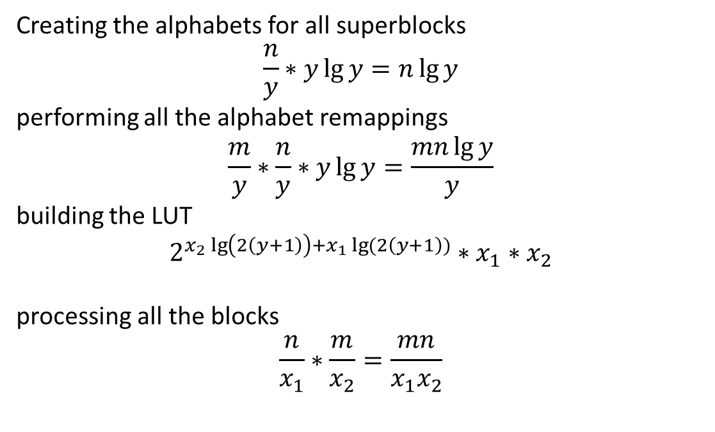
BFC’s Time complexity
Creating the alphabets for all superblocks
$$\frac{n}{y}∗y\lg{y}=n\lg{y}$$
performing all the alphabet remappings
$$\frac{m}{y}∗\frac{n}{y}∗y\lg{y}=\frac{mn\lg{y}}{y}$$
building the LUT
$$2^{x_{2}\lg\left(2\left(y+1\right)\right)+x_{1}\lg{(2\left(y+1\right))}}∗x_{1}∗x_{2}$$
processing all the blocks
$$\frac{n}{x_{1}}∗\frac{m}{x_{2}}=\frac{mn}{x_{1}x_{2}}$$
$$O(n\lg{y}+\frac{mn\lg{y}}{y}+2^{x_{2}\lg\left(2\left(y+1\right)\right)+x_{1}\lg{(2\left(y+1\right))}}∗x_{1}∗x_{2}+\frac{mn}{x_{1}x_{2}})$$

Slide 14
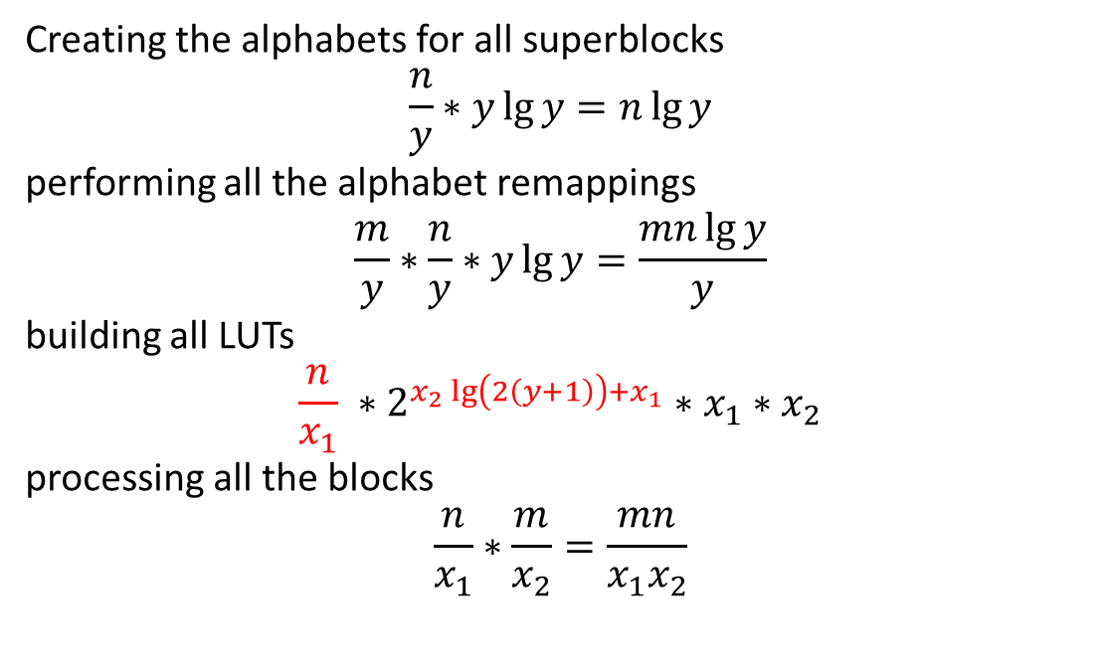
Time complexity
Creating the alphabets for all superblocks
$$\frac{n}{y}∗y\lg{y}=n\lg{y}$$
performing all the alphabet remappings
$$\frac{m}{y}∗\frac{n}{y}∗y\lg{y}=\frac{mn\lg{y}}{y}$$
building all LUTs
$$\frac{n}{x_{1}} ∗2^{x_{2}\lg\left(2\left(y+1\right)\right)+x_{1}}∗x_{1}∗x_{2}$$
processing all the blocks
$$\frac{n}{x_{1}}∗\frac{m}{x_{2}}=\frac{mn}{x_{1}x_{2}}$$
$$O(n\lg{y}+\frac{mn\lg{y}}{y}+\frac{n}{x_{1}} ∗2^{x_{2}\lg{(2\left(y+1\right))+x_{1}}}∗x_{1}∗x_{2}+\frac{mn}{x_{1}x_{2}})$$

Slide 15
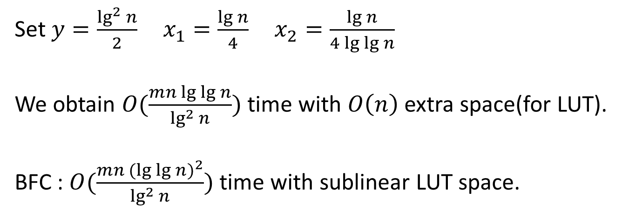
Time complexity
$$O(n\lg{y}+\frac{mn\lg{y}}{y}+\frac{n}{x_{1}} ∗2^{x_{2}\lg{(2\left(y+1\right))+x_{1}}}∗x_{1}∗x_{2}+\frac{mn}{x_{1}x_{2}})$$
Set $y=\frac{\lg^{2}{n}}{2} x_{1}=\frac{\lg{n}}{4} x_{2}=\frac{\lg{n}}{4\lg{\lg{n}}}$
We obtain $O(\frac{mn\lg{\lg{n}}}{\lg^{2}{n}})$ time with $O\left(n\right)$ extra space(for LUT).
BFC : $O(\frac{mn{(lg{\lg{n}})}^{2}}{\lg^{2}{n}})$ time with sublinear LUT space.

Slide 16
LCS combining tabulation and sparse dynamic programming
In this algorithm, also works in blocks of size (b+1)*(b+1),
but divide them into two groups :
sparse blocks :
contain at most K matches
dense blocks :
contain more than K matches

Slide 17

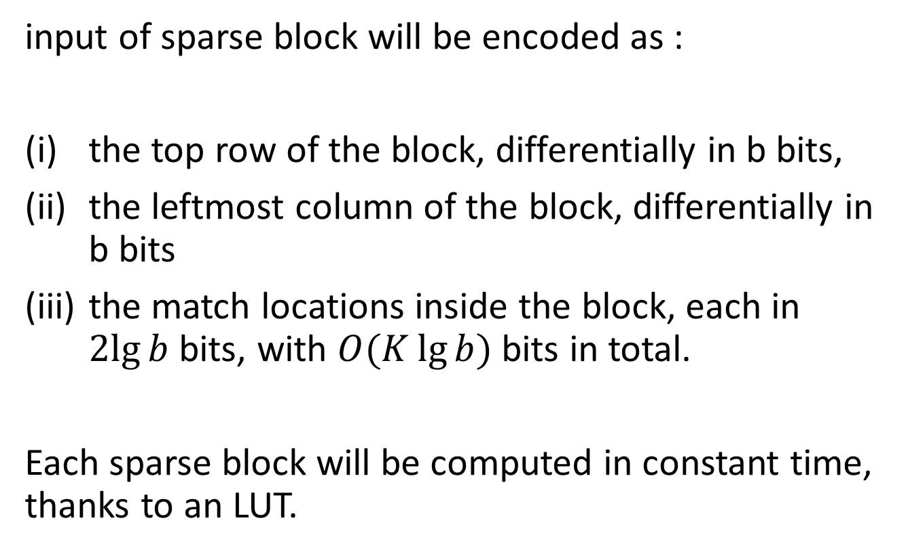

Sparse block
$$b$$
$$b$$
input of sparse block will be encoded as :
the top row of the block, differentially in b bits,
the leftmost column of the block, differentially in b bits
the match locations inside the block, each in $2lg{b}$ bits, with $O(K\lg{b)}$ bits in total.
Each sparse block will be computed in constant time, thanks to an LUT.

Slide 18

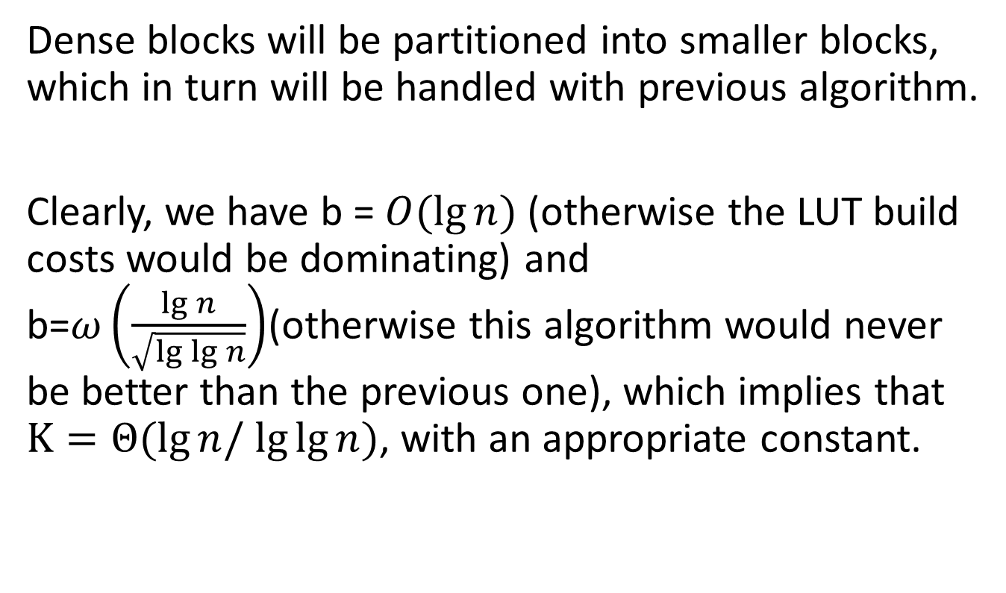

Dense block
$$b$$
$$b$$
Dense blocks will be partitioned into smaller blocks, which in turn will be handled with previous algorithm.
Clearly, we have b = $O(\lg{n)}$ (otherwise the LUT build costs would be dominating) and b=$ω\left(\frac{\lg{n}}{\sqrt{\lg{\lg{n}}}}\right)$(otherwise this algorithm would never be better than the previous one), which implies that $K=Θ(lg⁡n/ lg⁡lg⁡n)$, with an appropriate constant.

Slide 19


$$b$$
$$b$$

Slide 20
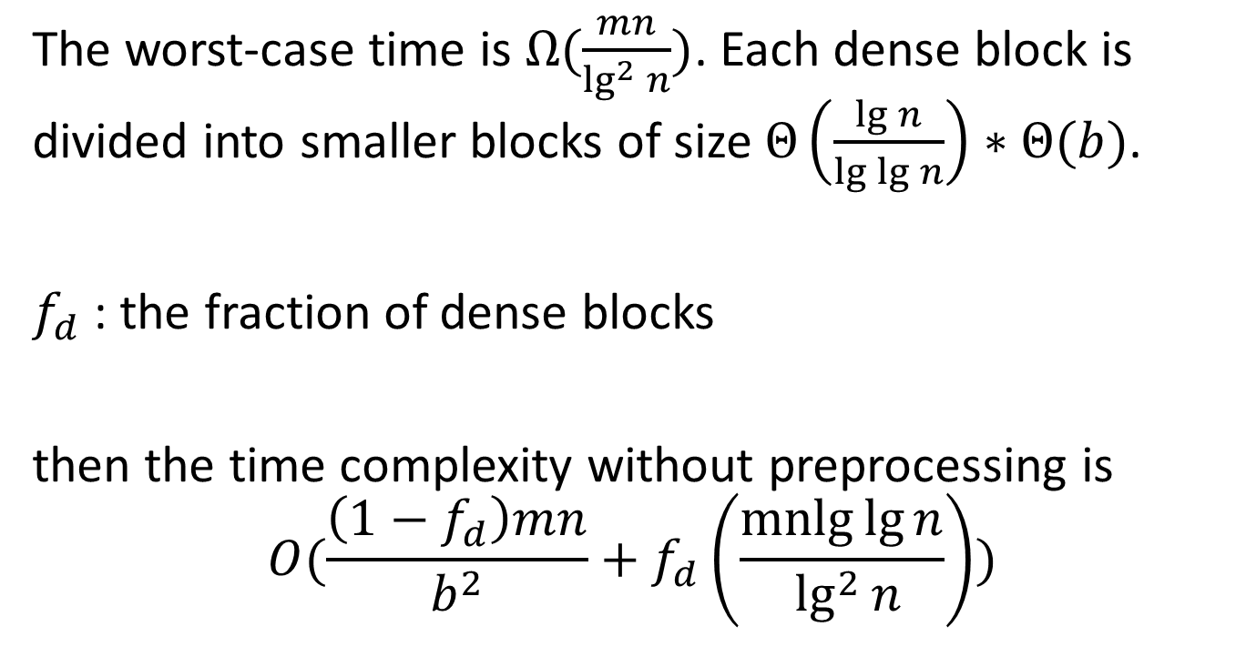
LCS combining tabulation and sparse dynamic programming
The worst-case time is $Ω(\frac{mn}{\lg^{2}{n}})$. Each dense block is divided into smaller blocks of size $Θ\left(\frac{\lg{n}}{\lg{\lg{n}}}\right)∗Θ(b)$.
$f_{d}$ : the fraction of dense blocks
then the time complexity without preprocessing is
$$O(\frac{\left(1−f_{d}\right)mn}{b^{2}}+f_{d}\left(\frac{\operatorname{mnlg}{\lg{n}}}{\lg^{2}{n}}\right))$$

Slide 21
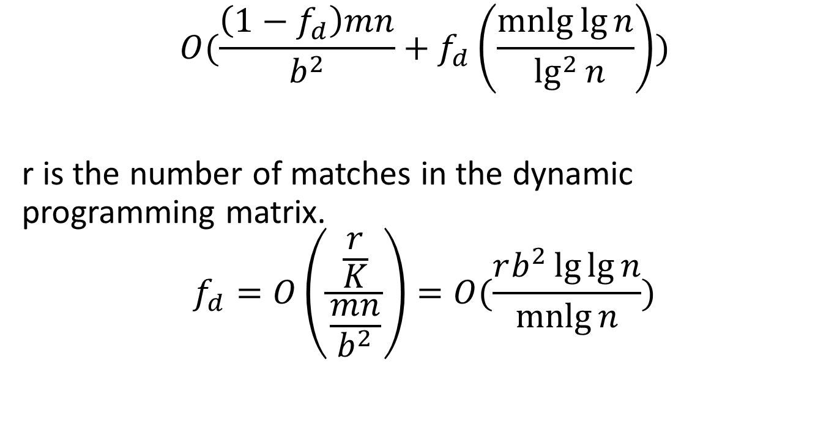
LCS combining tabulation and sparse dynamic programming
$$O(\frac{\left(1−f_{d}\right)mn}{b^{2}}+f_{d}\left(\frac{\operatorname{mnlg}{\lg{n}}}{\lg^{2}{n}}\right))$$
r is the number of matches in the dynamic programming matrix.
$$f_{d}=O\left(\frac{\frac{r}{K}}{\frac{mn}{b^{2}}}\right)=O(\frac{rb^{2}\lg{\lg{n}}}{\operatorname{mnlg}{n}})$$

Slide 22
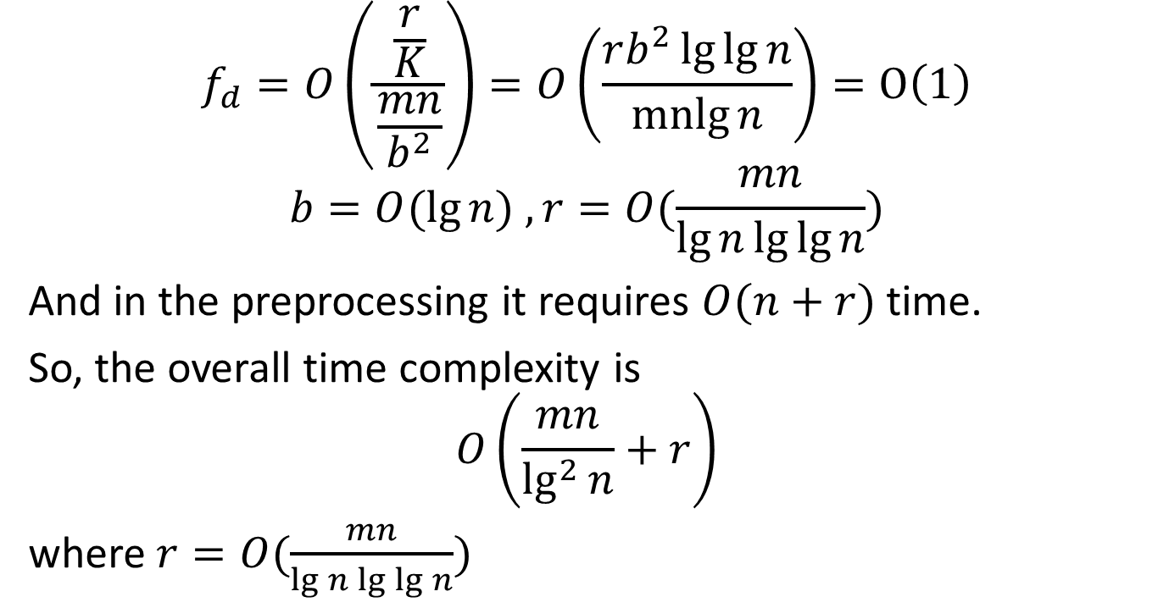
LCS combining tabulation and sparse dynamic programming
$$f_{d}=O\left(\frac{\frac{r}{K}}{\frac{mn}{b^{2}}}\right)=O\left(\frac{rb^{2}\lg{\lg{n}}}{\operatorname{mnlg}{n}}\right)=O\left(1\right)$$
$$b=O(\lg{n) , r=O(\frac{mn}{\lg{n}\lg{\lg{n}}})}$$
And in the preprocessing it requires $O(n+r)$ time.
So, the overall time complexity is
$$O\left(\frac{mn}{\lg^{2}{n}}+r\right)$$
where $r=O(\frac{mn}{\lg{n}\lg{\lg{n}}})$

Slide 23
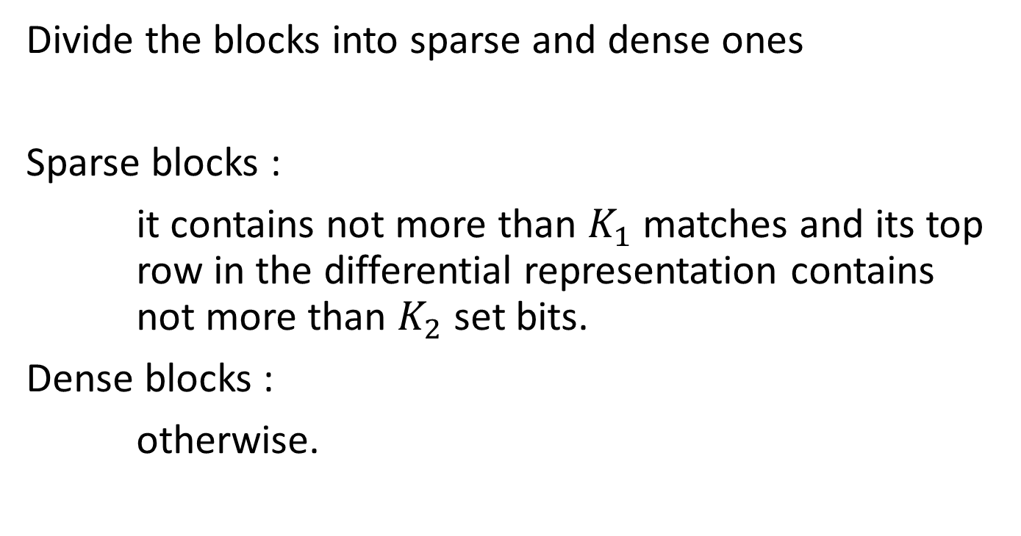
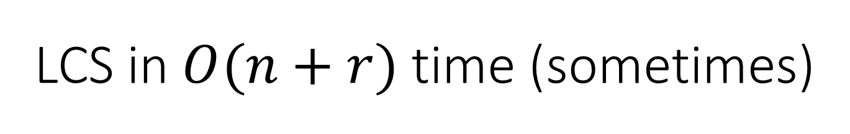
LCS in $O(n+r)$ time (sometimes)
Divide the blocks into sparse and dense ones
Sparse blocks :
it contains not more than $K_{1}$ matches and its top row in the differential representation contains not more than $K_{2}$ set bits.
Dense blocks :
otherwise.

Slide 24
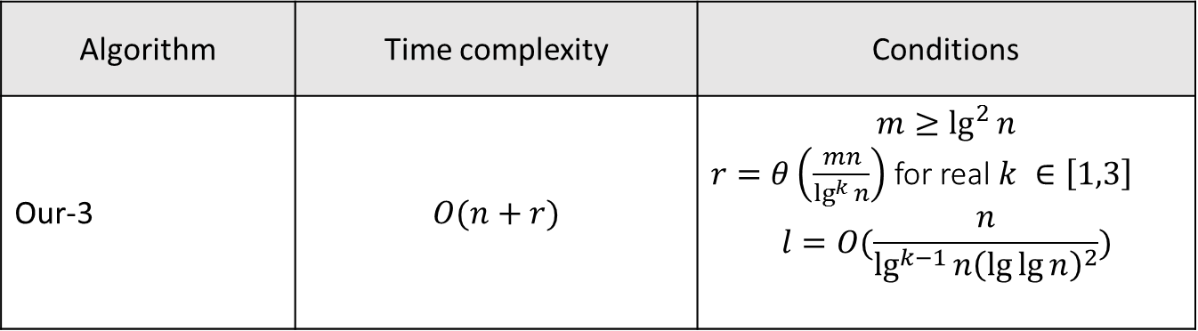
LCS in $O(n+r)$ time (sometimes)
Algorithm | Time complexity | Conditions
Our-3 | $$O(n+r)$$ | $$m≥\lg^{2}{n}$$ $r=θ\left(\frac{mn}{\lg^{k}{n}}\right)$ for real $k ∈\left[1,3\right]$ $$l=O(\frac{n}{\lg^{k−1}{n{\left(\lg{\lg{n}}\right)}^{2}}})$$

Slide 25
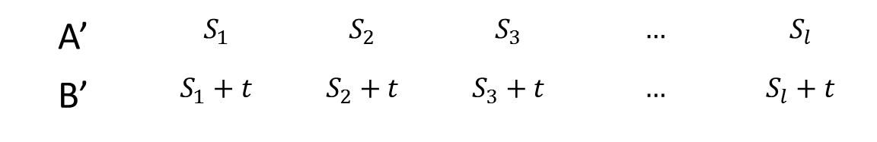
Algorithmic applications
LCS problem
Edit distance problem
Longest Common Transposition-invariant subsequence problem (LCTS)
A’ | $$S_{1}$$ | $$S_{2}$$ | $$S_{3}$$ | $$…$$ | $$S_{l}$$
B’ | $$S_{1}+t$$ | $$S_{2}+t$$ | $$S_{3}+t$$ | $$…$$ | $$S_{l}+t$$

Slide 26
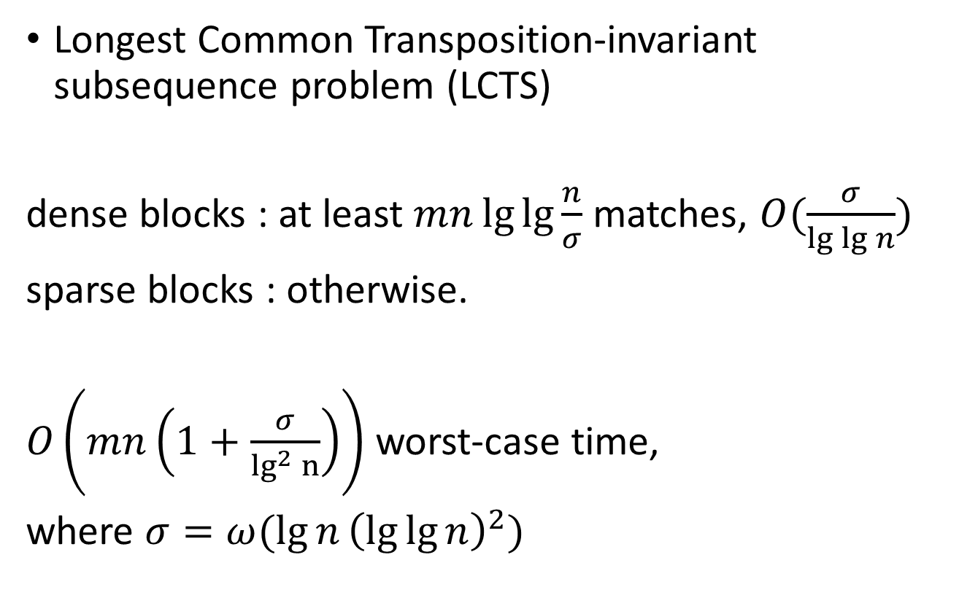
Algorithmic applications
Longest Common Transposition-invariant subsequence problem (LCTS)
dense blocks : at least $mn\lg{\lg{\frac{n}{σ}}}$ matches, $O(\frac{σ}{\lg{\lg{n}}})$
sparse blocks : otherwise.
$O\left(mn\left(1+\frac{σ}{\lg^{2} n}\right)\right)$ worst-case time,
where $σ=ω(\lg{n}{\left(\lg{\lg{n}}\right)}^{2})$

Slide 27
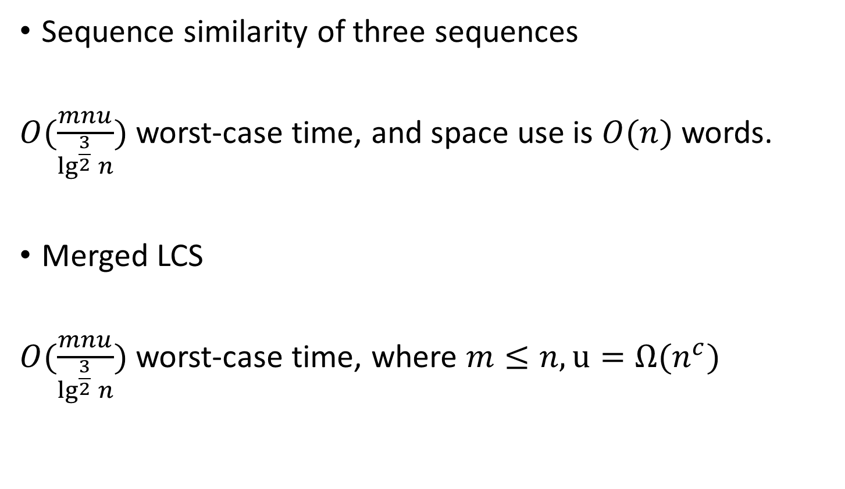
Algorithmic applications
Sequence similarity of three sequences
$O(\frac{mnu}{\lg^{\frac{3}{2}}{n}})$ worst-case time, and space use is $O(n)$ words.
Merged LCS
$O(\frac{mnu}{\lg^{\frac{3}{2}}{n}})$ worst-case time, where $m≤n, u=Ω(n^{c})$

