Slide 1
Palindromic Subsequence Automata and Longest Common Palindromic Subsequence
Md. Mahbubul Hasan, A. S. M. Sohidull Islam, M. Sohel Rahman, Ayon Sen
Mathematics in Computer Science June 2017, Volume 11,
Issue 2, pp 219–232
Presenter: Cheng-Han Wu
Date:2017/12/26

Slide 2
Abstract
In this paper, we present a novel weighted finite automaton called palindromic subsequence automaton(PSA) that is a compact representation of all the palindromic subsequences of a string. Then we use PSA to solve the longest common palindromic subsequence problem. Our automata based algorithms are efficient both in theory and in practice.

Slide 3

Longest Common Palindromic Subsequence
$$S_{1}=abba$$
$$S_{2}=abca$$
$$CPS=a, b, aa, aba$$
$$LCPS=aba$$
Notes:
DP,O(mn),the cells on the same diagonal in the score table doesn’t depend on each other, so that they can be computed in parallel

Slide 4
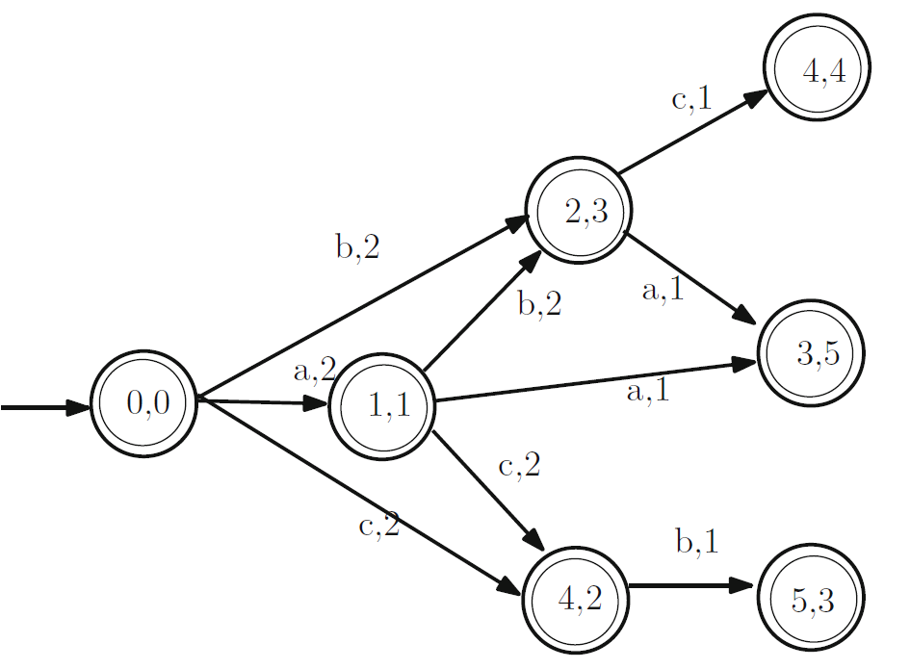

Palindromic subsequence automata (PSA)
String $S$, reverse of $S$ be $S^{R}$
PSA M accepts the first half of a palindromic subsequence of all palindromic subsequences of the given string S
PSA M is a 6 tuple $(Q, Σ, δ, σ, q_{0}, F)$
Notes:
rearranging the entries in the score matrix for greater parallelism

Slide 5

PSA M
$Q$:finite set of states. Here, $Q$ is a subset of pairs of positions in $S$ and $S^{R}$
$q_{0}∈Q$is the initial state
Each state $q_{a}∈ Q$ is associated with a pair of positions $(a_{i},a_{j})$ where $a_{i}$ and $a_{j}$ refer to positions in $S$ and $S^{R}$ respectively and $S[a_{i}]=S^{R}[a_{j}]$

Slide 6
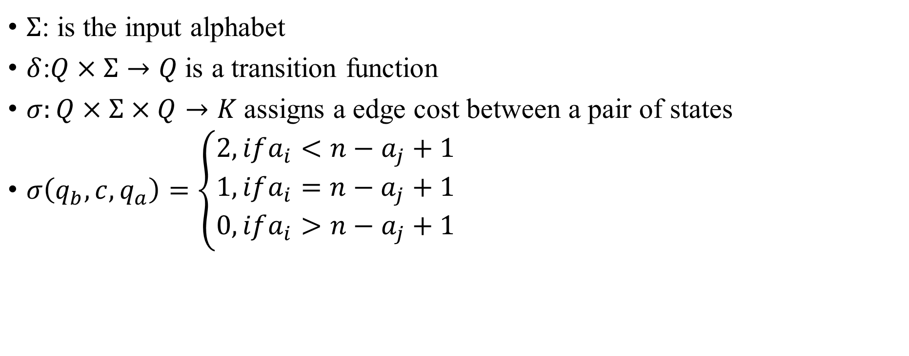
$Σ$: is the input alphabet
$δ$:$Q×Σ→Q$is a transition function
$σ:Q×Σ×Q→K$assigns a edge cost between a pair of states
$σ\left(q_{b},c,q_{a}\right)=\left\{\begin{aligned}2, ifa_{i}<n−a_{j}+1 \\ 1,ifa_{i}=n−a_{j}+1 \\ 0,ifa_{i}>n−a_{j}+1\end{aligned}\right.$

Slide 7

$$σ\left(q_{b},c,q_{a}\right)=\left\{\begin{aligned}2, ifa_{i}<n−a_{j}+1 \\ 1,ifa_{i}=n−a_{j}+1 \\ 0,ifa_{i}>n−a_{j}+1\end{aligned}\right.$$
$S =abacbca$
$S^{R} =acbcaba$

Slide 8
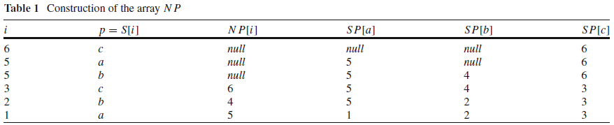

PSA Construction
NP(next position) is an array of size n
SP(start position) is an array of size $\left|Σ\right|$
$$S=abcbac$$

Slide 9









$$S =abacbca$$
$$S^{R} =acbcaba$$
$$Σ=\{a,b,c\}$$
time complexity:$O\left(n+R\left|Σ\right|\right)$
$$C\{\left(4,2\right),\left(3,5\right),(4,4)\}$$
$$C\{\left(2,3\right), \left(4,2\right),(3,5)\}$$
$$C\{(1,1), (2,3), (4,2)\}$$
$$C\{(0,0)\}$$
$$C\{\left(3,5\right),\left(4,4\right),(5,3)\}$$
$$C\{\left(4,4\right),(5,3)\}$$
$$C\{(5,3)\}$$
$$C\{\}$$

Slide 10

Application of PSA: Computing an LCPS
Step 1: Compute the PSA $M_{1}$ of $S_{1}$
Step 2: Compute the PSA $M_{2}$ of $S_{2}$
Step 3: Compute the CPSA $M_{3}$ by intersecting $M_{1}$ and $M_{2}$
Step 4: Compute the Max Length Automaton $M_{4}$ of $M_{3}$

Slide 11
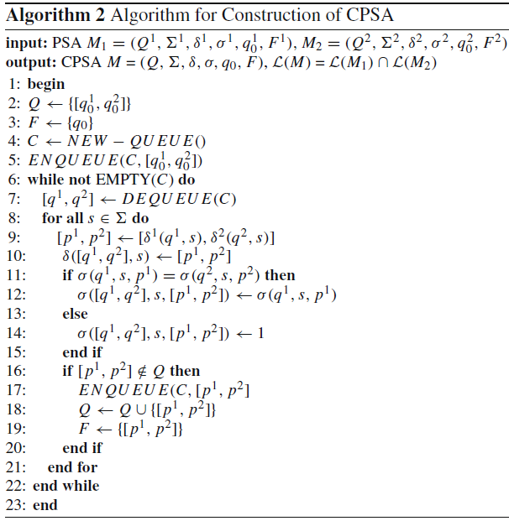
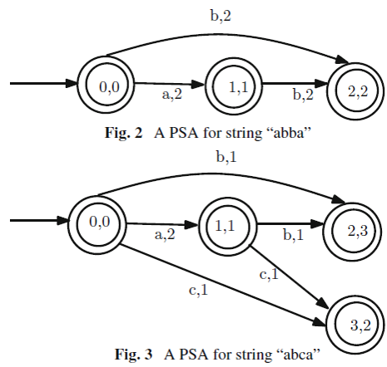
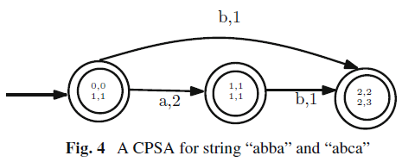

$$O\left(R_{1}R_{2}\left|Σ\right|\right)$$

Slide 12

Time complexity
$O\left(n+R_{1}\left|Σ\right|+{n+R_{2}\left|Σ\right|+R}_{1}R_{2}\left|Σ\right| \right)$
$R_{1}$ and $R_{2}$ at most $n^{2}$, so worst case is $O\left(n^{4}\left|Σ\right|\right)$

Slide 13
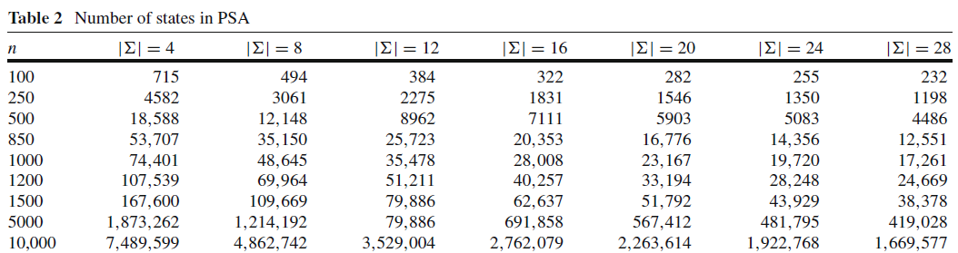
Random Data Experimental Results
Notes:
CUDA

Slide 14
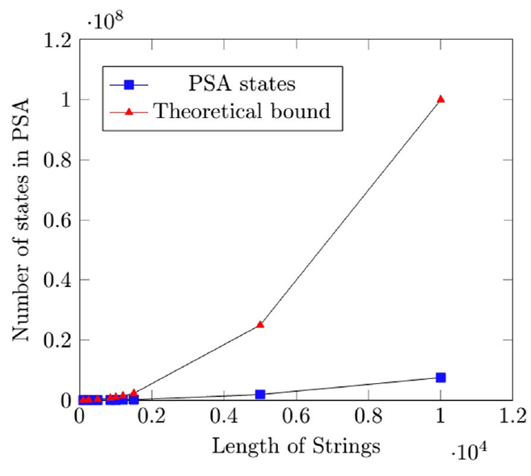
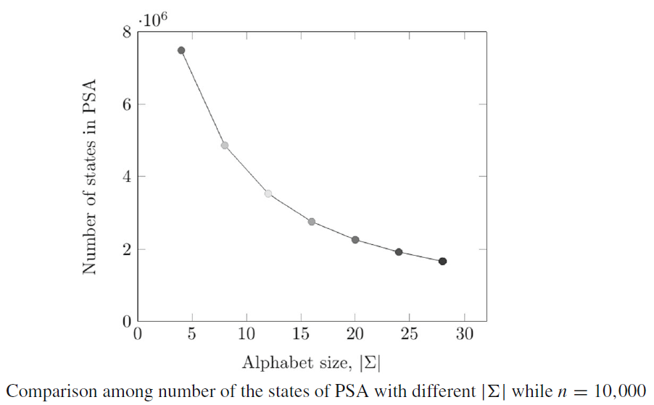

Slide 15
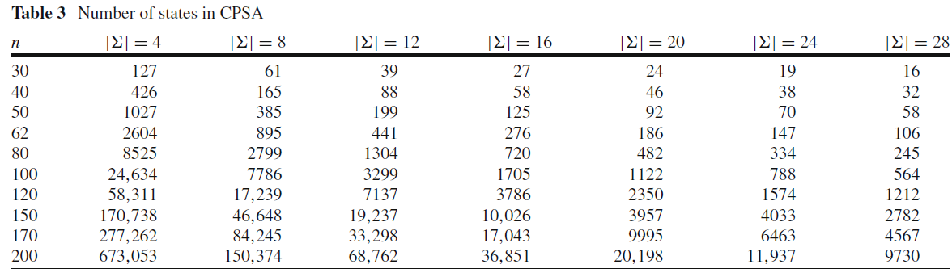

Slide 16
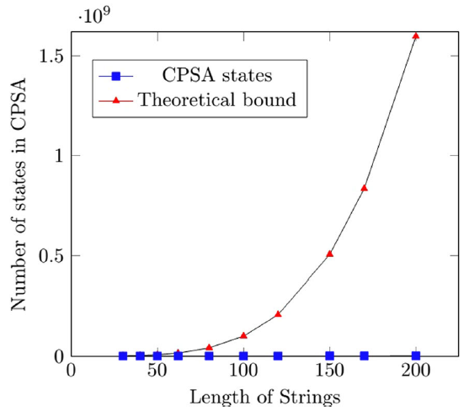
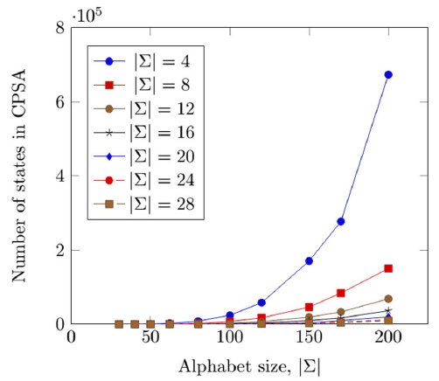
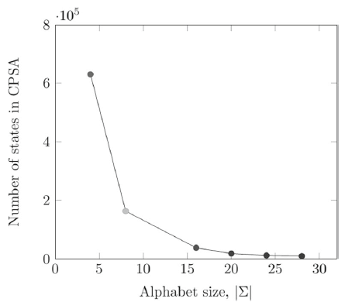
Real Data Experimental Results

Slide 17
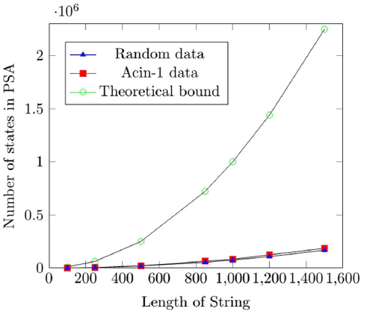
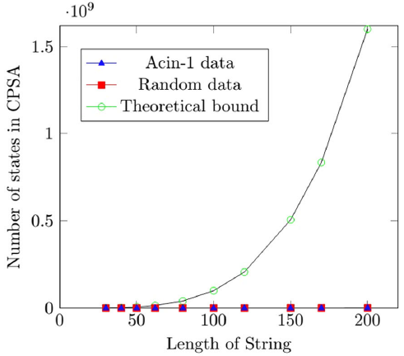

Slide 18
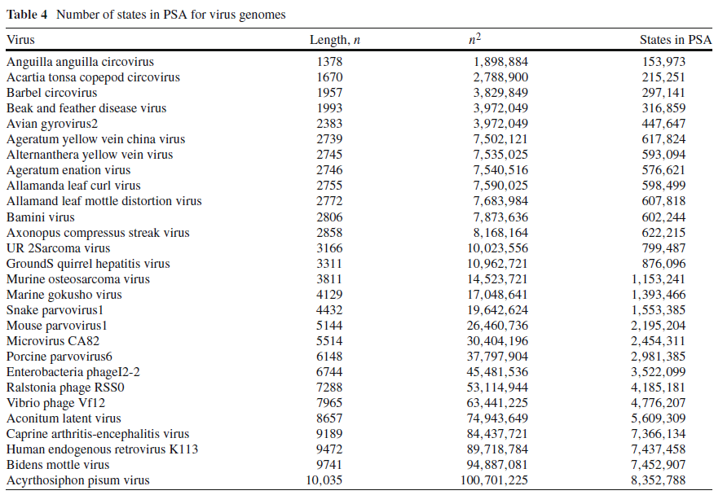

Slide 19
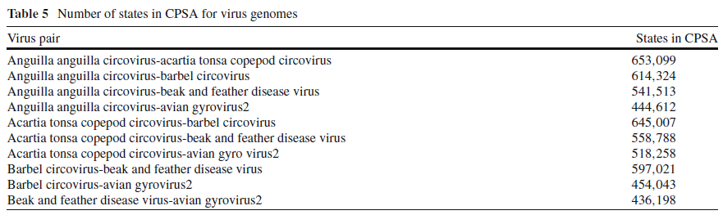
Notes:
computing the states of CPSA we have chosen five virus genomes, taken prefix of length 200 from each of them and computed CPSA between each possible pair of the prefixes.

