Slide 1
Data Structures
Chapter 7: Sorting
7-<number>

Slide 2
Sorting (1)
List: a collection of records
  Each record has one or more fields.
  Key: used to distinguish among the records.
 | Key | Other fields
Record 1 | 4 | DDD
Record 2 | 2 | BBB
Record 3 | 1 | AAA
Record 4 | 5 | EEE
Record 5 | 3 | CCC
Key | Other fields
1 | AAA
2 | BBB
3 | CCC
4 | DDD
5 | EEE
original list
sorted list
7-<number>

Slide 3
Sorting (2)
Original
pointer list
Sorted pointer list
File
Record 1
4 | DDD
2 | BBB
1 | AAA
5 | EEE
3 | CCC
Record 2
Record 3
Record 4
Record 5
It is easier to search a particular element after sorting. (e.g. binary search)
best sorting algorithm with comparisons: O(nlogn)
7-<number>

Slide 4
Sequential Search
Applied to an array or a linked list.
Data are not sorted.
Example: 9 5 6 8 7 2
  search 6: successful search
  search 4: unsuccessful search
# of comparisons for a successful search on record key i is i.
Time complexity
  successful search: (n+1)/2 comparisons = O(n)
  unsuccessful search: n comparisons = O(n)
7-<number>

Slide 5
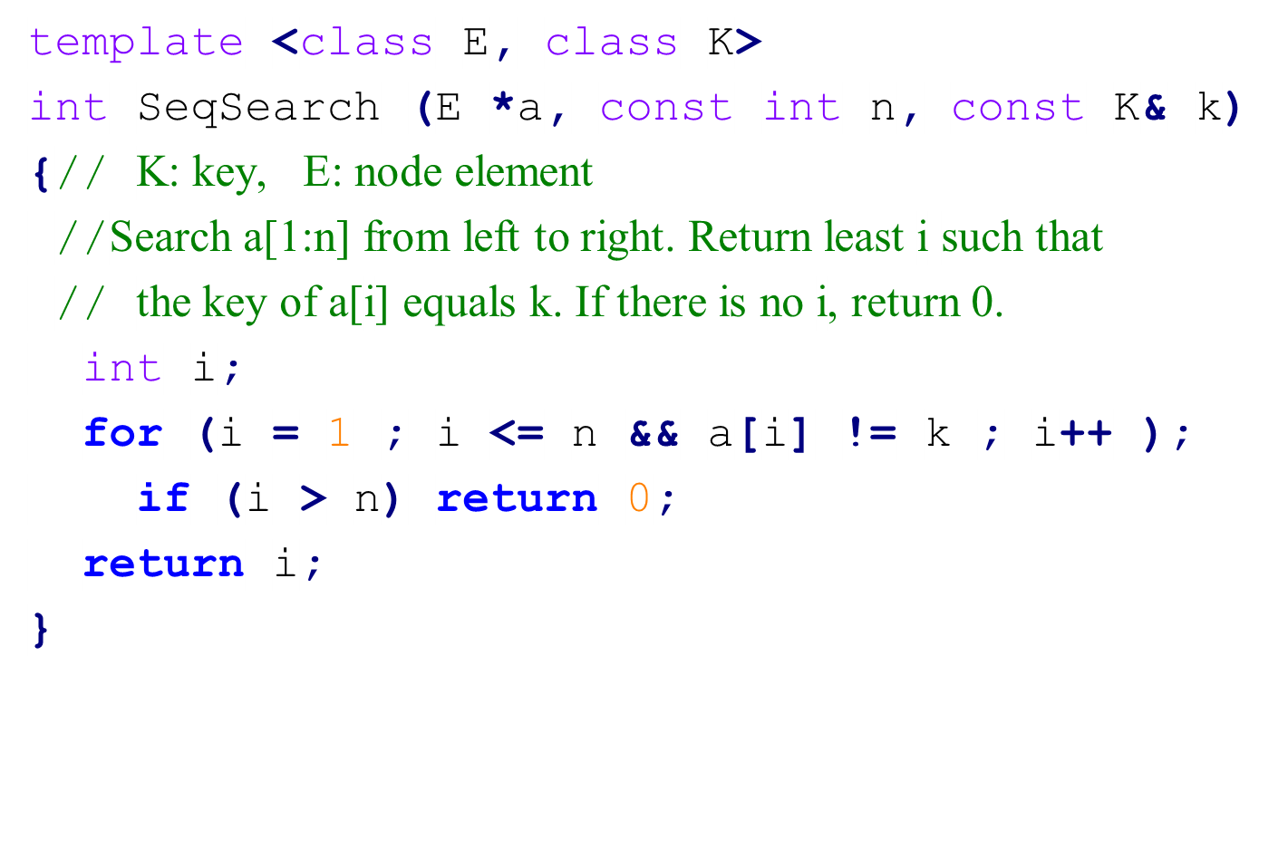
Code for Sequential Search
7-<number>

Slide 6
Motivation of Sorting
A binary search needs O(log n) time to search a key in a sorted list with n records.
Verification problem: To check if two lists are equal.
  6 3 7 9 5
  7 6 5 3 9
Sequential searching method: O(mn) time, where m and n are the lengths of the two lists.
Compare after sort: O(max{nlogn, mlogm})
  After sort: 3 5 6 7 9 and 3 5 6 7 9
  Then, compare one by one.
7-<number>

Slide 7
Categories of Sorting Methods
stable sorting : the records with the same key have the same relative order as they have before sorting.
  Example: Before sorting 6 3 7_{a} 9 5 7_{b}
  After sorting 3 5 6 7_{a} 7_{b} 9
internal sorting: All data are stored in main memory (more than 20 algorithms).
external sorting: Some of data are stored in auxiliary storage.
7-<number>

Slide 8
Insertion Sort
e.g. (由小而大 sort， nondecreasing order )
5 9 2 8 6
pass 1
5 9 2 8 6
pass 2
5 2 9 8 6
2 5 9 8 6
pass 3
2 5 8 9 6
2 5 8 9 6
2 5 8 6 9
pass 4
2 5 6 8 9
2 5 6 8 9
7-<number>

Slide 9
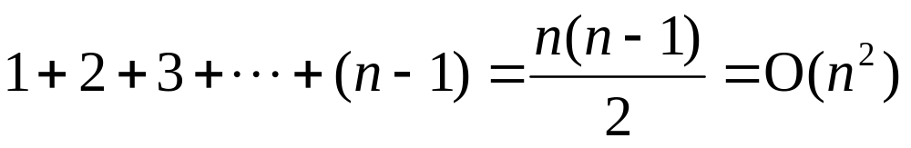
Insertion Sort
方法: 每次處理一個新的資料時，由右而左insert至其適當的位置才停止。
需要 n-1 個 pass
best case: 未 sort 前，已按順序排好。每個 pass僅需一次比較, 共需 (n-1) 次比較
worst case: 未 sort 前, 按相反順序排好。比較次數為：
Time complexity: O(n²)
7-<number>

Slide 10
Insertion into a Sorted List
template <class T>
void Insert(const T& e, T* a, int i)
// Insert e into the nondecreasing sequence a[1], …, a[i] such that the resulting sequence is also ordered. Array a must have space allocated for at least i+2 elements
{
a[0] = e; // Avoid a test for end of list (i<1)
while (e < a[i])
{
a[i+1] = a[i];
i--;
}
a[i+1] = e;
}
7-<number>

Slide 11
Insertion Sort
template <class T>
void InsertionSort(T* a, const int n)
// Sort a[1:n] into nondecreasing order
{
for (int j = 2; j <= n; j++)
{
T temp = a[j];
Insert(temp, a, j-1);
}
}
7-<number>

Slide 12
Quick Sort
Input: 26, 5, 37, 1, 61, 11, 59, 15, 48, 19
R₁ | R₂ | R₃ | R₄ | R₅ | R₆ | R₇ | R₈ | R₉ | R₁₀ | Left | Right
[26 | 5 | 37 | 1 | 61 | 11 | 59 | 15 | 48 | 19] | 1 | 10
[26 | 5 | 19 | 1 | 61 | 11 | 59 | 15 | 48 | 37] | 1 | 10
[26 | 5 | 19 | 1 | 15 | 11 | 59 | 61 | 48 | 37] | 1 | 10
[11 | 5 | 19 | 1 | 15] | 26 | [59 | 61 | 48 | 37] | 1 | 5
[1 | 5] | 11 | [19 | 15] | 26 | [59 | 61 | 48 | 37] | 1 | 2
1 | 5 | 11 | [19 | 15] | 26 | [59 | 61 | 48 | 37] | 4 | 5
1 | 5 | 11 | 15 | 19 | 26 | [59 | 61 | 48 | 37] | 7 | 10
1 | 5 | 11 | 15 | 19 | 26 | [48 | 37] | 59 | [61] | 7 | 8
1 | 5 | 11 | 15 | 19 | 26 | 37 | 48 | 59 | [61] | 10 | 10
1 | 5 | 11 | 15 | 19 | 26 | 37 | 48 | 59 | 61

Slide 13
Quick Sort
Quick sort 方法： 以每組的第一個資料為基準(pivot)，把比它小的資料放在左邊， 比它大的資料放在右邊，之後以pivot中心， 將這組資料分成兩部份。然後，兩部分資料各自recursively執行相同方法。
平均而言，Quick sort 有很好效能。
7-<number>

Slide 14
Code for Quick Sort
void QuickSort(Element* a, const int left, const int right)
// Sort a[left:right] into nondecreasing order.
// Key pivot = a[left].
// i and j are used to partition the subarray so that
// at any time a[m]<= pivot, m < i, and a[m]>= pivot, m > j.
// It is assumed that a[left] <= a[right+1].
{
if (left < right) {
int i = left, j = right + 1, pivot = a[left];
do {
do i++; while (a[i] < pivot);
do j--; while (a[j] > pivot);
if (i<j) swap(a[i], a[j]);
} while (i < j);
swap(a[left], a[j]);
QuickSort(a, left, j–1);
QuickSort(a, j+1, right);
}
}
7-<number>

Slide 15
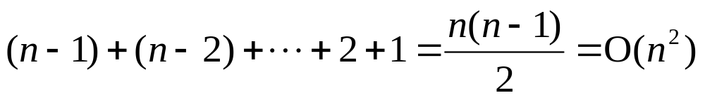
Time Complexity of Quick Sort
Worst case time complexity: 每次的基準恰為最大，或最小。所需比較次數：
Best case time complexity：O(nlogn)
  每次分割(partition)時, 都分成大約相同數量的兩部份 。
n
n
×2 = n
2
log₂n
n
×4 = n
4
...
...
...
7-<number>

Slide 16
Mathematical Analysis of Best Case
T(n): Time required for sorting n data elements.
T(1) = b, for some constant b
  T(n) ≤ cn + 2T(n/2), for some constant c
  ≤ cn + 2(cn/2 +2T(n/4))
  ≤ 2cn + 4T(n/4)
  :
  :
  ≤ cn log₂n + T(1)
  = O(n log n)
7-<number>

Slide 17
Variations of Quick Sort
Quick sort using a median of three:
  Pick the median of the first, middle, and last keys in the current sublist as the pivot. Thus, pivot = median{K_{l}, K_{(l+n)/2}, K_{n}}.
Use the selection algorithm to get the real median element.
  Time complexity of the selection algorithm: O(n).
7-<number>

Slide 18
Two-way Merge
Merge two sorted sequences into a single one.
設兩個 sorted lists 長度各為 m, n
Time complexity: O(m+n)
[1 5 26 77][11 15 59 61]
merge
[1 5 11 25 26 59 61 77]
7-<number>

Slide 19
Iterative Merge Sort
26
5
77
1
61
11
59
15
48
19
5 26
1 77
11 61
15 59
19 48
1 5 26 77
11 15 59 61
19 48
1 5 11 15 26 59 61 77
19 48
1 5 11 15 19 26 48 59 61 77
7-<number>

Slide 20
Iterative Merge Sort
template <class T>
void MergeSort(T* a, const int n)
// Sort a[1:n] into nondecreasing order.
{
T* tempList = new T[n+1];
// l: length of the sublist currently being merged.
for (int l = 1; l < n; l *= 2)
{
MergePass(a, tempList, n, l);
l *= 2;
MergePass(tempList, a, n, l);
//interchange role of a and tempList
}
delete[ ] tempList; // free an array
}
7-<number>

Slide 21
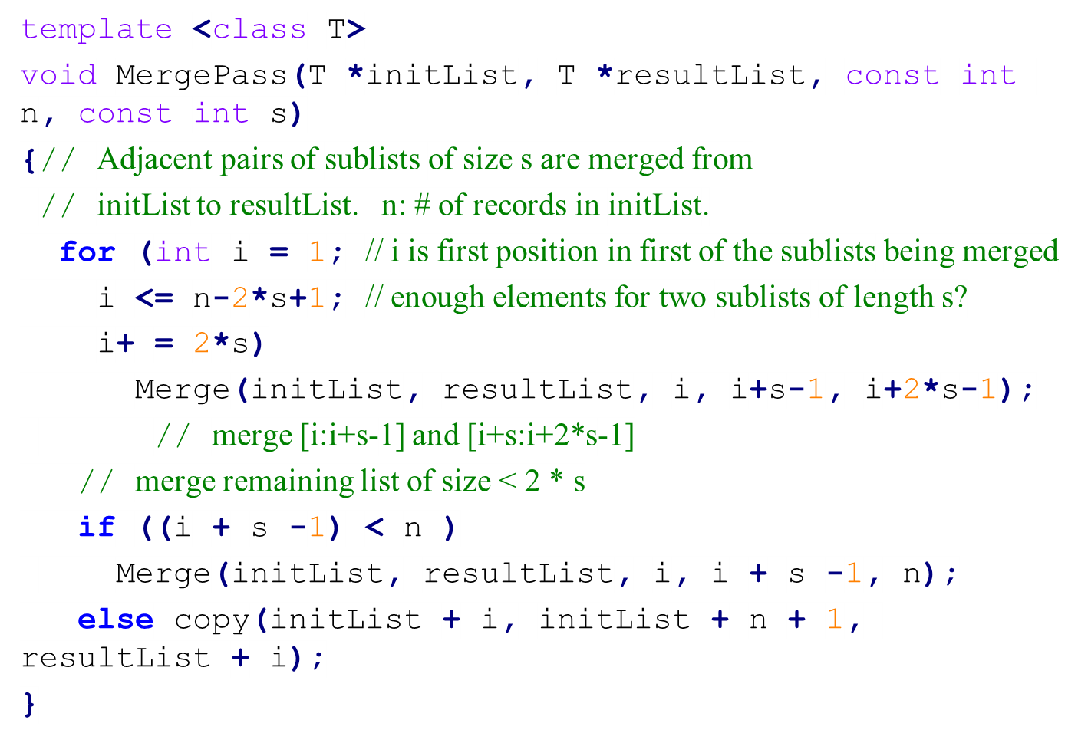
Code for Merge Pass
7-<number>

Slide 22
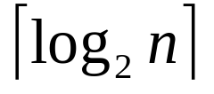
Analysis of Merge Sort
Merge sort is a stable sorting method.
Time complexity: O(n log n)
  passes are needed.
  Each pass takes O(n) time.
7-<number>

Slide 23
Recursive Merge Sort
Divides the list to be sorted into two roughly equal parts:
  left sublist [left : (left+right)/2]
  right sublist [(left+right)/2 +1 : right]
These two sublists are sorted recursively.
Then, the two sorted sublists are merged.
To eliminate the record copying, we associate an integer pointer (instead of real link) with each record.
7-<number>

Slide 24
Recursive Merge Sort
26
5
77
1
61
11
59
15
48
19
5 26
11 59
19 48
5 26 77
1 61
11 15 59
19 48
1 5 26 61 77
11 15 19 48 59
1 5 11 15 19 26 48 59 61 77
7-<number>

Slide 25
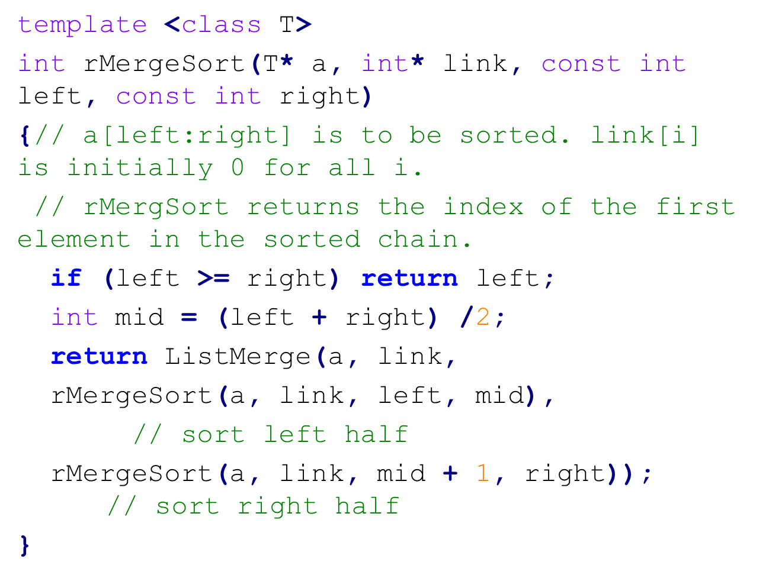
Code for Recursive Merge Sort
7-<number>
Notes:
integer array is used. link is integer not pointer here.

Slide 26
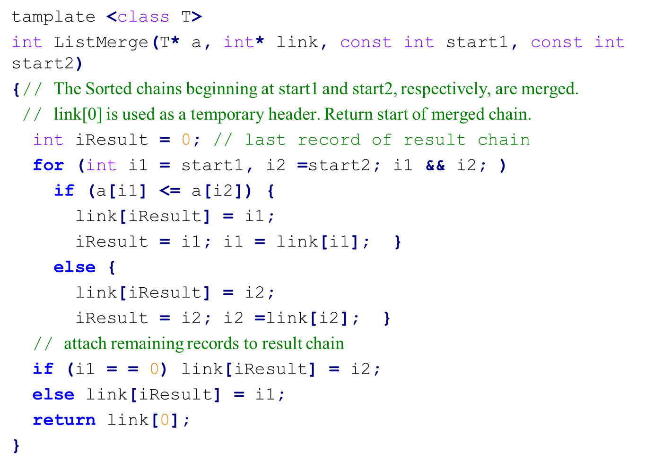
Merging Sorted Chains
7-<number>

Slide 27
Heap Sort (1)
Phase 1: Construct a max heap.
[1]
26
[1]
26
[2]
5
[3]
77
[2]
5
[3]
77
Step 2
Step 1
[4]
1
[5]
61
11
59
48
[4]
[5]
61
11
59
[6]
[7]
[6]
[7]
15
48
19
15
1
19
[8]
[9]
[10]
[8]
[9]
[10]
(a) Input array
(b) After Adjusting 61, 1
7-<number>

Slide 28
Heap Sort (2)
[1]
26
[1]
77
Step 4
Step 3
[2]
61
[3]
77
[2]
61
[3]
59
48
[4]
[5]
19
11
59
48
[4]
[5]
19
11
26
[6]
[7]
[6]
[7]
15
1
5
15
1
5
[8]
[9]
[10]
[8]
[9]
[10]
(c) After Adjusting 77, 5
(d) Max heap after constructing
7-<number>

Slide 29
Heap Sort (3)
Phase 2: Output and adjust the heap.
Time complexity: O(nlogn)
[1]
61
[1]
59
[2]
48
[3]
59
[2]
48
[3]
26
[4]
15
[5]
19
11
26
15
[5]
19
11
1
[6]
[7]
[6]
[7]
5
1
5
[8]
[9]
[8]
Heap size = 9
a[10] = 77
Heap size = 8
a[9]=61, a[10]=77
7-<number>

Slide 30
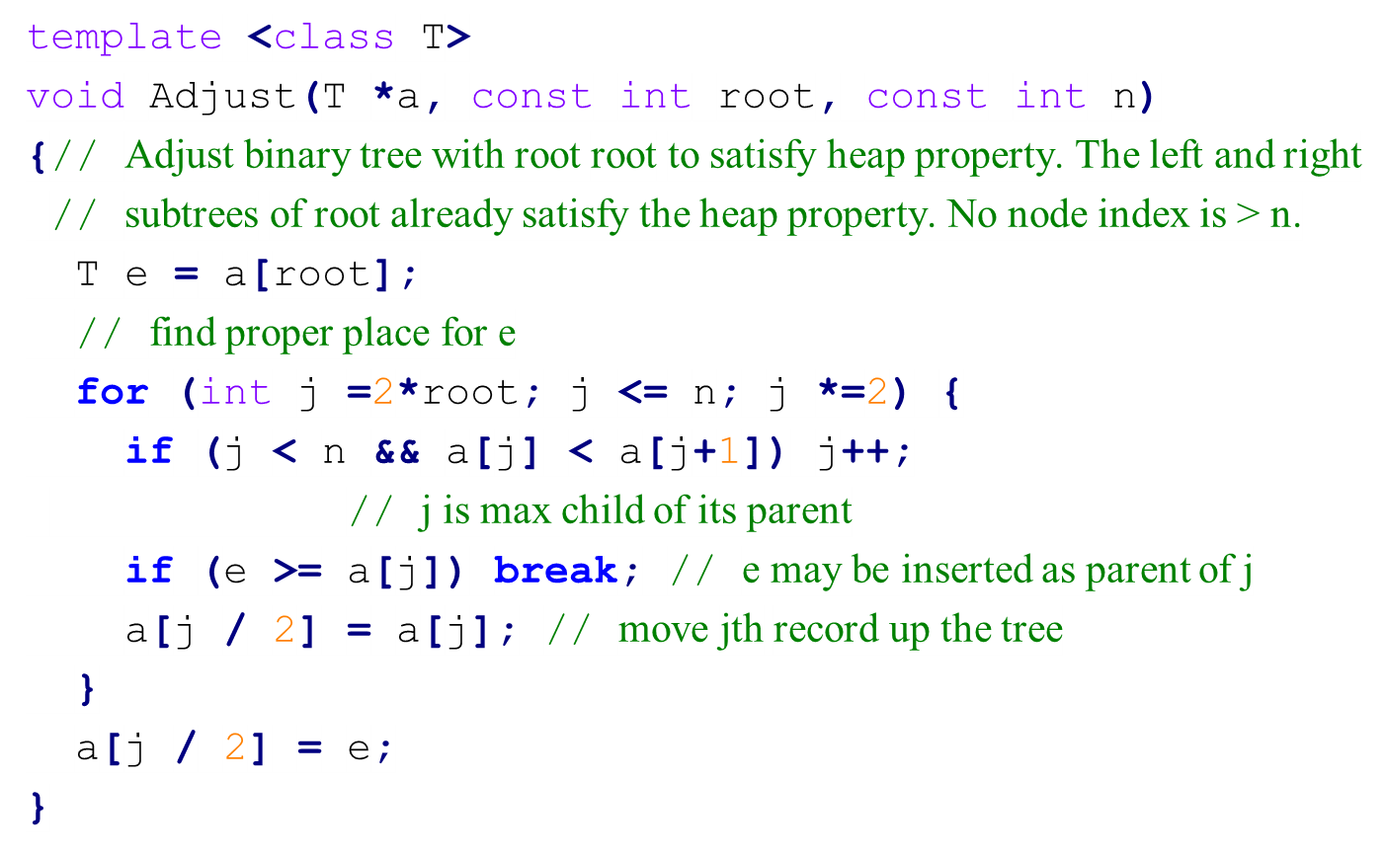
Adjusting a Max Heap
7-<number>

Slide 31
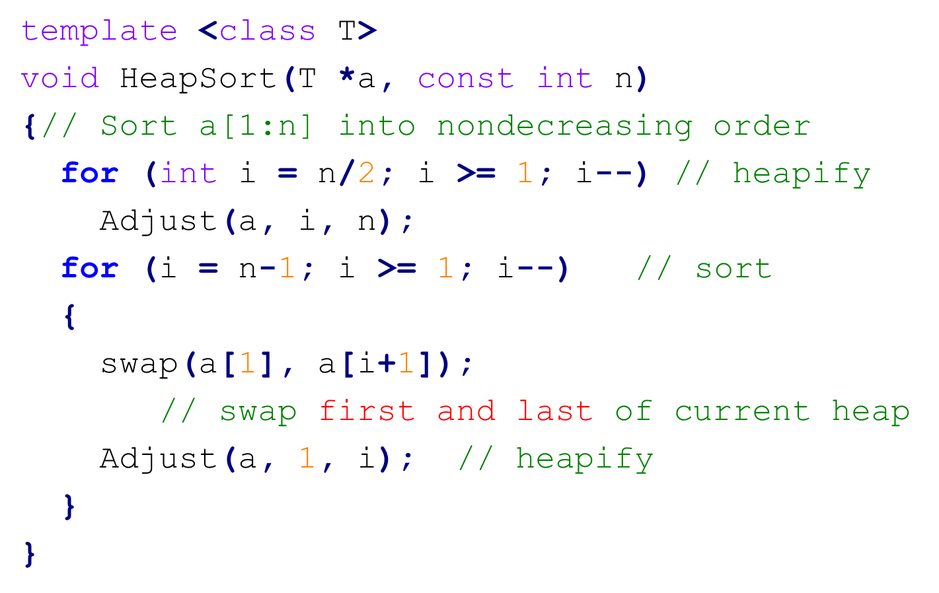
Heap Sort
7-<number>

Slide 32
Radix Sort基數排序: Pass 1 (nondecreasing)
a[1]
a[2]
a[3]
a[4]
a[5]
a[6]
a[7]
a[8]
a[9]
a[10]
179
208
306
93
859
984
55
9
271
33
e[0]
e[1]
e[2]
e[3]
e[4]
e[5]
e[6]
e[7]
e[8]
e[9]
9
33
859
271
93
984
55
306
208
179
f[0]
f[1]
f[2]
f[3]
f[4]
f[5]
f[6]
f[7]
f[8]
f[9]
a[1]
a[2]
a[3]
a[4]
a[5]
a[6]
a[7]
a[8]
a[9]
a[10]
271
93
33
984
55
306
208
179
859
9
7-<number>

Slide 33
Radix Sort: Pass 2
a[1]
a[2]
a[3]
a[4]
a[5]
a[6]
a[7]
a[8]
a[9]
a[10]
271
93
33
984
55
306
208
179
859
9
e[0]
e[1]
e[2]
e[3]
e[4]
e[5]
e[6]
e[7]
e[8]
e[9]
9
208
859
179
306
33
55
271
984
93
f[0]
f[1]
f[2]
f[3]
f[4]
f[5]
f[6]
f[7]
f[8]
f[9]
a[1]
a[2]
a[3]
a[4]
a[5]
a[6]
a[7]
a[8]
a[9]
a[10]
306
208
9
33
55
859
271
179
984
93
7-<number>

Slide 34
Radix Sort: Pass 3
a[1]
a[2]
a[3]
a[4]
a[5]
a[6]
a[7]
a[8]
a[9]
a[10]
306
208
9
33
55
859
271
179
984
93
e[0]
e[1]
e[2]
e[3]
e[4]
e[5]
e[6]
e[7]
e[8]
e[9]
93
55
33
271
9
179
208
306
859
984
f[0]
f[1]
f[2]
f[3]
f[4]
f[5]
f[6]
f[7]
f[8]
f[9]
a[1]
a[2]
a[3]
a[4]
a[5]
a[6]
a[7]
a[8]
a[9]
a[10]
9
33
55
93
179
208
271
306
859
984
7-<number>

Slide 35
Radix Sort
方法：least significant digit first (LSD)
(1)每個資料不與其它資料比較，只看自己放在何處
(2)pass 1 ：從個位數開始處理。若是個位數為 1，則放在 bucket 1，以此類推…
(3)pass 2 ：處理十位數，pass 3：處理百位數..
好處：若以array處理，速度快
Time complexity: O((n+r)log_{r}k)
  k: input data 之最大數
  r: 以 r 為基數(radix)， log_{r}k: 位數之長度
缺點: 若以array處理需要較多記憶體。使用 linked list，可減少所需記憶體，但會增加時間
7-<number>

Slide 36
List Sort
All sorting methods require excessive data movement.
The physical data movement tends to slow down the sorting process.
When sorting lists with large records, we have to modify the sorting methods to minimize the data movement.
Methods such as insertion sort or merge sort can be modified to work with a linked list rather than a sequential list. Instead of physically moving the record, we change its additional link field to reflect the change in the position of the record in the list.
After sorting, we may physically rearrange the records in place.
7-<number>

Slide 37
Rearranging Sorted Linked List (1)
Sorted linked list, first=4
i | R₁ | R₂ | R₃ | R₄ | R₅ | R₆ | R₇ | R₈ | R₉ | R₁₀
key | 26 | 5 | 77 | 1 | 61 | 11 | 59 | 15 | 48 | 19
linka | 9 | 6 | 0 | 2 | 3 | 8 | 5 | 10 | 7 | 1
Add backward links to become a doubly linked list, first=4
i | R₁ | R₂ | R₃ | R₄ | R₅ | R₆ | R₇ | R₈ | R₉ | R₁₀
key | 26 | 5 | 77 | 1 | 61 | 11 | 59 | 15 | 48 | 19
linka | 9 | 6 | 0 | 2 | 3 | 8 | 5 | 10 | 7 | 1
linkb | 10 | 4 | 5 | 0 | 7 | 2 | 9 | 6 | 1 | 8
7-<number>

Slide 38
Rearranging Sorted Linked List (2)
R₁ is in place. first=2
i | R₁ | R₂ | R₃ | R₄ | R₅ | R₆ | R₇ | R₈ | R₉ | R₁₀
key | 1 | 5 | 77 | 26 | 61 | 11 | 59 | 15 | 48 | 19
linka | 2 | 6 | 0 | 9 | 3 | 8 | 5 | 10 | 7 | 4
linkb | 0 | 4 | 5 | 10 | 7 | 2 | 9 | 6 | 4 | 8
R₁, R₂ are in place. first=6
i | R₁ | R₂ | R₃ | R₄ | R₅ | R₆ | R₇ | R₈ | R₉ | R₁₀
key | 1 | 5 | 77 | 26 | 61 | 11 | 59 | 15 | 48 | 19
linka | 2 | 6 | 0 | 9 | 3 | 8 | 5 | 10 | 7 | 4
linkb | 0 | 4 | 5 | 10 | 7 | 2 | 9 | 6 | 4 | 8
7-<number>

Slide 39
Rearranging Sorted Linked List (3)
R₁, R₂, R₃ are in place. first=8
i | R₁ | R₂ | R₃ | R₄ | R₅ | R₆ | R₇ | R₈ | R₉ | R₁₀
key | 1 | 5 | 11 | 26 | 61 | 77 | 59 | 15 | 48 | 19
linka | 2 | 6 | 8 | 9 | 6 | 0 | 5 | 10 | 7 | 4
linkb | 0 | 4 | 2 | 10 | 7 | 5 | 9 | 3 | 4 | 8
R₁, R₂, R₃, R₄ are in place. first=10
i | R₁ | R₂ | R₃ | R₄ | R₅ | R₆ | R₇ | R₈ | R₉ | R₁₀
key | 1 | 5 | 11 | 15 | 61 | 77 | 59 | 26 | 48 | 19
linkb | 2 | 6 | 8 | 10 | 6 | 0 | 5 | 9 | 7 | 8
linkb | 0 | 4 | 2 | 3 | 7 | 5 | 9 | 10 | 8 | 8
7-<number>

Slide 40
Rearranging Records Using A Doubly Linked List
template <class T>
void List1(T* a, int *lnka, const int n, int first)
{
int *linkb = new int[n]; // backward links
int prev = 0;
for (int current = first; current; current = linka[current])
{ // convert chain into a doubly linked list
linkb[current] = prev;
prev = current;
}
for (int i = 1; i < n; i++)
{// move a[first] to position i
if (first != i) {
if (linka[i]) linkb[linka[i]] = first;
linka[linkb[i]] = first;
swap(a[first], a[i]);
swap(linka[first], linka[i]);
swap(linkb[first], linkb[i]);
}
first = linka[i];
}
}
7-<number>

Slide 41
Table Sort
The list-sort technique is not well suited for quick sort and heap sort.
One can maintain an auxiliary table, t, with one entry per record, an indirect reference to the record.
Initially, t[i] = i. When a swap are required, only the table entries are exchanged.
After sorting, the list a[t[1]], a[t[2]], a[t[3]]…are sorted.
Table sort is suitable for all sorting methods.
7-<number>

Slide 42
Permutation Cycle
After sorting (nondecreasing):
Permutation [3 2 8 5 7 1 4 6]
Every permutation is made up of disjoint permutation cycles:
  (1, 3, 8, 6) nontrivial cycle
    R1 now is in position 3, R3 in position 8, R8 in position 6, R6 in position 1.
  (4, 5, 7) nontrivial cycle
  (2) trivial cycle
 | R₁ | R₂ | R₃ | R₄ | R₅ | R₆ | R₇ | R₈
key | 35 | 14 | 12 | 42 | 26 | 50 | 31 | 18
t | 3 | 2 | 8 | 5 | 7 | 1 | 4 | 6
7-<number>

Slide 43
Table Sort Example
Initial configuration
4
5
 | R₁ | R₂ | R₃ | R₄ | R₅ | R₆ | R₇ | R₈
key | 35 | 14 | 12 | 42 | 26 | 50 | 31 | 18
t | 3 | 2 | 8 | 5 | 7 | 1 | 4 | 6
1
2
3
after rearrangement of first cycle
key | 12 | 14 | 18 | 42 | 26 | 35 | 31 | 50
t | 1 | 2 | 3 | 5 | 7 | 6 | 4 | 8
after rearrangement of second cycle
key | 12 | 14 | 18 | 26 | 31 | 35 | 42 | 50
t | 1 | 2 | 3 | 4 | 5 | 6 | 7 | 8

Slide 44
Code for Table Sort
template <class T>
void Table(T* a, const int n, int *t)
{
for (int i = 1; i < n; i++) {
if (t[i] != i) {// nontrivial cycle starting at i
T p = a[i];
int j = i;
do {
int k = t[j]; a[j] = a[k]; t[j] = j;
j = k;
} while (t[j] != i)
a[j] = p; // j is the position for record p
t[j] = j;
}
}
}
7-<number>

Slide 45
Summary of Internal Sorting
No one method is best under all circumstances.
  Insertion sort is good when the list is already partially ordered. And it is the best for small n.
  Merge sort has the best worst-case behavior but needs more storage than heap sort.
  Quick sort has the best average behavior, but its worst-case behavior is O(n²).
  The behavior of radix sort depends on the size of the keys and the choice of r.
7-<number>

Slide 46
Complexity Comparison of Sort Methods
Method | Worst | Average
Insertion Sort | n² | n²
Heap Sort | n log n | n log n
Merge Sort | n log n | n log n
Quick Sort | n² | n log n
Radix Sort | (n+r)log_{r}k | (n+r)log_{r}k
  k: input data 之最大數 r: 以 r 為基數(radix)

Slide 47
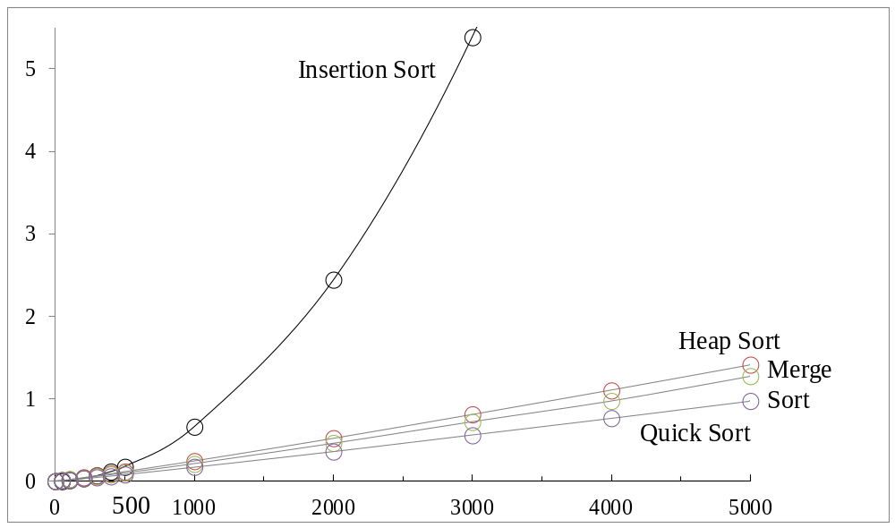
Average Execution Time
t
n
Average execution time, n = # of elements, t=milliseconds
7-<number>

Slide 48
External Sorting
The lists to be sorted are too large to be contained totally in the internal memory. So internal sorting is impossible.
The list (or file) to be sorted resides on a disk.
Block: unit of data read from or written to a disk at one time. A block generally consists of several records.
read/write time of disks:
  seek time 搜尋時間：把讀寫頭移到正確磁軌(track, cylinder)
  latency time 延遲時間：把正確的磁區(sector)轉到讀寫頭下
  transmission time 傳輸時間：把資料區塊傳入/讀出磁碟
7-<number>

Slide 49
Merge Sort as External Sorting
The most popular method for sorting on external storage devices is merge sort.
Phase 1: Obtain sorted runs (segments) by internal sorting methods, such as heap sort, merge sort, quick sort or radix sort. These sorted runs are stored in external storage.
Phase 2: Merge the sorted runs into one run with the merge sort method.
7-<number>

Slide 50
Merging the Sorted Runs
run1
run2
run3
run4
run5
run6
7-<number>

Slide 51
Optimal Merging of Runs
In the external merge sort, the sorted runs may have different lengths. If shorter runs are merged first, the required time is reduced.
26
26
11
15
6
20
6
5
2
4
5
15
2
4
weighted external path length
= 2*2 + 4*2 + 5*2 + 15*2
= 52
weighted external path length = 2*3 + 4*3 + 5*2 + 15*1
= 43
7-<number>

Slide 52
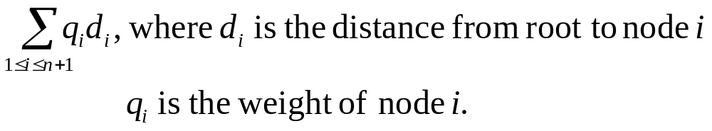
Huffman Algorithm
External path length: sum of the distances of all external nodes from the root.
Weighted external path length:
Huffman algorithm: to solve the problem of finding a binary tree with minimum weighted external path length.
Huffman tree:
  Solve the 2-way merging problem
  Generate Huffman codes for data compression
7-<number>

Slide 53
Construction of Huffman Tree
5
10
16
2
3
5
5
9
7
(c) [7, 9, 10,13]
(a) [2,3,5,7,9,13]
2
3
39
(b) [5,5,7,9,13]
23
16
23
10
13
9
7
10
13
5
5
Min heap is used.
Time: O(n log n)
5
5
2
3
2
3
(d) [10,13,16]
(e) [16, 23]
7-<number>

Slide 54
Huffman Code (1)
Each symbol is encoded by 2 bits (fixed length)
symbol code
A 00
B 01
C 10
D 11
Message A B A C C D A would be encoded by 14 bits:
00 01 00 10 10 11 00
7-<number>

Slide 55
Huffman Code (2)
Huffman codes (variable-length codes)
symbol code
A 0
B 110
C 10
D 111
Message A B A C C D A would be encoded by 13 bits:
0 110 0 10 10 111 0
A frequently used symbol is encoded by a short bit string.
7-<number>

Slide 56
Huffman Tree
ACBD,7
0
1
A,3
CBD,4
0
1
C,2
BD,2
0
1
B,1
D,1
7-<number>

Slide 57
IHFBDEGCA,91
IHFBD, 38
EGCA, 53
I, 15
HFBD, 23
E, 25
GCA, 28
HFB, 11
D, 12
GC, 13
A, 15
HF, 5
B, 6
G, 6
C, 7
H, 1
F, 4
decode
111 01000 10 111 011 A H E A D
encode
Sym Freq Code Sym Freq Code Sym Freq Code
A 15 111 D 12 011 G 6 1100
B 6 0101 E 25 10 H 1 01000
C 7 1101 F 4 01001 I 15 00

