Slide 1
The method for making .out file

Slide 2
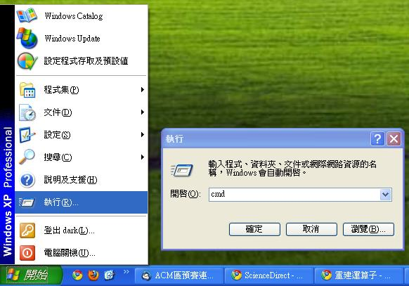
cmd

Slide 3
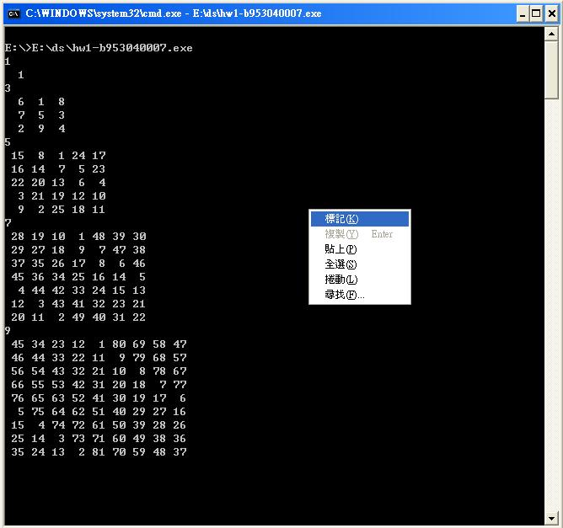
Method 1: copy-and-paste
After running the program in cmd, right click and select the ‘flag(K)’.

Slide 4
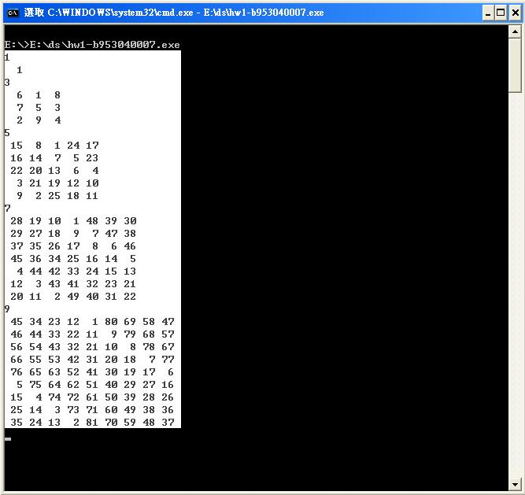
Method 1: copy-and-paste
Select the target range you want (highlight)

Slide 5
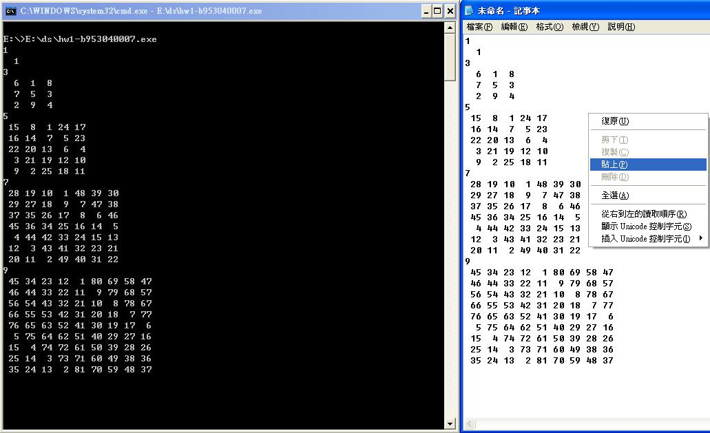
Method 1 :copy-and-paste
Right click again, and the highlight area will be copied. Then, you can paste it into the note.

Slide 6
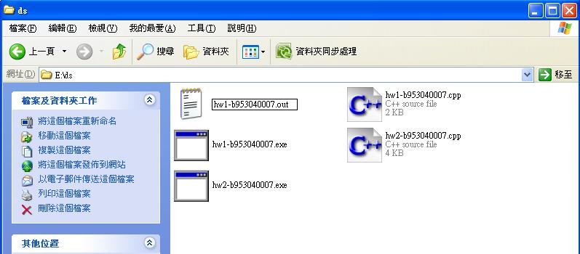
Method 1: copy-and-paste
Change the filename after saving the file.
( Recommend to turn on ‘show the filename extension’ )

Slide 7
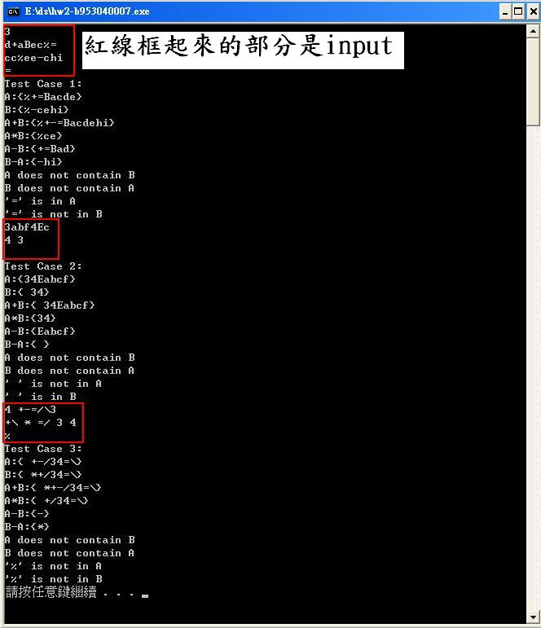
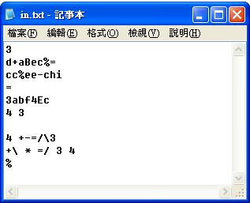
Method 2: pipeline
First, save the
inputs into a file.

Slide 8
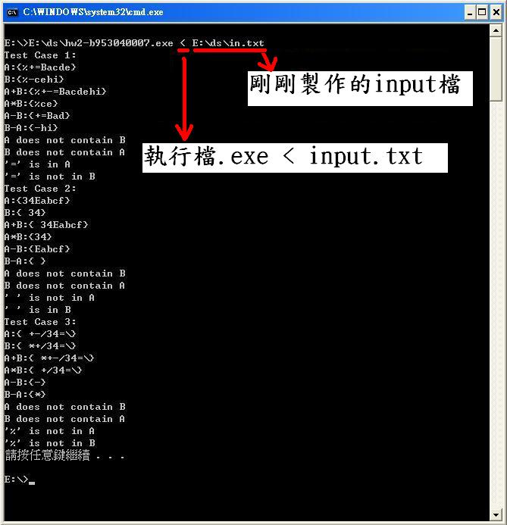
Method 2: Pipeline-import
Type the cmd (for example) hw2.exe < input.txt.
Then , use the method 1 to copy-and-paste.

Slide 9
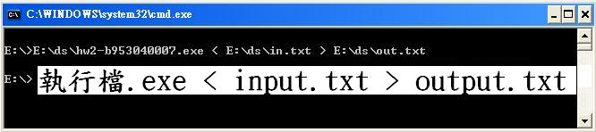
Method 2: Pipeline-import+export
Or you can use this cmd (for example)
hw2.exe < input.txt > output.txt
Then, the input will come from input.txt, and the output will be saved in output.txt. Then, you can change the filename for .out file.

Slide 10
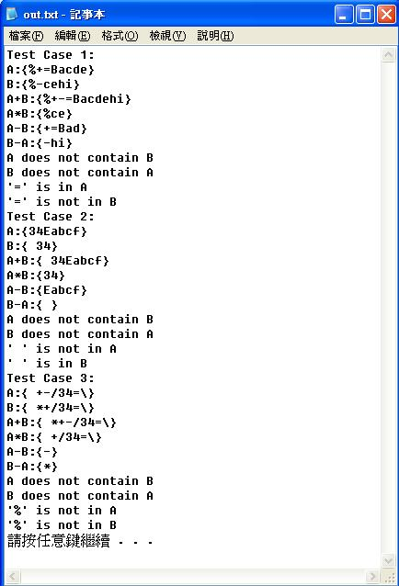
Method 2: Pipeline-output.txt
This figure is the output file from
previous page.
It’s easier than copy-and-paste.
In the previous page, you can also
change the output filename as
XXX.out, simply.

