Slide 1
Protein contact order prediction from primary sequences
Yi Shi, Jianjun Zhou, David Arndt, David S Wishart and Guohui Lin
BMC Bioinformatics, vol. 9, pp. 255, 2008.
Speaker: Chun-Jen Chen
Date: Apr. 6, 2010

Slide 2
Abstract
Background: Contact order is a topological descriptor that has been shown to be correlated with several interesting protein properties such as protein folding rates and protein transition state placements. Contact order has also been used to select for viable protein folds from ab initio protein structure prediction programs. For proteins of known three-dimensional structure, their contact order can be calculated directly. However, for proteins with unknown three-dimensional structure, there is no effective prediction method currently available.
115/11/08

Slide 3
Abstract
Results: In this paper, we propose several simple yet very effective methods to predict contact order from the amino acid sequence only. One set of methods is based on a weighted linear combination of predicted secondary structure content and amino acid composition. Depending on the number of components used in these equations it is possible to achieve a correlation coefficient of 0.857–0.870 between the observed and predicted contact order. A second method, based on sequence similarity to known three-dimensional structures, is able to achieve a correlation coefficient of 0.977. We have also developed a much more robust implementation for calculating contact order directly from PDB coordinates that works for > 99% PDB files. All of these contact order predictors and calculators have been implemented as a web server (see Availability and requirements section for URL).
115/11/08

Slide 4
Abstract
Conclusion: Protein contact order can be effectively predicted from the primary sequence, at the absence of three-dimensional structure. Three factors, percentage of residues in alpha helices, percentage of residues in beta strands, and sequence length, appear to be strongly correlated with the absolute contact order.
115/11/08

Slide 5
Contact
Two distinct amino acid residues in a protein are said to form a contact when there is a pair of heavy atoms (C, O, S or N), one from each residue, whose physical (euclidean) distance is within 6 Å
Bonneau et al. suggested that two residues form a contacting pair if and only if they are sequentially at least 3 residues away from each other and their β-carbons are within 8 Å

Slide 6
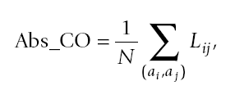

Contact Order
For two distinct residues a_{i} and a_{j}, if there are two non-hydrogen atoms, one from each residue, within 6 Å, then a_{i} and a_{j} form a contact. Assuming there are in total N contacts in the protein, the Abs_CO (Absolute Contact Order) of this protein is defined as

Slide 7
Three Scenarios
The input sequence exactly matches a known 3D structure
2. The input sequence is homologous(> 20% sequence identity, computed as the number of identical residues divided by the query sequence length) to a known 3D structure
3. The input sequence does not match any known structure.

Slide 8
Scenario 2
In implementing this approach we calculated the Abs_CO for 16, 499 nonredundant proteins obtained from the PDB. These proteins were selected using the PDB culling/filtering service called PISCES
1. More than 20% sequence identity to a protein in the CO database
2. The query sequence must be more than 40% of the length of the matching homologue.
If these two criteria are met, then the contact order is transferred to the query protein.

Slide 9
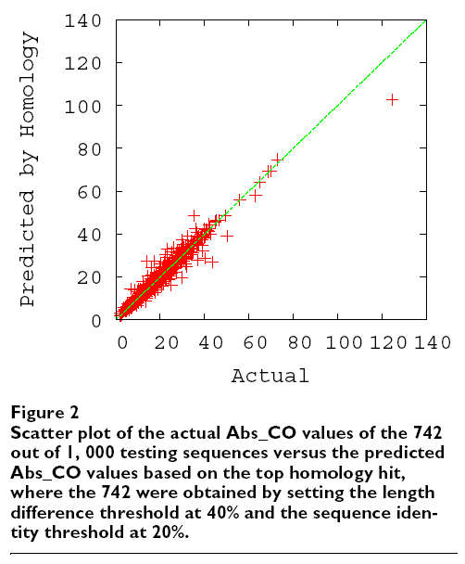

Slide 10
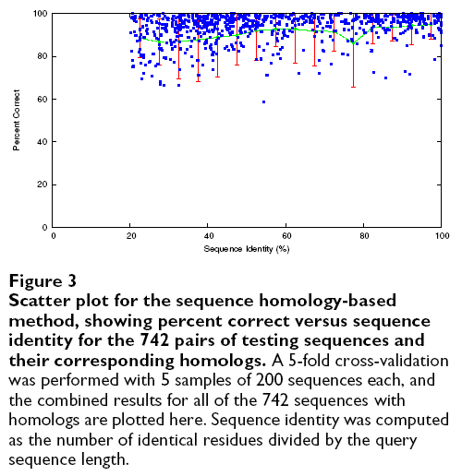

Average percent correct, defined for each prediction as min
where a is the true Abs_CO value of the query and b is the Abs_CO of the homolog)

Slide 11
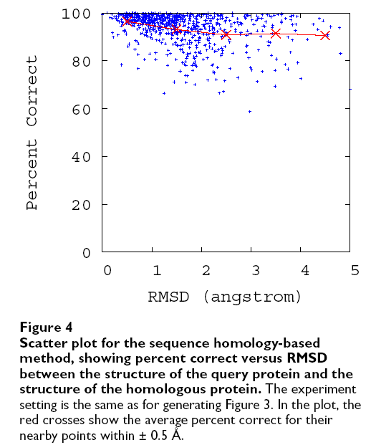

Slide 12

Scenario 3
where χ_{i}, _{i} = 1, 2, 3, are the coefficients of the three factors p(α), p(β), and L, and c is a constant value in the linear regression. Note that for proteins with unknown three-dimensional structure, their secondary structures are also unknown. Therefore, as part of the linear regression process as specified here, we predict their secondary structure content using Proteus

Slide 13
7 Factors (F7-LR)
1.The number of beta hairpins (two adjacent beta-strand segments form a hairpin if they are separated by 2 to 5 residues)
2.The number of distant beta strands (two adjacent beta-strand segments are considered "distant" if they are separated by at least 5 residues),
3.The number of Cysteine residues (C),
4.The number of hydrophobic amino acid residues (V, I, L, M, F, W, C).

Slide 14
27 Factors (F27-LR)
These 27 factors include the first 5 factors in the F7-LR method, (the other two factors in the F7-LR method, the number of Cysteine residues and the number of hydrophobic amino acid residues, are replaced by) 19 amino acid frequencies of the 20 ones in the target protein, and 3 hydrophobicity frequencies.

Slide 15
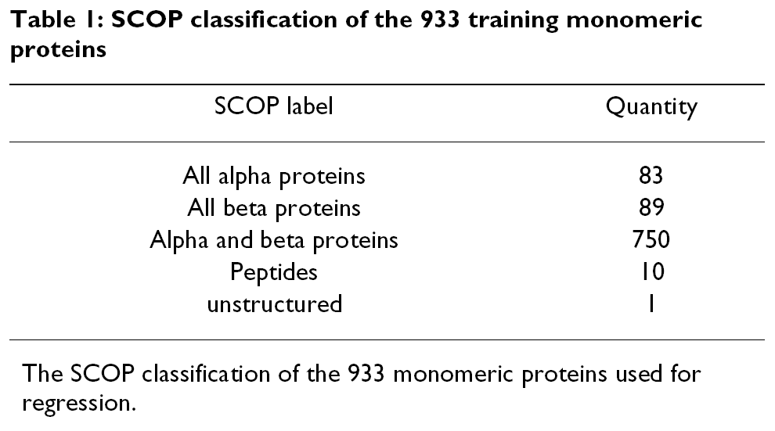

Slide 16
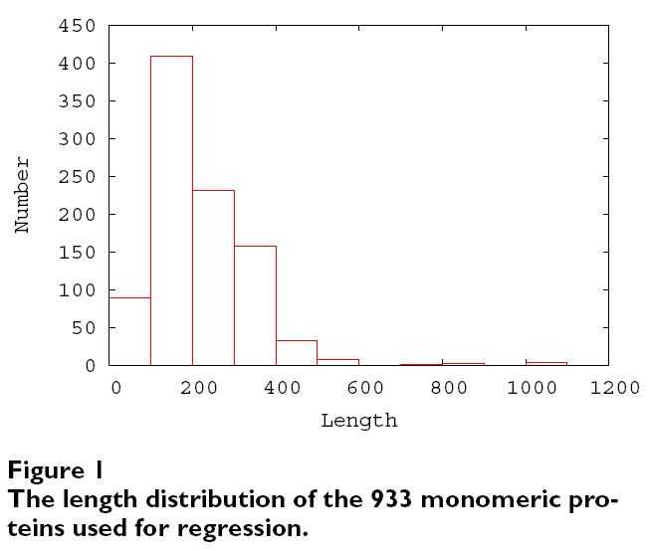

Slide 17
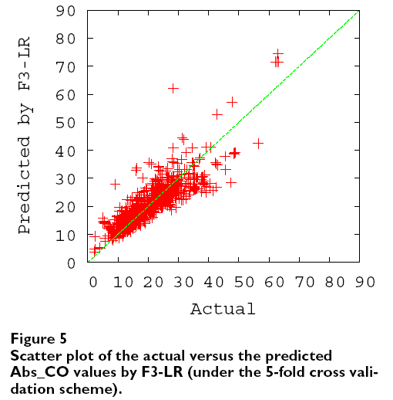

Slide 18
