Slide 1
New efficient algorithms for the LCS and constrained LCS problems
Costas S. Iliopoulos , M. Sohel Rahman
Information Processing Letters 106 (2008) 13–18
Presenter: Kai-Yu Chen
Date: Apr. 13, 2010

Slide 2
Abstract
In this paper, we study the classic and well-studied longest common subsequence (LCS) problem and a recent variant of it, namely the constrained LCS (CLCS) problem. In the CLCS problem, the computed LCS must also be a supersequence of a third given string. In this paper, we first present an efficient algorithm for the traditional LCS problem that runs in O(Rlog log n + n) time, where R is the total number of ordered pairs of positions at which the two strings match and n is the length of the two given strings. Then, using this algorithm, we devise an algorithm for the CLCS problem having time complexity O(pRlog log n+n) in the worst case, where p is the length of the third string.

Slide 3
Introduction
Example X = TCCACA, Y = ACCAAG and Z = AC
LCS(X, Y )=CCAA LCS_{Z}(X, Y )=ACA
If X[i] = Y[j ] M ={ (i, j ) | X[i] = Y[j ], 1 ≤ i, j ≤ n}
|M|=R
Ex. M={(2,2),(2,3),(3,2),(3,3),(4,1),(4,4),(4,5),(5,2), (5,3),(6,1),(6,4),(6,5)} R=12
The preprocessing requires O(Rlog log n + n) time to get the set M in the required order [15].

Slide 4
BoundedHeap
Insert(H, Pos, Value, Data): Insert into the Bounded-Heap H the position Pos with value Value and associated information Data.
IncreaseValue(H, Pos, Value, Data): If H does not already contain the position Pos, perform Insert(H, Pos, Value, Data). Otherwise, set this position’s value to max{Value, Value}, where Value is its previous value. Also, update Data accordingly.
BoundedMax(H, Pos): Return the item (with additional data) that has maximum value among all items in H with position smaller than Pos. If H does not contain any items with position smaller than Pos, return 0.
Theorem 1. (See [5].) BoundedHeap data structure can support each of the above operations in O(log log n) amortized time, where keys are drawn from the set {1, . . . , n}. The data structure requires O(n) space.

Slide 5
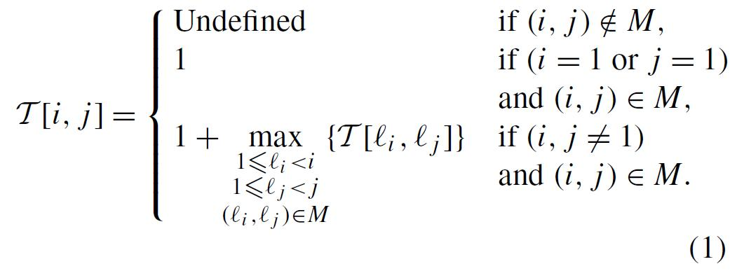
LCS problem
We follow the simple dynamic programming formulation of [15] and improve its running time of O(n² + R) to O(Rlog log n + n). The dynamic programming formulation from [15] is as follows:

Slide 6
AlgLCSNew
Recall that we perform a row by row operation.
While considering row i, we already have the BoundedHeap data structure H_{i−1} at our hand; now we construct the BoundedHeap data structure H_{i}.
At first H_{i} is initialized to H_{i−1}.
Assume that we are considering the match (i, j ) ∈ M_{i} :
T [i, j ].Value = BoundedMax(H_{i−1}, j).Value+ 1.
T [i, j ].Prev = BoundedMax(H_{i−1}, j).data.
Then we perform the following operation:
IncreaseValue(H_{i} , j, T [i, j ].Value, (i,j)).

Slide 7
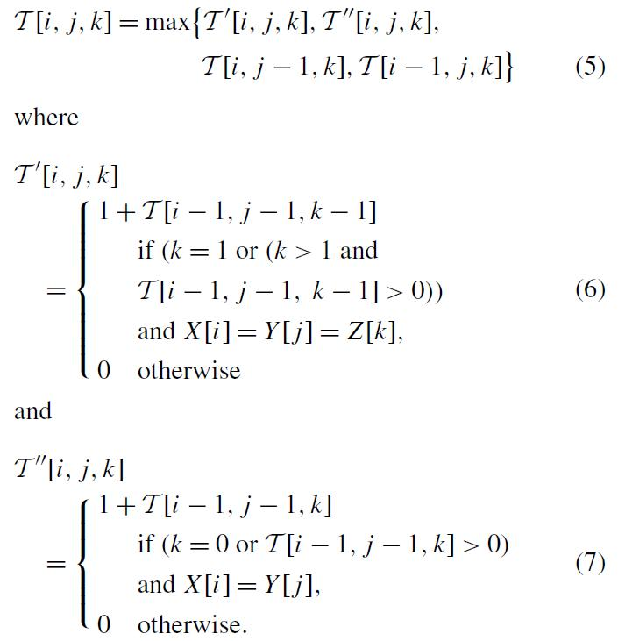
CLCS problem

Slide 8

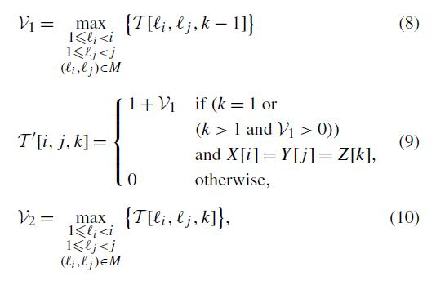
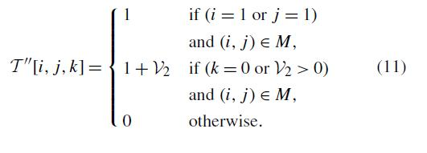
AlgCLCSNew

Slide 9
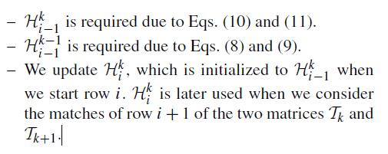
AlgCLCSNew
we always deal with 3 BoundedHeap data structures and

